Slide 1
FCC-EE Layout progress
Pantaleo Raimondi & Marc Andre Jebramcik
Fermilab / CERN

Slide 2
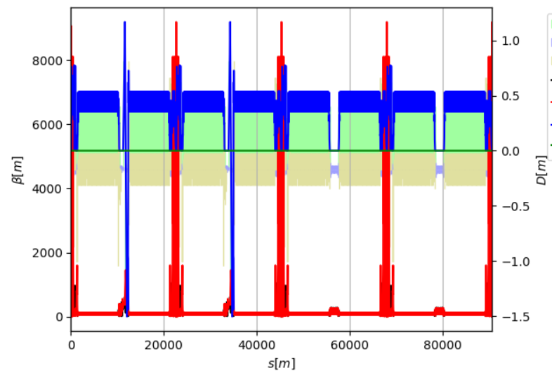
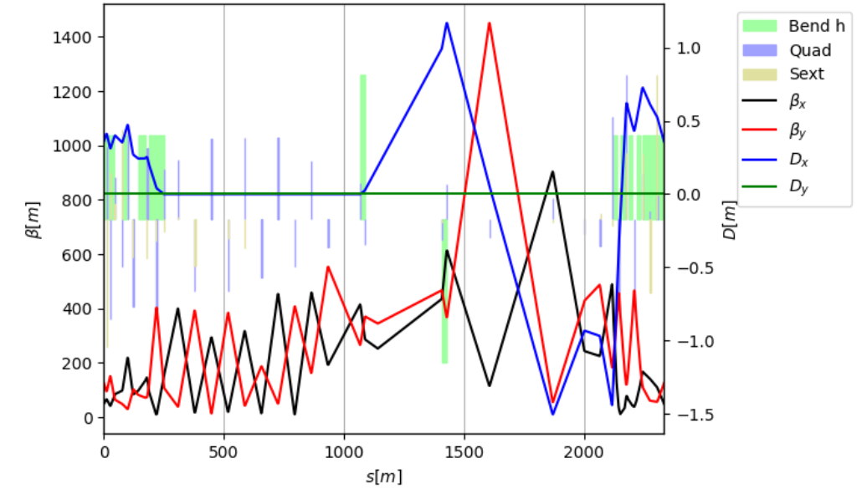
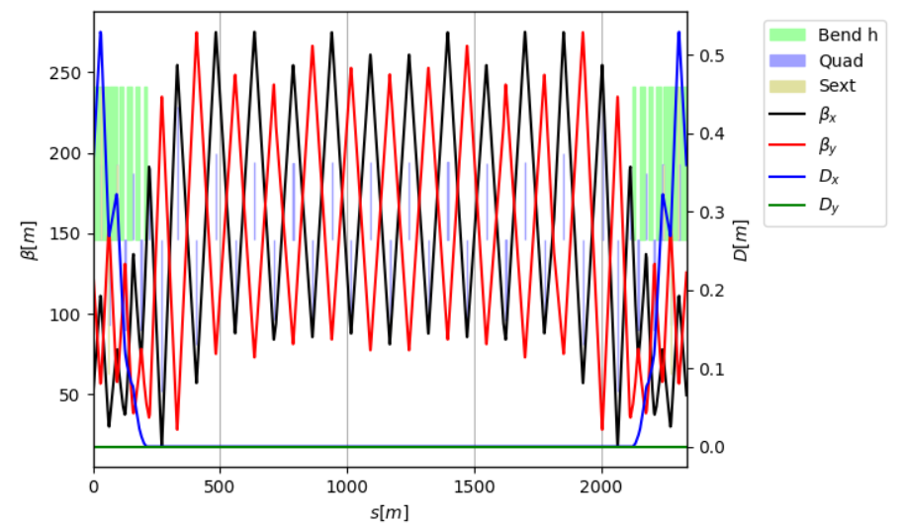
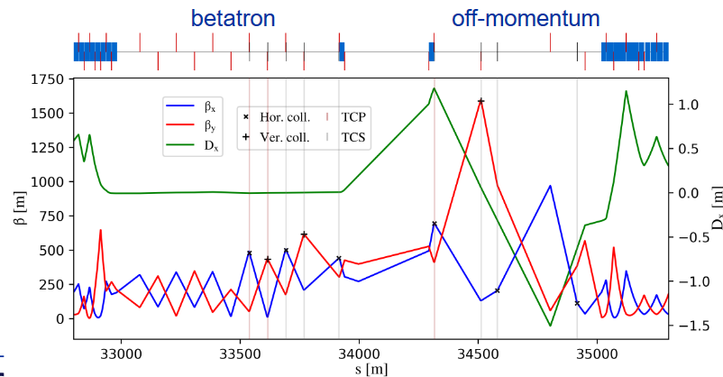
Work on the LCC insertions
M. Jebramcik
Intermediate solution → Insertion of GHC universal straight section in two consecutive straight sections
LCC straight sections are not yet adjusted to their respective function
Modified LCC lattice
“new” LCC straight
LCC
Besides linear optics, matching of Wx, Wy, ddx, sextupole RDTs (locally) + Survey matching with constant k0
2 Universal straights (injection & collimation)
Small chromaticity correction after insertion
GHC
This is a temporary solution allowing us to perform the basic studies.
Work on this version is discontinued…

Slide 3
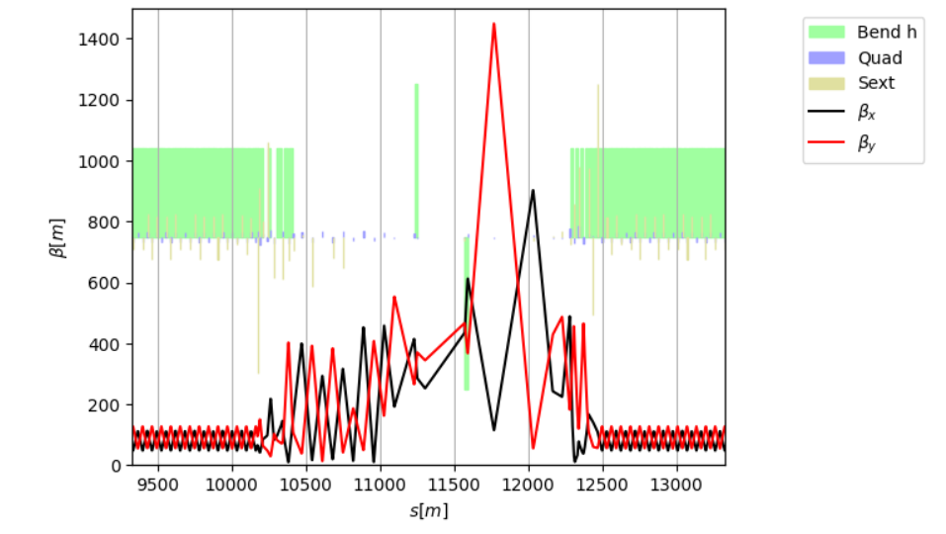
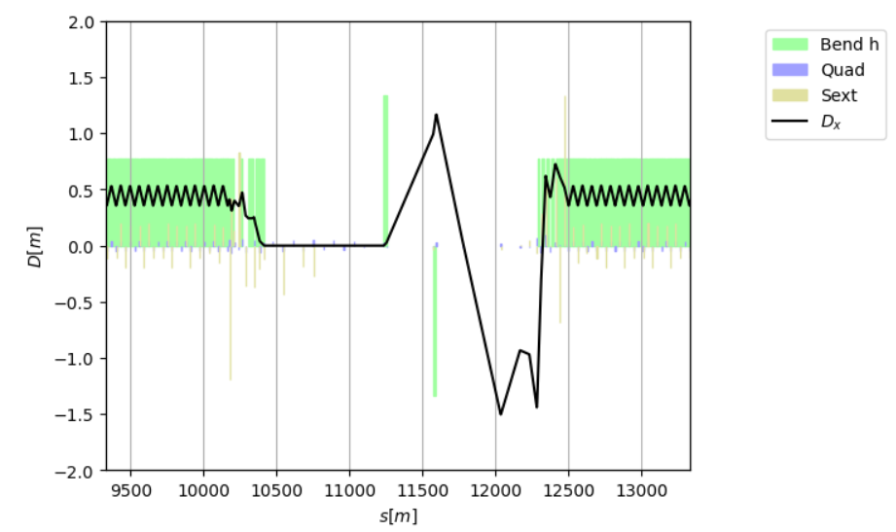
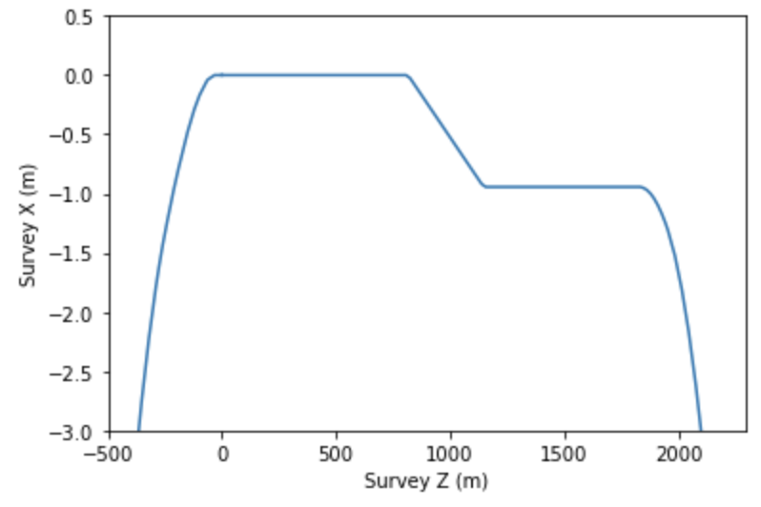
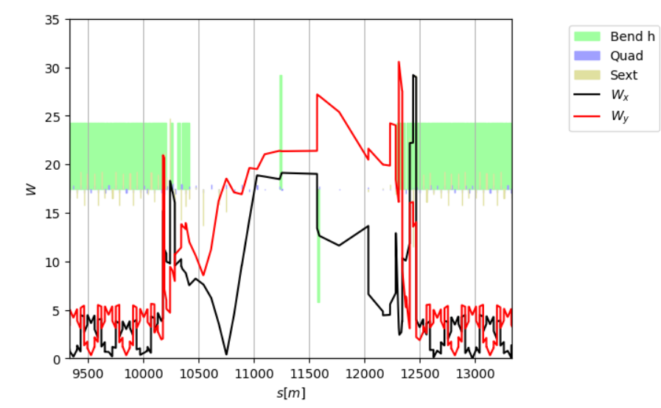
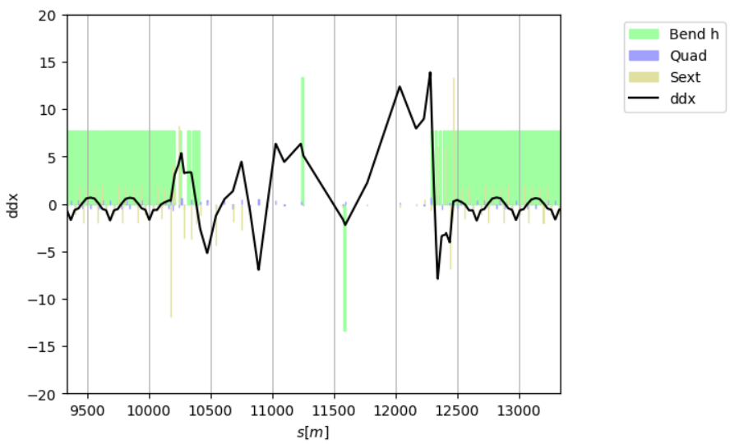
Matching with transparency conditions
M. Jebramcik
To maintain good MA and DA, the insertion has to be made transparent: linear optics, W functions and the second order dispersion function do not interrupt the natural periodicity of the arc that follows.
With the GHC following a different concept, additional chromatic sextupoles are required to tune the chromatic functions (W functions and second-order dispersion).
Survey
960mm separation in straight;
350mm separation start/end of arc.

Slide 4
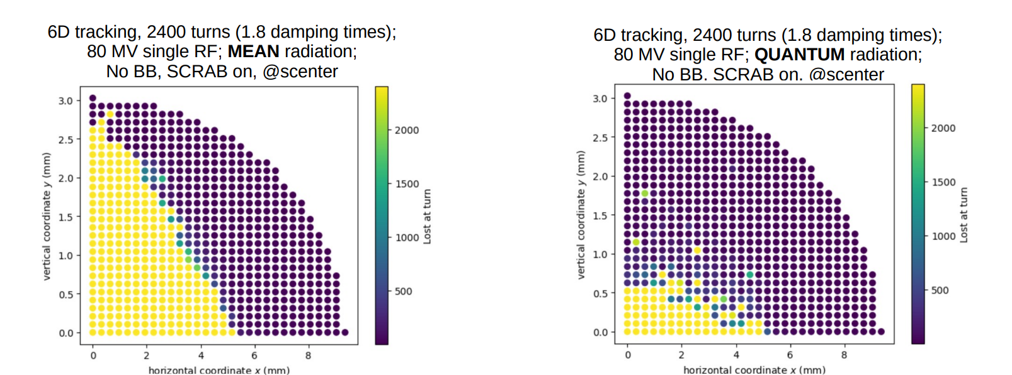
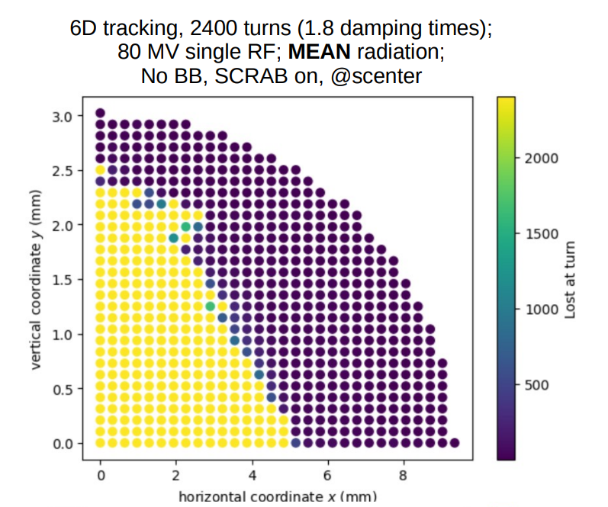
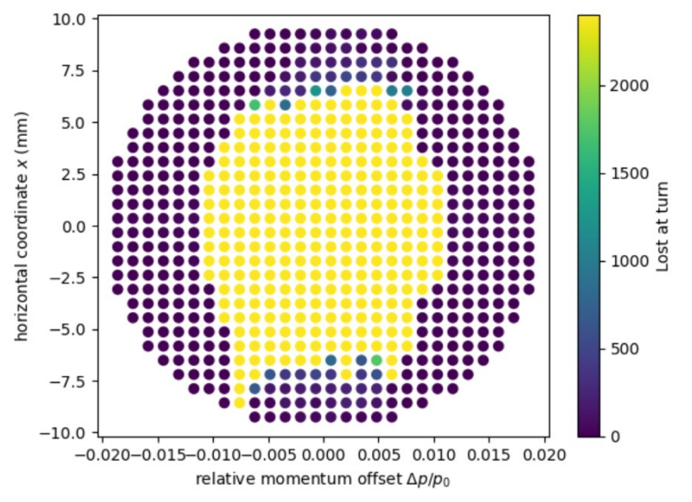
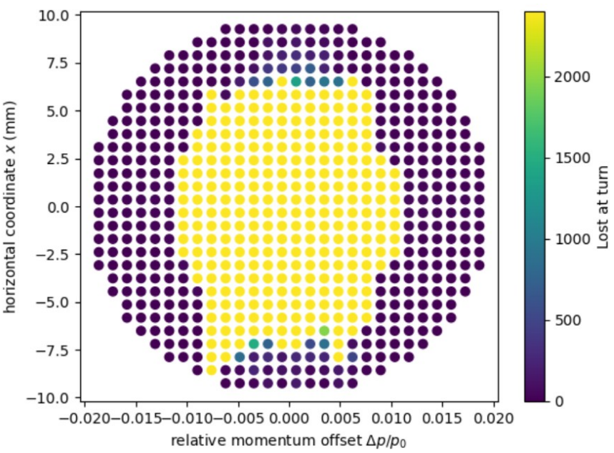
DA and MA before and after insertion
M. Jebramcik
LCC 92a 107
Modified LCC 92a 107
The DA and MA are maintained.
There remains an issue with SR + stochastic quantum process.
Some issues with SR + quantum

Slide 5
Summary
M. Jebramcik
This intermediate optics version can be used to do initial studies for e.g. collimation and injection; however, it is in a sense discontinued (see Pantaleo’s part)
By matching according to the “transparency conditions” + sextupole RDTs, one is able to match “anything” into the straight sections → had to add sextupoles though
Giacomo had a very first look at this optics version. TCPs could(!) open from X: 9.5 σ_{x} → 13-14 σ_{x}; Y: 50 σ_{y} → 75-90 σ_{y}

Slide 6
LCC straight sections optimization
July 10th,2025
Pantaleo Raimondi, Marc Jebramcik
Fermilab/CERN

Slide 7
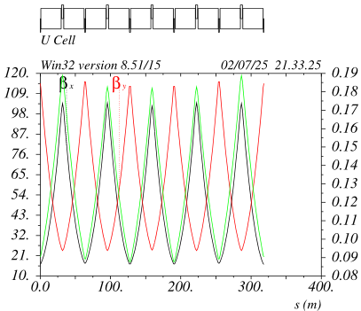
Recap of reoptimized HFD layout with 4 sextupole families (all modes)
All dipoles have the same length
All sextupoles are upstream the quads in the first half of the cell and downstream (symmetric) the quads in the second half.
In fact the “FODO” cell in the middle is shorter because there are no sextupoles in correspondance of the two central dipoles.
The relative beta-beating is large (~15%) and has to be corrected
There are 3 possibilities:
1) the middle quad has to run about 1.6% higher wrt to the other 4 QFs
2) the 2 center dipoles should be about 60cm longer
3) instead of lengthening the dipoles a drift space could be added
At the moment the lattice files have option (1):
1 dipole
2 quads families (2 lengths QF/QD)
4 sexts families (2 lengths SF/SD)
1 quad-trim ~2% on 1 QF out of 5
SF1 SF2
SD1 SD2

Slide 8
Straight section construction
Straight Sections (SSs) are being optimized individually for the different uses:
- RF (R)
- Collimation (C)
- Injection ( I )
- Diagnostic (D)
SSs are being integrated in the lattice with TCs condition in order to minimize:
- impact on machine parameters (Eloss, emittance, DA&MA etc)
- requirements on the ARC hardware (in particular the sextupoles) and
SSs are being built in this sequence:
- RF for ttbar, compatible for Z (good starting solution developed)
- Collimation for ttbar, compatible with Z (under study)
- Injection (not started)
- Diagnostic (not started)
Basic FCC requirements are being implemented as much as possible
Iterations with stakeholders will follow
Iterations based on hardware constraints and feasibility will follow

Slide 9
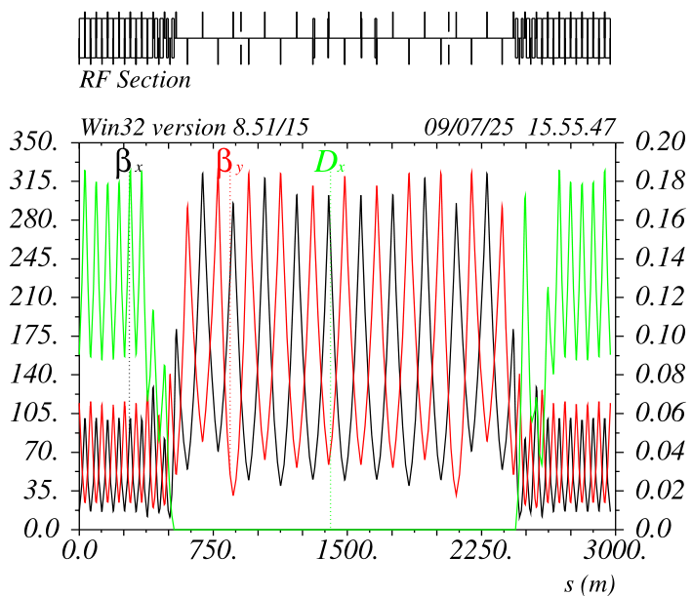
RF section (R) ttbar
The cell sequence is the one requested by the RF team, with the correct distance between the quads
However the 800MHz sections are 12 (not 13)
To be checked with the stakeholders if ok (considering the reduced RF requirement for LCC )

Slide 10
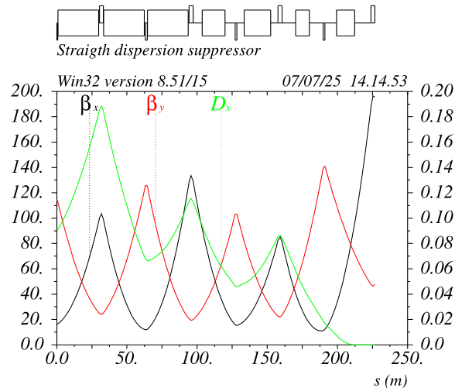
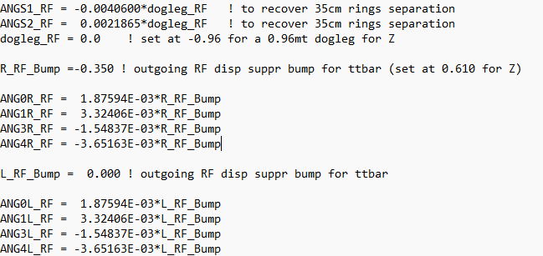
RF section (R) ttbar
Four dipoles (~0.5-1.5mrad) are modified in the outgoing DS to separate the beams (by 0.35mt)
The ES/Septum/Etc requirements and other interference issues have not been analized
The four dipoles delta_angles are determined by imposing: delta_x =-0.35 while keeping unchanged x’,dx,dx’.
No changes of optics are needed
For Z mode the deltas are rescaled imposing dx=0.61 and turning the center dogleg for dx=-0.96

Slide 11
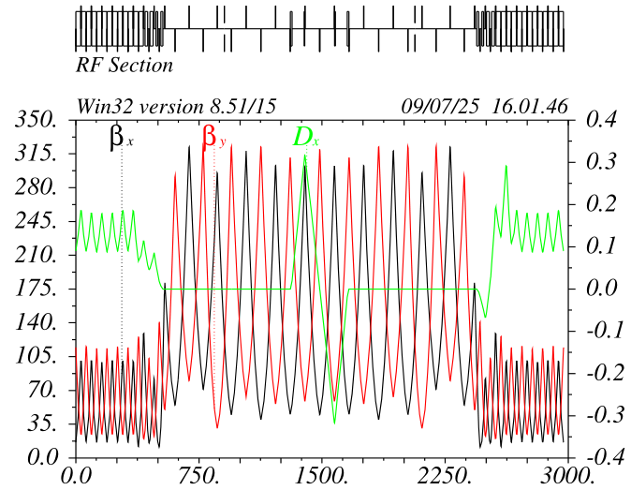
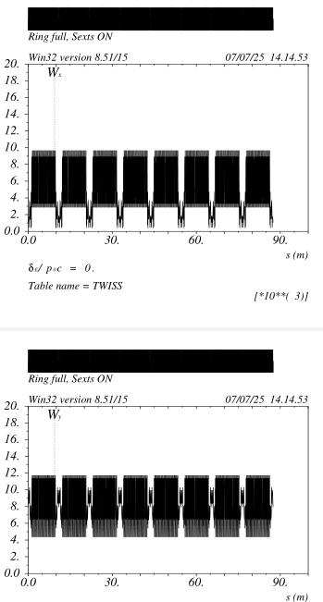
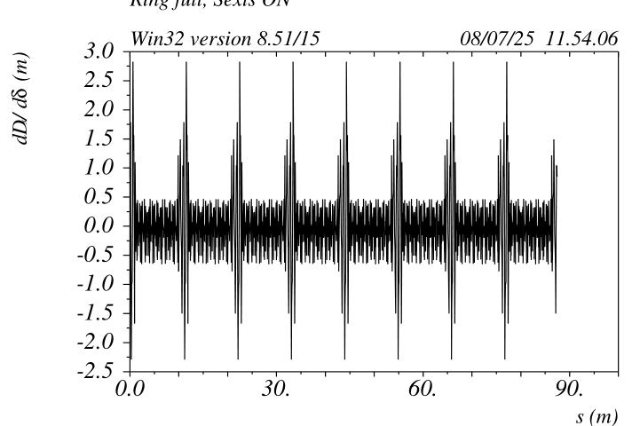
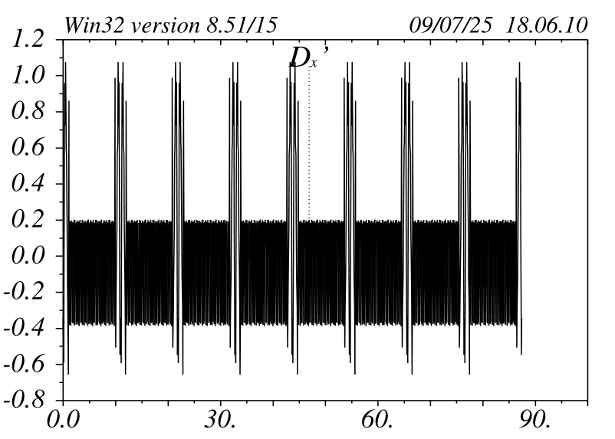
RF section (R) ~Z mode
Dipole changes cause just a ripple on ddx (natural is 0.2mt)
This does not affect the DA&MA but it could be studied how to reduce it
With doglegs
No doglegs

Slide 12
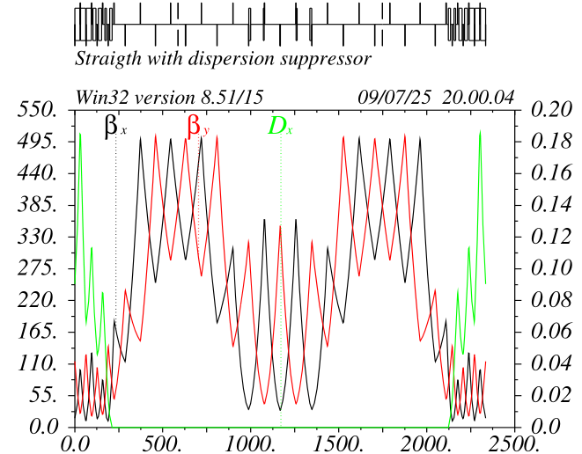
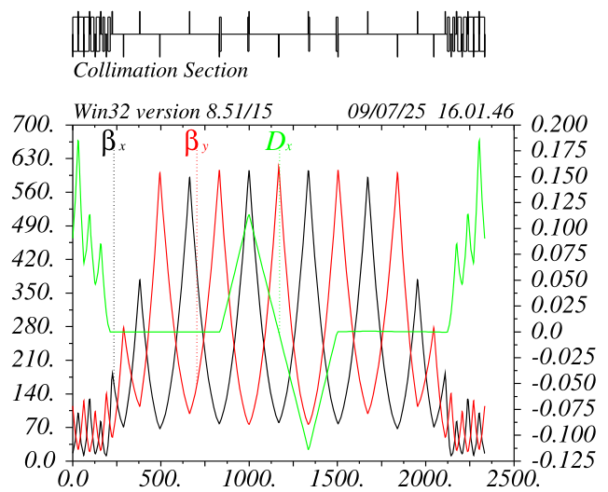
Collimation section (C) under study ttbar mode
Option 1:
3 collimators/plane and two phases of collimation
phases between the collimators within the desired range
Betas ~500mt
Option 1:
3 collimators/plane and 1 phase of collimation
(as present scheme)
Work in progress: need to move the dogleg downstream and
adjust the phases between the collimators
Betas could be around 1000mt

Slide 13
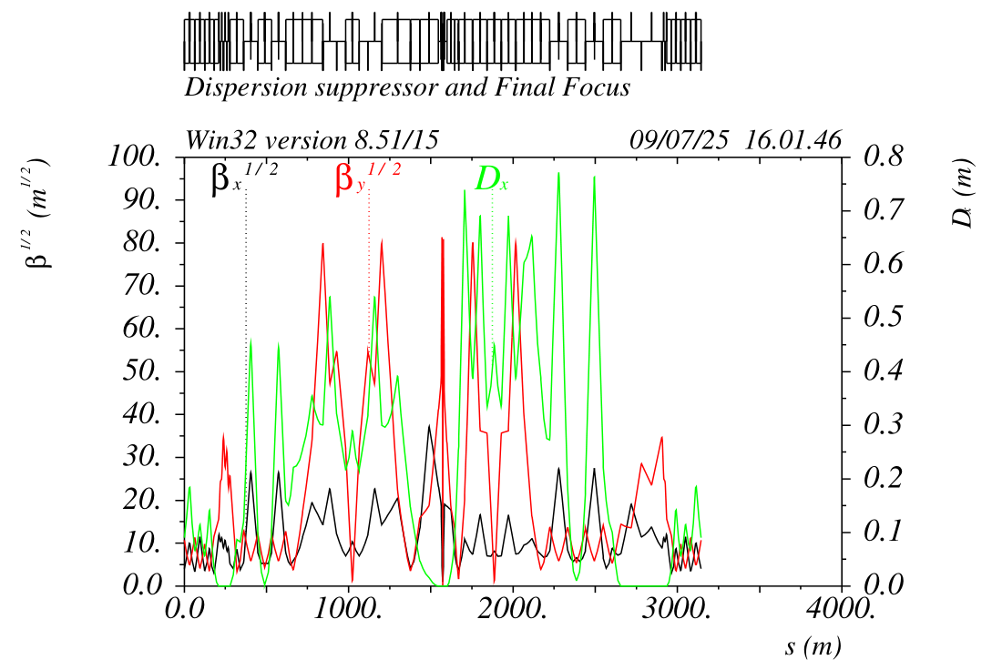
Energy Collimation all modes
Outgoing FF has a built-in 0.75mt dispersion peak at the very end.
I suggest to study if the energy collimation could be more effective in this location (using the Marc lattice) wrt to the SS case.
In principle it is more apt to clean the debris from the collision and could be done after each IP (preparing the beam for the next one)
Collimator gaps should be in the range of +/-15mm@Z and +/-20mm@ttbar

