Slide 1

Future Circular Collider
Technical Infrastructure
Comparison criteria for GHC and LCC: Cooling and ventilation
I. Martin Melero, D. Najdrowski, A. Coleman (EN/CV)

Slide 2

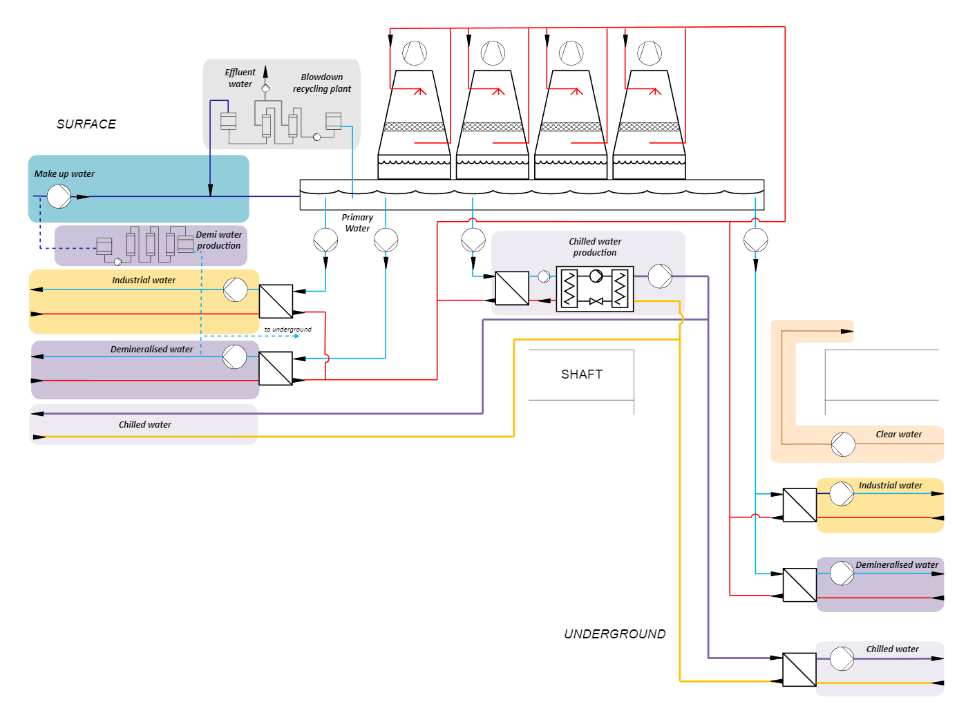
Inigo Martin Melero (EN/CV)
2
0. Definitions
- Primary water → transfers heat load from subcircuits to cooling towers
- Make-up water → compensates losses in cooling towers and is used to produce demineralised water
- Demineralised water → cools sensible equipment like magnets or SR absorbers
- Chilled water → produced at chillers, dissipates heat load from air in AHUs, fancoils
- Industrial water → same quality as primary water, cools equipment like cryogenics
- Clear water → evacuated from infiltrations and drains
- Effluent water → byproduct of blowdown recycling, high salts concentration

Slide 3
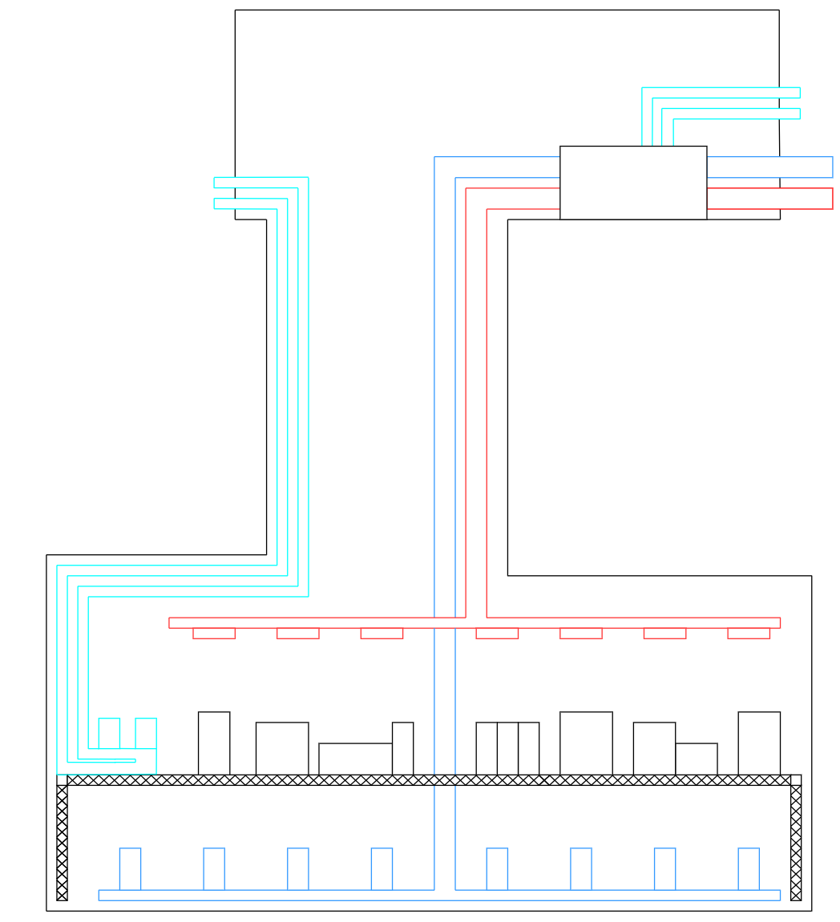
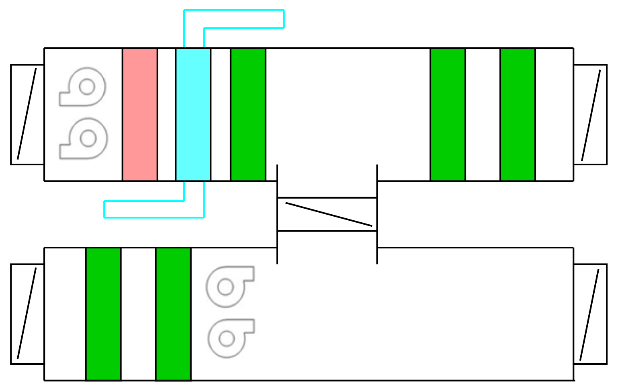

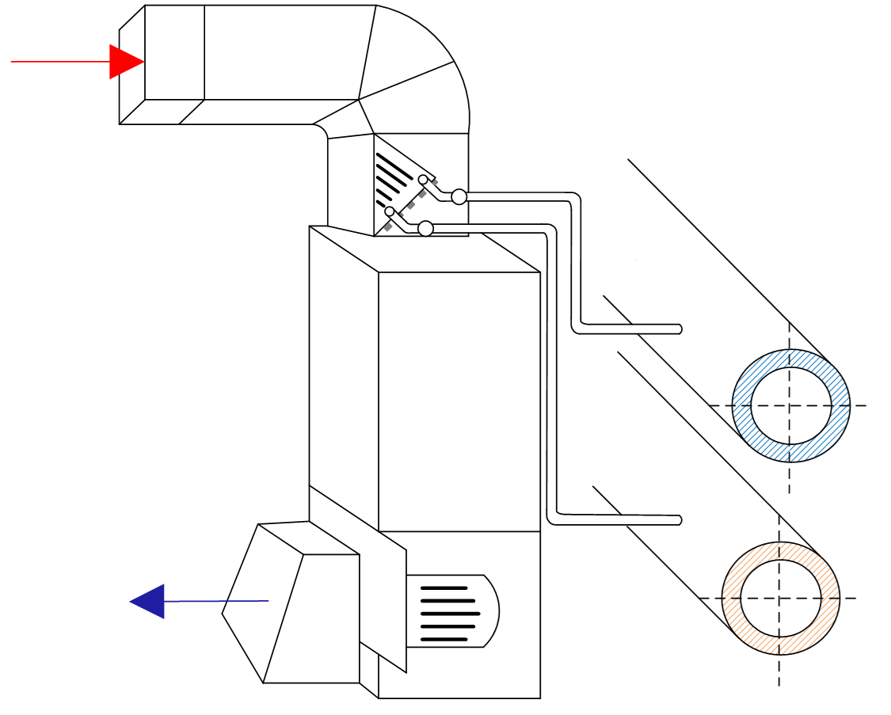
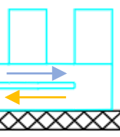
Inigo Martin Melero (CERN/EN/CV)
3
0. Definitions
Surface
AHUs
Treatment of the air to temperature and humidity conditions
Chilled water
Supply
Return
Chilled water
Chilled water
Supply
Supply AHU
Supply air
Supply
AHUs
Supply air
Return
Exhaust air
Supply air
Cold battery
Heating battery
Air filter
Air filter
Air filter
Underground
Shaft
Return
Recycled air
Air filter
Air filter
Exhaust air
Cavern
Hot air
Return AHU
Exhaust air
Heat Exchanger
Fancoils
Recirculation of air through coils to locally adjust temperature conditions
Fancoils
Cold air
Chilled water supply and return
Blower

Slide 4
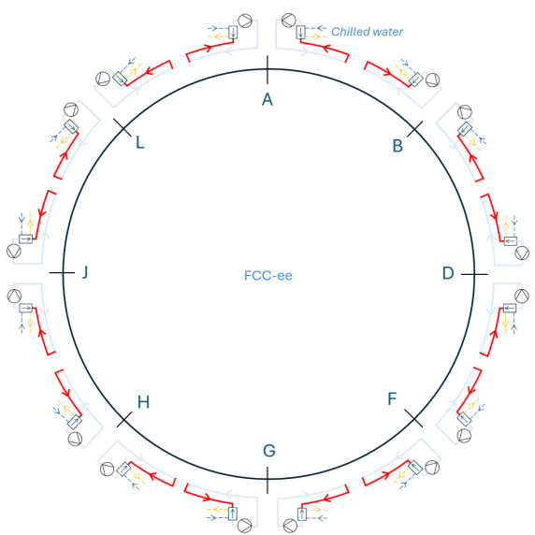
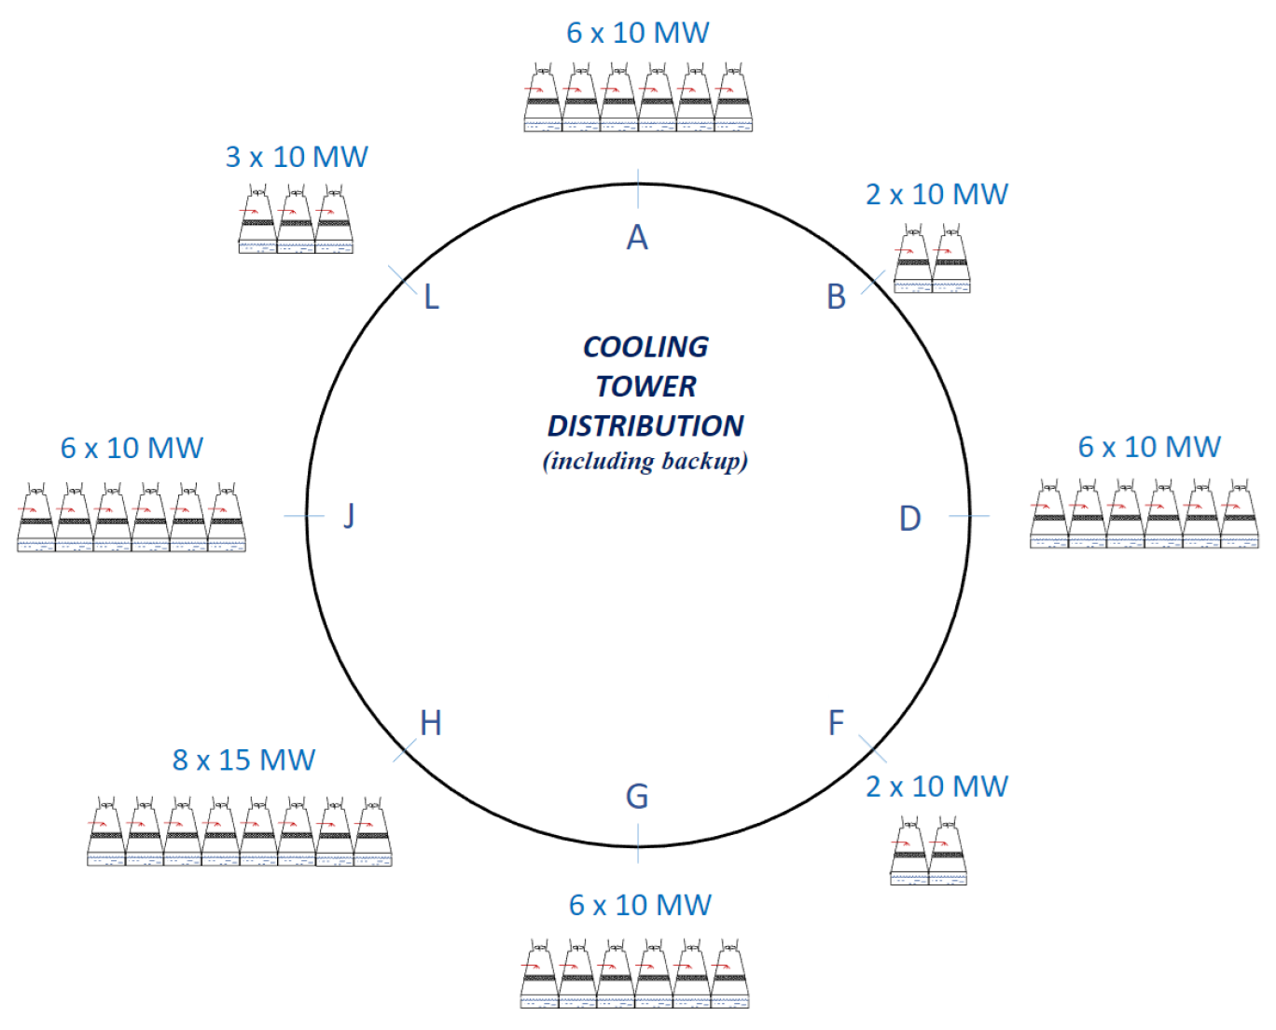
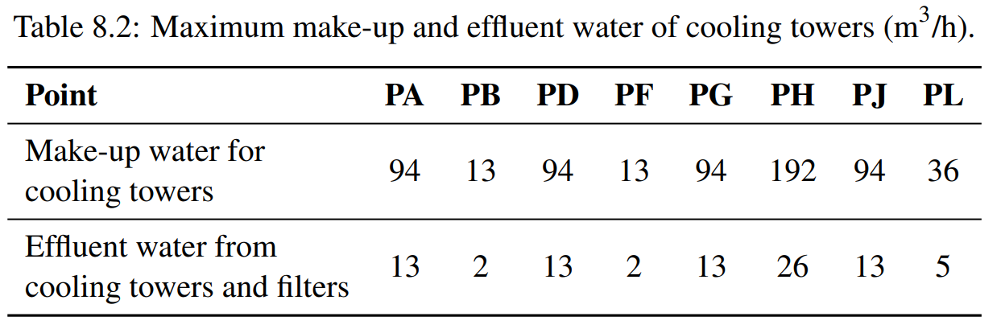
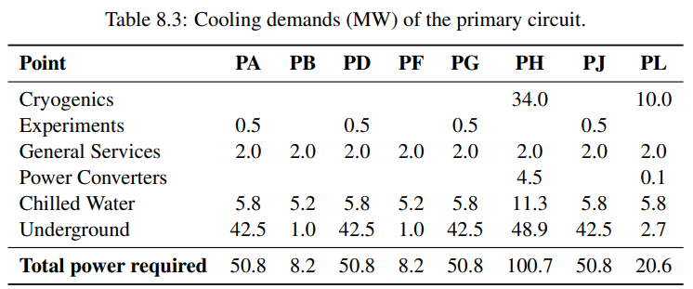

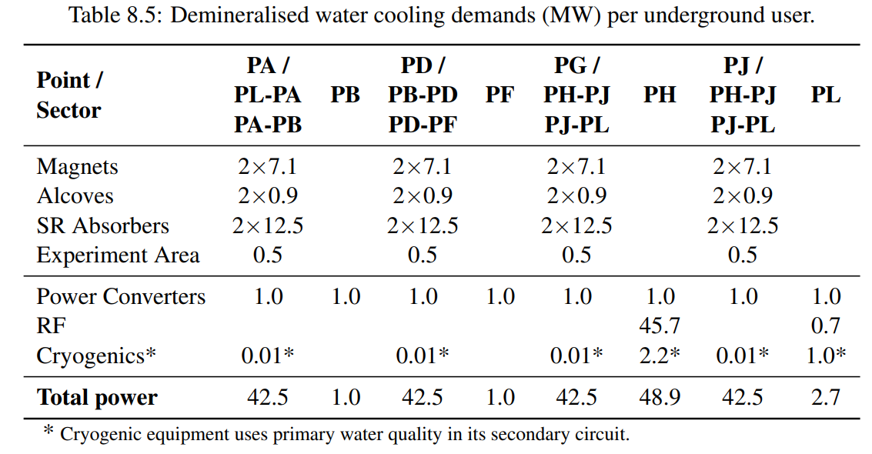
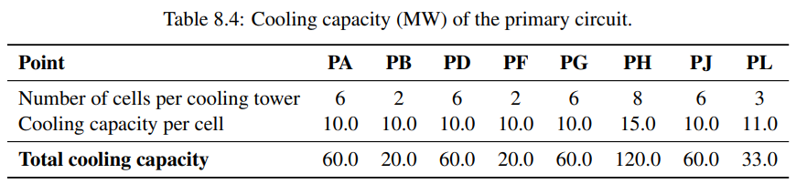
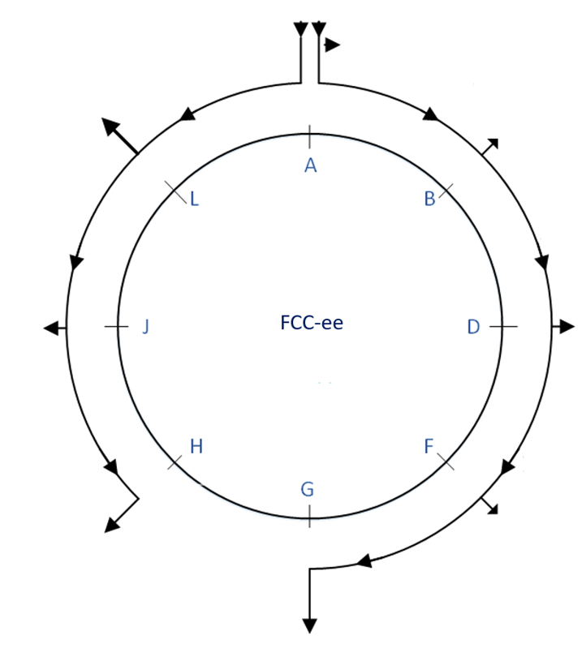
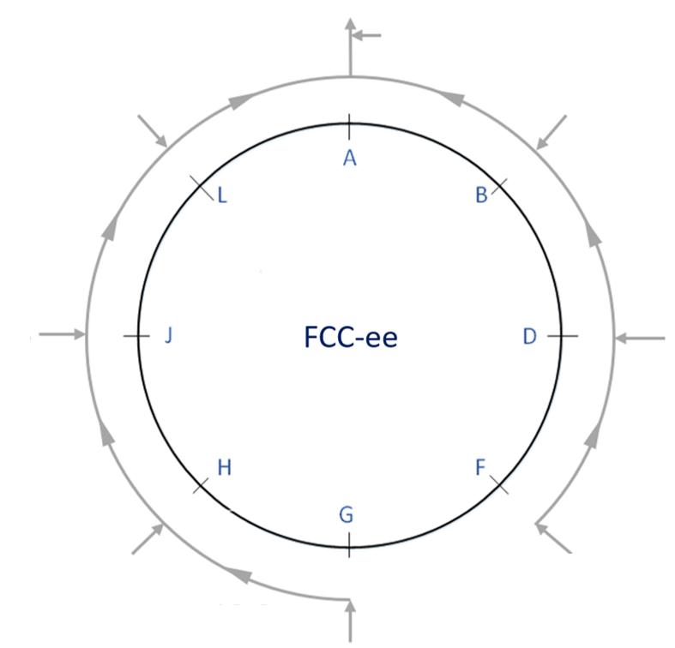
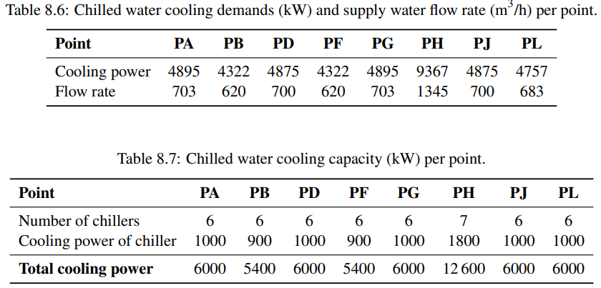
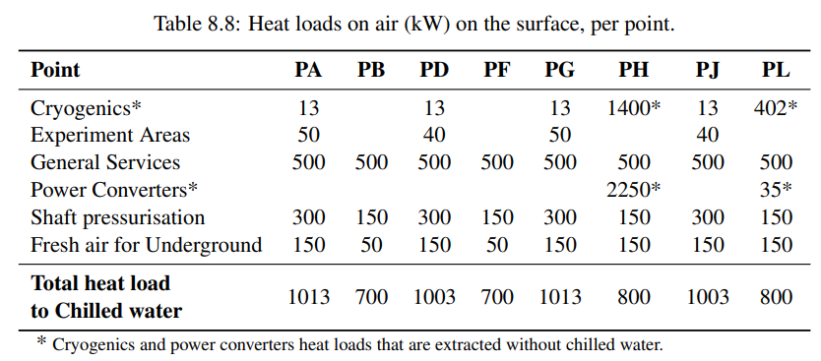
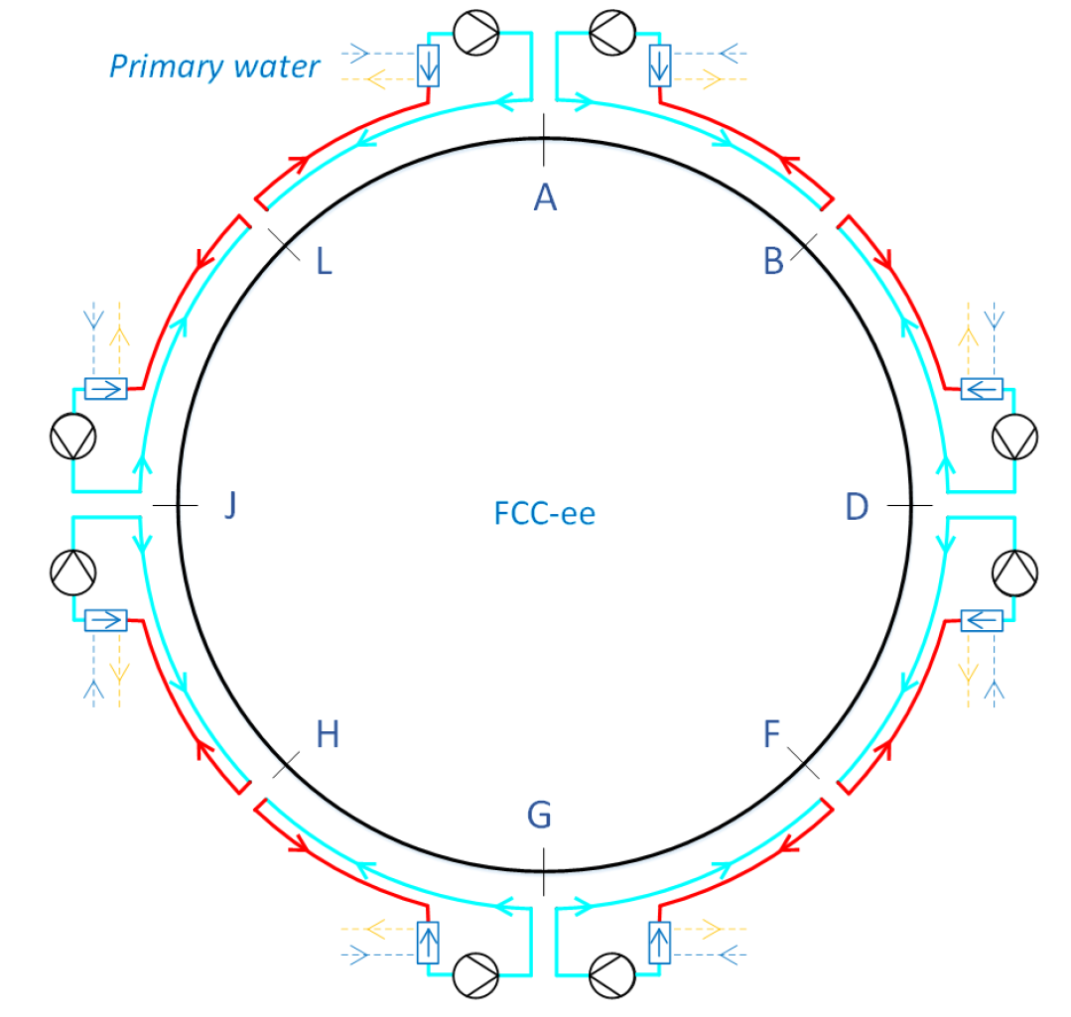
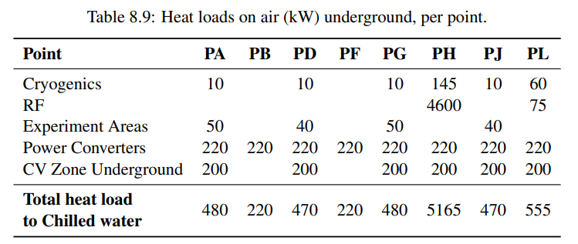
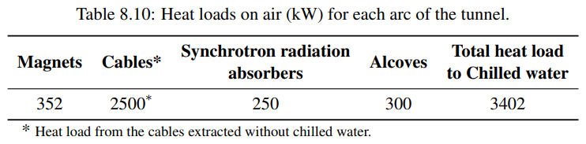
1. CV current status
Chilled water distribution in Tunnel
Cooling towers for FCC-ee
Cooling
Raw water distribution
Effluent water distribution
Demineralised water distribution in Tunnel
Are we directly affected by the optics? → NO
Are we affected by systems that are affected by the optics? → YES
Ventilation

Slide 5
2. Questions by optics
What are the prerequisites you need to perform the comparison?
- At the current design stage, we do not need lattice descriptions / technical and experimental insertions from optics.
- Even though we are not directly affected by optics, we are affected by the heat load changes happening in the other systems interacting with the beam.

Slide 6
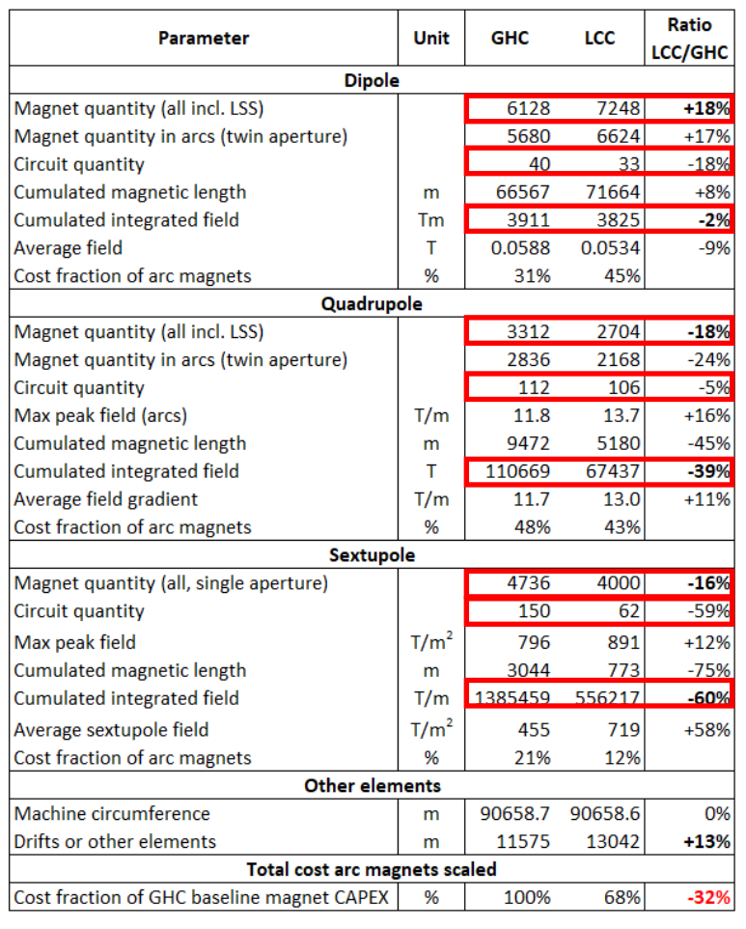
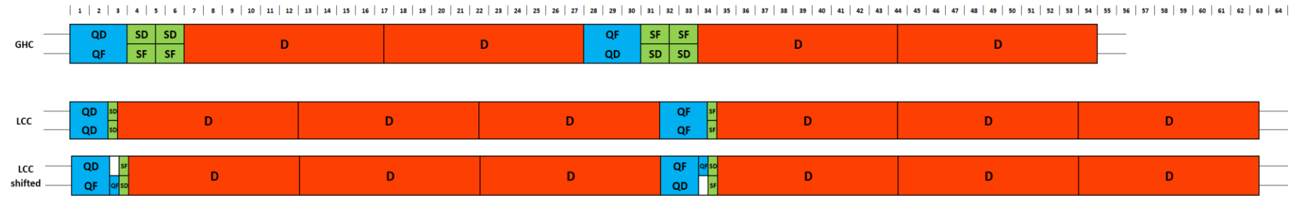
2. Questions by optics
Do you require input from other teams and groups?
YES
Collider, booster magnets → Layout for connection to demineralised water pipes
Heat load to water / air, ∆T… of new magnet design (dipoles, quads, sexts)
How will this affect the power converters + cables to magnets?
Data to be collected shortly via Excel requirements

Slide 7
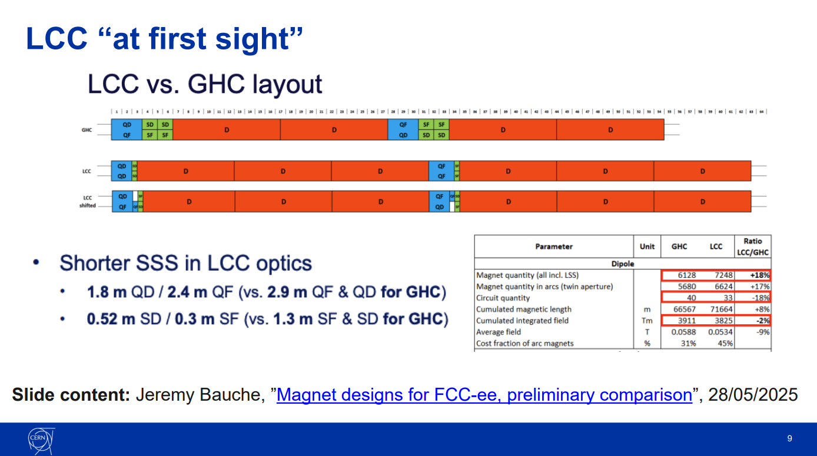
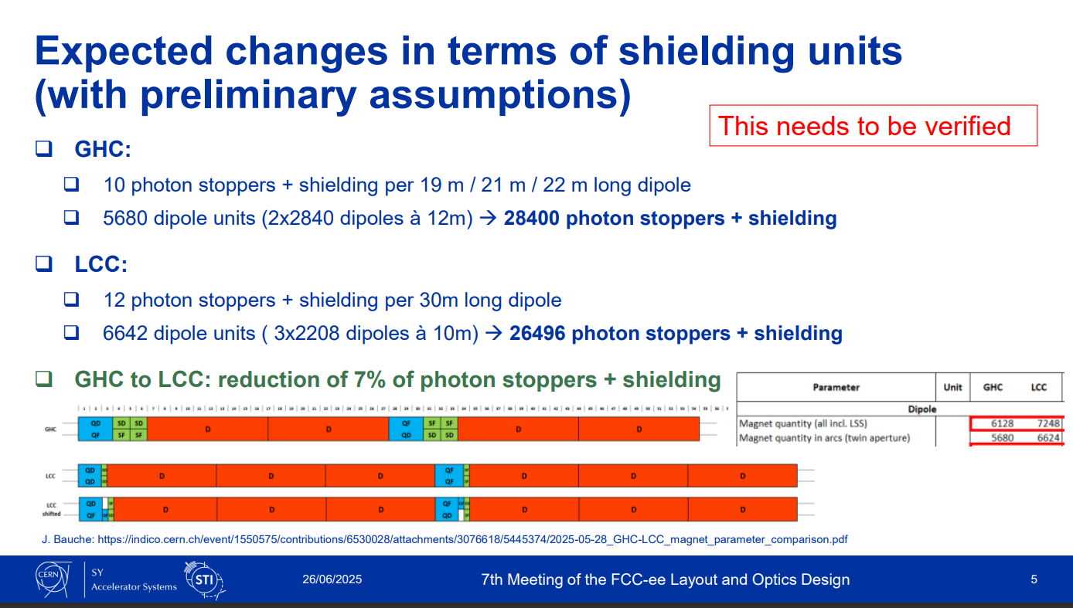
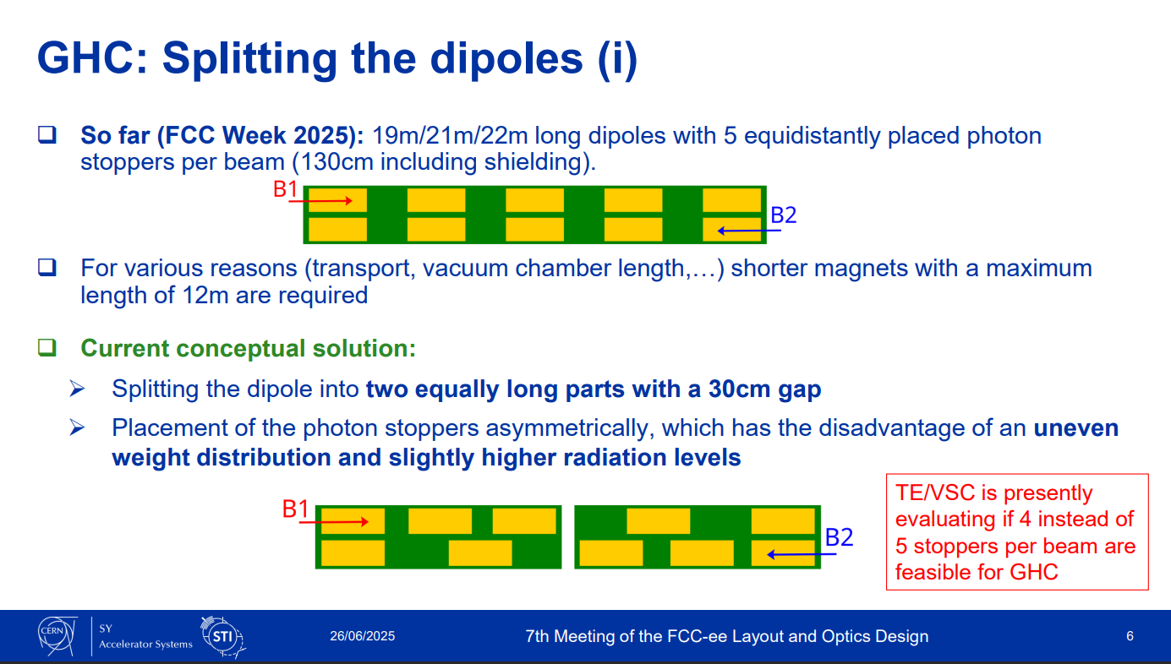
2. Questions by optics
Do you require input from other teams and groups?
YES
Vacuum, radiation shielding → Proportion of the 50 MW / beam that now goes to SR absorbers, radiation shielding, photon stoppers and environment
Layout for connection to demineralised water pipes
Heat load to water / air, ∆T… of all these elements
Data to be collected shortly via Excel requirements

Slide 8
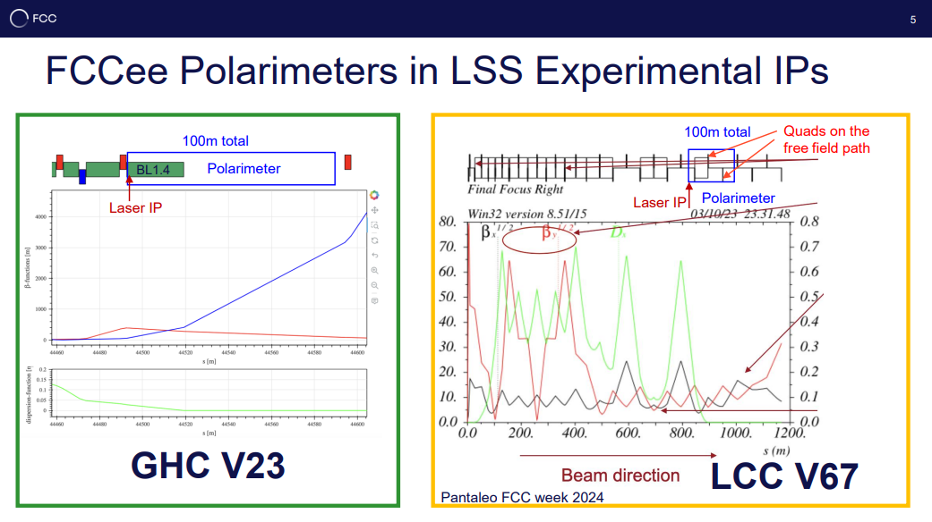
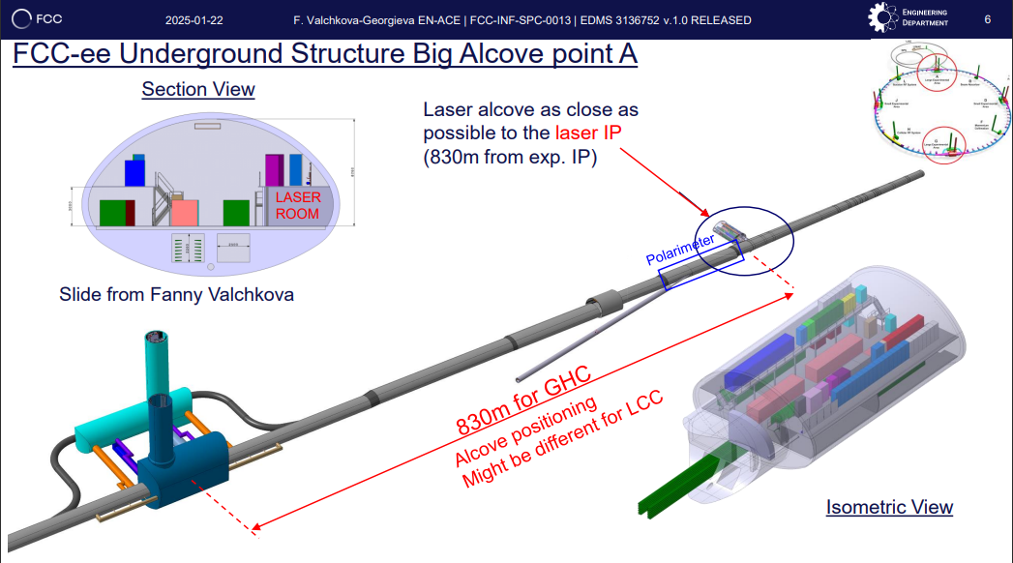
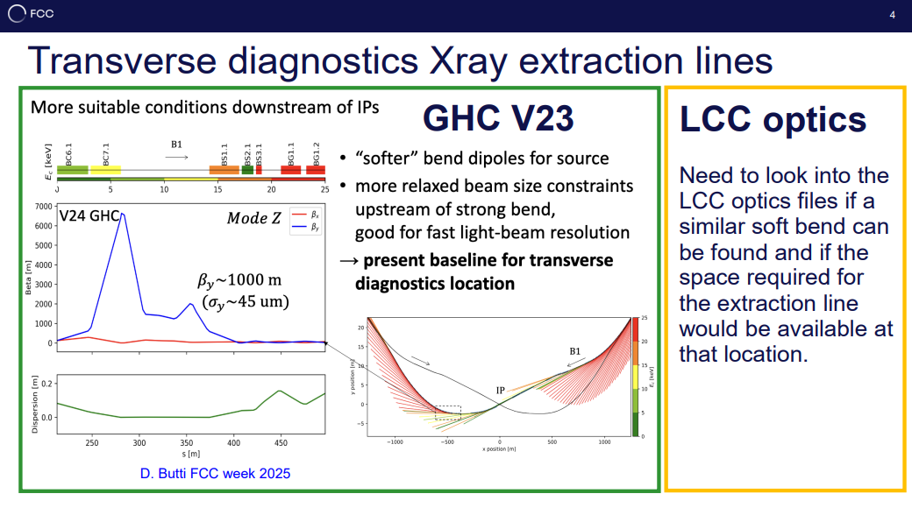
2. Questions by optics
Do you require input from other teams and groups?
YES
Beam Instrumentation → Numbers of BPMs, BLMs in Tunnel, heat evacuated to water / air
Refined conditions like temperature stability
Change of conditions in polarimeter, laser hutch in alcove
Data to be collected shortly via Excel requirements

Slide 9
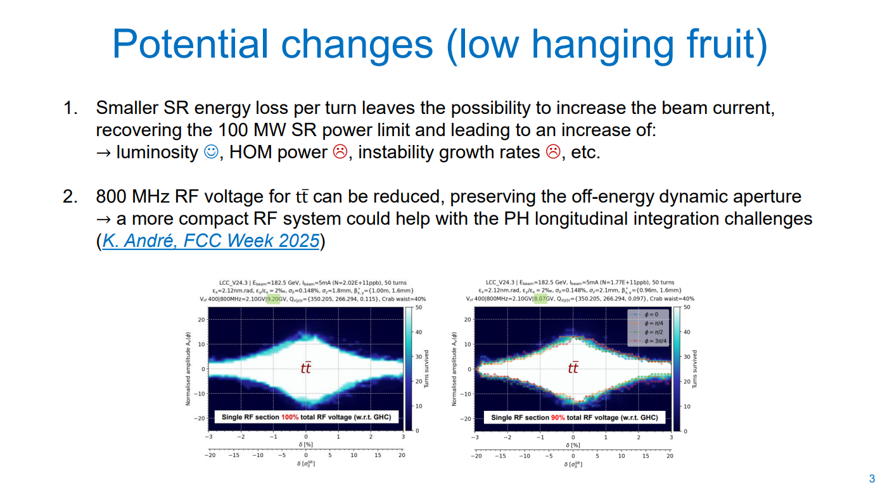
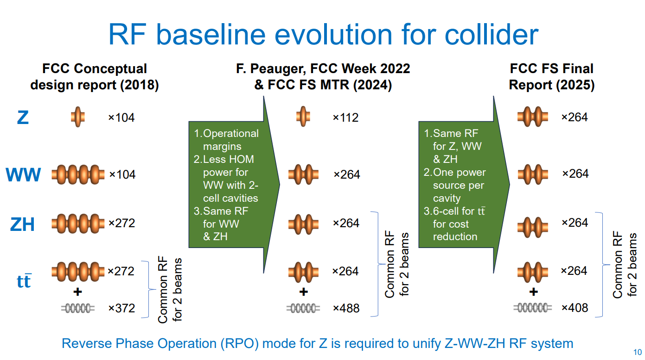
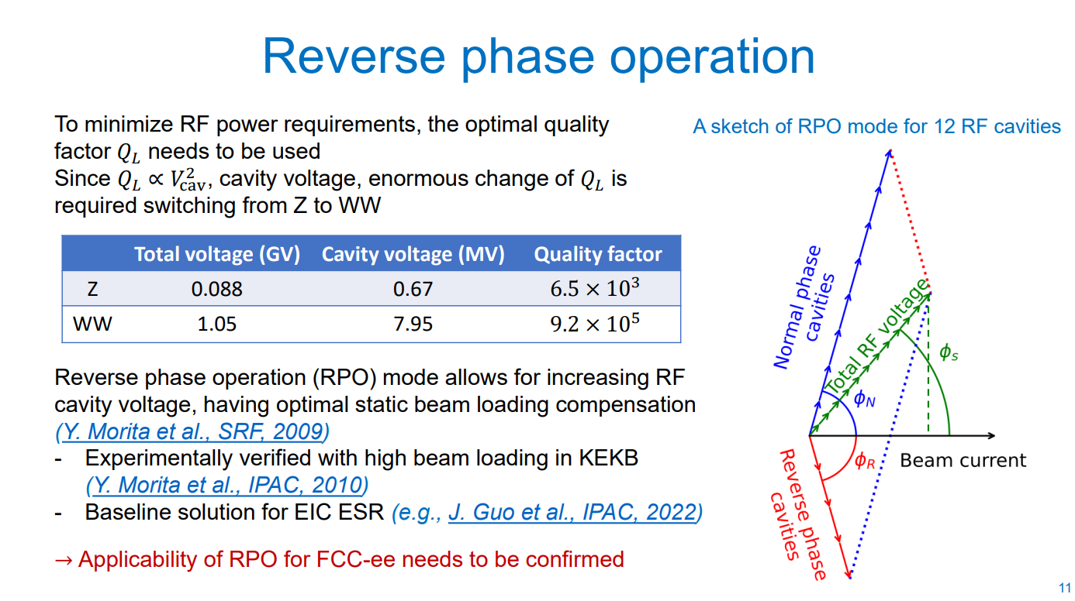
2. Questions by optics
Do you require input from other teams and groups?
YES
RF → Layout for connection to demineralised water pipes
Integration in Point H and Point L, refitting of CV services
Heat load to water / air, ∆T… of all cavities, update on Point H and Point L
Data to be collected shortly via Excel requirements
Updates from other users that might change heat load:
Power converters
Racks from EN-EL
Cryogenics
…

Slide 10
2. Questions by optics
What are the criteria under your scope of study that you consider relevant for the comparison?
The amount of heat load extracted from each equipment
+ heat load → + pumping power, pipes, etc → + cooling tower needs → + cost
The distribution of the heat load
to demineralised water → more cooling capacity
to air → extracted through chilled water via fancoils, - efficient & + cost
Conditions in special areas
stricter conditions → + complexity → + deviations from baseline circuits → + cost

Slide 11
2. Questions by optics
What output will your team or group provide as a result? How long do you estimate this will take you?
Update of the global thermal load: resizing of chillers, cooling towers, circuits…
Evaluation of the complexity of the systems and refinement of the design (deeper detail)
Some details must be refined anyway for the GHC too
Does the choice of optics have a significant impact on your activities?
- Not directly, but rather on the heat loads / cooling and ventilation requirements of our users, consequence of that choice

Slide 12
SPARES

Slide 13
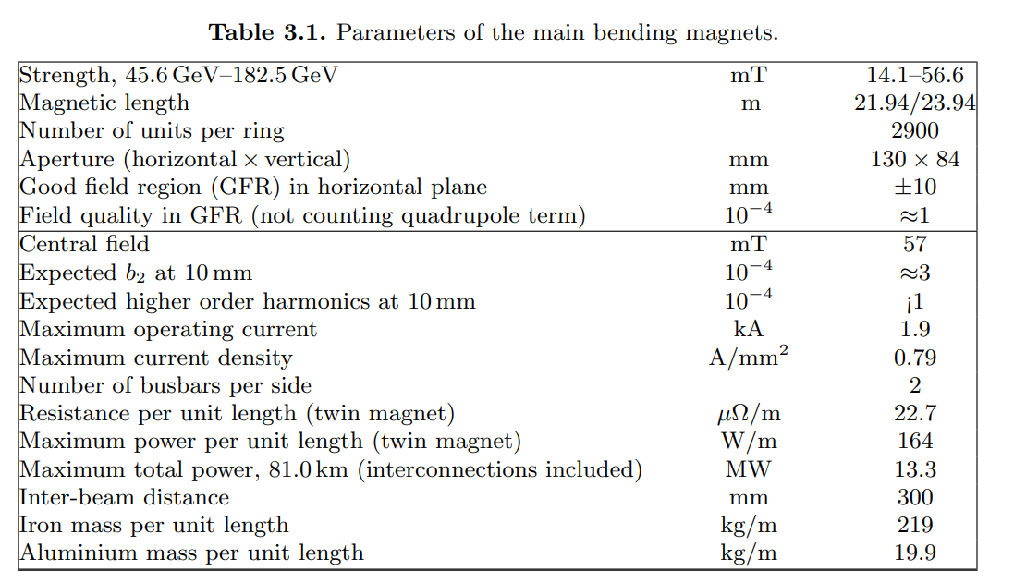
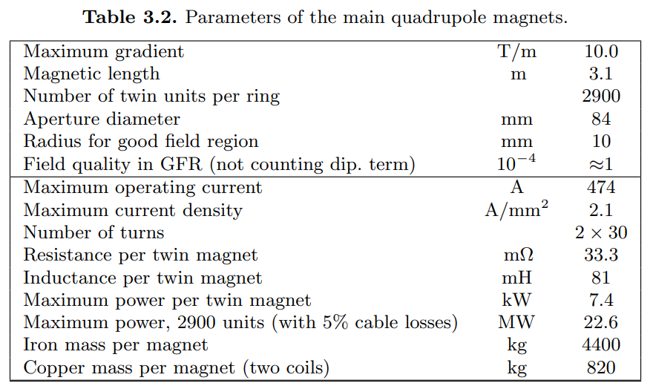
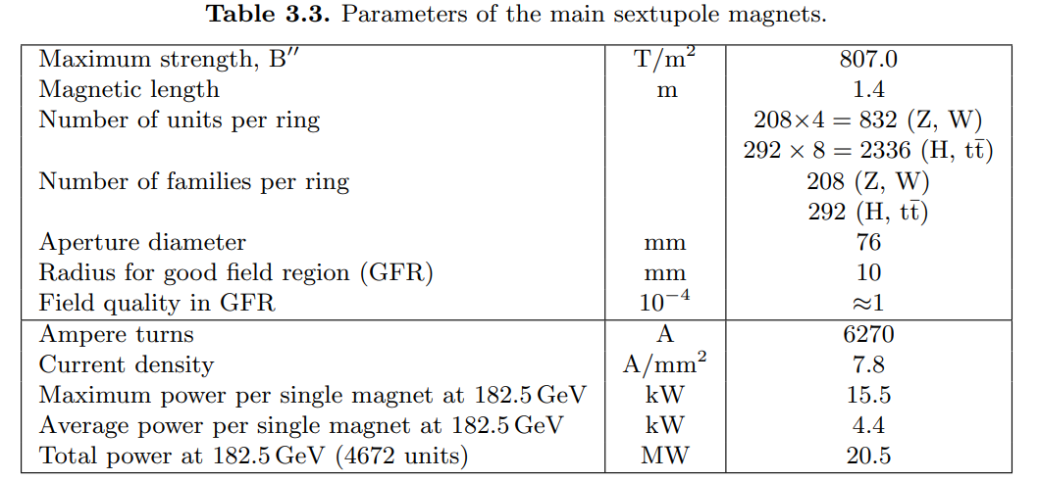
Demineralised water loads (MW)
Location | Magnets | Alcoves | SR Absorbers | Detectors | Power converters accelerator | RF underground | Cryogenics* | Underground TOTAL
L-A | 7.1 | 0.9 | 12.5
A |  |  |  | 0.5 | 1.05 |  | 0.01 | 42.56
A-B | 7.1 | 0.9 | 12.5
B |  |  |  |  | 1.05 |  |  | 1.05
B-D | 7.1 | 0.9 | 12.5
D |  |  |  | 0.5 | 1.05 |  | 0.01 | 42.56
D-F | 7.1 | 0.9 | 12.5
F |  |  |  |  | 1.05 |  |  | 1.05
F-G | 7.1 | 0.9 | 12.5
G |  |  |  | 0.5 | 1.05 |  | 0.01 | 42.56
G-H | 7.1 | 0.9 | 12.5
H |  |  |  |  | 1.05 | 45.7 | 2.2 | 50.95
H-J | 7.1 | 0.9 | 12.5
J |  |  |  | 0.5 | 1.05 |  | 0.01 | 42.56
J-L | 7.1 | 0.9 | 12.5
L |  |  |  |  | 1.05 | 0.69 | 1.0 | 2.74
*Cryogenic equipment is cooled with Industrial water
To water
(13.3 + 22.6 + 20.5) / 8 sectors = 7.1 MW
To air
7.1 MW * 5% = 356 kW
Thermal loads to air in Arc Sector (kW)
Magnets | Cables
352 | 2,500
SR absorbers | Alcoves
250 | 300
TOTAL PER SECTOR
3,402

Slide 14
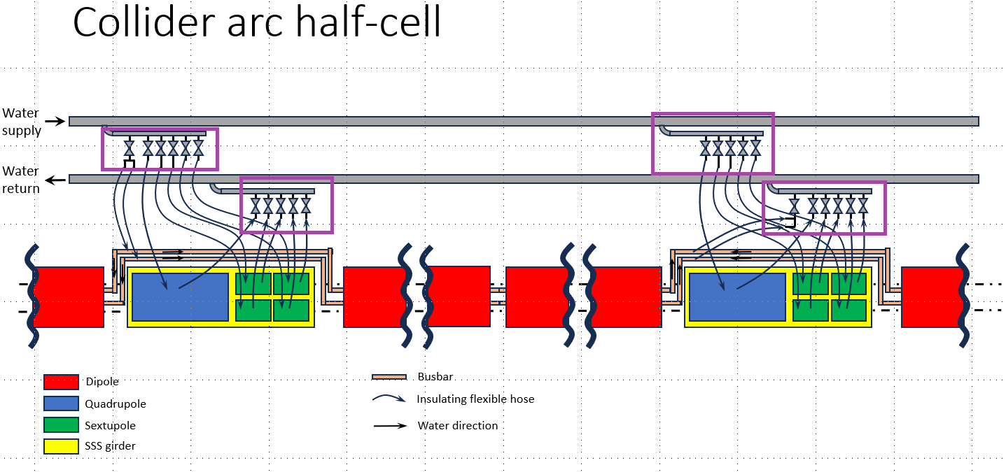
Exchanges in August, December 2024:
Preferences EN-CV:
Delta P around 3-4 bars, maximum 5 bars
Supply water around 27 C, preferred delta T as high as possible, 20-30 C
Only one circuit is foreseen, for copper.
Info from collider magnets:
Delta T 15-20 C, and delta P around 5-6 bars. Sextupoles challenging to attain 5 bar.
Required supply temperature?
Updated thermal load to water?
Updated thermal load to air?
Info from booster magnets:
Delta T 7-26 C, and delta P around 2-7 bars
Required supply temperature?
Thermal load to water?
Thermal load to air?
Exchange January 2024: Layout
Does this layout still hold? Need to iterate / further define it
Current EN-CV assumption for cost estimate, etc: one manifold every 50 m.
What would the interface magnets/EN-CV be?
The flexibles are already considered as magnets?

Slide 15
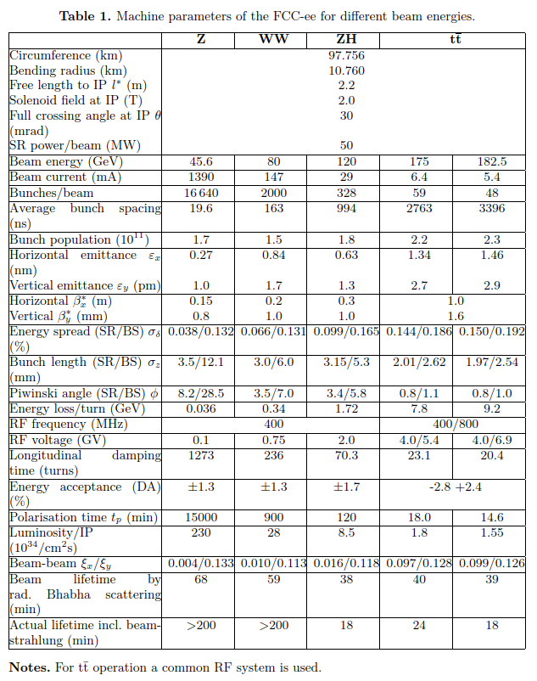
Heat loads (MW) at Cooling Towers, FCC-ee ttbar
Demineralised water loads
Location | Magnets | Alcoves | SR Absorbers | Detectors | Power converters accelerator | RF underground | Cryogenics* | Underground TOTAL
L-A | 7.1 | 0.9 | 12.5
A |  |  |  | 0.5 | 1.05 |  | 0.01 | 42.56
A-B | 7.1 | 0.9 | 12.5
B |  |  |  |  | 1.05 |  |  | 1.05
B-D | 7.1 | 0.9 | 12.5
D |  |  |  | 0.5 | 1.05 |  | 0.01 | 42.56
D-F | 7.1 | 0.9 | 12.5
F |  |  |  |  | 1.05 |  |  | 1.05
F-G | 7.1 | 0.9 | 12.5
G |  |  |  | 0.5 | 1.05 |  | 0.01 | 42.56
G-H | 7.1 | 0.9 | 12.5
H |  |  |  |  | 1.05 | 45.7 | 2.2 | 50.95
H-J | 7.1 | 0.9 | 12.5
J |  |  |  | 0.5 | 1.05 |  | 0.01 | 42.56
J-L | 7.1 | 0.9 | 12.5
L |  |  |  |  | 1.05 | 0.69 | 1.0 | 2.74
*Cryogenic equipment is cooled with Industrial water
To water
2 beams x 50 MW = 100 MW
100 / 8 sectors = 12.5 MW
To air
12.5 MW * 2% = 250 kW
Exchanges in November 2022, December 2024:
Delta T = 11 C
Delta P = 2.5 bar
Required supply temperature?
Thermal load to water?
Thermal load to air?
Thermal loads to air in Arc Sector (kW)
Magnets | Cables
352 | 2,500
SR absorbers | Alcoves
250 | 300
TOTAL PER SECTOR
3,402

Slide 16
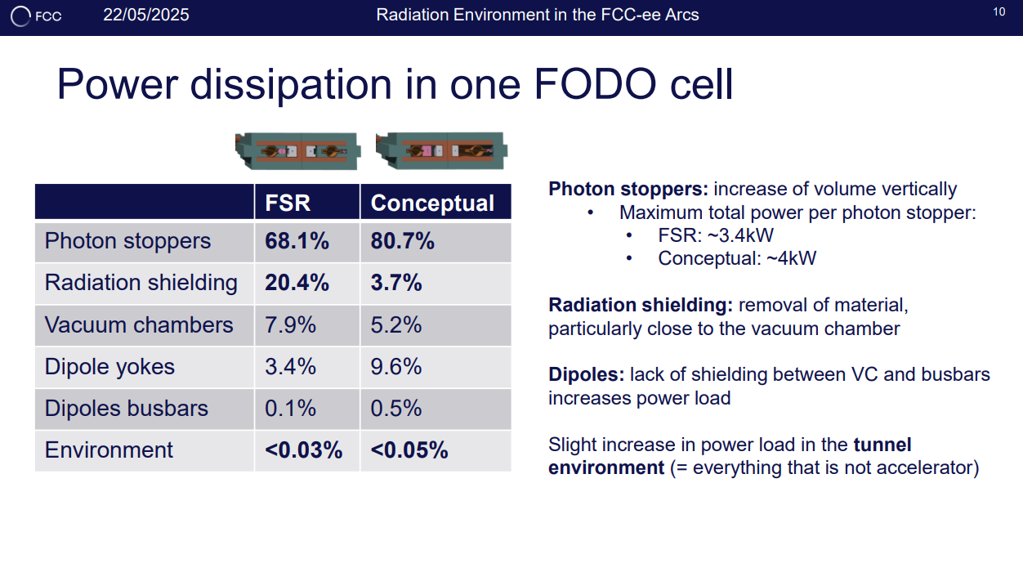
What does each line mean in terms of kW?
To magnets?
To SR absorbers?
Photon stoppers are included in which category?
Requirements gathering by CV, shortly

