Slide 1

Comparison criteria for GHC and LCC: supports
E. Bernard, F. Carra, M. Timmins, A. Piccini
Thursday 24th July 2025

Slide 2
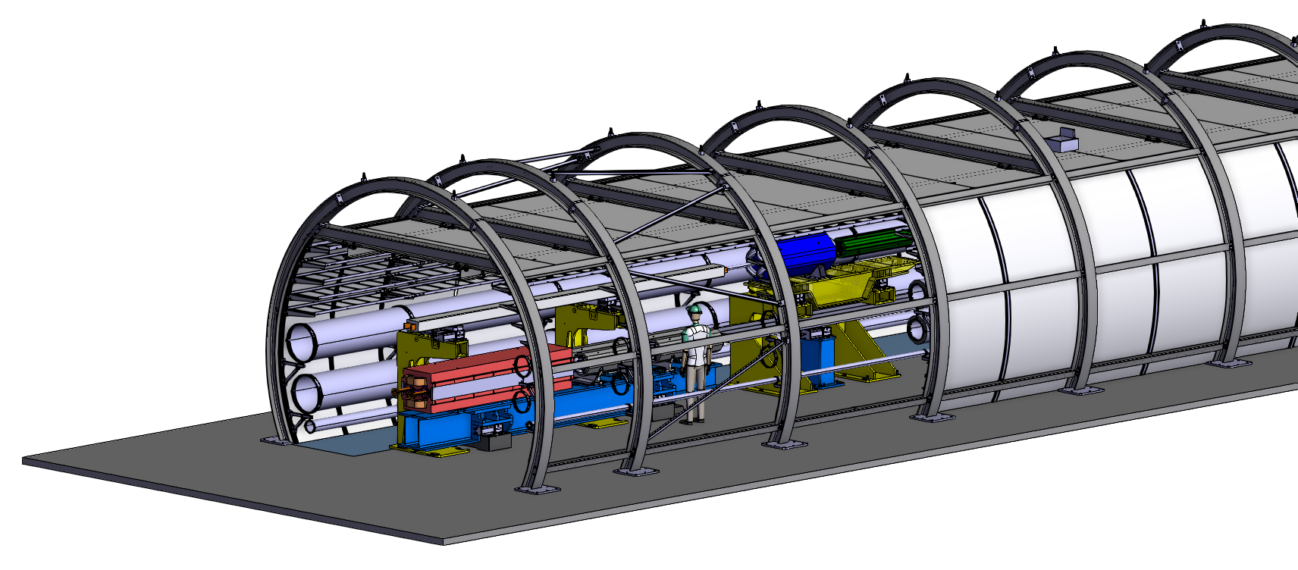
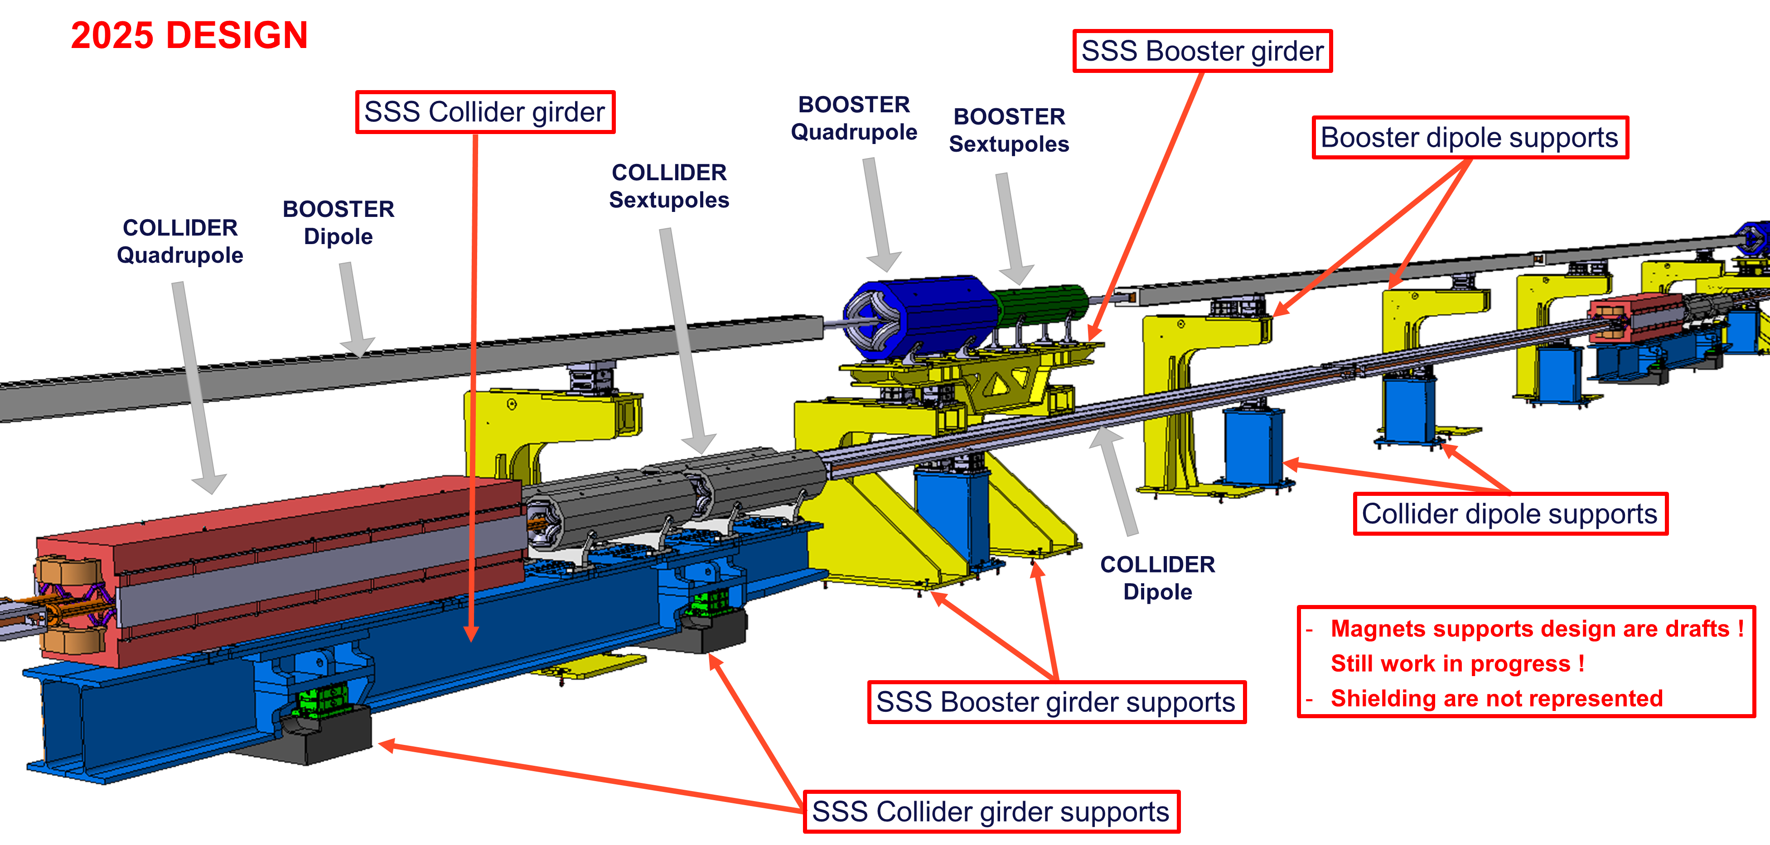
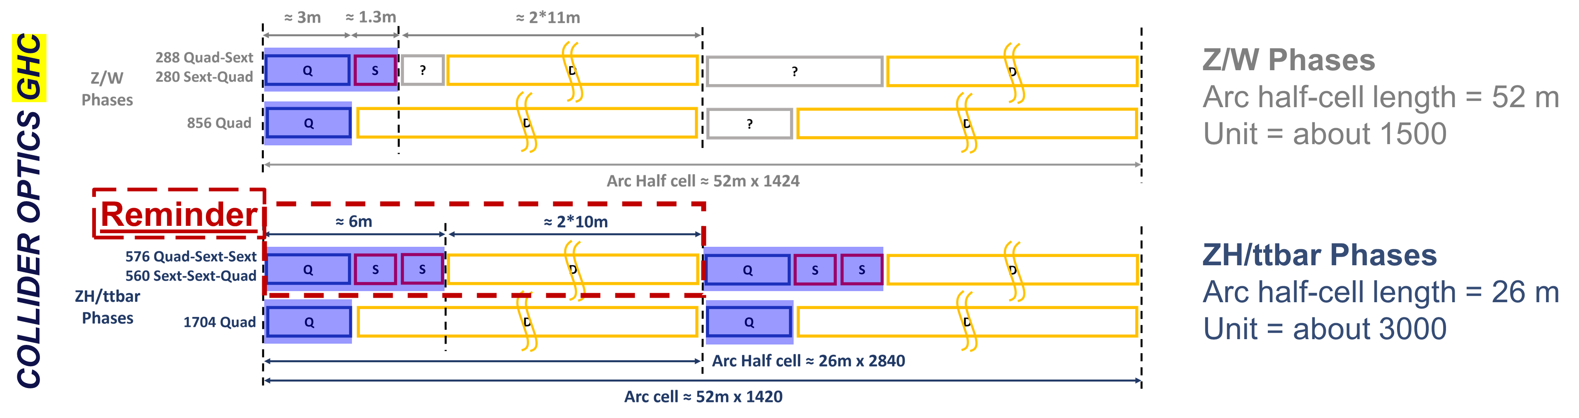
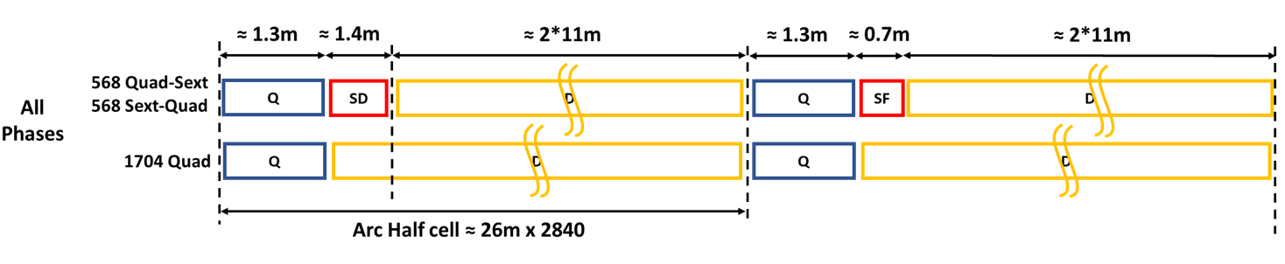
Status of support design
As part of the scope of the mock-up project, the team worked on the design of the different supports.
The version of the supports shown in this slide will be installed in the mock-up!
As a reminder: the mock-up will represent:
COLLIDER = the GHC (V24.3) optics and in particular an arc half-cell at the ZH/ttbar phase (config.: Quad-Sext-Sext).
BOOSTER = the V24_FODO optics (config. Sext. Defocusing)
BOOSTER
OPTICS

Slide 3
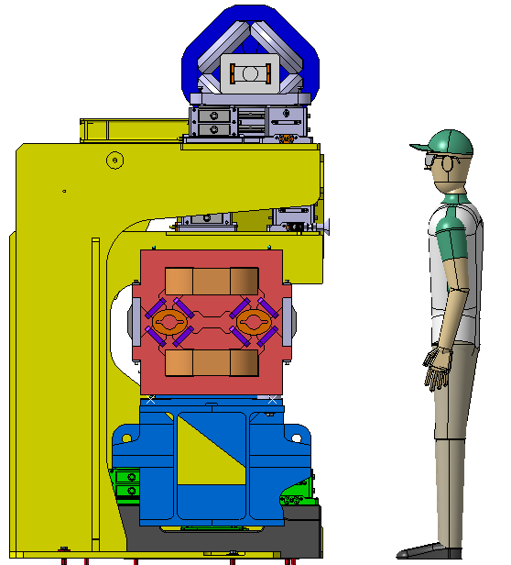
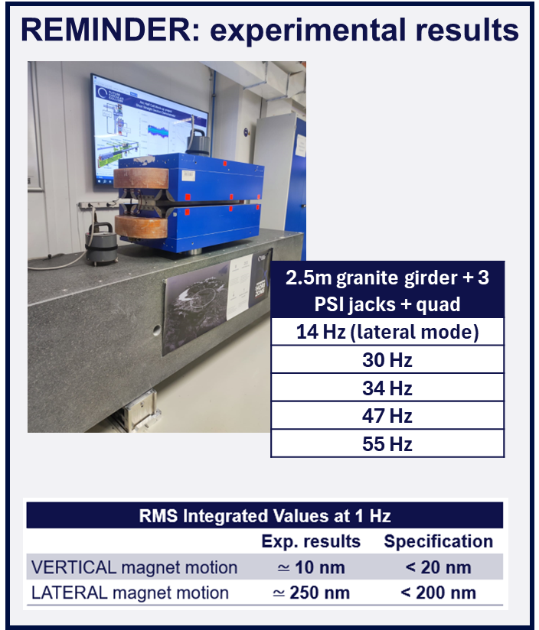
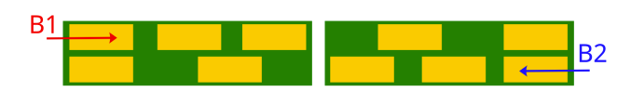
Status of support design open questions
Designing this first version of the supports, several points and questions were raised that need to be addressed in the Pre-TDR phase.
The current designs need to be optimised in terms of:
  Cost reduction, sustainability,
  Stability,
  Transport, installation, maintenance,
  Alignment compatibility…
And the designs need to be reviewed:
  If the position of the machine axes change,
  If the magnets design change,
  With respect to the position of the shielding and the number,
  If the optics change…
Shifting of machines axes?
Stability issue demonstrated with experimental campaign
Position of shielding
See Radiation_LayoutOpticsDesign_2025_06_26_v2.pdf

Slide 4
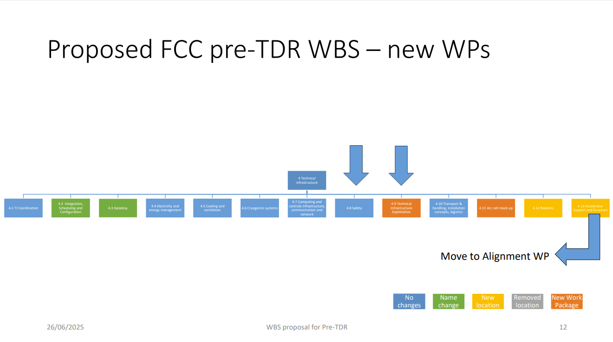
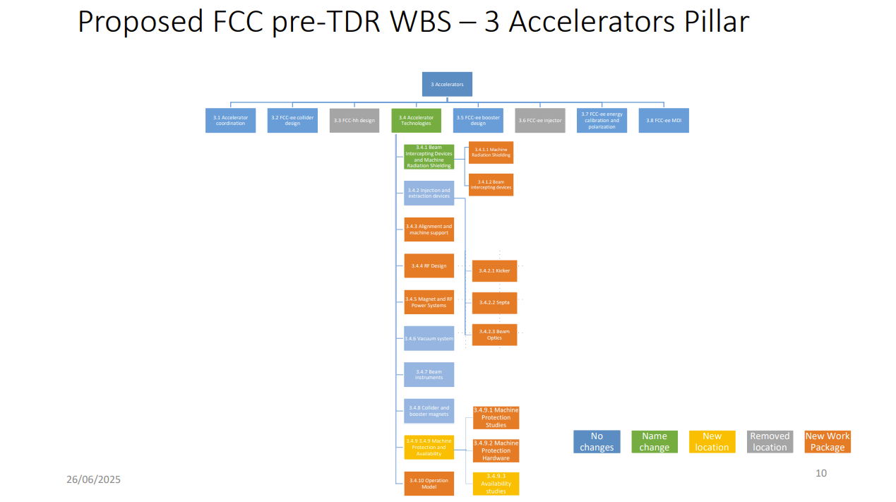
Reminder: Work package Pre-TDR
Two WPs are now in place for the Pre-TDR, one for the mock-up (responsible EN/MME) and one for alignment and machine support (responsible BE/GM).
The aspects presented after give a feedback on the design work carried out so far as part of the mock-up project, as well as an impact of the optics choice on the mock-up.
4. Technical Infrastructure
3. Accelerators
4.11 Arc cell mock-up (EN/MME)
3.4 Accelerator technologies
3.4.3 Alignment and machine support (BE/GM)
Work Package Structure
See WBS Presentation V0011 26.06.2025.pdf

Slide 5
Comparison between GHC and LCC optics
Do you require input from other teams and groups? What are the prerequisites that the team would need to perform the comparison?
We report below what inputs will be needed to update the supports and the mock-up in case of change of optics
Supports | Mock-up
BE/ABP: Lattice for all the arcs, magnetic length, (quantity of SSS and dipoles, then we can obtain the quantity of supports). Position of the collider and booster magnetic center in the tunnel (impact on the design of the supports). Alignment and stability requirements. Impact on booster? TE/MSC: Magnet mechanical length and simplified cross section to have their mass. TE/VSC + SY/STI: Position, numbers and masses of the assembly photon stoppers + shielding. | BE/ABP: New optics to be implemented in the mock-up. TE/MSC: Preliminary designs of magnets. TE/VSC: Preliminary designs of vacuum equipment. SY/STI: Preliminary designs of shielding assembly. BE/GM+EN/MME: Preliminary designs of supporting structure.

Slide 6
Comparison between GHC and LCC optics
What are the criteria under the scope of study that you consider relevant for the comparison?
Supports | Mock-up
Quantity of supports Cost of supports Sustainability of supports Position of the machines' axes in the tunnel and in relation to each other (can be decisive for stability, safety, robotic access, etc.) Stability performance / requirement Alignment requirement Dimensions allocated to the supports in the tunnel cross section | Systems space requirements Dimensioning of elements heavier or lighter Ease of maintenance / installation (to be checked with HE)
What output will the team or group provide as a result?
Supports | Mock-up
Designs of the different supports for collider and booster. Performance assessment of the supports. Cost estimation + optimisation with respect to support design. | An update of the installed mock-up in case of a change of the optics (in case, not before 2028, as frequent changes of the installed configuration are expensive and time-consuming)

Slide 7
Comparison between GHC and LCC optics
How long do you estimate this will take you?
Supports | Mock-up
Needs further discussion between BE-GM and EN-MME | From the moment that the choice is done + preliminary designs of magnets, vacuum, absorbers, supports are available → probably 6-12 months (depending on the number of changes) to finalize the fabrication drawings, procure the new elements, and install them. NB: as the first version of the mock-up is installed by end of 2025, we consider that a major change of the experimental configuration should not come before 2028. Too frequent changes are expensive and time-consuming.
Does the choice of optics have a significant impact on your activities? YES!!!
  Even if we know that the work done for GHC optics and the concepts can be reused for LCC optics, it is still needed to review all the designs.

