Slide 1
2025 TS2 & YETS planning meeting
A.Tauro

Slide 2
TS2: general information
TS2-2025: 3 days from Monday 10th at 6:00 (beam off) to Wednesday 12th November at 17:00
Magnet schedule:
Monday 6:00 AM: ramp down both magnets
Wednesday 12:00 – 14:00 (2h): operate L3 at 0.2T B field (requested by FV0)
Wednesday 14:00 – 17:00 (3h): operate L3 + Dipole at nominal field (requested by EP-DT/Elisa)
Stop L3+Dipole cooling on Monday 8:00, restart on Wednesday 9:00 → action EN-CV
RP & smear tests on Monday between 8:00 and 9:00 (Klaus, André)
TOF cooling sample collection (by HSE-RP) agreed with EN-CV
Access from Monday 9:00 to Wednesday 17:00
Access condition: Restricted Automatic (access with key)

Slide 3
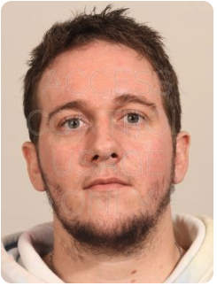
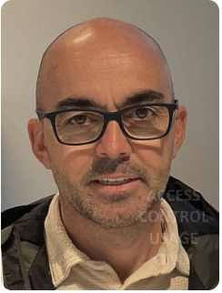
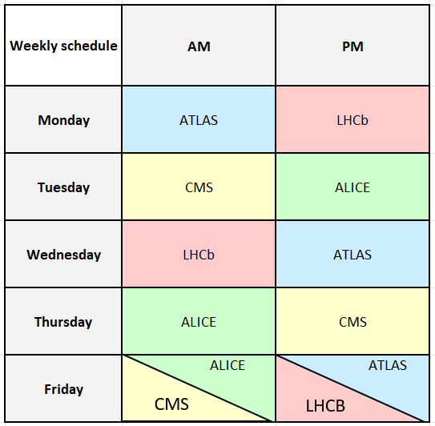
Safety coordinators (EROS team)
Alexandre Rousset
Bruno Dumontet
Welcome Alex and Bruno!

Slide 4
DCS
Usual backup on the Monday morning (for some detectors the backup will exceptionally be done on Friday 07.11).
Central operation will not be possible during the backup on Monday (approx. 2hrs).
André

Slide 5
Detector’s activities
TPC: minor interventions on the C-side
ITS:
Power board replacement for one IB stave (L1_10) and patch cord replacements
→ approx. 2 hrs on mini-frame and/or in the rack area A on Monday morning
Threshold retuning
Readout unit scrubbing image update
MFT:
Mon PM: EN-CV will have a look to the cooling plant, to check the status of the bypass valves
Tue PM: access inside the magnet C-side to clean some fibers and, also on the miniframe, to prepare LS3 (MFT uncabling: we will just observe and take pictures)
FIT-A: install two bundles of the FoCal-H plastic scintillation fibers at the Miniframe, near the "trampoline" (Z=450 cm, R = 10 cm) - either right before the BCM, or further downstream. The two bundles will be viewed by SiPMs - bias voltage for them (45 V) will be supplied using the spare FIT-A HV cables. Entire job will take 3-4 occasions, 1-3 hours each, scattered over all three days of the TS2. We are flexible in time.
TRD: Wiener PCU inspection (C-side racks)
TOF: restore proper water recirculation in some crates after the restart of the cooling plant on Monday PM
Most likely we will access L3 on Monday late afternoon / Tuesday
MCH: work on Station 1, 2 and 3
Improve readout (DS board and cable consolidation)
Nacelles won’t be put in service

Slide 6
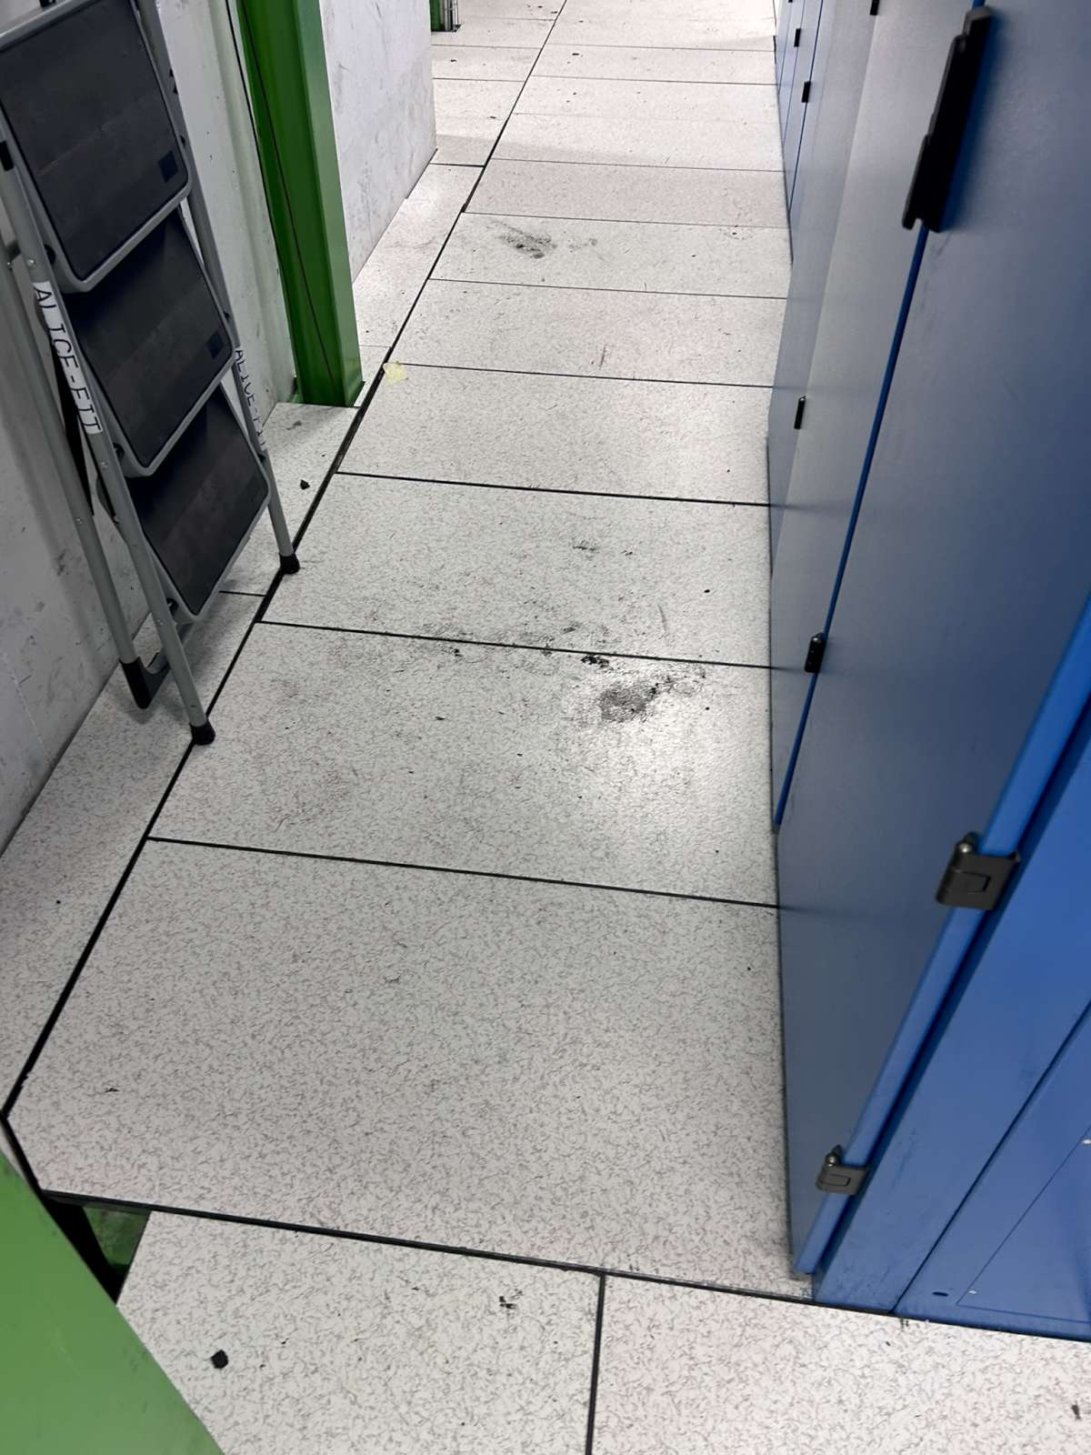
Other activities
EP-DT: blimp test → requires 2h with magnet ON
IT: technical visit for replacement of the telecom cable during the YETS (Tue 9:00) (IT, EN-EL, ALICE)
PPS: technical visit for the installation of the ODH sensors inside L3/Dipole during LS3 (Tue 10:30)
EN-EL:
Fix broken lights UX25 cavern
Repair AUG button in UX25
STEM: cleaning of the cavern floor. Please be reminded to clean your muddy shoes before entering the cavern... Hiking boots should not be used as safety shoes (or vice-versa).

Slide 7
EN-CV activities
Intervention on MFT cooling plant on Monday afternoon
Stop TOF cooling plant to check the motor and frequency driver (related to issue of this week)
Florent/Olivier/Sylvain

Slide 8
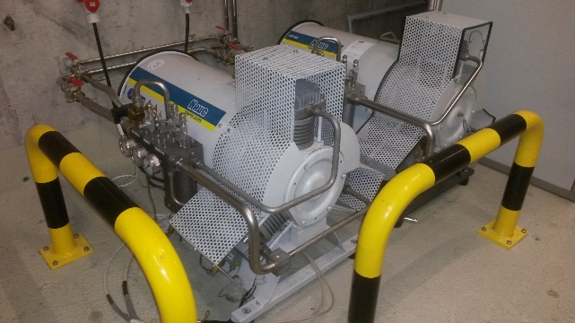
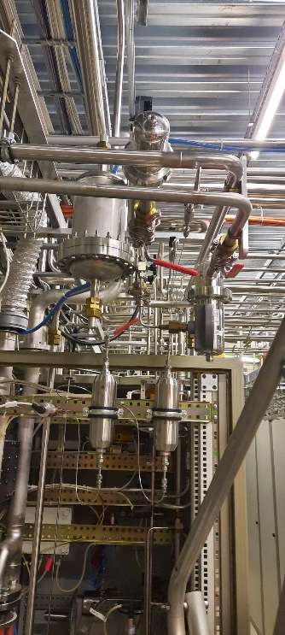
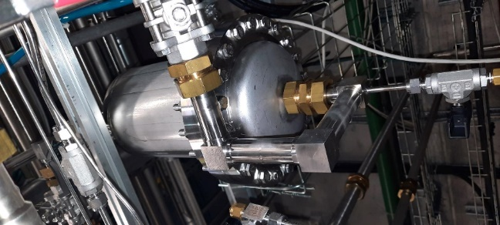
ALICE TS2 and YETS 2025 GAS OPERATIONS
* TPC pump swap (TS)
* Pump to swap if we don’t have time to send and get back before the restart of the RUN (Yets)
* Filter change / improve instalation
Louis-Philippe

Slide 9
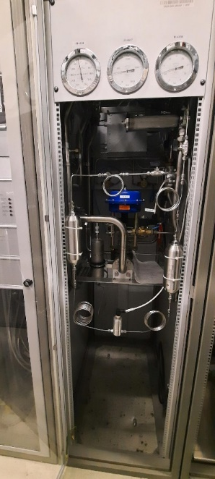
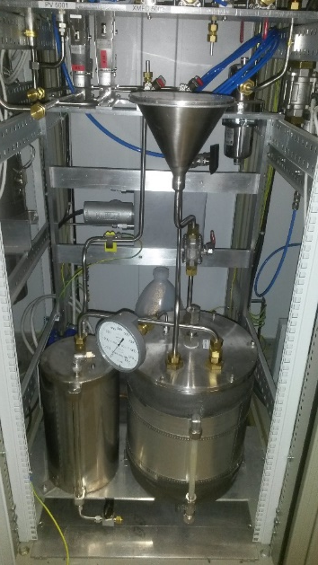
ALICE TS2 and YETS 2025 GAS OPERATIONS
* TOF Filters change ( TS)
* MID humidifier filling improvement (yets)
* ALICE TOF leak search around distribution modules
* MID prototype supply in carvern
* TOF pump swop and membrane change (TS)
* All Humidifiers filling ( TS or/and YETS)
Louis-Philippe

Slide 10
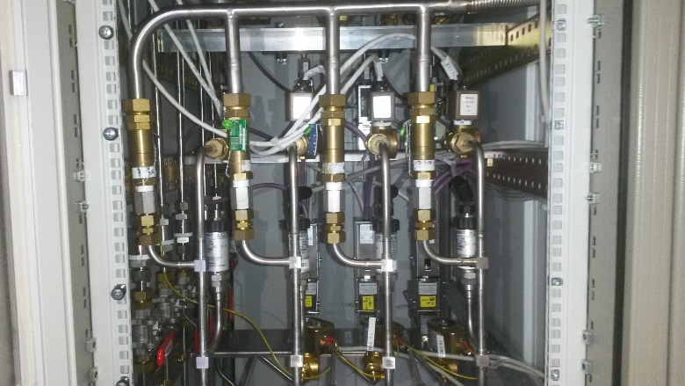
ALICE TS2 and YETS 2025 GAS OPERATIONS
* Safety valves checks ( Yets)
* HMPID purifier regeneration ( Yets)
* Grounding checks (yets)
* Power supply check ( yets)
* …….
Louis-Philippe

Slide 11
ALICE TS2 and YETS 2025 GAS OPERATIONS
Electrical part
* Grounding checks (yets)
* Power supplies checks( yets)
Louis-Philippe

Slide 12
2025-26 YETS

Slide 13
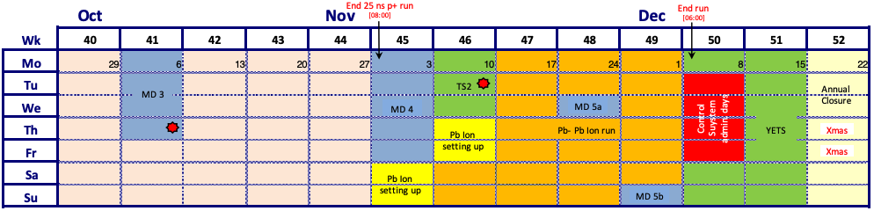
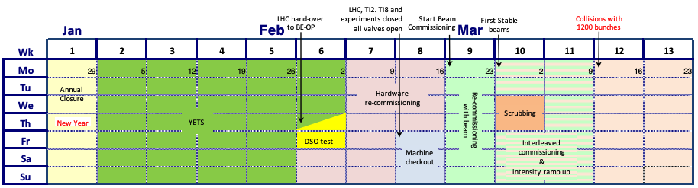
YETS 2025-26
YETS from Mon, December 8th, 2025 to Mon, February 23rd, 2026 – 11 weeks beam to beam
Access in General mode
Cavern access stops on Thu, February 19th → restricted access during machine checkout (19-21 Feb)
Start beam commissioning on Mon, February 23rd
‘Reduced’ maintenance of P2 services and infrastructure:
Cooling & ventilation maintenance: w2-3 2026
Electricity: test arrets-d’urgence (AUG) will be skipped
Test of safety, gas & fire detection systems
Magnets turned off and locked-out, L3 doors & shieldings will not be opened
Private visits possible between 8 Dec 2025 and 19 Feb 2026
Visitor’s path will be declassified by HSE-RP

Slide 14
DSO test
DSO test on February 5-6 → ALICE closed from Thursday, February 5th at 15:00 to Friday, February 6th, at 18:00

Slide 15
Central systems
DCS: backup on the first Monday (08.12), exact timing to be defined. Later during YETS, in order to install patches etc., DCS will be interrupted for one day. The date is to be decided with RC (probably in January). Since no AUG test is foreseen, the DCS will otherwise remain available throughout the YETS, including the End-of-Year closure.
FLP/CR1: central services will be kept running, which means patrols and periodic checks. Best effort, if anything breaks it will be fixed at the first occasion. All detectors' FLPs expected to be powered off, with exceptions to keep some of them on.
EPN:
Replacement of the air filters
Shock treatment (CV) postponed to end March

Slide 16
Detector’s activities (non exhaustive)
ITS:
PP1 custom backplane installation; 5 weeks of work (week 50/2025 - week 4/2026)
Work on mini-frame (preferred exclusively) and on cavern floor next to A-side racks on the O-side
ITS requests to have cooling plant running at all times (skip winter maintenance)
TPC:
Access A-side with Philippe for endoscopic inspection (in LS3) of the field cage
Look at the lower A side to check access to the laser boxes
ACO:
Install MID prototype above the L3 magnet. Requiring ArCO2.

Slide 17
Other groups
EN-EL:
Test N/S 16 December 2025 → will cut general services and gas systems for few minutes, no access UX25 from 5:00 AM to 9:00 AM
UPS and 48 VDC maintenance → no impact
Check dimensions Hazemeyer rack (for installation during LS3)
EN-CV: extension of ARC ventilation in coffee room (requiring to access inside ARC): 22-23 December
IT: replacement telecom cables
Scheduled during machine checkout (TBC)
EP-DT (magnet): replace Dipole emergency stop button

Slide 18
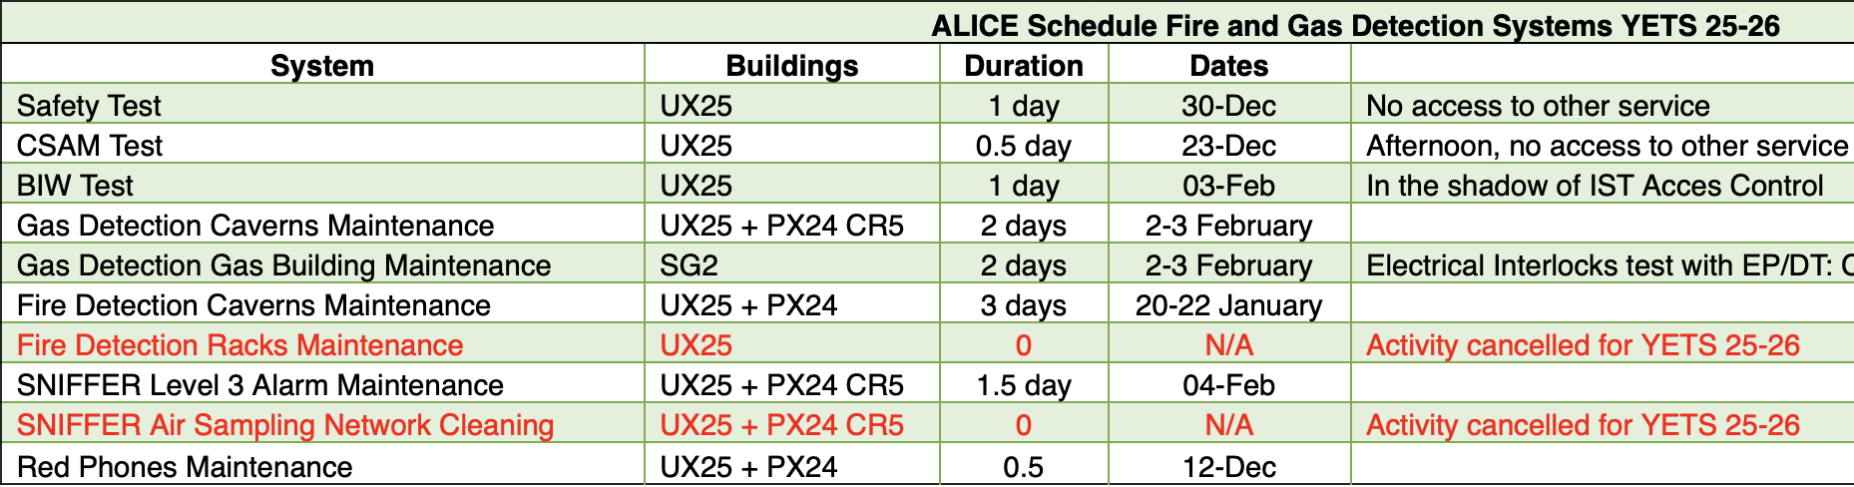
Safety & access
HSE-RP: declassification cavern’s visitor path
Firefighter exercise: 14-15 February
EN-AA: maintenance access doors: 18-19 December (Maintenance des portes et boites de patrouille)

Slide 19
EOY gas consumption
Louis-Philippe

Slide 20
EOY closure – 22 Dec 2025 to 4 Jan 2026
As always, we ask detectors to switch off all equipment that is not strictly needed
In the past mainly for safety reasons, as there is only limited monitoring; and to protect the equipment itself (e.g. in case of power cuts)
But also to save power (so this recommendation goes for the whole EYETS)
Gas & cooling systems will go to pre-defined status and no flammable gases will be circulated
Flammable gases: stop CH4 Dec 8th (restart end March); stop i-butane TBC (restart end Jan); stop Ar-H2 Dec 19 (restart 5 Jan)
There will be the usual inspection tours in ALICE, every second day (schedule tbc)
Let us know if there is something specific to be checked.
Let us know if you plan to remain in the local area to help with the tours
Shuttle service to P2 will be stopped between 8th December and 2nd February
Access to CERN premises during the EOY closure:
Only for authorized persons for strictly professional reasons such as stand-by service and indispensable maintenance work
No private visits (even on surface)
Please send an email to me (with justification) if you need access to CERN during the EOY closure

