Slide 1
Target complex service building RP Sumps 25th June 2025 - CERN
Jean-Louis GRENARD - Gemma HUMPHREYS – CERN - SY-STI-TCD
with the contribution of all the members of HI-ECN3 WP4

Slide 2
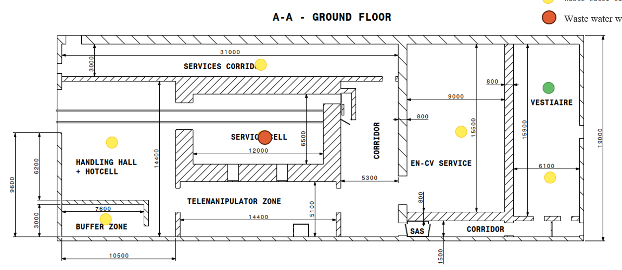
Considered Scenario Waste water management - internal
Conventional wastewater
Cold changing room and toilets
Directly connected to sceptic tank
Potential RP concern waters
Hot changing room
CV-Room and Hall rooms drainage
High RP concern waters
Service Cell drainage waters
Water collection sumps
Number
Location
Volume
Connection to conventional drainage

Slide 3
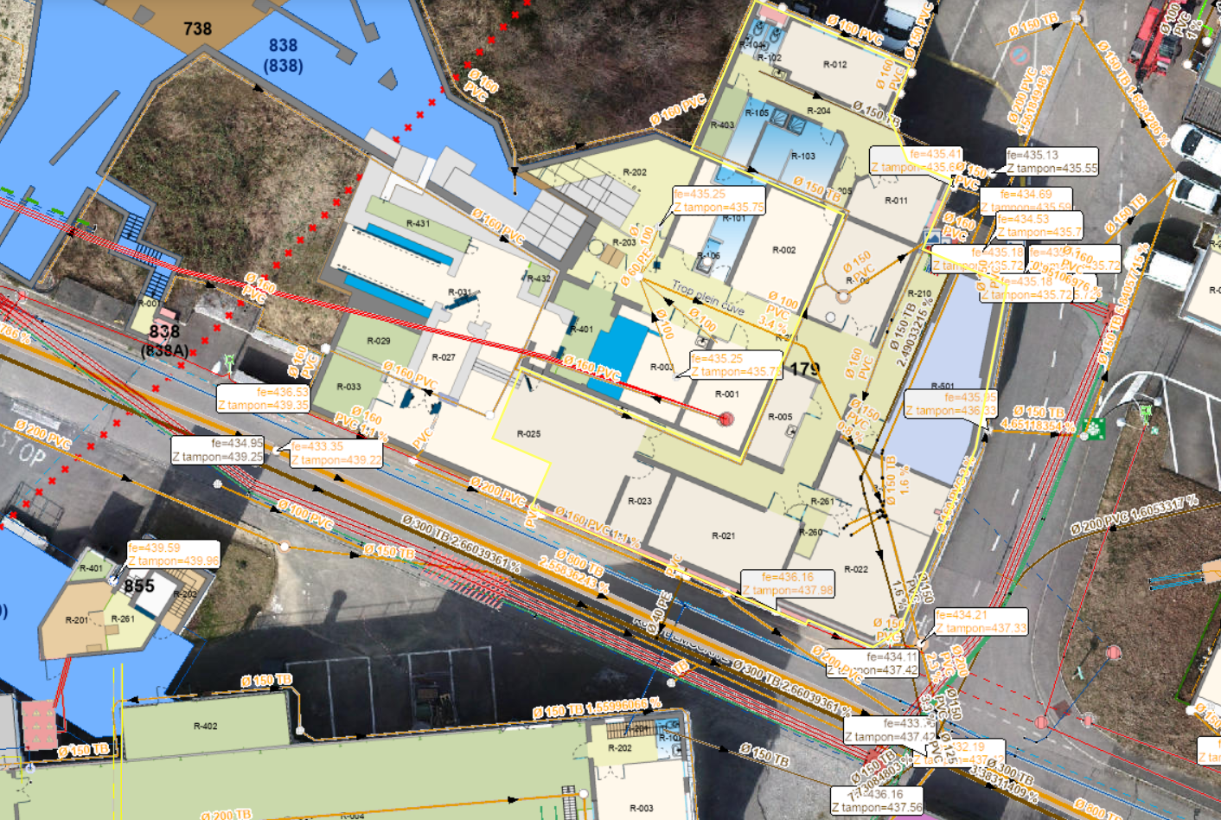
ISOLDE configuration
Retention tank ~2x1m³
Mixing plant
1tank in stanby
by while RP
measurment on going
Sump~2m³
Water from traget area
RP shower & sink
Drainage network
from class A lab
Collection of RP
water vacuum cleaner

