Slide 1

Wake potential from Wakefield and Eigenmode solvers
Leonard Thiele (University of Rostock, CERN), David Amorim
R. Calaga, H. Damerau, A. Grudiev, I. Karpov, E. Lamb, U. van Rienen, S.-A. Udongwo

Slide 2
Outline
Simulation and calculation setup
Single-cell self-consistency between EM and WF solvers
Multi-cell
Automatic determination polarity separation

Slide 3
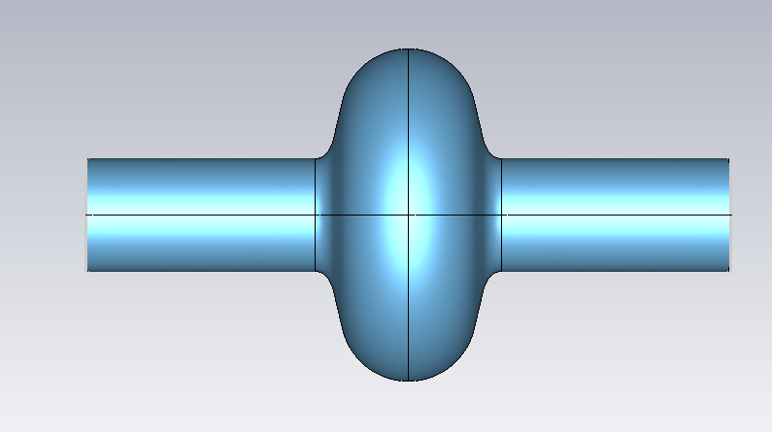
Simulation setup
Single-cell TESLA cavity without couplers
Symmetry planes to ensure correct polarity of modes
WG ports used with 5 modes → cutoff of highest mode is 4.16 GHz
Frequency limited to 3.5 GHz
  Directly in EM solver and via bunch length of 29mm in WF solver
WF solver:
  Beam path offset by 5mm
  Integration path at same location as beam path

Slide 4
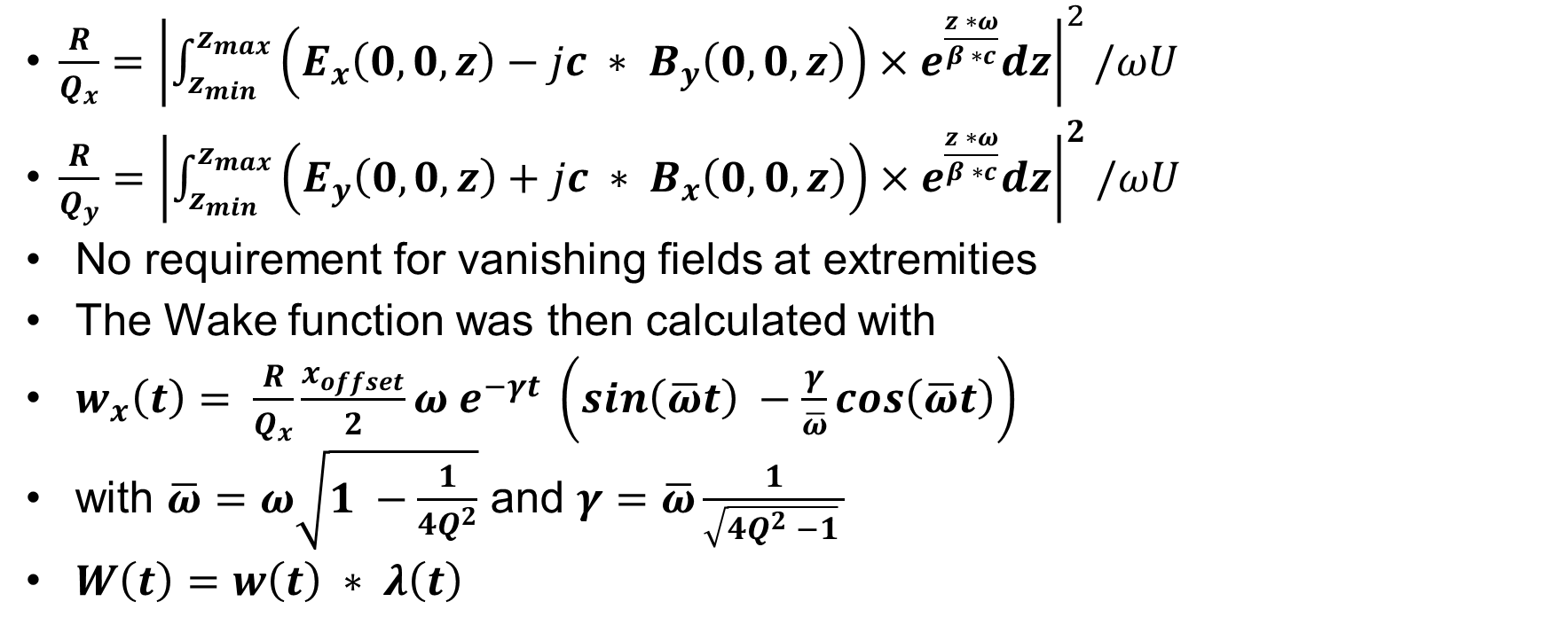
Fomulae in use
$\frac{R}{Q_{x}}={\left|\int_{z_{min}}^{z_{max}}{\left(E_{x}\left(0, 0, z\right)−jc ∗ B_{y}\left(0, 0, z\right)\right)×e^{\frac{z ∗ω}{β ∗c}}dz}\right|}^{2}/ωU$
$\frac{R}{Q_{y}}={\left|\int_{z_{min}}^{z_{max}}{\left(E_{y}\left(0, 0, z\right)+jc ∗ B_{x}\left(0, 0, z\right)\right)×e^{\frac{z ∗ω}{β ∗c}}dz}\right|}^{2}/ωU$
No requirement for vanishing fields at extremities
The Wake function was then calculated with
$w_{x}\left(t\right)= \frac{R}{Q_{x}}\frac{x_{offset}}{2}ω e^{−γt} \left(sin\left(\overline{ω}t\right) −\frac{γ}{\overline{ω}}cos\left(\overline{ω}t\right)\right)$
with $\overline{ω}=ω\sqrt{1 −\frac{1}{4Q^{2}}}$ and $γ=\overline{ω}\frac{1}{\sqrt{4Q^{2} −1} }$
$W\left(t\right)=w\left(t\right) ∗ λ\left(t\right)$

Slide 5
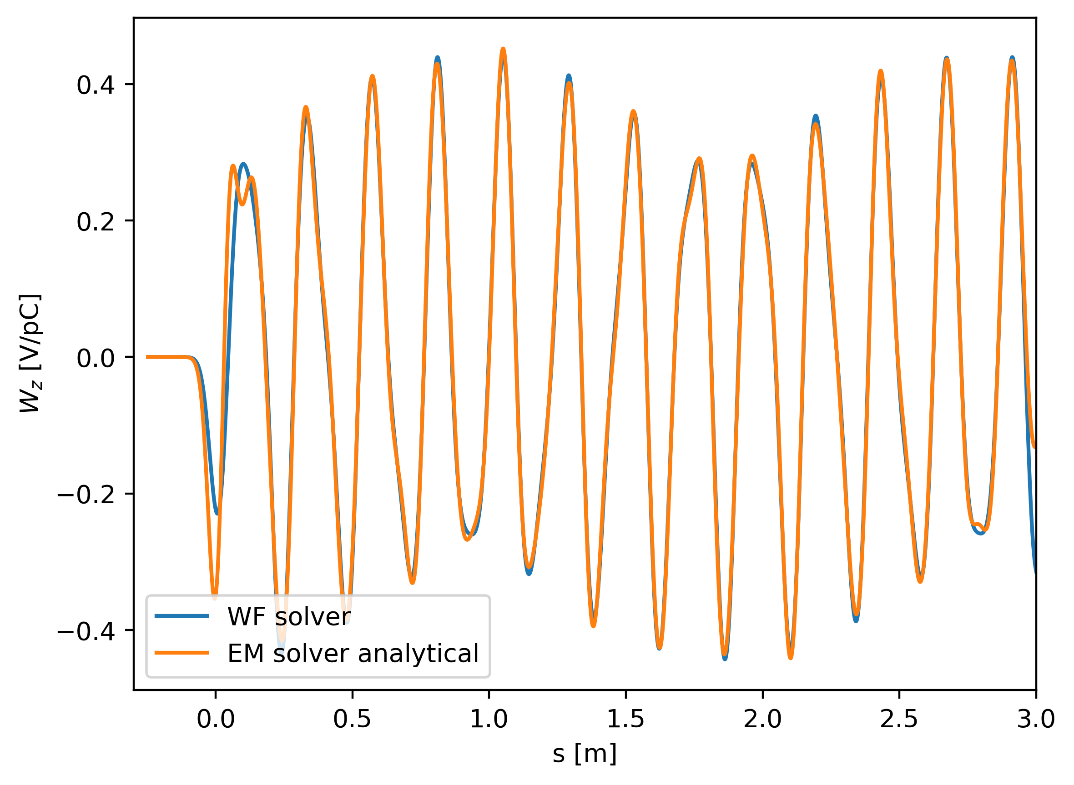
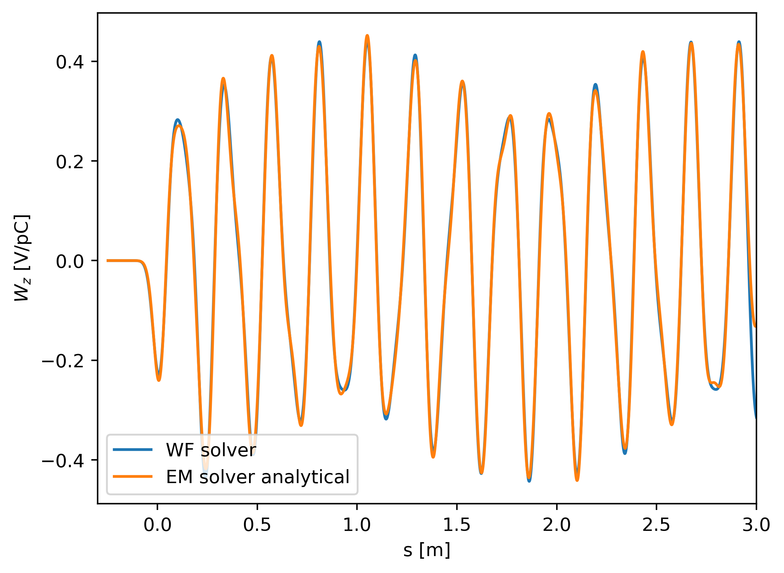
Longitudinal wake potential
$\frac{R}{Q}={\left|\int_{z_{min}}^{z_{max}}{E_{z}\left(0, 0, z\right)e^{\frac{jωz}{βc}}dz }\right|}^{2}/ωU$
Including all modes
Only modes with Q_ext > 15

Slide 6
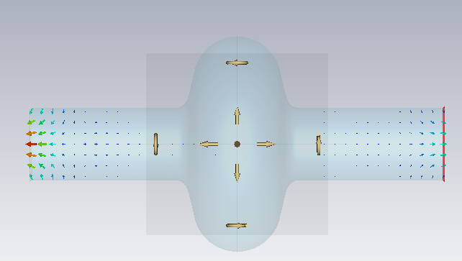
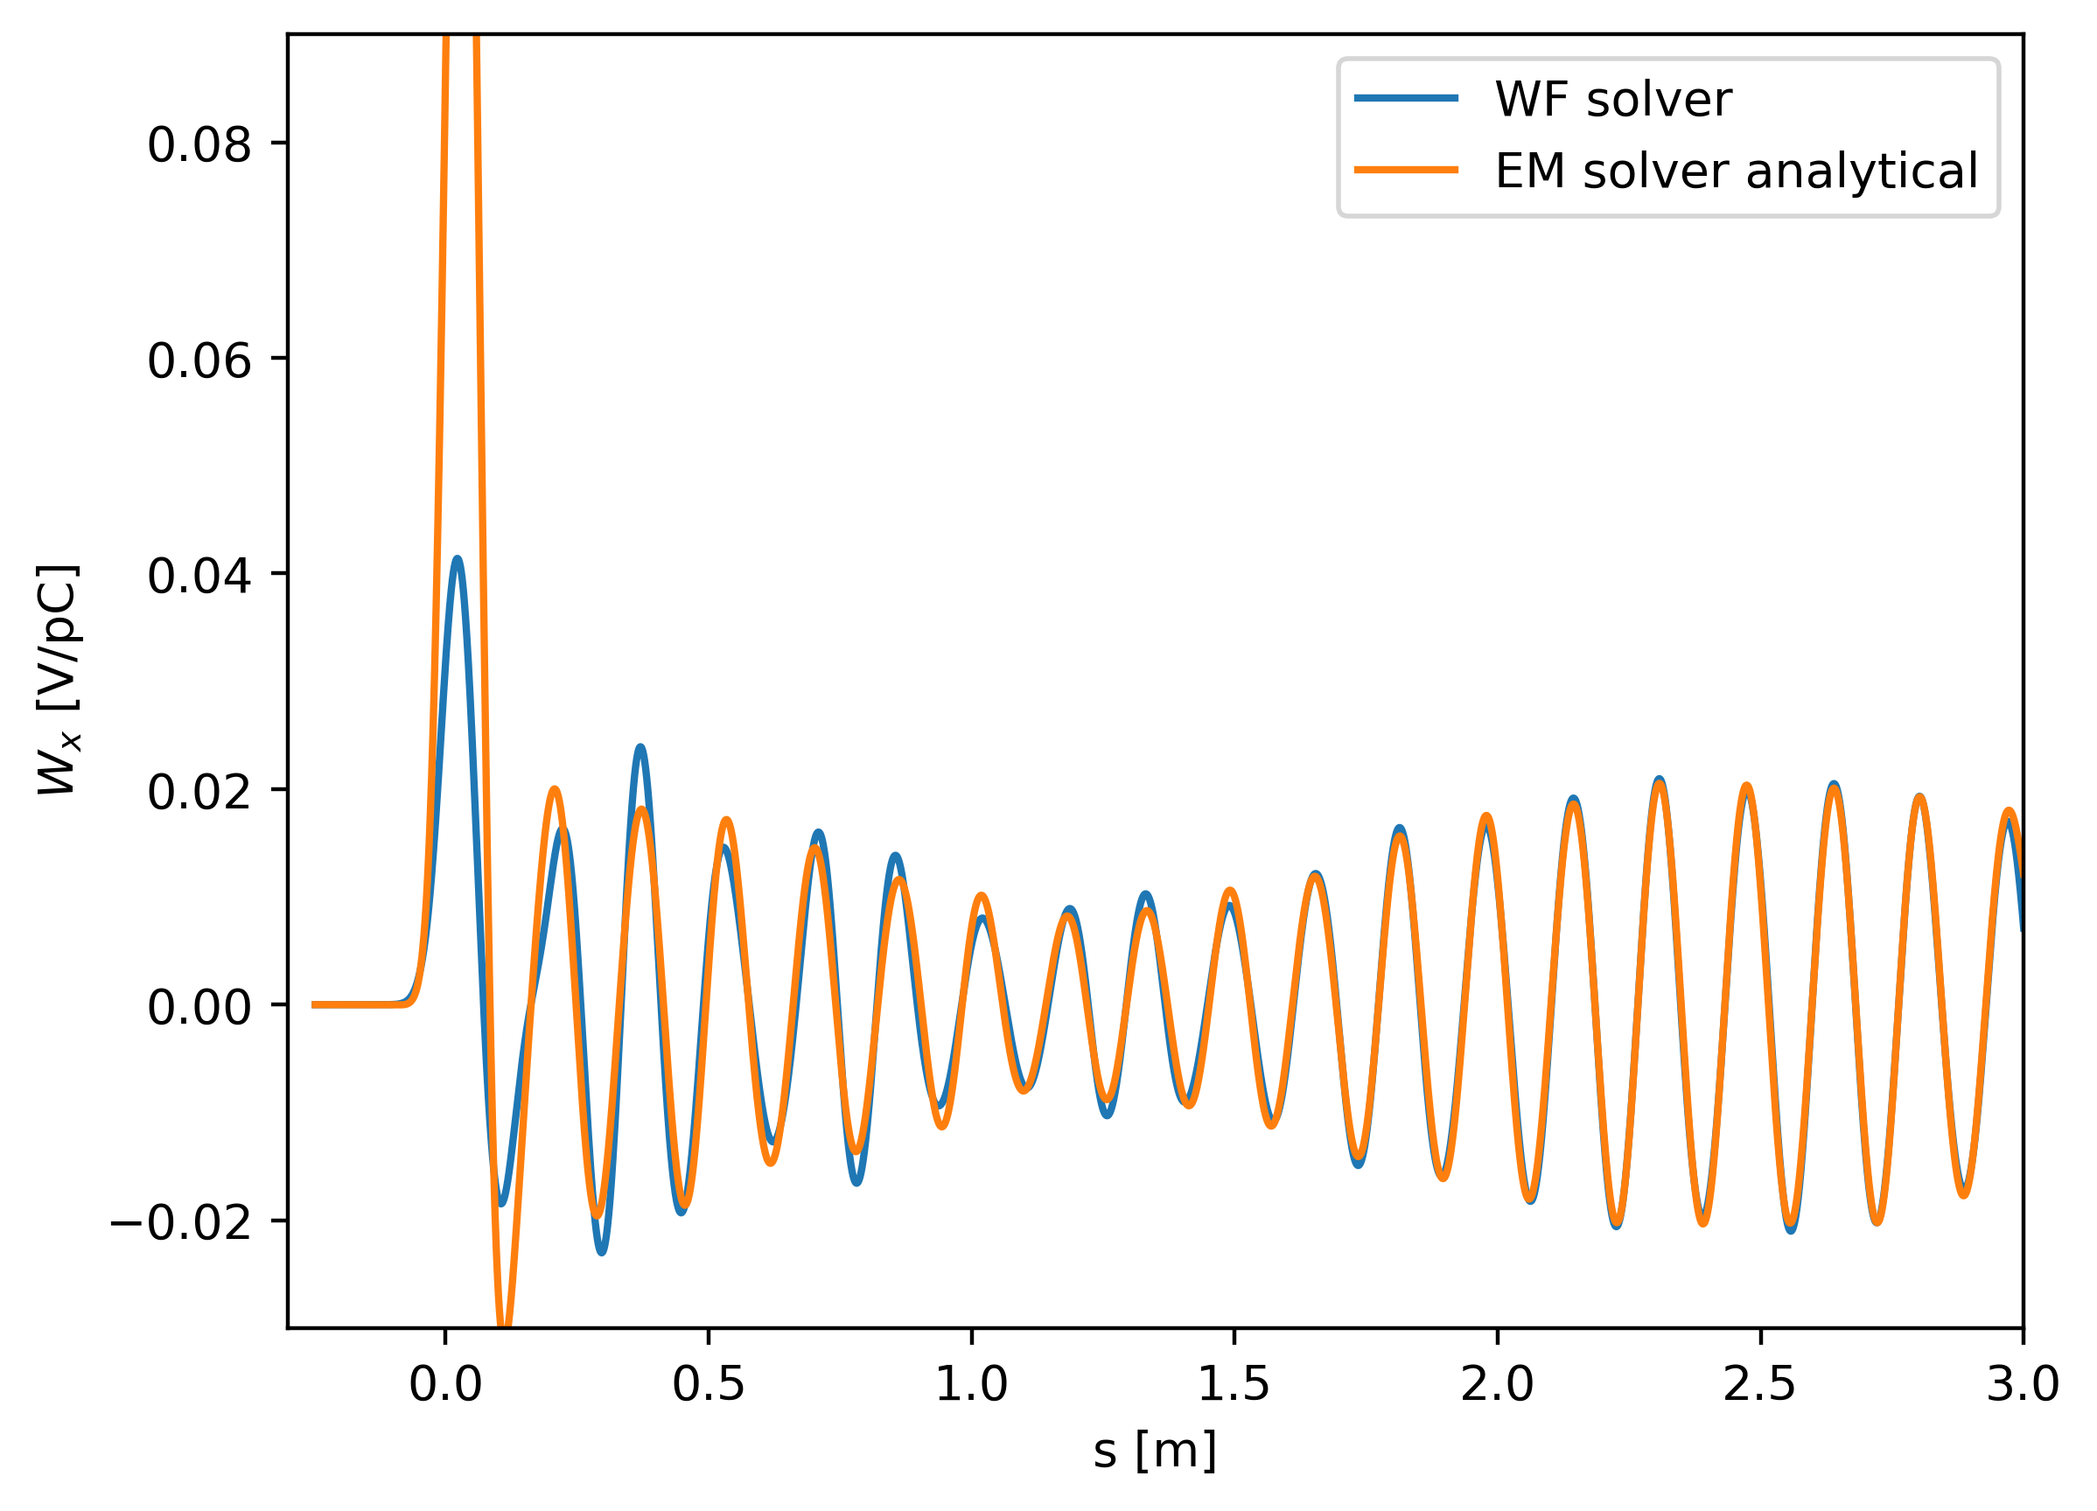
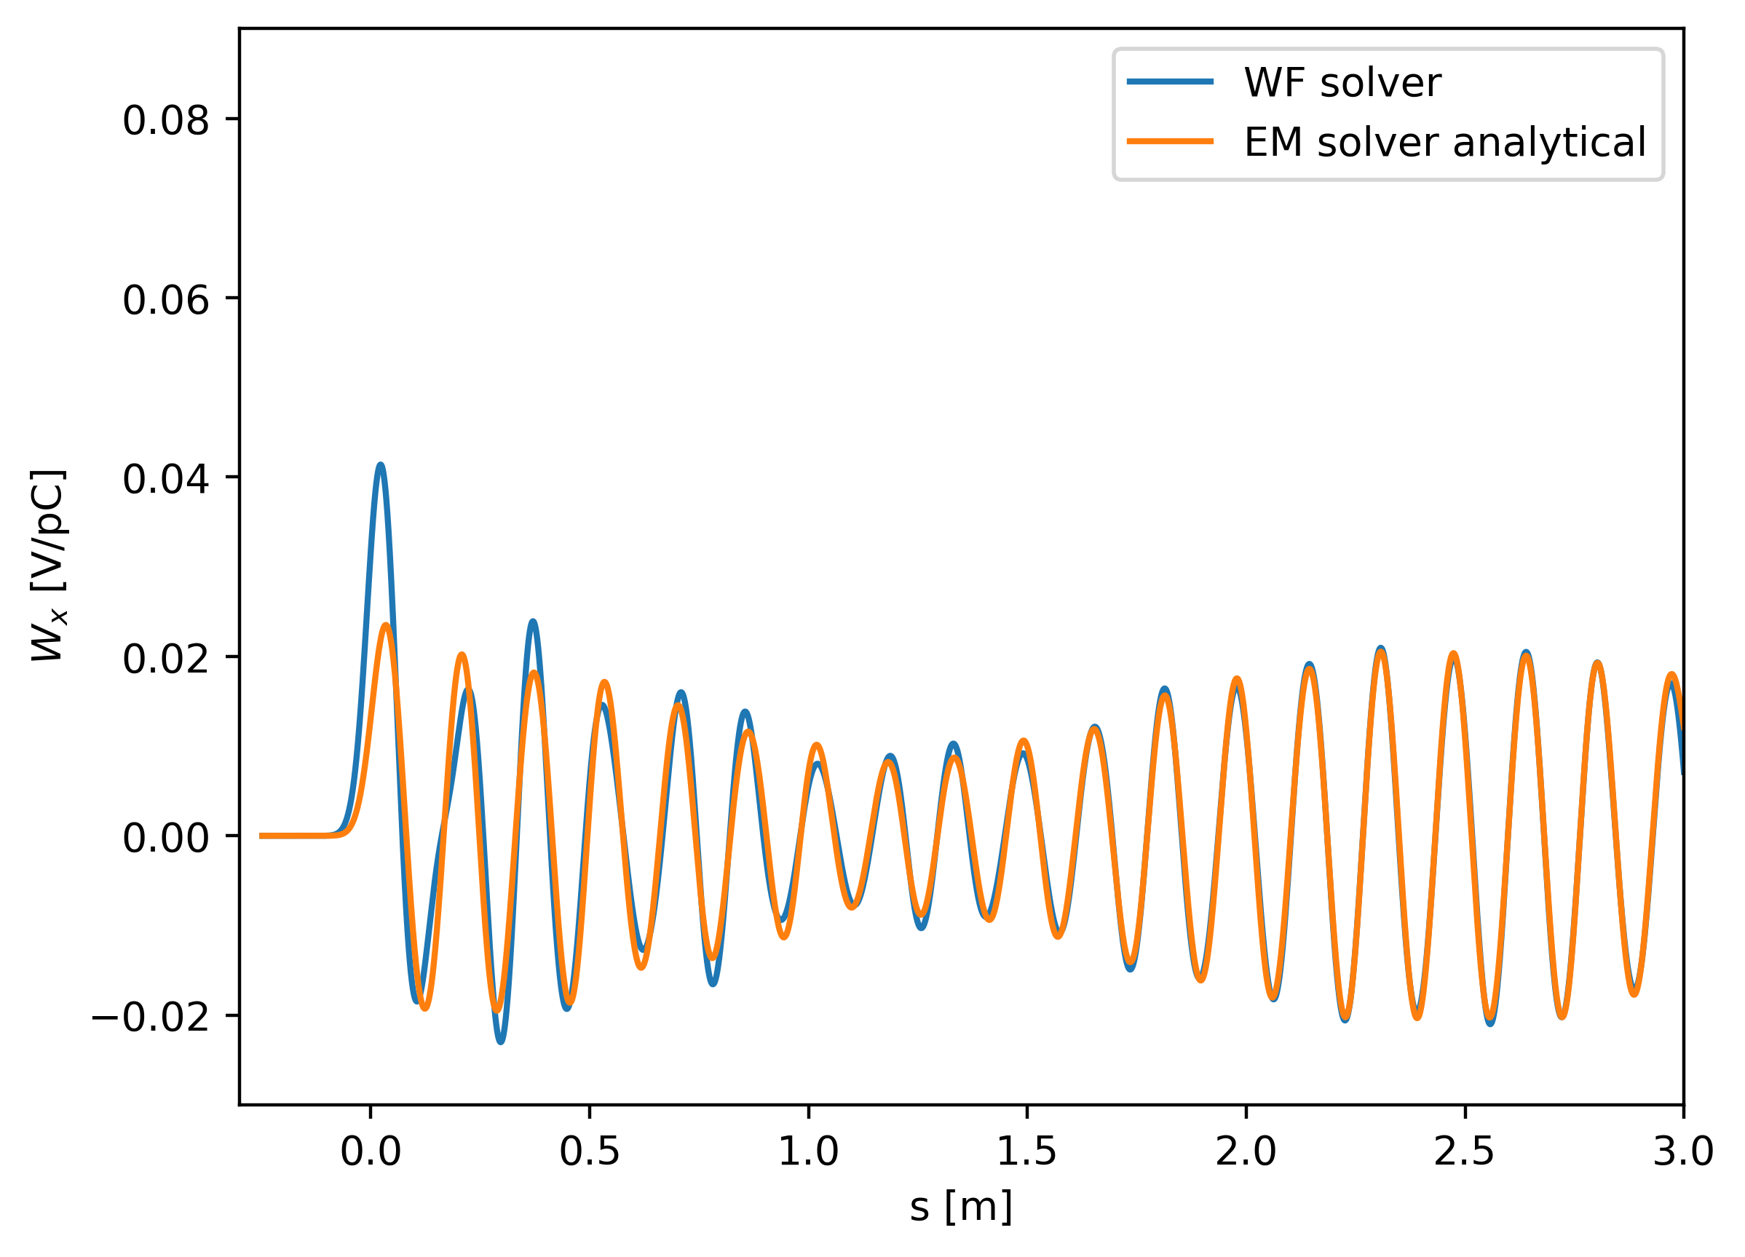

Single cell cavity simulations
Including all modes
Only modes with Q_ext > 15

Slide 7
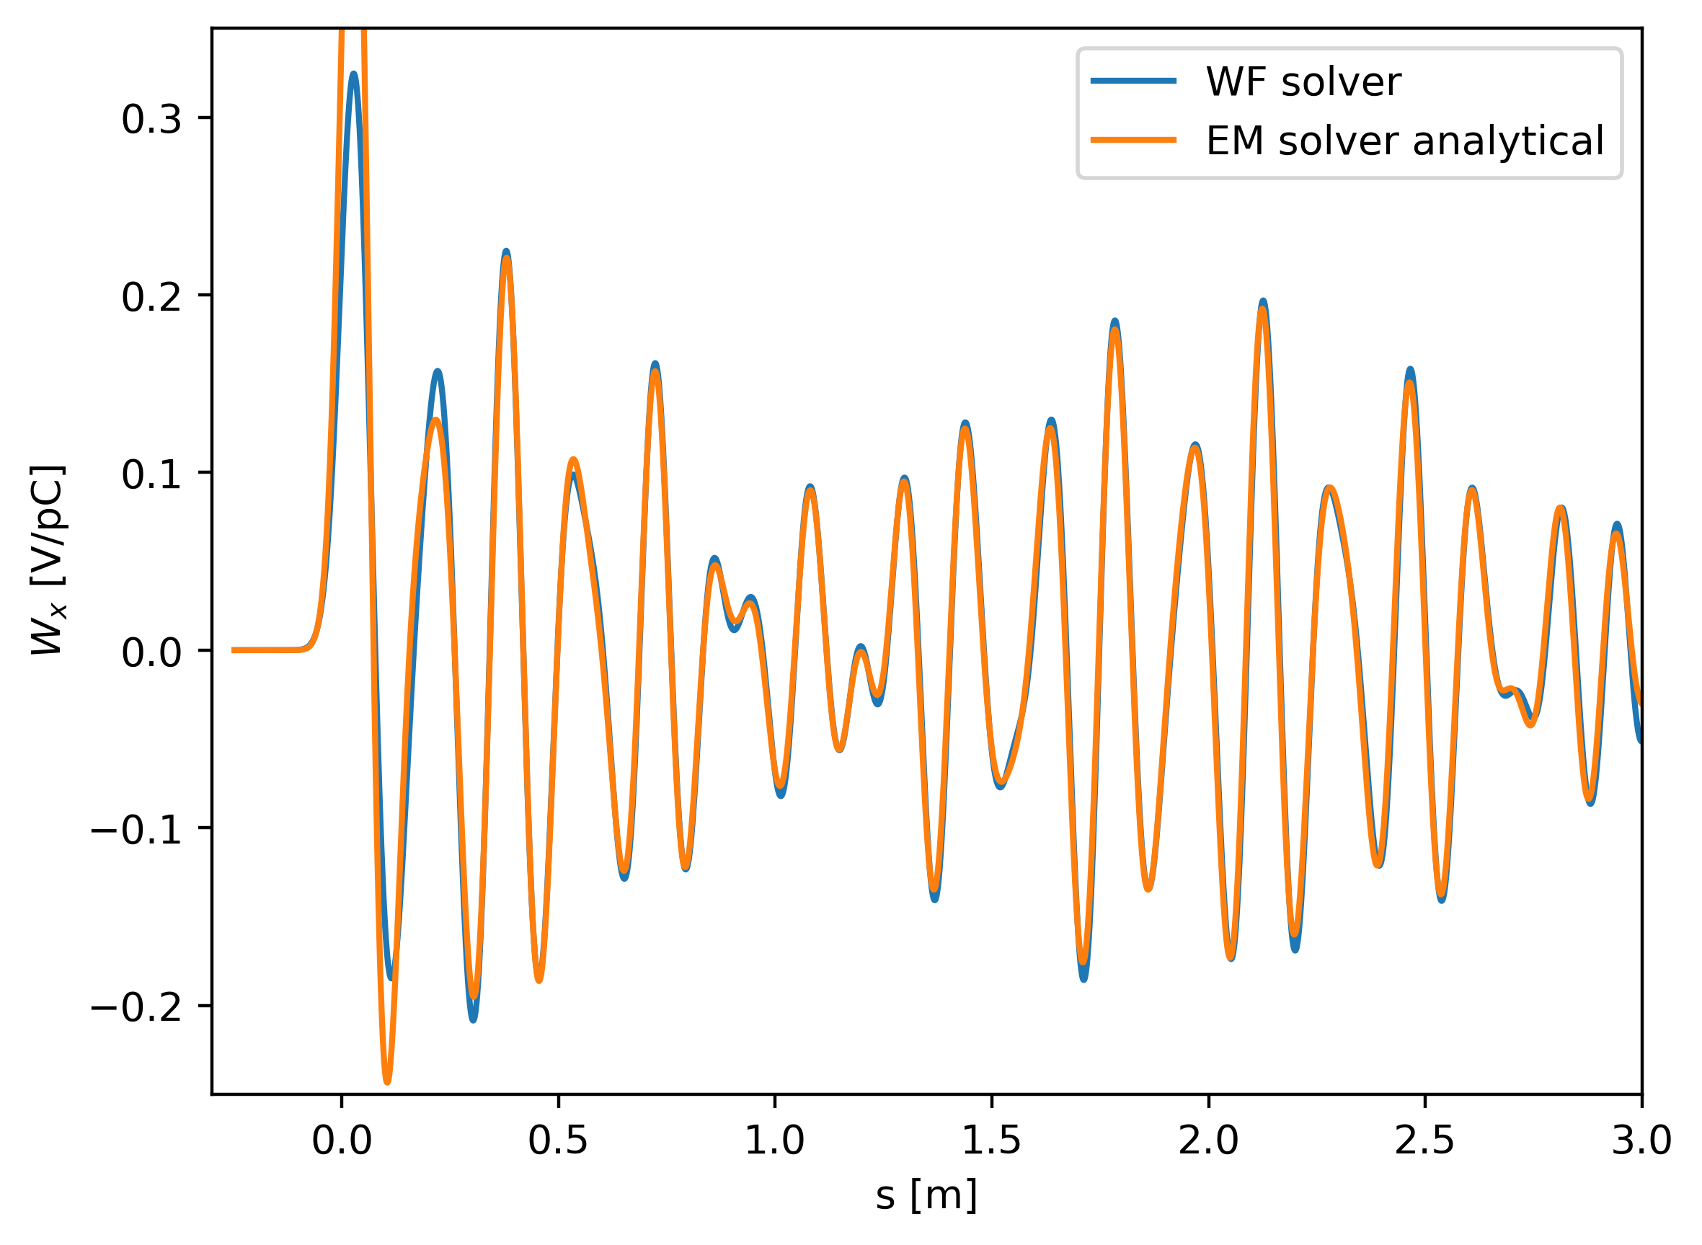
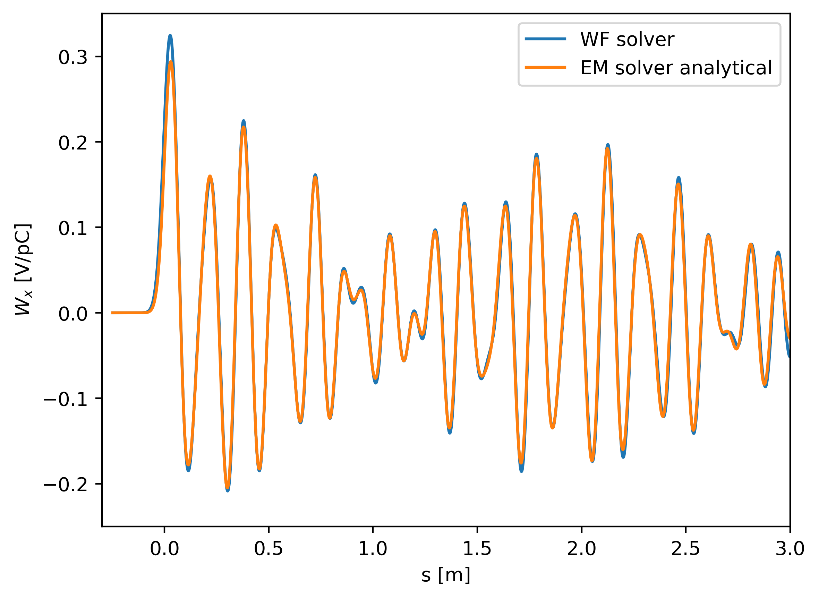
Multicell simulations
Including all modes
Only modes with Q_ext > 15

Slide 8
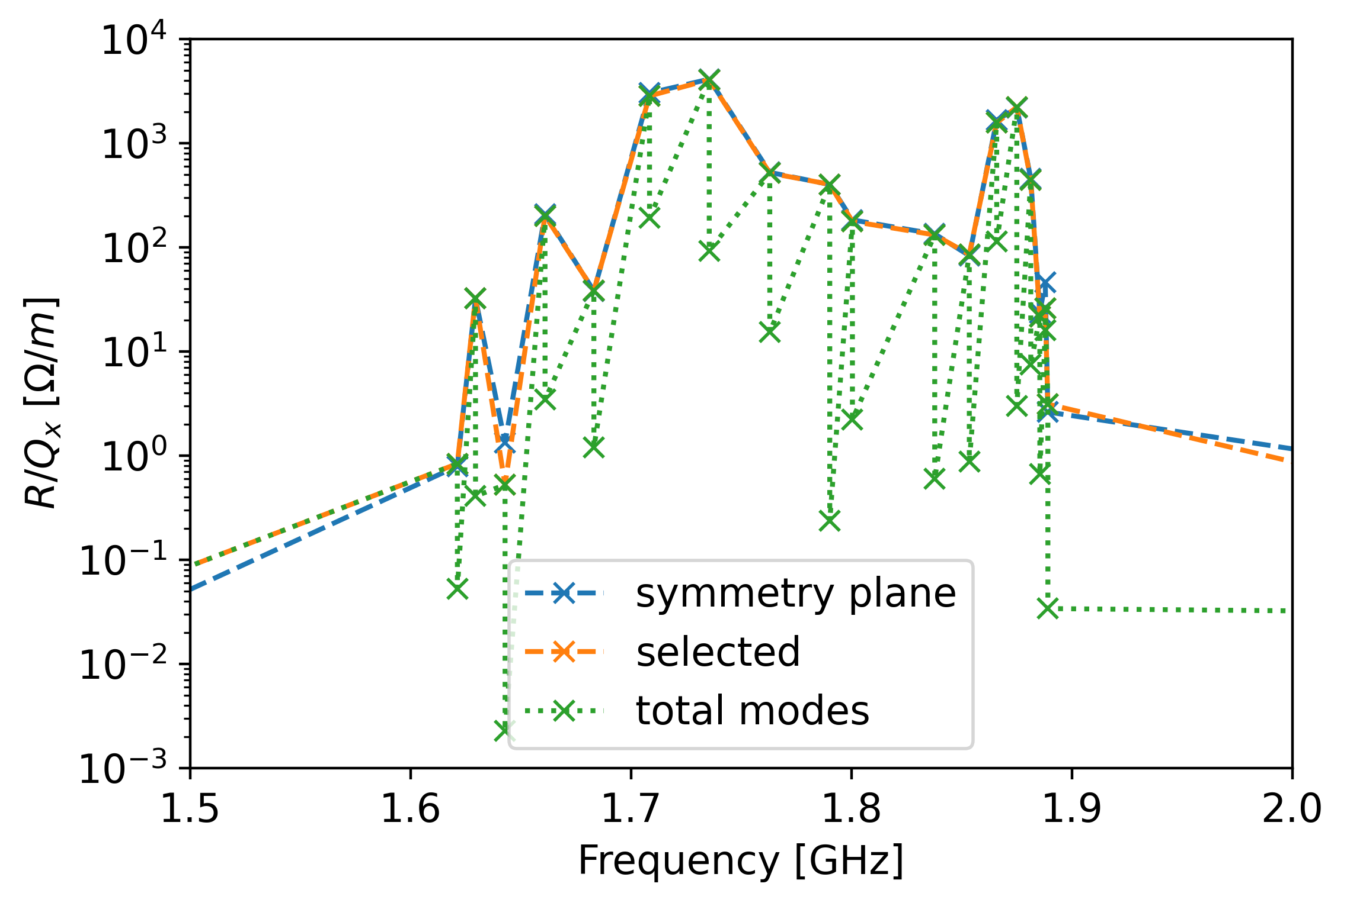
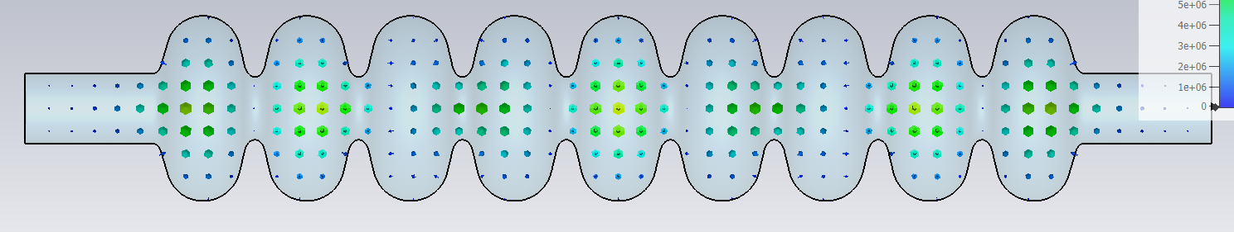
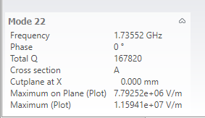
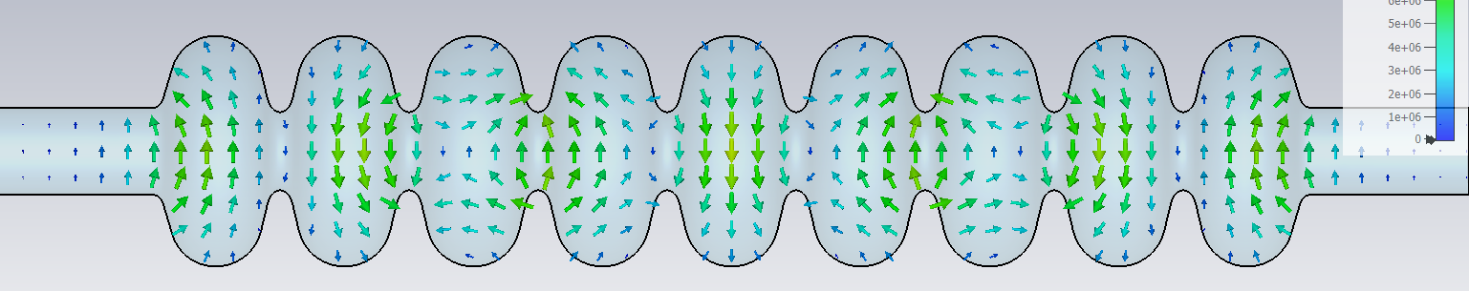
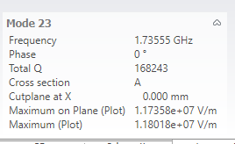

Mode filtering
Which modes are different polarities of the same modes?
Important for dressed cavity, as symmetry planes are not usable
$\frac{R}{Q_{x, 1}}+\frac{R}{Q_{y, 1}}=\frac{R}{Q_{x, 2}}+\frac{R}{Q_{y, 2}}$ and $f_{1}≈f_{2}$
Open BC

Slide 9
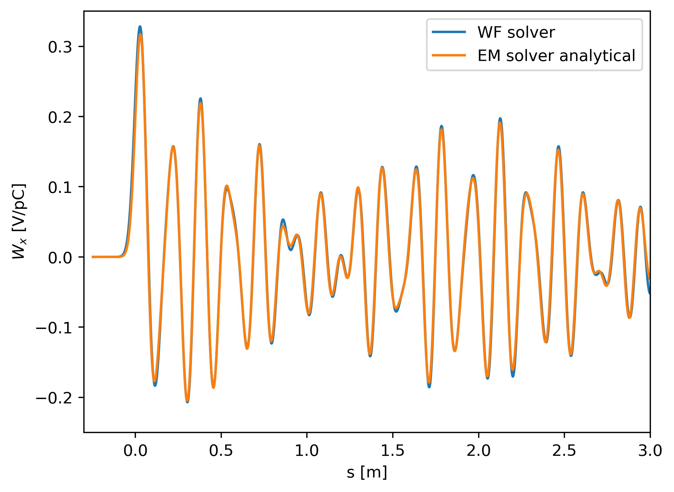

Mode filtering
Modes with symmetry planes
Filtered modes from full simulation
No large impact in symmetric cavity

Slide 10
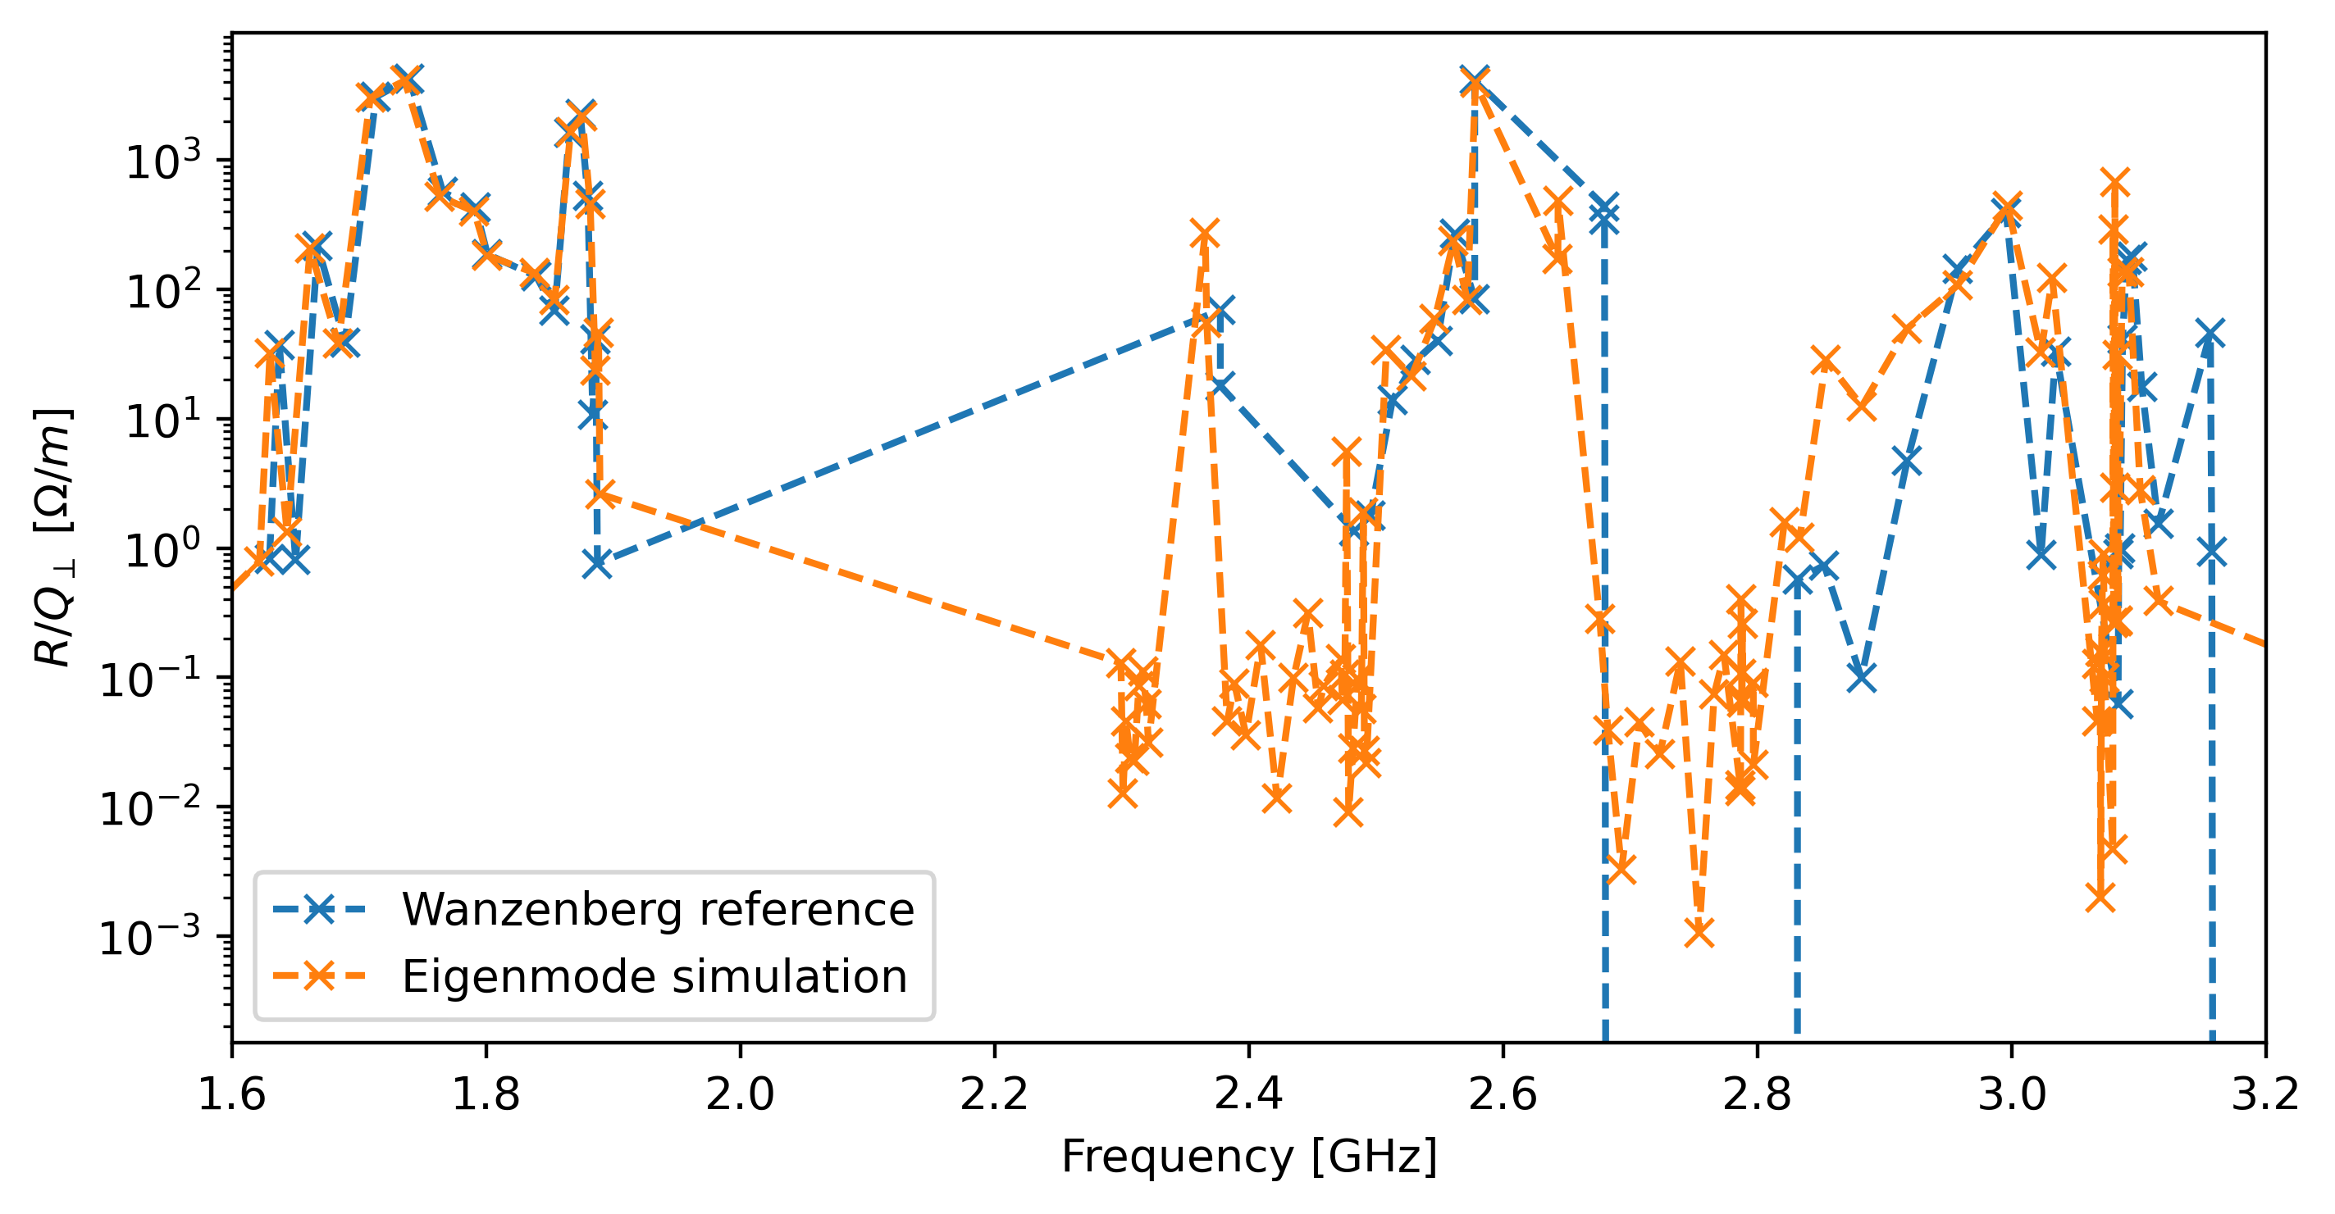
R/Q comparison with WB
Above BP cutoff: not very accurate → retry with different port configurations & symmetry planes

Slide 11
Conclusion/Outlook
Self-consistency between WF and EM solvers ensured for single-cell and multicell symmetric cavities
Modes with Q_ext < 15 were filtered out as beampipe modes
Automatic filtering of polarities implemented
Next:
Compare with 2D solvers (ABCI, echo2d, Wakis, etc.)?
Cross-referencing against Wanzenberg paper for higher frequencies?
Apply to cavity with couplers
Compare directly with modeling in Xsuite / BLonD to ensure correct scaling
Double-bunch verification with BLonD profiles

Slide 13
Wanzenberg paper
Simulations were performed in 2D with MAFIA
  MAFIA not available at CERN?
  No couplers possible → Q_ext not computable
  Rectangular mesh with 33000 Mesh points → coarse for high-frequencies
  Only one polarity will show up → no differentiation between x and y planes
  Both electrical and magnetic boundary conditions were used
Perfect boundary approximation available in MAFIA?

Slide 14
WF – EM differences
WF:
  Time domain with Hexahedral mesh
  Frequency resolution is given by bunch length
  Result is just the integral of the fields, not the fields themselves
  Wake kernel would need to be convoluted with bunch spectrum → much slower for BD
  Can profit from SLURM multi-node calculations → large meshed and high frequencies possible
EM:
  Frequency domain with Tetrahedral mesh
  All modes in desired frequency band can be calculated
  Usually, multiple polarisations of each mode exist → only one will be excited by the beam
  Resulting R/Q and Q_ext can be used in resonator model → fast calculation for BD
  Becomes extremely challenging at high frequencies due to high number of modes and large mesh → RAM limiting, larges nodes have 1TB, which can easily be exceeded

Slide 15
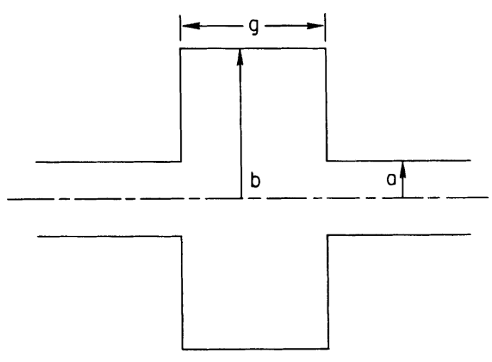
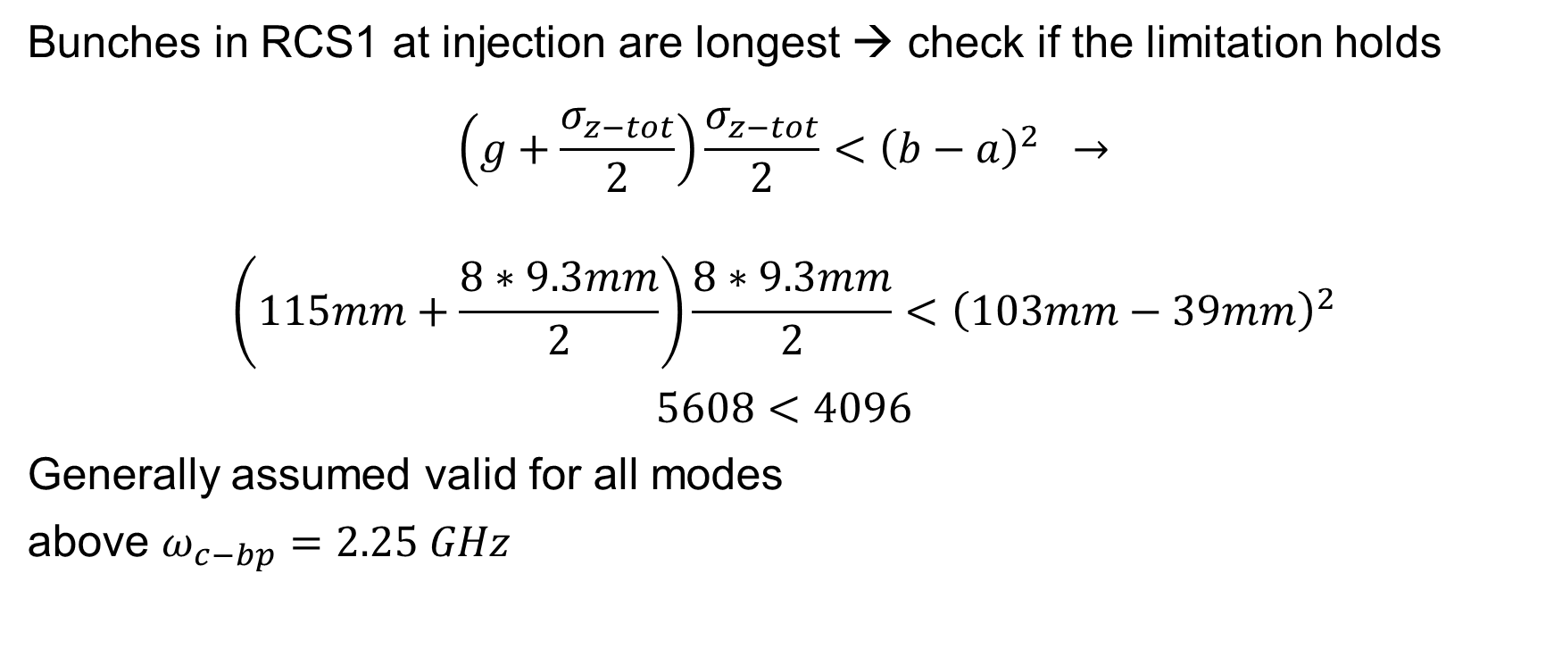
K. Bane formula limits
Bunches in RCS1 at injection are longest → check if the limitation holds
$$\left(g+\frac{σ_{z−tot}}{2}\right)\frac{σ_{z−tot}}{2}<{\left(b−a\right)}^{2} →$$
$$\left(115mm+\frac{8∗9.3mm}{2}\right)\frac{8∗9.3mm}{2}<{\left(103mm−39mm\right)}^{2}$$
$$5608<4096$$
Generally assumed valid for all modes
above $ω_{c−bp}=2.25 GHz$
https://cds.cern.ch/record/184288/files/p73.pdf

