Slide 1

Temperature test, RH test , and FBGs activity during RH test.
(Package K9 analysis)
DOOMNULL (26-06-2025)

Slide 2
Temperature Calibration Test @RH ~ 0%
(Package K9 analysis)
DOOMNULL (26-06-2025)

Slide 3
K9: 3 Sensors
One LPG(T, RH & D)
One FBG–Radhard (T)
One FBG-Radsoft (T & D)

Slide 4
Evolution plots: shift due its temperature response

Slide 5
LPG Spectra : Wavelength vs. time

Slide 6
LPG Calibration : acquiring stable points

Slide 7
LPG : Temperature Calibration curve

Slide 8
FBG-Radhard : Zoomed-in

Slide 9
FBG-radhard Calibration : Stable points

Slide 10
FBG-radhard : Temperature Calibration curve

Slide 11
FBG-Radsoft : Zoomed-in

Slide 12
FBG-radsoft Calibration : Stable points

Slide 13
FBG-radsoft : Temperature Calibration curve

Slide 14
Temperature curves: LPG ; FBG-rh & FBG-rs

Slide 15
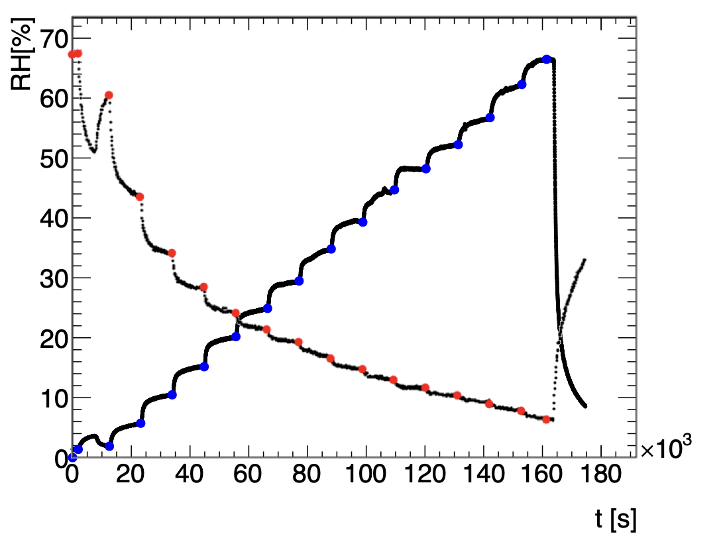
RH TEST @ T ~ -20°C
K9 FOS Analysis
DOOMNULL (20-06-2025)
/Users/doomnull/K9-CH3-12-06-2025/RH-test_T_-20C

Slide 17
LPG: RH Spectra before temperature compensation

Slide 18
LPG wavelength shift due to temperature fluctuation

Slide 19
LPG spectra after temperature compensated

Slide 20
Stables points used for RH calibration

Slide 21
LPG RH calibration curve

Slide 22
FOS LPG RH measurement

Slide 24
RH < 10 % , 20 % , 30 % , 40 %, ALL

Slide 25
Investigating FBG response
RH test @ T ~ -20°C
(Package K9 )
DOOMNULL (25-06-2025)
/Users/doomnull/K9-CH3-12-06-2025/RH-test-T_-20C/

Slide 26
SENSOR CONNECTION (interrogator)
CH3 : K9 LPG [T, RH, D].
CH4 : FBG-rh [T] & FBG-rs [T, D].
Data is from RH test .
RH [%] vs. t [s] (baseline/background plot).
Investigate how the sensors respond to temperature in RH test.
FBG-rh [T] & FBG-rs [T, D] in comparison to the pt10k response.

Slide 28
RH test: Baseline & Valve opening plots.

Slide 32
MORE STUDIES ON FBGs : PACKAGING EFFECT(?)
Splicing.
Pre-strain.
Interrogator channels/Diode.
Condition in our climatic chamber.
Moves with the package and not with the channel.

