Slide 1


FOS Update
Xola Mapekula, Doomnull Unwuchola, Matt Connell, Simon Connell, Loan Truong
09 April 2025
University of Johannesburg

Slide 2
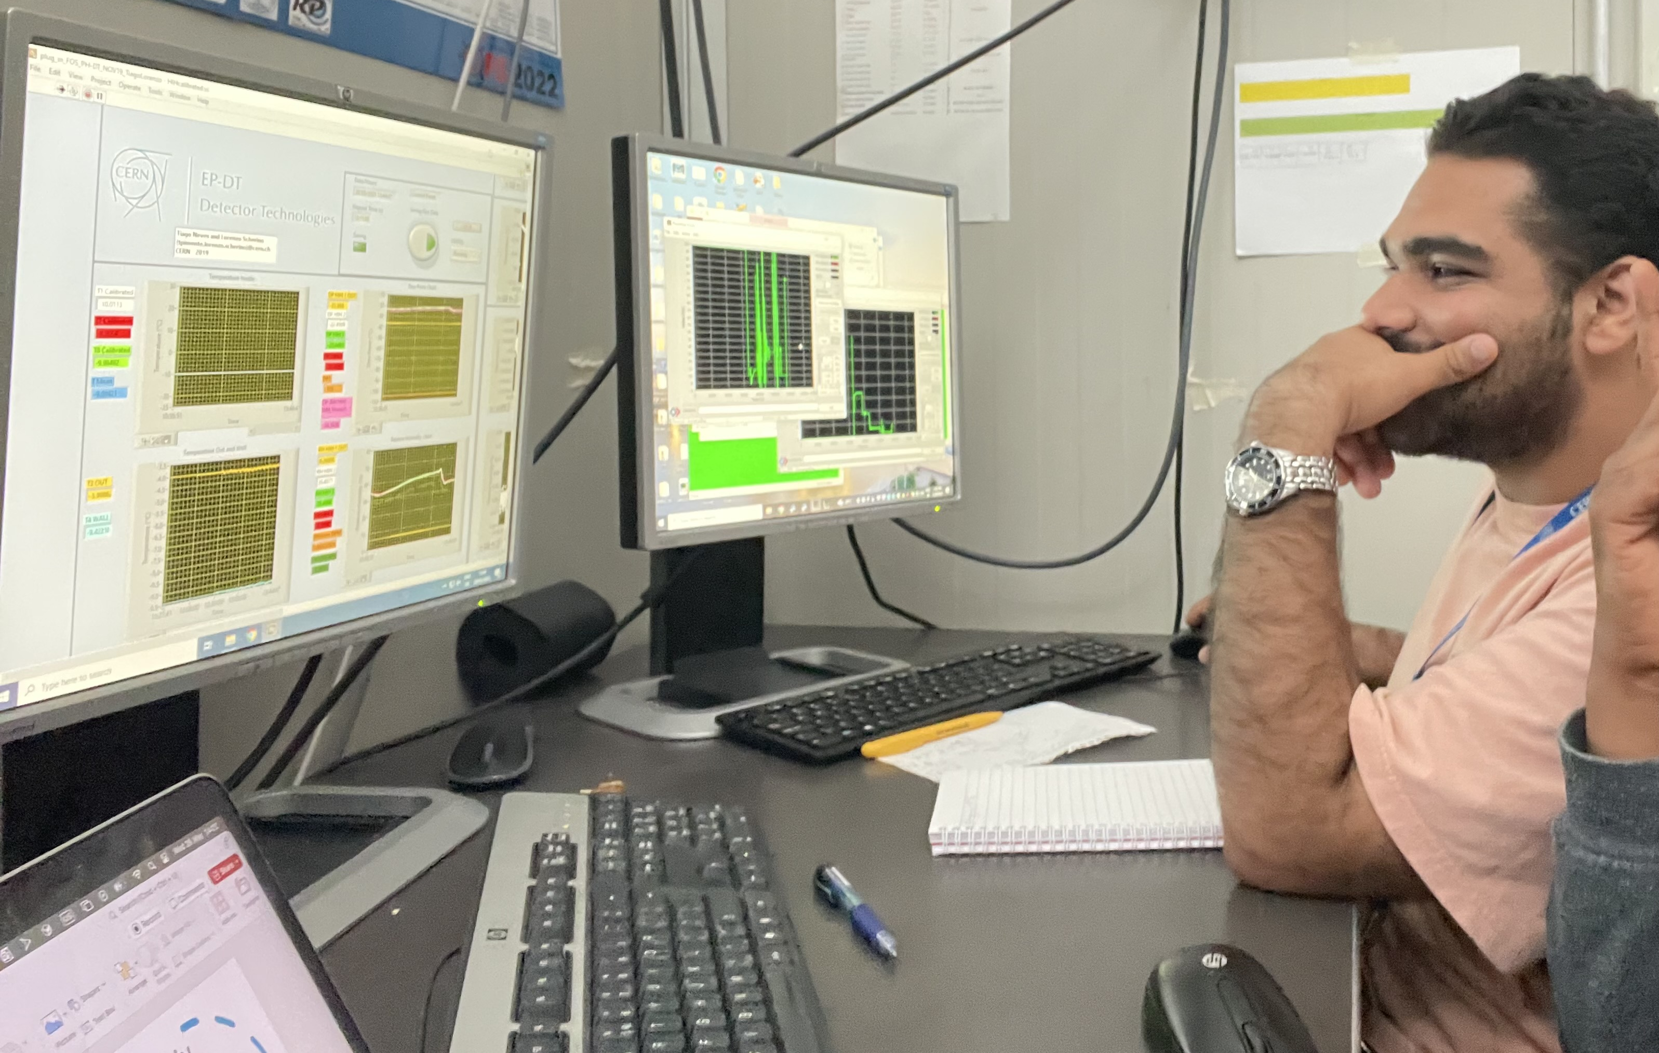
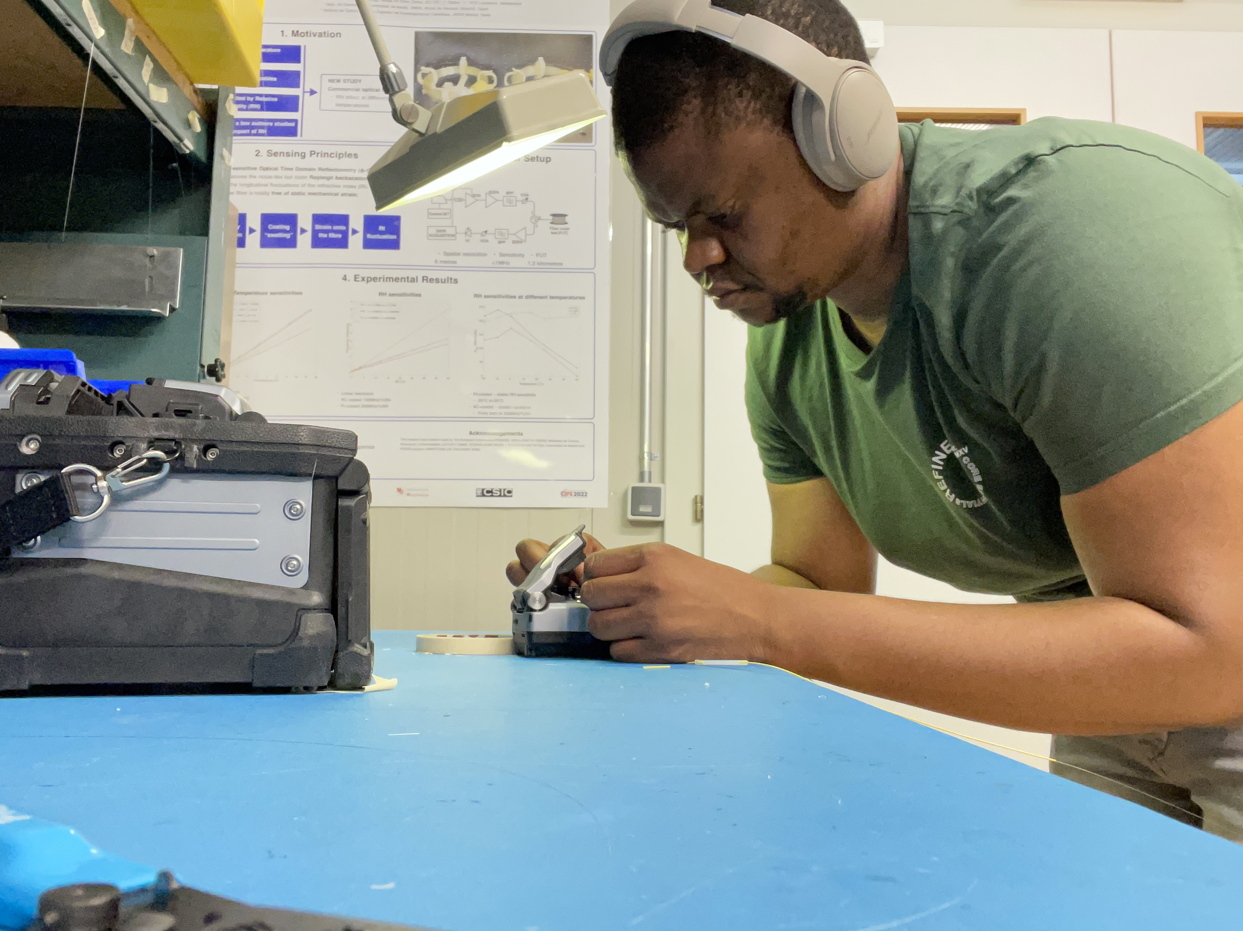
Package assembly status
Assembled 8 FOS package.
QA/QC done on four package
Need to do QA/QC on two more packages
  6 packages need to be delivered to Strips EC
Assembly procedure is being updated:
  https://edms.cern.ch/ui/file/2956801/1.2/FOS_Protocol__Package_Assembly.pdf

Slide 3
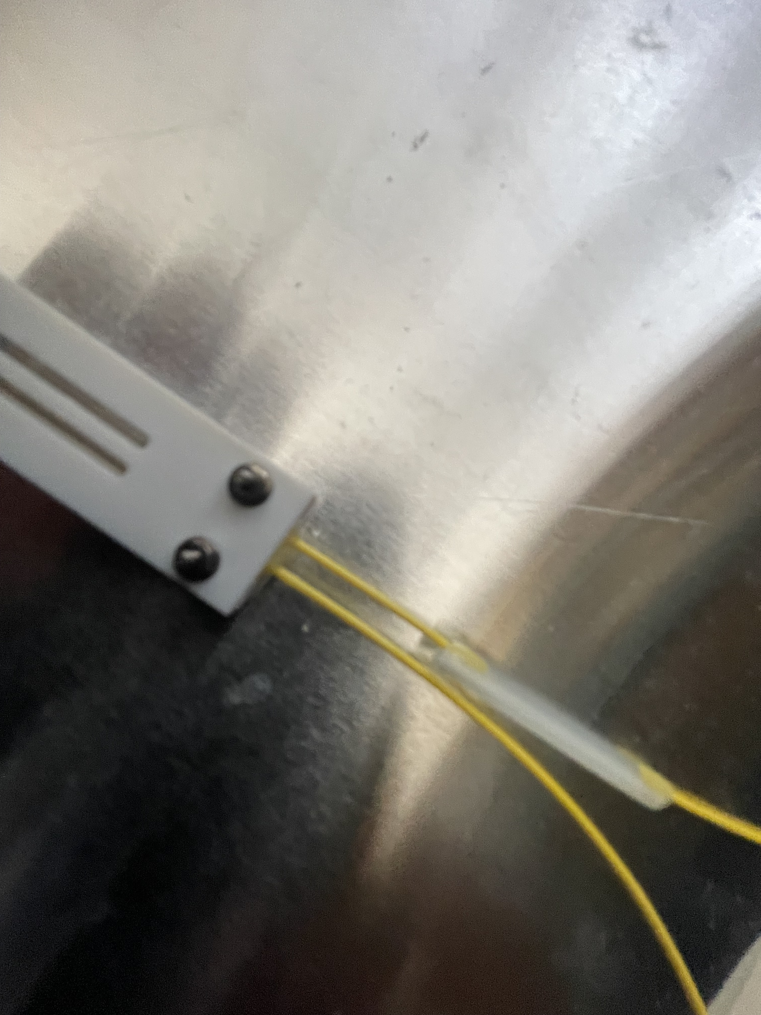
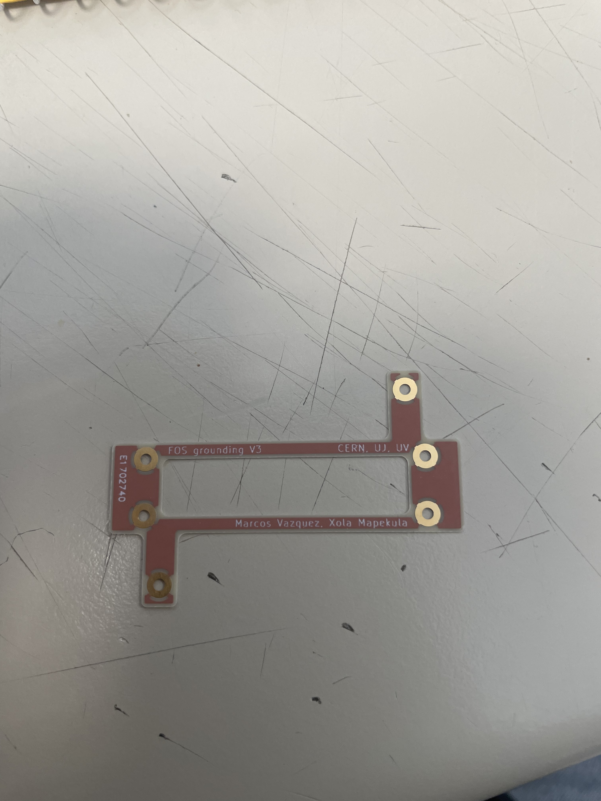
Grounding and stress relief
Araldite
Added araldite to the entry points of the neoceram
Received 34 PCB boards from Euro circuits with new design

Slide 4
Production schedule
Current production schedule with dates
We need to produce 4 packages a week after getting all necessary components (FBG rad soft)
Expected date of arrival of 8 FBG rad soft = 2 June 2025

Slide 5
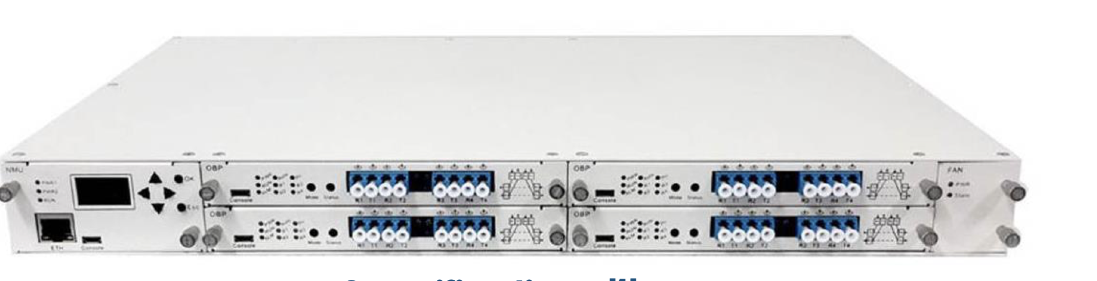
Interrogator
The following optic switch is due to be shipped tomorrow from Hong Kong
Dual 1x64, WL (1460-1620), Dual, Rack mount, SM28, loose tube, FC/APC
$4650

Slide 6
Inventory
Inventory of core parts of FOS package
Full inventory will be taken soon
Pt10k: 61
HIH-4000:
  0 in lab
FBGs:
  10 Radsoft
  5 Radhard
LPGs: 15 (1 faulty acrylic that’s too short - try sending back) (25% ordered) Standard: K2, 6-12, 15-17, 19, 20, 22, 23 (used K7, K8, K16)
  0 in lab
  2? Broken (K17 and ?)
  11 Available (3 are backup)
  3 in use
Ceramic packages: 74 (top and bottom pieces)
PEEK wire:
  1.1km twisted double
1.15km twisted triple

