Slide 1

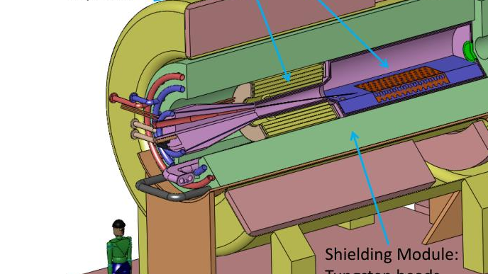
Target Studies for Muon Production
6/25/2025
Ruaa

Slide 2
Magnetic Field Implementation
Flair (the user-interface of Fluka) only allows the application of a uniform magnetic field. There isn’t a direct method to apply fringe fields to a solenoid.
Here, I am exploring the implementation of more realistic magnetic field profiles of a solenoid to my setup.

Slide 3
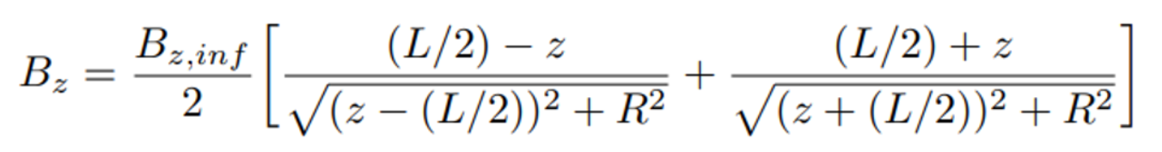
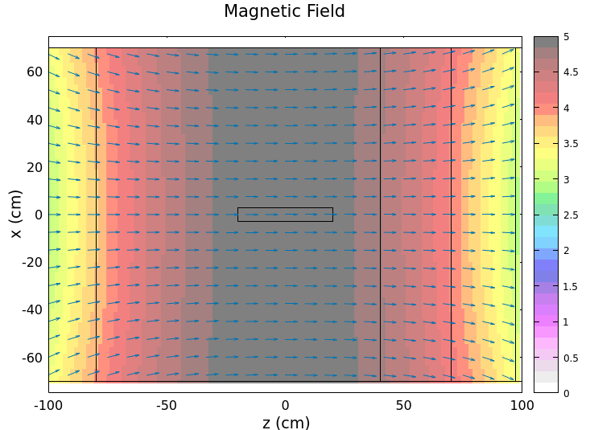
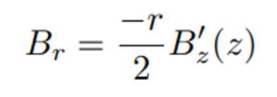
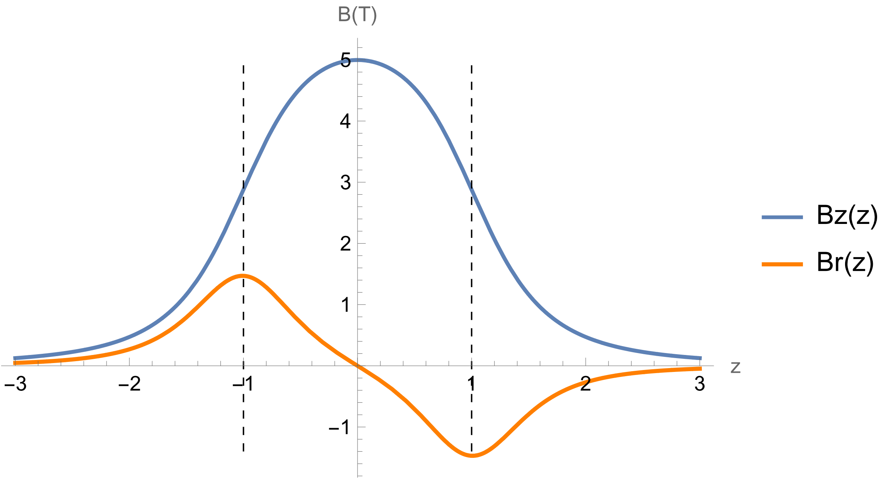
Magnetic Field Implementation
(1) Axial Field Approximation
Successfully produced the field map of this expression.

Slide 4
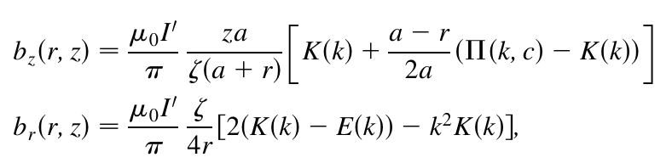
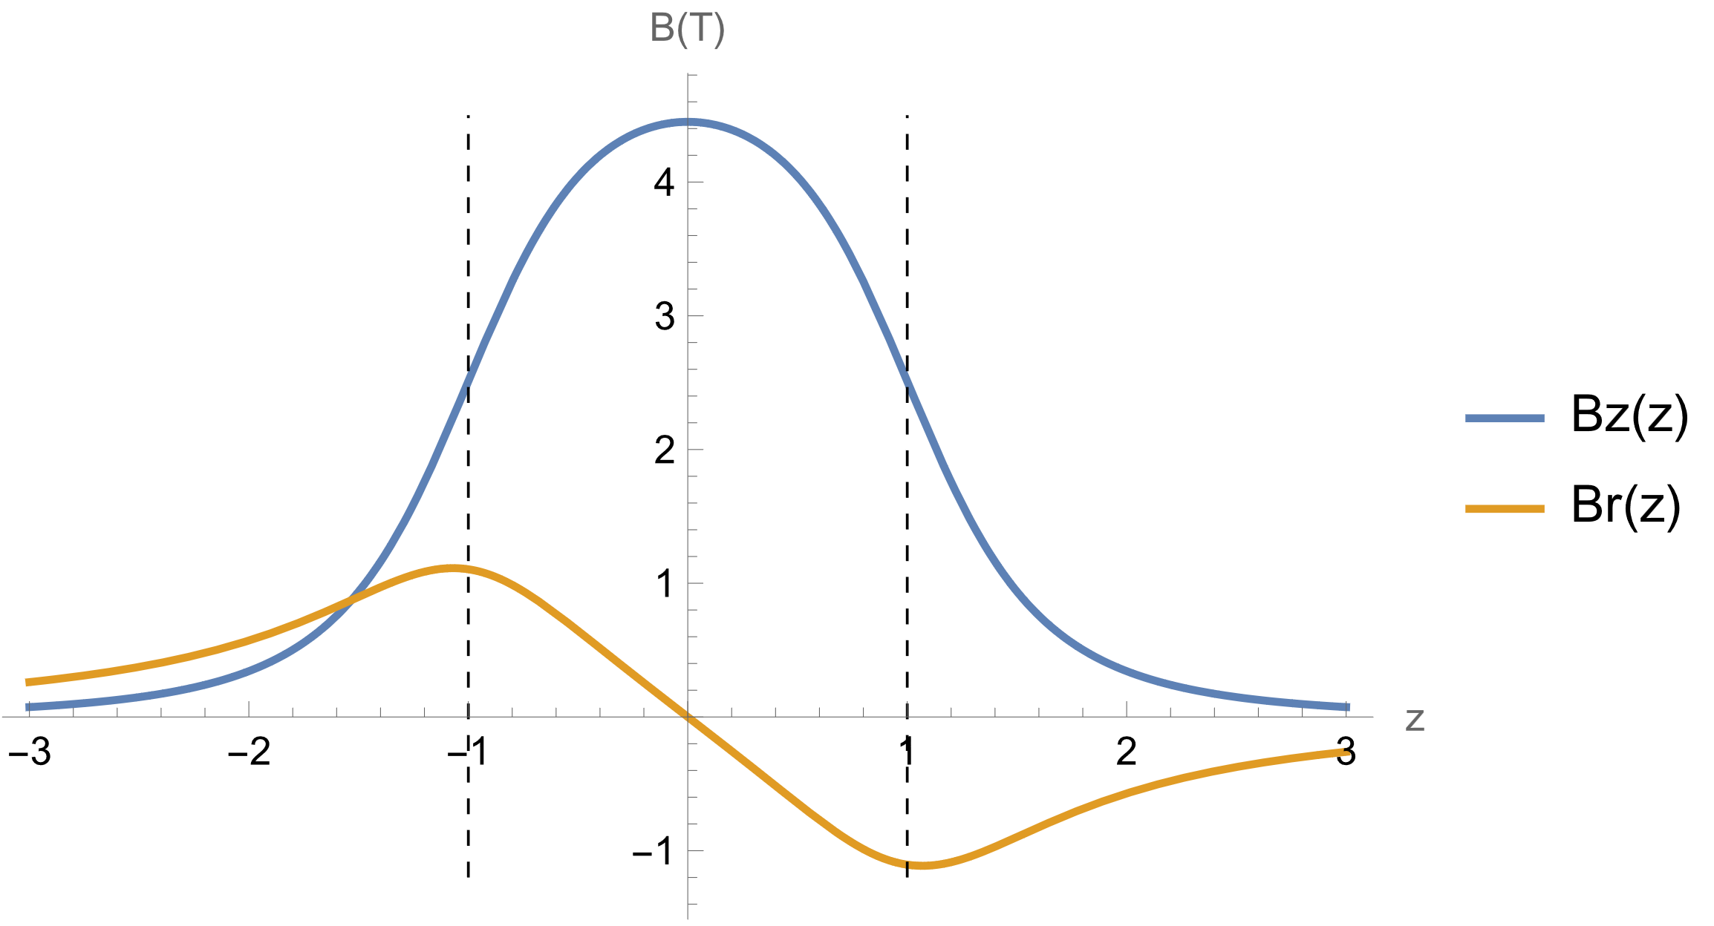
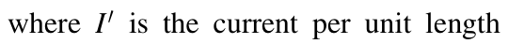
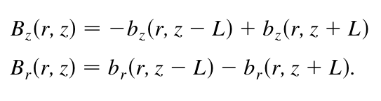
Magnetic Field Implementation
(2) Off-axis B-field expressions
Still working on generating a field map using these expressions.

Slide 5
Magnetic Field Implementation
(3) Generate Field Map from g4bl
Successfully produced a field map using g4bl.
The data needs to be re-ordered and restructured for Fluka to be able to read it.
Importing it should not be difficult.
Then I will look into interpolating the data??

