Slide 1
NLL soft and Coulomb resummation for squark and gluino production at the LHC
Chris Wever (ITF Utrecht)
Based on: P. Falgari, C. Schwinn, CW [arXiv: 1202.2260 [hep-ph]]
Phenomenology 2012 Symposium, Pittsburgh University, 7-9 May

Slide 2
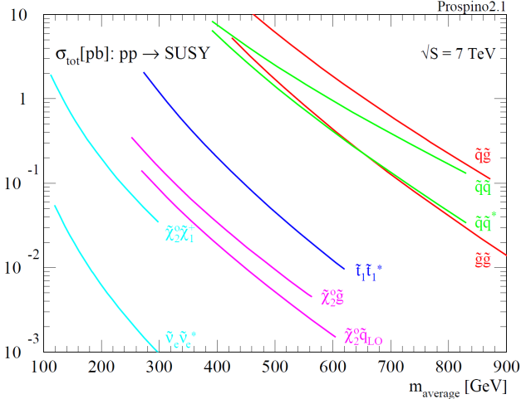
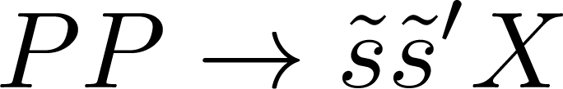

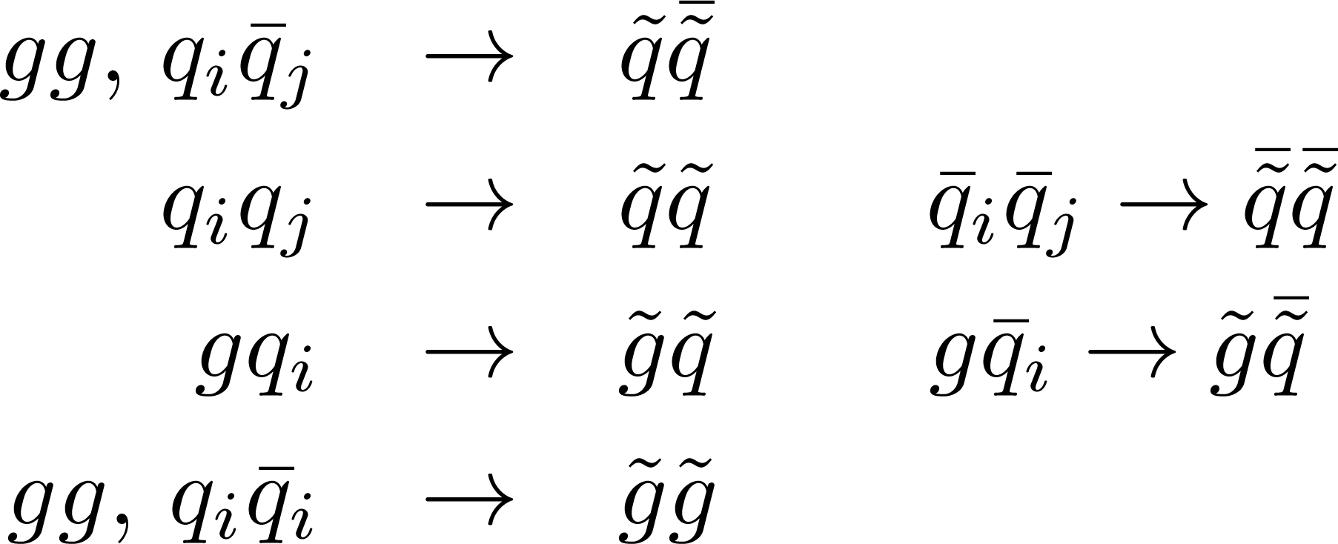
Introduction
Motivation
SUSY searches important at LHC
In MSSM SUSY particles are pair produced
Main production: squark and gluino pairs
Strong exclusion bounds on masses
[Plehn,
Prospino 2.1]
Hadronic processes:
Partonic processes:
Primarily proceed through strong interactions focus on QCD interactions
Analytic LO calculations [Kane, Leveille ’82; Harisson, Smith ’83; Dawson, Eichten, Quigg ’85]
Numeric NLO calculations [Beenakker et al. ’95-’97; Plehn, Prospino 2.1]

Slide 3




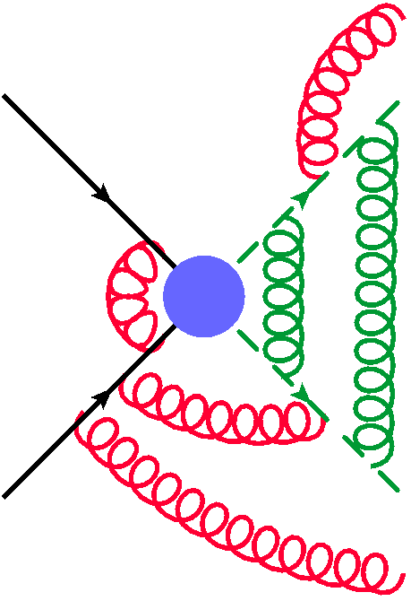







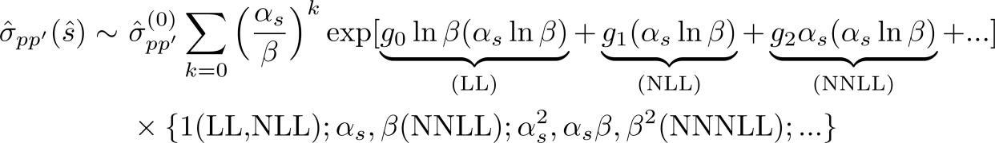

Threshold
Introduction
Partonic processes:
Threshold region:
Relevant modes at threshold:
Collinear:
Hard:
Soft gluons:
Potential (gluons):
[Catani et al. ’96; Becher, Neubert ’06; Kulesza, Motyka ’08; …]
[Fadin, Khoze ’87-’89; Fadin et al. ’90; Kulesza, Motyka ’09; …]
Partonic cs enhanced near threshold by soft and coulomb corrections need to resum
Threshold enhanced terms also approximate well away from threshold

Slide 4
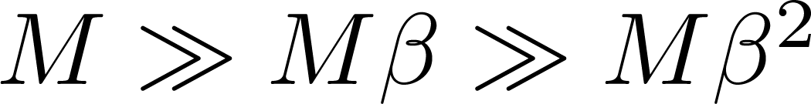
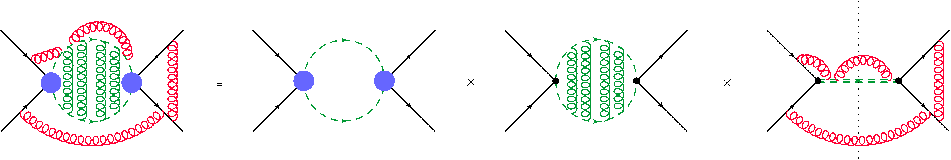

EFT resummation
Factorization using EFT
Hierarchy in scales:
use EFT
Effective lagrangian:
Collinear-soft
Potential-soft
Field redefinitions: soft gluons decouple from collinear and potential modes at LO in 
[Beneke, Falgari, Schwinn’10]
Partonic cross section
Hard contributions
Coulomb contributions (potential gluons exchange)
Soft contributions
(soft gluons exchange)
Coulomb contributions also contain bound-state effects below threshold ( )
Factorization valid up to NNLL for S-wave processes
The factorization is also valid for P-wave processes (qqbar fusion in stop production) [FSW ’12]

Slide 5
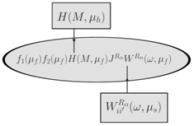



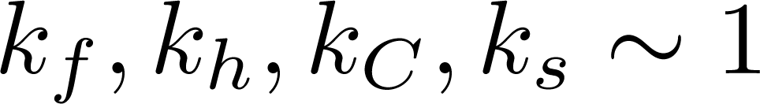
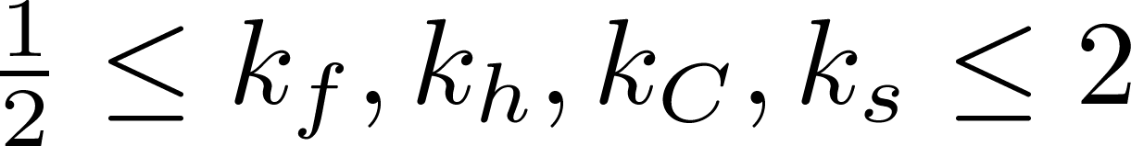

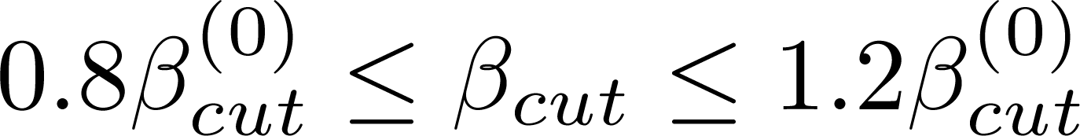
EFT resummation
Resummation using RG flow
H and W satisfy evolution equations choose scales to minimize higher order corrections:
RG flow resums logs
Theoretical errors:
Parameterization errors:
PDF and _{s} errors
Scale variations:
Use MSTW2008NLO PDF’s and match the cs to the full NLO result from Prospino 2.1 [Plehn]:
NLL resummation ingredients: for all 4 processes known
NNLL ingredients: squark-antisquark [Beenakker et al. ’11] and gluino-gluino [Kauth et al. ’11]
Next we present our results resumming both soft and Coulomb terms at NLL

Slide 6

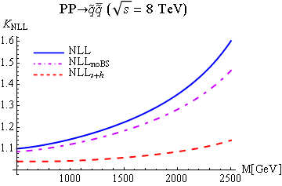
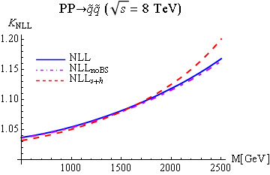
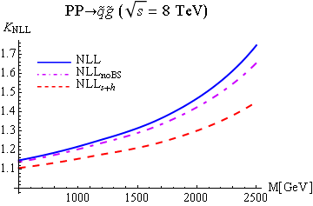
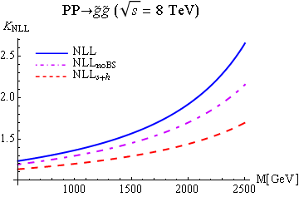
Results
Equal squark and gluino masses:
NLL: combined soft and Coulomb resummation
NLL_{noBS}: no bound-state effects
NLL_{s+h}: no Coulomb resummation
Large corrections: 5-160% of NLO
Coulomb corrections: 0-90%
Bound state corrections: 0-40%

Slide 7
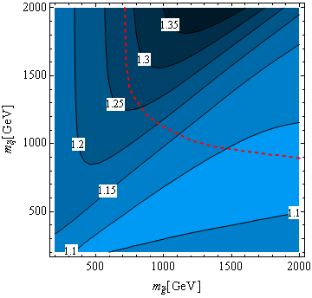
Results
Contour plot K_{NLL}
An (old) ATLAS 7 TeV exclusion bound
Corrections can become as large as 40%, if squark mass is larger than gluino mass
Exclusion bound goes through large K_{NLL} regions

Slide 8
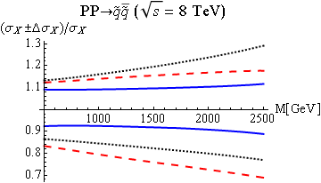
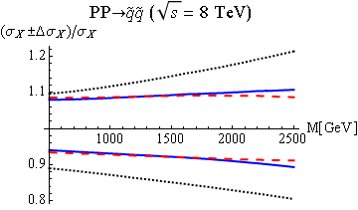
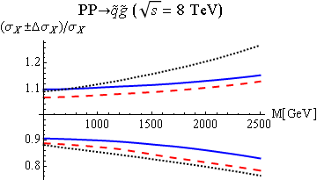
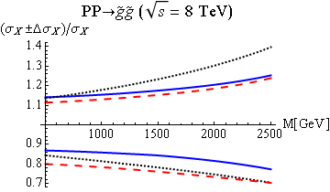

Results
Uncertainties
Scale and parameterization errors of:
NLL: combined soft and Coulomb resummation
NLL_{s+h}: no Coulomb resummation
NLO: fixed order calculation to _{s}³
Equal squark and gluino masses
Corrections reduce NLO errors to 10%
Soft-Coulomb interference reduces errors

Slide 9
Summary
and
Outlook
Summary
The corrections on total SUSY process can be as large as 15-30%
Errors reduced to 10%
Coulomb corrections can be as large as soft corrections need to resum them
Corrections need to be taken into account for setting more accurate squark-gluino mass (bounds)
Outlook
Extend results to non-degenerate squark masses
Include finite width effects
NNLL resummation

Slide 10
Backup slides

Slide 11
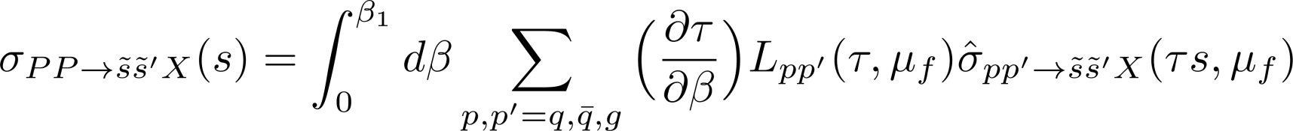
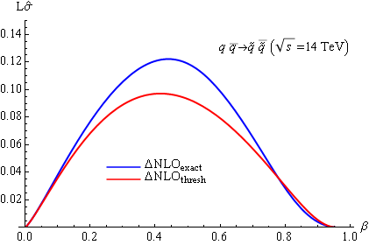
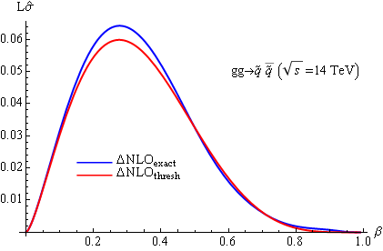
Introduction
Need for resummation
Sizeable contribution from small  region need to resum at threshold
Threshold enhanced terms also approximate well away from threshold
Soft logarithms resummation [Catani et al. ’96; Becher, Neubert ’06; Kulesza, Motyka ’08; Langenfeld, Moch ’09; Beenakker et al. ’09]
Coulomb resummation [Fadin, Khoze ’87-’89; Fadin, Khoze, Sjostrand ’90; Kulesza, Motyka ’09]
Simultaneous soft and Coulomb resummation for squark-antisquark at NLL [Beneke, Falgari, Schwinn ’10] and top-quark pairs at NNLL [Beneke et al. ’11]

Slide 12
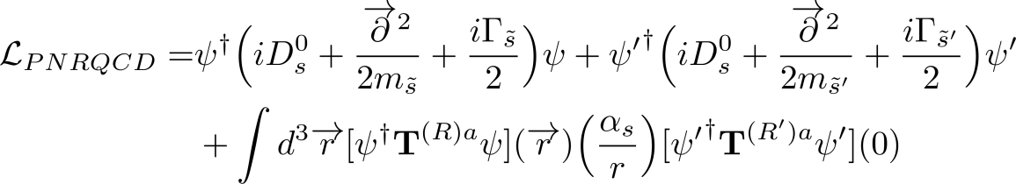



EFT resummation
Effective lagrangian
Effective lagrangian:
Collinear-soft:
Potential-soft:

Slide 13
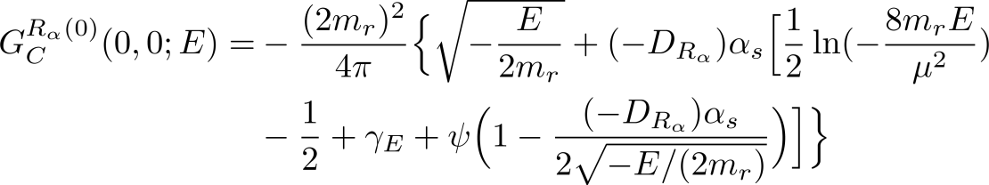
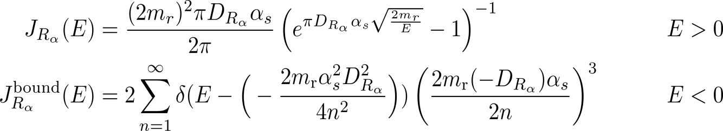

EFT resummation
Potential function
The potential function sums the Coulomb terms:
The potential function equals twice the imaginary part of the LO Coulomb Green’s function:
Potential function J:
It depends on the Casimir coefficients:

Slide 14

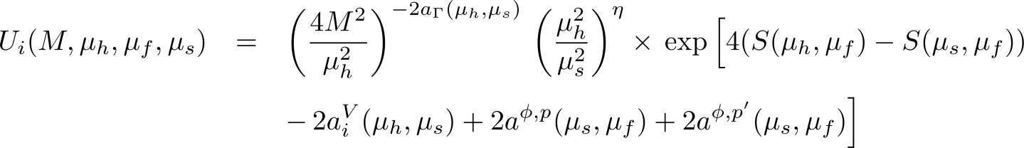
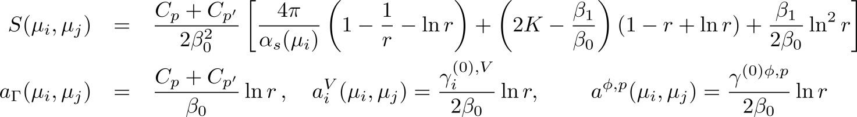
NLL resummation formula
NLL partonic cross section is a sum over the total color representations of final state:
[Beneke, Falgari, Schwinn’10]
Hard function H is determined by Born cross section at threshold:
The function Ui follows from the evolution equations of H and W:
’s are the one-loop anomalous-dimension coefficients, ’s the beta coefficients and C’s are the Casimir invariants, while other constants are:

Slide 15
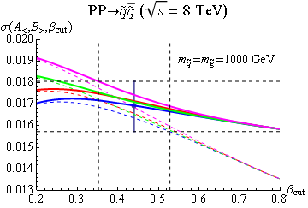
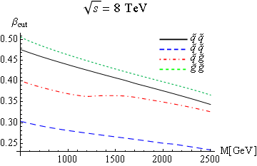
Determination of _{cut}
_{cut} is determined by minimizing the width of the envelope created by:
[Beneke et al. ’11]
Eight different implementations:
Default implementation is NLL₂
Error from envelope when varying _{cut} by 20% around its default value

Slide 16
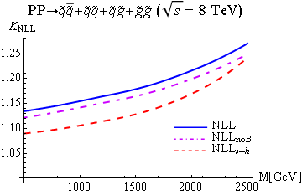
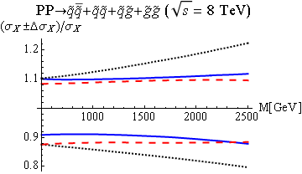
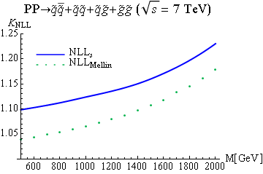
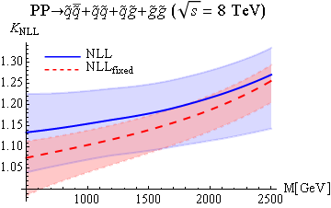
Total SUSY cross section
The corrections are about 15-30%
Errors reduced to 10%

Slide 17
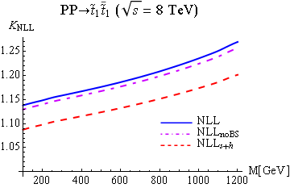
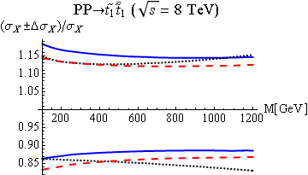
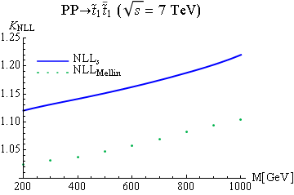
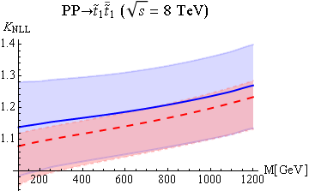
Stops
Q-qbar fusion P-wave suppressed compared to gluon fusion
Relatively larger soft corrections from gluon fusion than squark-antisquark

Slide 18
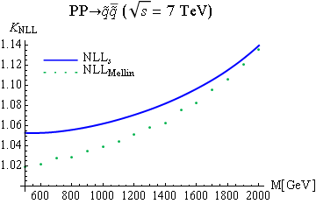
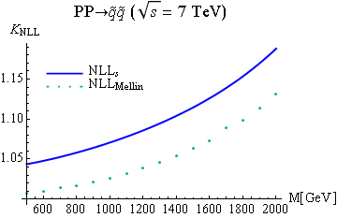
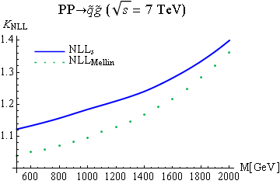
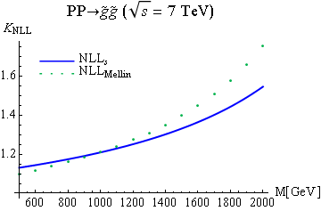


Mellin comparison
Mellin space comparison
Mellin transf.:
Only soft resummation: NLL_{s}
Compare with NLL_{Mellin} [Beenakker et al. ’09, NLLFast]
Agreement is within error bars
Threshold:
Resum and transform back to momentum space

