Slide 1
HI-ECN3 Target Complex Infrastructure Workshop
Wrap-up actions
17th June 2025
I. Angulo Vaquero, J-L. Grenard, G. Humphreys, F. Pedrosa

Slide 2
Objectives of the workshop
Workshop focused on the new target complex service building
https://indico.cern.ch/event/1546119/
Ensure all requirements are understood
Understand studies progress by the different stakeholder
Ensure sufficient spaces are reserved within the target complex
Ensure interfaces between systems are defined
Include specific aspect linked to the rooting of utilities from / to ECN3 / TCC8 and interfaces with SHiP
We are in the design phase some aspect are based on certain assumptions or similar facility
*Planning, Budget and Resources won't be discussed during this Workshop
Workshop Minutes: https://codimd.web.cern.ch/s/GSoAIZzlQ#

Slide 3
Objectives of the workshop
Thanks all of you for taking part and preparing this workshop!
Was very dense and productive day!

Slide 4
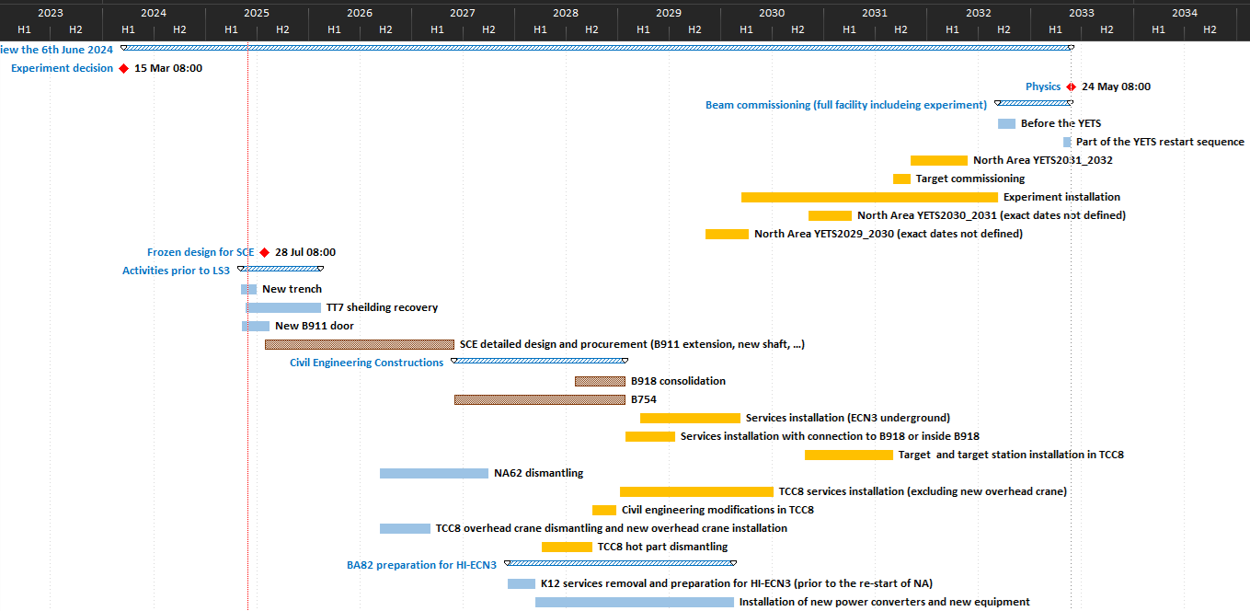
Timeline
Works Phase 1:
Preparation:
dismantling & civil engineering
Works Phase 2:
Installation:
BDF & SHiP experiment
Long Shutdown 3 (SPS)
TDR Phase
(Facility)
TDR
extension
LS4
Below freezing design for SCE!
(Detailed design from consultant before contractor Invitation to Tender)
July 2026
IRP board targeted in September 2025

Slide 5
Missing input for IRP / CE relevant aspects
Status:
3D model of Building 754 has been updated based on latest integration comments, including architectural details→ CATIA model and2D drawings to be shared this week
CE Missing information:
Finalise the design of Building 754’s sump system. The current proposal is to install three 2m³ sumps: 1 for the service cell (high RP concern), 1 for the rest of the building (potential RP concern) and 1 as backup. The same system could be used for firefighting and water storage.
  Define sump requirements
  Define the volume of firefighting water to be stored.
Safe room configuration for the control room
Installation of noise retention panels on the building’s roof
Final building height to fit the crane in CV room.
Courtesy of D.R.Gomez

Slide 6
Short term actions – 15th August
*IRP required information
List Not Exhaustive
Sump design → [39], [41]
Safe room requirements → [27]
Over pressure difference and pressure cascade → [16], [18]
Over head crane in the CV room - > Height of the CV room → [40], [42]
Noise study: need of noise insulation panel of the ventilation systems in the roof → [11], [19], [44]
Racks for the safety systems → [23]
Clarify the needs for EN-CV and EN-EL. (the information missing in the distributed Excel table) → [32]
FIRIA study
Fibre routing path → [35]
Failure mode analysis of the systems to define the UPS and secure network needs →[34]
All slide modifications

Slide 7
Medium term action – 30th September
List Not Exhaustive
LOCA: timing of the no-cooling of the target → [13]
Definition of the final safety matrix
    ODH…
Seismic study -> for the underground is mid term but the one for the building is needed now
Dry risers’ location schematic → [7], [8]
Wider infrastructure workshop for the Hi-ECN3 (Target complex, BA82, cooling aspects of the magnets…) → [1]
The interface between the systems: TSAC recommendations summarised in a document →[6]
Different assessments’ feedback: → [10]
    ODH
    Seismic..
  Risk assessment after the PID → [29]

Slide 8
Long term action – 15th December
Evaluate the superconducting magnet integration in the target area → [5]
The cooling loop → [12]
Target exchange procedure definition → [14]
Assess possibility of performing skid maintenance during run → [15]
Fire detection control panel → [22]

Slide 9
Inputs Required
System | Stable net. [kW] | Secured net. [kW] | UPS [kW]
Power sockets | 72 | 0 | 0
Lighting circuits | 12 | 0 | 0
Crane (30t) + hoist (2.5t) – Main Hall | 45 | 0 | 0
Crane (10t) – Service cell | 15 | 0 | 0
Electric hoists (16t & 2t) | 11 | 0 | 0
Motorized trolley | 4 | 0 | 0
Service cell | 33 | 0 | 0
Cooling station and ventilation system | 200 | 140 | 0
Racks (various) | 4* | 5* | 4*
Primary Vacuum Pumps | 4 | 0 | 0
Sum Total | 400 | 145 | 4
Preliminary sketches, not the final designs
Information to define the different systems
Information to establish interfaces between the systems
Summary tables
Good example of possible summary table

Slide 10
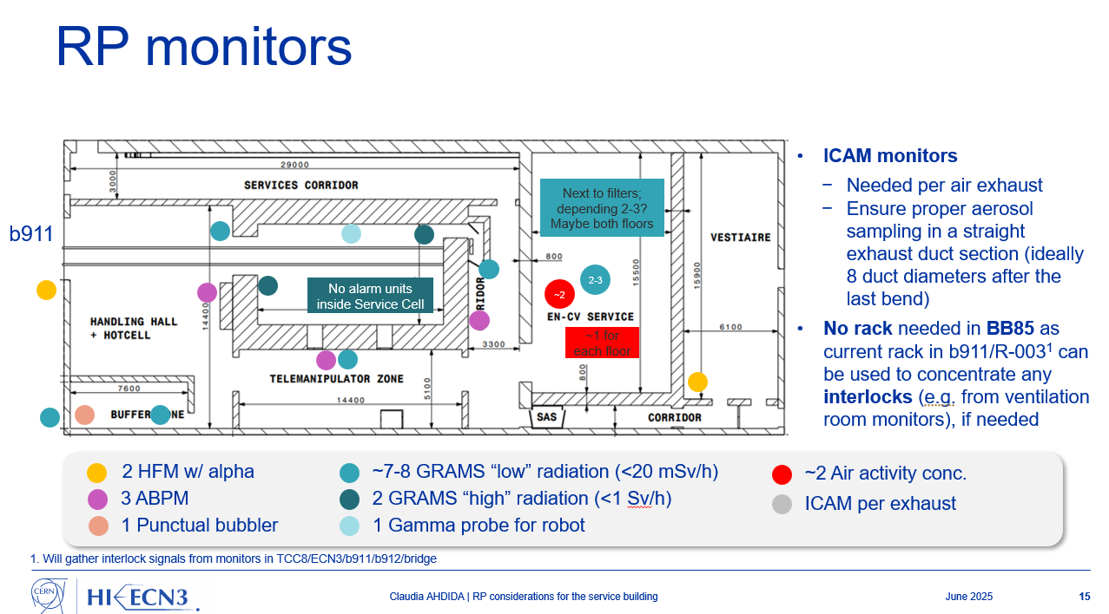
Example of sketches showing systems
Very good example of what we would like to obtain to illustrate requirements

Slide 11
Conclusion
Stakeholders have to tackle actions
Actions will be followed in WP4 coordination meeting
We need inputs to complete the IRP
Wider workshop to treat similar subjects to follow the progress of the studies and exchange between different projects stakeholder
  Service building update
  Target area
  Upstream part of TCC8 including dilution system
  BA82 upgrade linked to HI-ECN3
  General infrastructure for SHIP
  → October 2025 target date (After the medium-term actions for follow up)

Slide 13
Short term actions -15th of August
Action Number | Assigned | Detail | Deadline | Current progress
9 | J. Currie, F. Dragoni, C. Ahdida, J.L. Grenard | to sit together to converge on a pressure cascade proposal that is to be validated by HSE management. | 15th August
11 | J.Minier | Specify the noise limits in the area that need to be respected by the new installations: * A global noise study/analysis should be performed as soon as possible with all the noise sources including the NA-CONS future contributions. * The requirements need to be clarified so that CV & other teams can apply the appropriate technical solution to mitigate noise production if needed | 15th August
16 | A. Henriques, F. Dragoni, C. Ahdida , J.L. Grenard | to sit together and revise the pressure cascade requirements. These requirements are needed for the service cell design study and to define the requirements transmitted to the selected company. | 15th August | Meeting held 23.06.2025 and levels decided, technical note being prepared.
18 | F.Dragoni | Estimate the impact on the pressure cascade when the extraction system is active in one area. This may modify the requirements for the evacuation doors. (i.e., whether pressure handles are required, like in Medicis, or should ideally be avoided.) | 15th August
19 | J. Minier | Complete a noise study for the project that also includes and any future changes related to NA-CONS. The results will have to be taken into account in the building design. | 15th August | Document in progress, waiting for information from manufacturers
20 | R.Rinaldesi | Analyse crane coexistence feasibility for the two bridge cranes in TCC8 (existing one + new) and prepare a pros/cons report. | 15th August
23 | M. Dole | Define the smoke detection system that will be used underground and in B754, define the specific requirements (e.g. false floor, space, safety cable trays, number of racks, fire compartment, …), and the ideal position for the LASDs. | 15th August
27 | B. Morand, M.Dole | to provide info about safe room requirements to SCE (examples, safe room for HI-Lumi in P1 SU17 (3180) and P5 (SD57)) | 15th August
28 | B. Morand/M. Dole | Currently, HI-ECN3 Service Building does not require compliance to the levels for high activity sources (e.g. GIF++), but in case authorities one day will ask us to, we should be able to upgrade the building accordingly (e.g. anti-intrusions, etc.). Define the access system in a way that can be upgraded to more restringent requirements. | 15th August
31 | M.Dole | Provide at least a simple diagram as soon as possible showing how the safety systems will be distributed | 15th August
32 | Hi-ECN3 WP leaders | Update power requirements table shared by EN-EL. | 15th August
34 | F. Dragoni | Perform failure mode analysis and define needs for UPS and secure network for the ventilation systems | 15th August
35 | J.Blanc | Confirm fibre routing path and define if it comes from B911 or if a specific connection going from the caniveau to B754 is needed | 15th August
37 | M. Souayah | An integration analysis shall be performed to validate if one or two IT racks are needed (90 meters distance limit) | 15th August
38 | J.Blanc | Conduct further analysis to ensure that the signal cabling cable trays can be used to pass the optic fiber tube | 15th August
39 | C.Ahdida, F. Dragoni | Define number, location, and volume of drainage sumps ASAP. | 15th August
40 | F.Dragoni, R. Rinaldesi | Provide equipment height limits to finalize room heights. (Study of the crane in the integration model) | 15th August
41 | D. Rodriguez | Hold a meeting to define the waste water sump requirements and risks for each rooms | 15th August
42 | R. Rinaldesi, B. Sutil | Integrate the volume for the crane (in the cooling room) into the integration model | 15th August
44 | F. Dragoni, J. Currie | Define if acoustic panels are requried on the roof | 15th August
45 | All | Submit updated .STP models to EDMS folder and confirm via email before 27 June. | 15th August
46 | E. Cano | Validate rack size and door accessibility for electrical/control rooms. | 15th August
47 | O.Rios | Clarify fire rating requirements | 15th August

Slide 14
Medium term actions – 30th September
Action Number | Assigned | Detail | Deadline | Current progress
1 | All | Think on a more wider workshop to treat similar subjects and improve the sharing of study information between the different parties! | 30th September
4 | M. Liebsch | Clarify the needs for EN-EL for slide 12, is it 20kw or 50kw | 30th September
6 | WP leaders | Translate TSAC1 recommendations into actionable milestones by 2026 | 30th September
7 | O. Rios, J.L. Grenard | to propose layout and provide sketch of dry riser for surface building to understand how to connect it in the different rooms. With collaboration of EN-CV, EN-AA and HSE. | 30th September
8 | Matthias | to propose a layout of the dry risers with the best ideal location per compartment and the routing. | 30th September
10 | HSE: S. Marsh, J. Currie | to provide regular feedback where we are standing in the different assessments (e.g. seismic, ODH, general safety, etc) and implement risk reduction measures. | 30th September
13 | R. Ximenes | Define the maximum time the target could be without cooling and check the compatibilty with the 3 days assumption of EN-CV. | 30th September
21 | All | Provide equipment volumes to continue with transport study | 30th September
24 | B.Martinez Sutil and J.L Grenard | Take into account the requirements of EN-AA in the integration studies. | 30th September
25 | J.L Grenard | Define who will perform the 3D modelling for the detection systems | 30th September
29 | F.Dragoni | Perform a risk assessment to evaluate if an ODH detection is required. As done for the TCC2 prototype, a risk assessment needs to be carried out once the PID is validated so that source of leaks are identified ( flanges, valves etc), amount of helium, volume of the room, air changes per hour etc. It is to be noted that we have helium under the form of gas and not LHe which in general created larger ODH. To be assessed with EN-CV and HSE. The Gas Detection control panel was upgraded in 2021 and it’s located in 918, in case gas detection is required, it would be doable | 30th September
30 | J.L Grenard | A discussion is needed on the integration responsibilities/organization to ensure that the Safety Systems get integrated as soon as possible (e.g. pipes, racks, …) | 30th September
33 | O.Rios | Confirm fire resistance specifications for cable trays (e.g. cables powering areas like the service cell ventilation that shall remain operational even if the building colapse, …). | 30th September
43 | D. Rodriguez & G. Cnudde | look globally to the need of a water retention basin, the compensation needed for the 1300 m2 covered area (removed from the green space) and suggest an economically efficient solution | 30th September

Slide 15
Long term action – 15th December
Action Number | Assigned | Detail | Deadline | Current progress
5 | J.L Grenard and P.Santos Diaz | Evaluate the superconducting magnet integration in the target area and specially the possible interference of the magnetic field of 0.1T in the surrounding environment. | 15th December
12 | F. Dragoni | To provide a list of equipment that is connected in the same cooling loop as the proximity shielding in the current study. | 15th December
14 | J.L. Grenard | Define the target exchange procedure: * Cool down time *Dismantling procedure *Cooling needs during the transport from underground and surface | 15th December
15 | F.Dragoni | to discuss/agree on the possibility of performing the skid maintenance during run (to reduce the works during the YETS where the services are already overloaded) | 15th December
22 | B. Morand | Fireman cubicle ( coffret pompier by EN-CV) - to be further developed and designed. * EN-AA assumed a Fire Detection Control Panel dedicated to the Service Building will be provided. We need to check if this is really required. A brand new control panel was commissioned during LS2 in BA82 SFDIN-00268. If required, a dedicated battery bank can be provided to feed the BB85 ASD | 15th December

Slide 16
Safety system
Provide a sketch of the layout and coverage of:
Dry Risers | Oriol and Matthias
Fire Cubicle (location) | Matthias
Fire Detection Strategy | Oriol
Fire Detection Pipes, Fire Detector Racks, ASDs | Michael
Sirens, ODH Detector Racks | Michael
Evacuation Button | Michael
Access System (Compartmentation Strategy, Rack, Card Reader, Video Cameras) | Michael
Emergency Buttons, AUG | Eva
[O. Rios/J.L. Grenard] – Provide layout sketch of dry risers.
7
[Matthias] – Propose optimal layout and compartment outlets for dry risers.
8
Safety matrix and interfaces with systems
Link with CV systems
Fire dampers, doors, fire detection systems, fire extinguishing means, ODH
Requirement keeping alive safety relevant systems (ie ventilation of class A lab)

Slide 17
Cooling Aspects
LOCA
  Restart of back up skid
  Safe powering
  Including target exchange
Target exchange:
  Time required
  Critical time for cooling loss and target handling
[F. Dragoni] – Provide list of components currently covered by the same cooling loop as the proximity shielding
12
[R. Ximenes] – Define the time needed for target exchange. Provide critical time range for cooling loss and target handling.
13
[F. Dragoni] – Assess skid maintenance possibility during Run to be discussed jointly with RP.
15

Slide 18
Ventilation
[J. Currie, F. Dragoni, C. Ahdida, J.L. Grenard] – Review and converge on pressure cascade proposal.
9
[J.Minier]– Specify noise limits and complete a global study including NA-CONS.
19
[A. Henriques, F. Dragoni, C. Ahdida , J.L. Grenard] – Reassess underpressure cascade for service cell.
16
[F.Dragoni] - Perform failure mode analysis and define needs for UPS and secure network for the ventilation systems
34
[F.Dragoni] – Estimate extraction-phase underpressures to support evacuation door design.
18

Slide 19
Slide modifications
Missing data of presented values and general actions
[M. Parkin] – Remove 'may be 50mm' from slide and possibly organise dedicated discussion.
2
[M.Liebsch] – Clarify the 20kW power value presented. The maximum power consumption is 50kW.
4
[J-L. Grenard] – Modify slide 5 to show TCC8 with correct position of confinement wall.
3
[WP leaders] – Translate TSAC1 recommendations into actionable milestones by 2026.
6
[N. Zaric] – Change 'smoke extraction' to 'fire-rated underpressure system' in documentation.
17
Communication:
[All] – Think on a wider workshop to treat similar subjects and improve the sharing of study information between the different parties!
[B. Morand] – Update EI60 rating for DI racks on slide 9.
1
26
[J. Blanc] – Complete slide 5 with control and IT rack details.
36

Slide 20
Safety matrix
[O. Rios/J.L. Grenard] – Provide layout sketch of dry risers.
7
[F.Dragoni] – Perform failure mode analysis and define needs for UPS and secure network for the safety systems
34
[Matthias] – Propose optimal layout and compartment outlets for dry risers.
8
[J.L.Grenard] – Define who will perform the 3D modelling for the detection systems.
25
[B. Morand] – Finalise fireman cubicle layout (coffret pompier).
22
[B. Morand/M.Dole] – to specify the specific requirements to a high activity source upgrade of the building in the future. (e.g. anti-intrusions, etc.)
28
[M.Dole] – Confirm location of LASDs to avoid aspirated air contamination.
23

Slide 21
General safety
[HSE: S. Marsh, J. Currie] – Provide regular feedback on progress of seismic/ODH, general safety assessments.
10
[J. Currie, F. Dragoni, C. Ahdida, J.L. Grenard] – Review and converge on pressure cascade proposal.
9
[F.Dragoni] – Estimate extraction-phase underpressures to support evacuation door design.
18
[J.Minier] – Perform global noise study across all contributions:
CV
Other user ie EL transformer
Including NA-CONS and SHiP
11
[J.Minier)] – Specify noise limits and complete a global study including NA-CONS.
19
[A. Henriques, F. Dragoni, C. Ahdida , J.L. Grenard] – Reassess underpressure cascade for service cell.
16
[F.Dragoni] – ODH detection requirement. Risk assessment once the PID is validated.
29
Pressure cascade to include:
  Layout
  Service cell underpressure
  Evacuation doors design for underpressure differences
Noise general study.
  Define the limits for the equipment
  The groups should define the noise of their equipment
  Propose mitigation measures (noise proof insulation (?))

Slide 22
Target
Cooling
[F. Dragoni] – Provide list of components currently covered by the same cooling loop as the proximity shielding
[R. Ximenes] – Define the time needed for target exchange. Provide critical time range for cooling loss and target handling.
12
13
[J.L. Grenard] – Define the target replacement procedure, including cooldown and dismantling steps.
14
[F. Dragoni] – Assess skid maintenance possibility during Run to be discussed jointly with RP.
15
Target exchange:
  Time required
  Critical time for cooling loss and target handling
  Replacement procedure (with cooldown and dismantling steps)
Cooling:
  List of components covered by the He cooling
  Skid maintenance during the run
  Cooling interruption protocol and exchange steps

Slide 23
Transport studies
[R.Rinaldesi] – Analyse crane coexistence feasibility and prepare pros/cons report.
20
Cranes:
Study of the 2 cranes in ECN3-TCC8
Crane study for the CV room
Study the transport of the installation when the volumes are provided.
[All] –Provide transport volumes to continue with transport study
21

Slide 24
Electrical infrastructure
32
[HI-ECN3 WP leaders] – Update power requirement table shared by EN-EL.
Update the EN-EL table by the different groups (Eva already updated with the values in the presentations)
  Safety systems
  Fire resistance specifications
918 -754 link
  Evaluate the fibre optics link
  Confirm the routing path of other systems
[O.Rios] – Confirm fire resistance specifications for cable trays.
33
[J.Blanc] – Confirm fibre routing path and whether B911 is required.
35
[J.Blanc] – Conduct further analysis to ensure that the signal cabling cable trays can be used to pass the optic fibre tube
38

Slide 25
Civil Engineering studies
Sump
[C.Ahdida/ F.Dragoni] – Define number, location, and volume of drainage sumps ASAP.
[B. Morand/M.Dole] – Provide safe room reference designs to SCE.
39
27
[D. Rodriguez] – Convene drainage and water retention risk meeting. (Water requirements and risks for each room)
[R.Rinaldesi/B.Sutil] – Integrate crane volume into 3D model and coordinate slab openings.
41
42
43
[D. Rodriguez & G. Cnudde] – Propose cost-effective retention solution for 1300 m² waterproofed surface.
Sump:
  Define the number, location and volume of drainage sumps
  Convene drainage and water retention risks
CV room:
  Crane
  CV equipment volumes
44
[F.Dragoni/J.Currie] – Define if acoustic panels are required on the roof.

Slide 26
Integration studies
[J-L. Grenard/P. Diaz] – Evaluate superconducting magnet integration in target area and the effect of possible magnetic interference with surroundings.
[F.Dragoni/R.Rinaldesi] – Provide equipment height limits to finalize room heights.
(Study of the crane in the integration model)
5
40
[B. Sutil/ J-L. Grenard] – Take into account requirements of EN-AA in the integration studies.
24
[All] – Submit updated .STP models to EDMS folder and confirm via email before 27 June.
45
[J-L. Grenard] – Integration responsibilities/organization for the safety systems.
30
[E.Cano] – Validate rack size and door accessibility for electrical/control rooms.
46
[M.Dole] – Provide integration diagram for detection systems (pipes, racks, power).
31
CV room
Safety systems: pipes, racks power…
IT start points
Electrical/control room: Size and door accessibility
  [M.Souayah]– Determine if 1 or 2 starpoint racks needed in B754 (max 90m cable limit).
37

