Slide 1
RF MD#1 Flash Results
H. Bartosik, R. Calaga, M. Hostettler, B. Karlsen-Baeck, S. Kostoglou, S. Lauber, C. Marrelli, D. Mirarchi, N. Mounet, D. Soriano Guillen, H. Timko, G. Trad, K. Turaj, S. Valuch, M. Zampetakis
HiLumi Joint WP2/WP4 Meeting, 1st July 2025

Slide 2
Overview
MD 15425 – Improved cleaning of de-bunched beam at LHC injection
MD 15423 – RF capture and start of ramp with HL-LHC beams

Slide 3
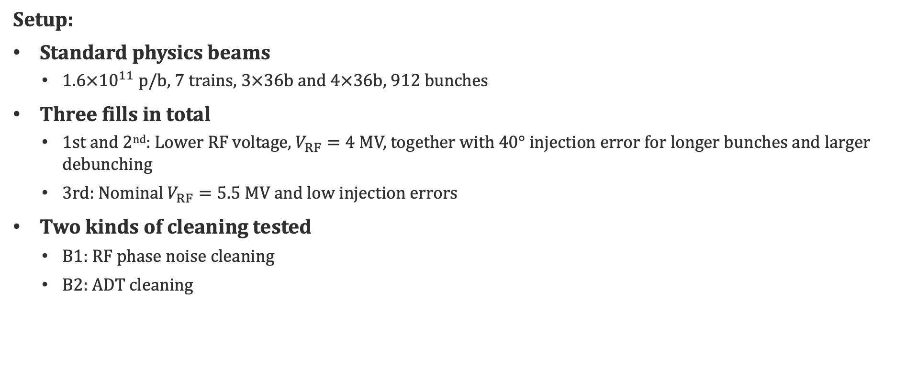
MD15425 – Improved cleaning of de-bunched beam at LHC injection
Setup:
Standard physics beams
  $1.6×{10}^{11}$ p/b, 7 trains, $3×36$b and $4×36$b, 912 bunches
Three fills in total
  1st and 2nd: Lower RF voltage, $V_{RF}=4$ MV, together with $40°$ injection error for longer bunches and larger debunching
  3rd: Nominal $V_{RF}=5.5$ MV and low injection errors
Two kinds of cleaning tested
  B1: RF phase noise cleaning
  B2: ADT cleaning

Slide 4
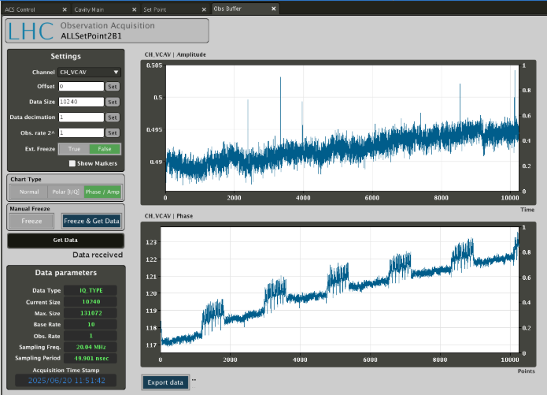
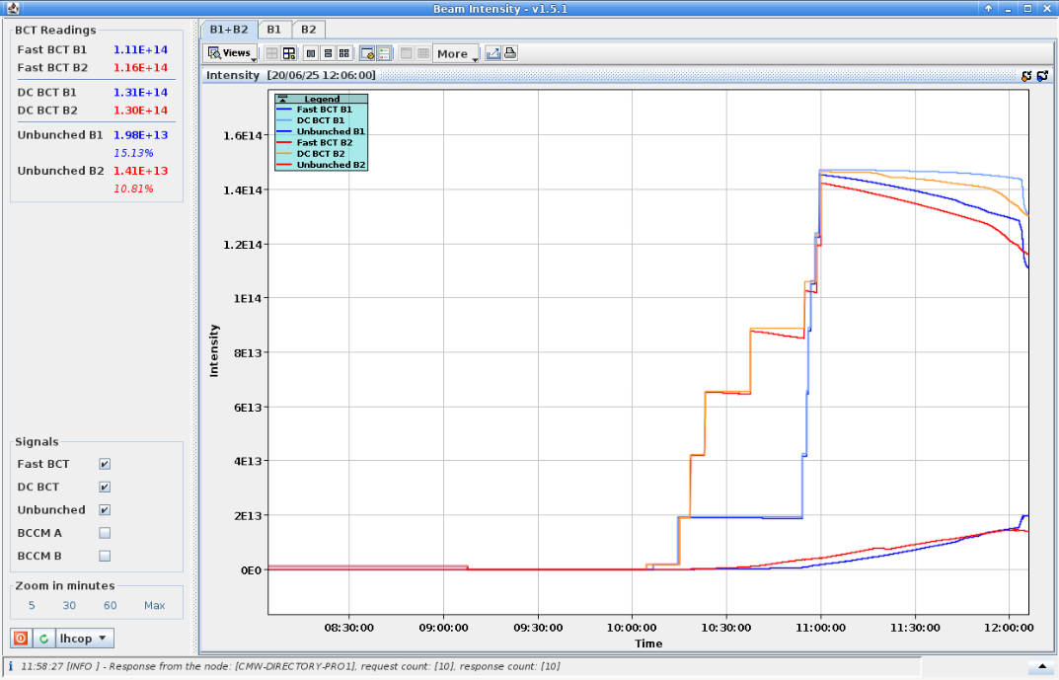

MD15425 – RF Phase Noise Cleaning
Part 1: The aim was to inject phase noise in the no-beam segment, into the RF phase set point of cavity 2B1
  Beam phase loop has been masked in the no-beam segment
  Attempted different configurations
      Noise injected in the entire ring, increasing debunched population in all cases
Noise amplitude $0.3°$

Slide 5
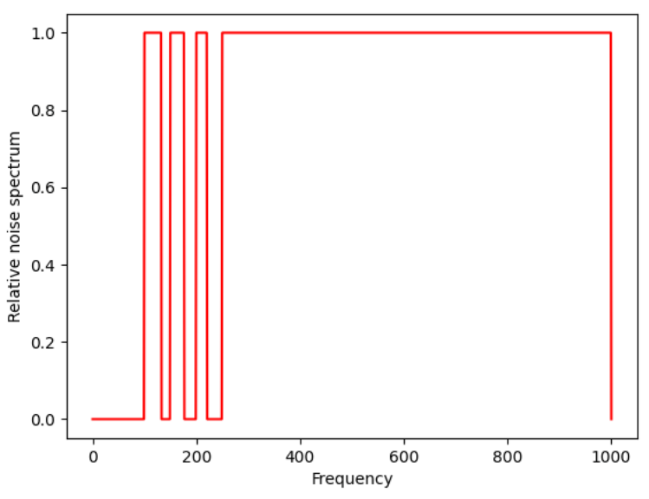
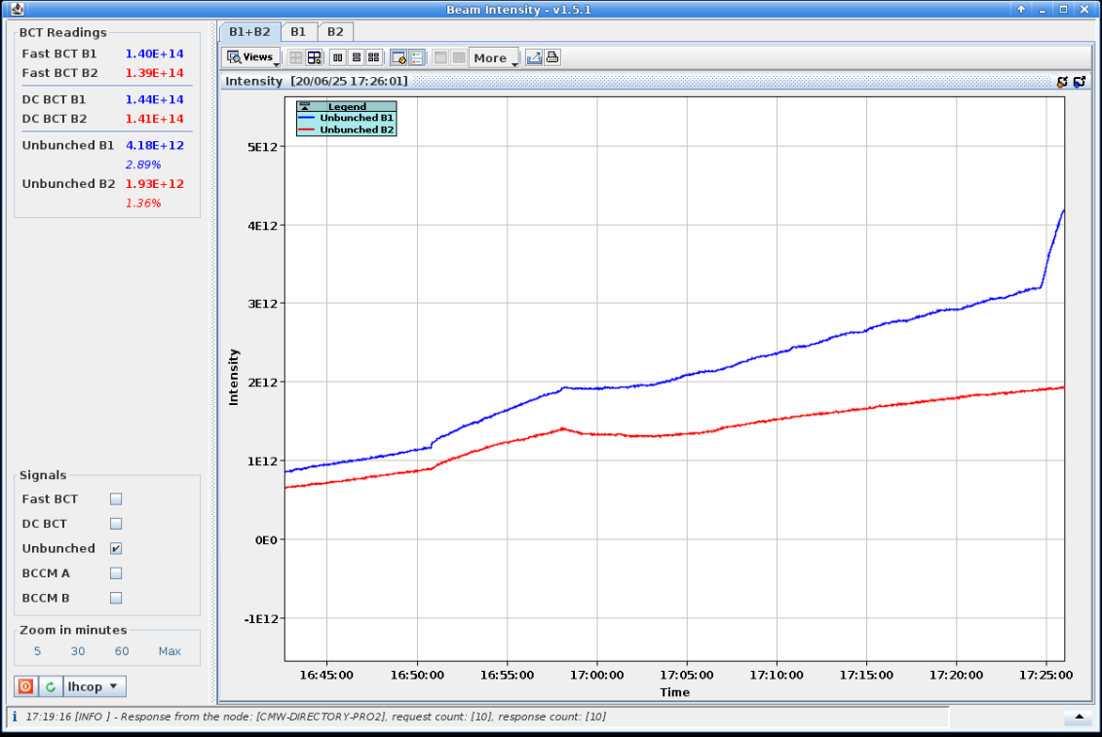

MD15425 – RF Phase Noise Cleaning
Part 2: Inject phase noise through the beam phase loop (used during operation)
  Flat spectrum in the frequency band 100–1000 Hz
  Spectrum with gaps, avoiding the 3rd, 4th and 5th multipoles of 44–50 Hz ($f_{s0}=47$ Hz)
  3rd fill: B1 with nominal injection and abort gap cleaning to compare with ADT cleaning in B2
    Then, excitation frequency band scan: 100…900–1000 Hz in steps of 100 Hz
    Last step with frequency band of 1–10 Hz which led to a beam dump
Conclusions:
Data will be analyzed in detail
Simulations will be conducted to try to reproduce the observed increase in debunching ⇒ not present in preliminary studies
Prepare software and re-try in the abort gap only
B1: 100–1000 Hz
Flat spectrum
Flat spectrum with gaps

Slide 6
MD15423 – RF capture and start of ramp with HL-LHC beams
No-beam measurements for B1
  The circulator bias was scanned and the best matching close to saturation was found on line 1B1
  For every working point, the cavity loaded Q was verified via a voltage drop measurement
  The operational settings turned out to be optimal for the return losses, on this particular line
Optimized the cavity tuner phase for the half-detuning scheme
  These settings will be used in MD#2 to accelerate the beam
In this optimized state, the maximum voltage without saturation was investigated (with OTFB closed)
  5.9 MV for B1, and 6.1 MV for B2. Voltage partitioning was required for some lines
Time spent at injection for B2
  Post-process the de-bunched population to estimate the number of bunches we can accelerate in MD#2
Longitudinal bunch profiles were acquired to look at bunch lengthening and injection oscillations

