Slide 1
Extended “Flash” MD results with HL INDIVs: emittance growth, losses, tails, noise, luminosity
F. Asvesta, H. Bartosik, D. Butti, A. Calia, I. Efthymipoulos, M. Hostettler,
S. Kostoglou, N. Mounet, K. Pervaina, J. Pucek, A. Radoslavova,
F. Soubelet, G. Sterbini, G. Trad, D. Valuch, C. Young
Many thanks to MD coordinators & injectors for excellent preparation
WP2, 01/07/2025

Slide 2
MD overview
Main points to address with HL INDIVs:
  Additional emittance growth beyond IBS at injection ~0.2 um/h?
  Emittance growth during collisions ~0.07 um/h?
  Difference in emittance growth between colliding & non-colliding.
  Tail population or tail cleaning during the cycle?
  Reliability of BSRT for emittance and tail measurements through WS comparison at injection & top energy.
  Measure difference in losses & integrated luminosity between q=1 and q=1.5. Simulations indicated gain up to ~4%.
  Parasitic observations of 8kHz during ramp.

Slide 3
MD overview
Fills 10738 (20/6 00:22 to 02:35 UTC, 2h &12mins) and 10739 (20/6 02:35 to 09:09, 6h & 34 mins)
Fill 10738:
  Injected a few q=1 HL INDIVs to improve injection steering.
  Attempted “lossless” ADT blowup tests for controlled emittance increase in view of 2026 tests.
Fill 10739:
  6 HL INDIVs and 1 INDIV 1.5e11ppb distributed in the ring to be able to use WS:
    idx_b1 = [20, 500, 750, 1250, 1800, 2250, 2874]
    idx_b2 = [20, 500, 1050, 1250, 1800, 2500, 2874]
  3 of q=1 and 4 q=1.5, 2 colliding and 1 non-colliding per group.

Slide 4
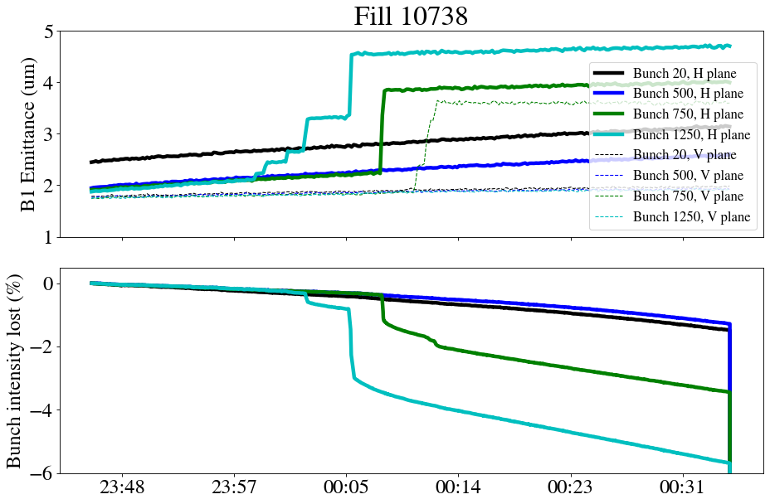
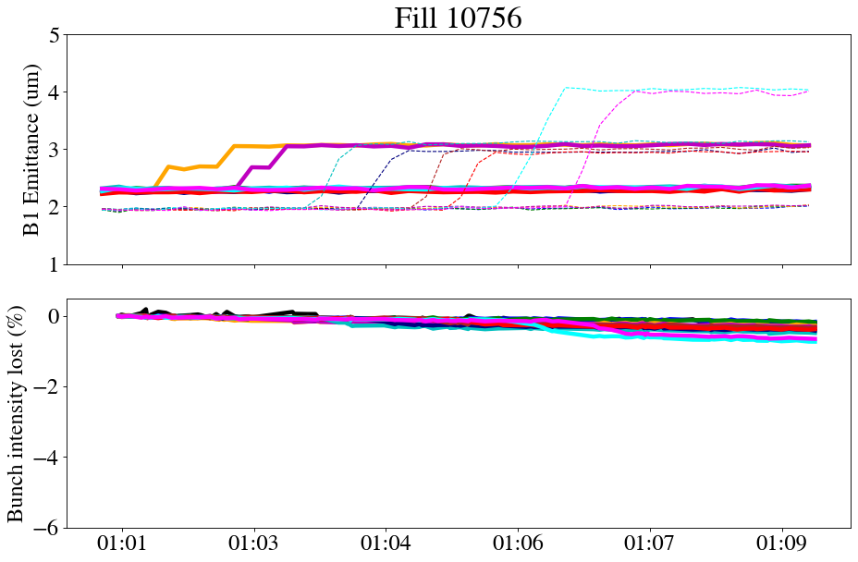
Emittance blowup with ADT
Blowing up the core with white noise using ADT
~5% loss of bunch intensity to reach emittance of 5 um
Further improved by D. Valuch in next MDs (see Dora’s MD) with bunch intensity losses <1%: recipe is to blowup with ADT OFF

Slide 5
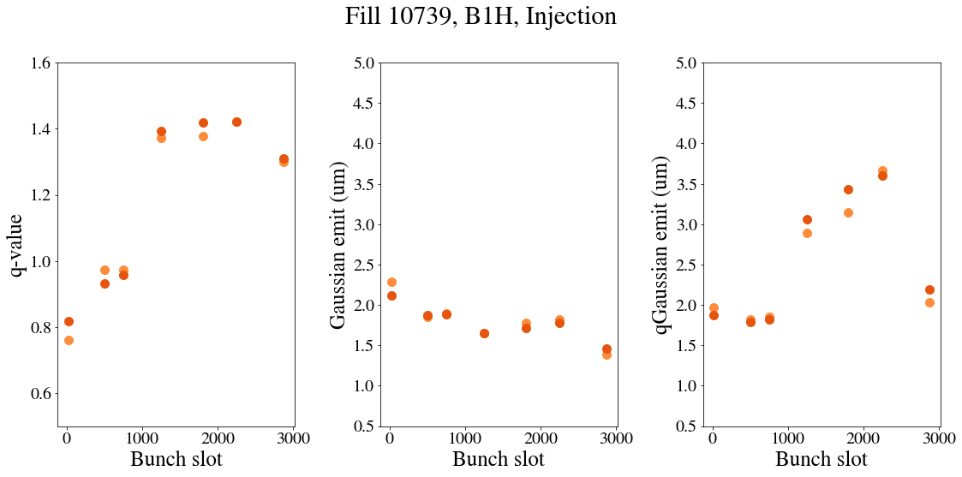
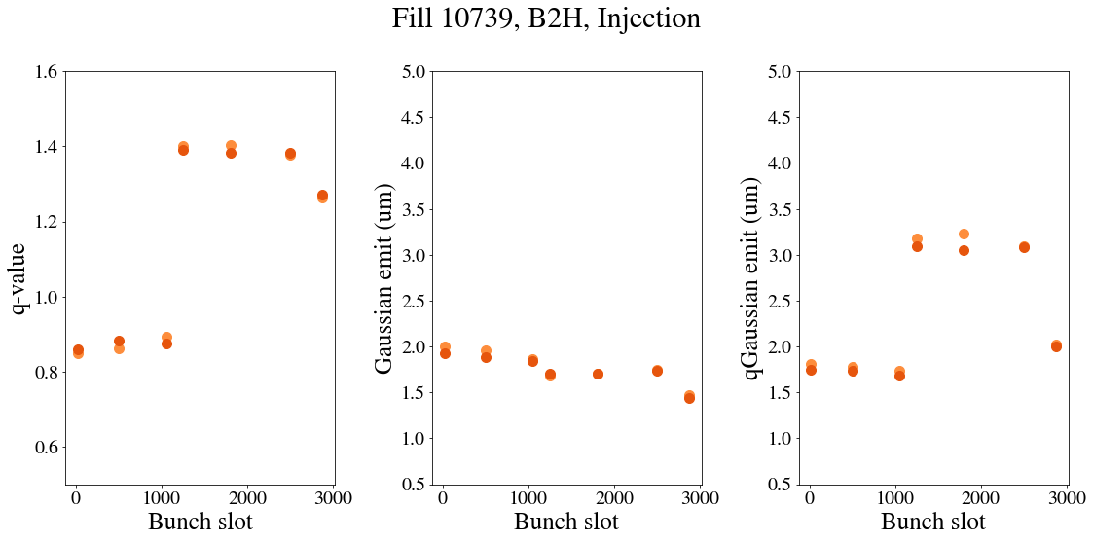
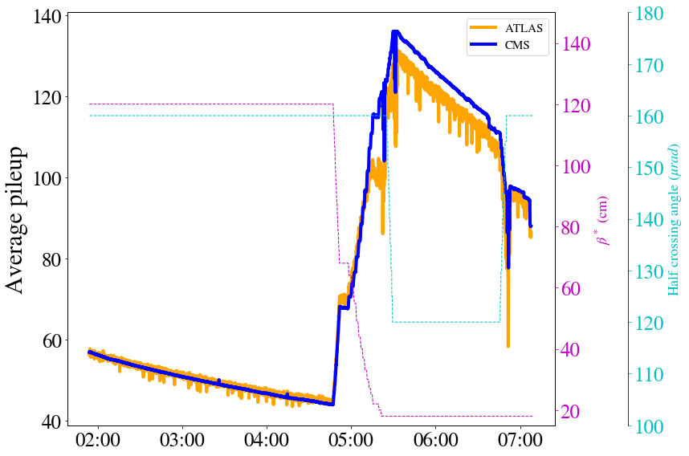
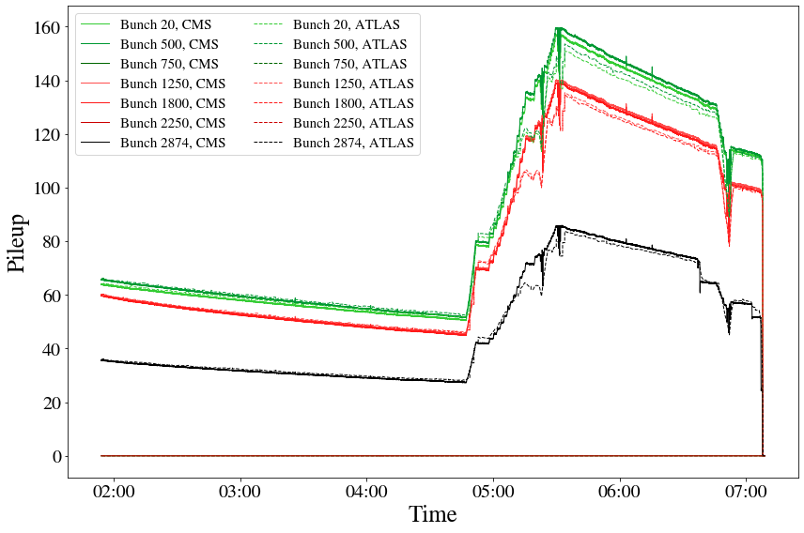
MD overview
Start of Injection
Collisions
Stayed for ~5h at 1.2m,
Fast beta* leveling to 60/18 cm
→ Reached pileup of 160!
Xing reduction to 120 urad
Back to 160 urad

Slide 6
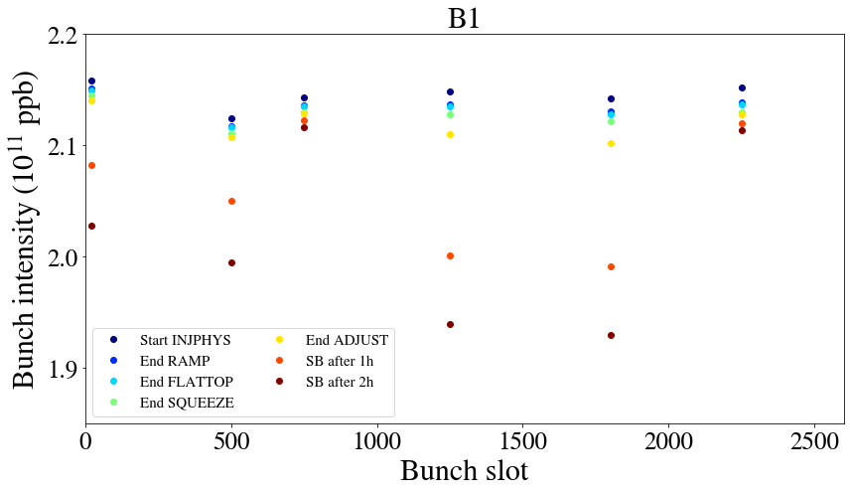
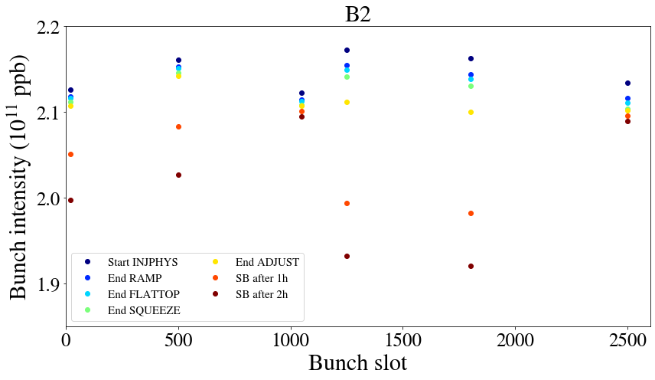
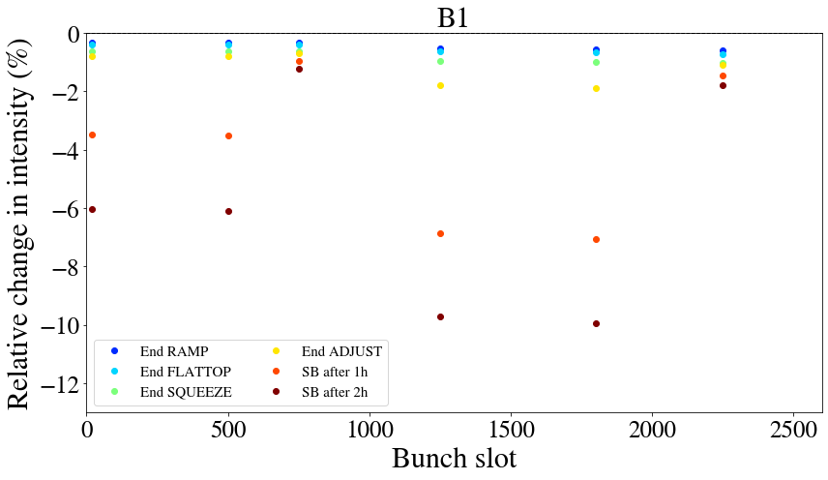
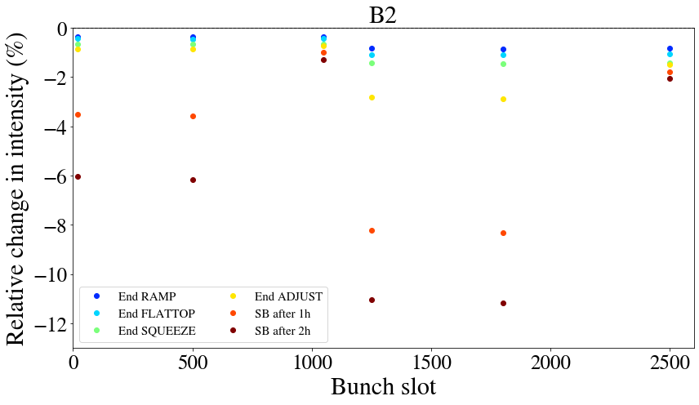
Bunch intensity during the cycle
q=1
q=1.5
Non-colliding
Non-colliding

Slide 7
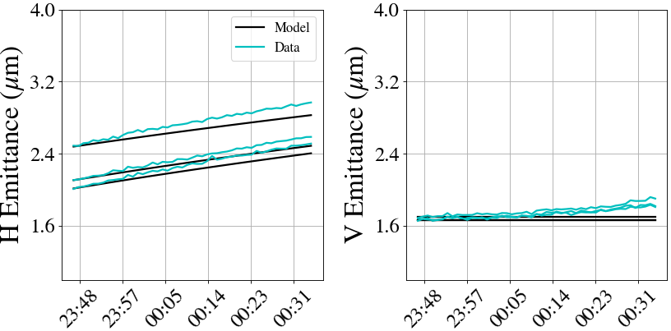
Emittance growth at injection
IBS model

Slide 8
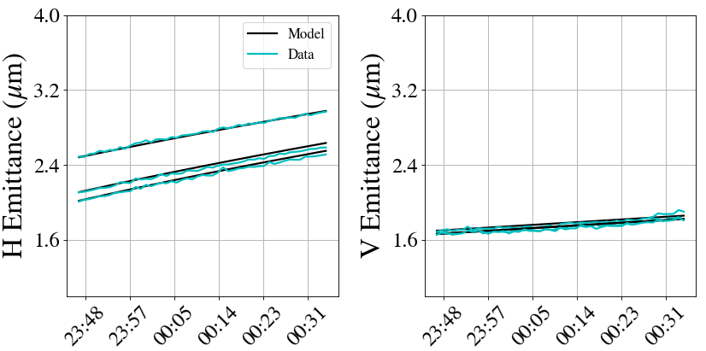
Emittance growth at injection
Adding 0.2 um/h on top of IBS
There is a discrepancy in bunch length evolution with IBS predictions, to be followed up.

Slide 9
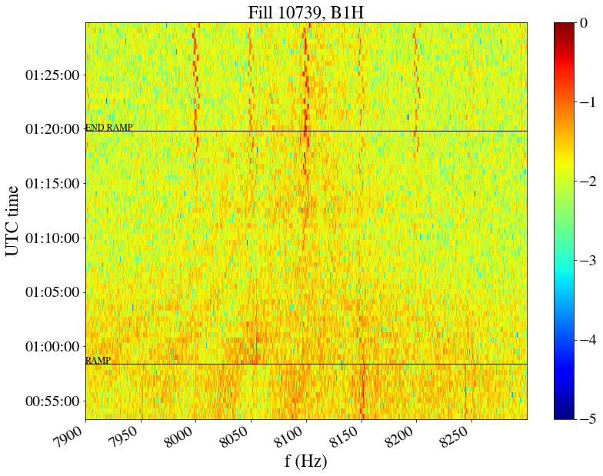
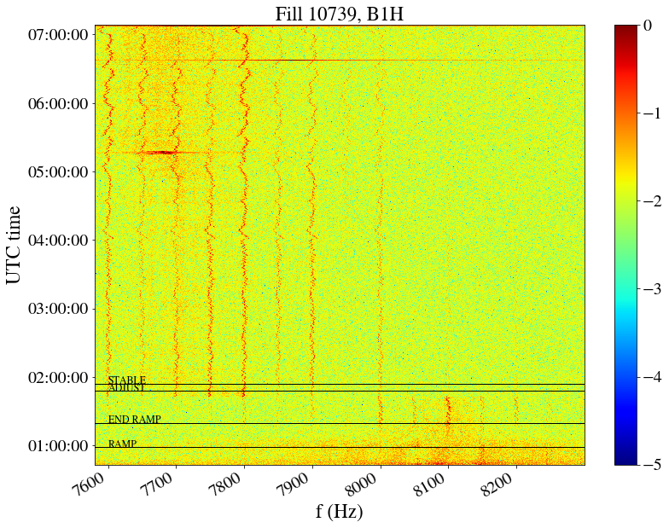
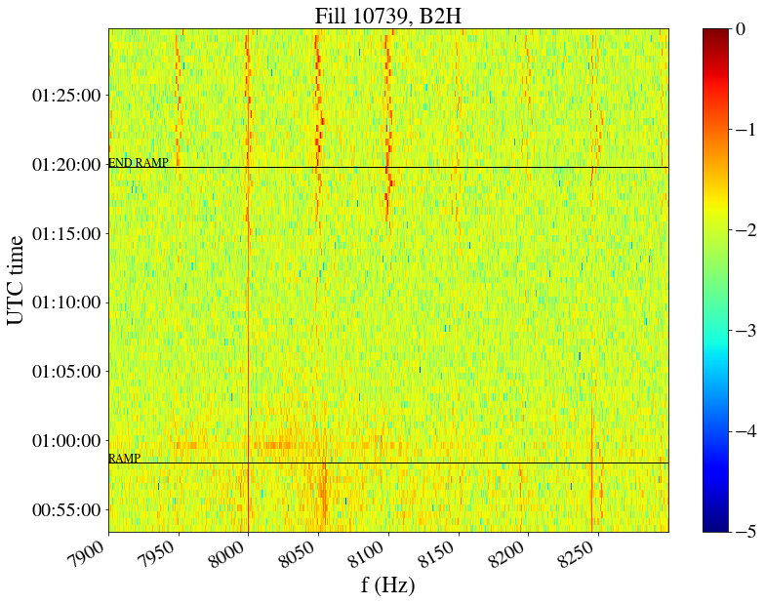
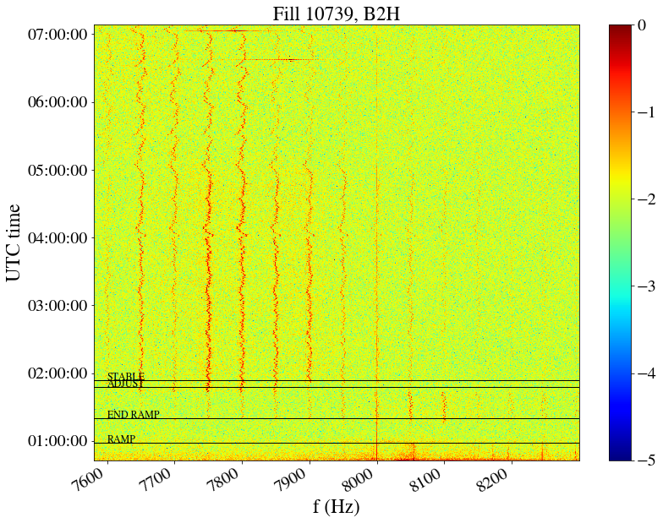
Noise during ramp
A. Radoslavova
8kHz amplitude increase end of ramp, ~5.5 TeV

Slide 10
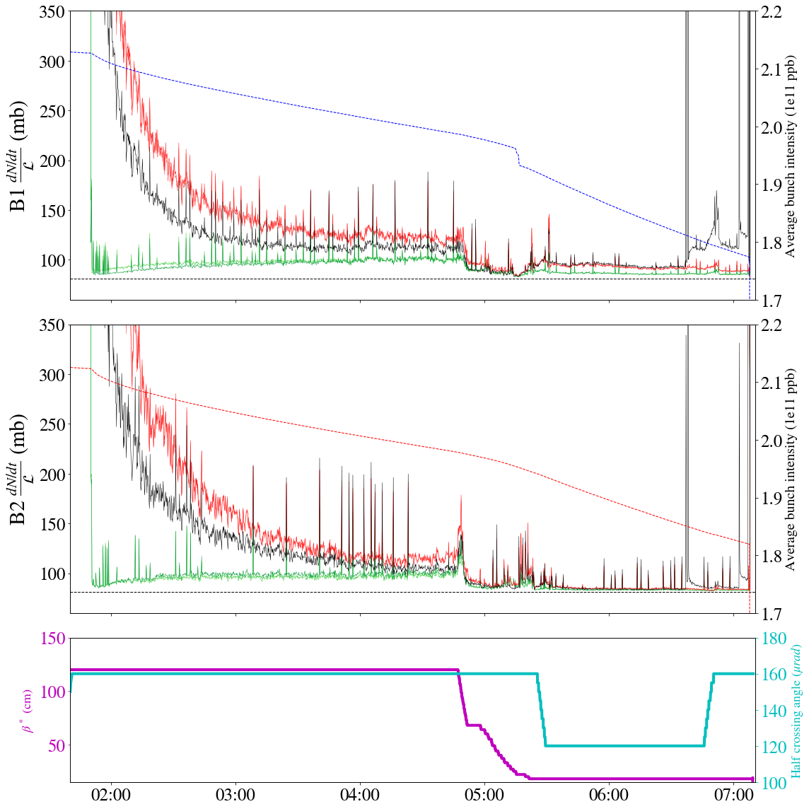
Losses during adjust
q=1 and 4 q=1.5

Slide 11
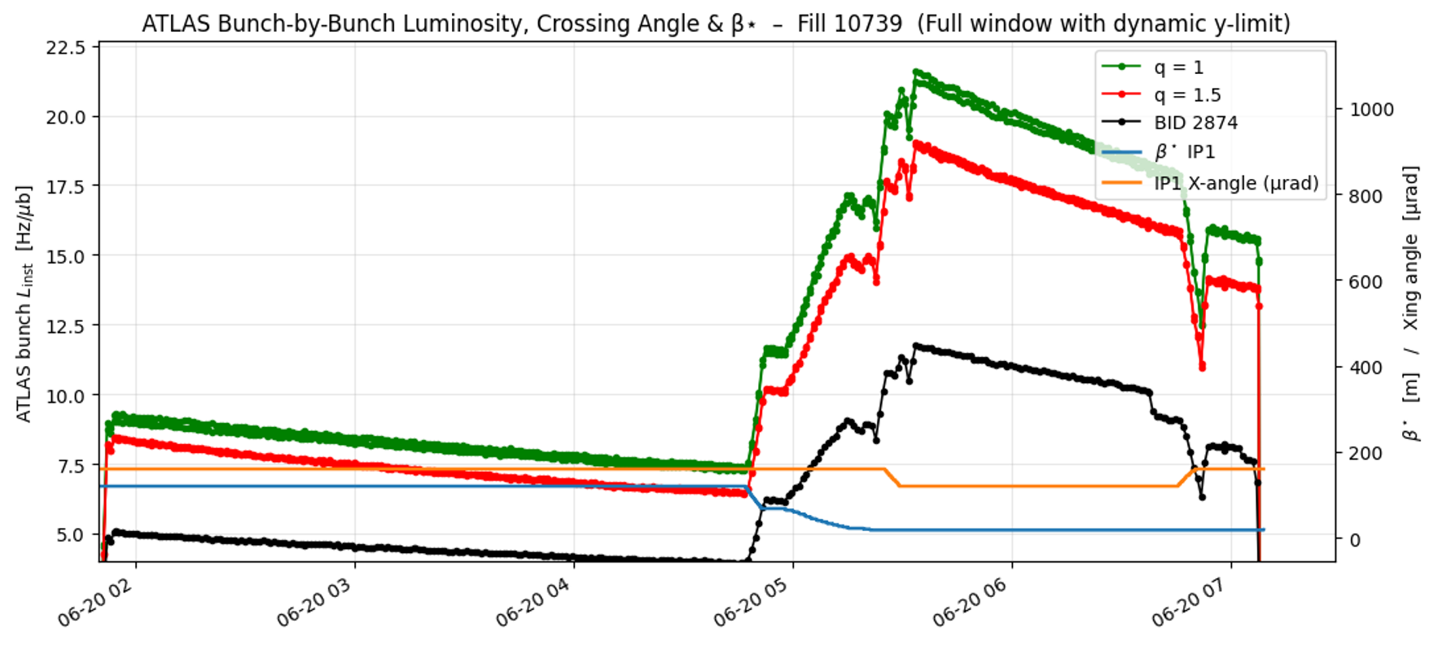
Integrated luminosity
K. Pervaina

Slide 12
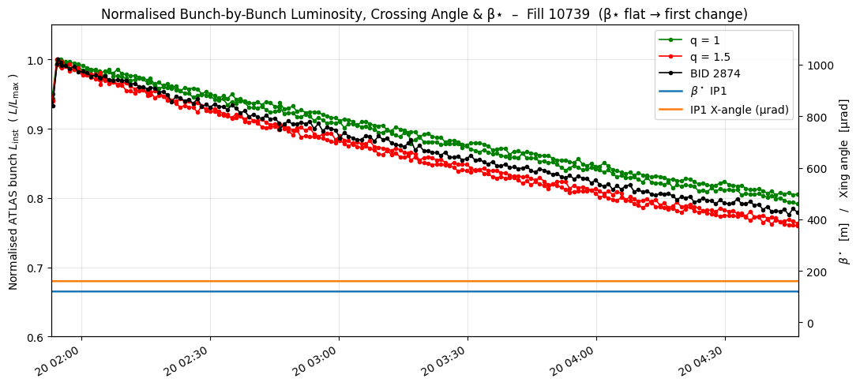
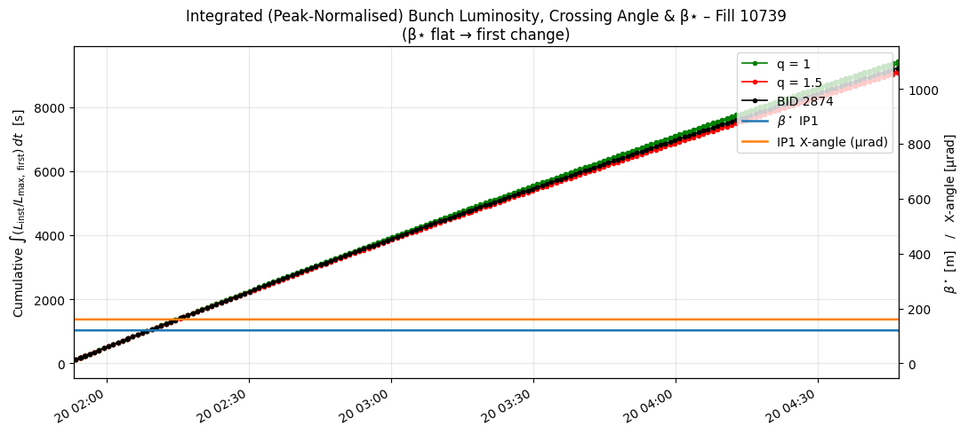
Integrated luminosity
K. Pervaina

Slide 13
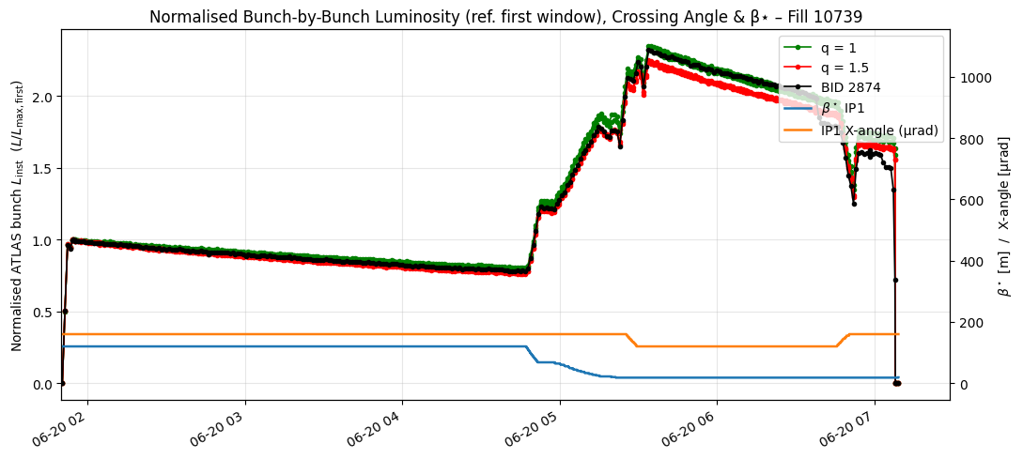
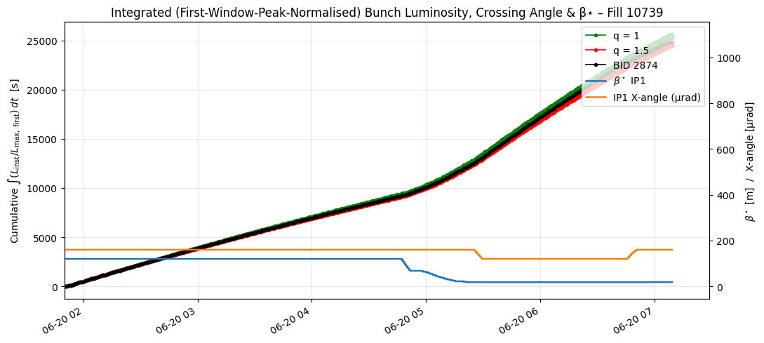
Integrated luminosity
K. Pervaina
q=1.5 w.r. to q=1 | Static conditions (%) | + beta & xing leveling (%)
ATLAS | -3.1 | -3.8
CMS | -3.1 | -4.1
AVERAGE | -2.9

Slide 14
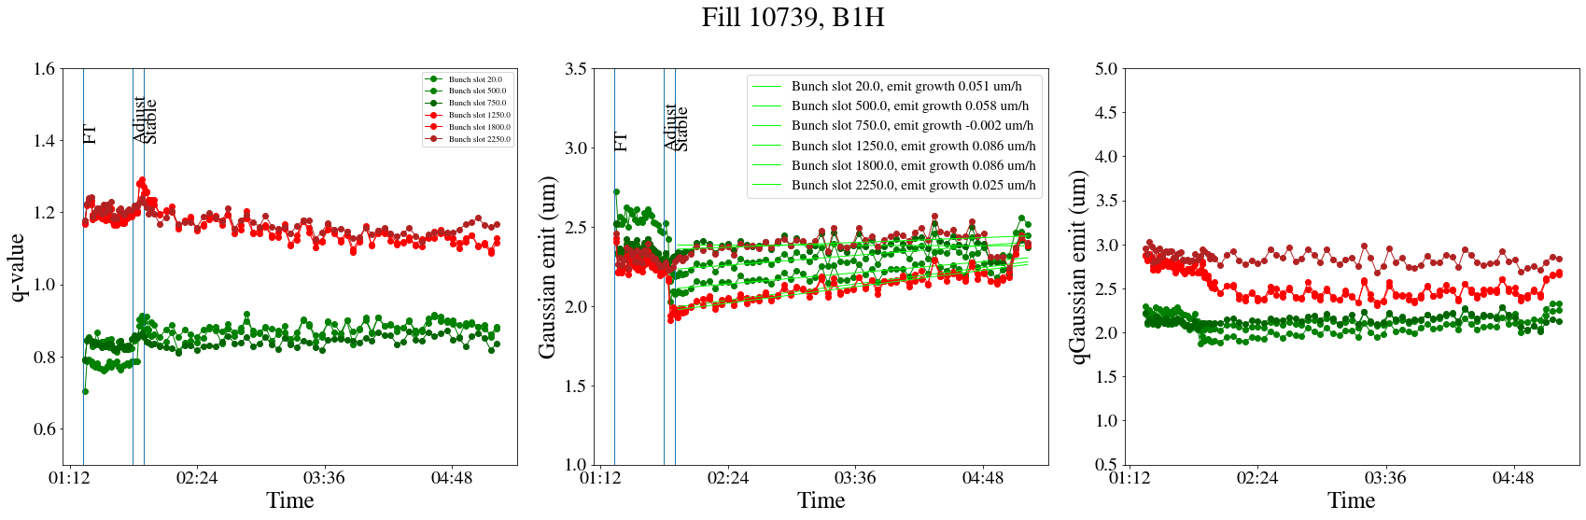
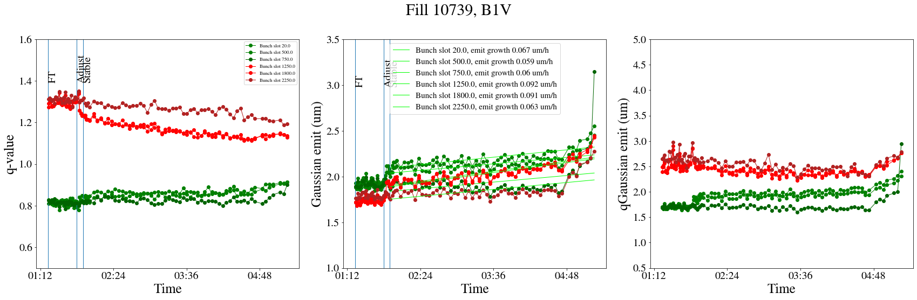
Emittance growth during collisions
0.05 to 0.09 um/h
Non-colliding blowing up less but not shrinking in V.
Tend to gaussianize, slower for non-colliding.

Slide 15
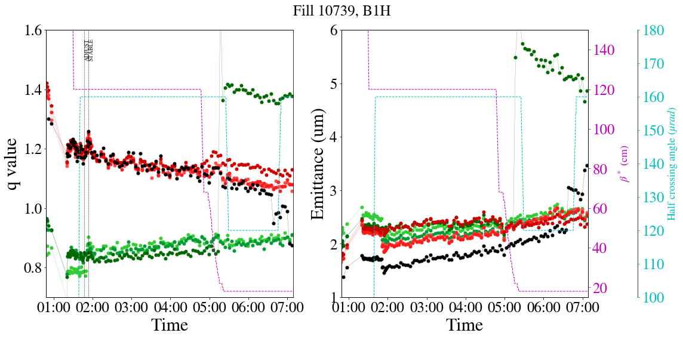
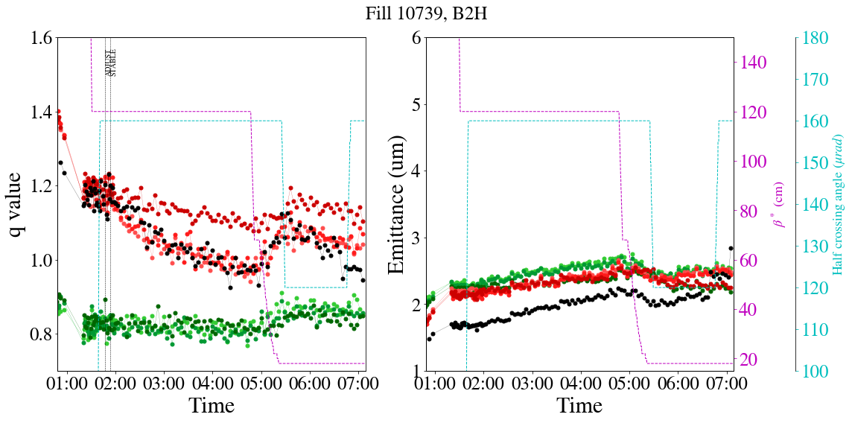
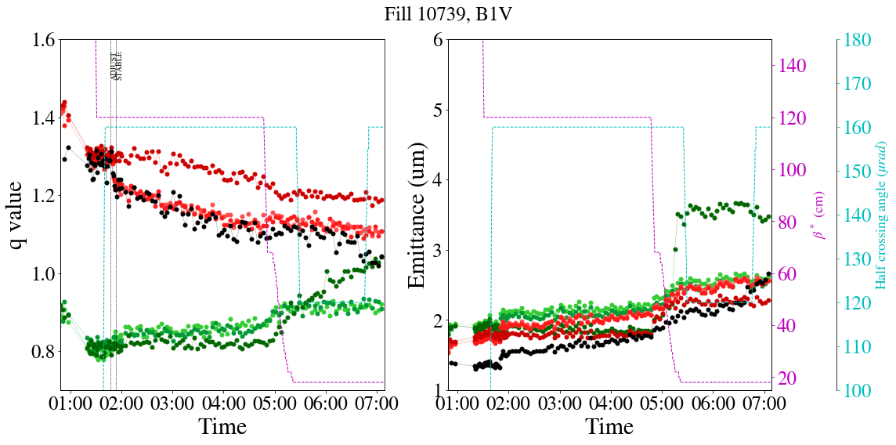
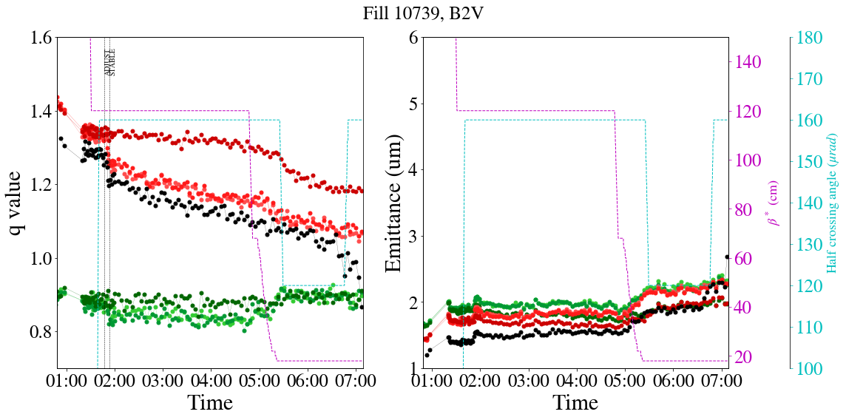
Emittance growth during collisions
Non-colliding unstable
ADT resonant excitation
Change in emittance evolution during beta* steps
1 non-colliding became unstable because chroma was reduced to 10 during beta* leveling

Slide 16
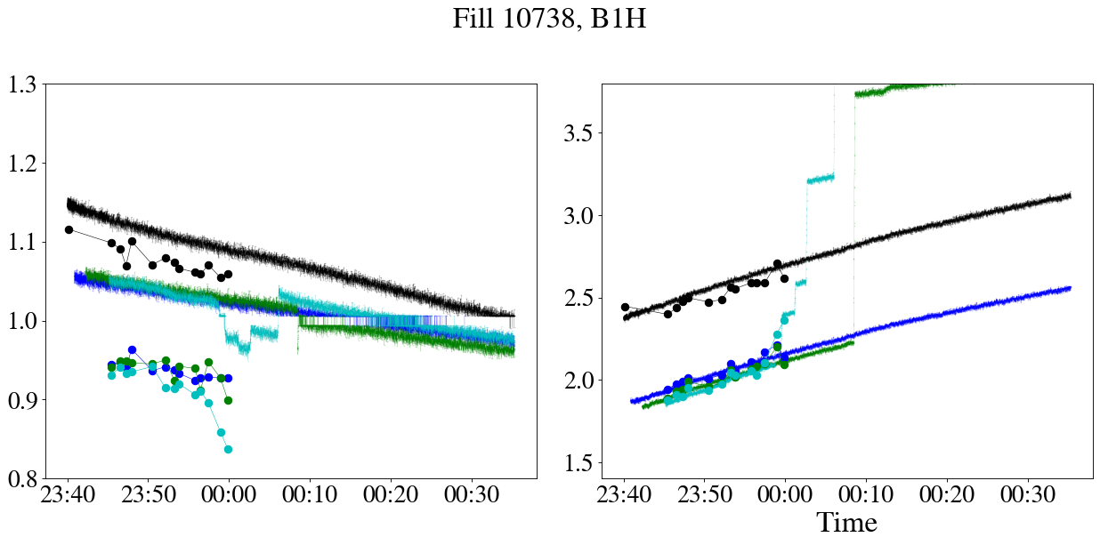
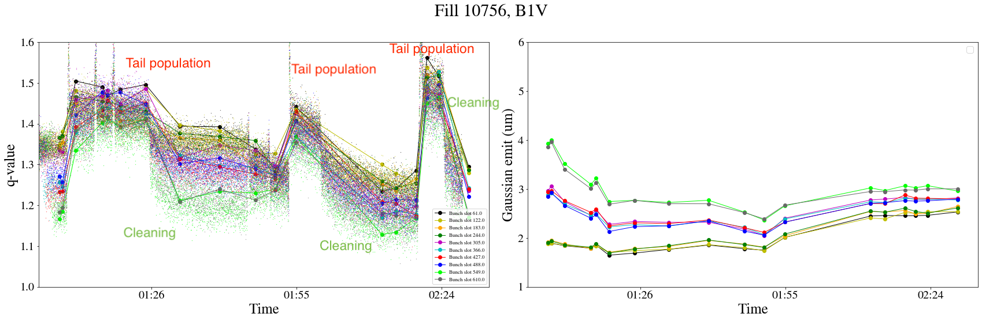
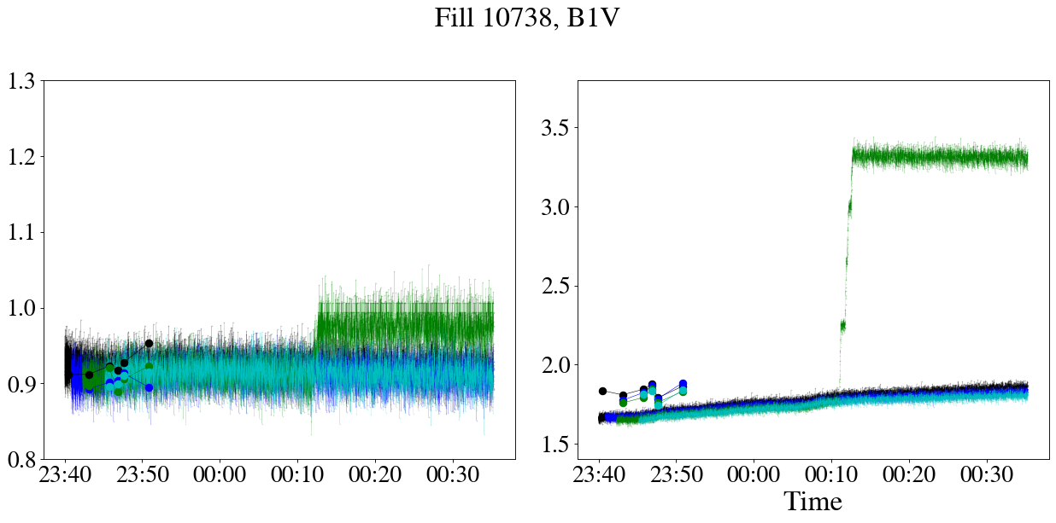
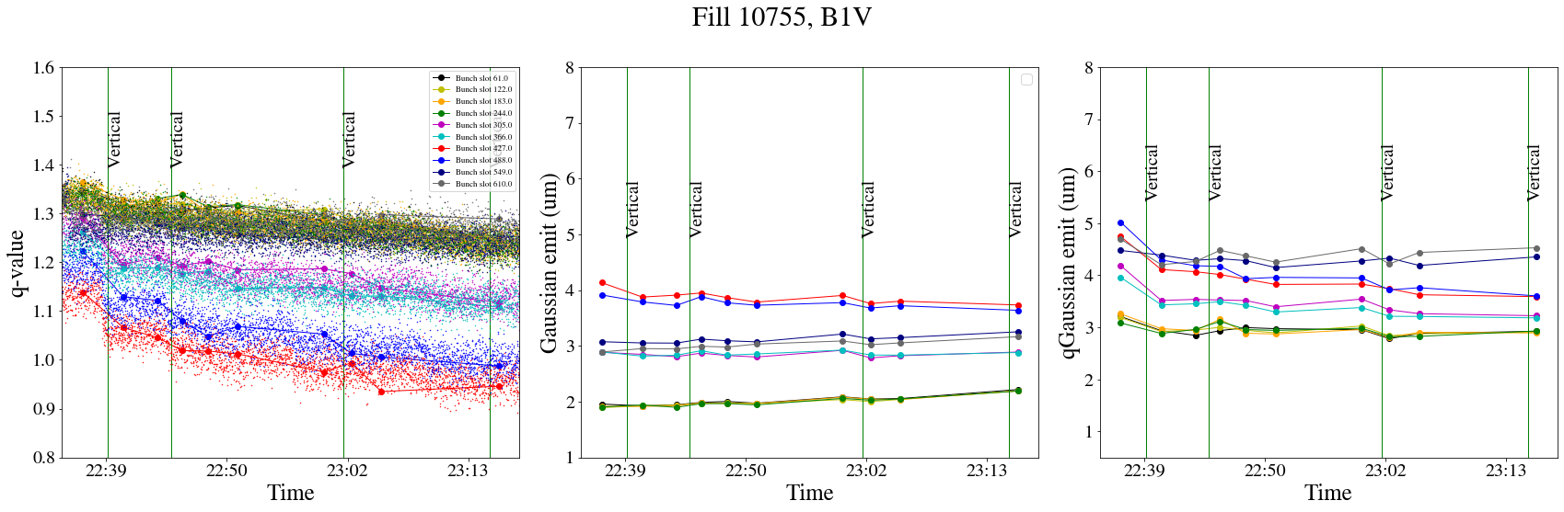
WS vs BSRT: tails & emittances at injection
Dora’s MD at injection:
* The point is to show the good agreement between WS and BSRT at injection, see Dora for MD results
Fill 10738 at injection

Slide 17
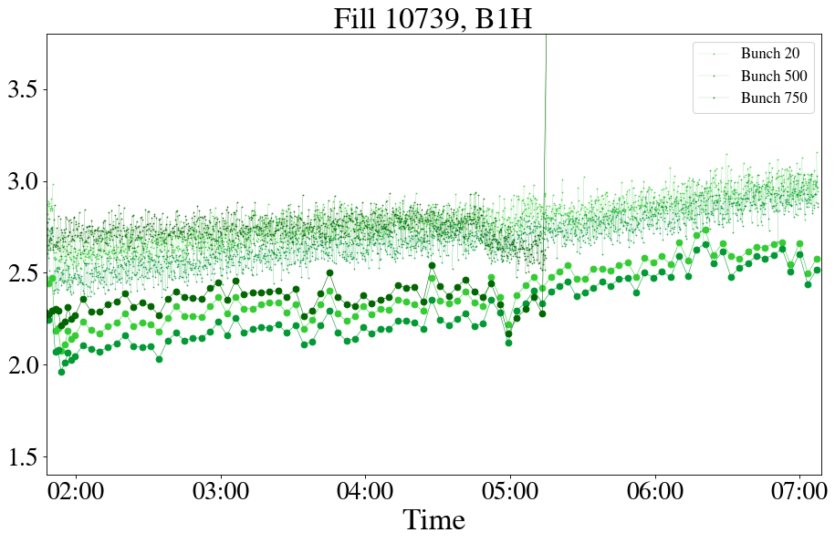
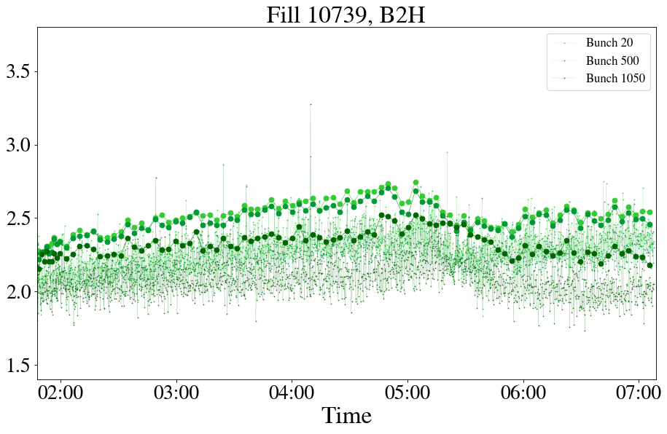
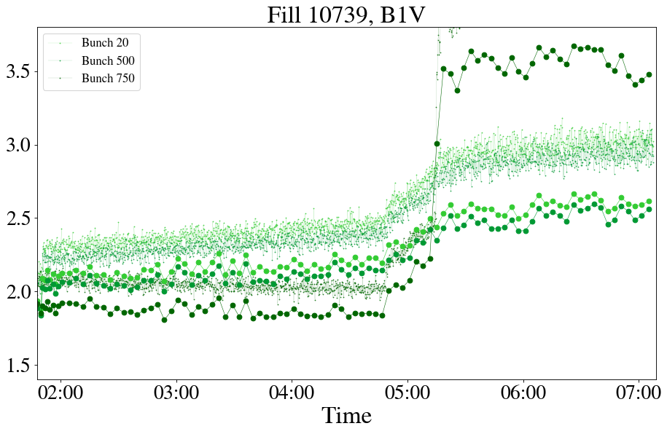
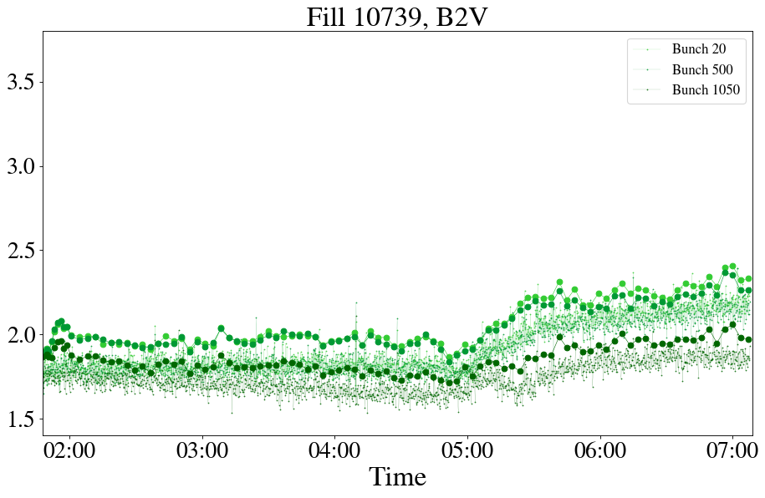
WS vs BSRT: emittances at top energy
WS vs BSRT emittances diverge for B1

Slide 18
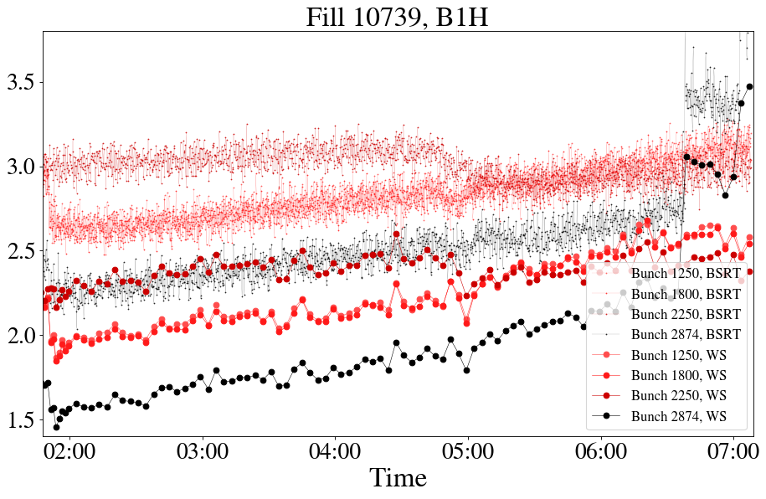
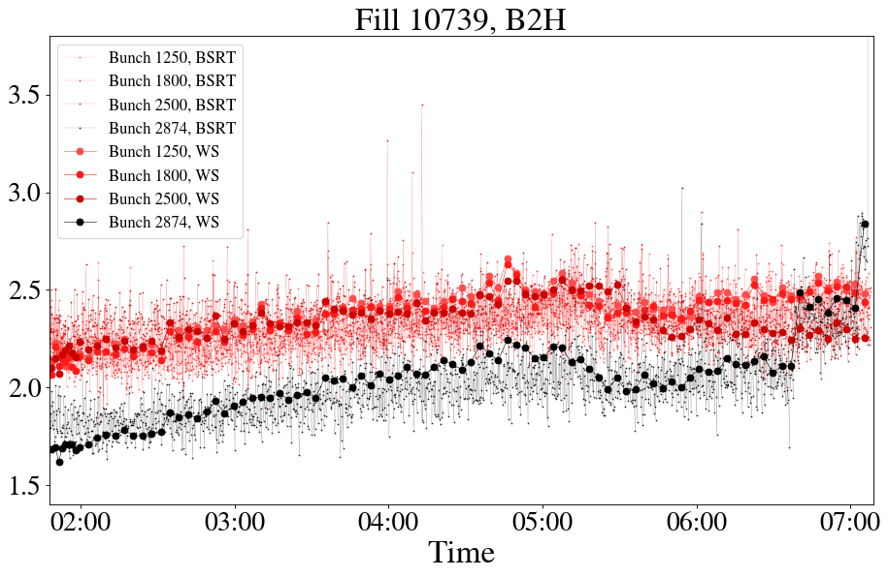
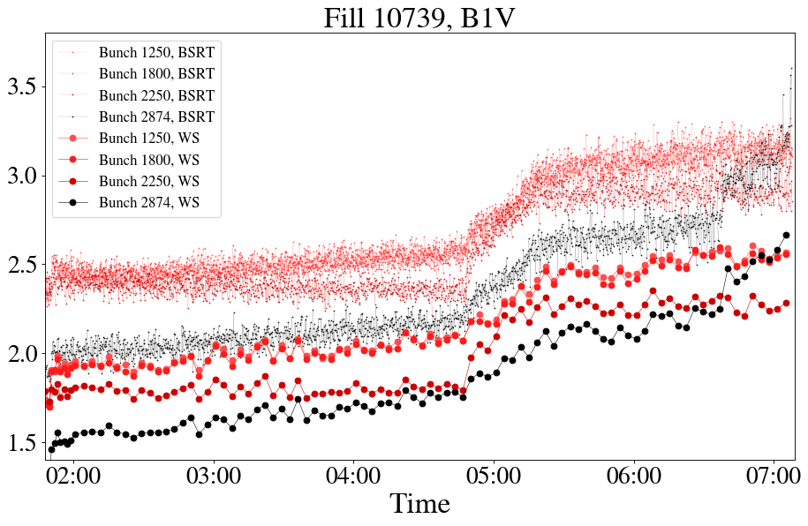
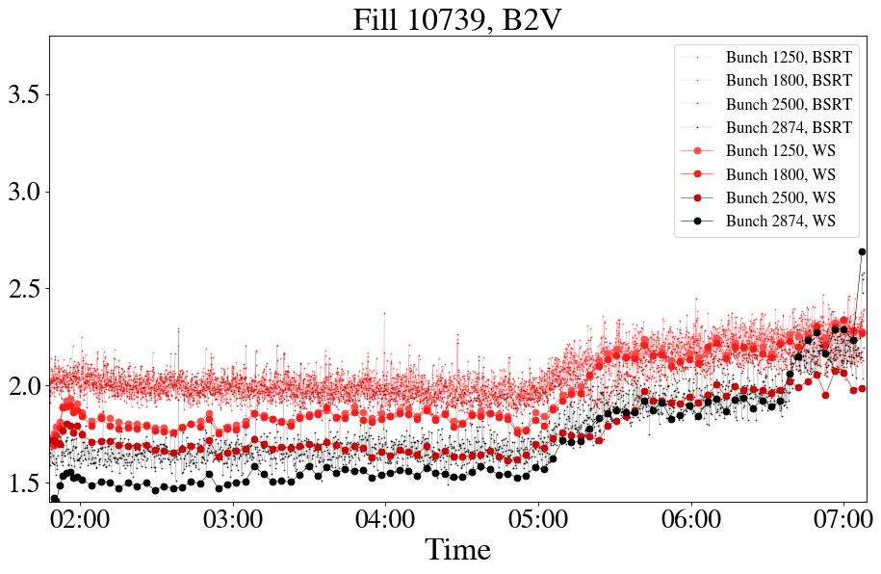
WS vs BSRT: emittances at top energy
WS vs BSRT emittances diverge for B1, worse for non Gaussian bunches

Slide 19
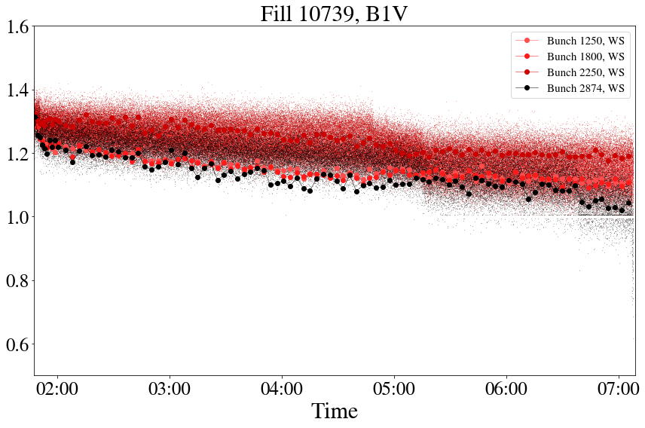
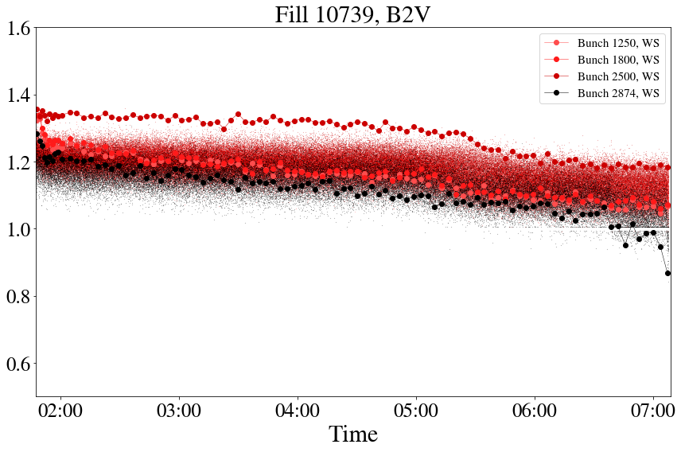
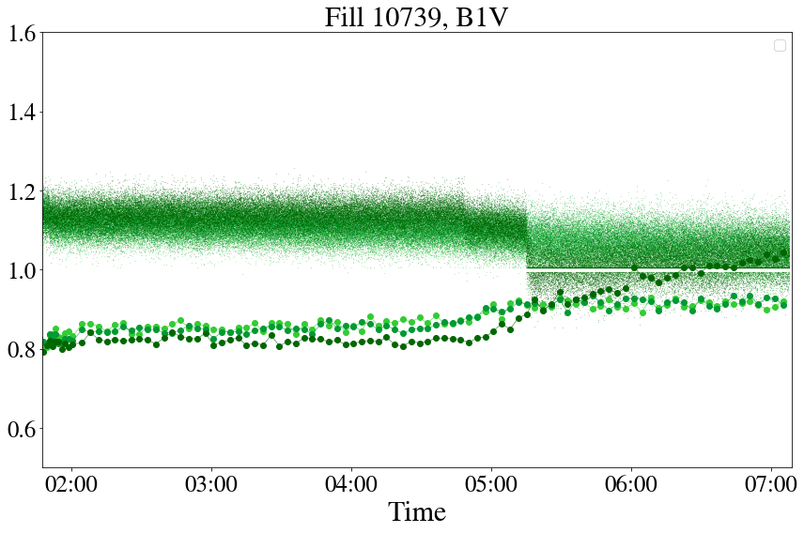
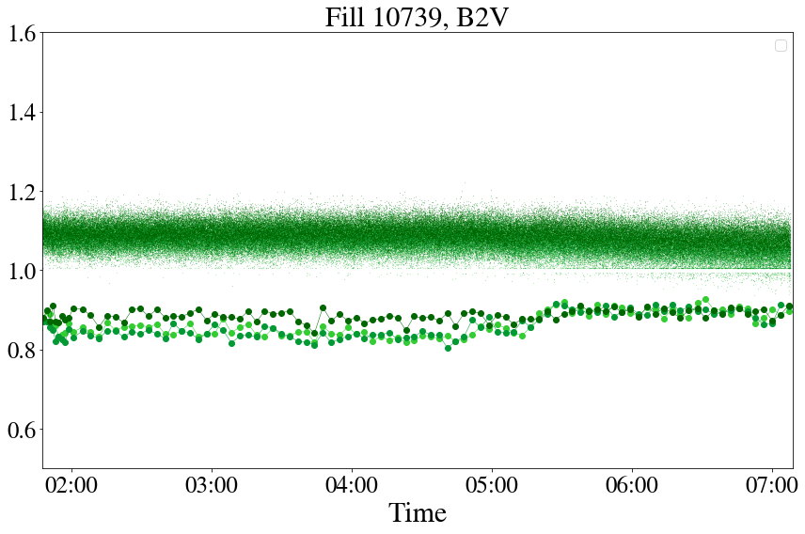
WS vs BSRT: tails at top energy
Focusing only on V plane
WS vs BSRT tail agreement diverge for Gaussian bunches

Slide 20
MD overview
Main points to address with HL INDIVs:
  Additional emittance growth beyond IBS at injection ~0.2 um/h? YES
  Emittance growth during collisions ~0.07 um/h? YES, changes wih beta* leveling
  Difference in emittance growth between colliding & non-colliding. YES, lower emittance blowup in non-colliding (still not shrinking in V) and slower gaussianization
  Tail population or tail cleaning during the cycle? Some tail evolution (cleaning or small population) during ADJUST, otherwise tend to gaussianize
  Reliability of BSRT for emittance and tail measurements through WS comparison at injection & top energy. Tail & emittance measurements OK for injection, not reliable for top energy, will also test D. Butti UCAP analysis for FT as he has a more refined analysis.
  Measure difference in losses & integrated luminosity between q=1 and q=1.5. Simulations indicated gain up to ~4%. Clear difference in effective cross secion between q=1 and q=1.5, measured gain in integrated lumi by 3%.
  Parasitic observations of 8kHz during ramp. 8 kHz cluster increasing at ~5.5 TeV.

Slide 21
Next steps
Plans for MD2:
Collide trains of 8b4e with 2.3e11 ppb, preparation from injectors ~July
1 HL-LHC INDIV at 3 TeV for IBS bunch length evolution: cycle needed
Distributed filling scheme in ramp in steps cycle for noise.

