Slide 1


MD15463: Long-range beam-beam compensation with flat-optics
E.H.Maclean, S.Horney, R.Tomas

Slide 2
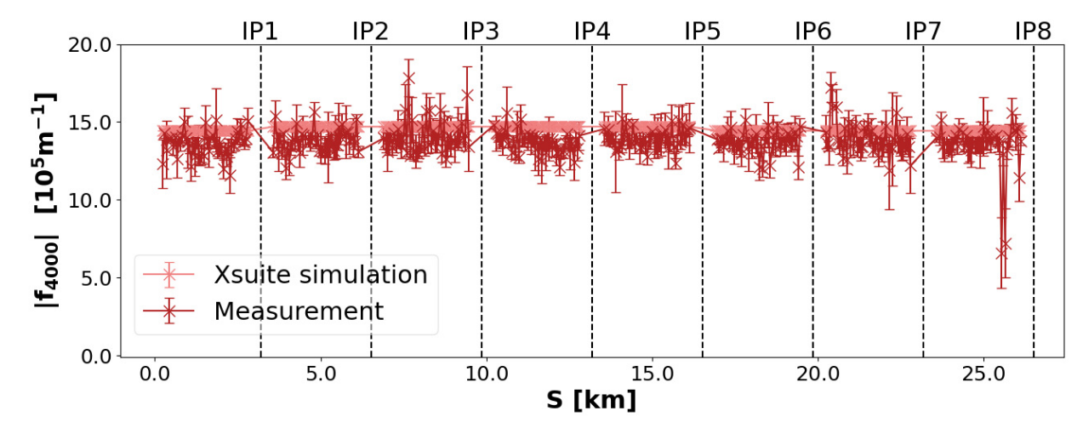
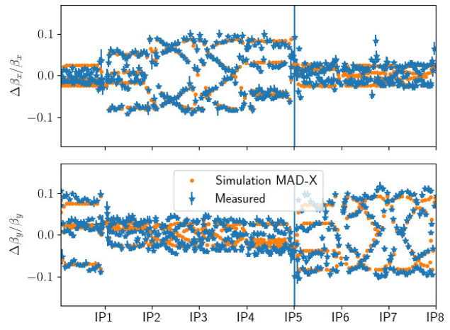
2024 MD12263 MD demonstrated traditional ACD optics measurements on probes in collision with nominals
3 pilots in Beam2 colliding with trains in Beam1. Excite only pilots with the AC-dipole
Allowed measurements of optics perturbations from long-range beam-beam
Good agreement between predicted and measured beta-beat
Good agreement between predicted and measured shifts to 3Qy (skew sextupole) and 4Qx (normal octupole) RDTs
BEAM-BASED BEAM-BEAM BENCHMARKING AND CORRECTION, IPAC 2025, WEPM010

Slide 3
Procedure
Very non-standard procedure compared to usual optics measurements
→ 1 beam setup for nominal trains, other beam setup for safe pilots and ACD excitation
Dedicated filling scheme with 3 pilots in Beam1 (weak beam) & 36b trains in Beam2 (strong beam)
→ 1x pilot no collisions, 1x pilot full LR in IP1/5, 1x pilot partial LR in IP1/5
Remove common BPM from OFB. Safe beam flag + ACD keys only on weak beam. BCM unmasked. Configure BPM offset asymmetrically in the 2 beams.
→ Requires special sequence at INJECT PHYSICS BEAM, to only modify BPM calibration & flags for strong beam
→ Used in MD12263: INJECTION PHYSICS BEAM 1 (BEAM 2 IS LOW INTENSITY) Equivalent being prepared by Andrea/Delphine with beams swapped
Mask ACD,Collimators (which will be disregarded for strong beam as no safe beam flag set)
Reduce MO and Q’ in the weak beam to usual values for OMC
separate beams at all IP 5 sigma at 1.2m (prevent HO) then go to EoS
Load dedicated collimator sequence at EoS with nominal setup in strong-beam and NLO in the weak beam.
→ Daniele has prepared dedicated beam1/beam2 NLO collimator sequences
Perform optics measurements on weak beam with ACD
More measurements performed in MD1, this time with flat-optics and with weak Beam1

Slide 4
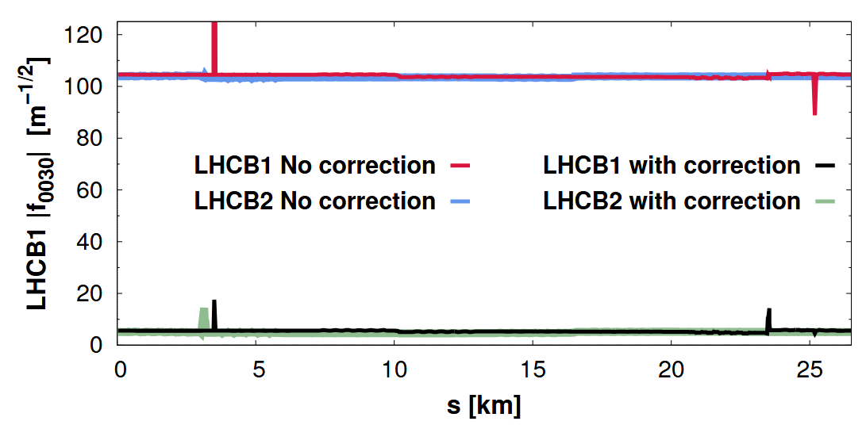
Couple of key points of interest for HL-LHC & flat-optics
LR-driven skew-sextupole RDT dominated by IR with vertical crossing-angle
→ inherently with flat-optics V-Xing occurs where betay is reduced compared to round optics
→ expect that flat-optics scheme will inherently reduce LRBB contribution to key resonance like 3Qy
Given good results of benchmarking the LRBB RDT shifts to the real machine studied the possibility in MAD-NG/Xsuite of compensating some specific RDTs with the IT-corrector package
Key normal/skew-sextupole resonances 3Qy and Qx+2Qy could be corrected in simulation for round/flat optics

Slide 5
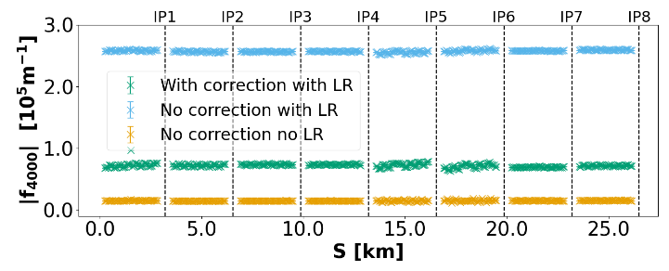
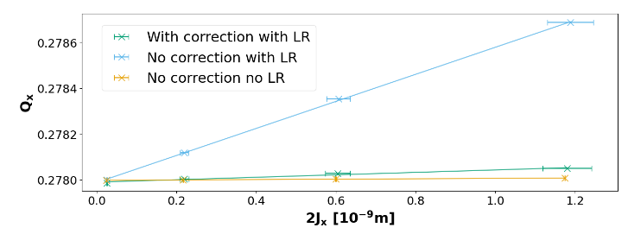
Couple of key points of interest for HL-LHC & flat-optics
LR-driven skew-sextupole RDT dominated by IR with vertical crossing-angle
→ inherently with flat-optics V-Xing occurs where betay is reduced compared to round optics
→ expect that flat-optics scheme will inherently reduce LRBB contribution to key resonance like 3Qy
Given good results of benchmarking the LRBB RDT shifts to the real machine studied the possibility in MAD-NG/Xsuite of compensating some specific RDTs with the IT-corrector package
With flat-optics only could also correct normal octupole direct detuning and RDT terms
but not cross-term or 2Qx-2Qy
Not possible with round optics

Slide 6
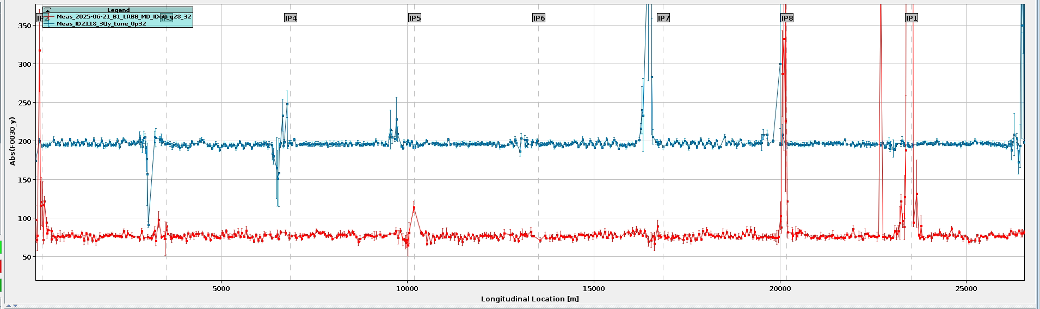
Tested in MD
Detailed analysis still to be done, but some interesting online results
3Qy strength measured with flat optics much smaller than last years round optics
→ Consistent with expectation of suppression of 3Qy by flat optics
Flat-optics

Slide 7
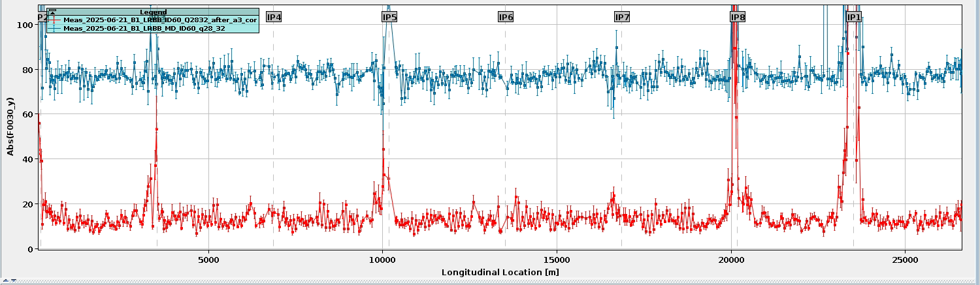
Tested in MD
Detailed analysis still to be done, but some interesting online results
Simulation based 3Qy correction applied & showed good reduction of the f0030
3Qy correction (for full LR in IR1/5)

Slide 8
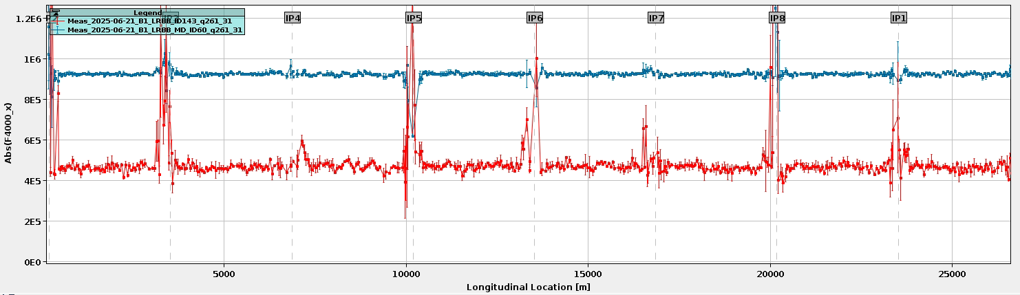
Tested in MD
Detailed analysis still to be done, but some interesting online results
Full vs half LR encounters gives ~50% of RDT strength for the octupole term
(reference with no LR measured noise)
x2 LR encounters

Slide 9
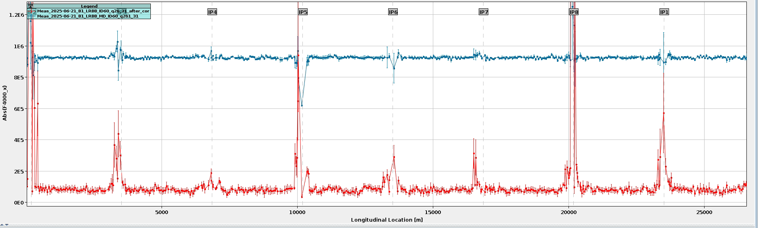
Tested in MD
Detailed analysis still to be done, but some interesting online results
Applying model-based MCOX correction (up to max strength) fully supressed the 4Qx resonance driven by full LRBB.
Half LR RDT amp unchanged with phase swap
No LR ref degraded to initial value of full LR
MCOX correction

Slide 10
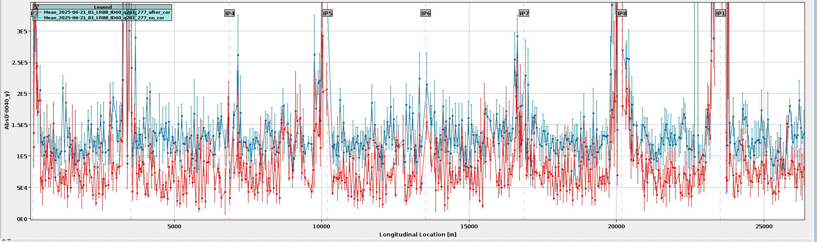
Tested in MD
Detailed analysis still to be done, but some interesting online results
Hard to measure 4Qy (less intensity left by this part of MD and RDT is much further away)
→ Still seemed to show some reduction when MCOX correction applied

Slide 11
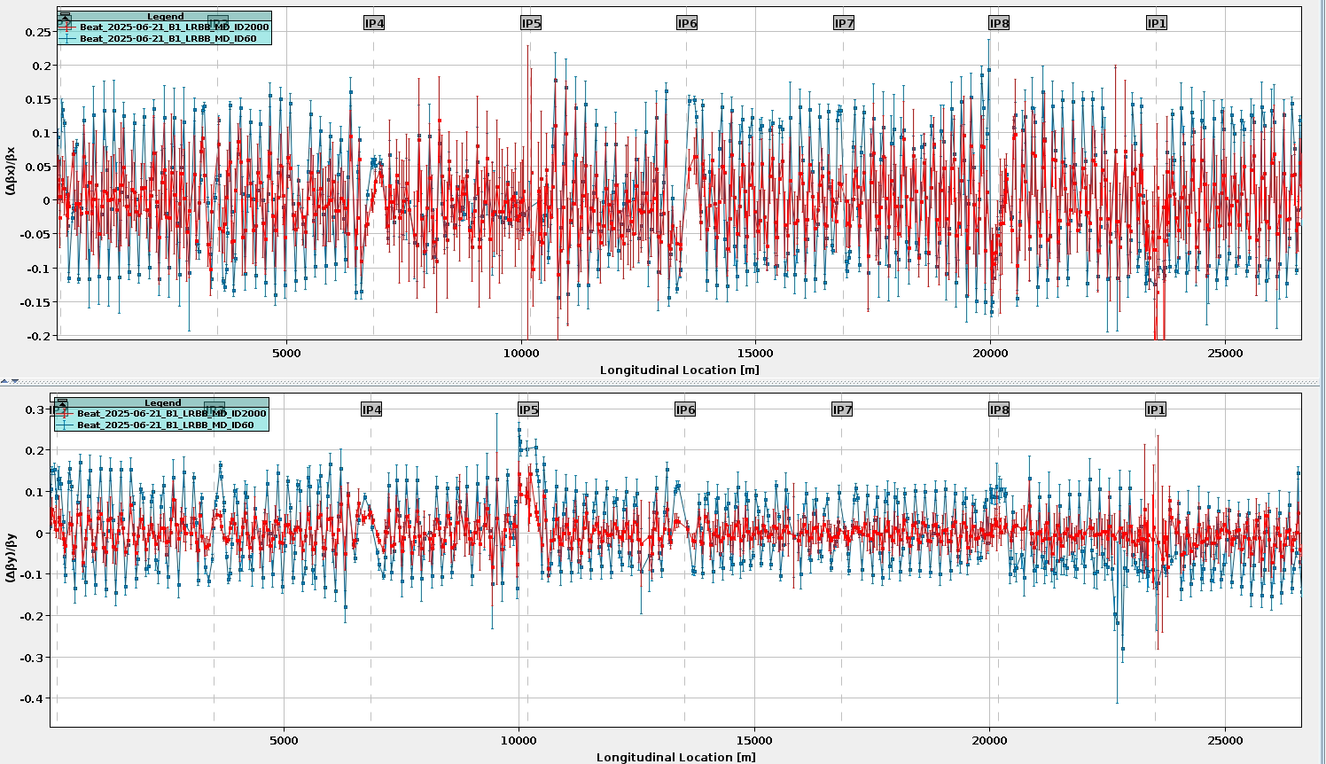
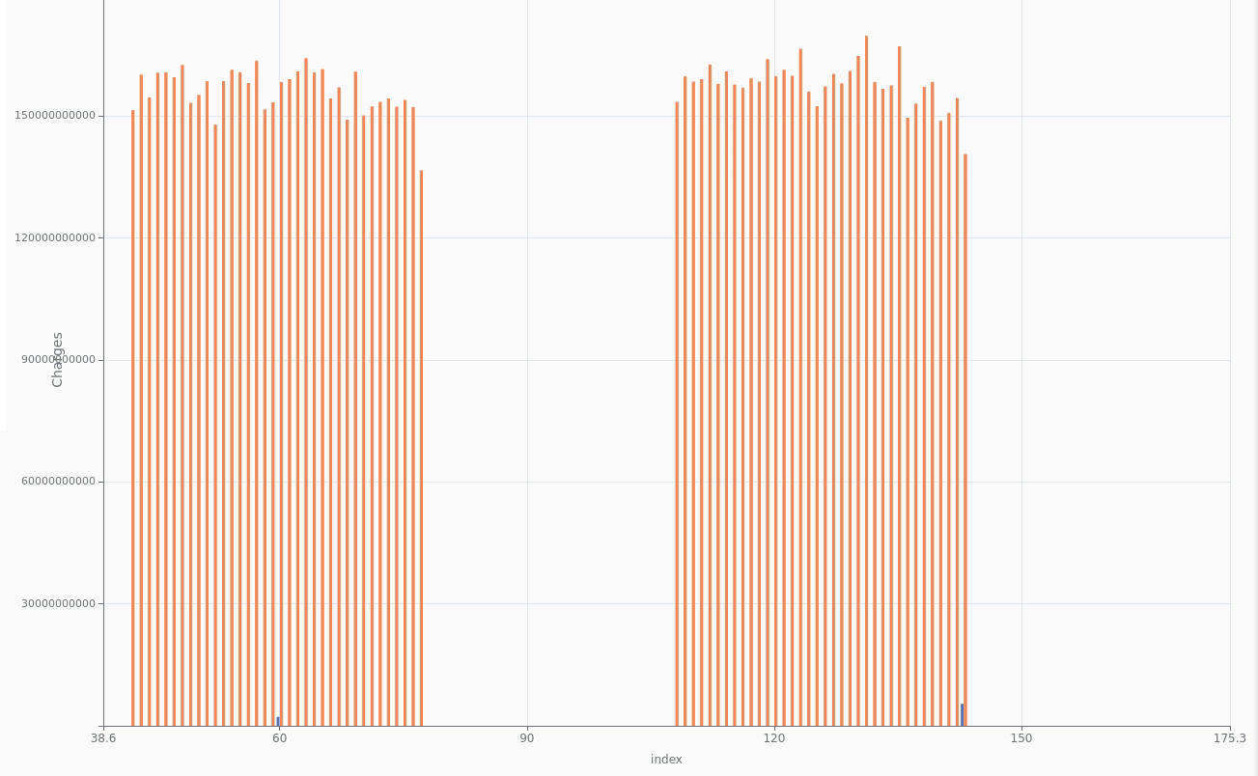
Tested in MD
Detailed analysis still to be done, but some interesting online results
Beta beating from lrbb at 160urad at 1.5 p/b

Slide 12
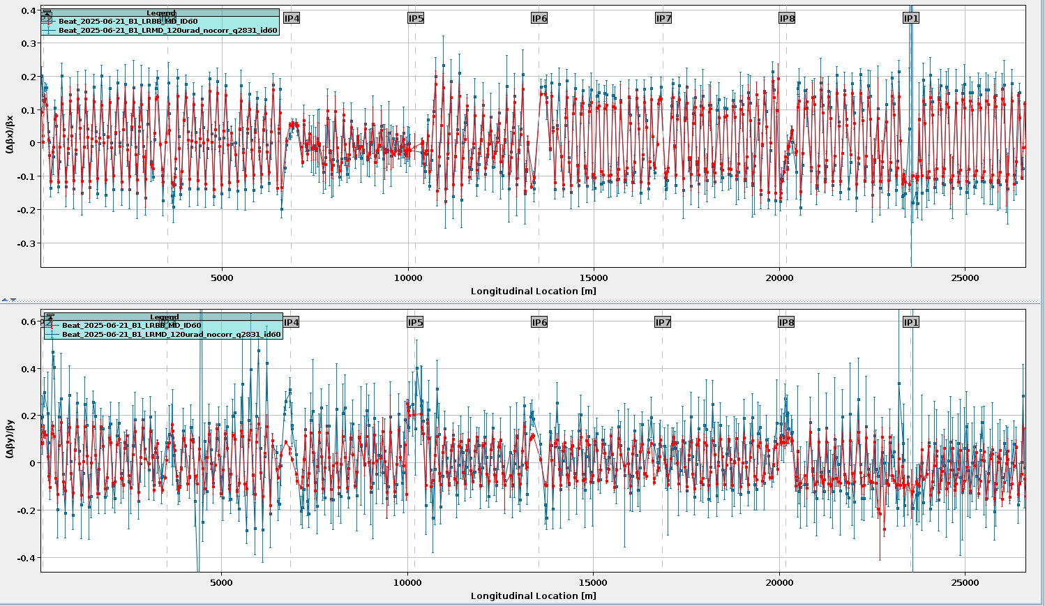
Tested in MD
Detailed analysis still to be done, but some interesting online results
Beta beating increase as go to 120urad

