Slide 1

ATLAS Highlights
F. Cerutti LBNL
On behalf of the ATLAS Collaboration

Slide 2
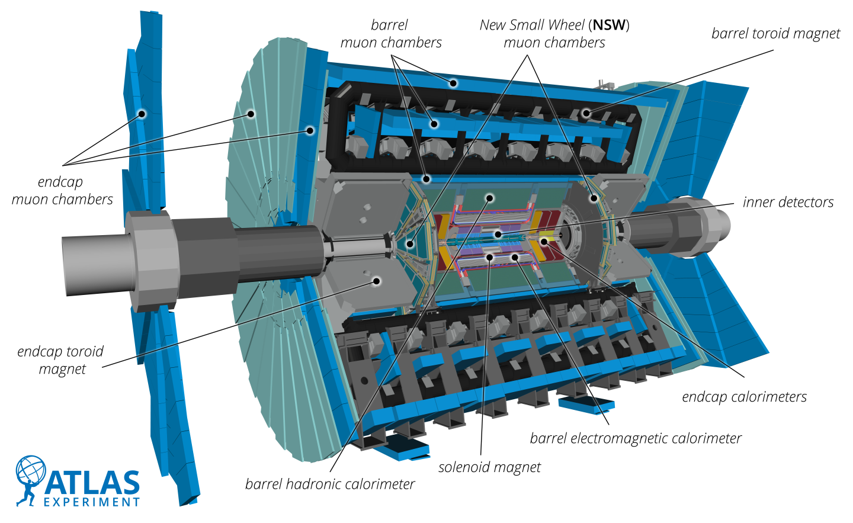
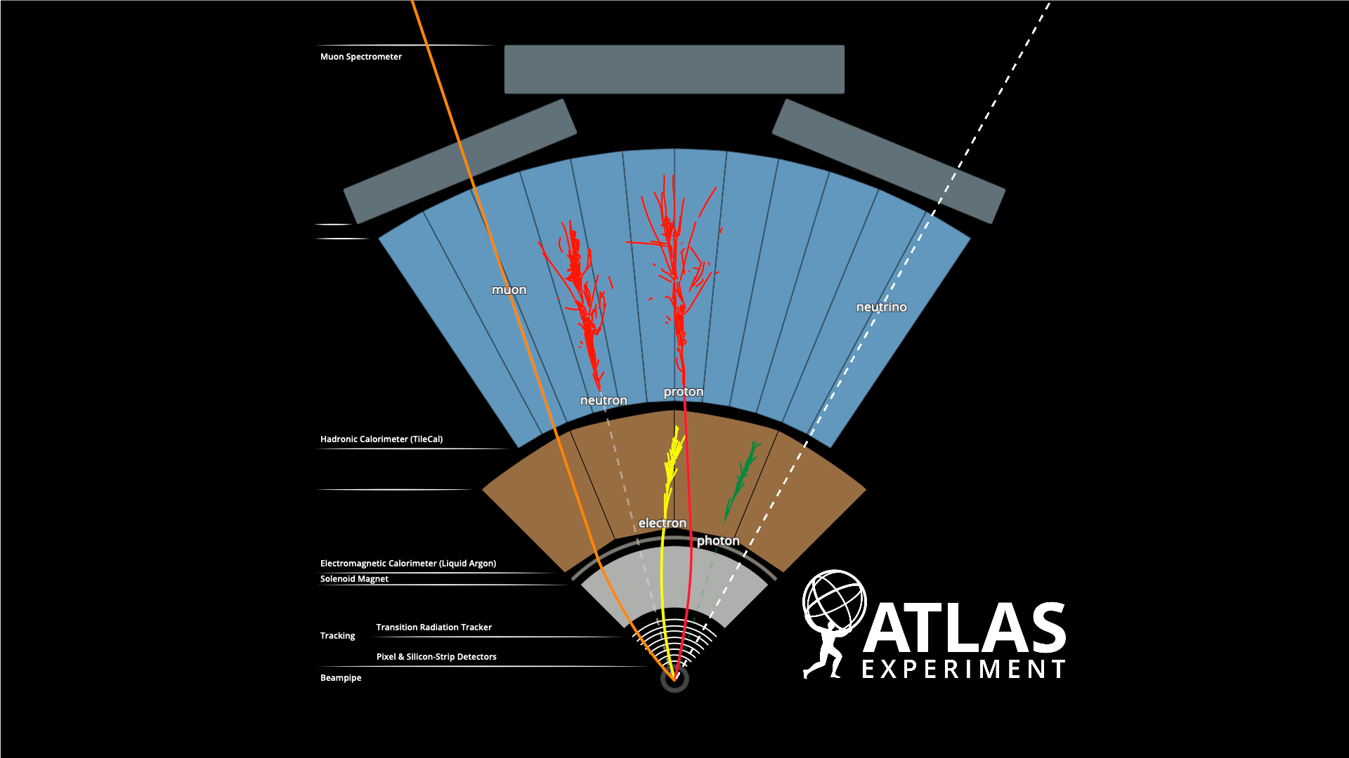
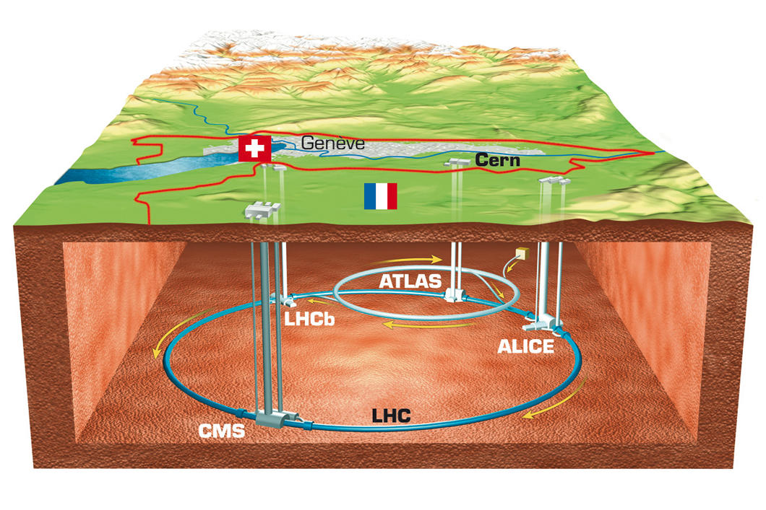
The ATLAS experiment
ATLAS is a general-purpose detector running at the LHC collider with excellent reconstruction, identification and energy-momentum measurement of electrons, photons, muons, jets, taus and flavor-tag covering a range from ~few hundreds MeV up to the TeV
Collecting proton-proton (and HI) collisions at E_{CM} = 13.6 TeV (world record collider energy) at instantaneous luminosity ~2 x 10³⁴ s⁻¹cm⁻² with ~60 minimum bias collisions per bunch crossing (well above the design value of 20)

Slide 3
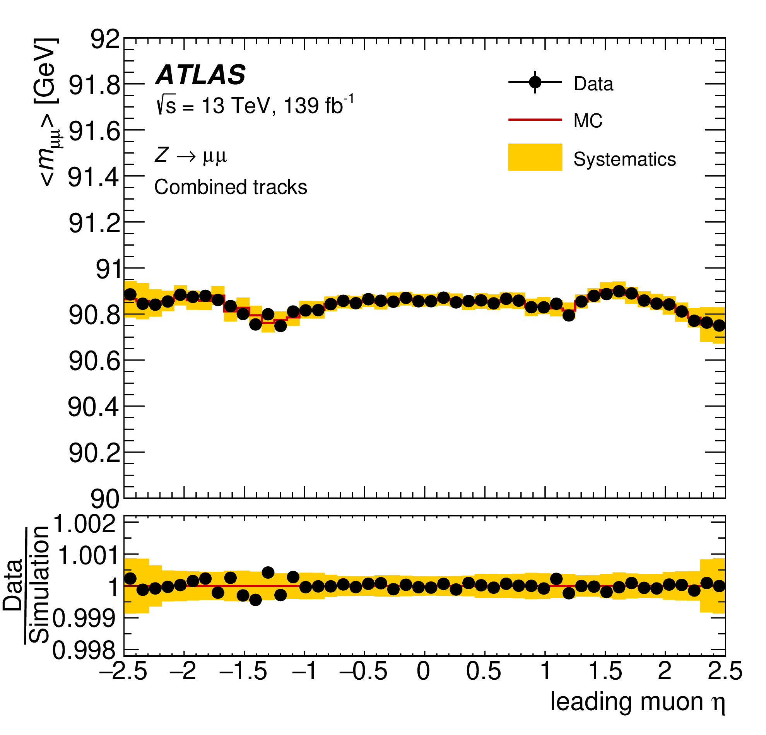
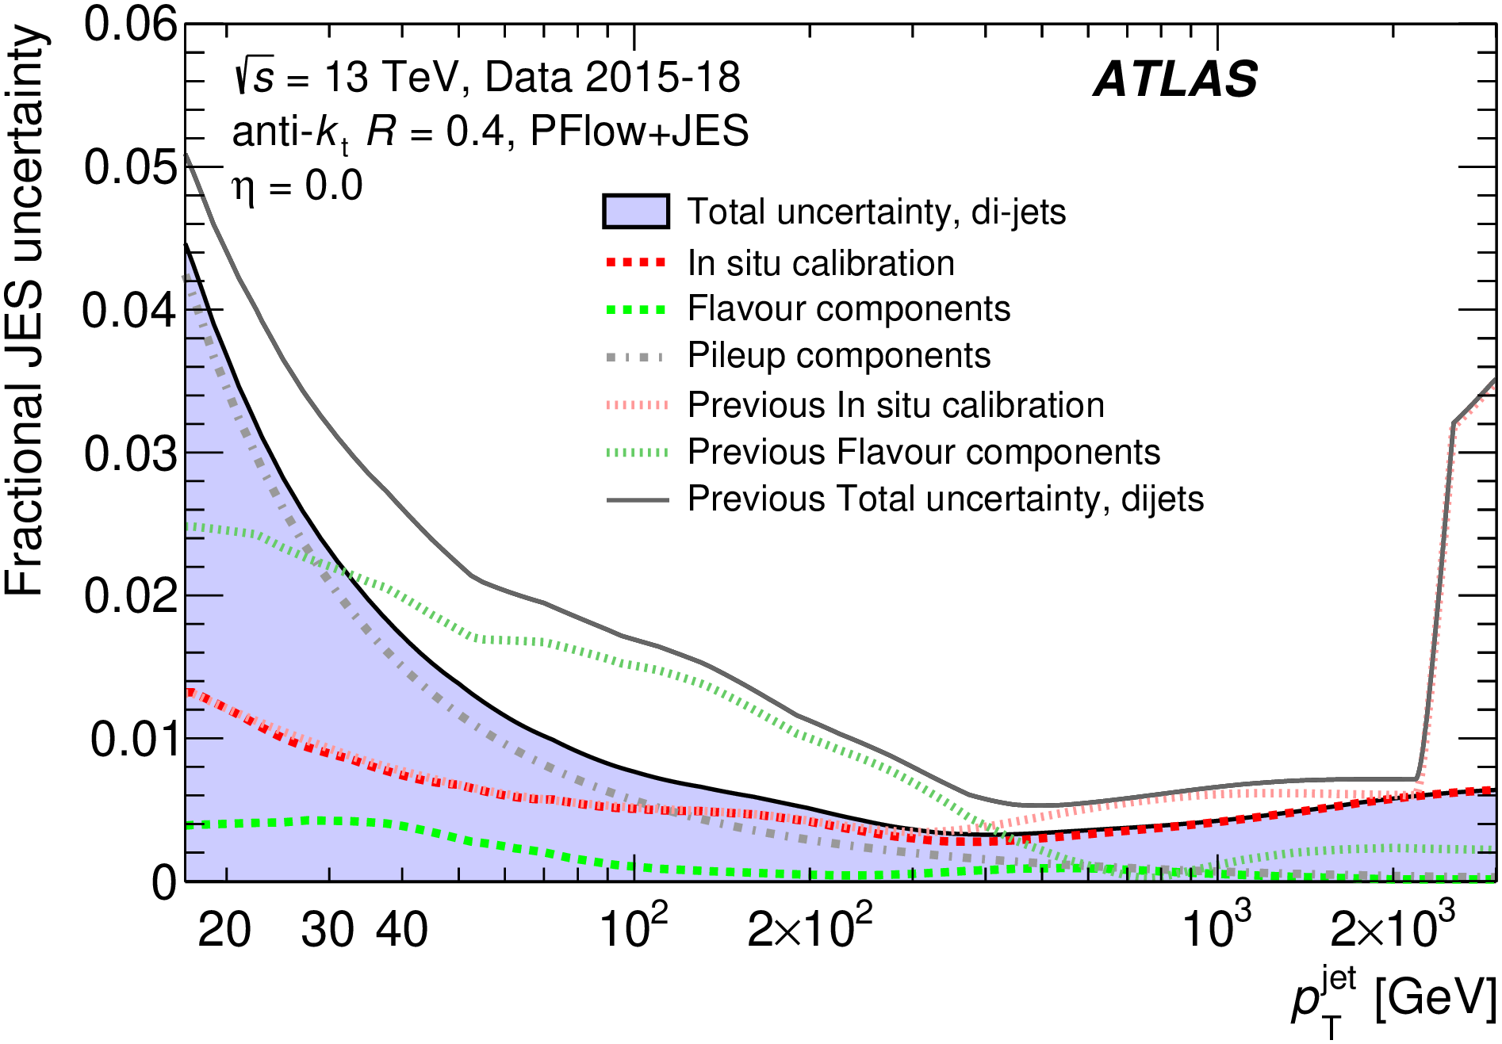
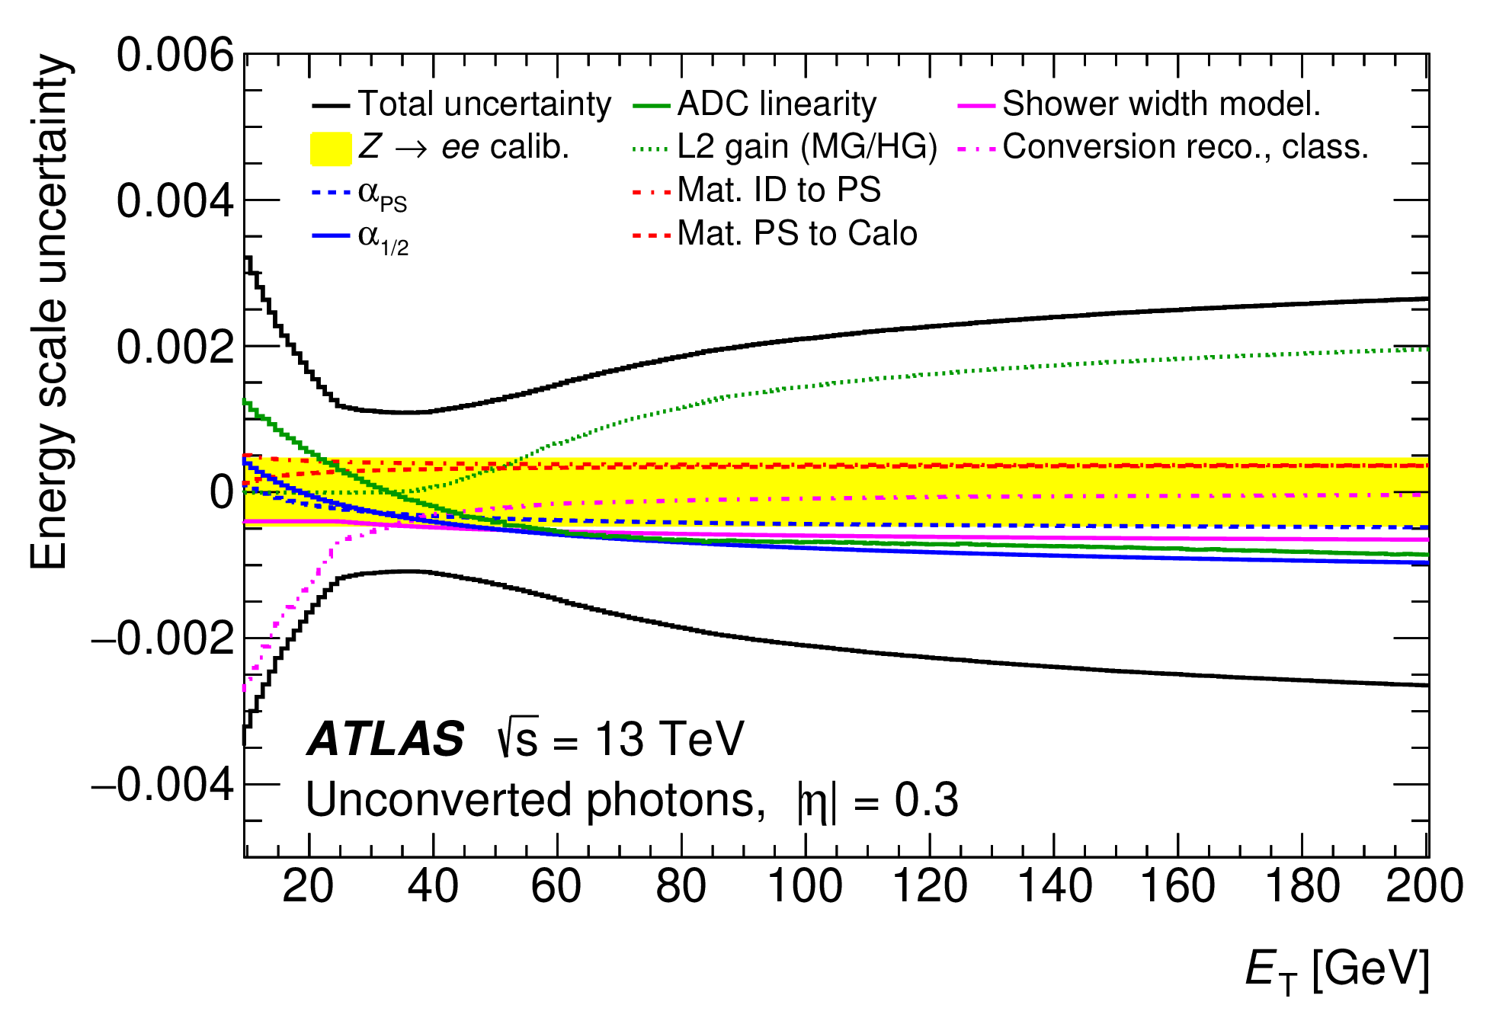
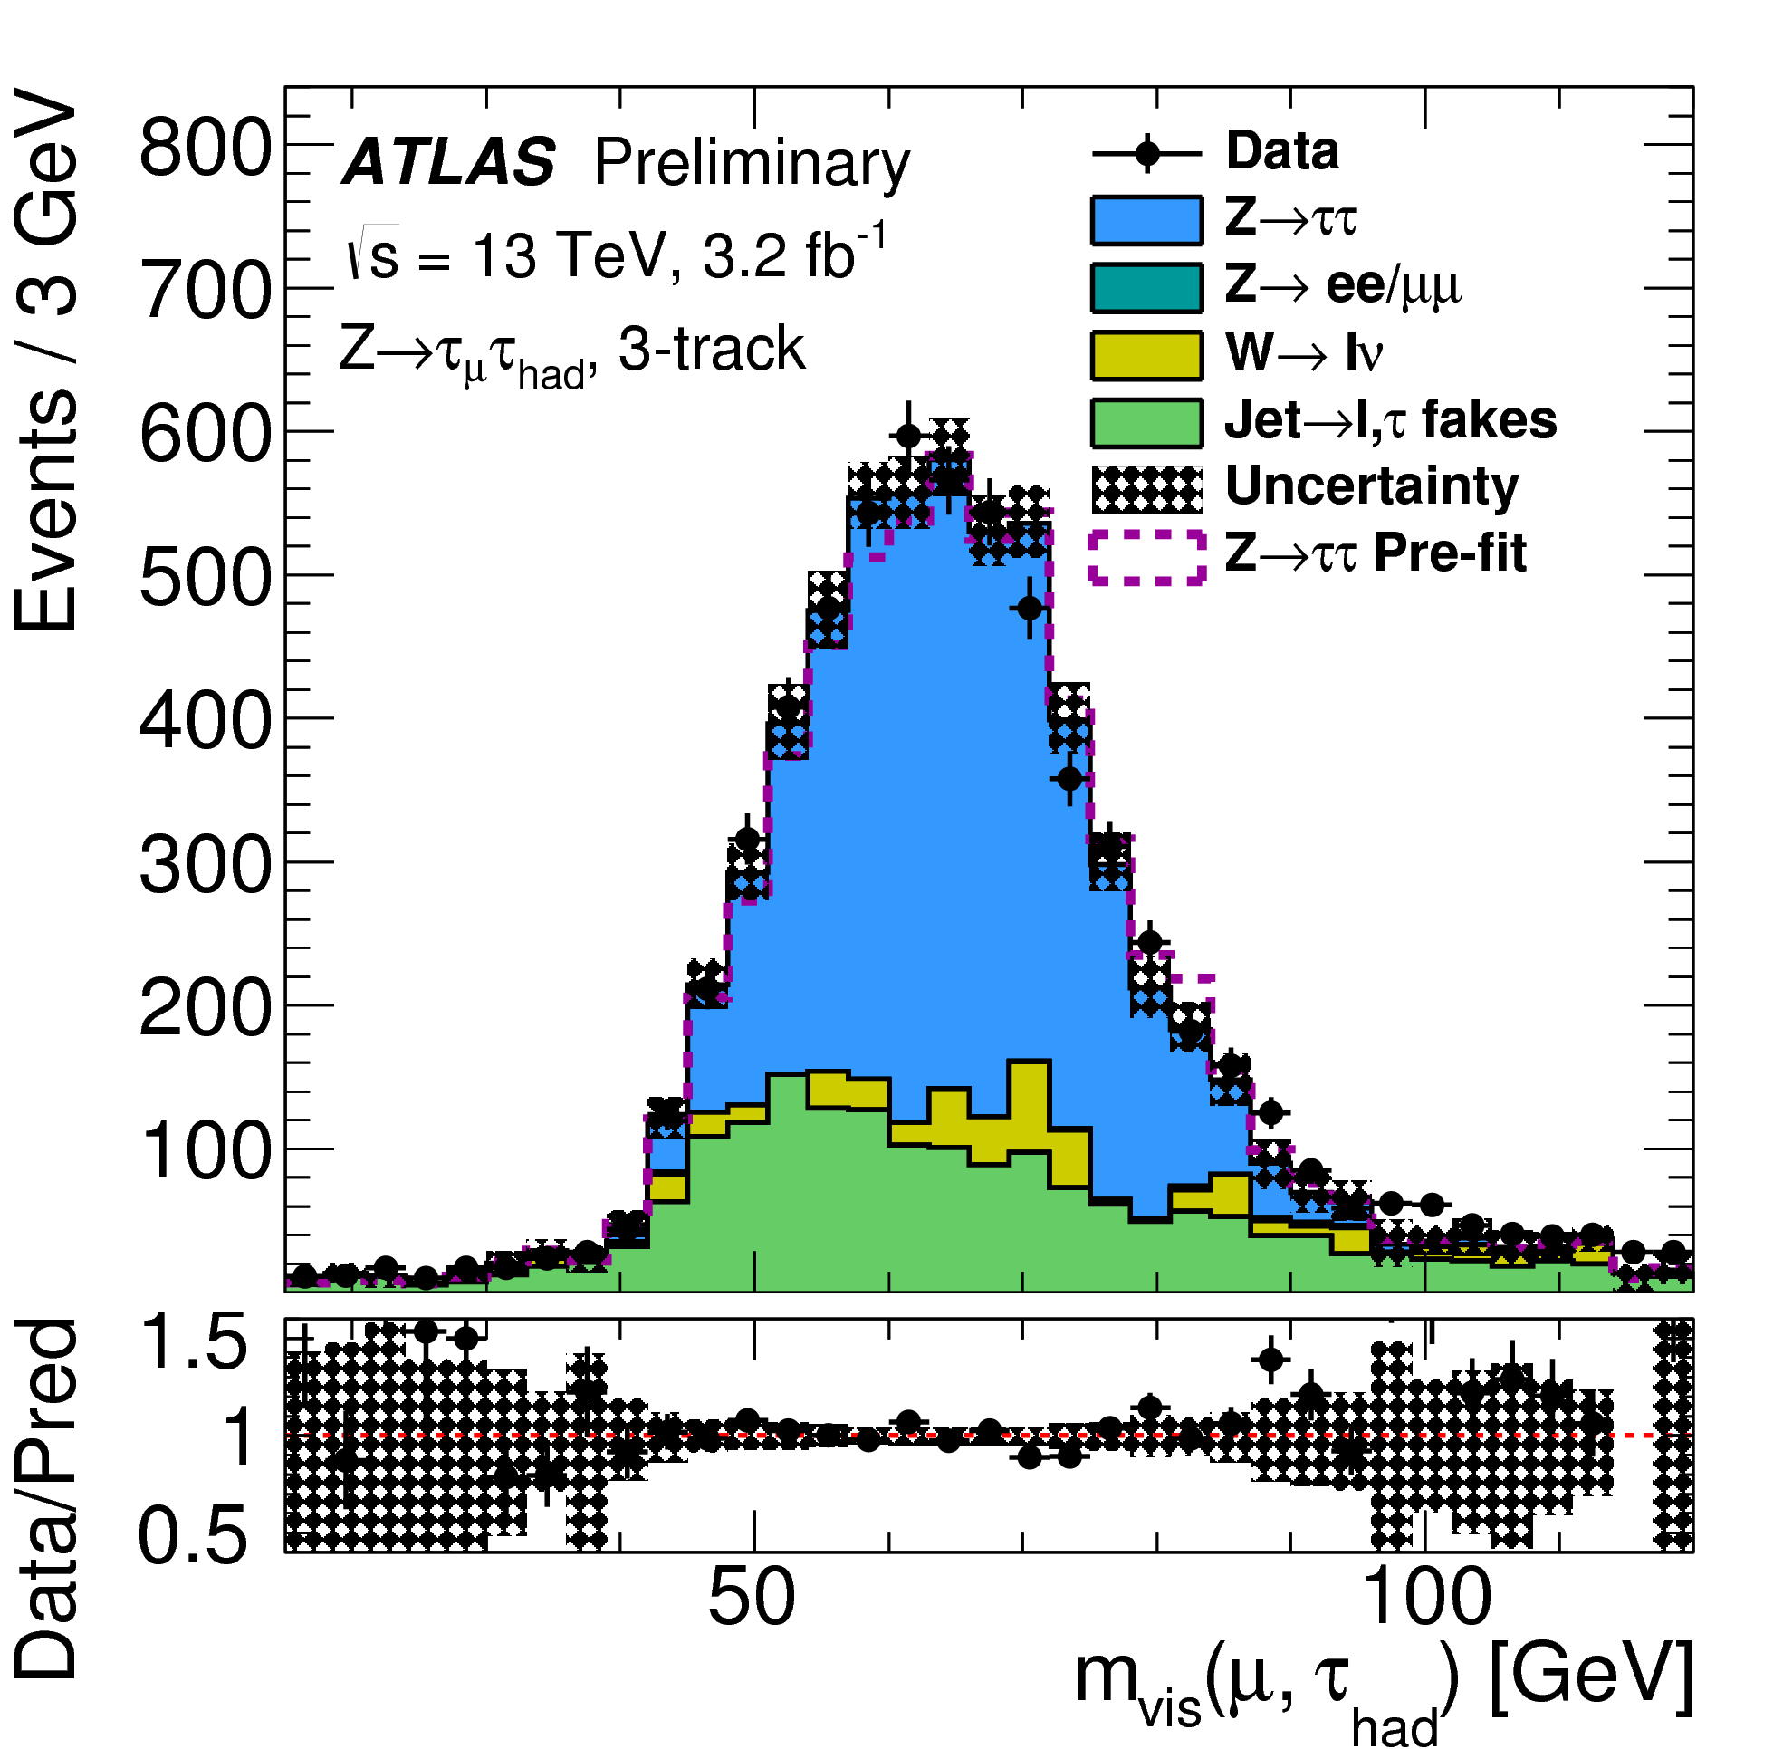
Physics Objects calibration
JINST 19 (2024)
Eur. Phys J. C 83 (2023) 686
2407.15627 Subm. EPJC
ATLAS-CONF-2017-029
The excellent performance requires excellent calibrations:
  γ: energy calibration 0.2% at 60 GeV, e energy calibration 0.05% at 45 GeV
  μ: energy scale calibration at 0.1-0.05% and resolution at 1.5-2%
  Jet: energy calibration scale at (better than) 1% level for p_{T} above 60 GeV
  τ: energy scale calibrated at ~1% level

Slide 4
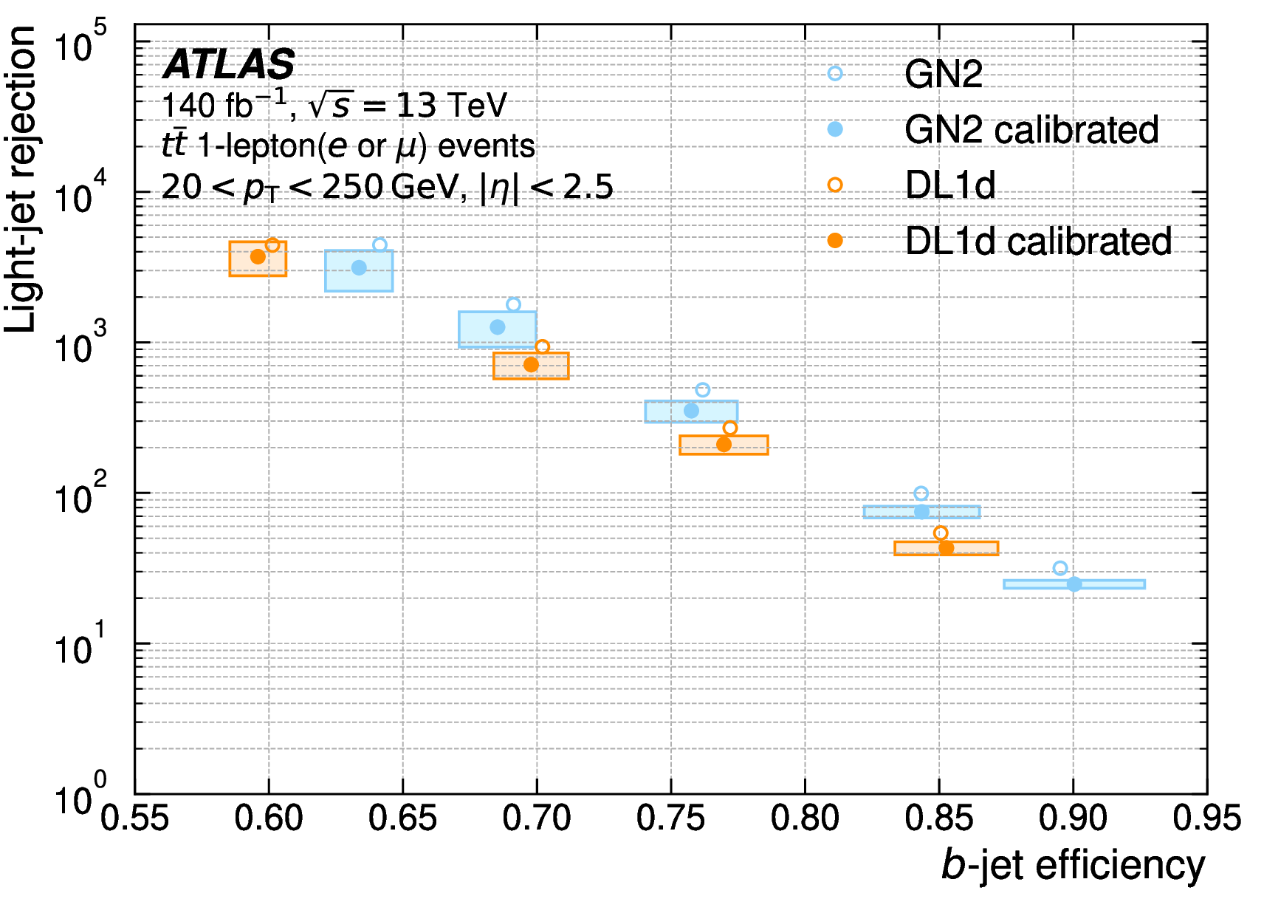
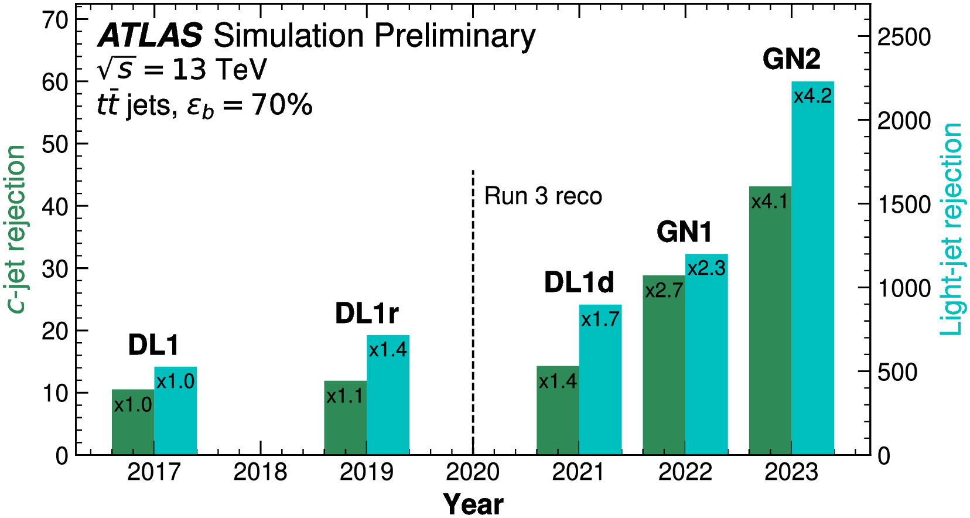
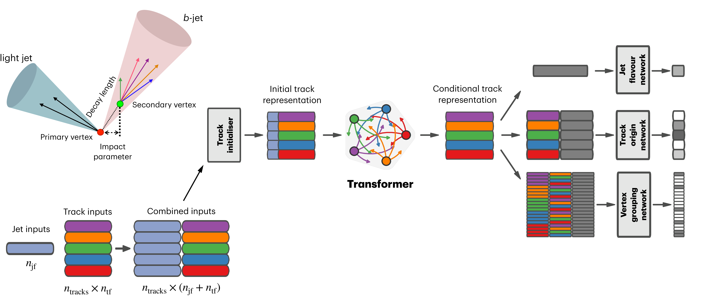
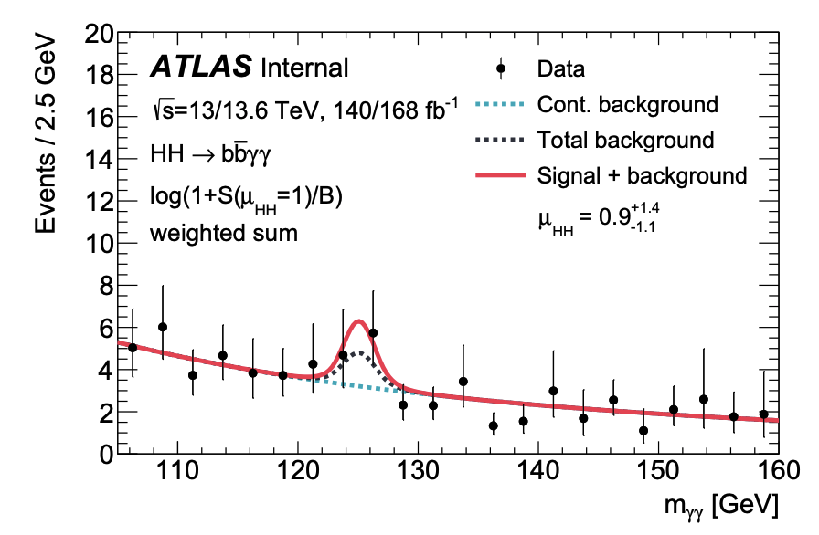
Improvements in Flavor Tag
arXiv:2505.19689 Sub. to Nature Communications
Run 3
Run 2
Traditional approach (DL1r): low-level quantities based on track followed by high-level multivariate classifier
New approach (GN2): directly process track and jet information. In addition to the primary training target (jet flavor prediction) auxiliary training objectives are introduced to reconstruct the internal structure of a jet by grouping tracks originating from a common vertex
GN2 used in Run2+Run3 HH→bbγγ analysis → 20% improvement on σ_{HH} sensitivity
  Observed 𝜇_{𝐻𝐻} = 0.9 ^{+1.3} _{−1.0} (stat) ^{+0.6} _{−0.5} (syst)
  Observed 0.8 σ significance (1.0 expected)
ATLAS-CONF-2025-005

Slide 5
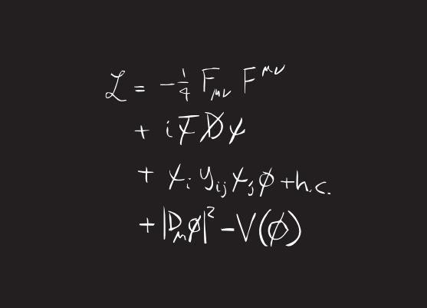
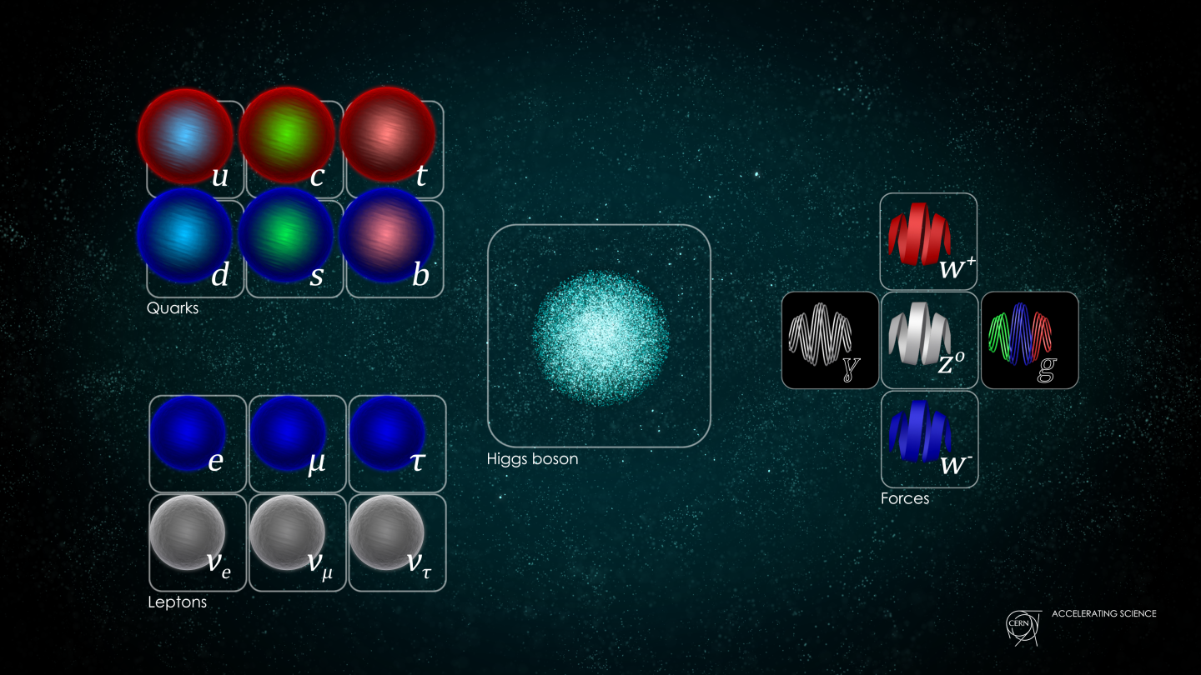
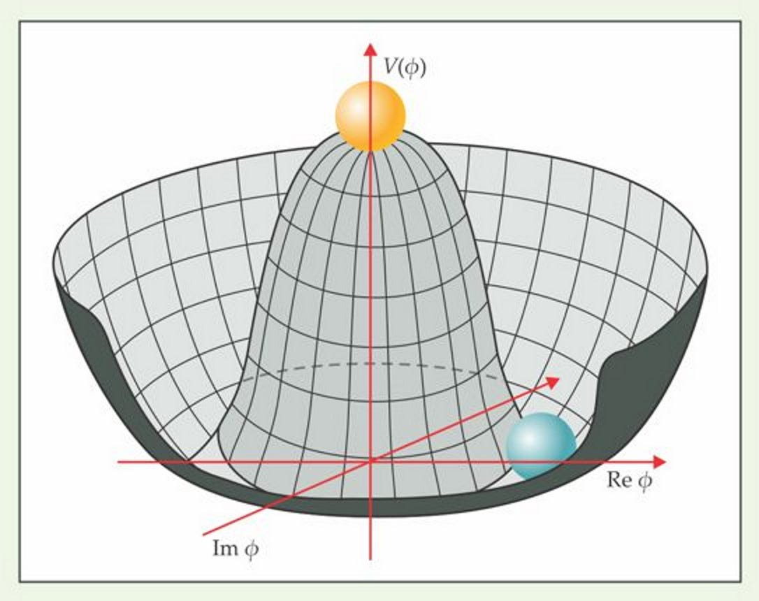
Addressing fundamental questions …
SU(3)_{QCD} x SU(2)_{L} x U(1)_{QED}
Interactions between elementary particles described by a quantum field theory based on invariance under local Gauge symmetries
SU(2) symmetry spontaneously broken by BEH mechanism: generates vector bosons (W and Z) and fermion masses, symmetry restored at vey high energy → well behaved perturbative computation and renormalizability + a new elementary scalar particle, the Higgs boson
The ATLAS experiment is designed to shed light on interactions between elementary particles and to test and/or disprove this model

Slide 6

Addressing fundamental questions …
Fundamental questions in particle physics
ATLAS physics program
Is the BEH mechanism the (only) responsible of the EW symmetry breaking?
Measurement a wide range of processes at energy scales up to few TeV involving jets, W, Z bosons, Top quark
Are the Higgs interactions as described by the SM and the only origin of all elementary particle masses?
Precisions Tests of the EW sector and measurement of “input” observables: m_{W}, sin²(θ_{W}), α_{s}, m_{top}, m_{H}
Is the Higgs boson an elementary particle, and the only elementary scalar?
Measurement of the Higgs boson properties and interactions wit other SM particles (including self-interactions)
What is the origin of the matter-anti-matter asymmetry (1st order phase transition + CP violation needed)
Search for BSM phenomena in model driven and model independent approaches
Study of flavor physics and CP violation in B-sector but also in the Higgs and EW sector
Cosmological implications of the SM (Higgs potential)
Study of the quark gluon plasma in heavy ion collisions
What is the origin of dark matter?
Is QCD correct and what are the properties of the Quark-Gluon plasma?
Search for direct production of dak matter particles

Slide 7
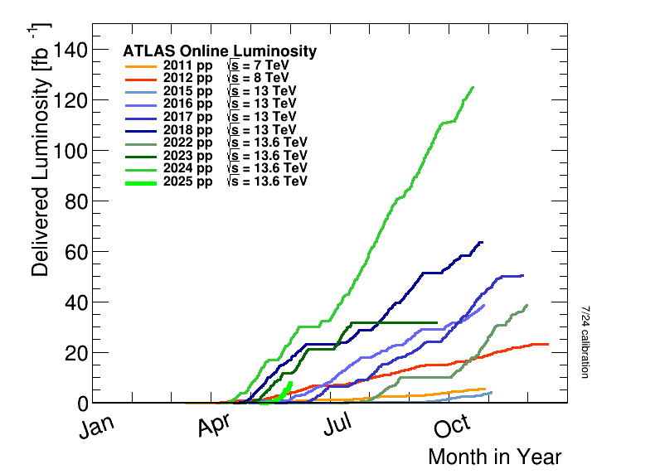
This talk …
In the last year ATLAS submitted 91 papers to journals (1389 in total): AtlasPublicResults
This talks will highlight a few results focusing on what is new and of highest impact on particle physics, with some results using up to 2024 data
More details of the ATLAS results submitted at EPS in other plenary talks by Emanuele Di Marco, Thimothy Gershon, Josh Bendavid, Francesco Prino and Tamara Vasquez + the 52 ATLAS talks in parallel sessions + 22 ATLAS posters
Run 1:
25 fb⁻¹ @ 7+8 TeV
Run 2:
140 fb⁻¹ @ 13 TeV
Run 3: 2022-2024
168 fb⁻¹ @ 13.6 TeV
HL-LHC:
3 ab⁻¹ @ 13.6 TeV

Slide 8
BMS searches
Much More results in Tamara Vazquez Schröder talk on Friday

Slide 9
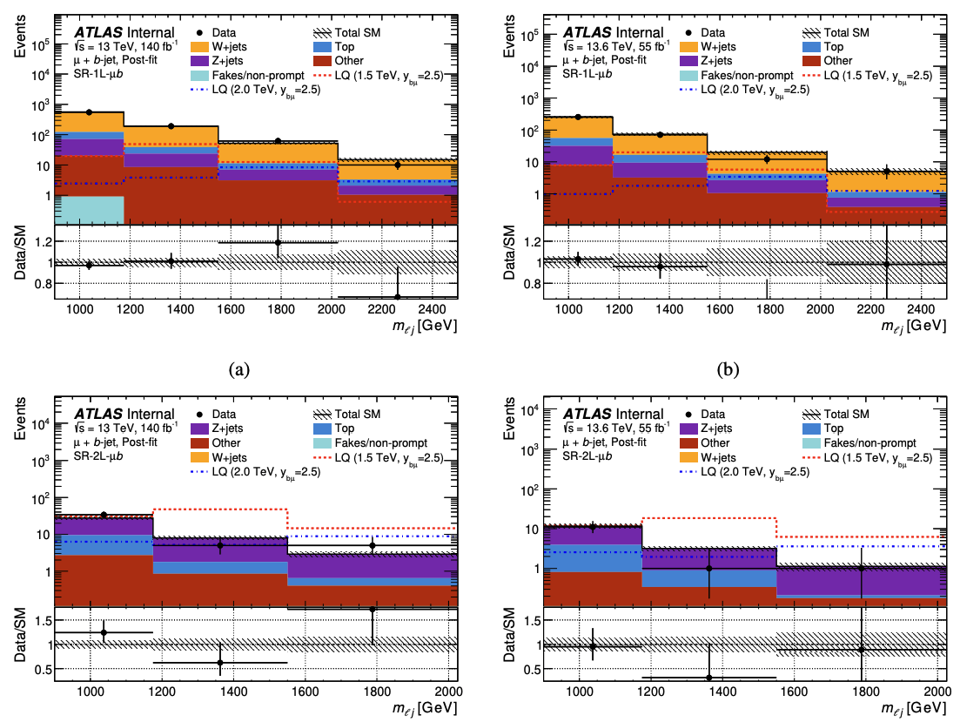
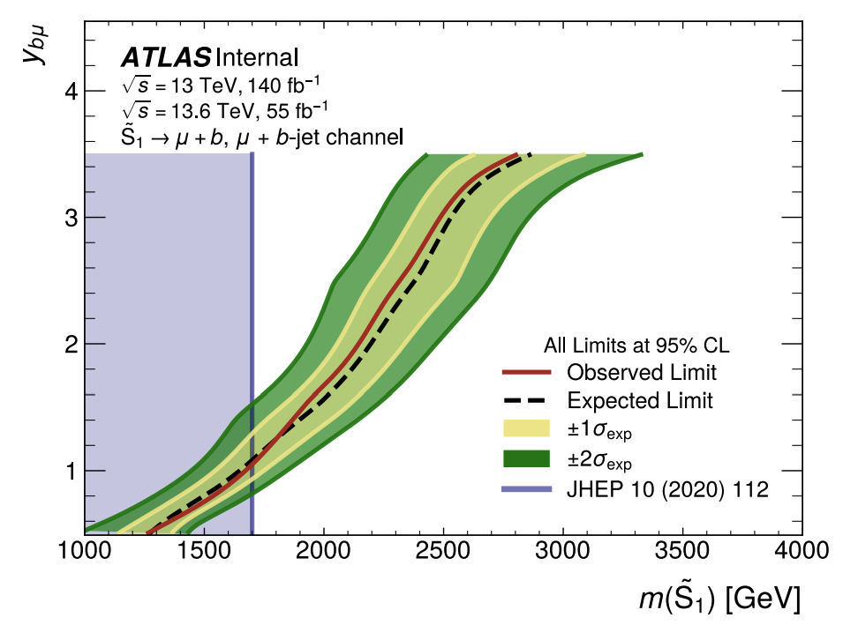
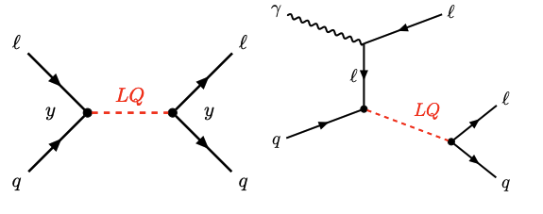
Search for resonant LQ in l+jet
New
ATLAS LQ pair-prod.
First search that exploit LQ resonant production via “lepton PDF” of the proton Run 2 + Run 3 (2022+2023):
  lepton+jet resonances in m_{lj}, untagged-jet and b-tagged categories
  1- and 2-lepton channels
  No significant excesses: limits on LQ mass vs coupling derived

Slide 10
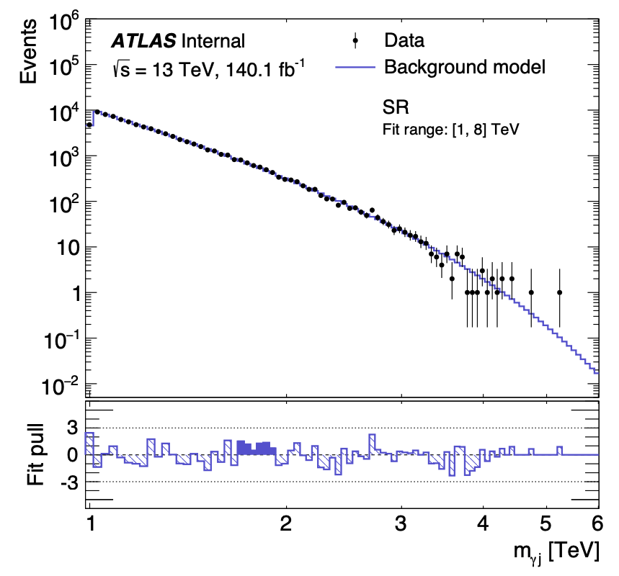
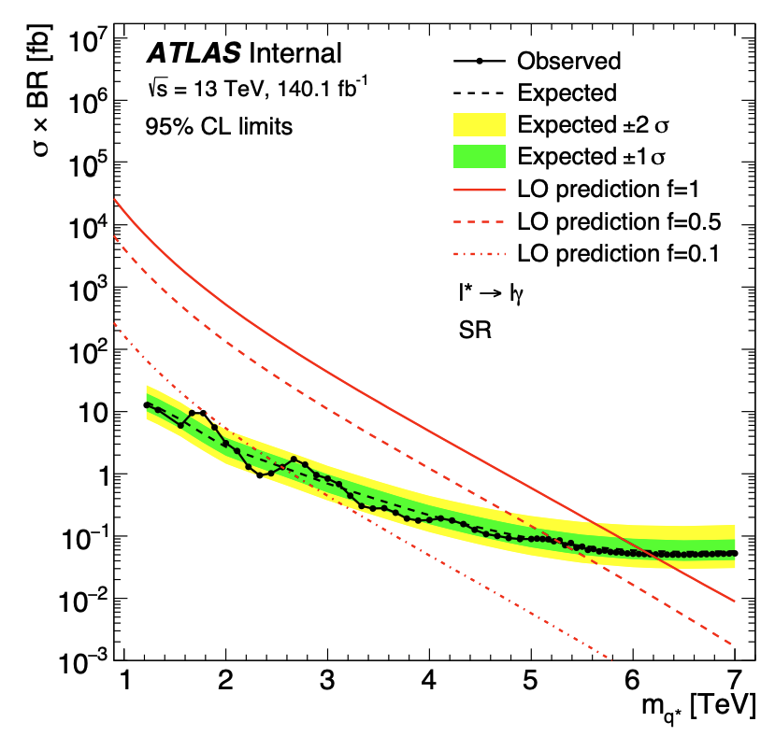
Quark compositeness at the highest energy scale
New
Look for BMS phenomena in events with high energy jets and an isolated photon:
  High mass γ+jet resonances, generic q* but also by flavor u*/d*, c* and b*
  Fit the mγj distribution
No significant excess observed in any of the searches and 95% CL limits set up to masses of 6.2 TeV for excited quarks
  testing length scales down to ~ [hc/ 10 TeV] ~ 10⁻²⁰ m

Slide 11
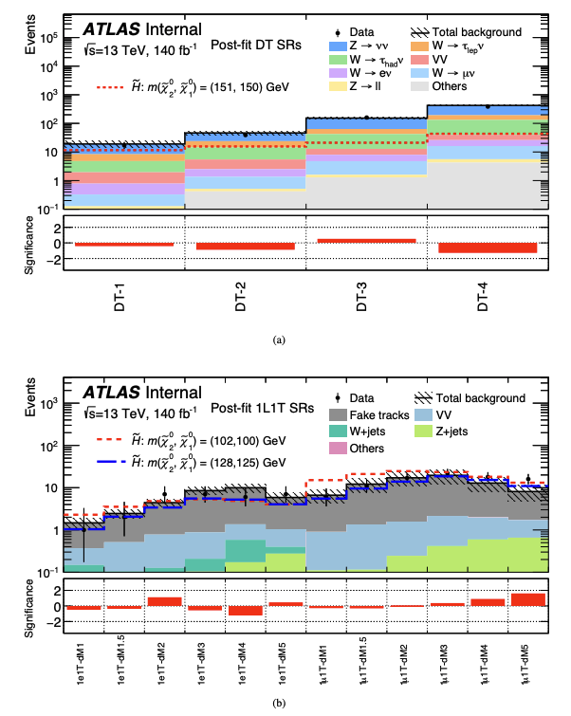
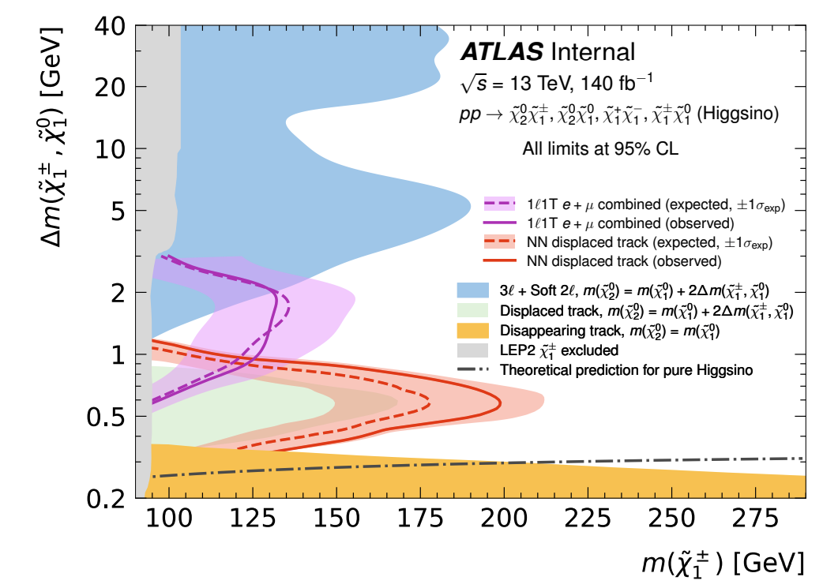
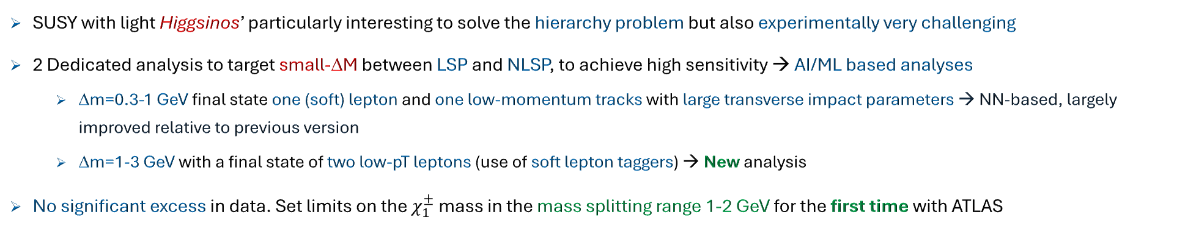
Higgsino in low ΔM regime
New
SUSY with light Higgsinos’ particularly interesting to solve the hierarchy problem but also experimentally very challenging
2 Dedicated analysis to target small-ΔM between LSP and NLSP, to achieve high sensitivity → AI/ML based analyses
  Δm=0.3-1 GeV final state one (soft) lepton and one low-momentum tracks with large transverse impact parameters → NN-based, largely improved relative to previous version
  Δm=1-3 GeV with a final state of two low-pT leptons (use of soft lepton taggers) → New analysis
No significant excess in data. Set limits on the $χ_{1}^{±}$mass in the mass splitting range 1-2 GeV for the first time with ATLAS

Slide 12
SM and Top Measurements
Moch more results in Josh Bendavid talk on Wednesday

Slide 13
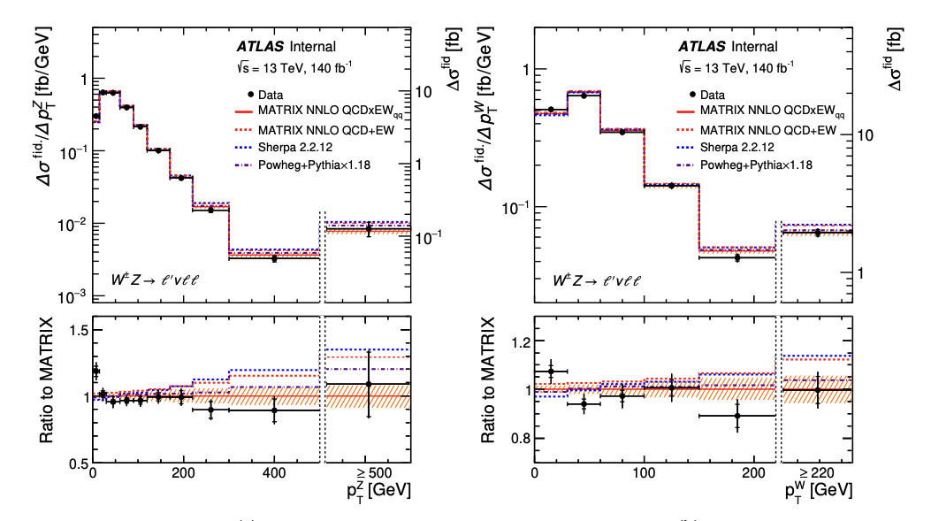
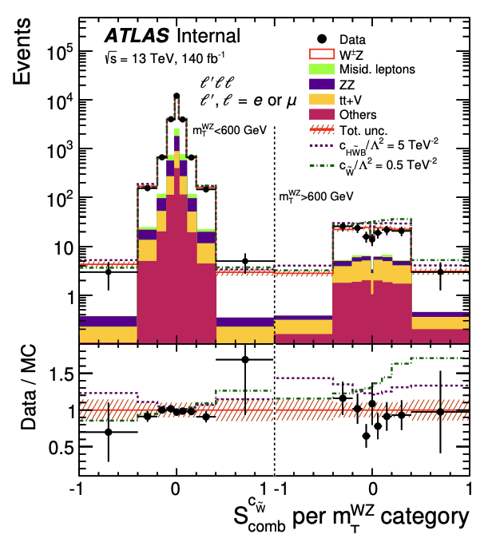
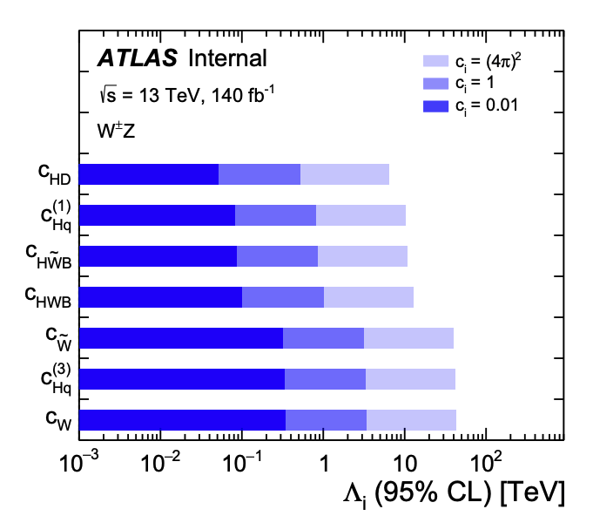

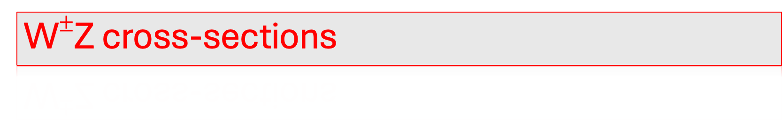
W$±$Z cross-sections
New
SM (NNLO QCD x NLO EW)=
WZ cross-section entering in the precision domain:
  Fiducial xs measured with 4% accuracy and several observables compared with state-of-the-art predictions,
  Dedicated “CP-odd” observable used to constrain EFT CP-odd operators

Slide 14
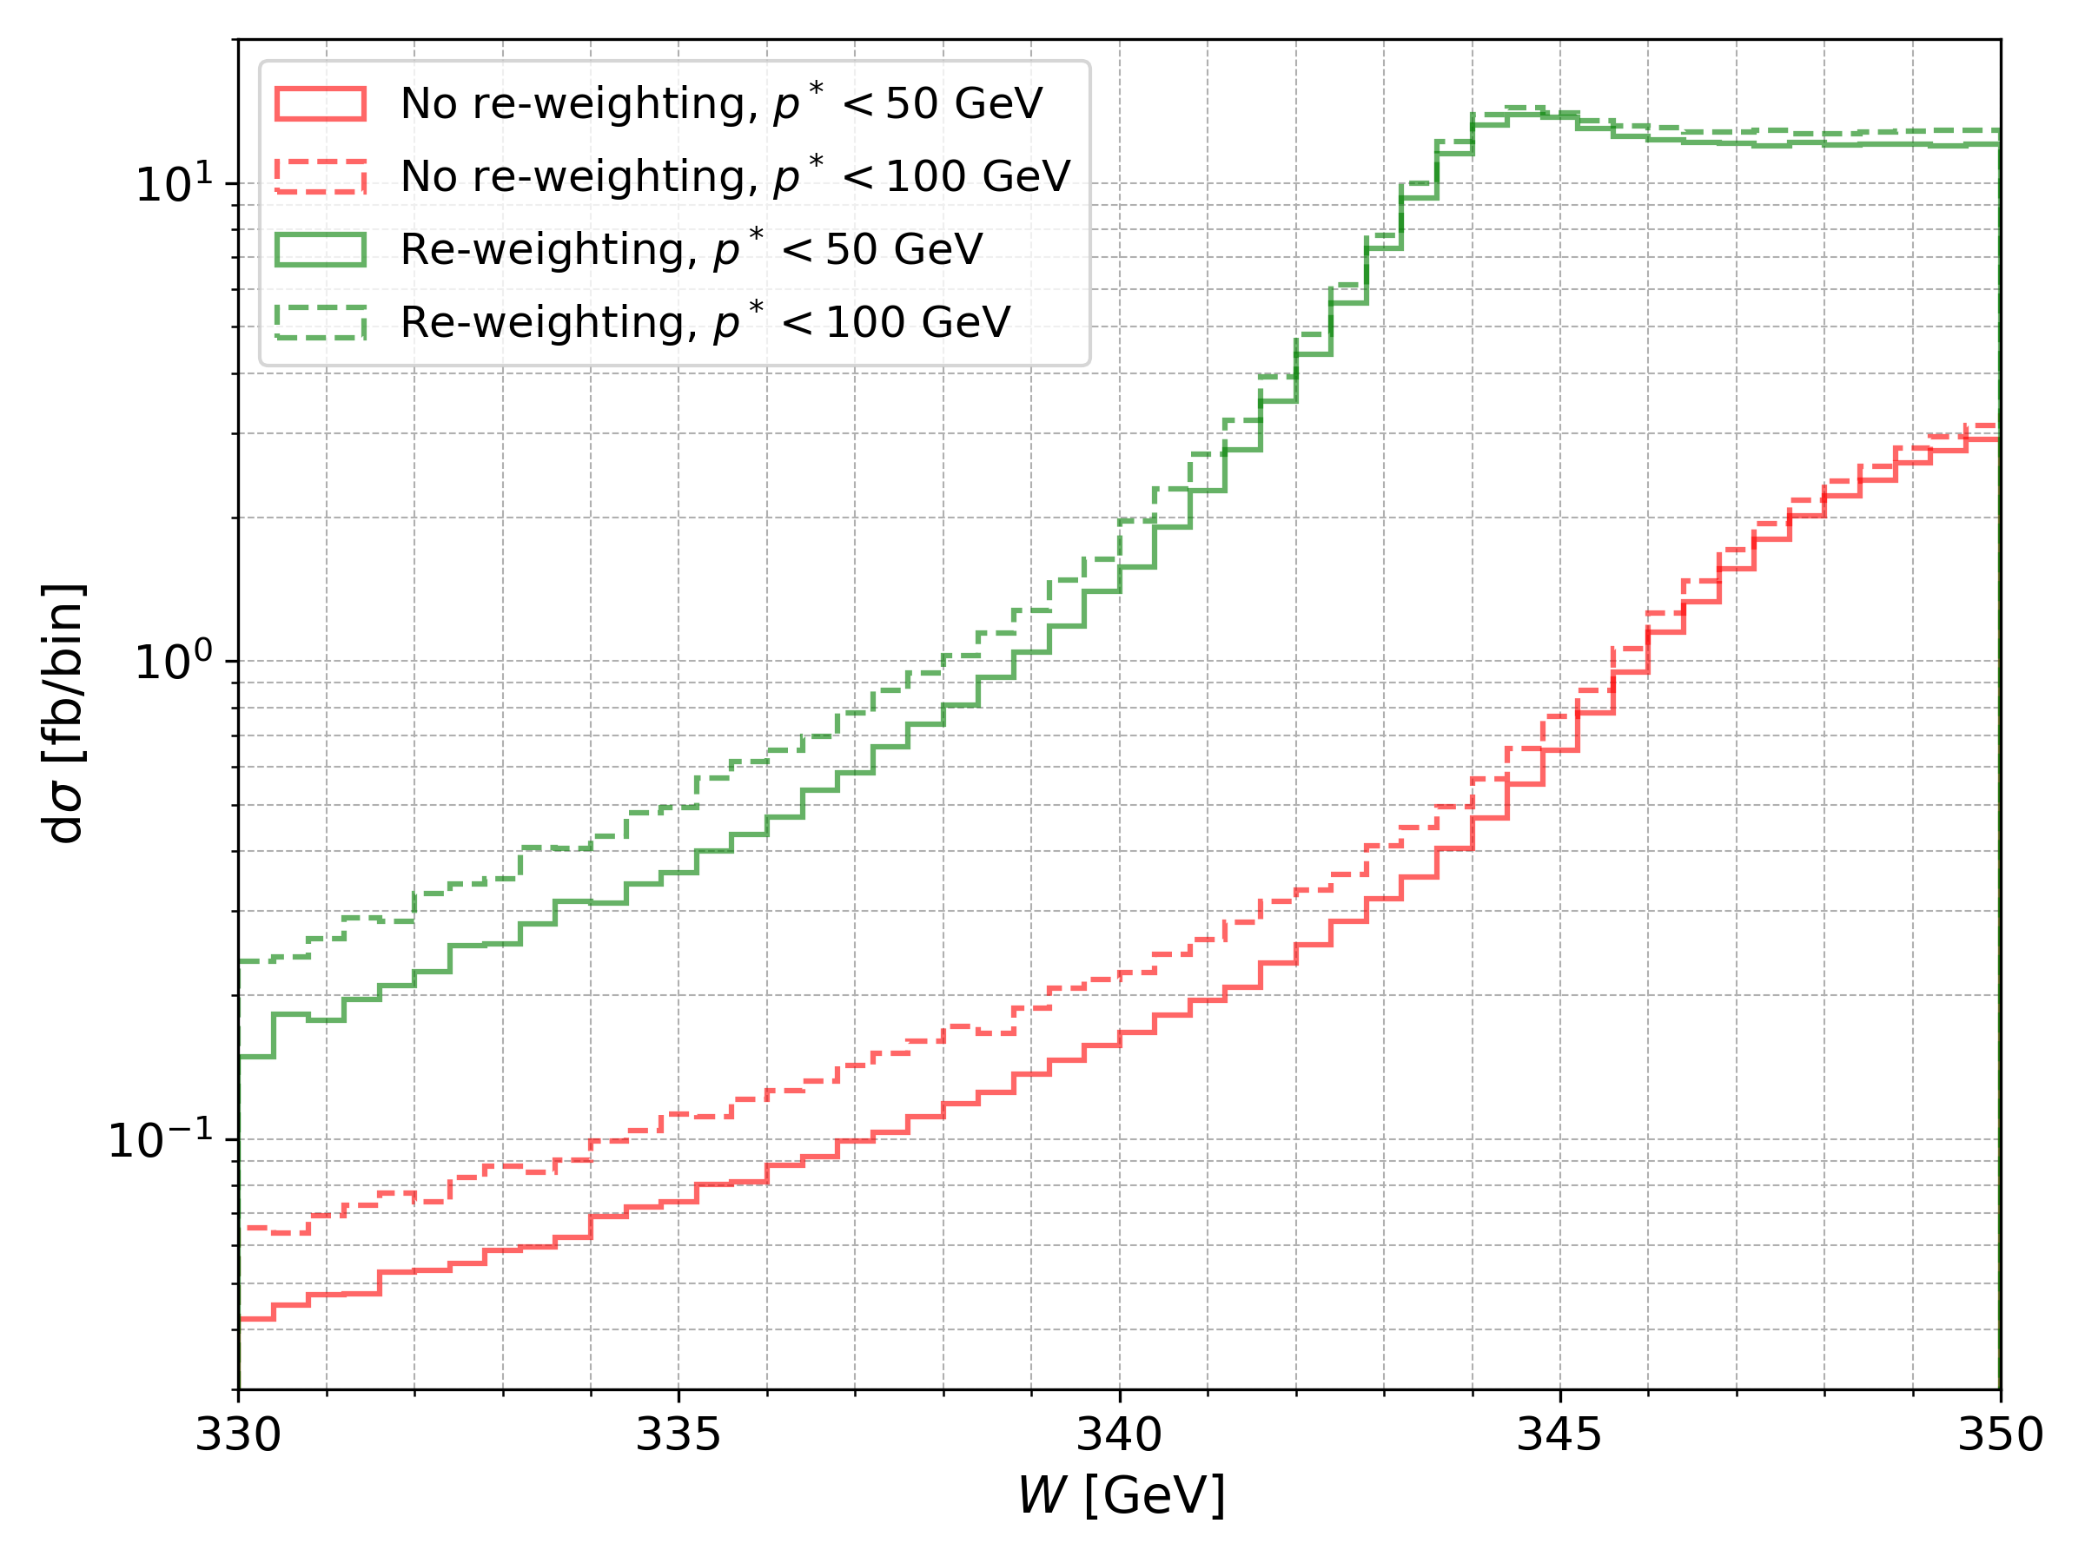
tt cross-section at threshold
New
Top-quark pair production at threshold:
  Non-Relativistic QCD effects expected to be important and are not included on our baseline top modeling, based on PS-matched pQCD predictions reweighted to NNLO-QCD+NLO-EW accuracy
  Among NR-QCD effects the formation of colour-singlet, 𝑆-wave, quasi-bound-states (η_{t}) with masses just below the production threshold. Given the small top lifetime these states do not form a BW resonances but rather a cross-section enhancement
Observation by CMS arXiv:2503.22382 based on simplified model
  σ(η_{t}) = 8.8^{+1.2}_{-1.4} pb (>5σ significnance)
This is study uses an improved modeling of NR-QCD effects described via the re-weighting of the tt production MEs through the non-relativistic QCD Green’s function (Fuks et al.)
Fuks et al.

Slide 15
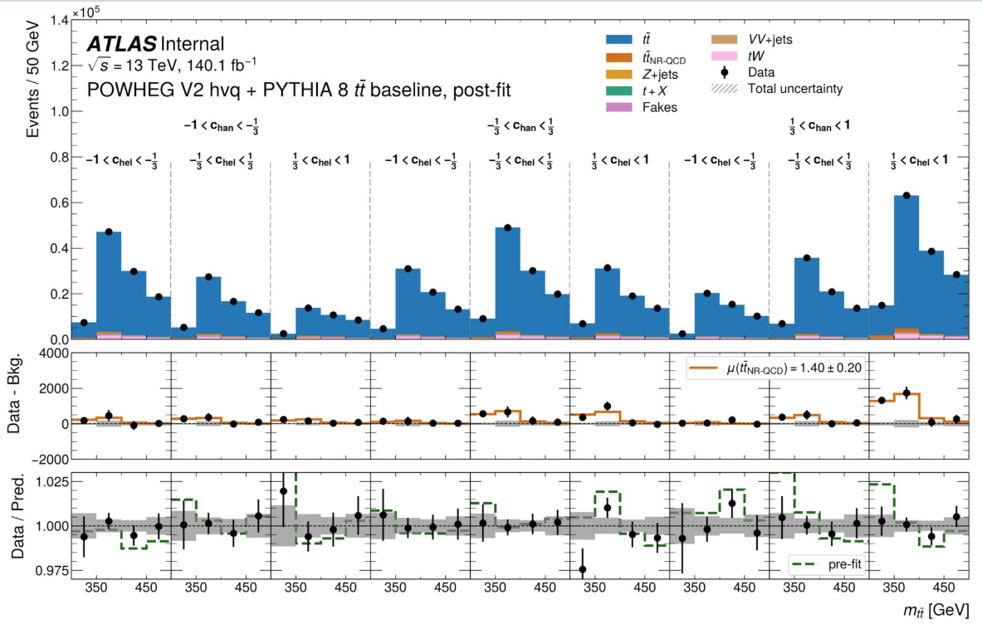
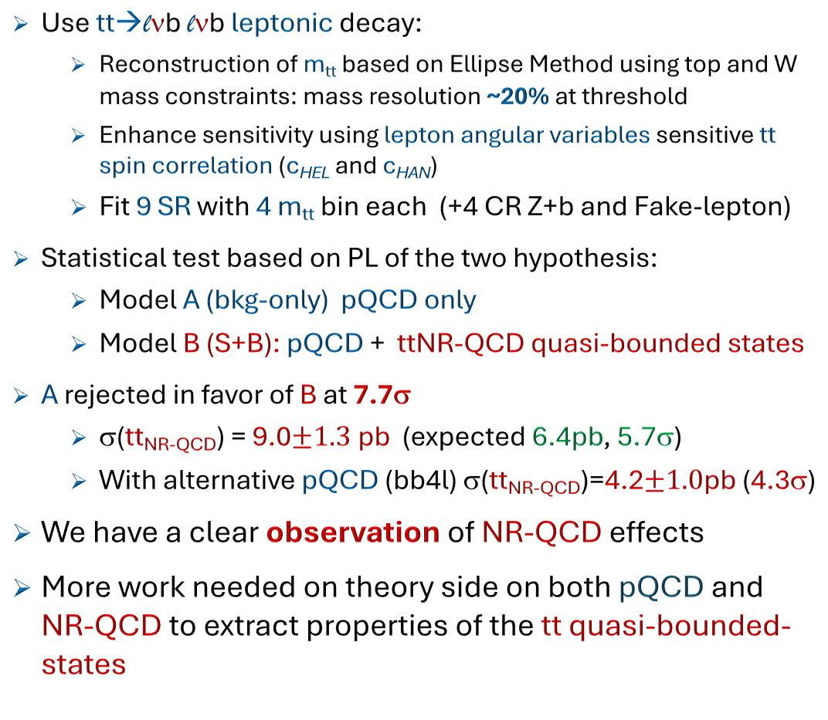
tt cross-secton at threshold
New
Use tt→lνb lνb leptonic decay:
  Reconstruction of m_{tt} based on Ellipse Method using top and W mass constraints: mass resolution ~20% at threshold
  Enhance sensitivity using lepton angular variables sensitive tt spin correlation (c_{HEL} and c_{HAN})
  Fit 9 SR with 4 m_{tt} bin each (+4 CR Z+b and Fake-lepton)
Statistical test based on PL of the two hypothesis:
  Model A (bkg-only) pQCD only
  Model B (S+B): pQCD + ttNR-QCD quasi-bounded states
A rejected in favor of B at 7.7σ
  σ(tt_{NR-QCD}) = 9.0$±1.3$pb (expected 6.4pb, 5.7σ)
  With alternative pQCD (bb4l) σ(tt_{NR-QCD})=4.2$±1.0$pb (4.3σ)
We have a clear observation of NR-QCD effects
More work needed on theory side on both pQCD and NR-QCD to extract properties of the tt quasi-bounded-states

Slide 16
Higgs Boson Physics
Much more results in Emanuele Di Marco talk on Tuesday

Slide 17
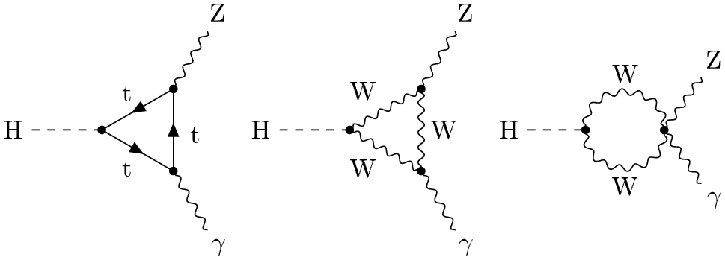
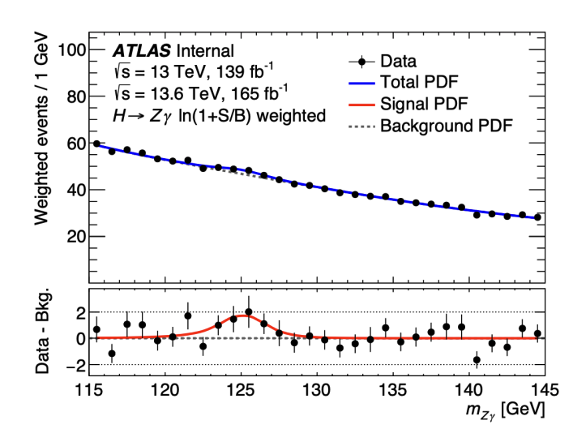
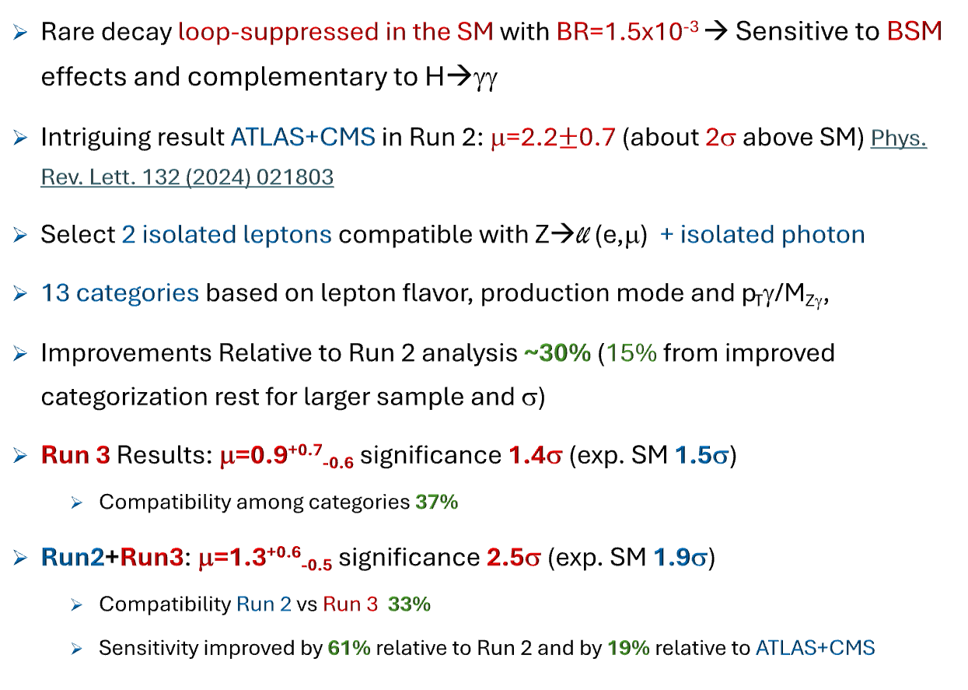


H → Zγ
New
Rare decay loop-suppressed in the SM with BR=1.5x10⁻³ → Sensitive to BSM effects and complementary to H→γγ
Intriguing result ATLAS+CMS in Run 2: μ=2.2$±$0.7 (about 2σ above SM) Phys. Rev. Lett. 132 (2024) 021803
Select 2 isolated leptons compatible with Z→ll (e,μ) + isolated photon
13 categories based on lepton flavor, production mode and p_{T}γ/M_{Zγ},
Improvements Relative to Run 2 analysis ~30% (15% from improved categorization rest for larger sample and σ)
Run 3 Results: μ=0.9^{+0.7}_{-0.6} significance 1.4σ (exp. SM 1.5σ)
  Compatibility among categories 37%
Run2+Run3: μ=1.3^{+0.6}_{-0.5} significance 2.5σ (exp. SM 1.9σ)
  Compatibility Run 2 vs Run 3 33%
  Sensitivity improved by 61% relative to Run 2 and by 19% relative to ATLAS+CMS
$$\sim$$
χ$±$
t

Slide 18
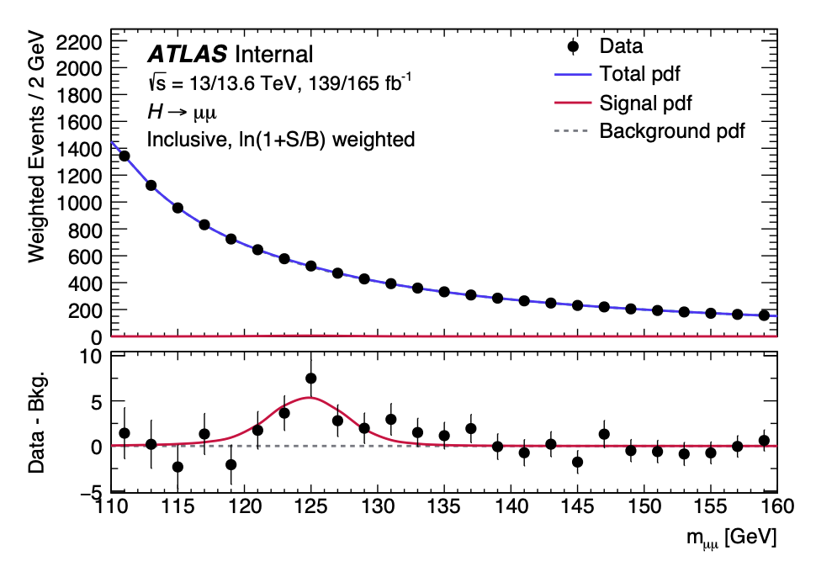
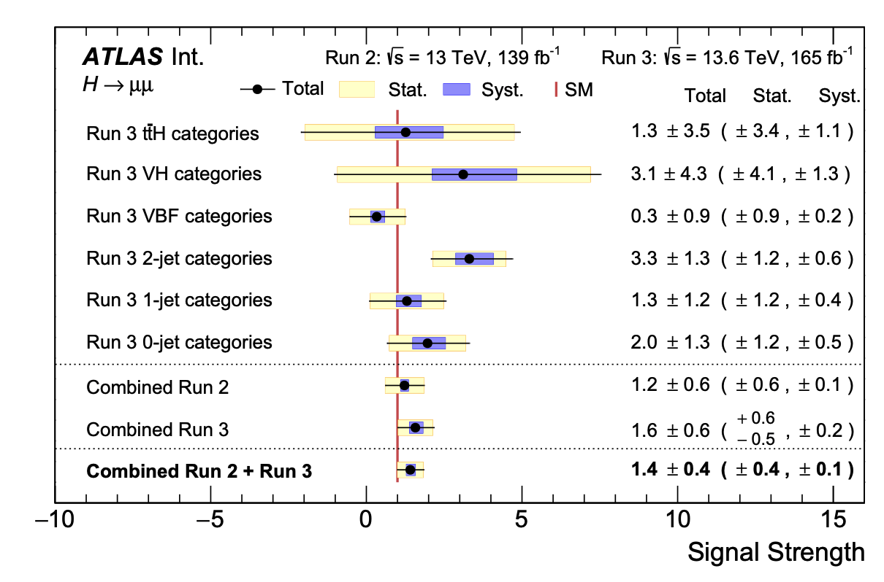
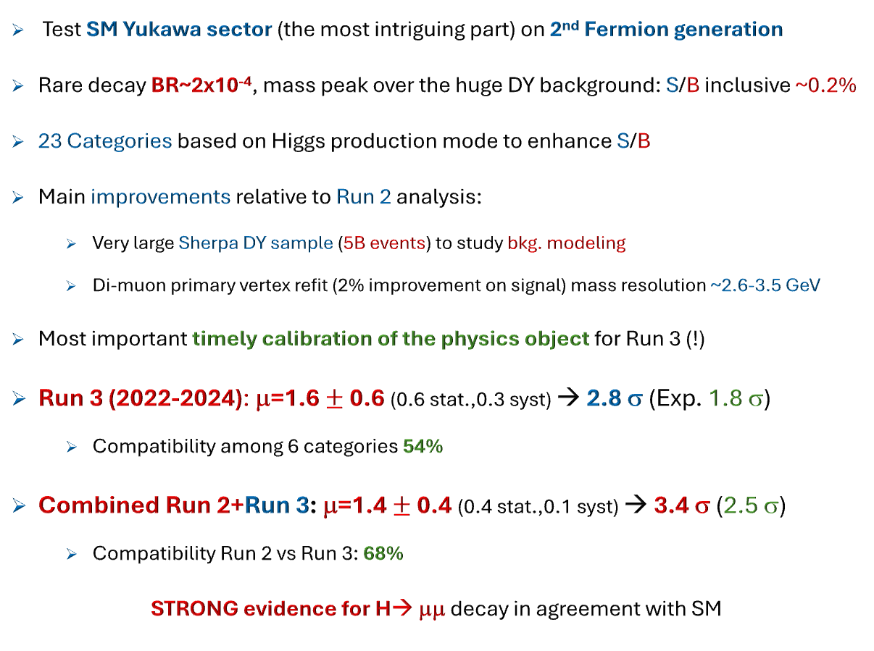

H → μμ
New
Test SM Yukawa sector (the most intriguing part) on 2nd Fermion generation
Rare decay BR~2x10⁻⁴, mass peak over the huge DY background: S/B inclusive ~0.2%
23 Categories based on Higgs production mode to enhance S/B
Main improvements relative to Run 2 analysis:
  Very large Sherpa DY sample (5B events) to study bkg. modeling
  Di-muon primary vertex refit (2% improvement on signal) mass resolution ~2.6-3.5 GeV
Most important timely calibration of the physics object for Run 3 (!)
Run 3 (2022-2024): μ=1.6 $±$ 0.6 (0.6 stat.,0.3 syst) → 2.8 σ (Exp. 1.8 σ)
  Compatibility among 6 categories 54%
Combined Run 2+Run 3: μ=1.4 $±$ 0.4 (0.4 stat.,0.1 syst) → 3.4 σ (2.5 σ)
  Compatibility Run 2 vs Run 3: 68%
STRONG evidence for H→ μμ decay in agreement with SM
BR(H→μμ) = (3.0$±$ 0.9)$×$10⁻⁴
304 fb⁻¹

Slide 19
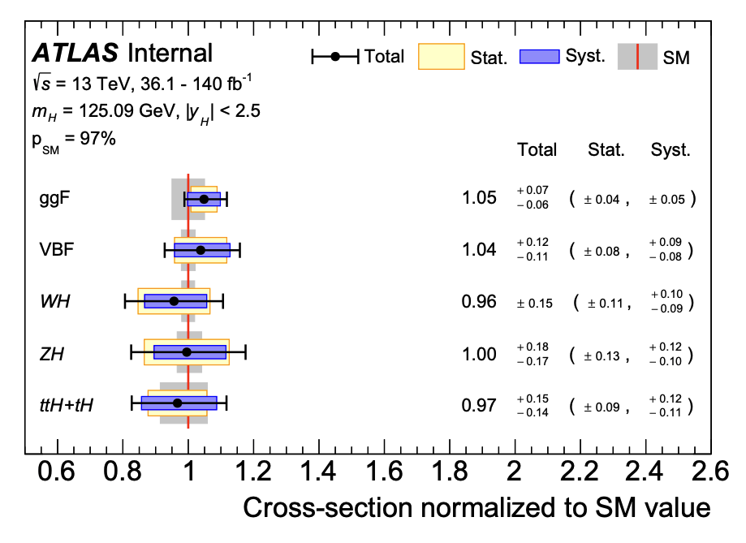
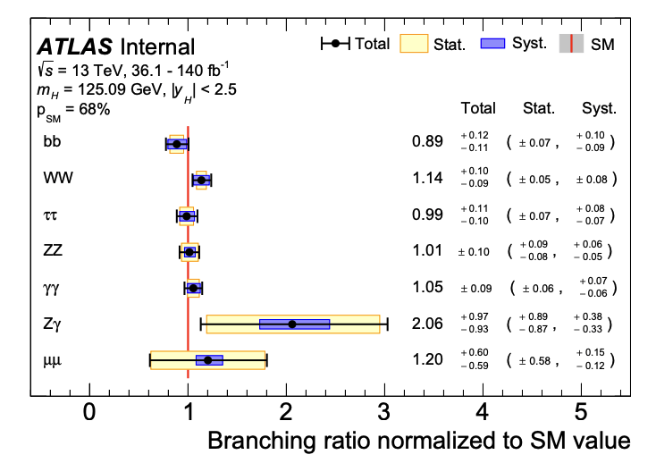
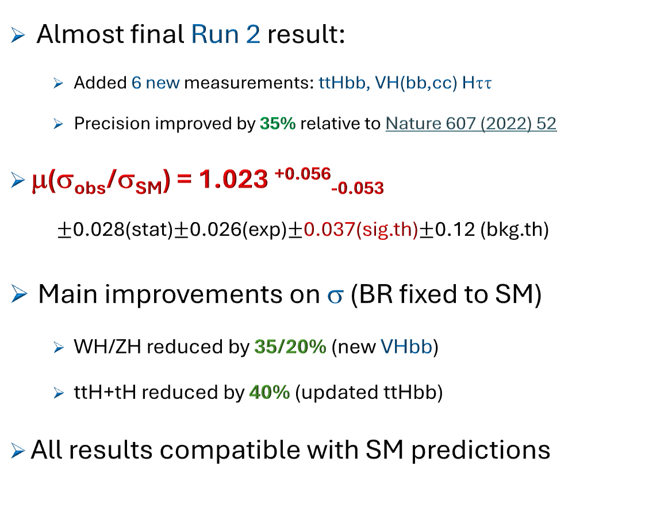
Run 2 Higgs coupling combination
New
Almost final Run 2 result:
  Added 6 new measurements: ttHbb, VH(bb,cc) Hττ
  Precision improved by 35% relative to Nature 607 (2022) 52
μ(σ_{obs}/σ_{SM}) = 1.023 ^{+0.056}_{-0.053}
  $±$0.028(stat)$±$0.026(exp)$±$0.037(sig.th)$±$0.12 (bkg.th)
Main improvements on σ (BR fixed to SM)
  WH/ZH reduced by 35/20% (new VHbb)
  ttH+tH reduced by 40% (updated ttHbb)
All results compatible with SM predictions

Slide 20
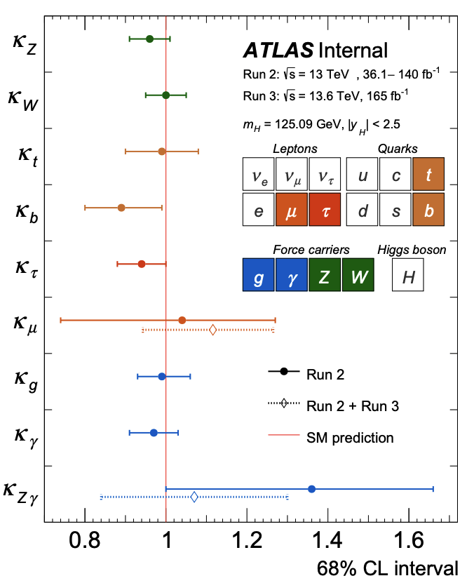
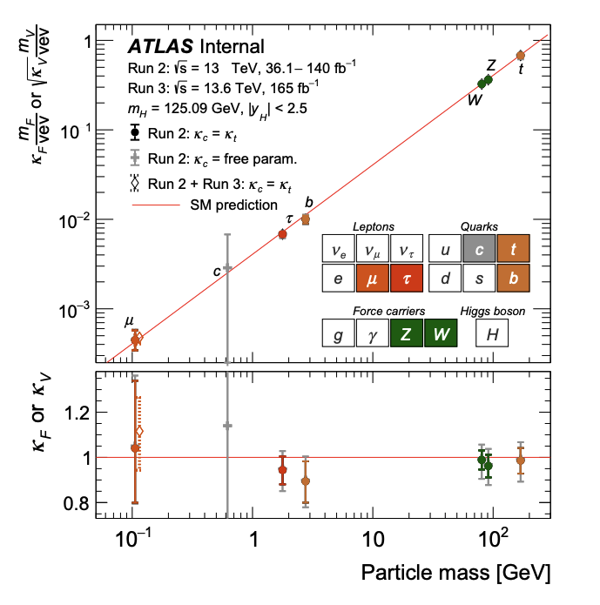
Run 2 Higgs coupling combination
New
Test SM with coupling modifiers
  κ_{p} = Hp coupling normalized to SM
Main improvements:
  κ_{c} 43% (new VHcc analysis)
  κ_{b} 21% (new VHbb analysis)
  κ_{t} 23% (new ttHbb analysis
All results compatible with SM predictions

Slide 21
A bright Future

Slide 22
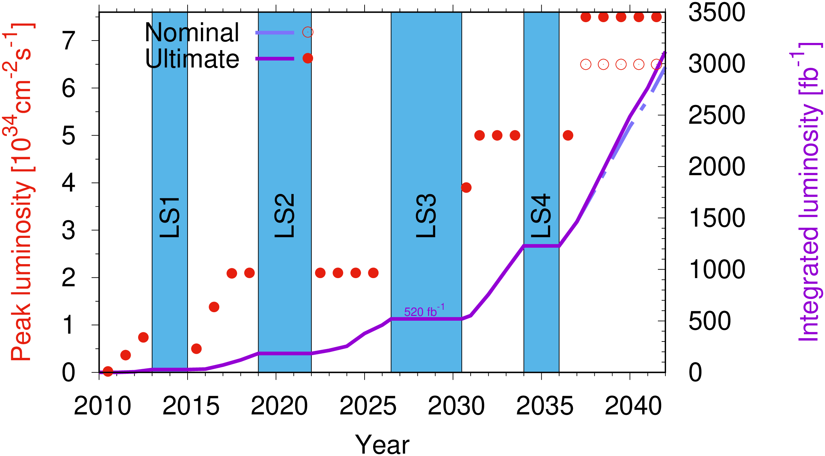
The Phase II upgrade program
ATLAS already successfully performed a Phase I upgrade (forward muon system, AFP and Trigger) between Run 2 and Run 3
Now working on an ambitious Phase II upgrade aiming to keep the detector performance (and in some cases improve them) in the harsh high-luminosity running conditions: designed to cope with up to 200 interactions per bunch crossing to collect 3 ab⁻¹
200 interactions / BC
170 interactions / BC

Slide 23
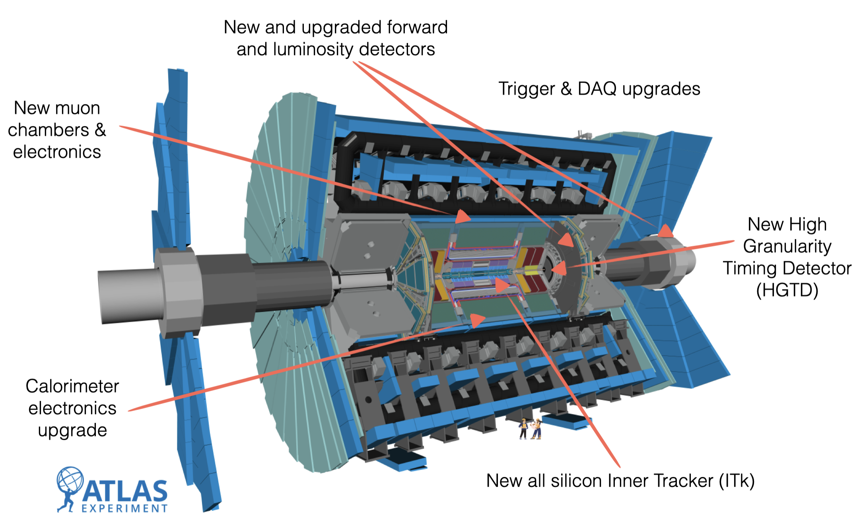
The Phase II upgrade program
1% luminosity accuracy
Improve trigger performance/rate:
more physics despite more PU → L0 trigger at 1 MHz, EF 10kHz
Improve muon trigger coverage, electronics and performance
50ps time resolution per hit
Improve PU rejection in forward region
Full granularity data accessible at L1 trigger, increased rate capability
Improve tracking performance: increased coverage, reduced occupancy, better track p_{T} resolution

Slide 24
The Phase II upgrade program
ITk Pixel
  Pre-production and production underway, incl. sensors, ASICs, on-detector local supports
  Solving (small) residual technical issue
ITk Strips
  Pre-production and production underway, incl. sensors, ASICs, on-detector local supports
  Main technical issue (sensor cracking) solved adding Kapton interposer
HGTD:
  sensor production started, solving technical problems on ASIC wafer probing
Muon spectrometer:
  sMDT very advanced, testing final choice for RPC (trigger) electronics
Calorimeter electronics:
  Good progresses addressing noise issues (Lar) and in production of electronic components
TDAQ:
  Finalizing prototype for final readout system (FELIX) and L0 global trigger
  Progresses on the choice of the Event Filter tracking technology

Slide 25
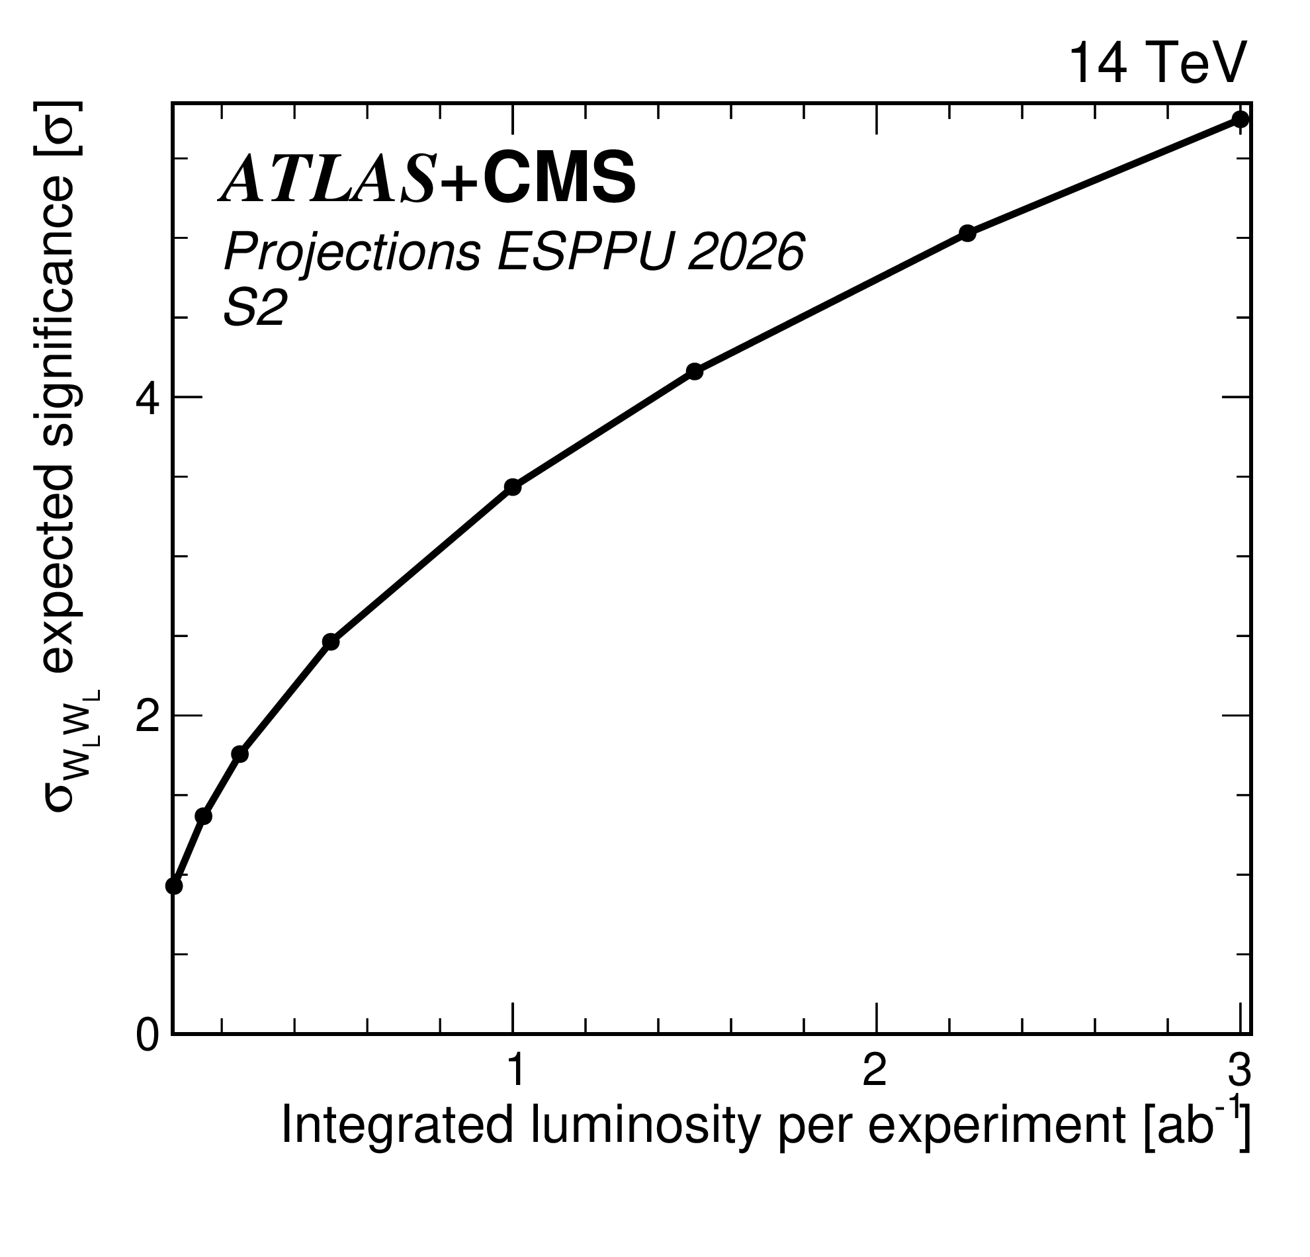
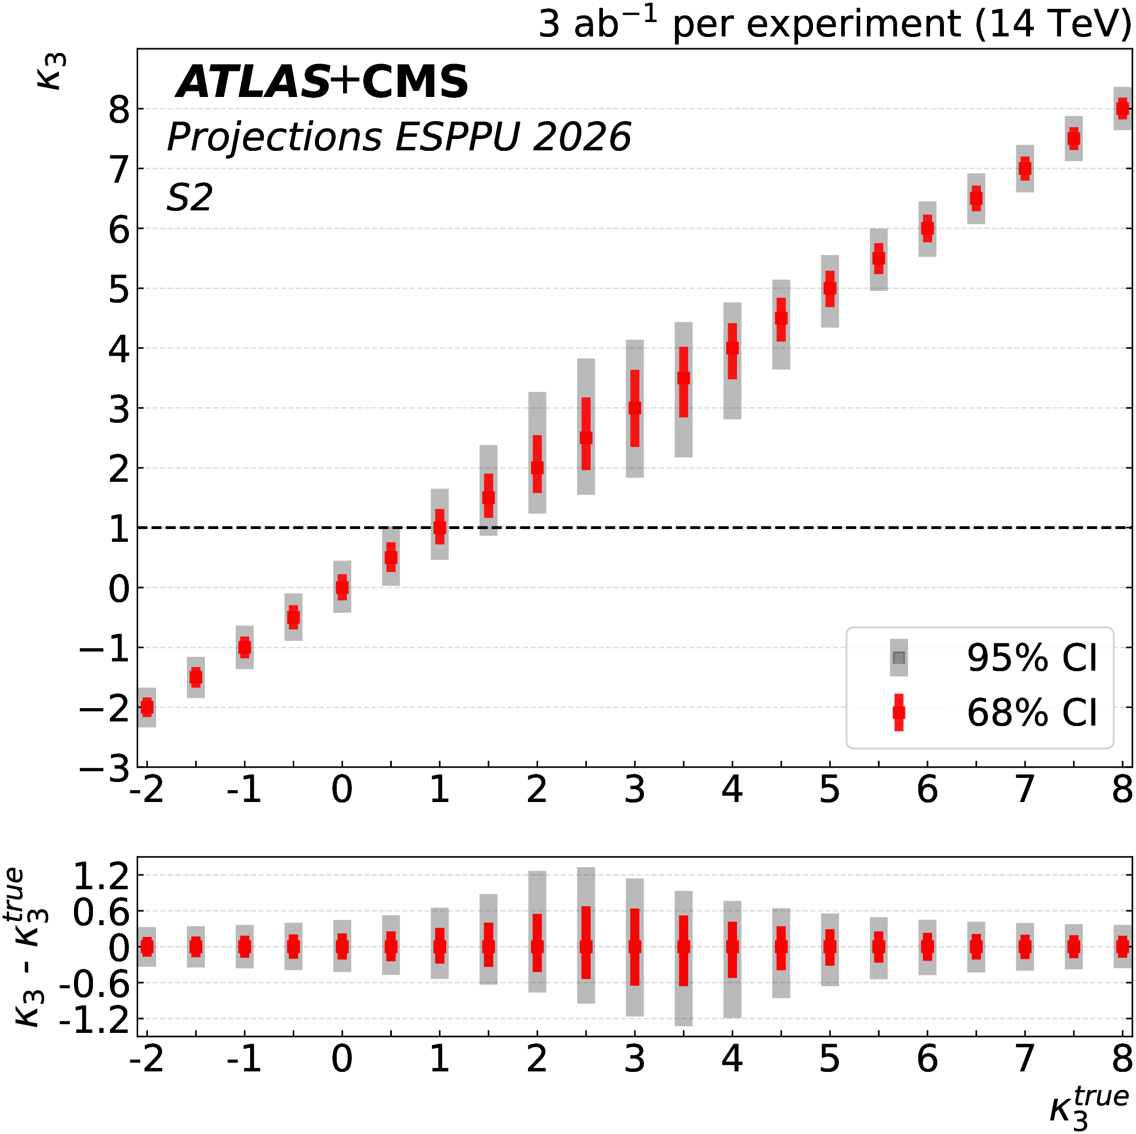
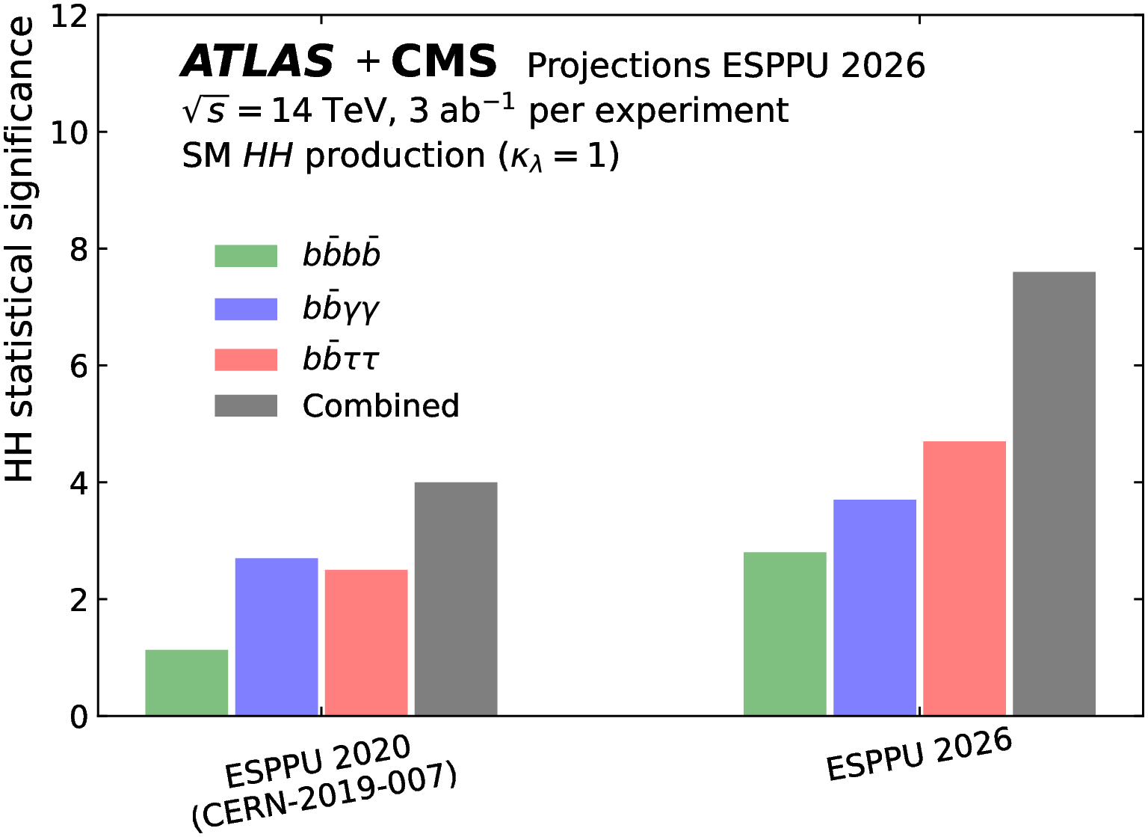
Why we are doing that …
Already improved by ~100% with Run 3 data
Among the main physics goals of the HL-LHC program we have
Observation of W_{L}W_{L} scattering (fundamental test of EWSB)
Measurement of the Higgs boson couplings at the few % level
Observation of the HH process and measurement of the Higgs boson self-coupling with a 30% accuracy
Search for BSM phenomena from low to very high energy scales

Slide 26
Conclusions
The ATLAS experiments continue to provide outstanding contributions to elementary particle physics:
  Precision measurements as test of the foundations of the SM: steady improvements brought by the ingenuity of our collaborators investing resources in innovative analysis techniques, including the physics objects identification and calibration
  A broad BSM search program: deeply explore the well-motivated motivated models (SUSY, Quantum gravity, dark matter and dark sector, quantum black holes), but also look for the unexpected no stones unturned (model independent signals, LLP and AD, etc.)
  Already profiting of the wonderful Run 3 data set with timely release of high-profile studies
  A bright future is in front of us thanks to the HL-LHC and Phase II upgrade projects …

Slide 27
Backup

Slide 28
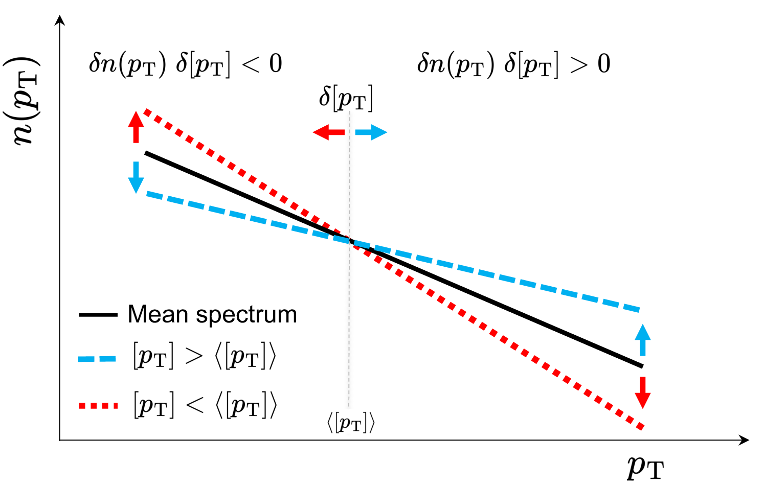
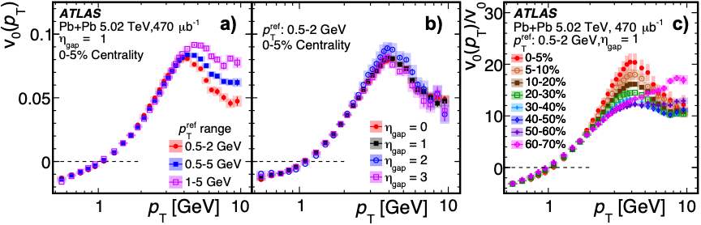
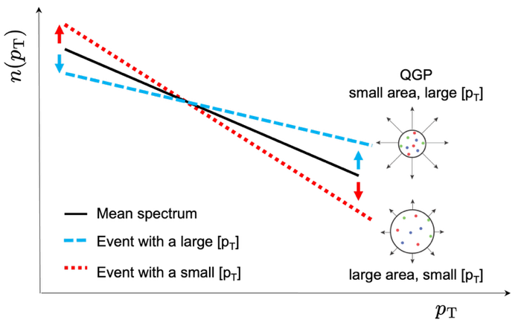
Radial flow in Pb+Pb
arXiv:2503.24125 sub. PRL
At LHC Pb+Pb collision produce quark gluon plasma: a state of matter where quarks and gluons are deconfined with a fluid-like behaviour
Measurement aiming to study collective effects in the isotropic QGP expansion “radial flow”: new observable ν₀(p_{T}) study the correlation between the fraction of particles in a given pT range and the average p_{T} in each event
Collective behavior proven by three key signatures:
  Radial flow factorization in (reference) p_{T}
  No dependency on rapidity gap (long range)
  Centrality independent shape (at low pT)

Slide 29
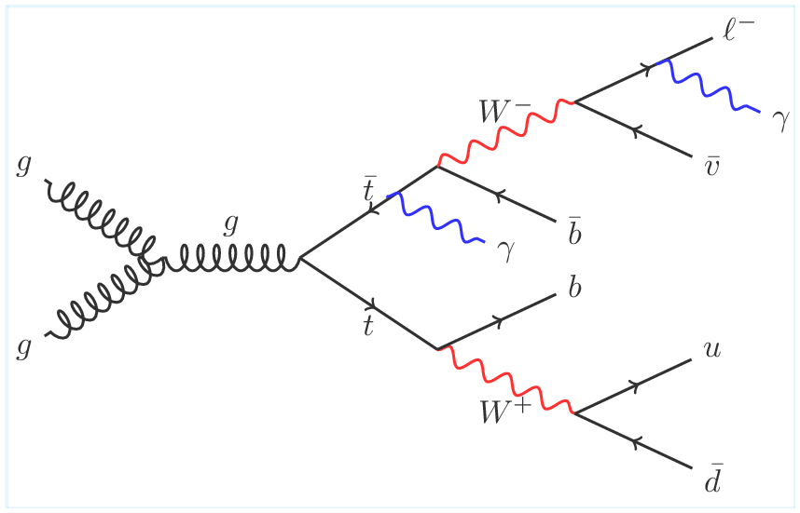

Observation of ttγγ process
New
Study production of top anti-top in association with tow prompt γ
Very rare process: expected cross-section ~ few fb
Select events with 1 leptons, 2 isolated photons and at least 4 jets of which at least one b-tagged
Use BDT based on photon and other event variables (19 in total) to enhance backgrounds rejection (mainly fake photons in tt events)
Measured fiducial cross-section σ(ttγγ) = (2.42^{+0.58}_{−0.53} ) fb
Prediction from LO MC 1.5^{+0.4}_{-0.5} fb x estimated k-factor ~1.7
Observed significance 5.2σ
arXiv:2506.05018 sub. to PLB

Slide 30
Improvements in Flavor Tag
arXiv:2505.19689 Sub. to Nature Communications
Traditional approach (DL1r): low-level quantities based on track followed by high-level multivariate classifier
New approach (GN2): directly process track and jet information. In addition to the primary training target (jet flavor prediction) auxiliary training objectives are introduced to reconstruct the internal structure of a jet by grouping tracks originating from a common vertex
GN2 used in Run2+Run3 HH→bbγγ analysis 20% improvement on σ_{HH} sensitivity ()
Run 3
Run 2

Slide 31
Improvements in Flavor Tag
2505.19689 Submitted to Nature Communications
Traditional approach (DL1d): low-level quantities based on track followed by high-level multivariate classifier
New approach (GN2): directly process track and jet information. In addition to the primary training target (jet flavor prediction) auxiliary training objectives are introduced to reconstruct the internal structure of a jet by grouping tracks originating from a common vertex

Slide 32

Search for HH→ bbγγ
ATLAS-CONF-2025-005
Legacy Run 2 analysis updated adding Run 3 data up to 2024: Total 308 fb⁻¹
BDT trained in two m*_{bbγγ} regions to increase sensitivity to κ_{λ} (Higgs self-coupling modifier)
Several improvements on HH sensitivity relative to Run 2 legacy analysis:
  Additional data 50%
  New flavor tag algorithm GN2: 20%
  m_{bb} kinematic fit : 5%
  Analysis preoptimization 10%
Signal extracted by a fit to the γγ mass spectrum

Slide 33


Search for HH→ bbγγ
ATLAS-CONF-2025-005
Signal strength:
  Observed 𝜇_{𝐻𝐻} = 0.9 ^{+1.3} _{−1.0} (stat) ^{+0.6} _{−0.5} (syst)
  Expected 𝜇_{𝐻𝐻} = 1.0 ^{+1.3} _{−1.0}
  Observed 0.8 σ significance (1.0 expected)
  Systematics dominated by the H+HF estimate (can be measured in or data
Higgs boson self coupling modifier limited in the range κ_{λ} $∈$[-1.7,6.6] @95% CL (assuming all other couplings are SM like)

Slide 34
Observation of ttγγ process
New
Study production of top anti-top in association with tow prompt γ
Very rare process: expected cross-section ~ few fb
Select events with 1 leptons, 2 isolated photons and at least 4 jets of which at least one b-tagged
Use BDT based on photon and other event variables (19 in total) to enhance backgrounds rejection (mainly fake photons in tt events)
Measured fiducial cross-section σ(ttγγ) = (2.42^{+0.58}_{−0.53} ) fb
Prediction from LO MC 1.5^{+0.4}_{-0.5} fb x estimated k-factor ~1.7
Observed significance 5.2σ
arXiv:2506.05018 sub. to PLB

Slide 35



Quark compositeness
New
Look for BMS phenomena in events with high energy jets
Broad resonances in di-jet angular analysis (sensitive to DM mediator and QBH in HQM models):
  Use dN/dχ normalized distribution in broad m_{jj} bins $χ=e^{|y1 −y2|}$ $\sim$ $\frac{1+\cos{θ^{∗}}}{1−\cos{θ^{∗}}}$
  QCD shape based on MC predictions (reweighted at NLO)
No significant excess found, and 95% CL limits derived: excluded QBH masses up to 8.7 TeV for n=2

Slide 36
H → μμ
New
Best chance to test SM Yukawa sector (the most intriguing part) on 2nd Fermion generation
Rare decay BR~2x10⁻⁴, signal mass peak over the huge DY continuum background: S/B inclusive ~0.2%
Define categories based on Higgs production mode to enhance S/B, 23 mutually exclusive categories:
  16 ggF and VBF categories BDT-based on number of jets (b-veto, 2 leptons, Etmiss cut)
  5 VH categories: 1 ZH4L, 2 ZH2LMET and 2 VH3L (4 leptons, 2L+Etmiss, 3 leptons)
  2 ttH category (b-tag) NN based
Main improvements relative to previous analysis:
  Very large Sherpa DY sample (5B events) to study bkg. modeling (most difficult part of the analysis)
  BDT score in ggF+VBF DY MC reweighted to mass SB to get better m_{μμ} modeling for DY
  Di-muon primary vertex refit (2% improvement on signal) mass resolution ~2.6-3.5 GeV
Most important work has been the timely calibration of the physics object for Run 3 (including 2024!)

Slide 37


H →μμ
New
Signal extracted via an analytical fit to m_{μμ} spectra
Bkg. Modeling based on Core x Empirical analytic fit or spectra
  Core DY same for all categories (no free DOF)
  Empirical: flexible enough to adapt to mass distortions caused by selection, between 1 and 4 shape DOF depending on category (plus normalization)
  Required good quality fit on: MC, data SB, MC systematic variations
  Uncertainties implemented via Spurious Signals (signal yields obtained from a fit to the background-only MC spectra) → Kept below 20% stat. uncertainty
Run 3 (2022-2024): μ=1.6 $±$ 0.6 (0.6 stat.,0.3 syst) → 2.8 σ (Exp. 1.8 σ)
  Compatibility among 6 categories 54%
Combined Run 2: μ=1.4 $±$ 0.4 (0.4 stat.,0.1 syst) → 3.4 σ (2.5 σ)
  All modeling systematics correlated, Experimental systematics (mainly SS) are of statistic nature → not correlated
  Compatibility Run 2 vs Run 3: 68%
STRONG evidence for H→ μμ decay in agreement with SM
BR(H→μμ) = (3.0$±$ 0.9)$×$10⁻⁴

Slide 38




H → Zγ
New
Rare decay loop-suppressed in the SM with BR=1.5$±$0.1 x 10⁻³
Sensitive to BSM effects and complementary to H→γγ
Intriguing result ATLAS+CMS in Run 2: μ=2.2$±$0.7 (about 2σ above SM) Phys. Rev. Lett. 132 (2024) 021803
Important to timely check with Run 3 data, need 2022-2024 sample ~165fb⁻¹
Select 2 isolated leptons compatible with Z→ll (e,μ) (10 GeV mass window) and isolated photon
Relative to Run 2 analysis:
  Improved mass resolution including FSR
  Improved categorization 13 categories 1 3L (target VH, ttH), 2 VBF categories, 5 BDT-based categories x 2 lepton flavors
Signal extracted by analytical fit to the m_{llγ} spectra (13 cat.)
Background modeling functions and systematics based on Spurious Signal test (S+B fit on bkg.-Only templates) → mainly of statistical nature, kept small relative to stat. unc.
Other systematics includes signal modeling and main exp. Uncertainties
$$\sim$$
χ$±$
t

Slide 39


H → Zγ
New
Main backgrounds Z+γ (irreducible) and Z+jet
Signal extracted by analytical fit to the m_{llγ} spectra (13 cat.)
Background modeling functions and systematics based on Spurious Signal test (S+B fit on bkg.-Only templates) → mainly of statistical nature, kept small relative to stat. unc.
Other systematics includes signal modeling and main exp. Uncertainties
Run 3 Results: μ=0.9^{+0.7}_{-0.6} significance 1.4σ (exp. SM 1.5σ)
  Compatibility among categories 37%
Run2+Run3: μ=1.3^{+0.6}_{-0.5} significance 2.5σ (exp. SM 1.9σ)
  Modeling uncertainties correlated, experimental uncertainties (dominated by SS) non correlated: effects of systematics correlations negligible

Slide 40




Run 2 Higgs coupling combination
New
Almost final Run 2 result:
  Added 6 new measurements: ttHbb, VH(bb,cc) Hττ)
  Precision improved by 35% relative to Nature 607 (2022) 52
μ(σ_{obs}/σ_{SM}) = 1.023 ^{+0.056}_{-0.053}
  $±$0.028(stat)$±$0.026(exp)$±$0.037(th)$±$0.12 (th-bkg.)
Main improvements on σ:
  WH/ZH reduced by 35/20% (new VHbb)
  ttH reduced by 25% (updated ttHbb)
Main improvements on coupling modifiers:
  κ_{c} 35% (new VHcc analysis)
  κ_{t} 25% (new ttHbb analysis
All results compatible with SM predictions

Slide 41


Run 2 Higgs coupling combination
New
Almost final Run 2 result
μ(σ_{obs}/σ_{SM}) = 1.023^{+0.056}_{-0.053}
  0.028(stat) 0.026(exp) 0.037(th) 0.12 (th-bkg.) uncertainty reduce by 10%
Main improvements on σ:
  WH/ZH reduced by 35/20% (new VHbb)
  ttH reduced by 25% (updated ttHbb)
Main improvements on coupling modifiers:
  κ_{c} 35% (new VHcc analysis)
  κ_{t} 25% (new ttHbb analysis
All results compatible with SM predictions
P_{SM} 85%

Slide 42


Slide 43


Slide 44

The Phase II upgrade program

