Slide 1
Fabrication Techniques for RF Cavities
Marco GARLASCHÈ
On behalf of CERN FCC SRF R&D Project
2025-07-15
CERN-CODELCO Copper Mini-workshop

Slide 2

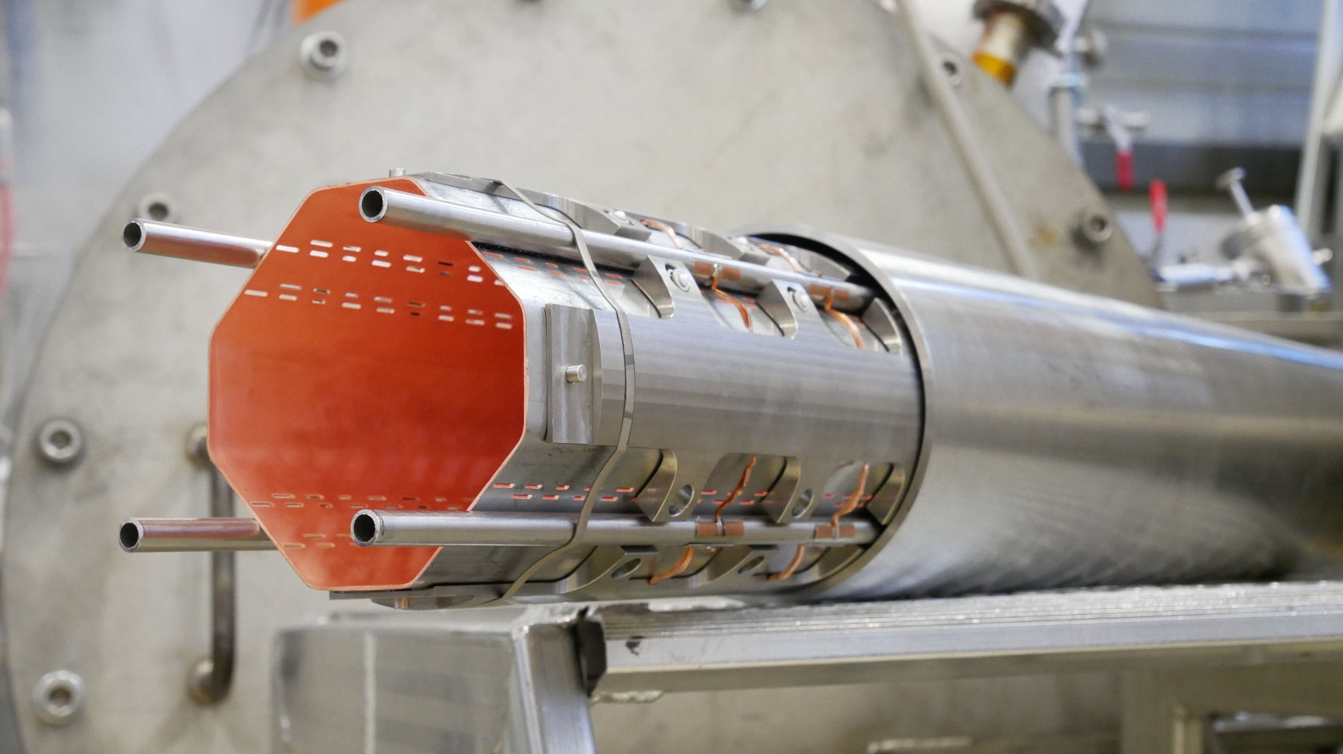
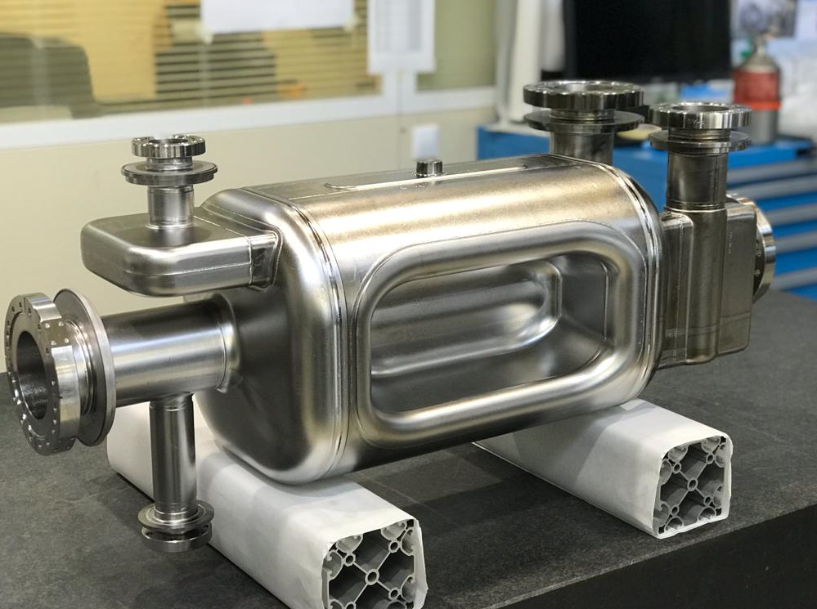
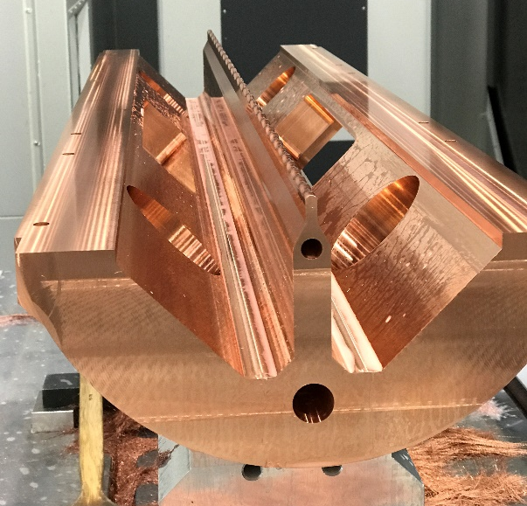
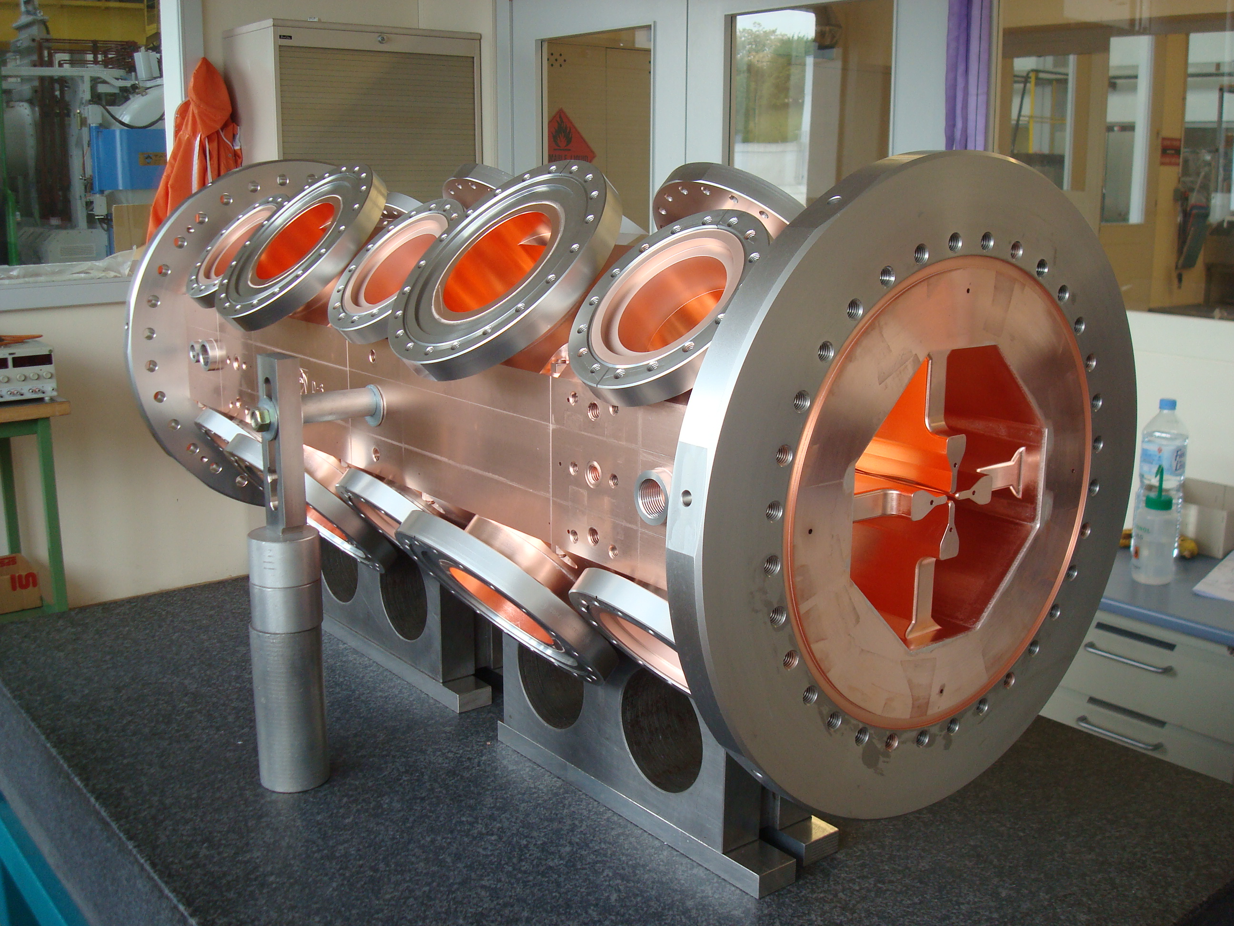
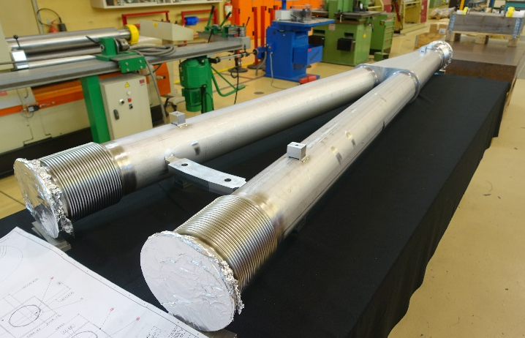
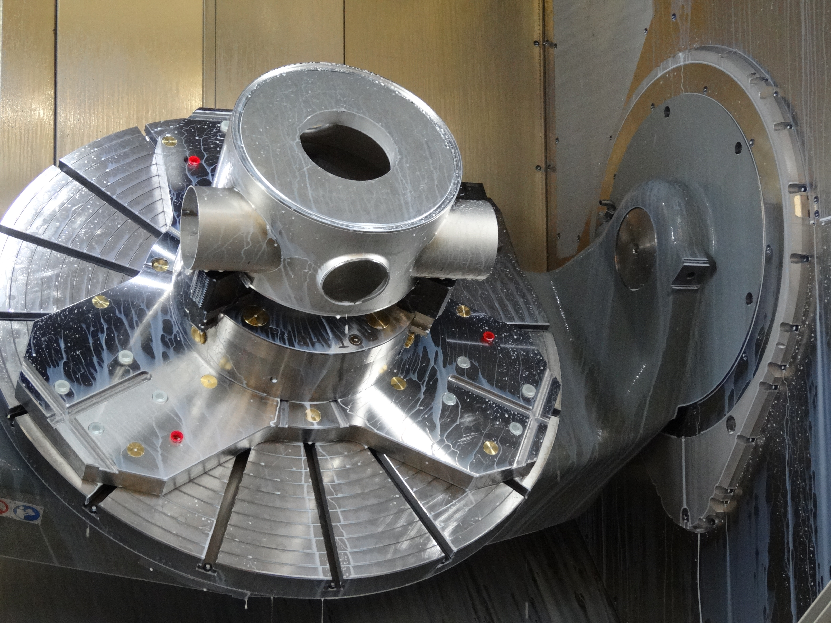
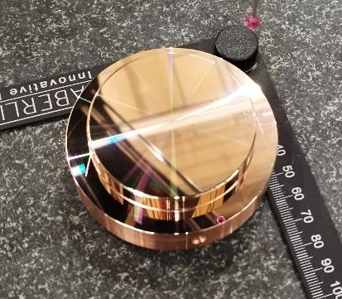

Slide 3
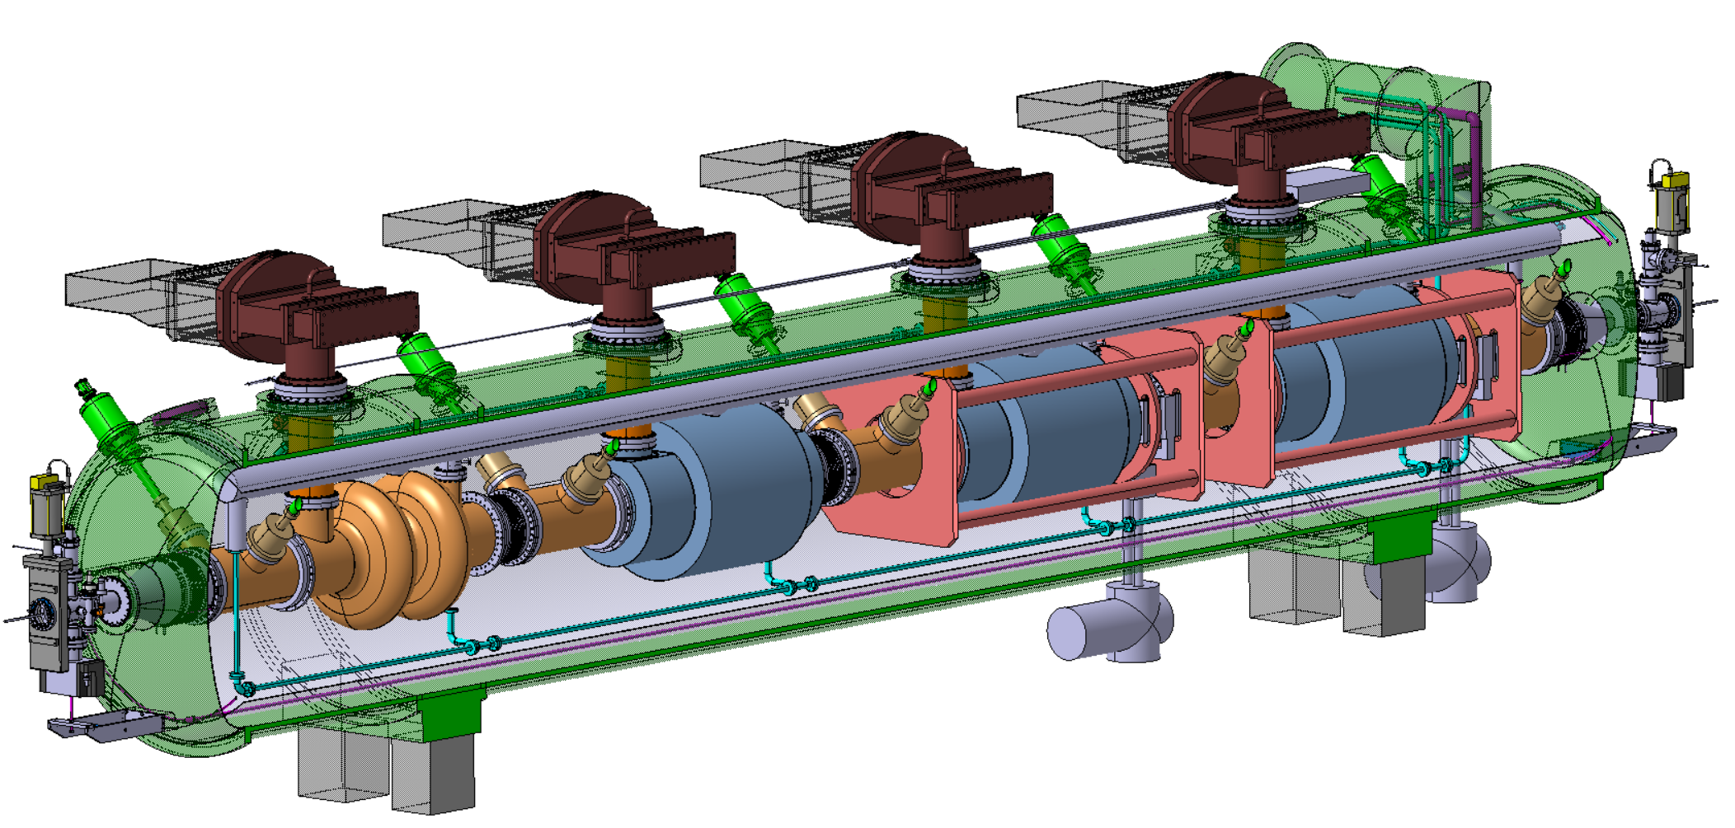
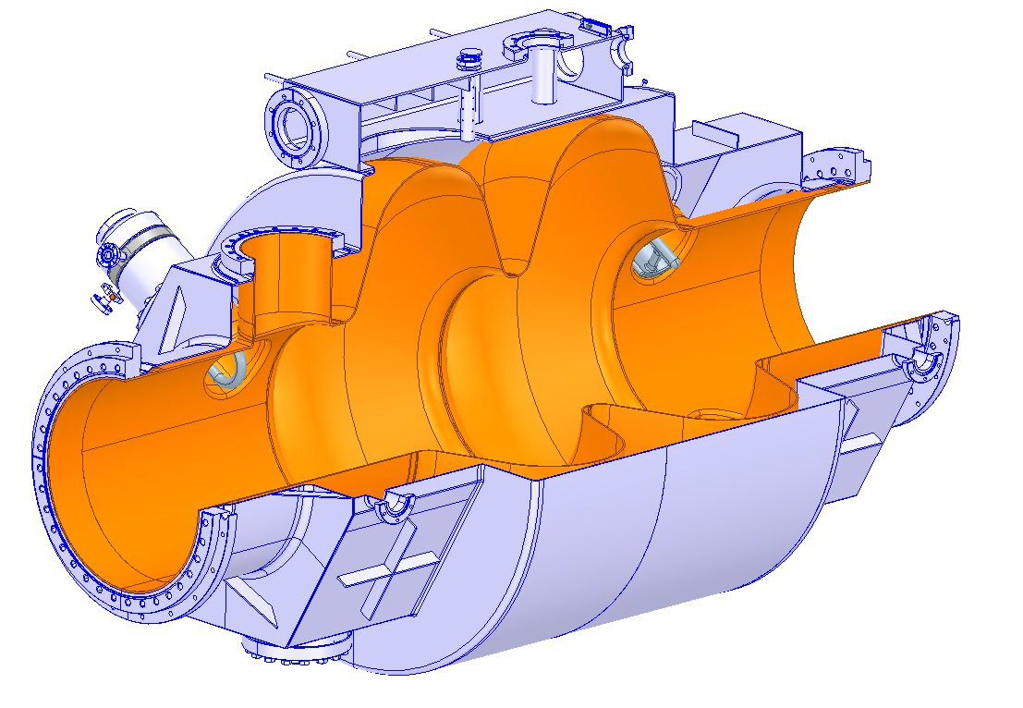
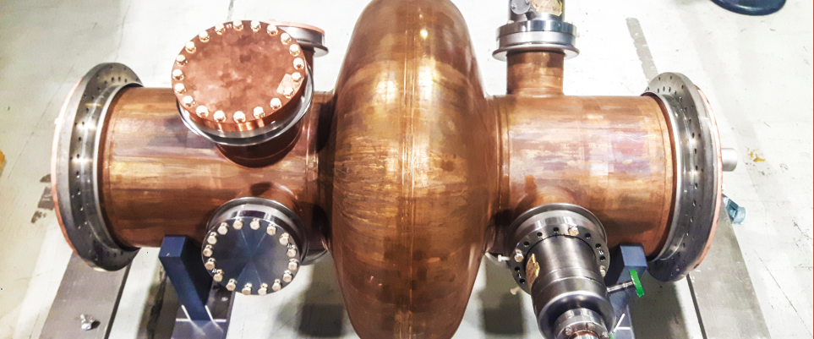
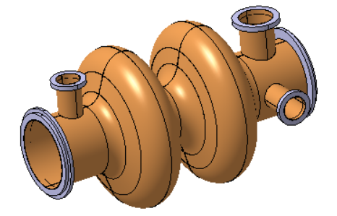
FCC Collider – 400 MHz Cavity System
Superconducting elliptical cavity
400 MHz, 2-cell
Copper substrate, Nb layer
Typical Cavity Subcomponents
…Flanges, Beam pipes , Extremities,…
…Half-cells, cells…
400 MHz – LHC type
1400mm
700mm
264x
≈>100kg

Slide 4
Core Technologies:

Slide 5
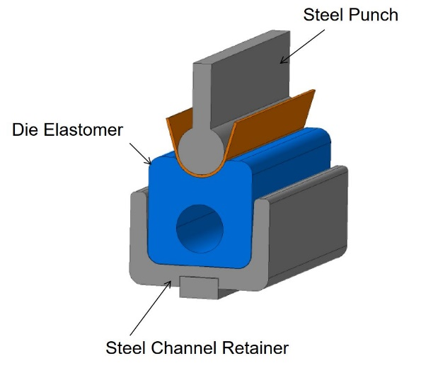
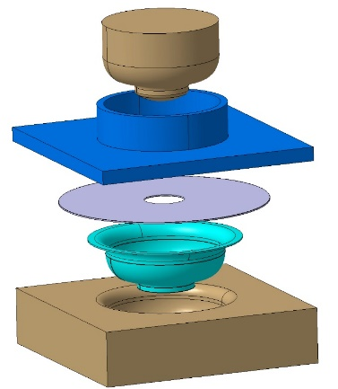
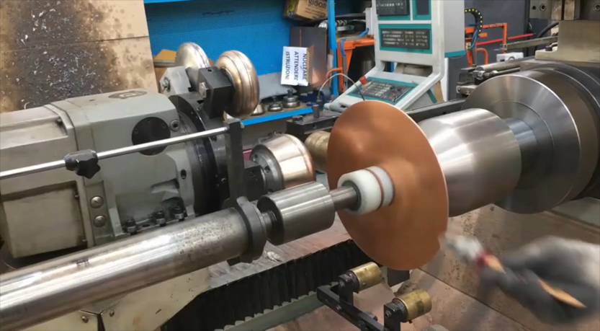
Core Technologies: Shaping
Metal Sheet Shaping
High precision shaping (≈ 0.3 mm)
Ultra high precision Edge Calibration (≈0.1mm)
Rolling &
(Press)Bending
Deep Drawing
Spinning

Slide 6
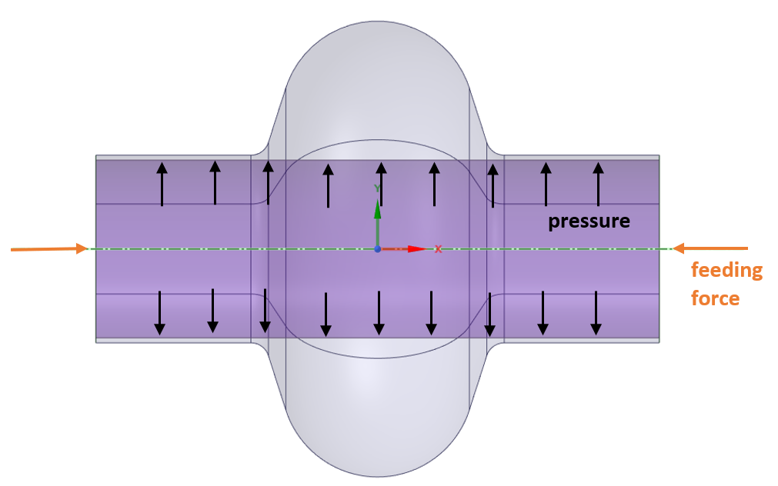
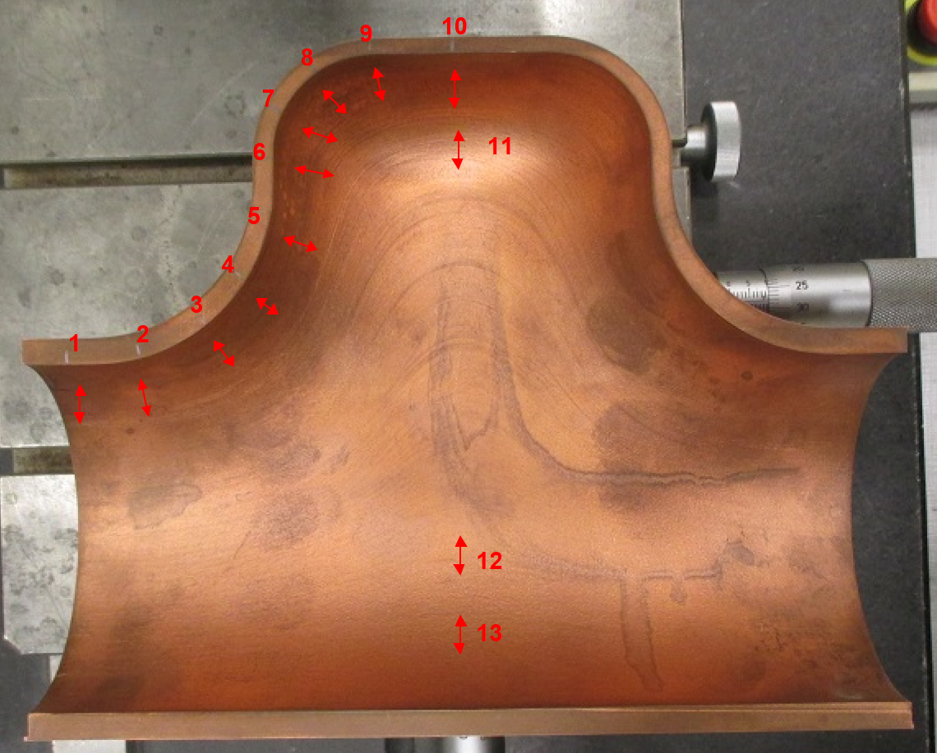
Core Technologies: Shaping
Metal Sheet Shaping
High precision shaping (≈ 0.3 mm)
Ultra high precision Edge Calibration (≈0.1mm)
Rolling &
(Press)Bending
Hydroforming
Open Die
Deep Drawing
Spinning

Slide 7
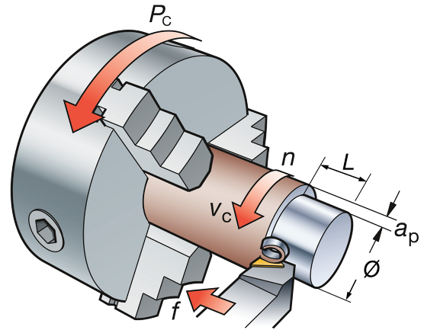
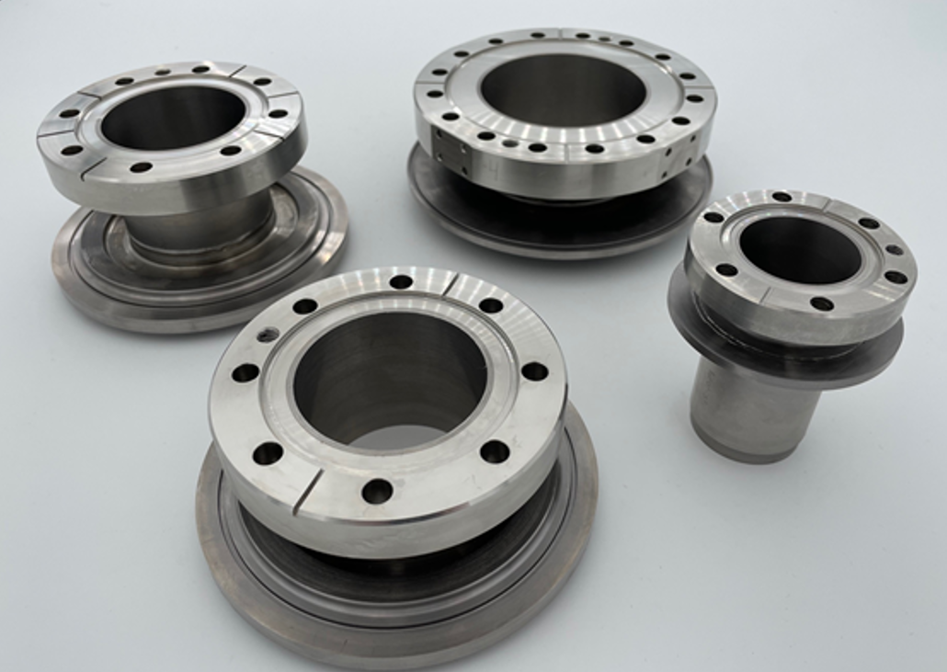
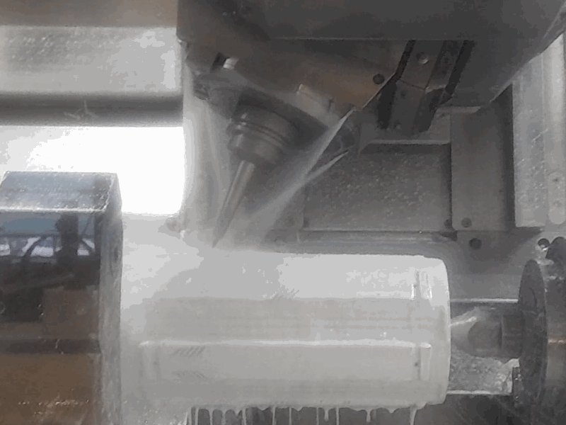
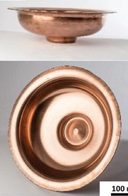
Core Technologies: Machining
CNC Turning and Milling
Both on bulk parts & on metal sheet shapes
Machining Copper at different tempers (Half-hard, Annealed)
Both lubricated and dry (alcohol, …UHV compatibility)
High precision (finishing ≈ 0.02 mm)
Milling for elliptical cavities : 3x Axis sufficient

Slide 8
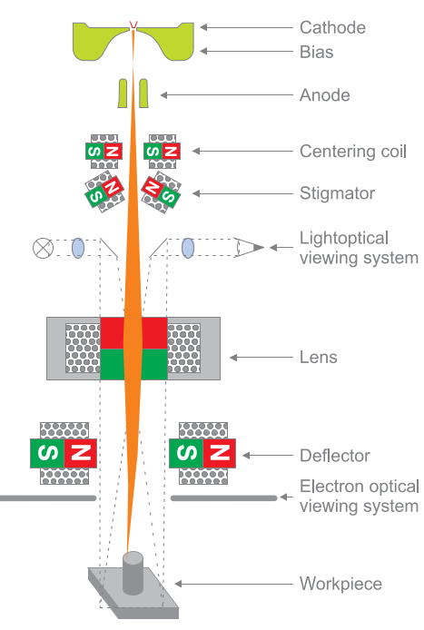
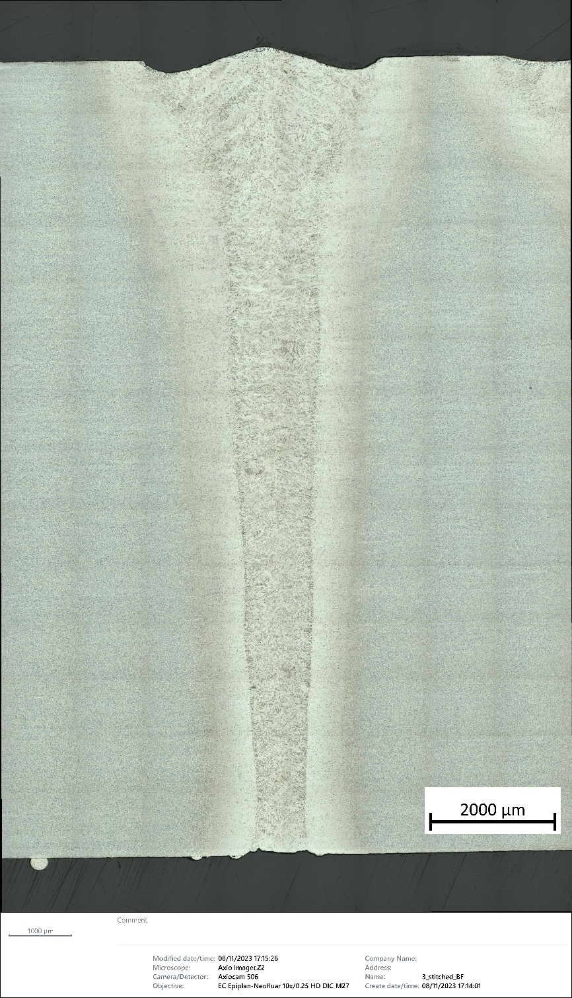
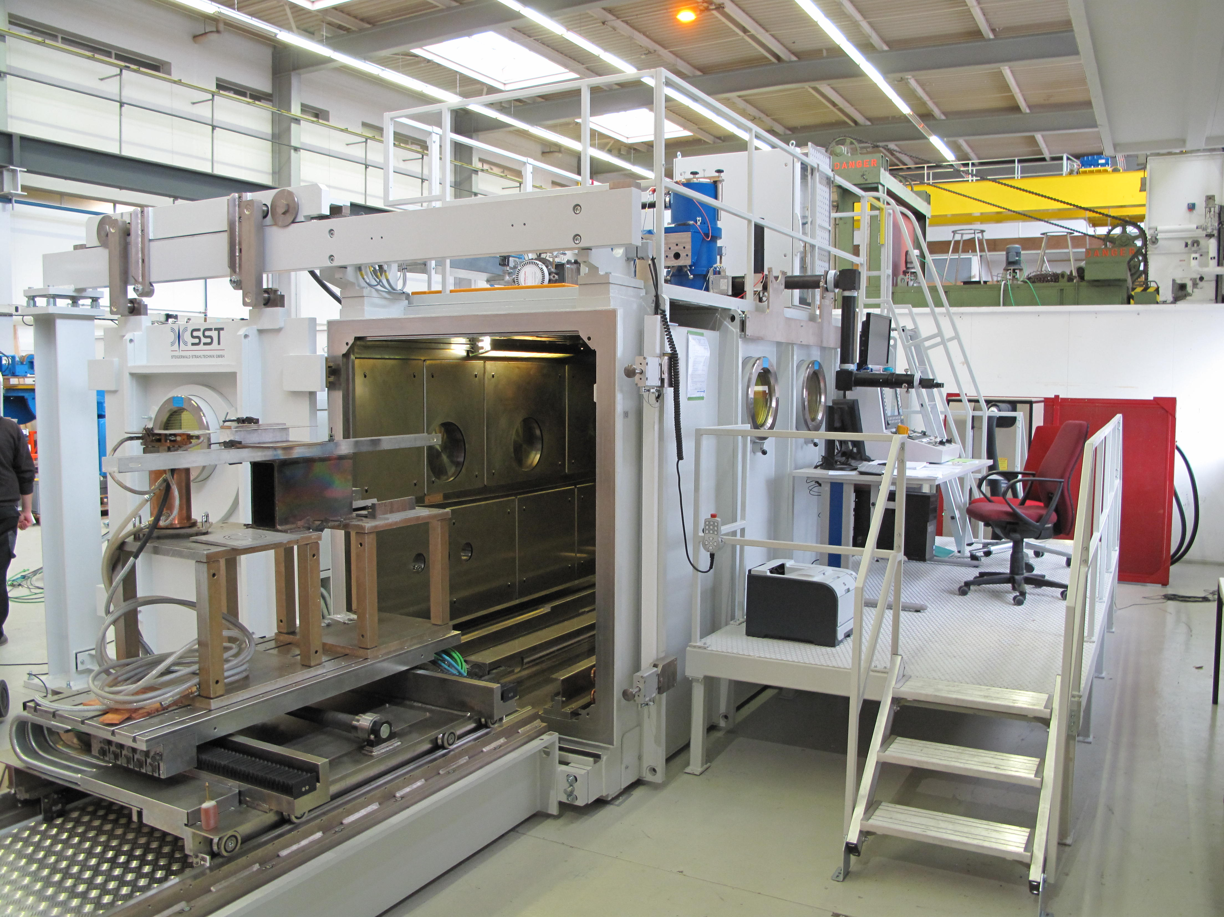
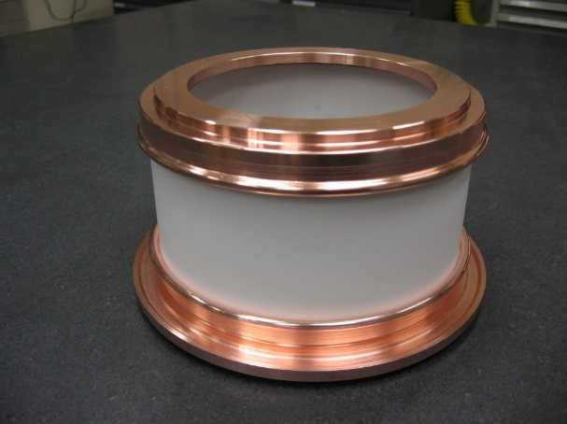
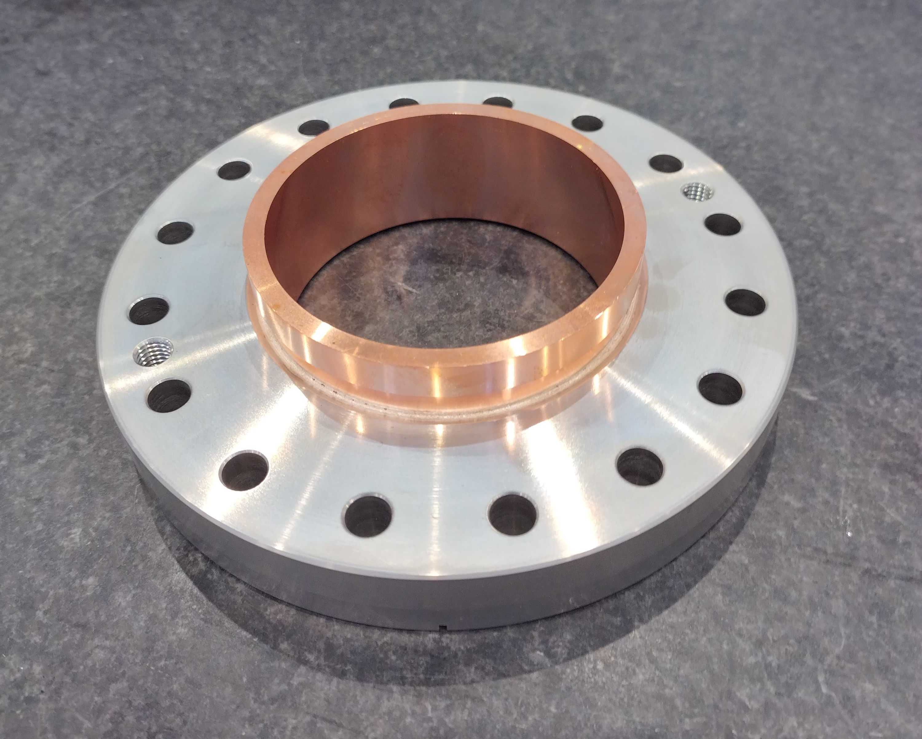
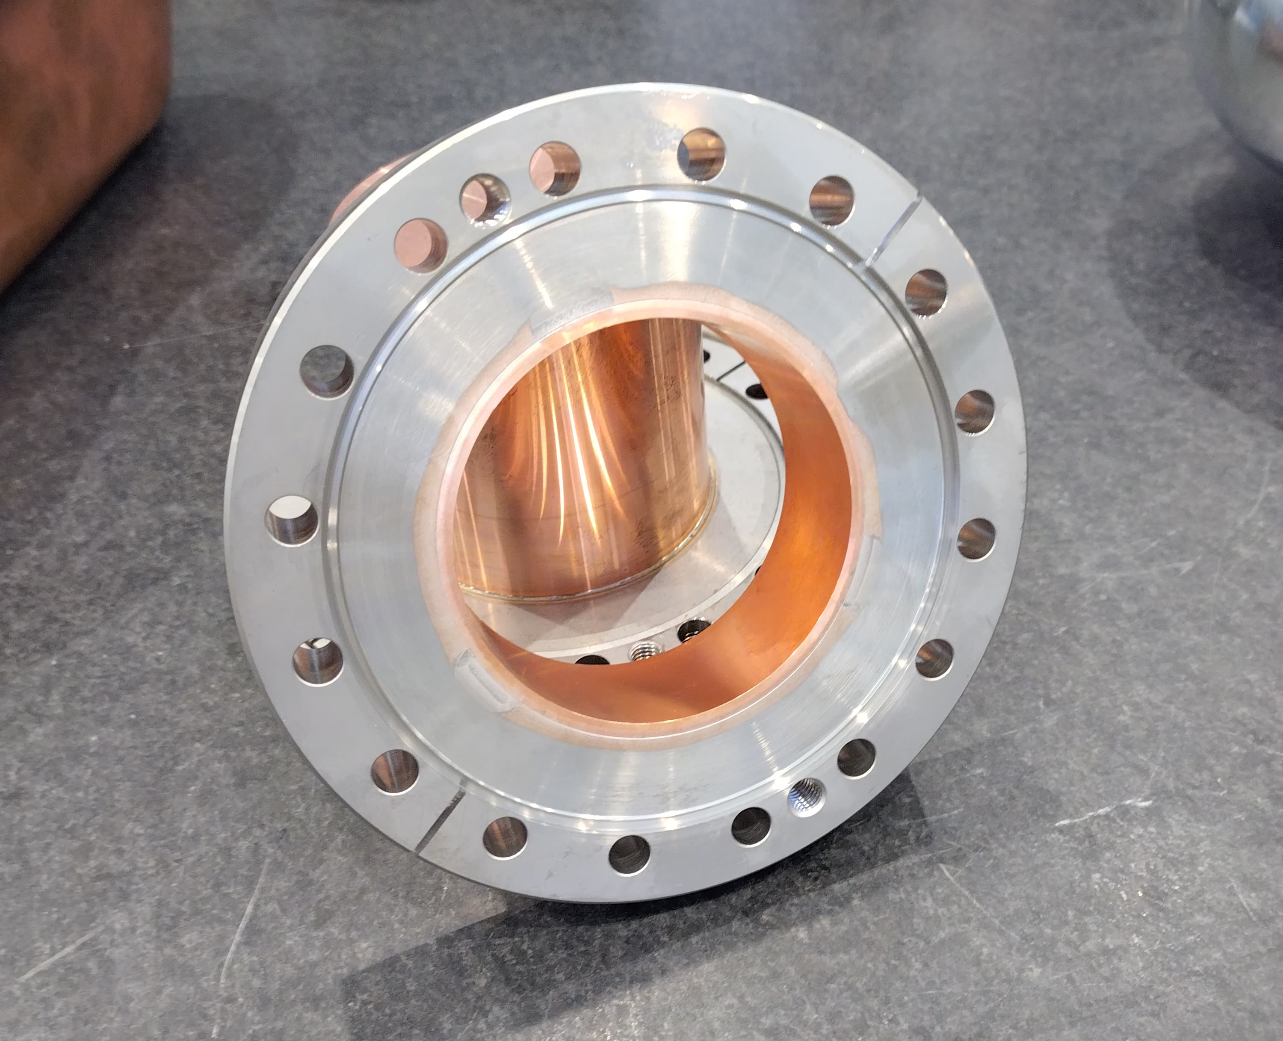
Core Technologies: Joining
Gun column diagram
EB weld on 12 mm Ti gr.5
Electron Beam Welding
Main Features of interest:
Process under vacuum → good protection against oxidation
Very high energy density → low distortion
Large range of weldable thicknesses (from 0,1mm to 200mm)
Many combination possible (Nb/Cu, Cu/SS, Al/Cu,…)
For both processes: High purity Copper requirement
Vacuum Brazing
Main Features of interest:
Join dissimilar materials &/OR not possible to weld (Cu-SS, ceramic)
NO welding shrinkage/fusion →deformation of base materials
Process under vacuum → good protection against oxidation
Complex & inaccessible geometries

Slide 9
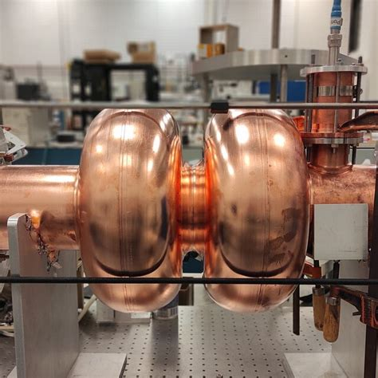
400 MHz SRF Cavity Fabrication Route

Slide 10
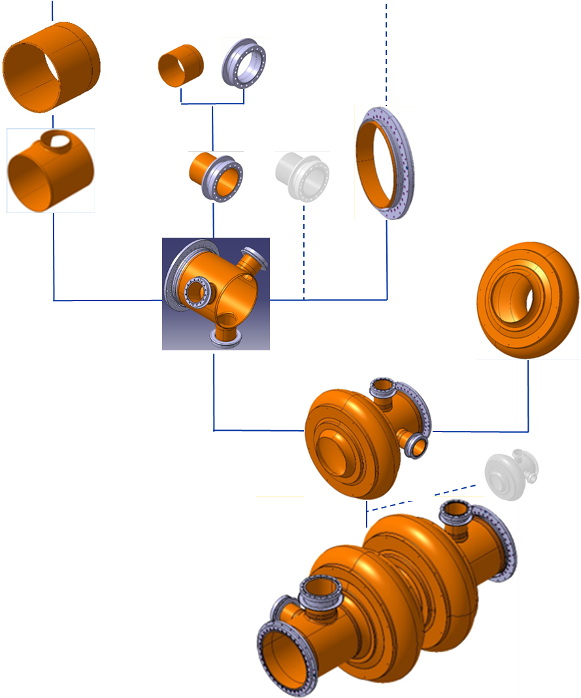
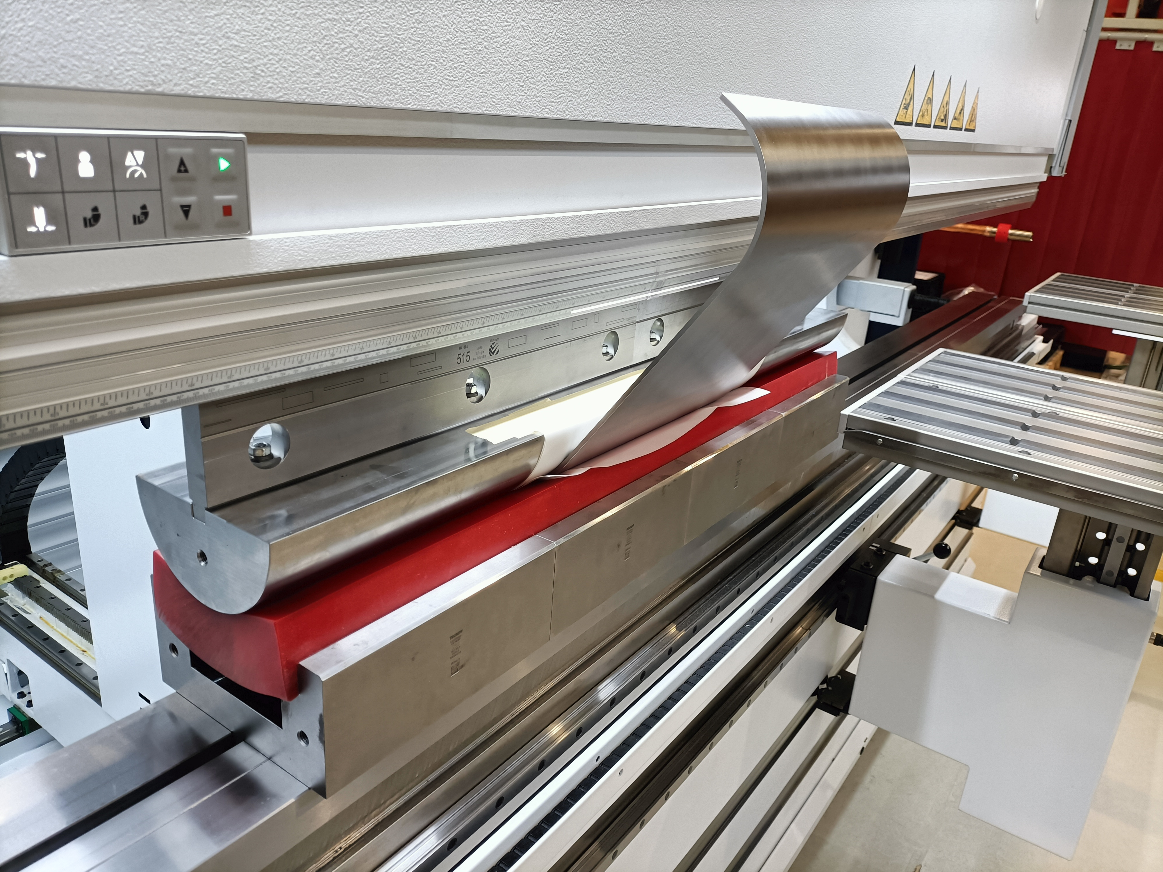
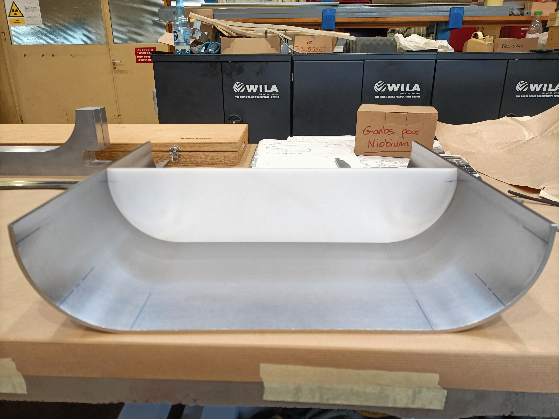
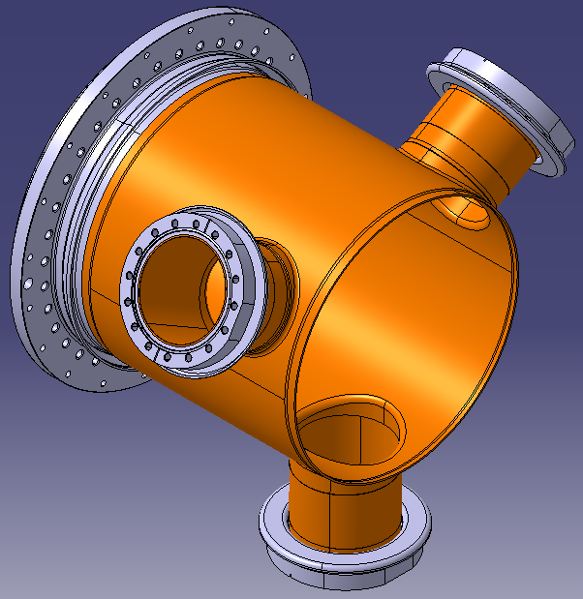
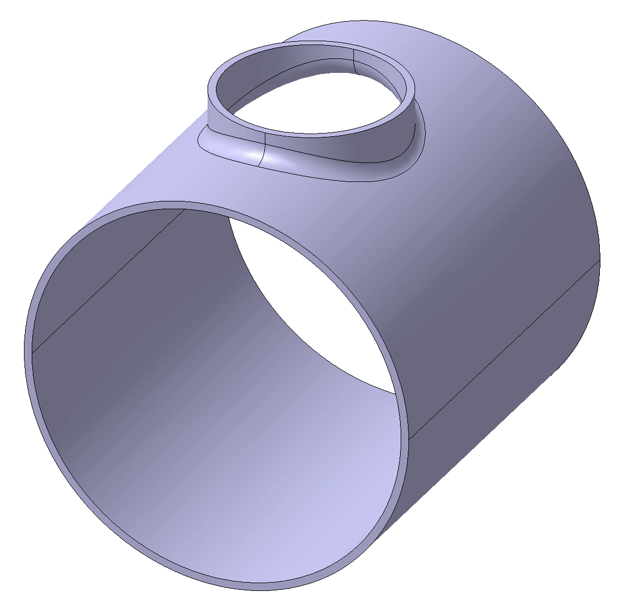
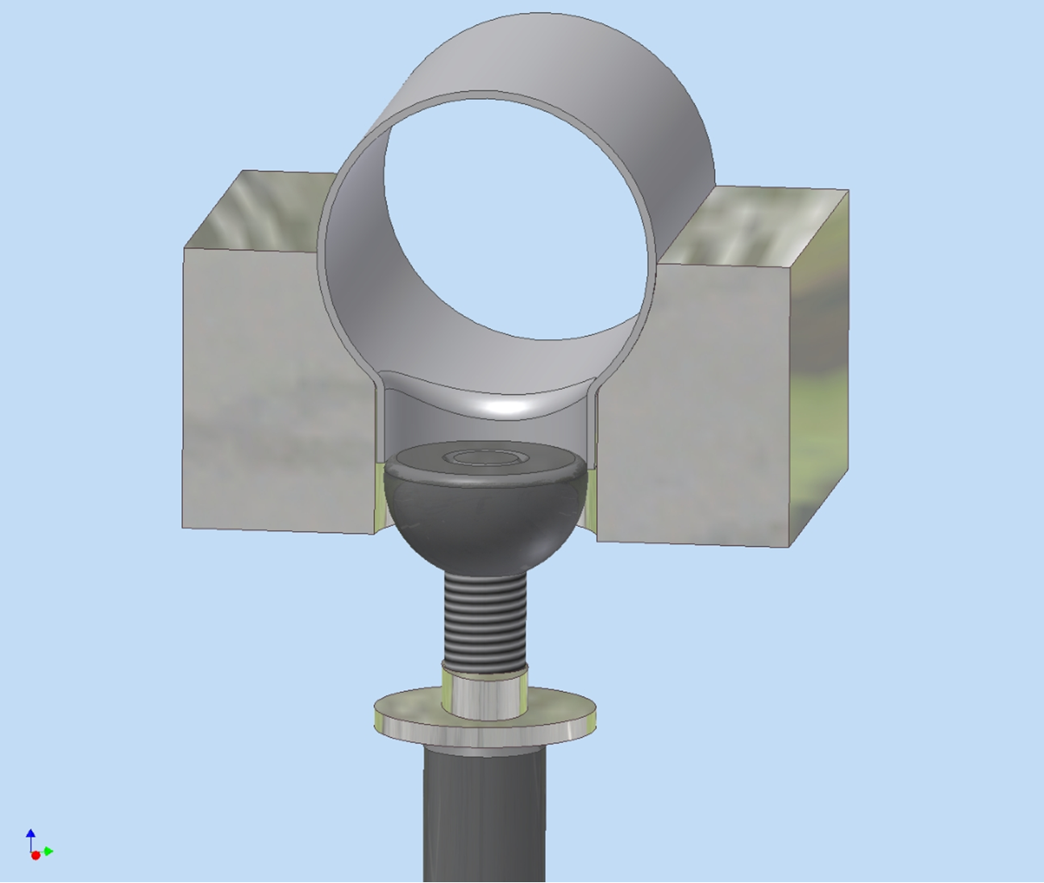
Extremity Pipes
Cu Raw material : Thin Sheet (~4mm)
Processes: Bent, Machined, EB-welded, Calibrated, Re-machined
Necking
Alternative to raw sheet : ‘’standard’’ tubes
Alternative to necking : thicker tube (or cored rod) → Machined

Slide 11
Flanged Connections
Cu Raw material : as per extremities
Alternative : bulk from rod/thick sheet
Processes:
Machined, Brazed, Re-machined
EBW of Flanged Connections & pipes…
…→ Extremity subcomponents → Beam Pipes

Slide 12
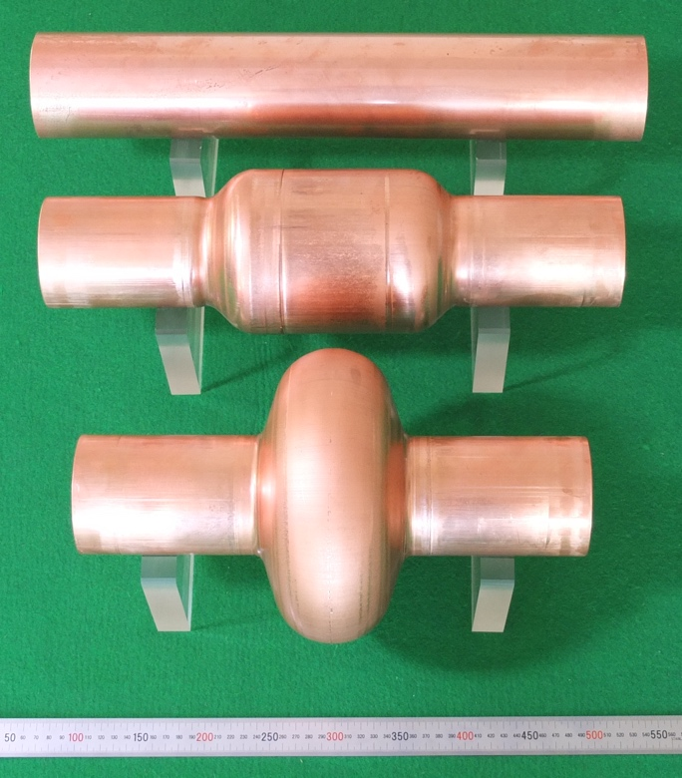
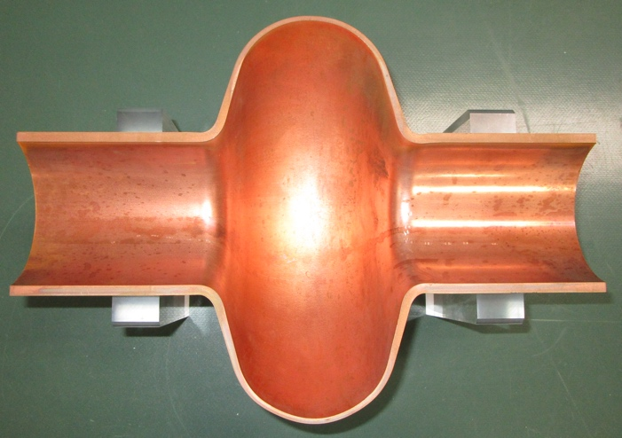
The Cells
Cu Raw : thin sheet
Cu Raw : thick tube
Half-Cells
Intermediate Stress Relief
Calibration
Machining
EB Welding
Remachining

Slide 13
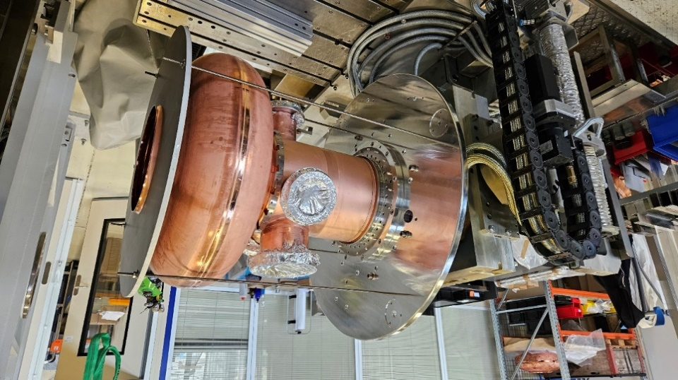
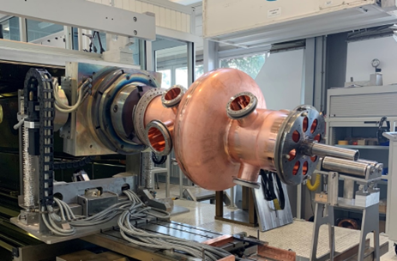
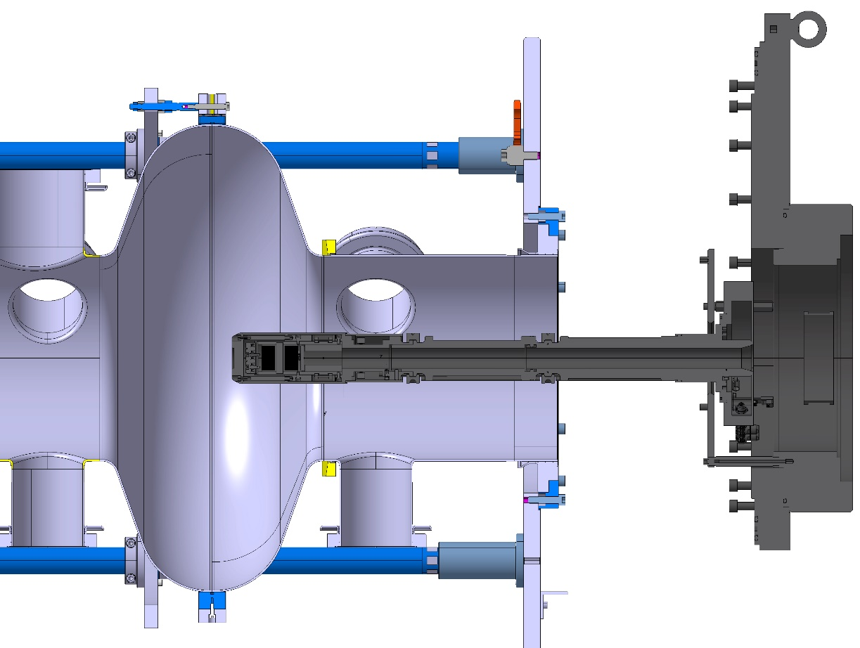
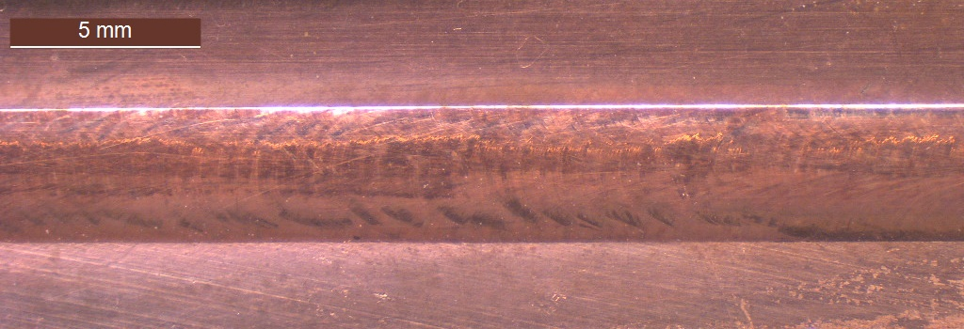
Final EB welding Steps
LHC 400 MHz cavity
Iris electron beam weld with inner deflector
RF side internal weld

Slide 14
Additional Technologies
Additional Core technologies involved in manufacturing:
Precision Metrology and NDT
Surface treatments
  Degreasing, Cu chemical etching
  (Electropolishing, Nb sputtering)
Manufacturing SRF components calls for strongly Interlaced and Multi-technology production
What goes Hand-in-hand ?
  Shaping + Machining
  Surface treatments + Joining

Slide 15
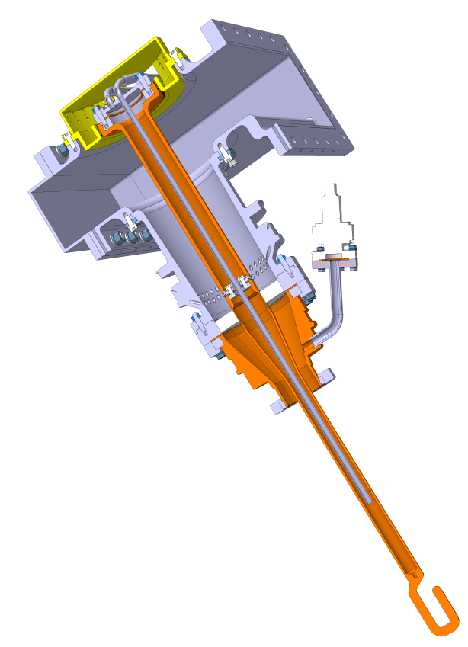
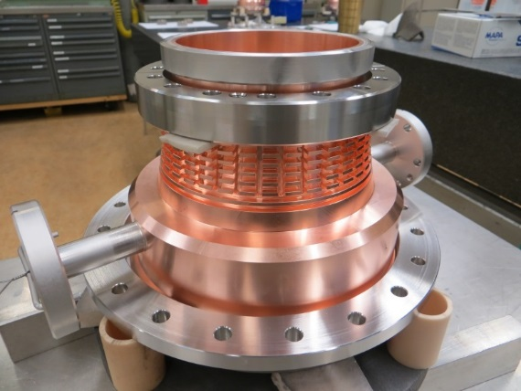
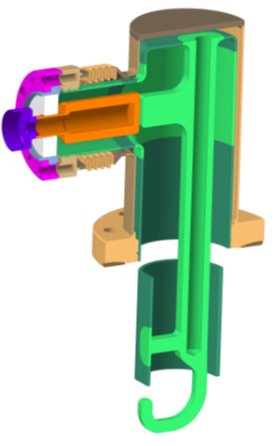
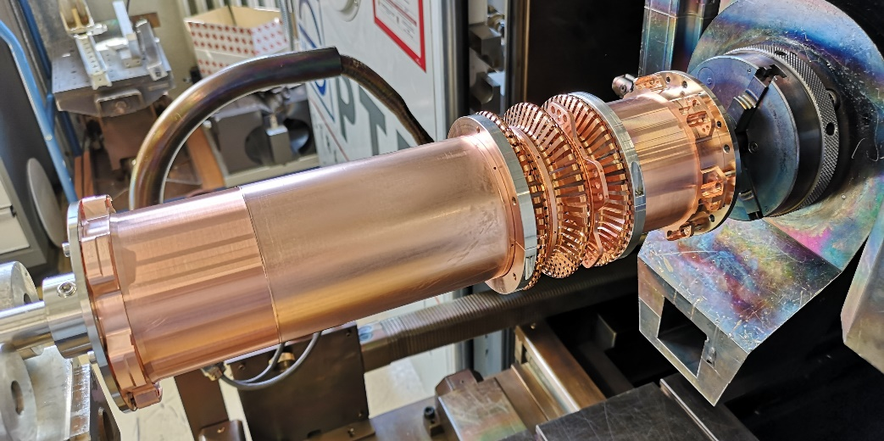
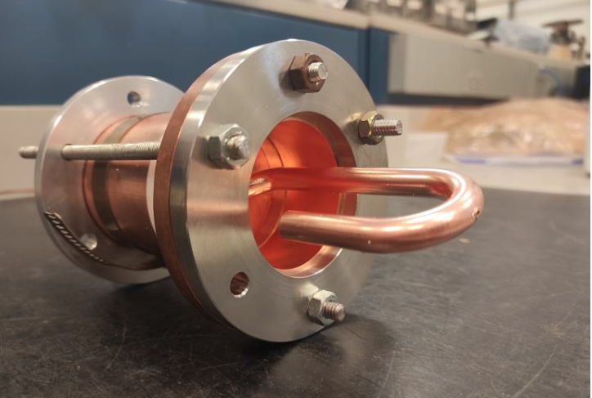
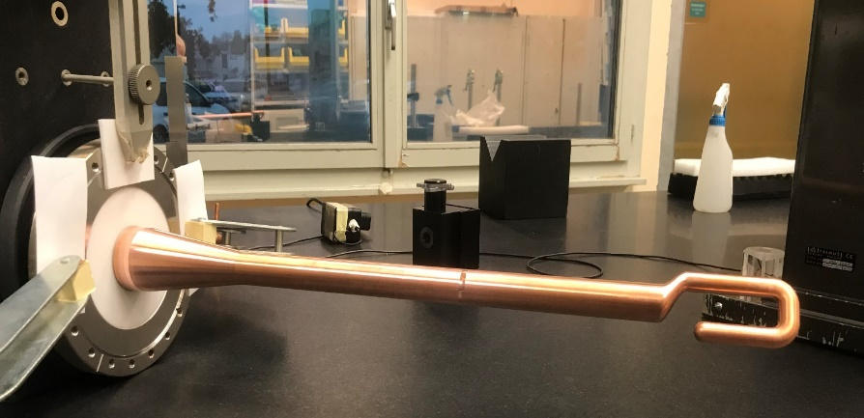
SRF Complementary Systems
Additional equipment required:
Fundamental Coupler (1x per cavity)
HOM Couplers/Antennas (few per cavity)
Core Technologies :
All the ones mentioned (machining > shaping)
Raw Material:
Bulk (rods, discs), thin sheet
~700mm
Beam
Screens
2025-07-15
M. Garlaschè [CERN EN-MME] | CERN-CODELCO Meeting

Slide 16
Additional Systems : Cu Requirements
Additional Copper & Alloys will be required, for FCC subsystems other than SRF
Subsystem | Quantity [tons, order of magn.] | Type
Magnets | Cu OFE : 4400 | Hollow conductors
Vacuum Equipment collider chambers + relative interconnections cooling channels + booster chamber photon absorbers + internal shielding flanges | Cu OFS : 1000 Cu OFE : 577 CuCrZr : 680 CuNiCrSi o CuBe : 50 | Sheets, rods, bulk
RF systems FCC Injector | Cu OFE : 285 | Sheets, rods, bulk
Source : S. Calatroni , A. Milanese, D. Schoerling, M. Morrone, A. Grudiev
2025-07-15
M. Garlaschè [CERN EN-MME] | CERN-CODELCO Meeting

Slide 18
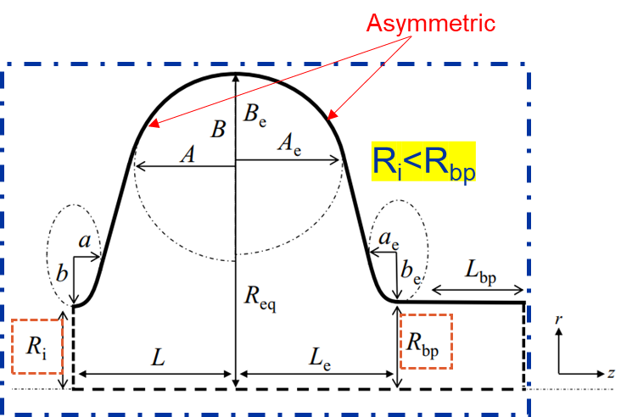
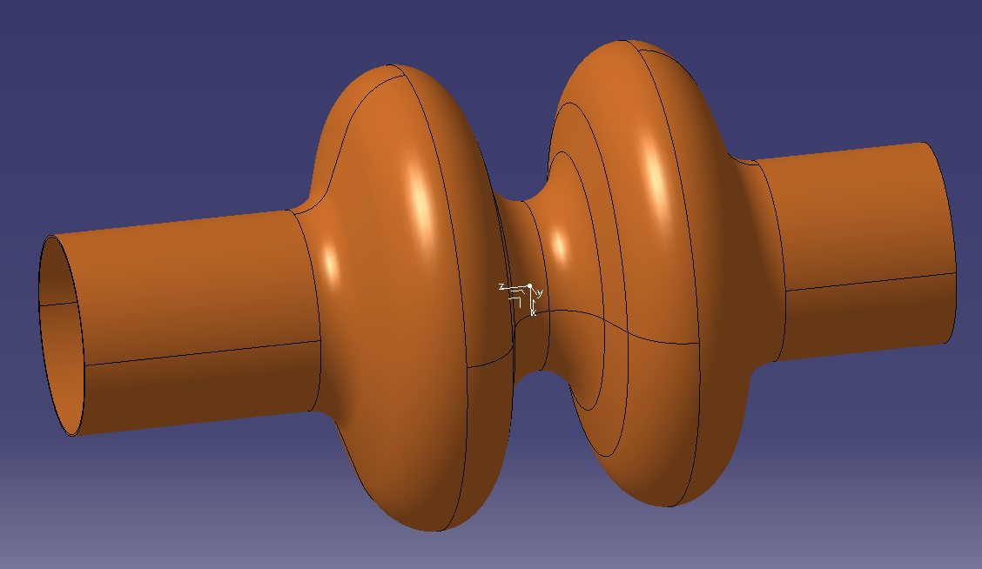
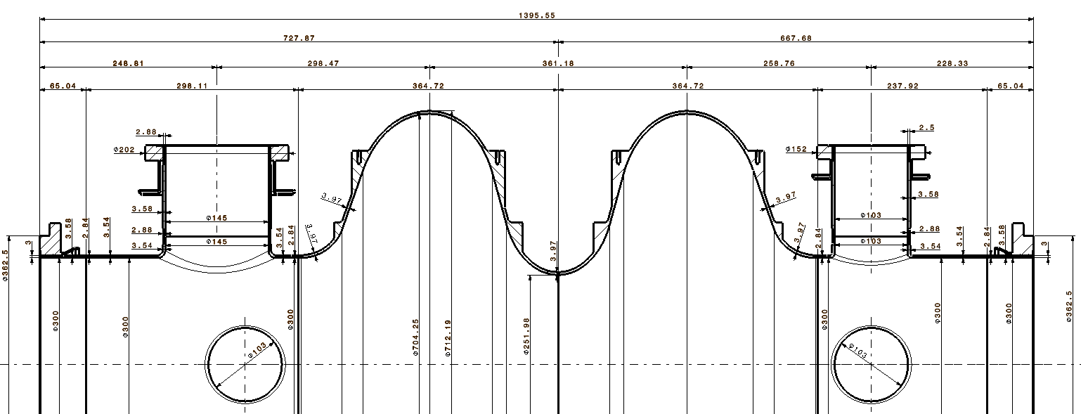
Back up – Crossectional view

Slide 19
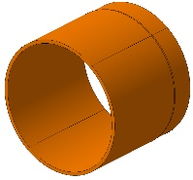
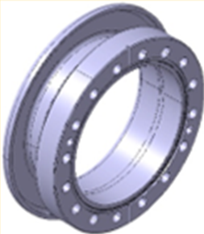








Slide 20

EN-MME: Mechanical & Materials Engineering Group
Engineering & Design
Fabrication
Materials & Metrology
Design Office:
  40+ designers and engineers
  CATIA / SmarTeam, ANSYS, LS-Dyna...
Experimental Mechanics Lab.
Mechanical workshop (4000 m²):
  ~100 technicians and engineers
  CNC machining
  Assembly & metal forming
  Welding (TIG, MIG, electron beam, laser, vacuum brazing)
Technical Subcontracting Service (MME-FS)
Material science consultancy:
  metallurgical analyses, microscopy, mechanical tests
NDT: US, radiography, tomography
Metrology: 350 m² lab. equipped with CMM.

Slide 21





Hydroforming : Further Info
1ST hydroforming
HF1
Hydroforming : process under study for FCC 400 MHz
No equatorial weld seam
$$∅ initial$$
Annealing
Process design
Testing
Process control
2ND hydroforming
HF2
09/04/2025
09/04/2025

