Slide 1
BOND
Updates on coil mock-ups
N. Lusa and J. Ferradas Troitino
08/07/2025

Slide 2
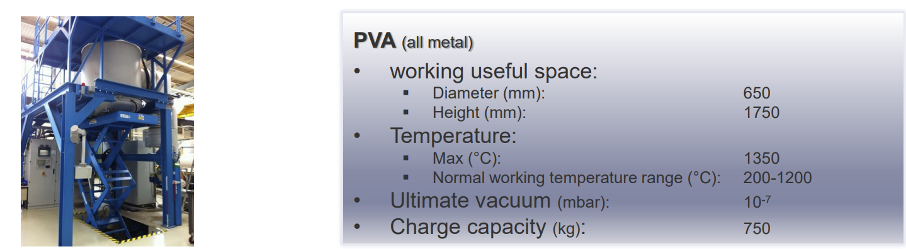
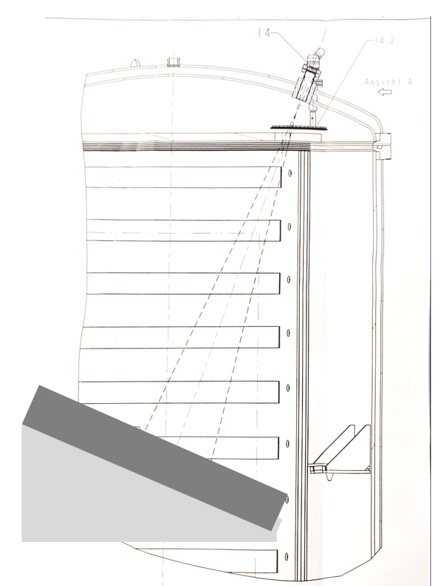
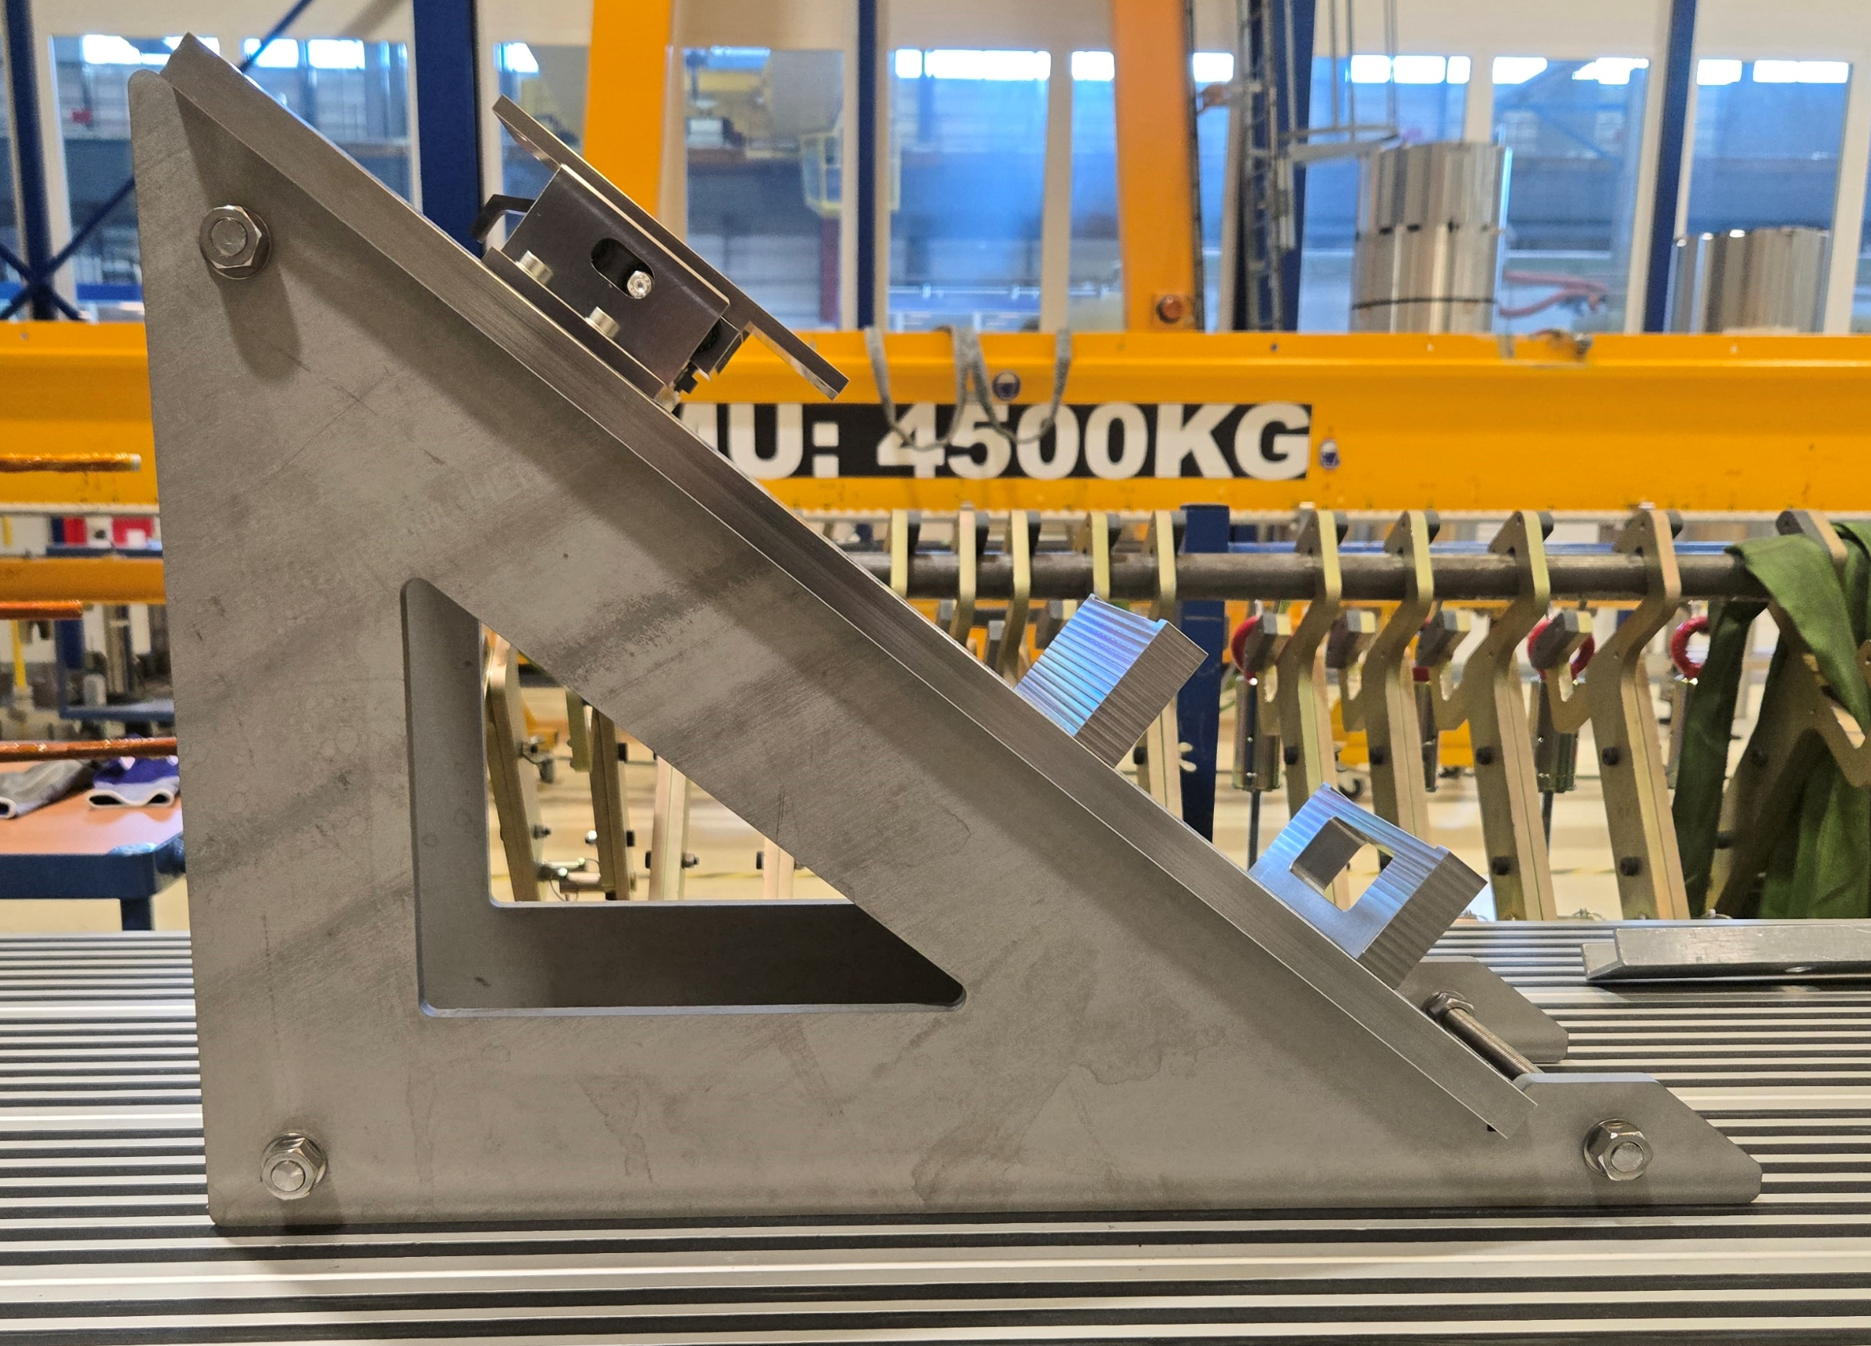
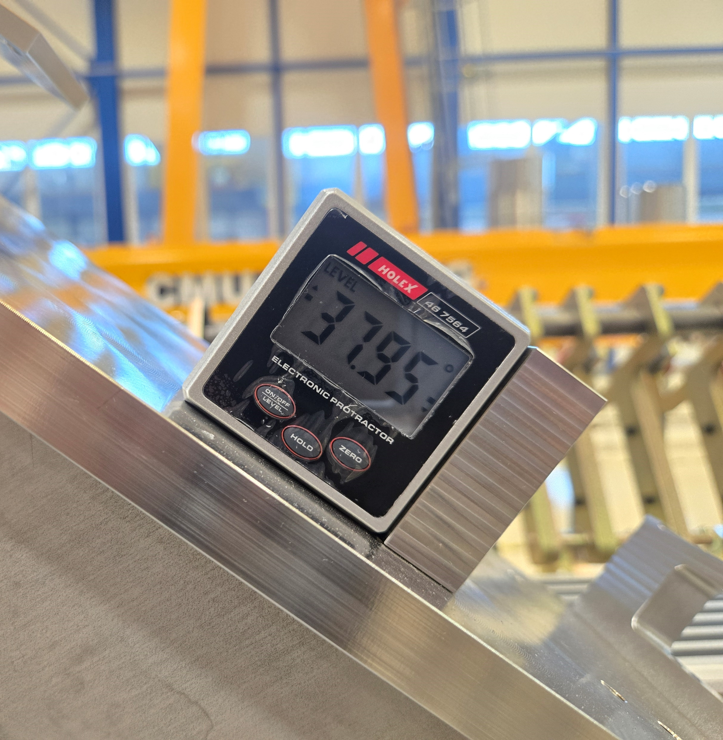
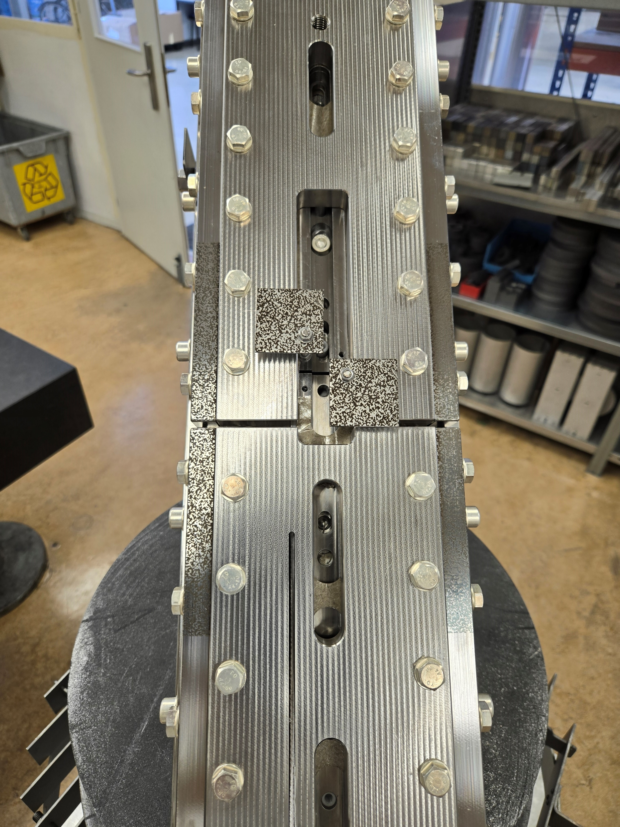
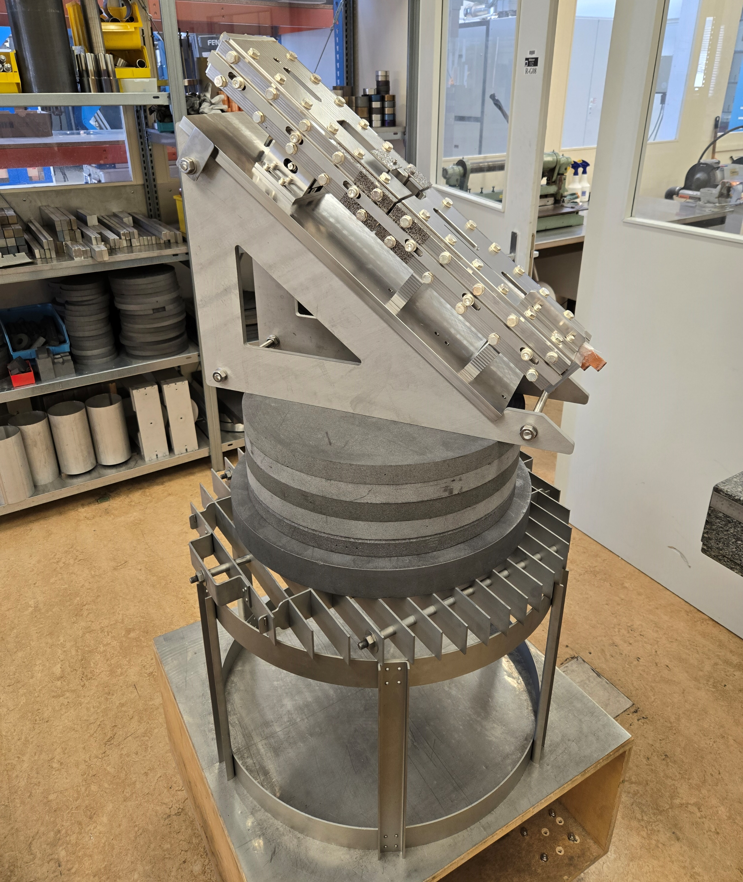
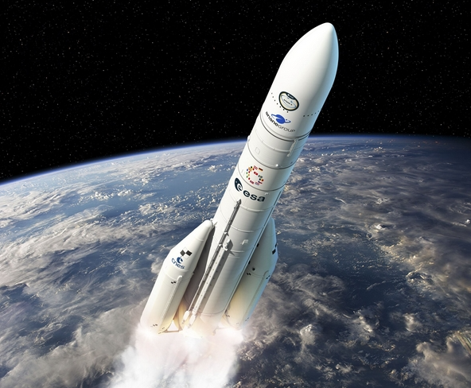
Racetrack coil mock-up
New oven proposal from EN-MME team (dated 25/06/2025)
  PVA vertical oven in building 112
The use of this oven requires modifications in the set-up
  Laser engraving of other parts
    For the mould displacement, the top plates
    For the pole displacement, 2 additional plates 38x38mm were manufactured and fixed to the poles via threaded rods
  Design and manufacturing of the inclined support to fit the opening of the oven
    Mock-up inclined by 38° w.r.t. the horizontal plane
  Displacement witnesses could not be used due to the inclination
    To correlate DIC measurement with witness displacement, most probably another test featuring the same gaps has to be repeated in the oven in 927

Slide 3
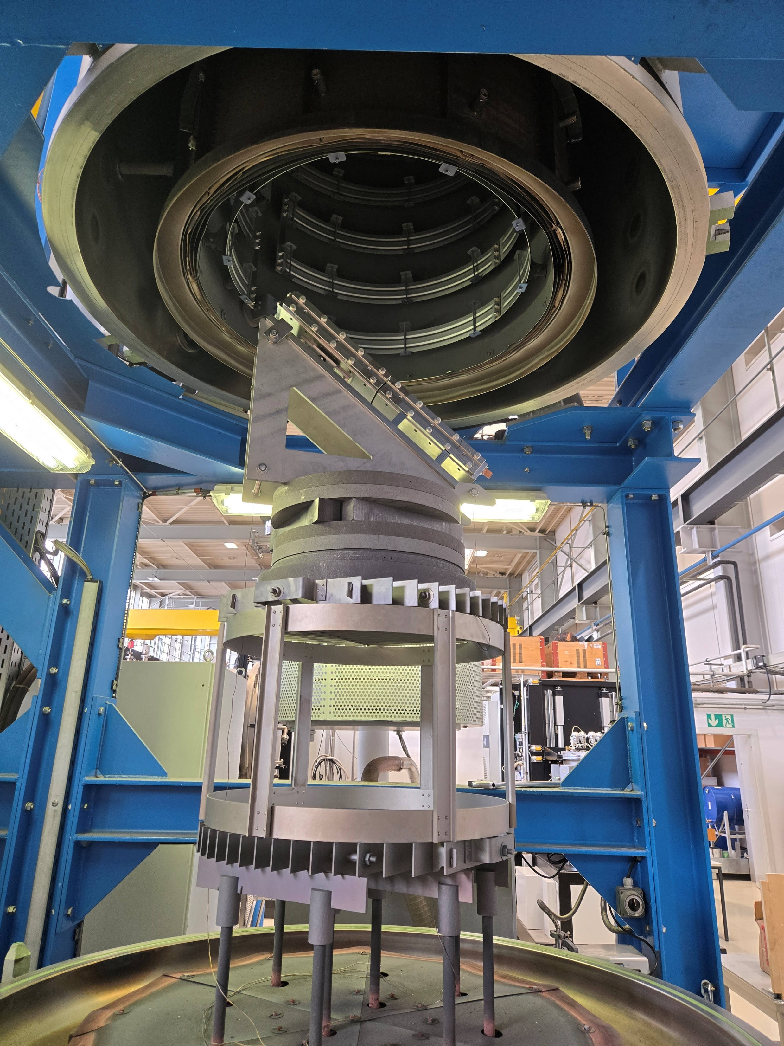
Racetrack coil mock-up
Positioning tests carried out on Friday the 4th of July
Blank cycle over the weekend to check the delta in temperature between the set point and the measured temperature → non negligible differences
Reaction cycle with mock-up launched on Monday the 7th of July
  Argon atmosphere
  Target
    210°C for 48h
    395°C for 48h
    663°C for 50h
  Ramp-up 50°C/h
  Free wheel cool-down
  2 TCs installed in the mould for temperature monitoring
  Gap change before RHT
    Gap between poles: 2 mm → 1.9 mm → 1.8 mm
    Gap between plates: 4 mm → 3.8 mm
Initial gap
Gap after realising of
the winding tension
Gap after removal of the side bars

Slide 4
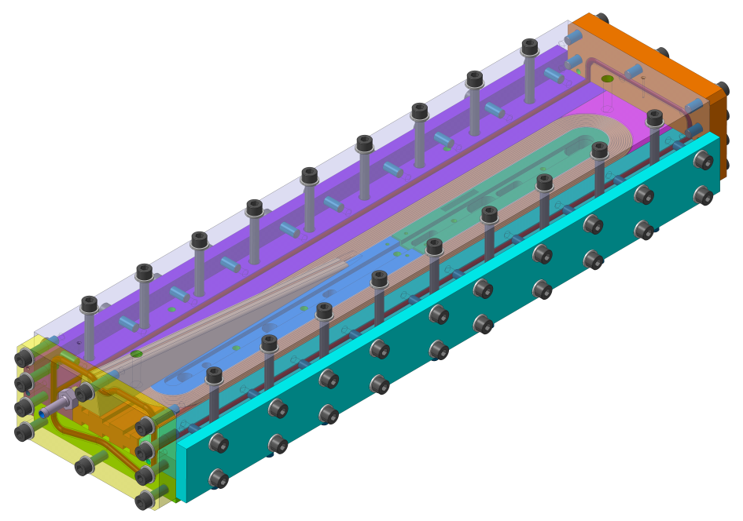
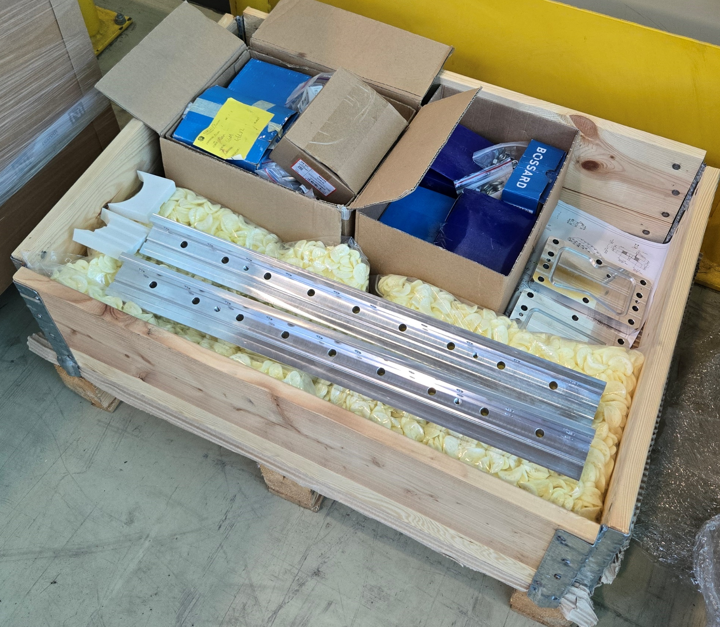
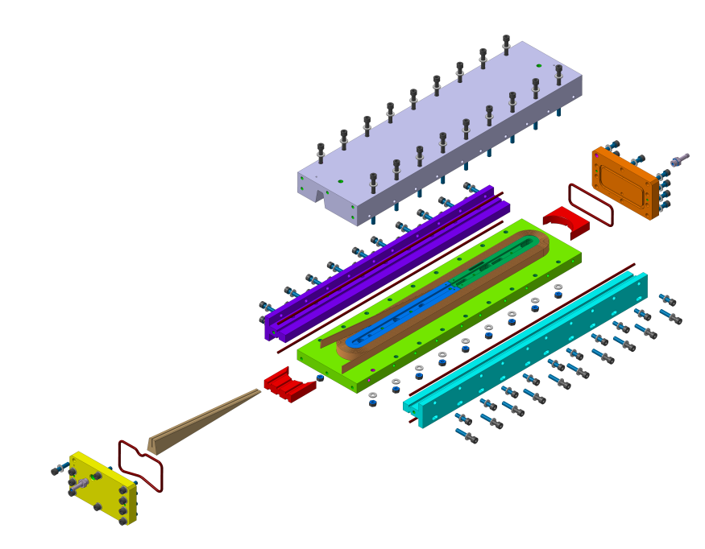
Racetrack coil mock-up: epoxy impregnation
Impregnation mold is manufactured, and all the parts are available
Courtesy of B. Pellet

Slide 5
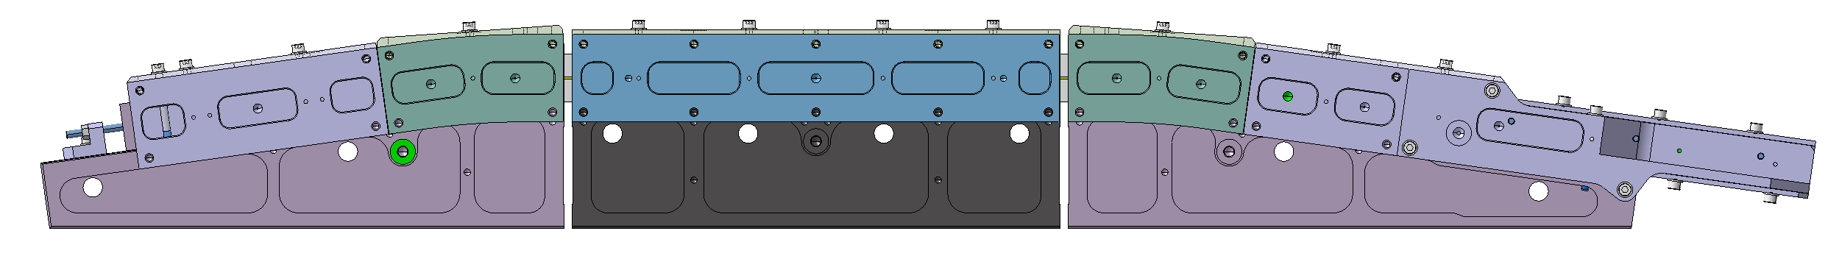
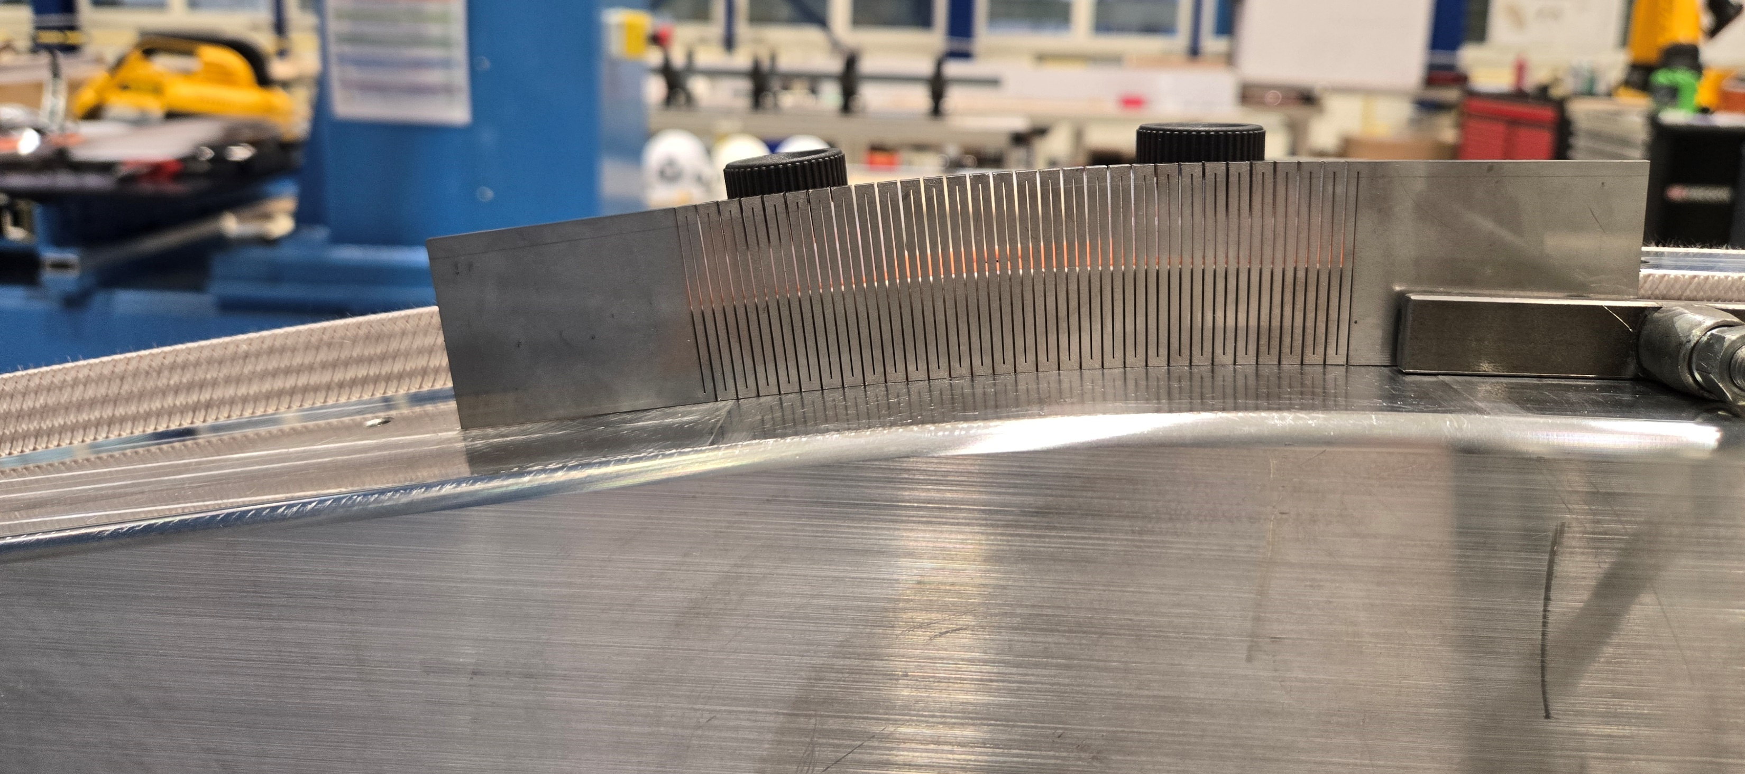
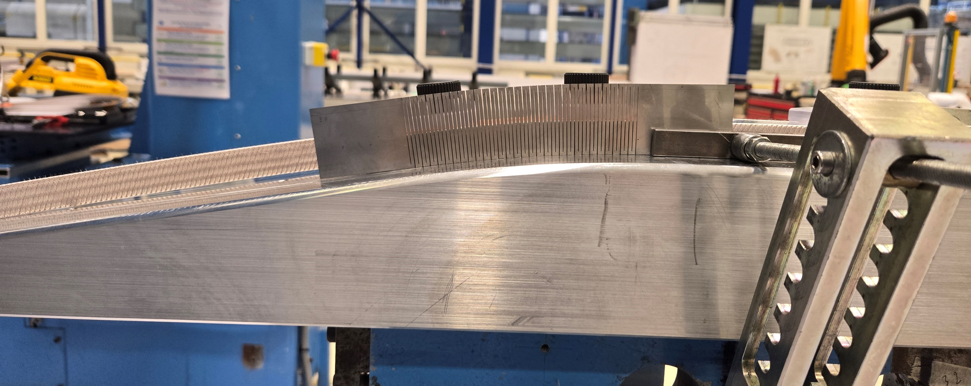
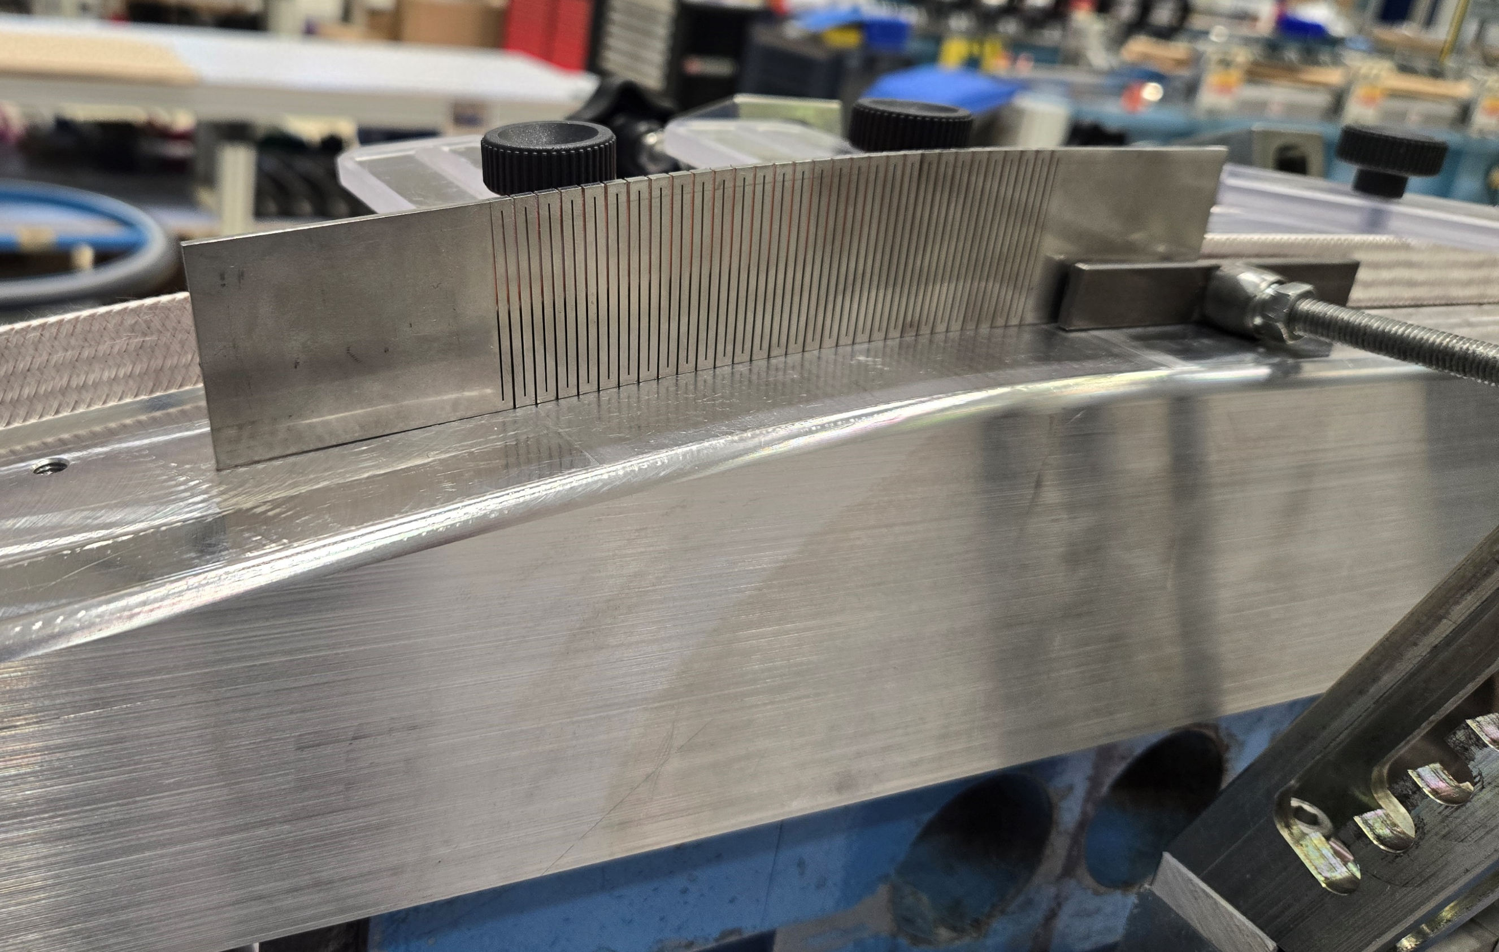
Parallel activities
Up to now, by design, only 2 mica layers are bridging and supporting the cable across the gap in the sectorized reaction mold
  “Flexible” metallic midplane shims may be envisaged to support laterally the turns
    They need to adapt to the flared geometry during reaction heat treatment cycle
    The most promising sample is the one with the most of cuts (laser cut width 0.5mm)

Slide 6
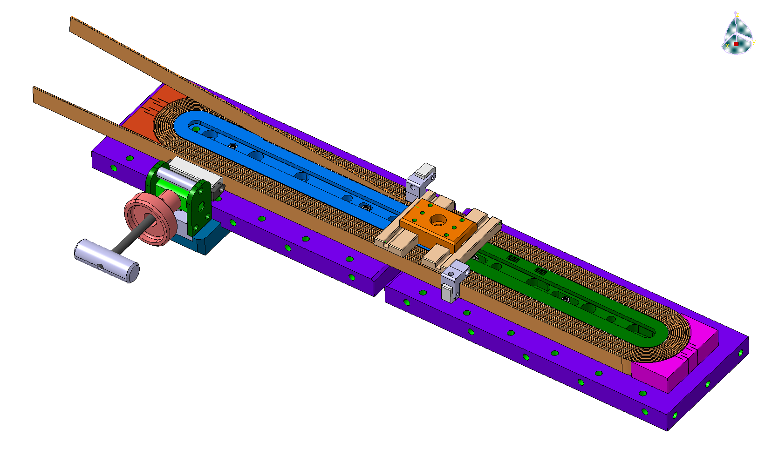
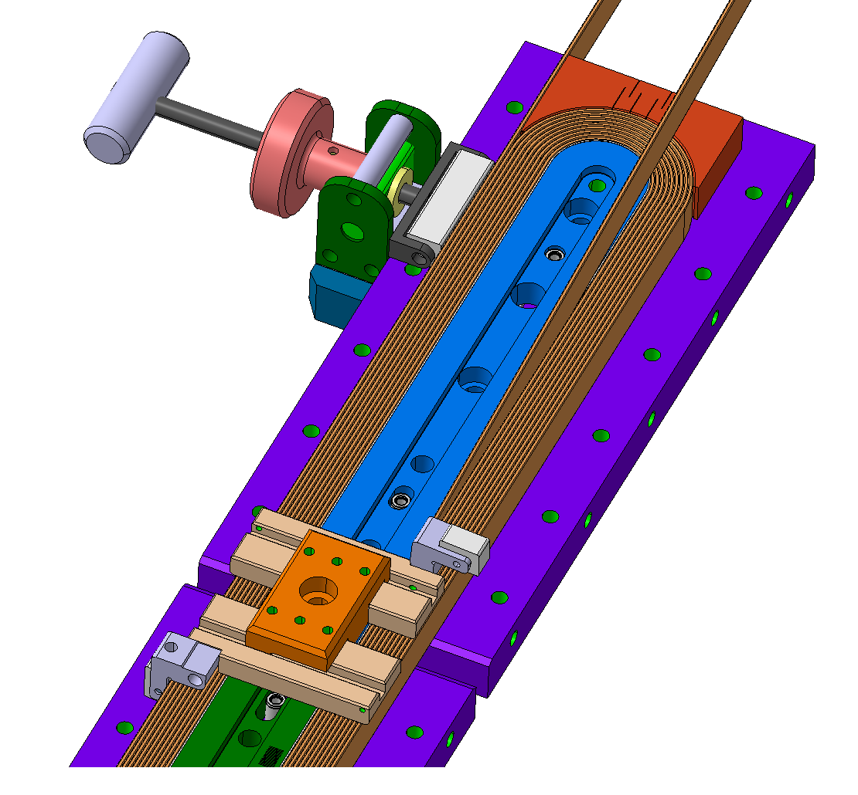
Parallel activities
Improvement of the winding tooling for next mock-ups
  Drawings done, internal manufacturing in 927 mechanical workshop
  Purchase order for BOND ceramic bearings launched (01/07/2025)
  40 bearings CCSI-6200FC C5 DRY (31.75€ each, delivery in 10 weeks i.e. around mid September)

Slide 7
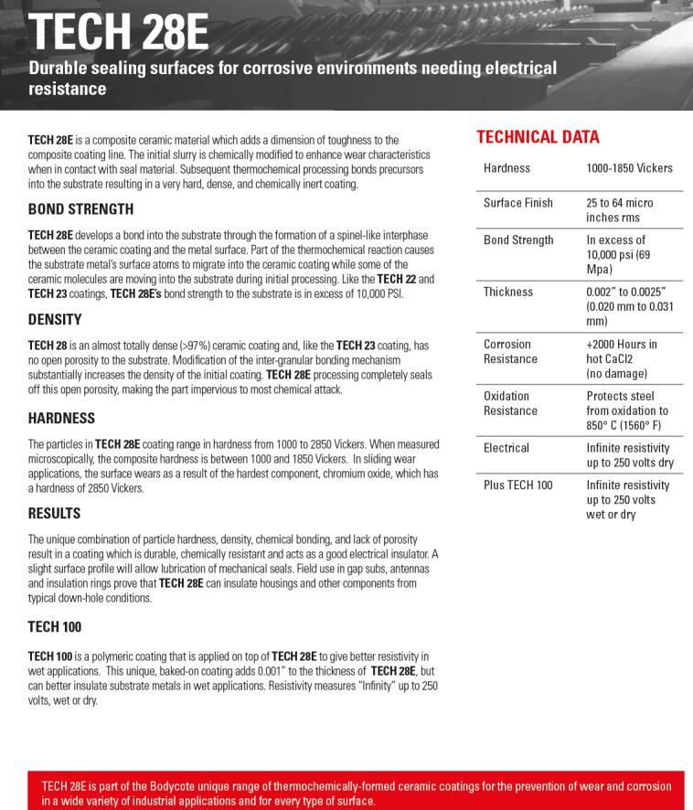
Parallel activities
Ceramic coating of the titanium poles
  Tech28E coating from Bodycoat could be an alternative to the ones already investigated
  Yann Farys is in contact with the company to get a quotation for test samples
  Cerapreg laminates under tests with Polymer Lab (interlayer possibility)
  Water jet cut of samples to perform, preliminary contact with Leila
    Flexural ans ILSS tests
    Dielectric tests
    Epoxy compatibility
    TGA + FTIR

Slide 8
Thank you

Slide 9
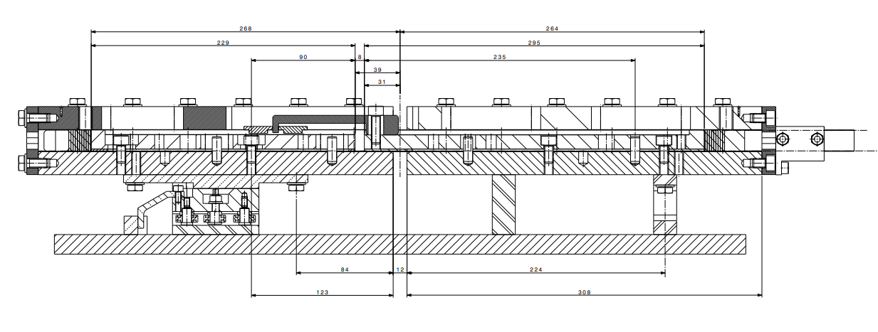
Racetrack coil mock-up
2
4

Slide 10
Spare slides

Slide 11

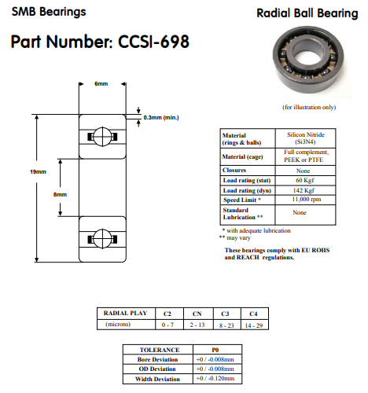
Selected solution
The selected sliding system is made by circular ceramic bearings
Just as a reminder, for the mock-ups, the following bearings were chosen
  Full Si₃N₄ bearings without cage CCSI-698

Slide 12
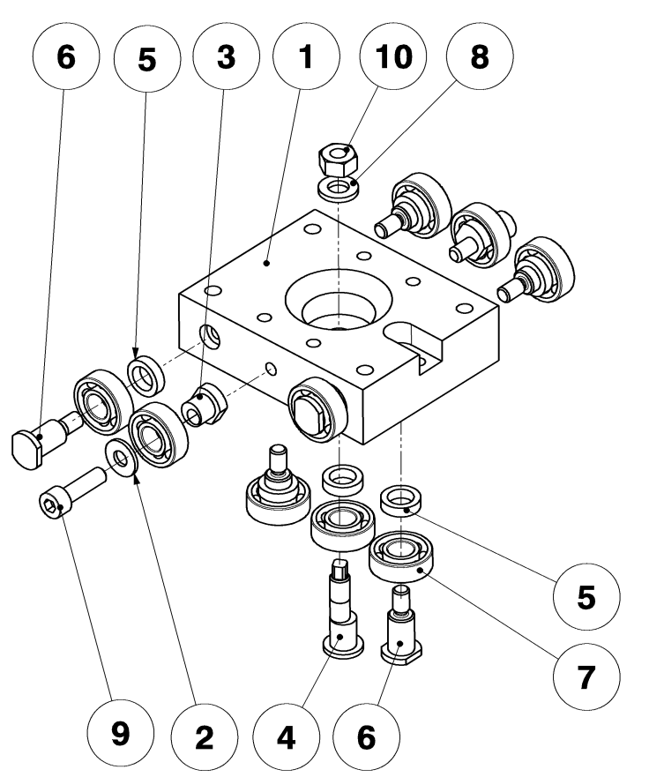
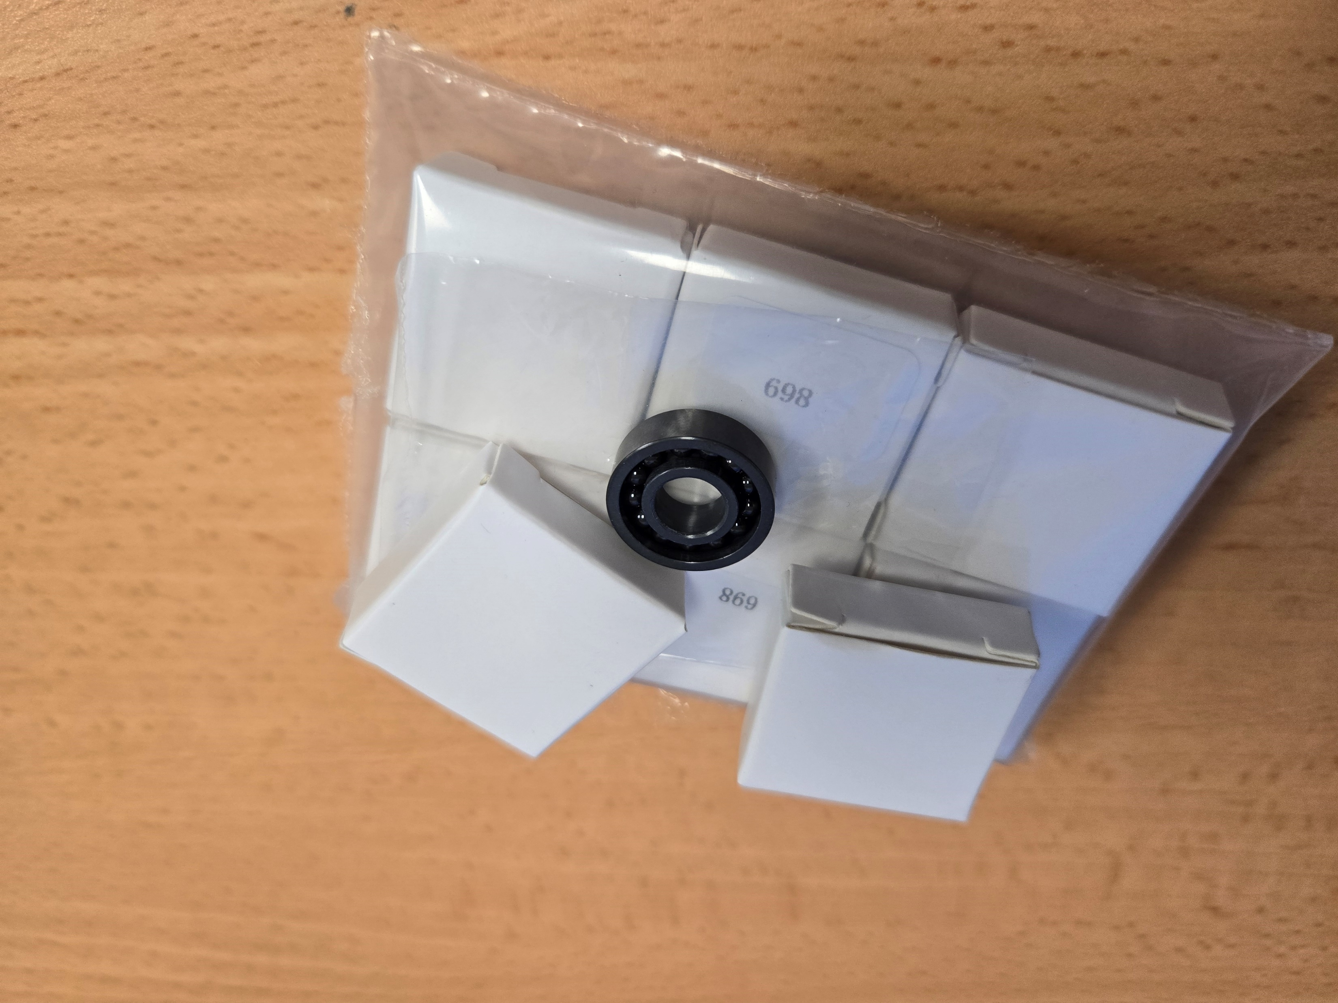
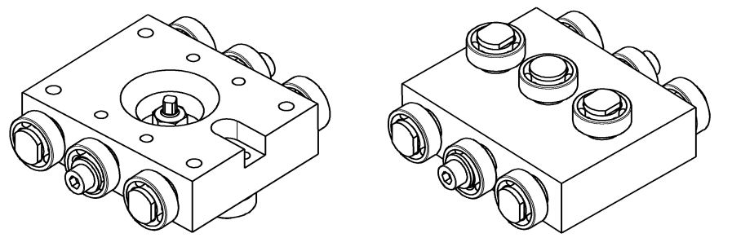
Circular Ceramic Bearings
Full Si₃N₄ ball bearings without cage
  Can be used up to 1200°C at low speed and low axial loads
  In principle for temperatures between 500-900°C a GH4099 nickel-based alloy cage could be used (not stored at the time of the PO)
The implementation and assembly of such system could be more challenging w.r.t. another system
  Fitting shaft/bearing must be careful check both at ambient and high temperatures to
    Ensure the alignment of the mold parts during the whole reaction cycle
    Make sure that interference fits due to differential thermal expansions do not reduce the radial play of the bearing to an unacceptable level (or shaft and housing fits should always accommodate for differences in expansion coefficients)
  3 bearings per raw where the central one is installed in an eccentric axis for alignment
  Parts #2, #3, #4, #5, #6 are made of Invar
Courtesy of B. Pellet

Slide 13
Circular Ceramic Bearings
Based on supplier’s exchanges, the theoretical lifetime (in hours) with
  60kgf radial load
  1kgf axial load
  100rpm speed
    L_{90% reliability} = 455h
    L_{95% reliability} = 291h
    L_{99.5% reliability} = 35h
The actual theoretical life is longer if we consider negligible speed
  At 10rpm speed → L_{99.5% reliability} = 350h
In our case the bearings will not even complete 1 turn:
  About 18° rotation (≈ 3mm) for basic mock-ups
  About 30° rotation (≈ 5mm) for racetrack coil mock-up
  At 1rpm speed → L_{99.5% reliability} = 3500h
  Tests should be carried out to assess the real lifetime

