Slide 1
Single source orders workshop
3 July 2025

Slide 2
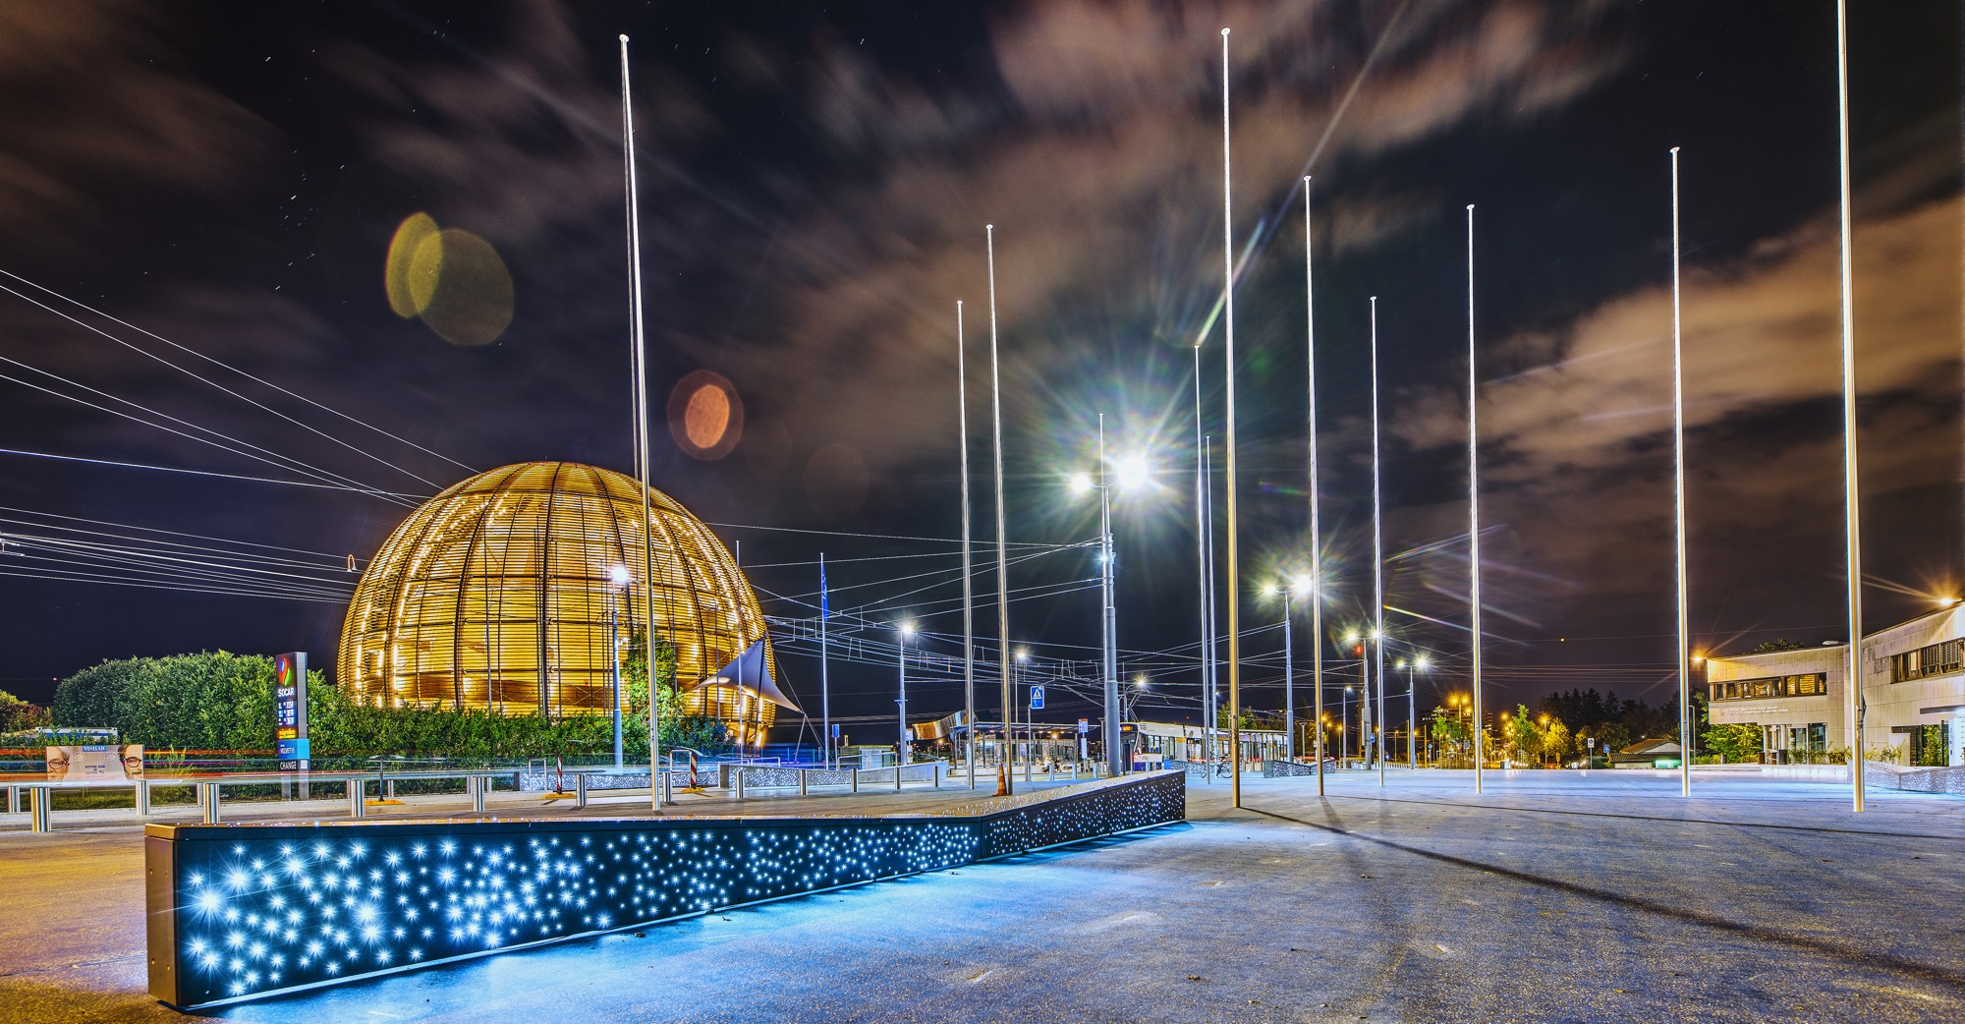
AGENDA
1. | Single source orders/contracts statistics
2. | Single source justifications
3. | Quiz
4. | Guidelines
5. | Brainstorming
6. | Signature rights

Slide 3

What is the percentage of single source orders in 2025 ?
3

Slide 4
1. Single source orders statistics
Next audits foreseen on single source orders:
External auditors
Internal auditors
ILOs
Conclusion:
Above 50kCHF, ~40% orders are single source (tendency going up)
Below 50kCHF, it is even worse
We need to take actions NOW
Objective: ~35% and 30% of single sources in 2026 and 2027 respectively (50-200kCHF)
~45% and 40%of single s ource for orders 10-50kCHF
4

Slide 5
1. Single source orders/contracts above 200k CHF (FC documents)
Conclusion:
35% increase compared to previous years.

Slide 6
2. Single source justifications (art. 17 of the Procurement Rules)
1. A single-source order refers to the procurement of a supply or service from a particular firm among several capable firms, where the selection is justified by specific constraints or strategic considerations. These may include:
Standardisation requirements;
Compatibility with existing systems or equipment;
Technical or strategic constraints;
Exceptional urgency due to unforeseeable events not attributable to CERN;
Collaboration with a scientific institution, university, funding agency, or other public body.
A sole-source order applies when the supply or service is proposed by only one firm, and competitive tendering is not feasible because no other suppliers are reasonably available or capable of meeting the requirements.
6

Slide 7


Examples
Description | Sole source | Single source
Water distribution
Schneider equipment
Retrofit of tooling machine
Special cables for radiation environment
Retrofit of klystrons
Bureau International Travail (BIT) services
Xilinx chips
Office Microsoft licences
Microsoft maintenance
Customisations of a software
Provision of electricity
Distribution of electricity

Slide 8
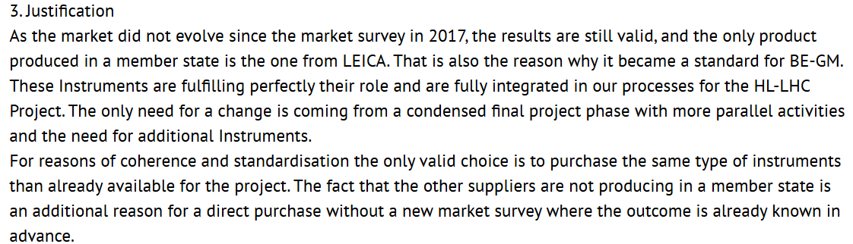

3. Quiz: Is this a valid justification or not ?
The same equipment has been bought under DAI 11223344
8

Slide 9
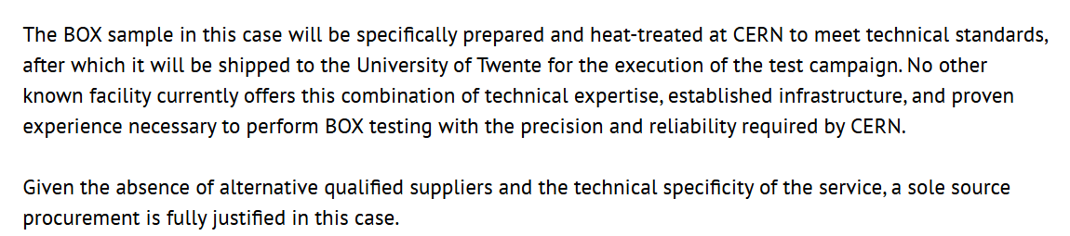
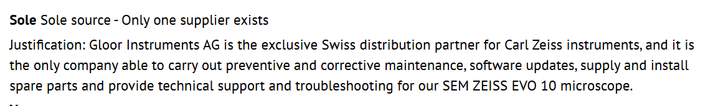
3. Quiz : Is this a valid justification or not ?
The new procured tensile testing machine will be installed next to the currently existing testing machine in the MME laboratory, having the two machines working in synergy with the same outlaid requirements (using the same infrastructure, software, tools, accessories, MME requirements, maintenance and calibration), their compatibility is essential. Moreover, the format of results exxportation is already incorporated in our systenm and data base, making it compatible and comparable with previous quality control analysis and research data. It is also esserntial to guarantee the compatibility of the testing protocols, which once developed and implemented in one machine, are exportable to the other one. An additional advantage of a Zwick machine is the possibility of grouping the maintenances and calibrations, as it is currently done with all the existing machines in EN/MME and also in EP/DT, with a centralization of the necessary yearly calibrations, saving time and money.
9

Slide 10
4. Guidelines
Challenge each single source order (in particular >50kCHF); Use AI in case of doubt (i.e. to propose vendors, to challenge explanation provided, etc);
Carry out a simplified DO whenever possible (shorter deadlines possible);
If non-MS firms can provide competitive products, find out the difference in price to assess the suitability to open the competition;
If the single source is unavoidable, carefully review the justification (see next slide), ask the TO to update it, if needed;
Come to me if the technical Dept disagrees.
10

Slide 11

5. Brainstorming
What would you do to lower the % of single source orders/contracts in the future ?
11

Slide 12
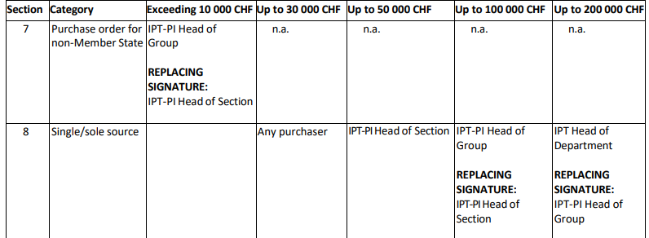
6. Signature rights
12

Slide 13
THANK YOU!

