Slide 1

CERN-ABB motorSENSE Project
Identifying Energy-Saving Potential through Smart Sensors, Digital Twins and Analytics
28.10.2025
A. Andersen | CERN | EN-CV-CES

Slide 2
Why Energy Efficiency

Slide 3

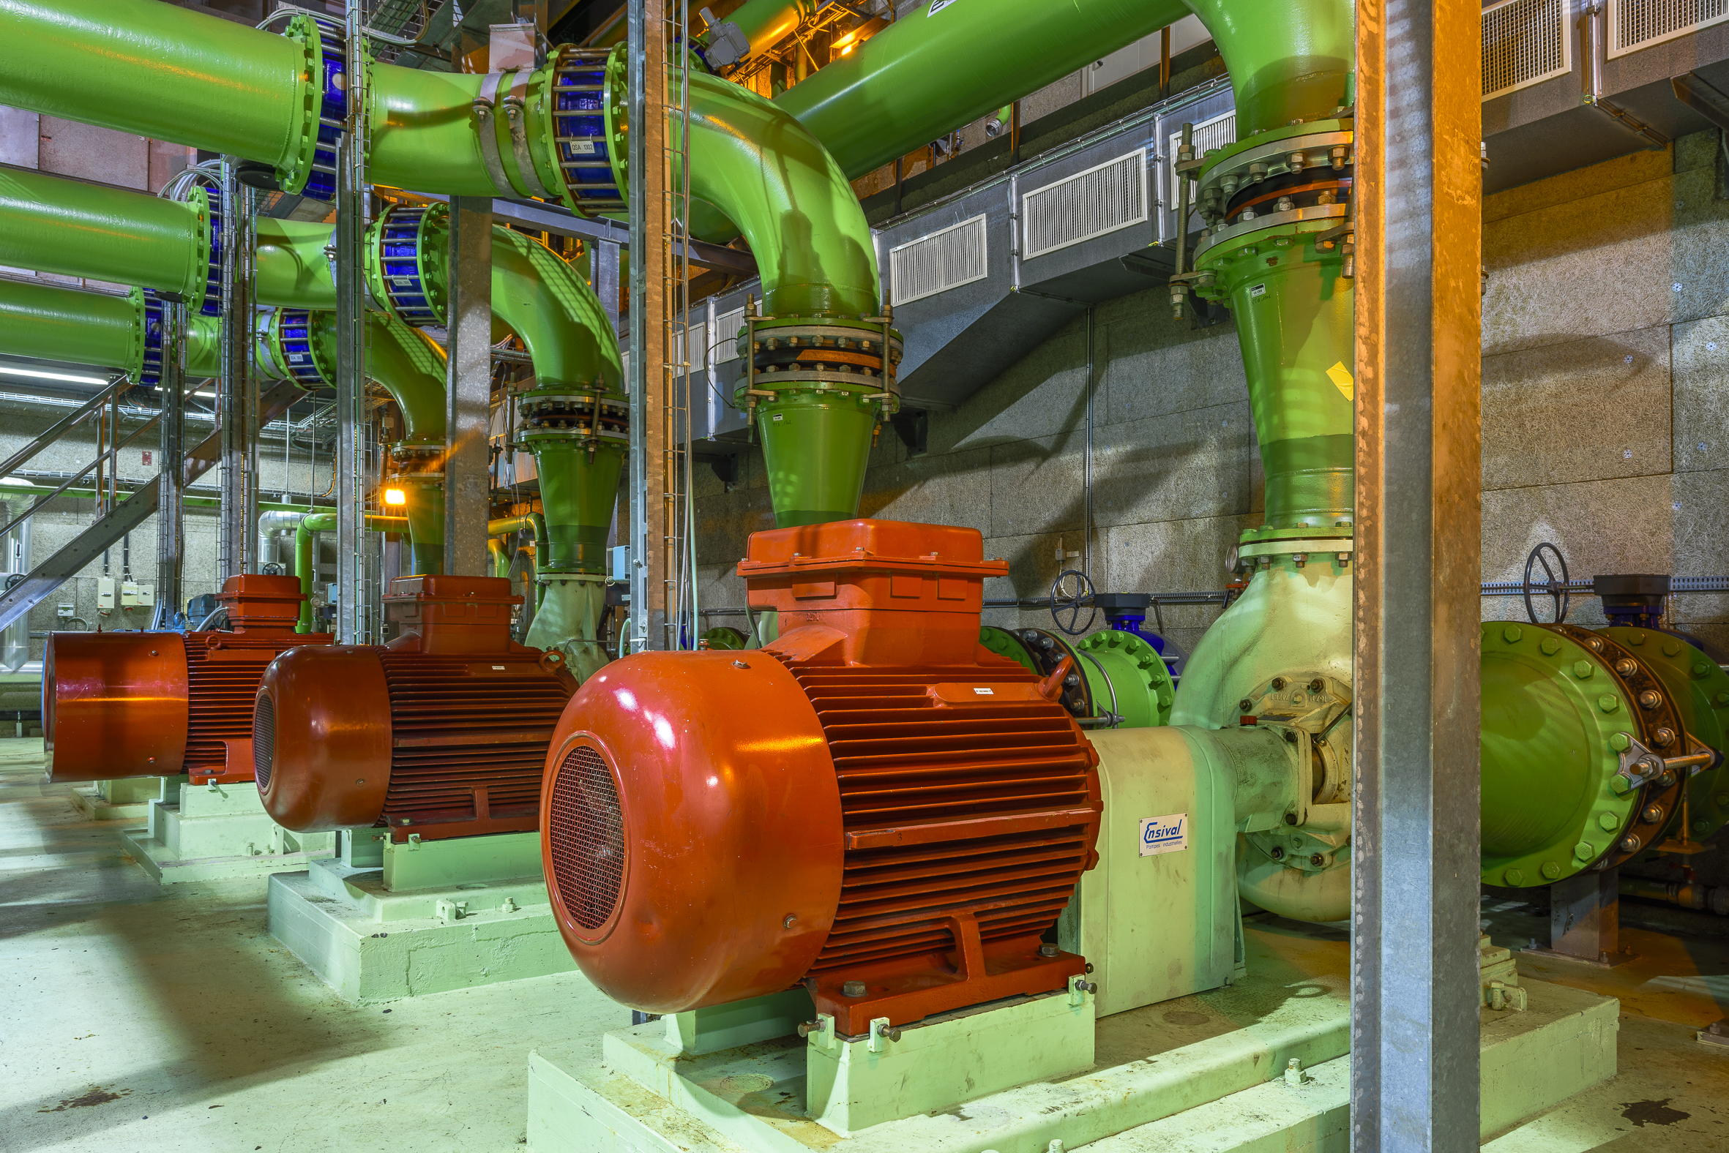
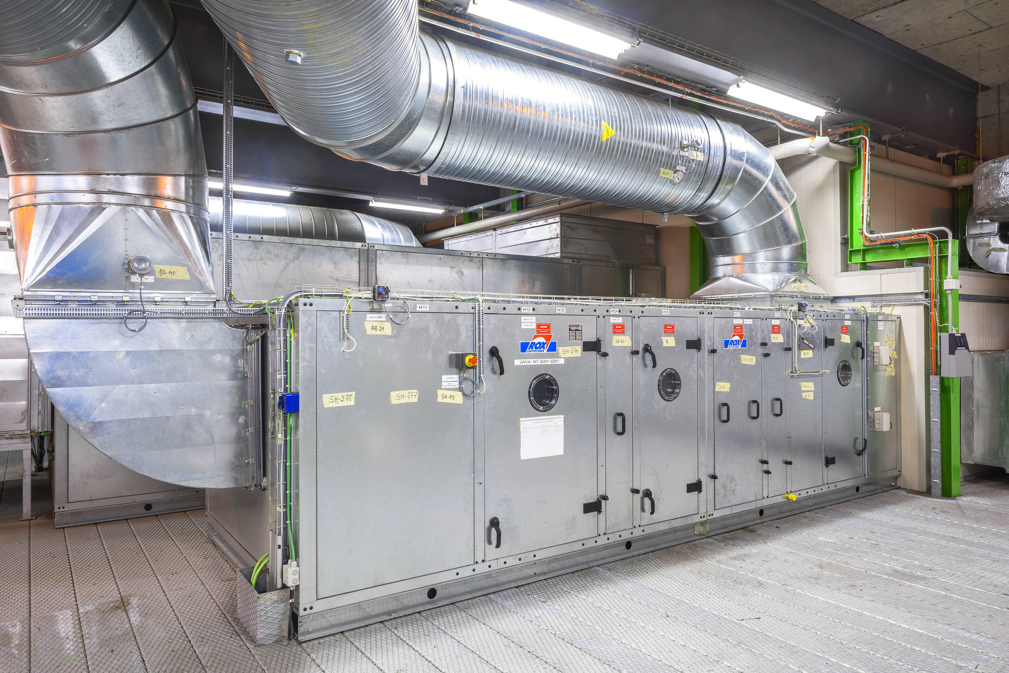
From Global Trends to CERN: The Need for Energy Efficiency
Cooling & Ventilation: An Opportunity for Energy Savings at CERN
Electric motion drives global sustainability, automation, and mobility
CERN’s total electricity use ≈ 1.3 TWh / year
Cooling & Ventilation = 14 % of LHC consumption
+2000 motors operated by EN-CV
45 % of the world’s electricity is converted by electric motors
Fewer than 25 % are controlled by speed drives
→ Major potential for efficiency gains
Global trend: demand for electric motion expected to double by 2040

Slide 4
CERN-ABB motorSENSE Collaboration

Slide 5












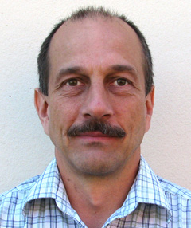




motorSENSE: a CERN–ABB collaboration born from Big Science Sweden 2020
CERN team
Ingo Rühl
EN-CV
Anders Andersen
EN-CV-CES
David Widegren
EN-IM
Han Hubert Dols
IPT-KT
Nauman Latif
EN-CV-CES
Diogo Monteiro
EN-CV-CL
Nikolina Bunijevac
EN-CV-CL
ABB team
Panagiotis Kakosimos
Principal Scientist
Industrial digitalization
Kristian Rönnberg
Principal Scientist
Thermal management
Kari Saarinen
Principal Scientist
Data analytics
Simon Lundberg
Discovery Trainee
ABB Sweden
Dmitry Svechkarenko
Team manager,
Powertrain & Digitalization
Matti Laitinen
Business Research Manager, ABB Motion
Ankush Gulati
Energy Efficiency Lead
ABB Motion Services
Duration: January 2022 to December 2023
28.10.2025
5

Slide 6



Collaboration Goals
Goal 1
Creating a roadmap with the aim of achieving a 10-15% overall energy reduction in the cooling and ventilation infrastructure at CERN
Goal 2
Create and validate a system digital twin of the cooling and ventilation infrastructure by enabling online diagnostics and maintenance
Goal 3
Public dissemination of results to share the learnings, best practices to inspire industries and large-scale research facilities around the World to become more sustainable and reliable
28.10.2025

Slide 7
Approach and Methods

Slide 8


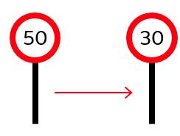
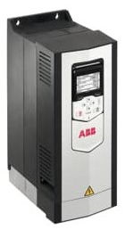
It’s all about the right approach to saving energy
Choosing the right way to control flow and save energy
How would you control your speed in this situation?
In cooling systems, controlling flow by throttling valves is like braking while keeping your foot on the accelerator
1
Take your foot off the accelerator and slow down?
2
Flow control
Keep your foot hard on the accelerator and control your speed with the brakes?
Variable Speed Drives control flow by adjusting speed — saving energy instead of wasting it through throttling
Speed control
What is the best approach? – is it obvious?
For a 30% flow reduction:
Throttling → only 11% power saving
Variable Speed Drive → 55% power saving
Speed control

Slide 9
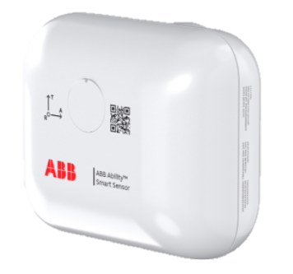
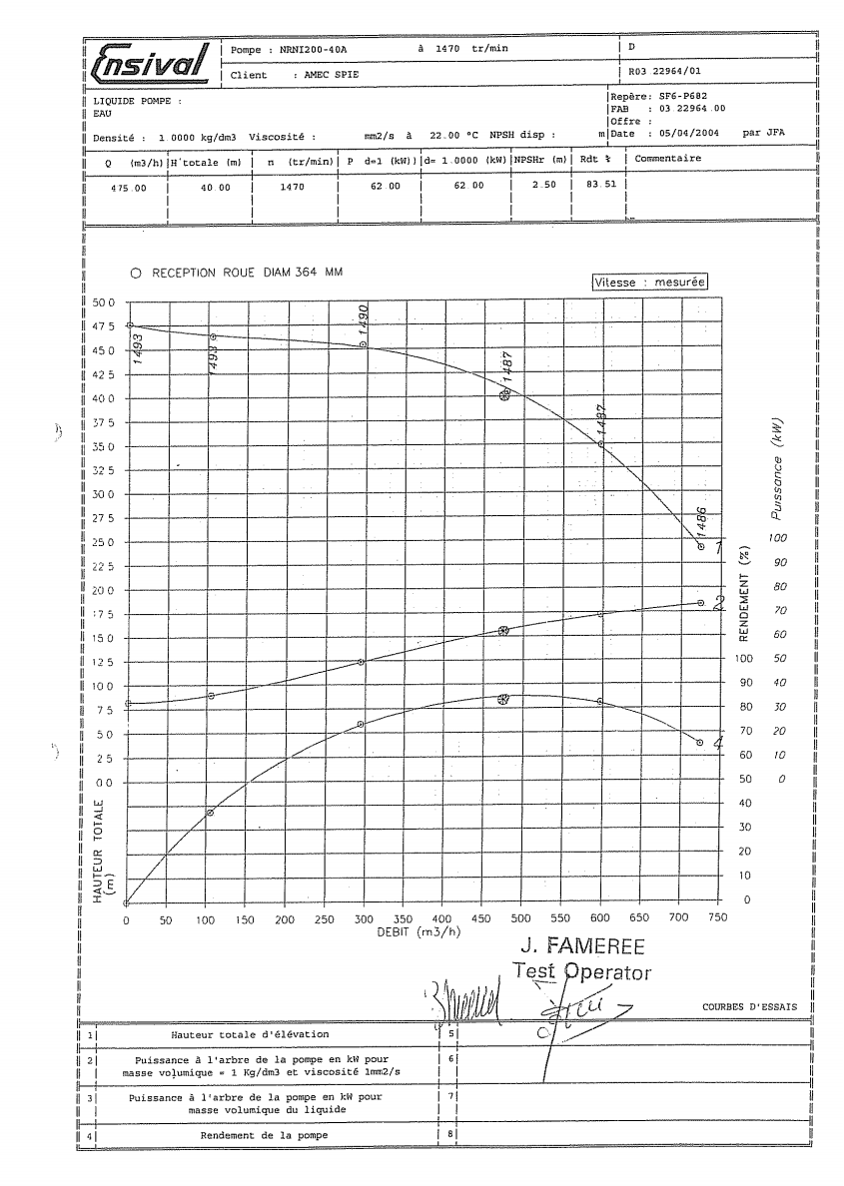
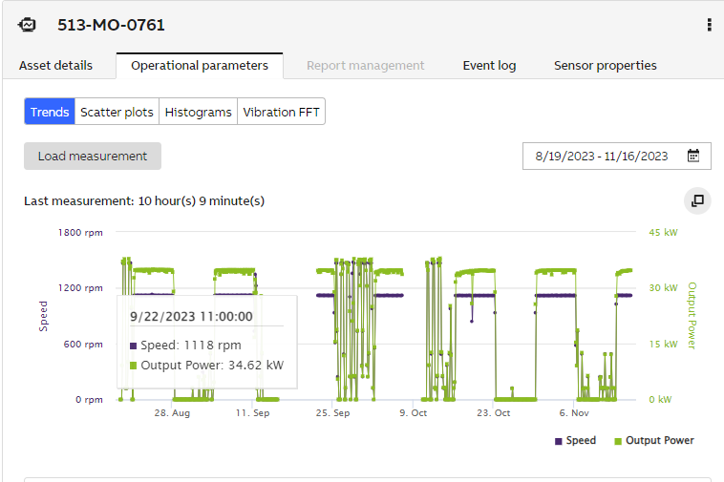
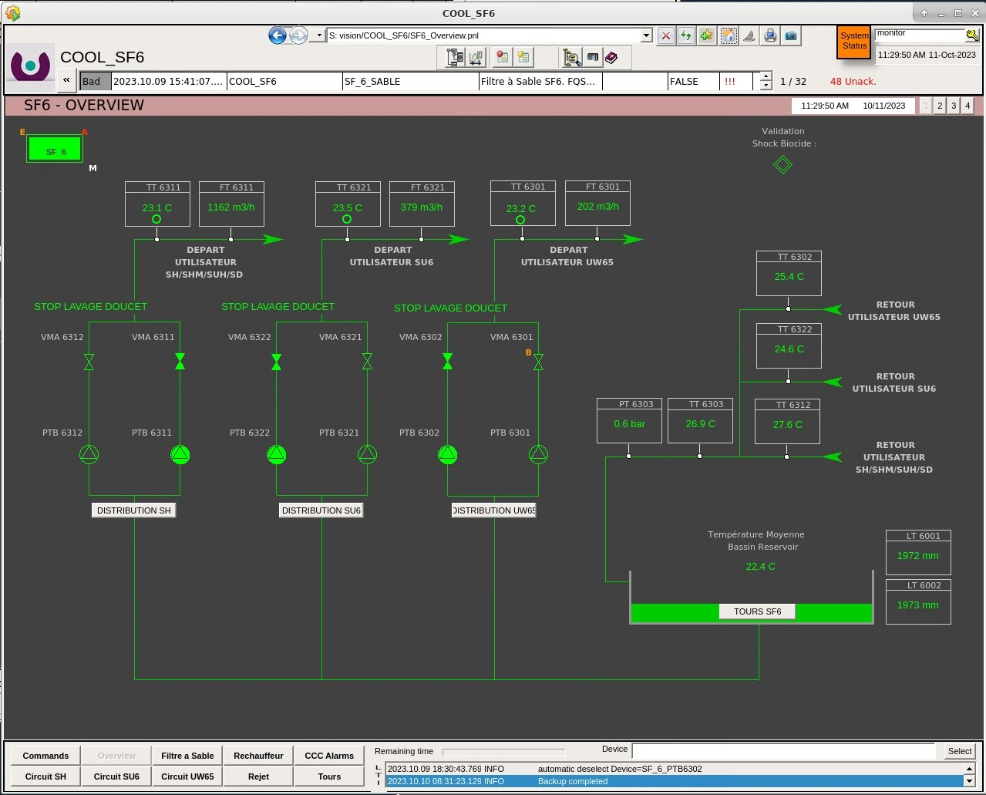
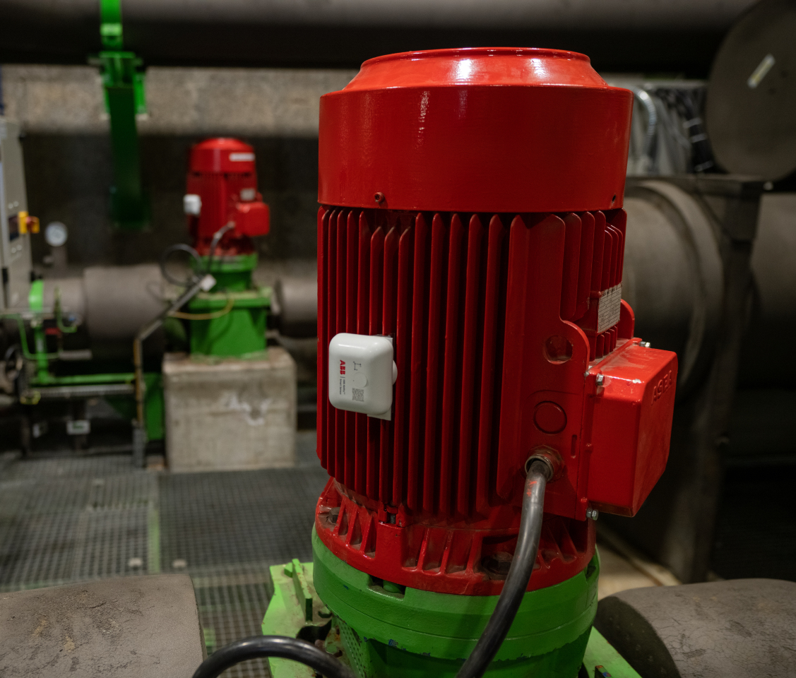
Energy Appraisal
Finding the balance between efforts and accuracy needed
Method A: Least amount of data
Method B: Medium amount of data
Method C: Large amount of data
Flow data from CERN SCADA system
SCADA flow data
Pump curve data
+
Basic motor data
Control method (VSD, DOL, …)
Load estimated or measured by ABB Smart Sensor
Effort & Accuracy increase →

Slide 10
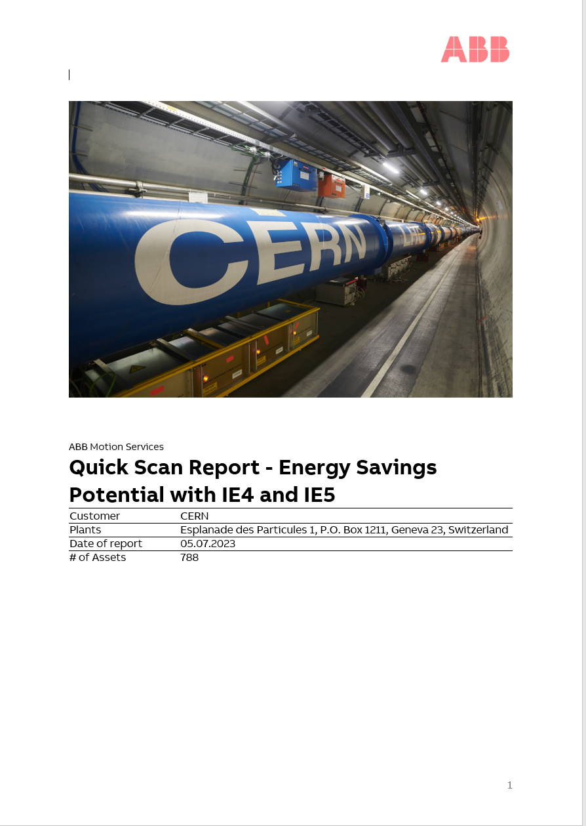
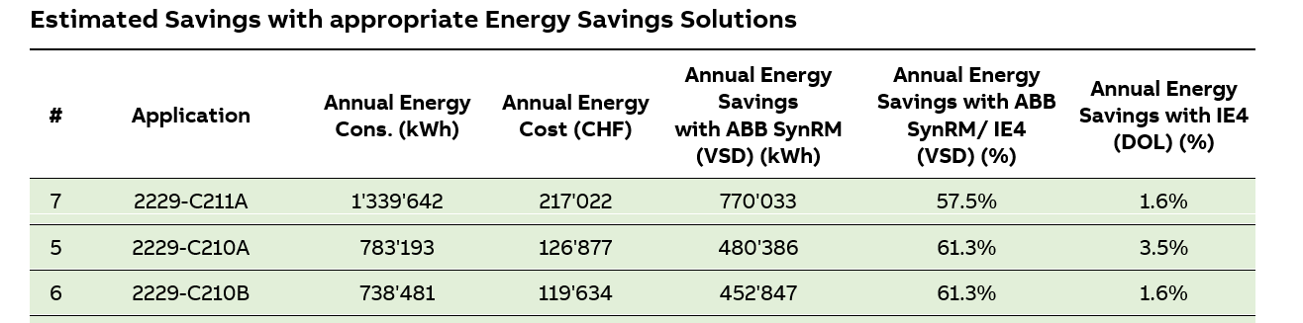
Energy Savings Calculations
Outcome Method A screening
The report presents two separate scenarios:
Motor only replacement
Upgrade to Variable Speed Drive (VSD)
≈ 60 % of motors operate without speed control
Most are IE1 or IE2 (low efficiency)
Excerpt from Top 30 assets with highest energy savings potential identified.
Assumption:
70% motor loading = 100% flow
Top 30 assets → potential savings
> 50 % (VSD) vs approx. 2 % (motor only)
788 assets considered

Slide 11
Going Further…
Case for a Pumped Network

Slide 12
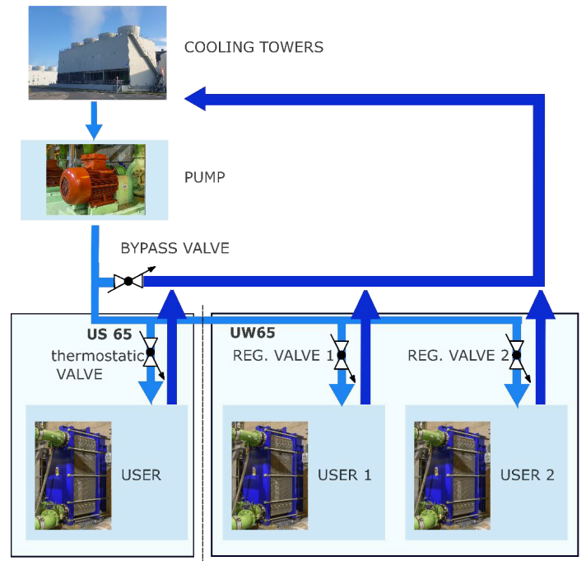
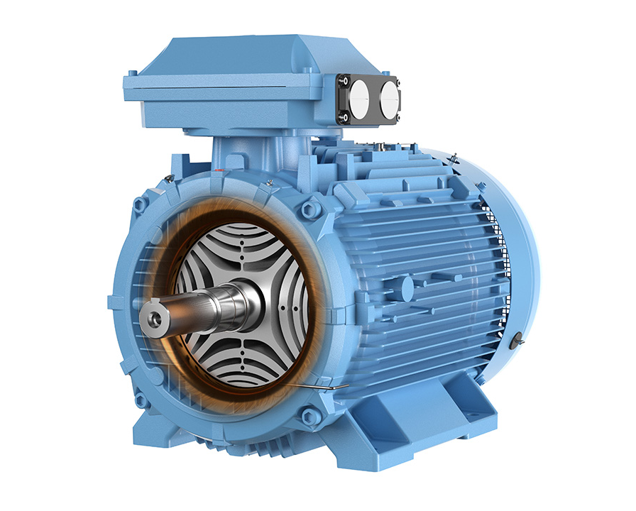
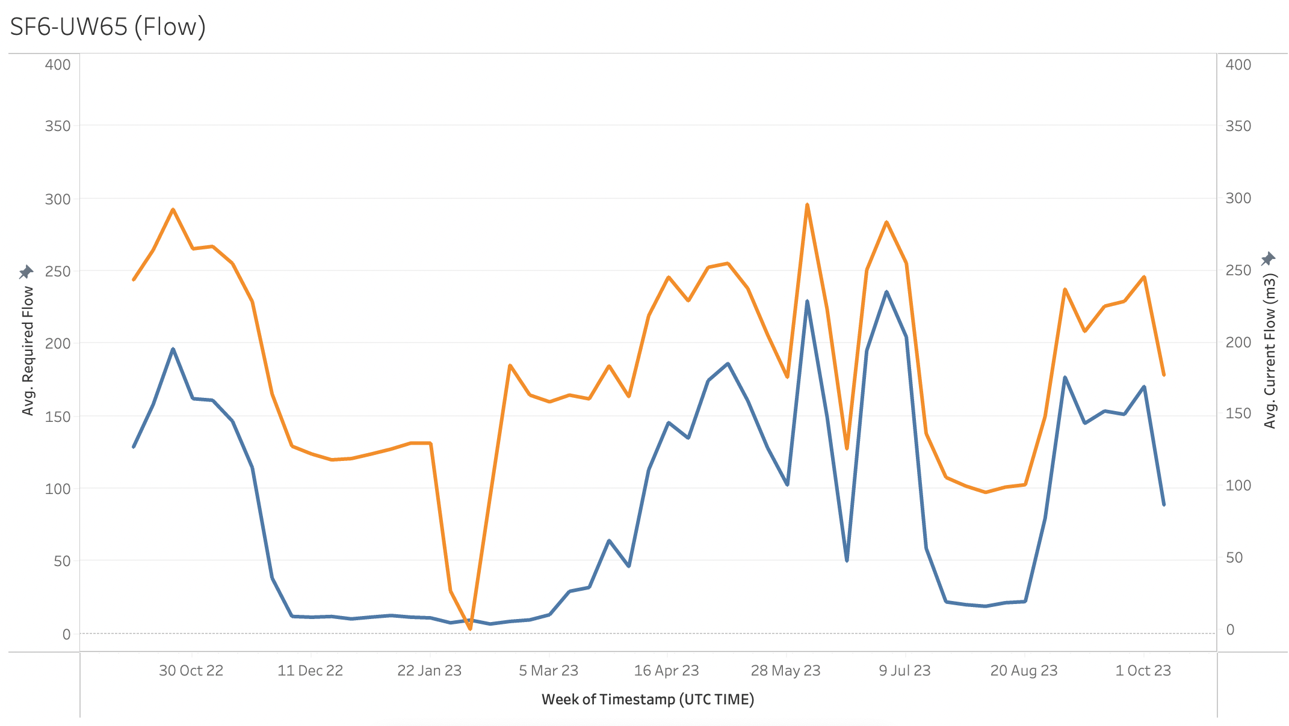
Detailed Study of a Pumped Network
SF6 to UW65 network – ABB analysis
Scope
Detailed assessment of a representative pumped cooling network
Network currently operating with combined throttling and bypass regulation
Identification of required modifications for variable-flow operation
Evaluation of energy savings through SynRM + VSD solution
Key outcomes
Confirmed feasibility of variable-flow operation
Estimated 64 % energy reduction (~47 t CO₂ / year)
Return-on-investment under 3 years
ABB evaluated a representative pumped network in CERN’s Cooling and Ventilation installations to validate the theoretical methods previously presented
Study based on historical flow and operating data (2023)
Flow profile used for estimation

Slide 13
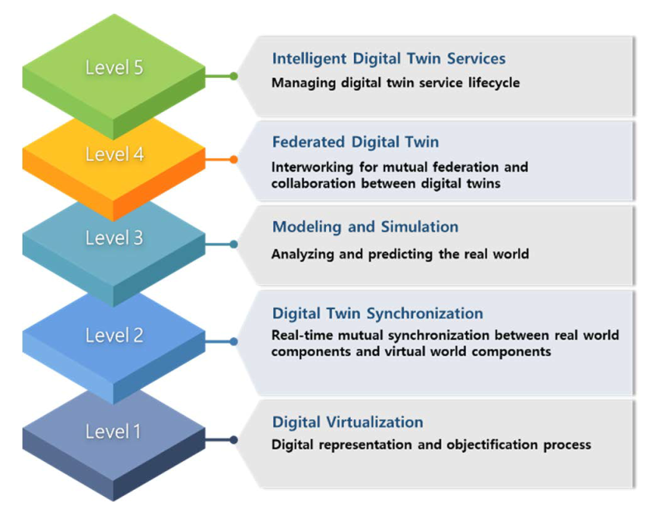
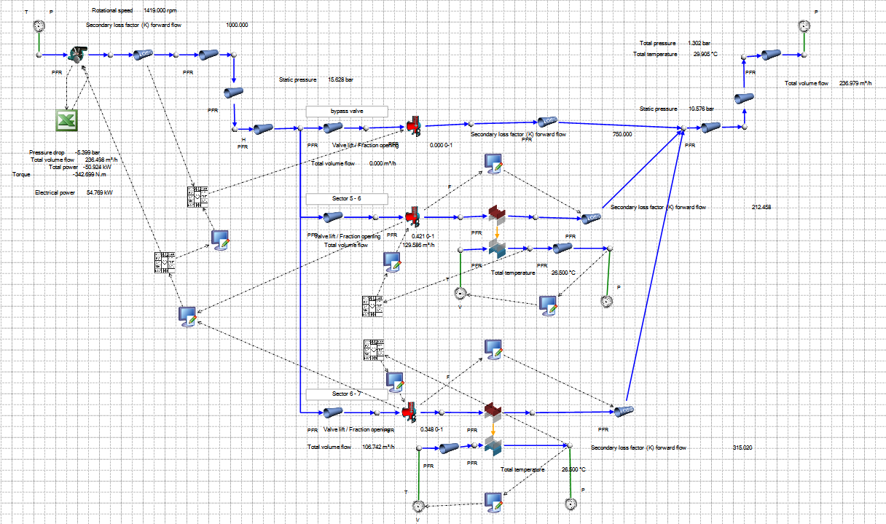
Digital Twin Study of the SF6–UW65 Network
CERN Controls Analysis
Scope
Full hydraulic reproduction of the SF6–UW65 network in Flownex digital twin platform
Dynamic simulation using historical operating data and real control parameters
Evaluation of variable-flow operation with CERN’s smart regulation
Key outcomes
Estimated 79 % energy saving, 2 years return-on-investment
Validated feasibility of stable variable-flow operation across all load conditions
Demonstrated the impact of advanced control and regulation strategies on network efficiency
CERN developed and simulated a full digital twin of the same pumped network to validate and extend the ABB analysis using real operating data and advanced control strategies
Digital twin reproducing the full hydraulic network – validating and extending ABB’s energy savings assessment.

Slide 14
Results and Beyond

Slide 15

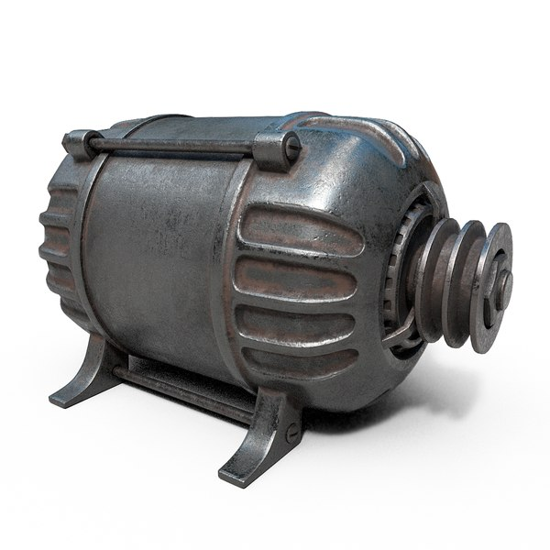
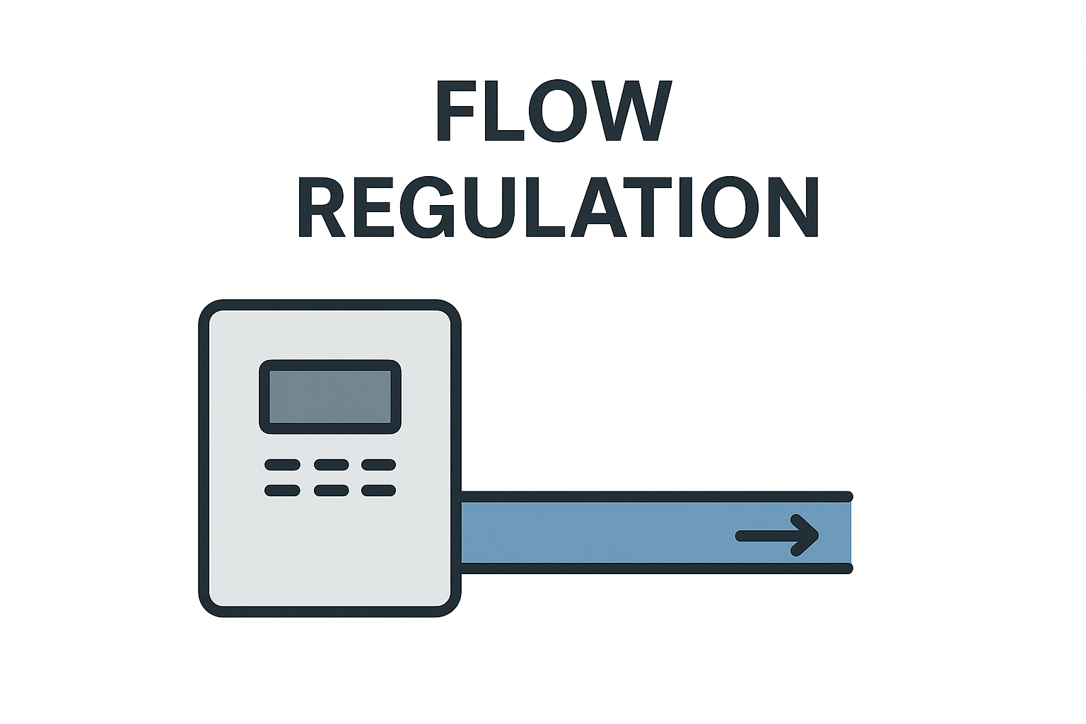
motorSENSE Collaboration – Key Conclusions
  POTENTIAL SAVINGS
  POTENTIAL SAVINGS
  17.4%
  across a fleet of
  800 motors based on method A appraisal
  *Based on method A appraisal
  >50%
  on networks suitable for variable-flow operation
  validated through detailed studies
+
+
=

Slide 16
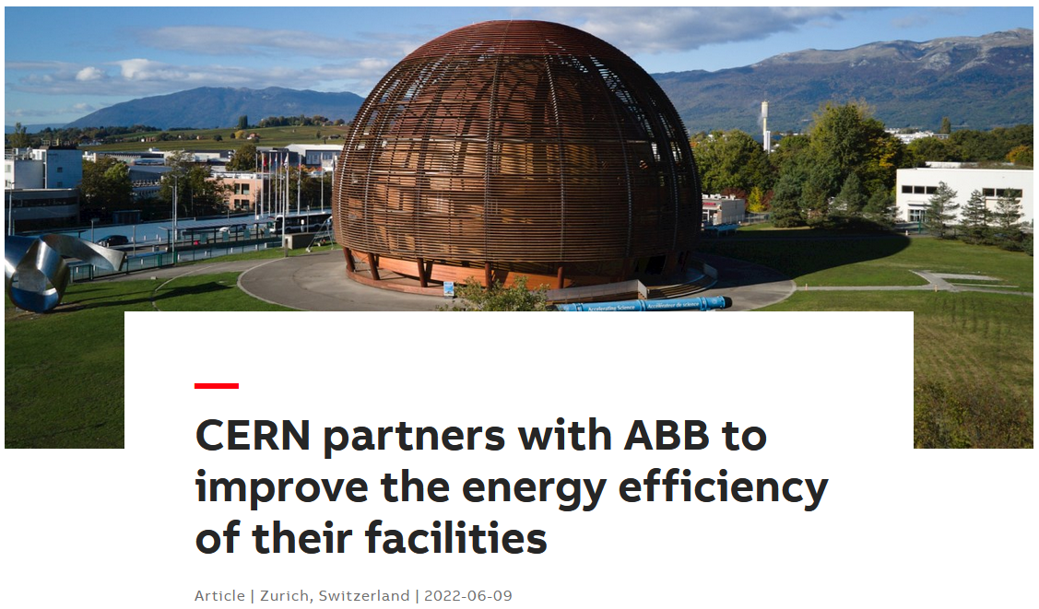

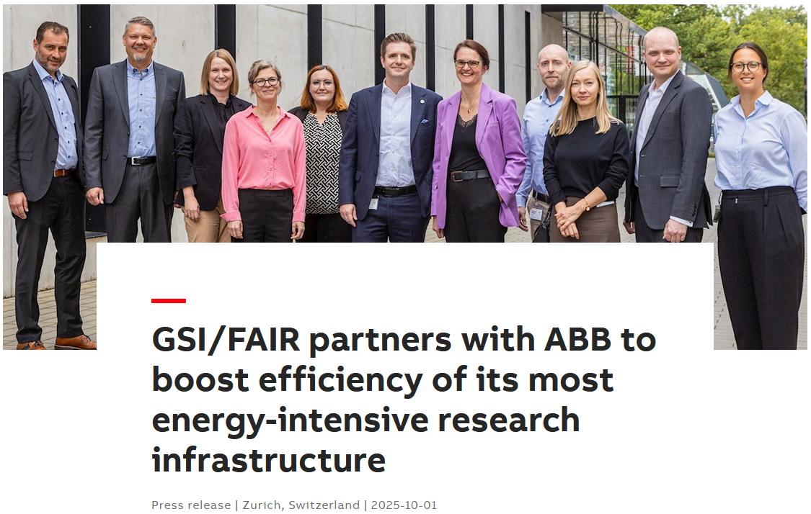
Beyond the motorSENSE Collaboration
10 years
energy efficiency consolidation program
On CERN Cooling and Ventilation installations
Approved in May 2025
2022
CERN’s 2022 collaboration with ABB inspired a similar energy-efficiency partnership at GSI in 2025
Implementation phase to extend efficiency improvements across CERN installations
2025
28.10.2025

Slide 17
Thank you for your attention
Questions?

Slide 18
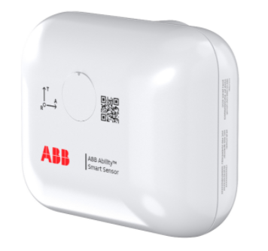
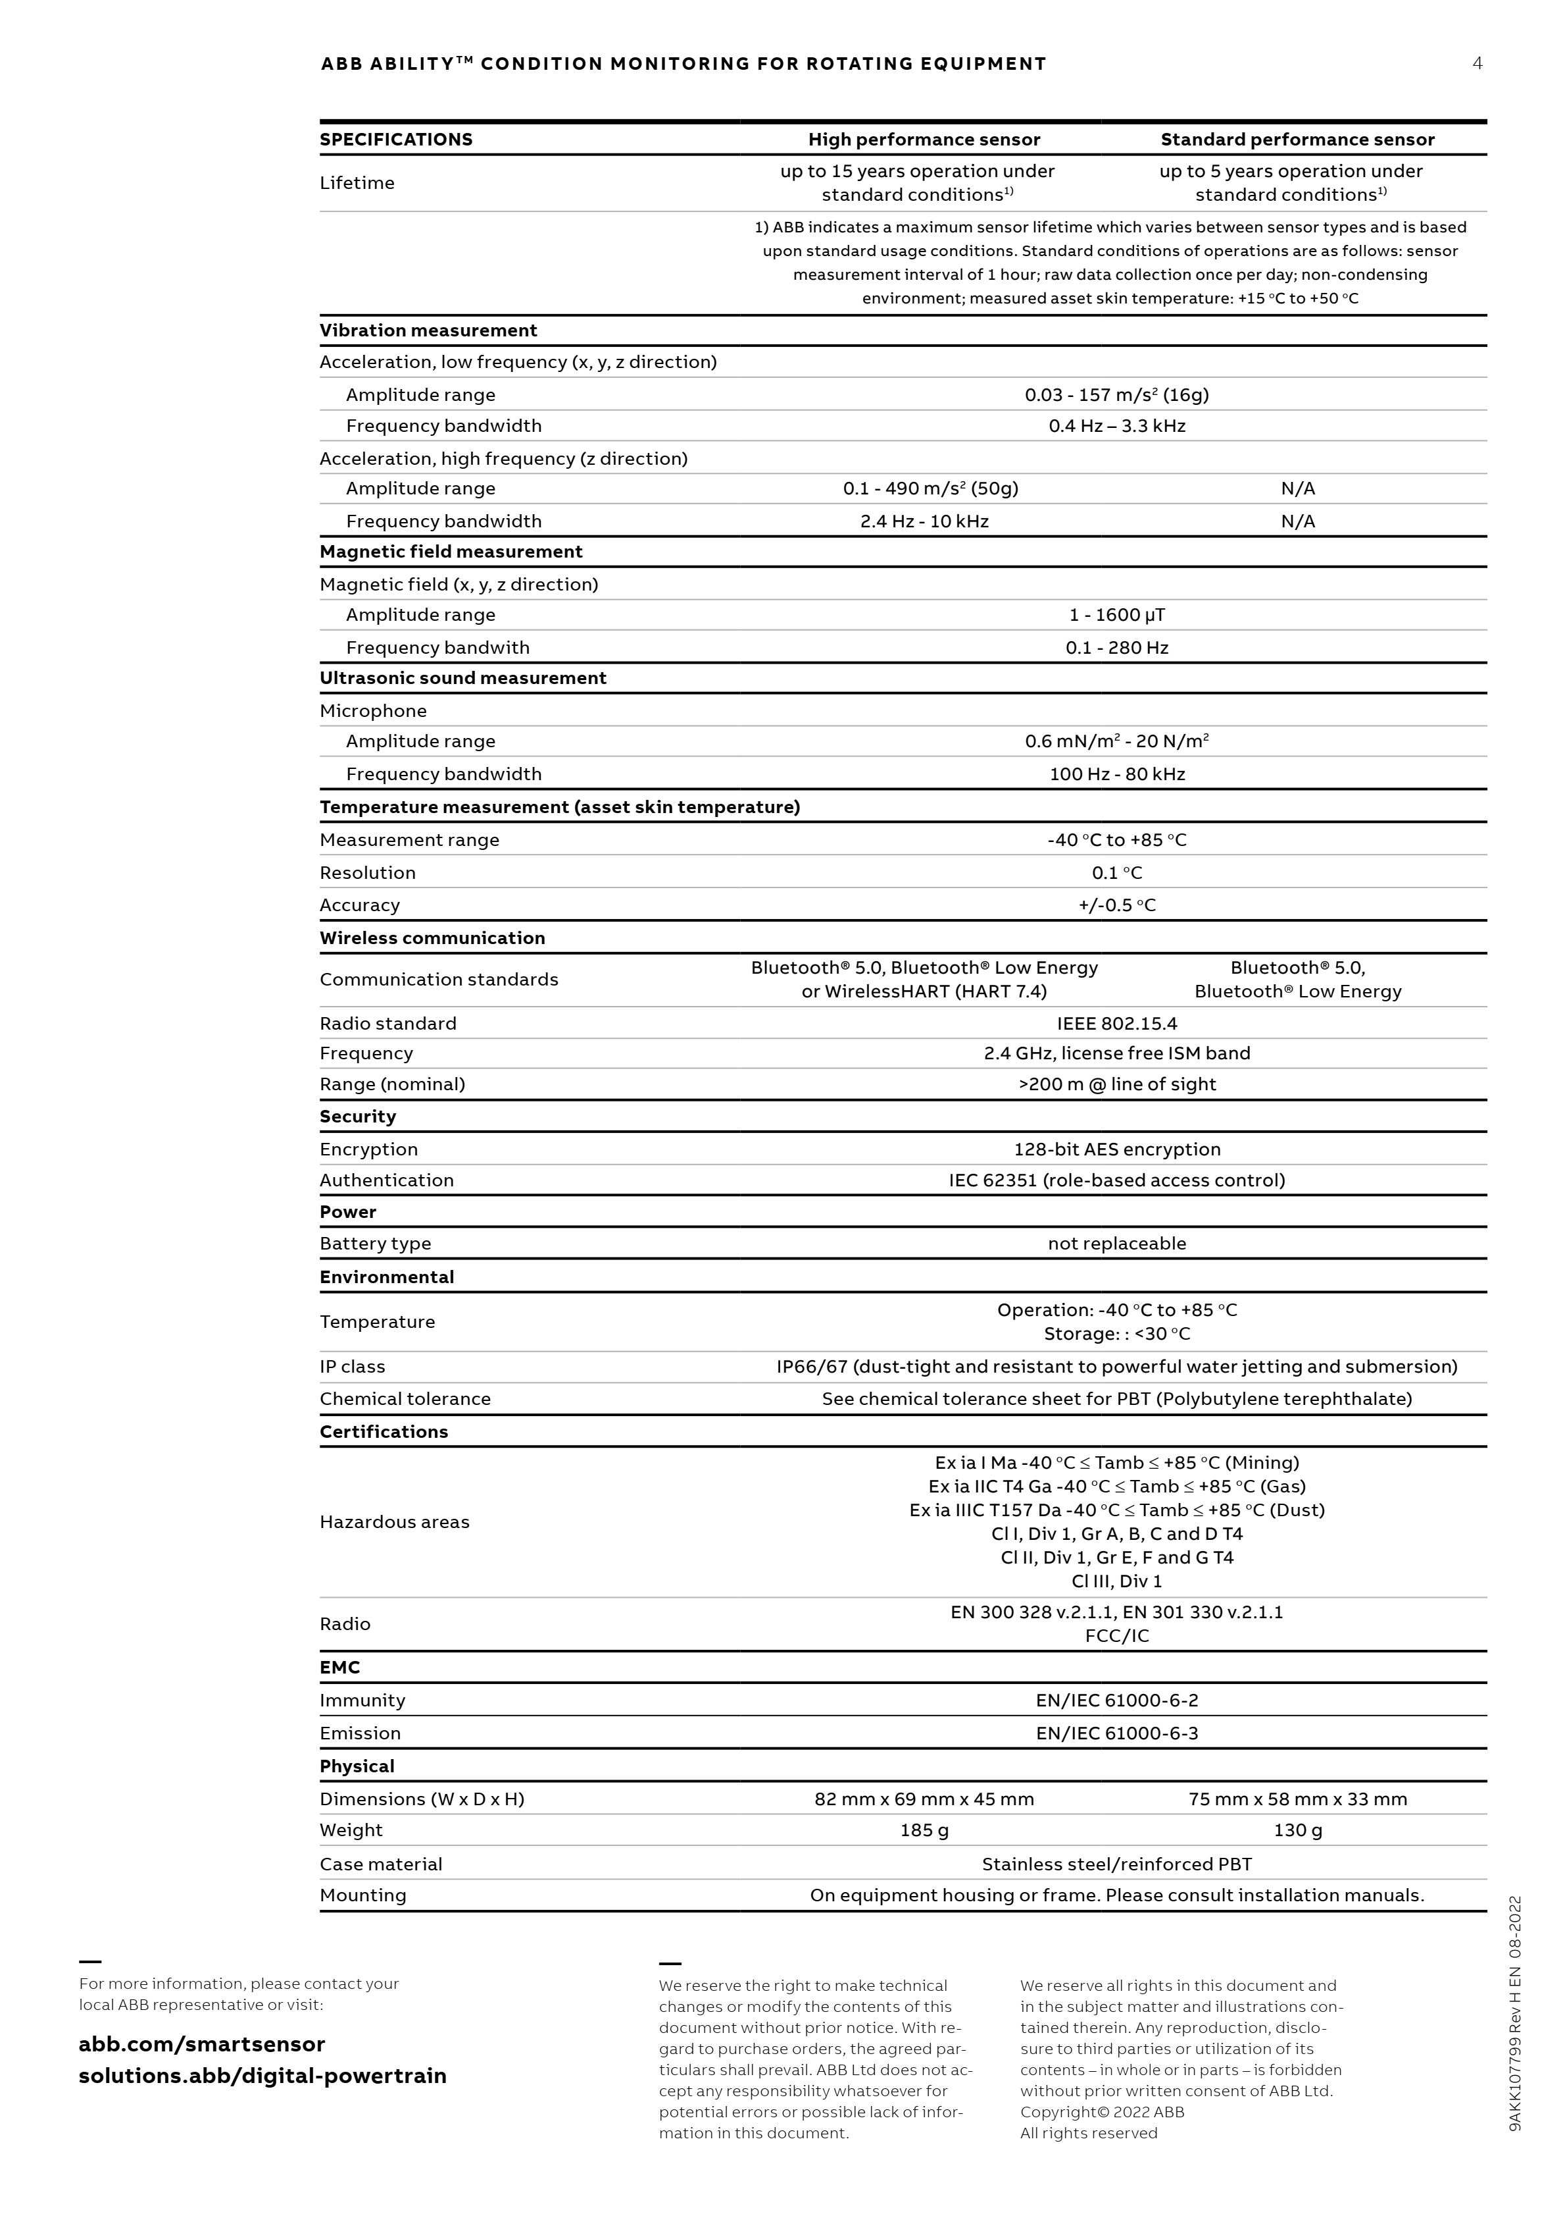
ABB Ability Smart Sensor
Specifications
More information can be found in ABB Ability™ Digital Powertrain - Condition monitoring of rotating equipment fitted with ABB Ability™ Smart Sensors (EN)

Slide 19
Monitored Parameters & Advantages
Monitored Motor Health Parameters | Monitored Motor Operating Parameters | Advantages
Overall condition Overall vibration Bearing condition Skin temperature Misalignment | Vibration (radial, tangential, axial) Velocity RMS Acceleration RMS Acceleration peak to peak Speed (rpm) Running time/Operating hours Total number of starts Supply frequency (Hz) Output power (hp/kW) Regreasing count-down Magnetic Field Acoustic signals | Early detection of potential problems minimises unplanned downtime Condition-based maintenance lowers costs Process optimisations reduce operating and energy costs Remote condition monitoring increases personnel safety Operating in explosive atmospheres Easily retrofitted to ABB or third-party equipment

Slide 20
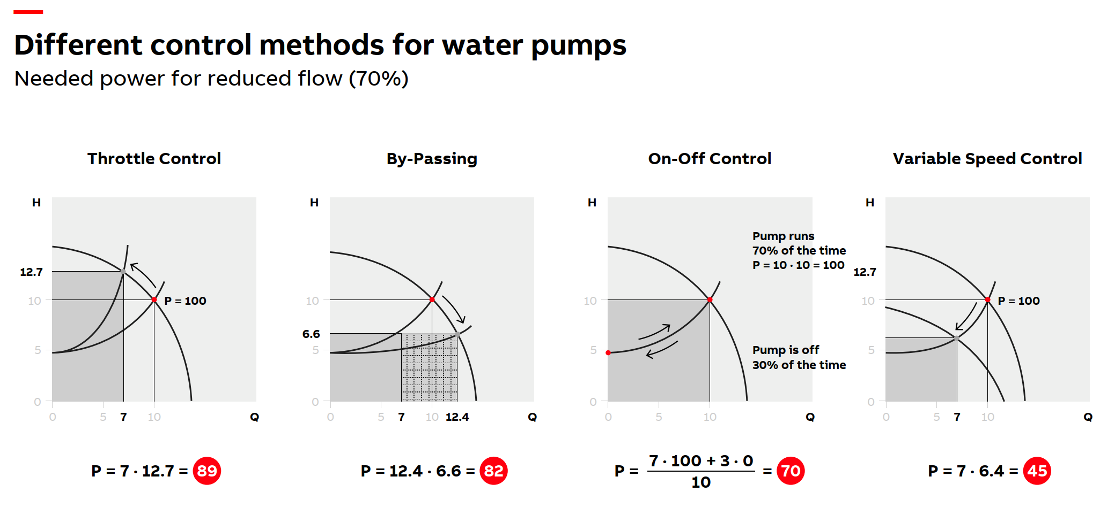
How Variable Speed Drives Cut Pump Energy Use
Savings
VSDs adjust speed instead of throttling, avoiding energy loss at partial flow
Notes:
When pumps operate at partial flow, a lot of energy is lost through throttling or bypassing.
Variable Speed Drives adjust the pump speed instead, matching demand and avoiding these losses — that’s where the savings come from.

Slide 21
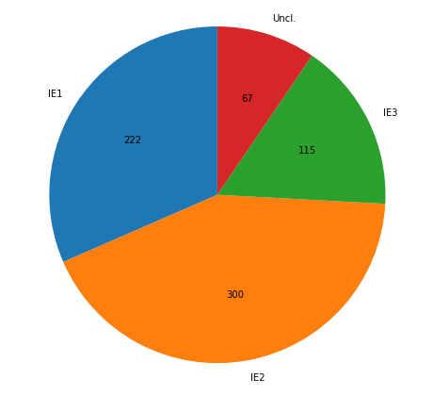
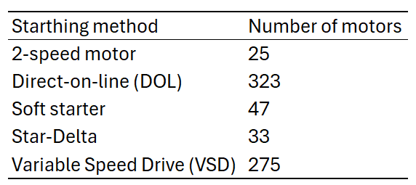
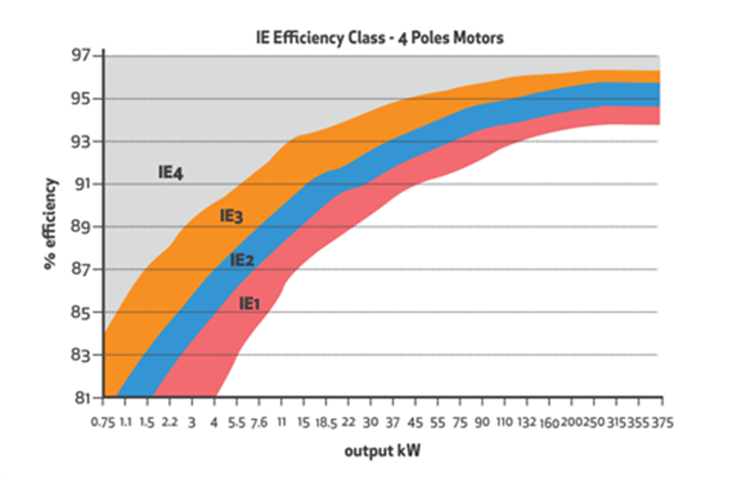
Motor Population and Efficiency Baseline
Data extracted from ABB motor audit – basis for energy savings calculations
Motor efficiency class distribution
Motor control method breakdown
Efficiency ranges for motors
≈ 60 % of motors operate without speed control (DOL, Soft starter, Star-Delta, or 2-speed,)
Most motors are IE1 or IE2

Slide 22
CERN Smart Regulation
White paper:
https://inspirehep.net/files/8adf5f2ffa67dd786649f45b274b8125

