Slide 1
Magnetic Measurement & Modelling
Status and project update
Marco Buzio, with the contribution of all the Section
CERN, 26.06.2025

Slide 2
Safety Matters

Slide 3
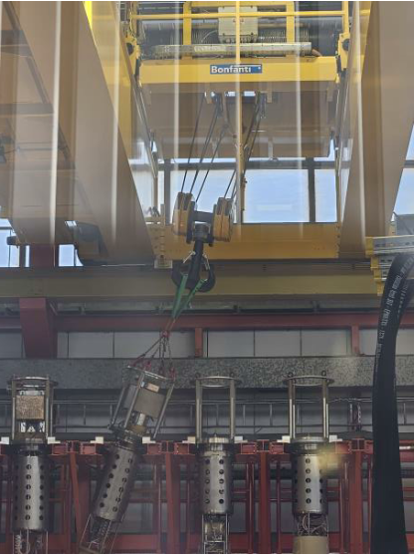
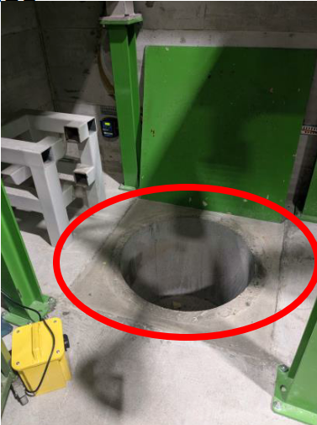
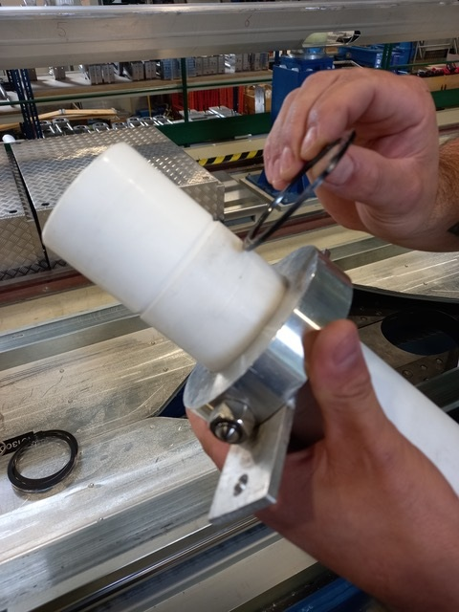
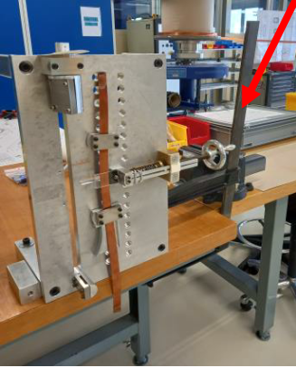
Accidents in MSC H1 2025
A few serious accidents, luckily no long-term health consequences/equipment damage
B927: high pressure gas/oil on face, following cutting of curing press refrigeration pipes
B927: large clamp hit on head during installation of winding machine
SMI2: large teflon alignment piece fallen on head during magnet cryostating
B288: trolley hit with knee loading large object obstructing view
SM18: twisted knee following fall in 0.5 m deep uncovered hole
B163: crane activated with previous load still attached to it
Notes:
Bonjour Carine,
Suite à l’analyse de l’incident EDH 11040809 (relevé des premiers faits HSE EDMS 3300928):
-la victime est allongée sur le dos sous un banc de montage pour une opération d’alignement d’une masse froide/écran de faisceau (masse froide suspendue au pont-roulant lors de cette opération, à quelques cm au dessus du banc de montage);
-la victime utilise une pièce cylindrique en Teflon (~2 kg) sur laquelle coulisse un anneau métallique de centrage;
-la victime tient cette pièce au dessus de son visage (~30 cm) pour cette opération;
-le cylindre lui échappe des mains et heurte son visage (entaille pommette gauche sur plusieurs cm).
Action immédiate:
Relevé HSE des premiers faits: EDMS 3303086
Rapport interne d’accident: EDH 11054913
Relevé des faits (le 27.05.25 sur place)
Lors du montage d’une station de test (photo 1) de câbles sur un établi:
-la victime maintient la station de test à la verticale pour éviter un basculement;
-le témoin fixe la station de test à l’établi à l’aide d’un serre-joint (~5 kg) (photo 2: sur l’établi et photo 3: sous
l’établi)
-lors de la phase de serrage, le serre-joint glisse, bascule et heurt la tête de la victime.
La victime ressent un malaise et s’allonge au sol.
Le témoin contacte immédiatement le Service Secours et Feu du CERN.
La victime est transportée à l’hôpital.
Safety Office TE Rapport établi le 02.06.25 par D.Létant-Delrieux (DSO TE)
Choc à la tête durant le montage d’une station de test de câbles
EDMS 3305986
Recommandations
-Modifier le moyen de fixation de la station de test à l’établi, pour éviter l’utilisation de serre-joint
➢ Le jour de la visite, la station de test a été modifiée et est vissée dans l’établi (photo 4). Cela évite
l’utilisation de serre-joint et assure la stabilité de la station de tests.
-Modifier et sécuriser le système de fixation du poids à l’échantillon de câble (photo 5) pour éviter qu’il ne
bascule/chute sur les pieds de l’opérateur.
➢ Une nouvelle table élévatrice adaptée et sécurisée est en cours d’achat.
Dear all,
Please see the details of the safety incident on 21.05.2025 which occurred at around 13h50.
Location – Building 288 – Department / Experiment concerned: TE
Activity – Putting the piece of load on trolley – Department / Experiment concerned: TE
Pendant des tests électriques sur un aimant dans le banc de test de grande
longueur, la victime a chuté dans une fosse de plus de 50cm de profondeur. La
victime s’est tordu le genou gauche.
Action immédiate
La victime s’est rendue par ses propres moyens à l’infirmerie du CERN.
Le service médical du CERN juge la blessure mineure et ne prévoit pas de soin
supplémentaire à ce stade.
La victime est retournée à son poste de travail.
Une déclaration d’incident a été rédigé.Event – Person was putting a piece of load on the trolley when he accidently hit the corner of trolley because of blocked visibility due to the load. After getting hit , he instantly fell on the ground and knee on his left leg get injured.
Immediate Actions – Person felt severe pain in the knee of the left leg and went to ME at 13h55, 21.05.2025.Knee has been badly swollen after the incident.
HSE called at 14h00, 21.05.2025, by ME and statement of facts made at 14h10, 21.05.2025.

Slide 4
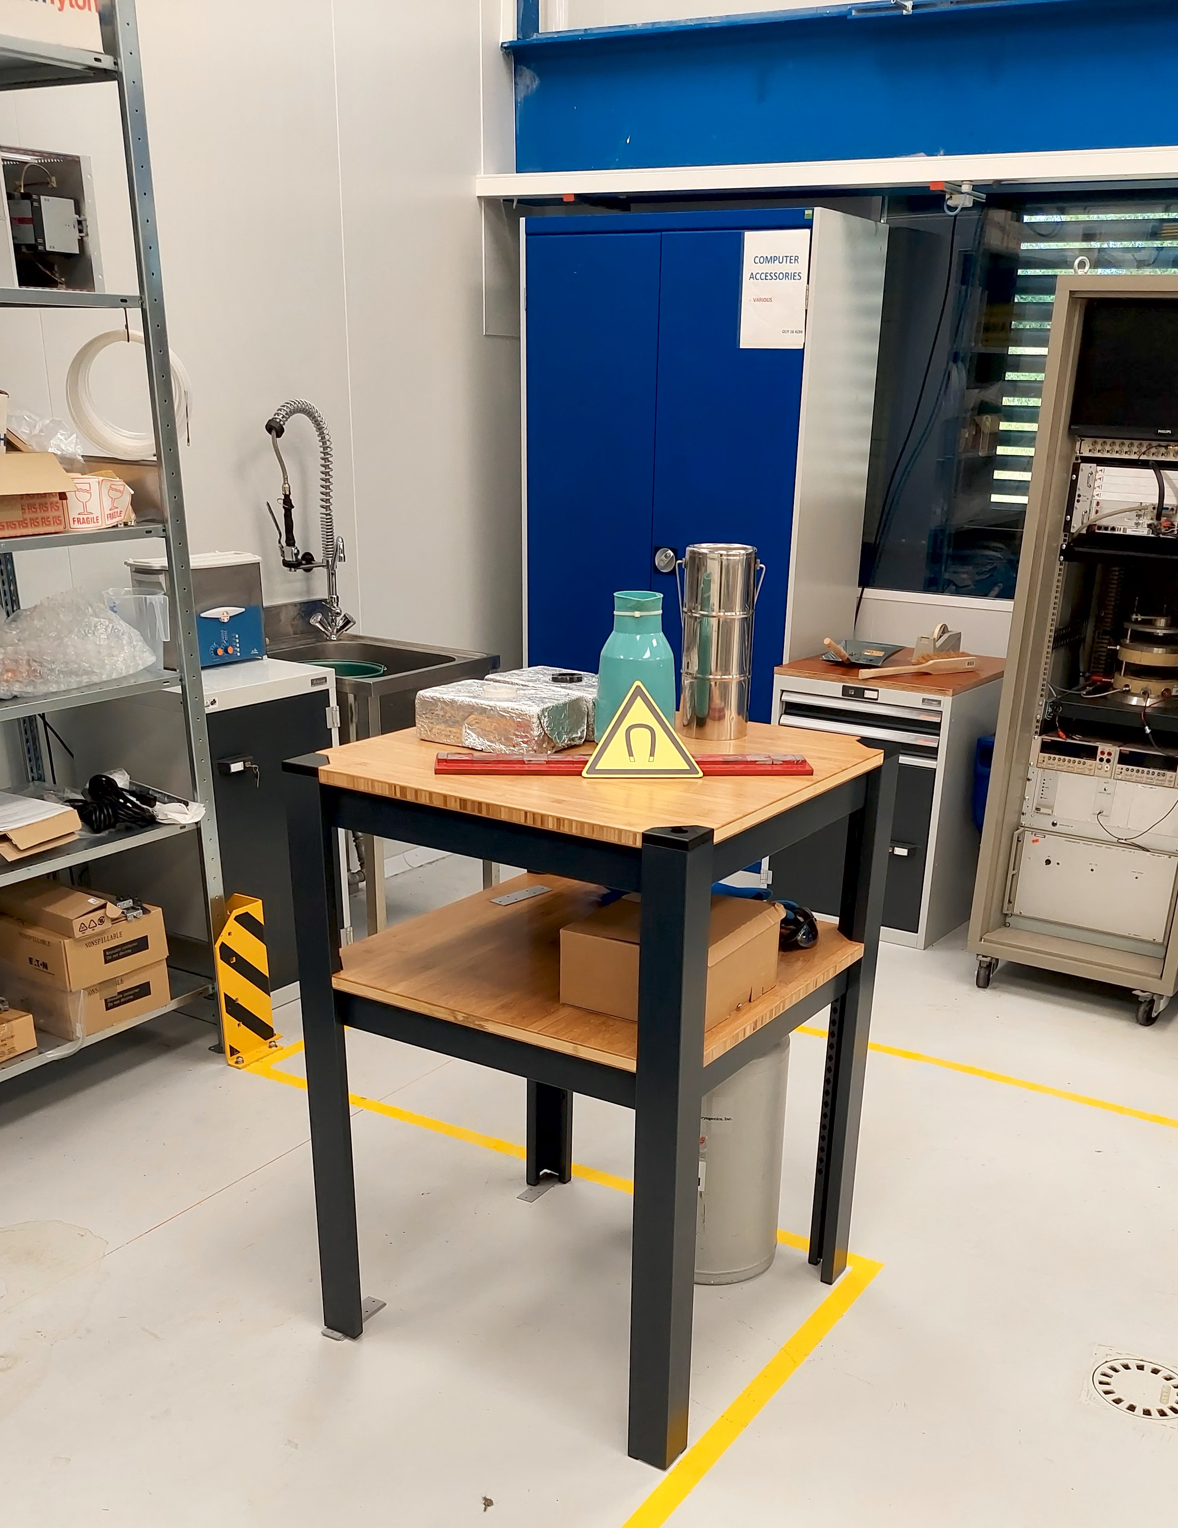
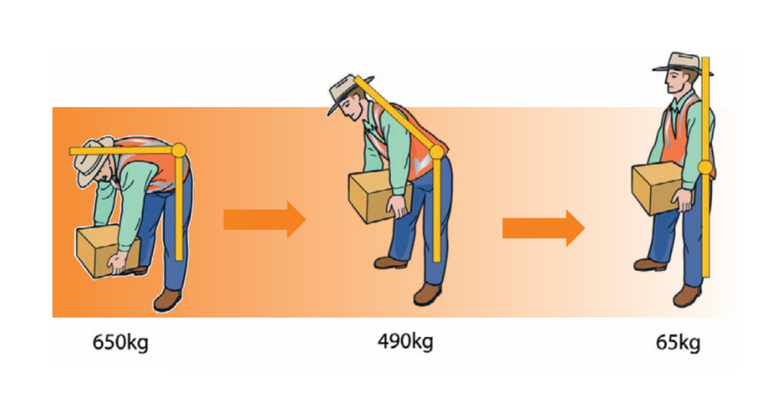
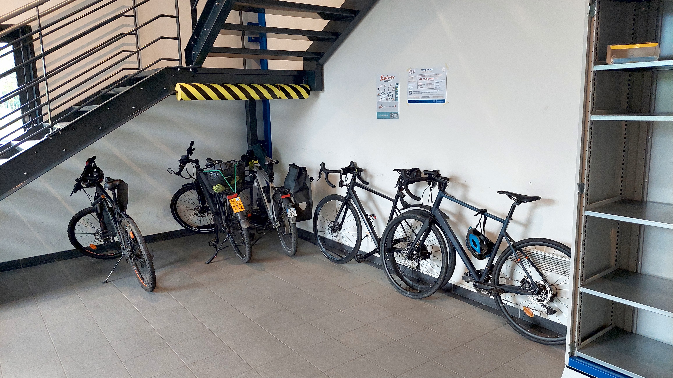
Safety actions
Pressure vessels > 0.5 barg must be inventoried in EAM database (according to GSI-M-2)
Locations with cryogenic hazards (even temporary) need authorisation =
documentation + risk assessment + implementation of risk mitigation measures
Proposal of Fire safety measures for Li-Ion battery charging EDMS 3234281 (→TSO, DTSOs)
− multiple laptops close together (0.1 kWh), power tools (0.5 kWh), multiple bicycles (1 kWh), UPS (1~200 kWh), forklifts (100 kWh)
− obligation of awareness safety course (upcoming)
− obligation of CERES registration if > 1 kWh, written declaration if > 5 kWh
− consider: location (e.g. on escape route); combination with other nearby risks; supervision; ventilation; firefighting devices ….
"Manual handling - Gestures and postures" now available on the Learning Hub

Slide 5
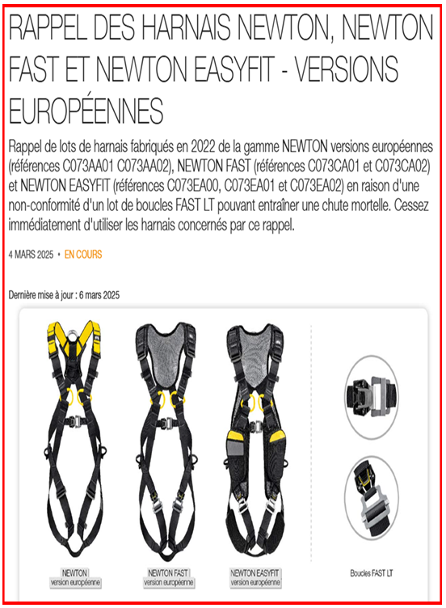
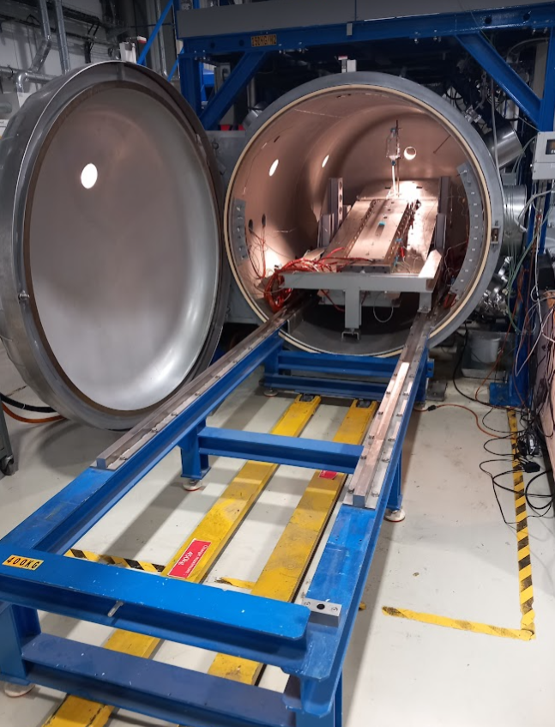

Are we concerned ?
Travail en hauteur
Travail en espace confine
Safety training necessary
Written procedure including risk assessment + mitigation measures
Course STCOS01I

Slide 6
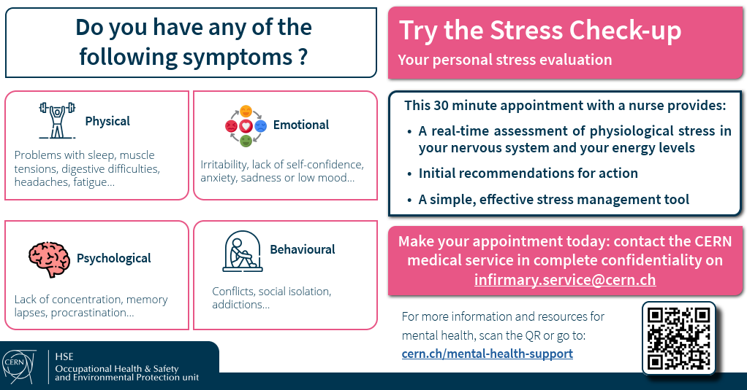
Safety actions

Slide 7
General communications

Slide 8
Personnel (07/2025)
Industrial Support (3)
Dominique DREVARD
Thierry SAINT-GEORGE
Francois RAKOTOARISON
(07.25)
Trainees/Students (5)
Alberto BELLELLI
Miguel GONZALES
Martin PRAZNOVSKY
Maurus TAUPADEL
Christoforos TSIOLAKIS
Nevena Veselinović (09.25)
Graduates/Fellows (4)
Konstantinos DIAMANTIS
Giorgiana DIMA
Abhishek GANESH
Nicolas VALLIS
CAD/design Eng. (H2 25)
Staff (12)
Ricardo BELTRON MERCADILLO
Matthias BONORA-TAM
Marco BUZIO
Regis CHRITIN
Guy DEFERNE
Olaf DUNKEL
Lucio FISCARELLI
David GILOTEAUX
Unai MARTINEZ HERNANDEZ
Mariano PENTELLA (07.25)
Carlo PETRONE
Stephan RUSSENSCHUCK
Visiting scientists
Uppsala: magnet test eng. (TBD)
GSI: SSW developer (Q4 25)
Notes:
- New magnet test positions opened at Uppsala/GSI

Slide 9
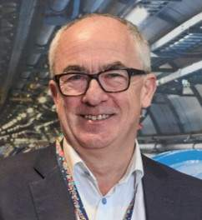
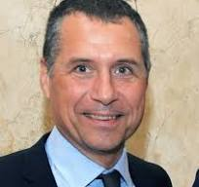
Official Communications
CERN Management 2026-2030
See last weeks BULLETIN
No change to ATS department structure
Department Heads to be nominated in September by Council.
Applications are welcome.
Group Leaders to be nominated or confirmed afterwards
… for us: no big change expected !
Telework Guidelines
flexibility offered by CERN to MPE (Staff + Graduates)
telework must be compatible with job description
40% averaged over 1 week =
2 days telework + 3 days at CERN
supervisor → written tasks
teleworker → written report
telework outside local area:
only under direct supervisor’s responsibility
(accidents may be considered professional)
combinations not recommended:
annual leave + telework
sick leave +telework > 2 days
generally accepted:
- occasional short-term flextime
- exceptional personal needs (any duration/location,
requires GL accord, possibly with HR/DH advice)
M. Thompson
DG
O. Brüning
ATS
TE ? BE ? EN ? SY ?
???

Slide 10
Budget Codes
All HFM-related materials
not for
general
use
All HL-related materials
Materials not related
to project BCs
Only if < 1000 CHF
otherwise please ask
PCs, office supplies, tools, consumables, fasteners, electrical components, travel, training (if not covered by TE), buildings, infrastructure
discontinued

Slide 11
A few highlights – H1 2025

Slide 12
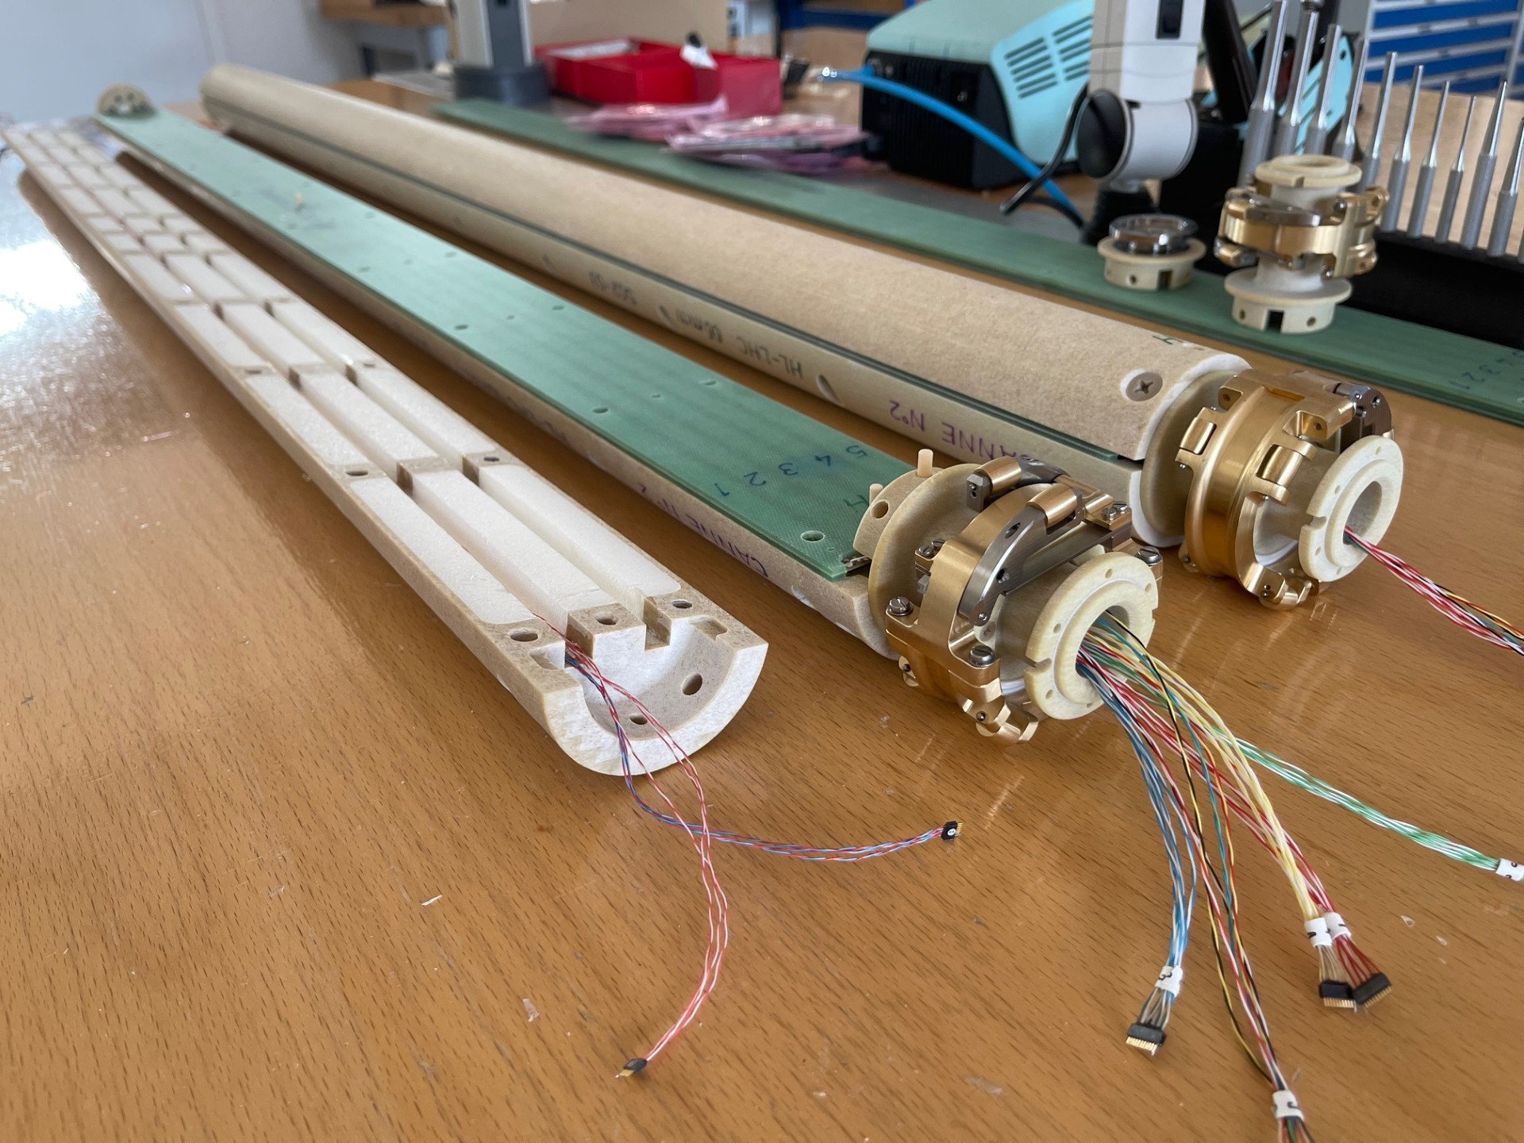
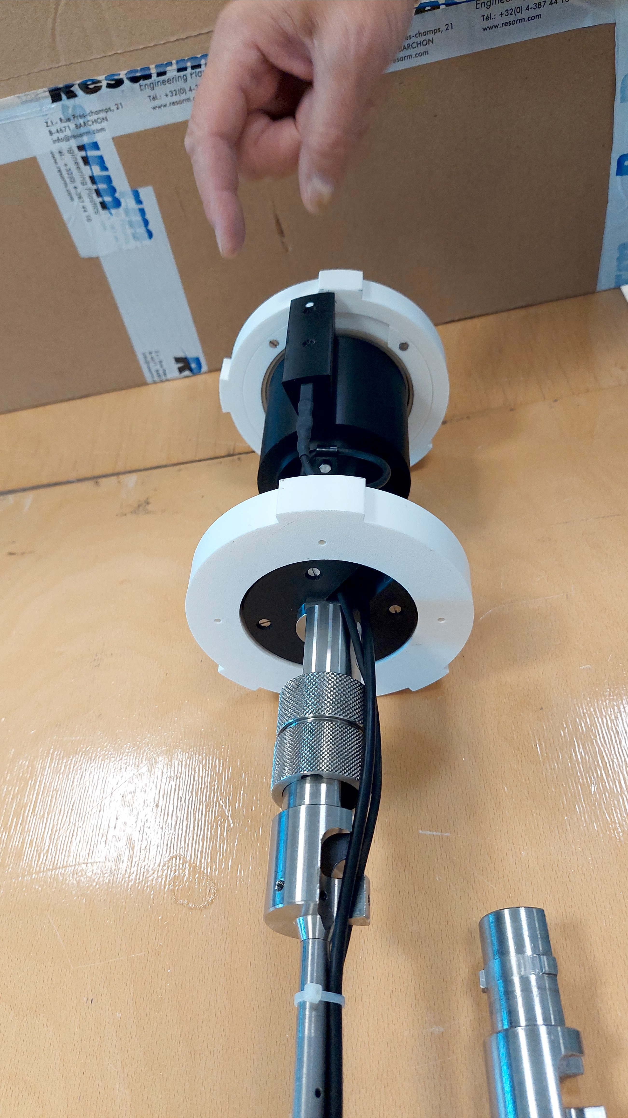
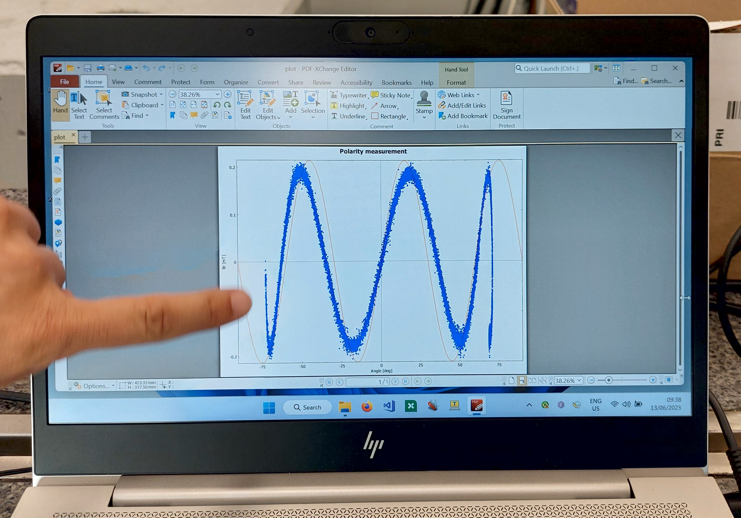
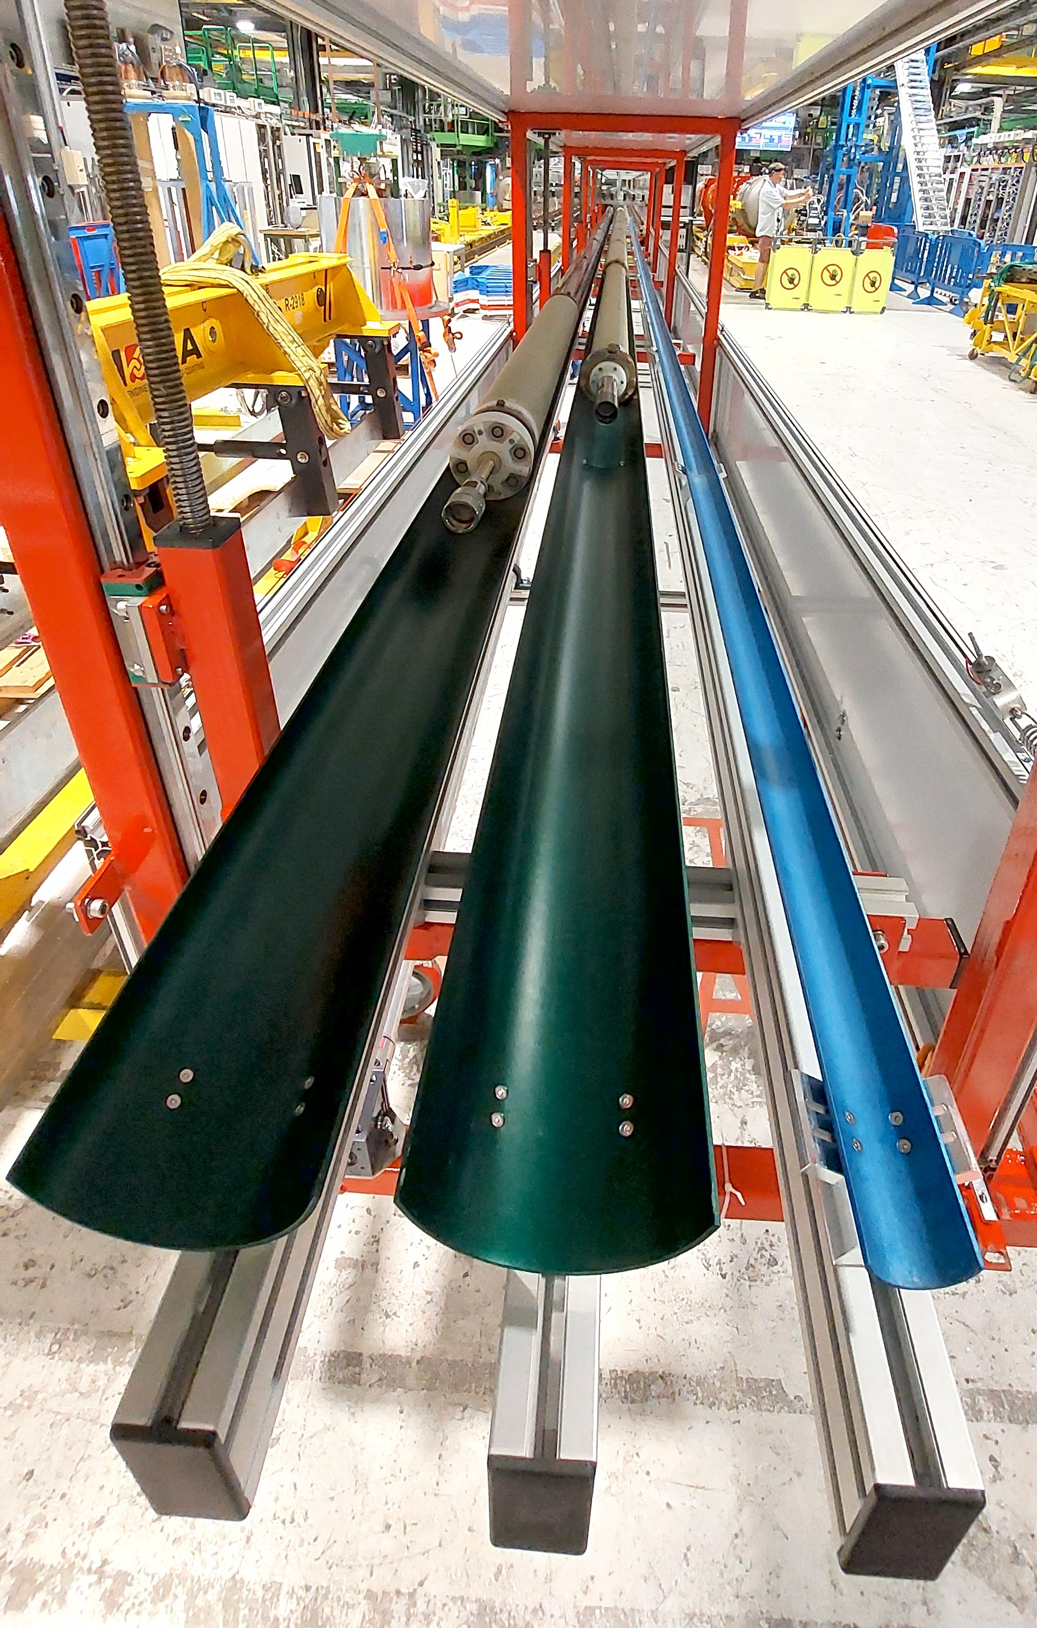
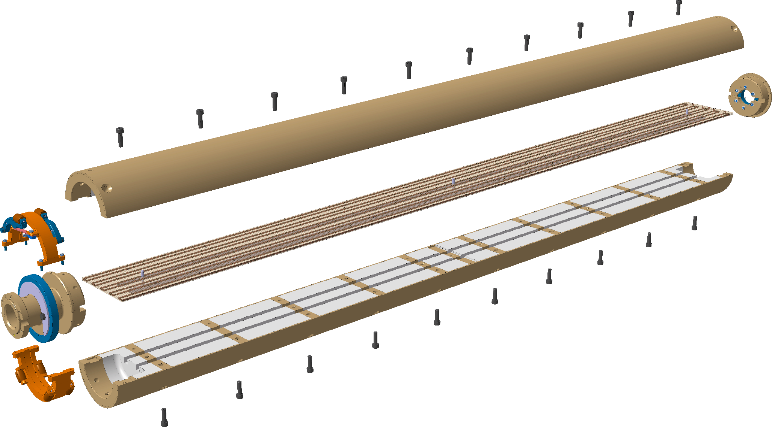
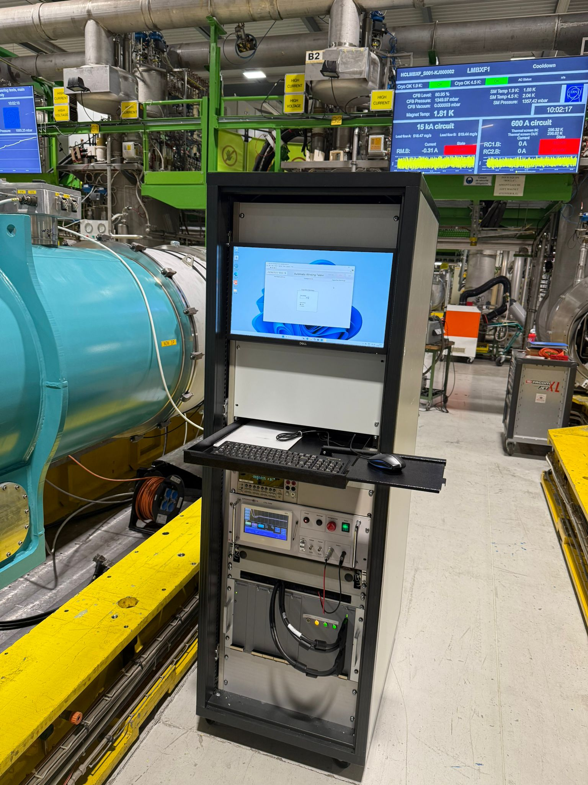
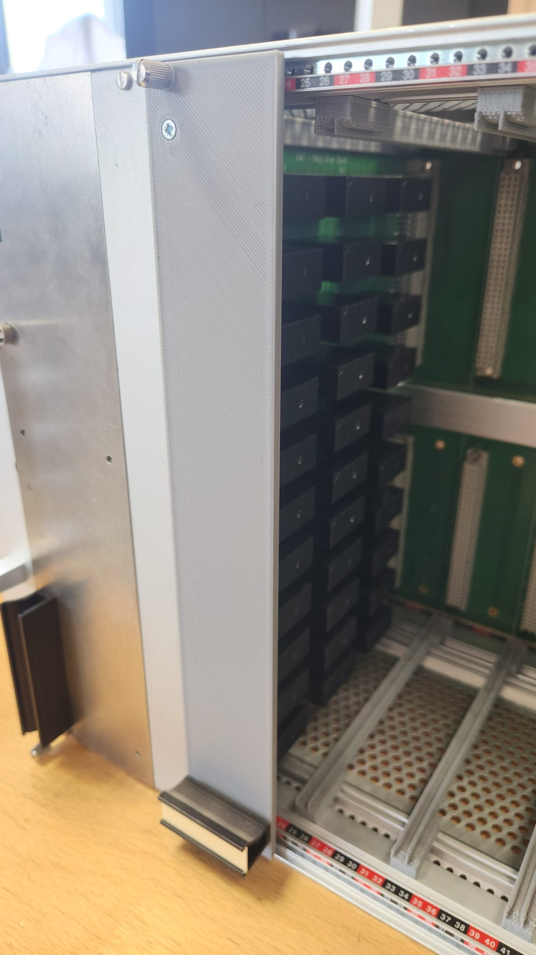
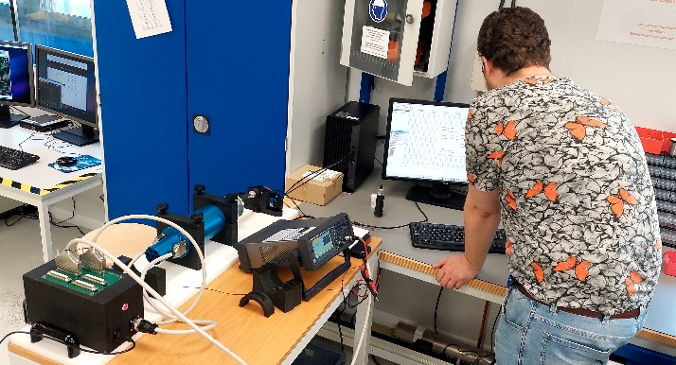
High Luminosity LHC - Instrumentation
considerable effort on rotating coil shafts in parallel with other activities provides important results as required (and appreciated!) by the project management: twin D2 coil shafts ready, spare MQXF and D1/CP shafts well advanced
many types of components and instruments, not always only for magnetic measurements
rotating coil shafts/QA
in operation at SM18
Hall-probe based polarimeter
for warm HL-LHC magnets
Relay matrix-based
automated HV test system
MRU signal
chain test station
Notes:
MRU Test Bench: a stand-alone bench for testing the rotation, cabling polarity and signal integrity of standard short (HL) and long (LHC) rotating units has been completed, including documentation. Already used to check the system used for MQXF in SM18 (see issues reported in Week 15), where the MRU has been validated, thus pointing to a fault in other elements of the acquisition chain

Slide 13
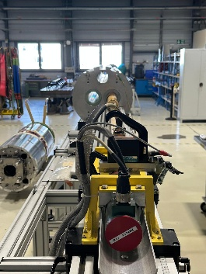
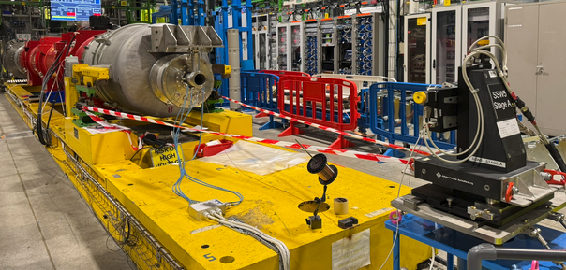
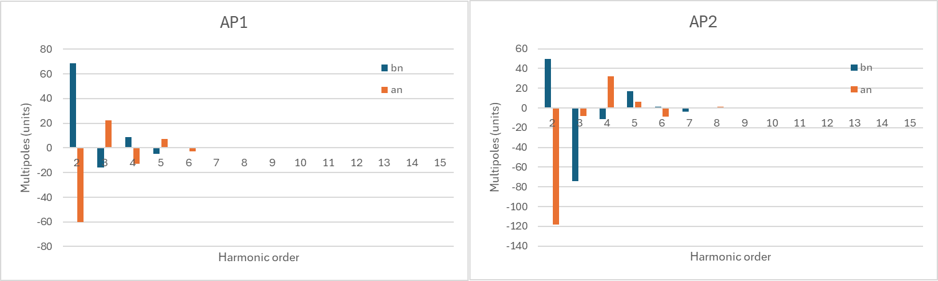
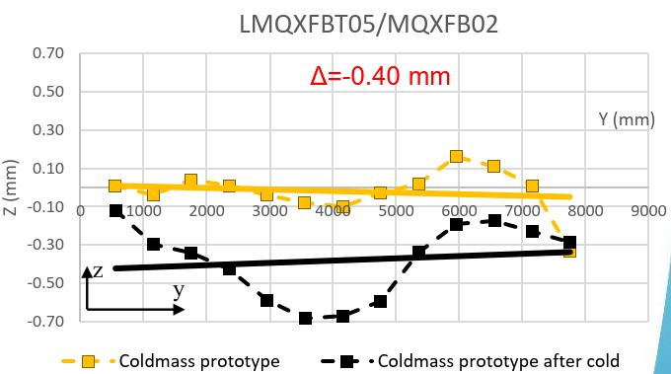
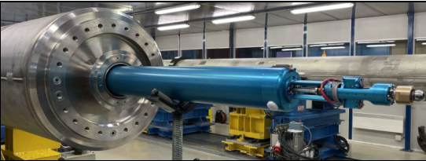
High Luminosity LHC – Series Test
warm and cold test workload ramping up fast, so far keeping up with project schedule. Careful planning of resources to complete the campaign needed
no showstoppers, but confirmation of the crucial role of magnetic measurement to catch hidden manufacturing issues
warm harmonics reveal
undesirable magnetic components
multiple magnetic axis measurements show unexpected cold mass movements after cold tests
Notes:
MCBRD05 (927): warm measurements repeated, confirm very large harmonics at low field level (~1 mT). This distortion was not seen at cold in IHEP, so in combination with the observed hysteresis (as reported last week) could signal the presence of parts that are magnetic around the coils. Data analysis ongoing to verify this hypothesis.

Slide 14
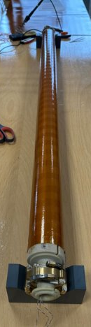
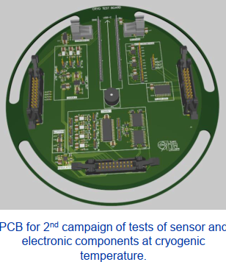
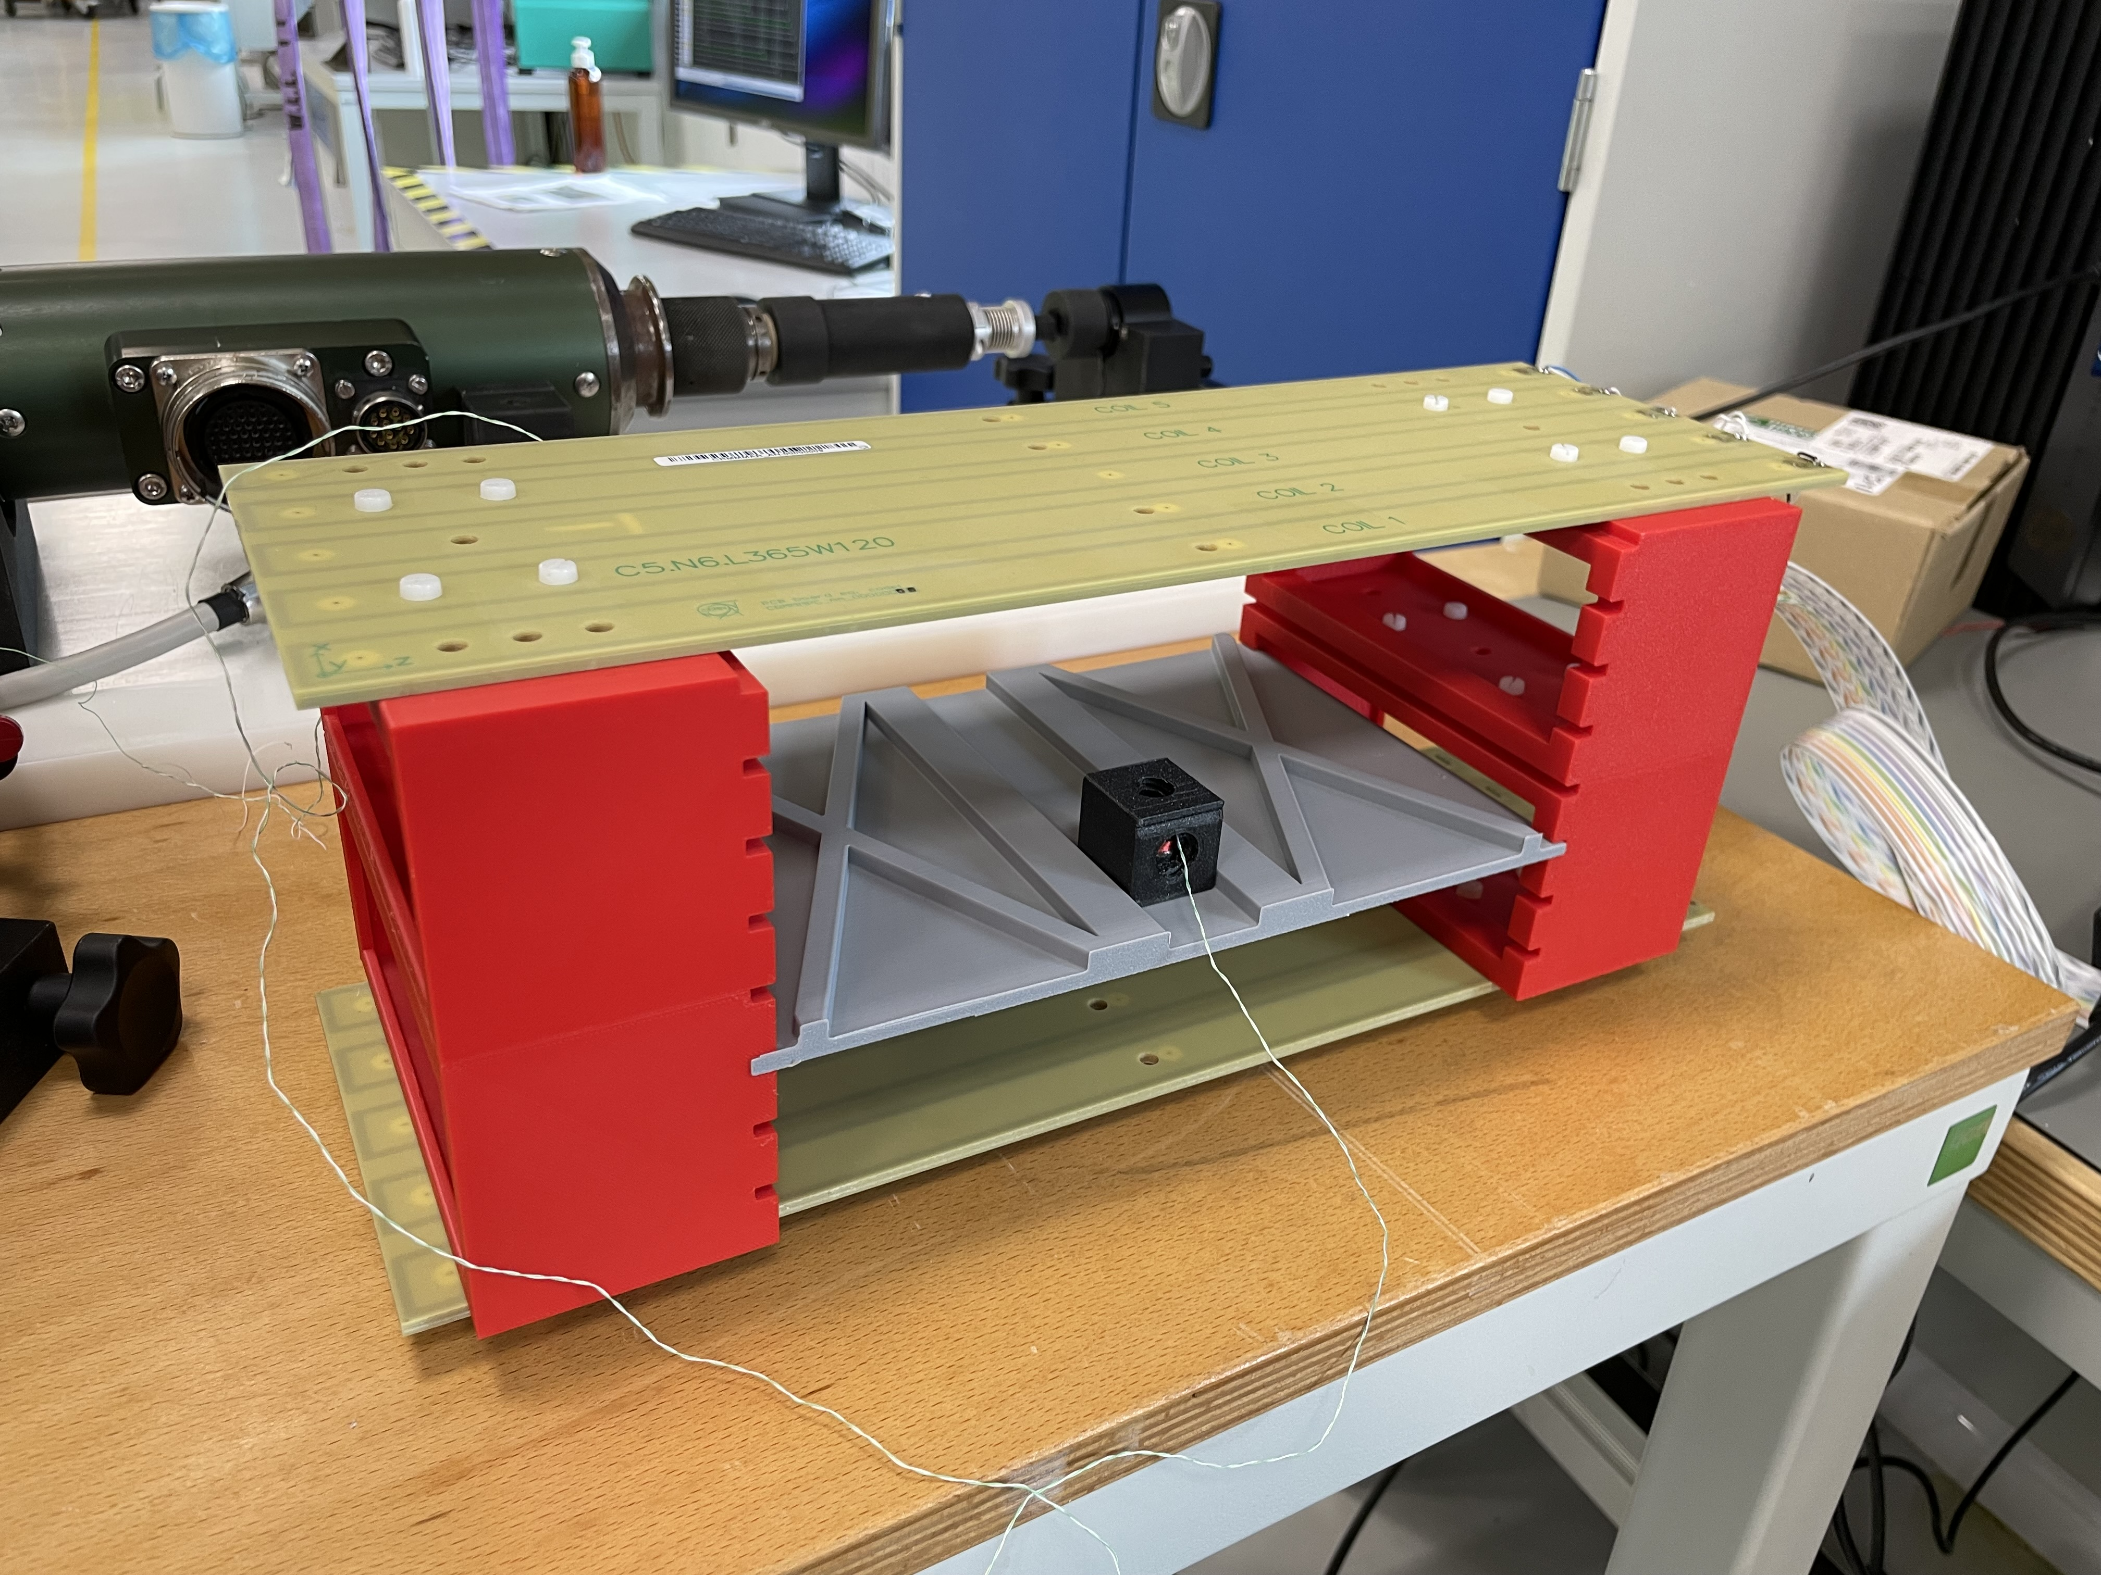
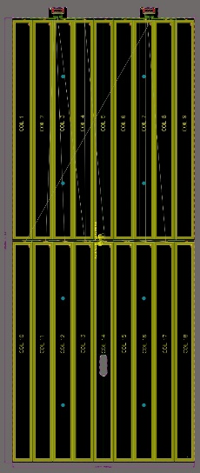
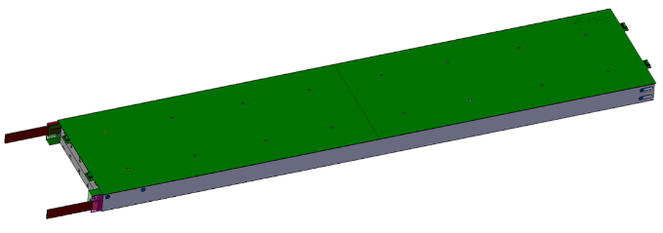
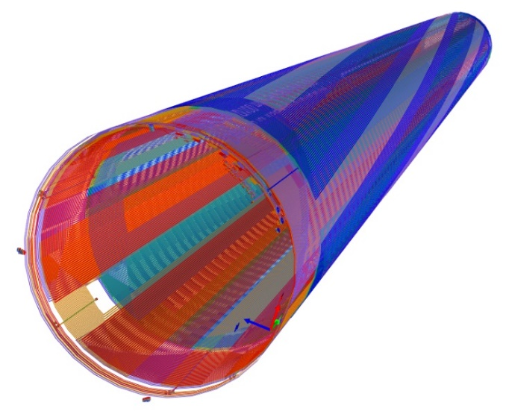
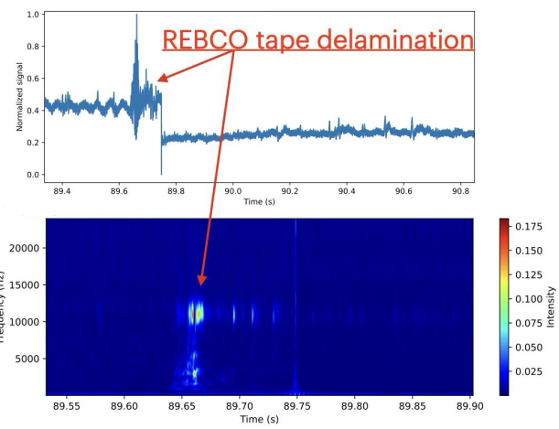
Quench Antennas/Cryomagnet Diagnostics
highly innovative quench detection/localization techniques based on magnetic field or mechanical transient
common theme: specialized knowledge such as harmonic magnetic field representation, instrumentation and data acquisition techniques translates to magnet protection domain for multiple projects (HL-LHC, HFM etc.)
B₃
A₃
A₄
B₄
quench antenna calibration setup
graded coils for longitudinal quench localization
helical flexi PCB coils for angular
and radial quench localization
1.9K electronics/DAQ
with quench detection microphones

Slide 15
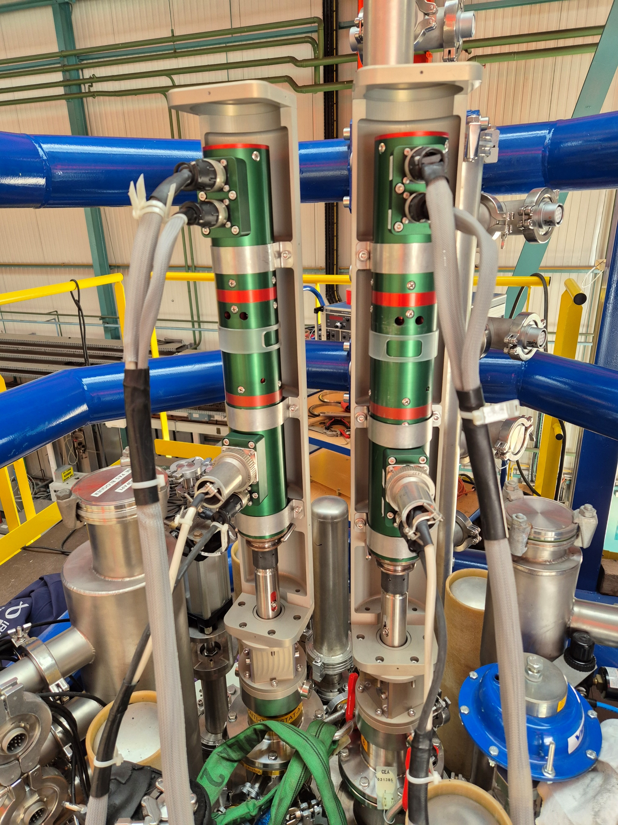
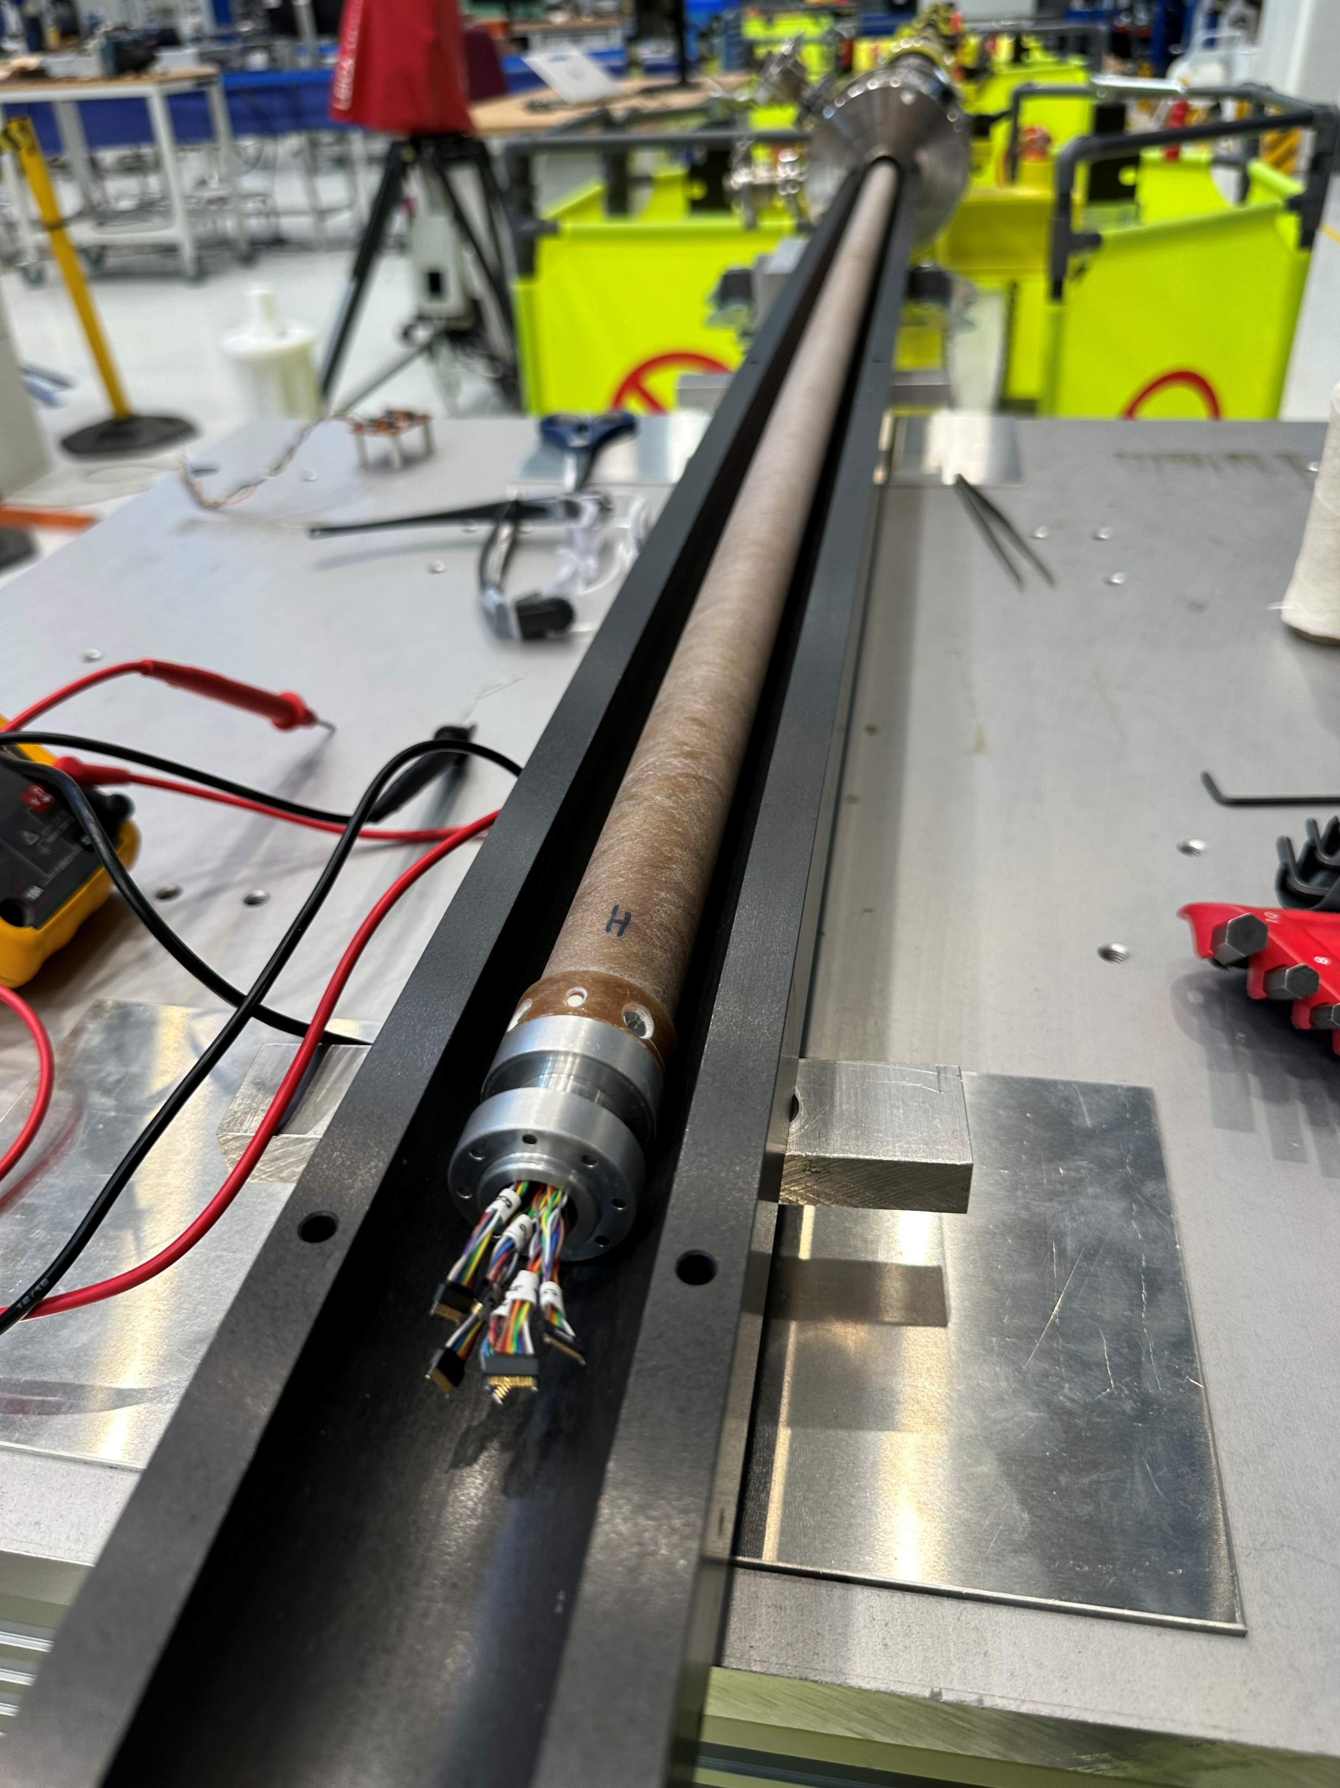
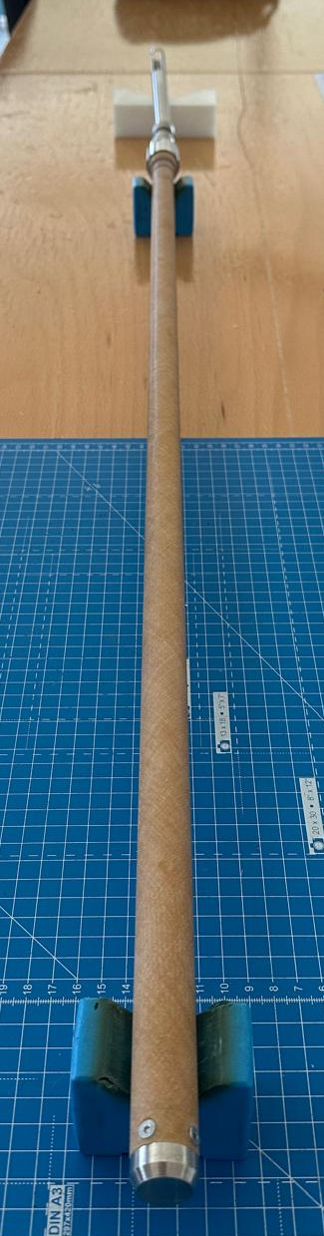
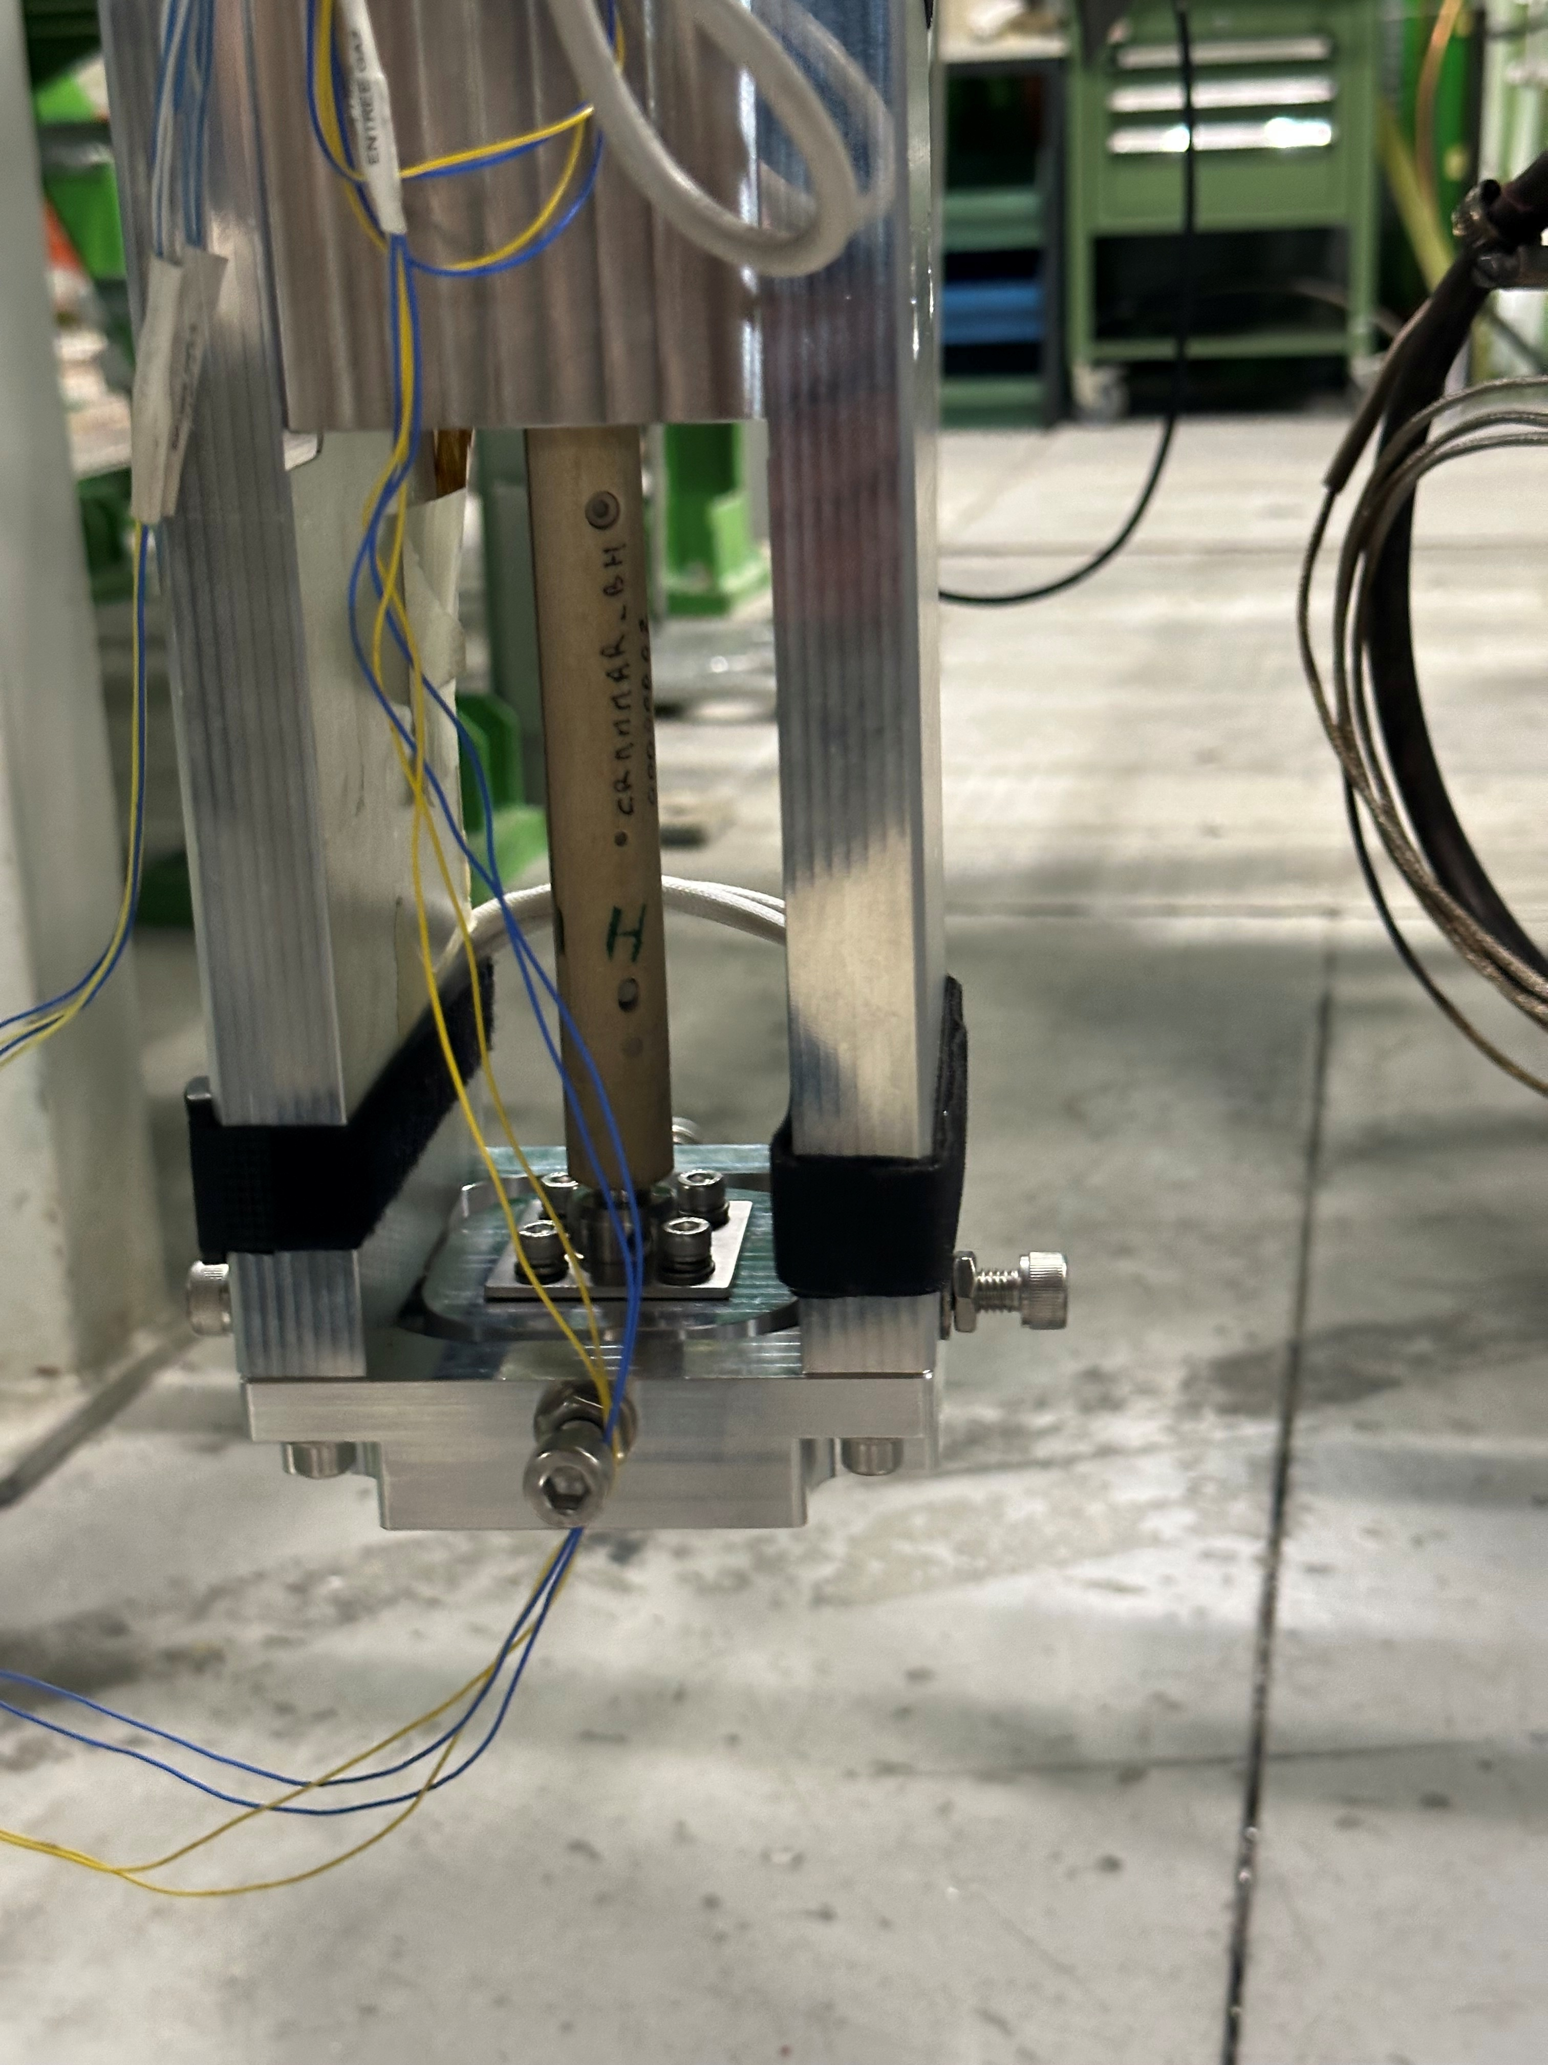

Vertical coil system collaborations
STAARQ (CEA Saclay)
Both shafts successfully prepared and delivered in spite of competing priorities and other difficulties
In the end, positive feedback received from CEA for a properly calibrated, state-of-the-art piece of instrumentation
HFM WP3.14 (PSI)
Subscale stress-managed Common Coil Demonstrator SMCC1
One ∅18mm, 0.9 m long 6-segment dipole shaft also completed and deployed in operation
Cold tests ongoing
Saclay cryostat
SM18 Cluster D
Notes:
Advantages: room-temperature calibration, better rotation → harmonic quality, maintainability, operation…

Slide 16
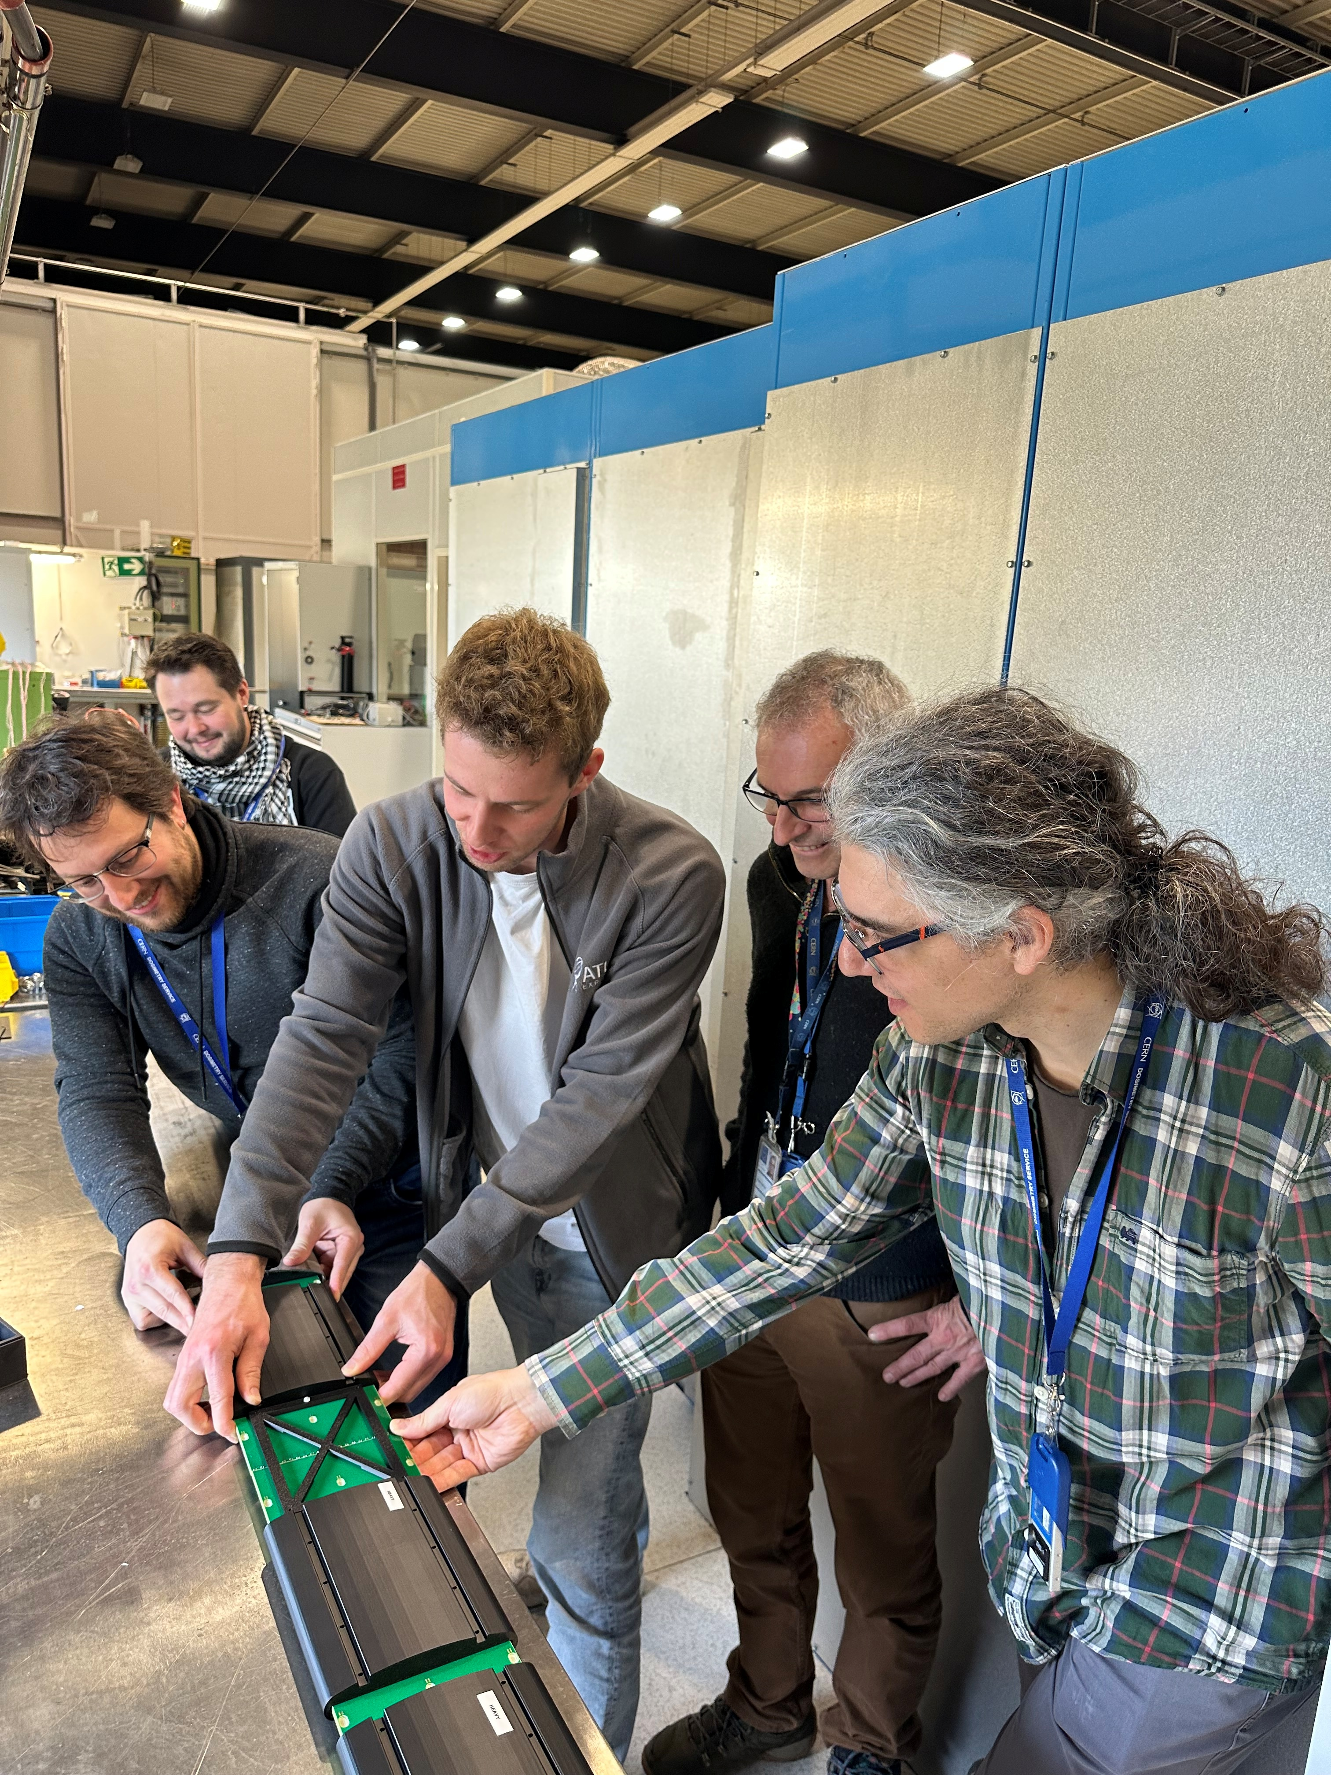
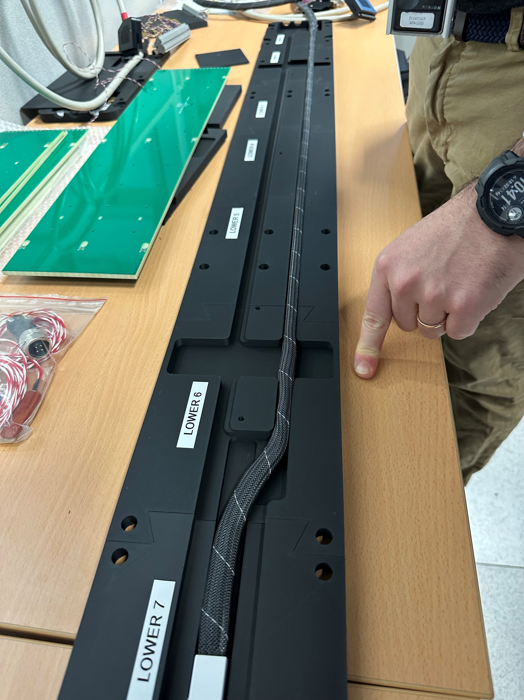
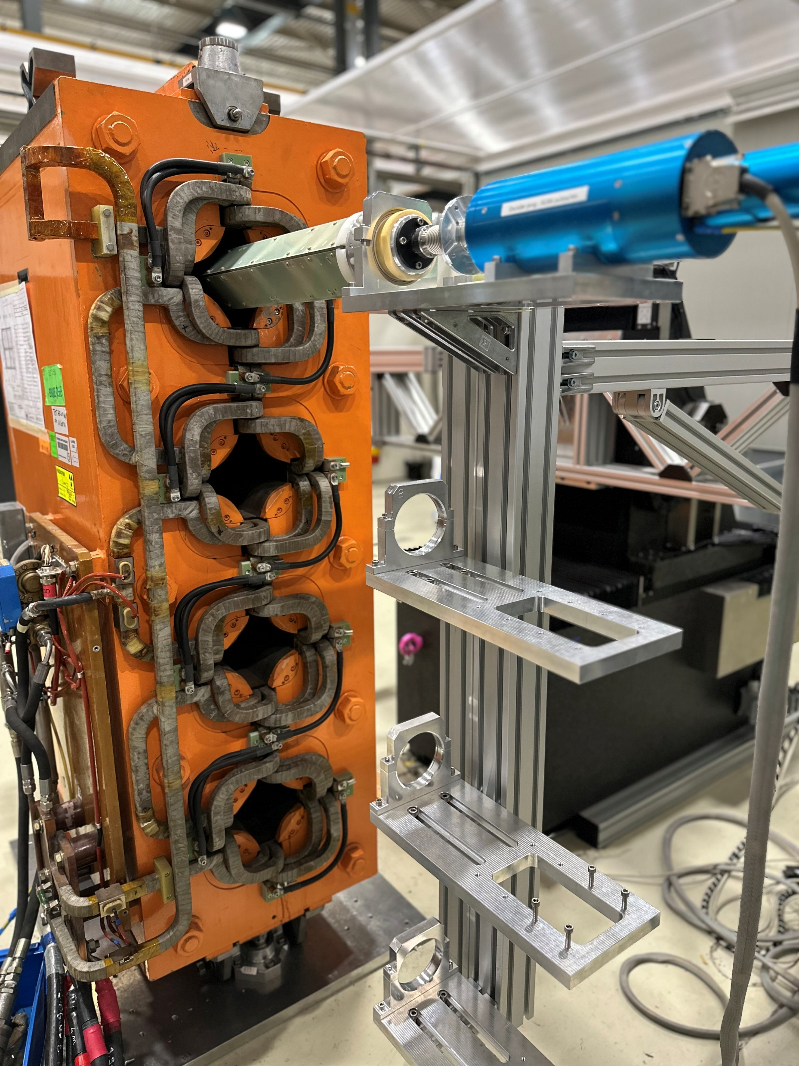
B867 – High current test station
radical renovation of infrastructure (6kA DC power converter, power distribution and control …) and instrumentation (“new Huron bench”, new long integral fluxmeters, new rotating coil systems) ongoing
unique lab set to get a central role during and after LS3
piecewise integral SPS MBA/MBB/MQ PCB coil arrays
rotating coil system for PSB quads
Notes:
FCC-hh energy frontier 2024 baseline: 90.7 km tunnel 85 TeV 14 T Nb₃Sn dipoles
- Staff recruitment
- Work together with beam dynamics experts on the finalization of the magnet design, depending on the optics choice
- Start building prototypes of the magnets presented in the feasibility report to address open questions (for example change of magnetic axis position in collider quadrupole) and develop the conceptual designs towards engineering design. Address the choice of the most cost-effective electrical steel, requirements on shuffling, etc
- Finalize building prototypes of magnets and start the magnetic measurements and related magnetic characteristic of the iron (permeability)
- Provide magnets to mock-up to arc half-cell mock-up, including shielding
- Finalize the magnetic measurements of the magnet prototypes
- Define an industrialization strategy and manufacturing methods
- Study magnetic measurement strategy and propose measuring system atomization to cope with large series qualification.
- Deliver the pre-TDR report together with the class 3 cost update
I am not sure if this is worth mentioning here, since this is somehow part of the engineering design. Also, I think that the material selection only impacts marginally on the cost of the magnets. Maybe the choice of the lamination thickness can have an influence on the manpower cost of the assembly (thinner laminations means more to punch and stack)
Attilio: Somewhere this should be covered

Slide 17
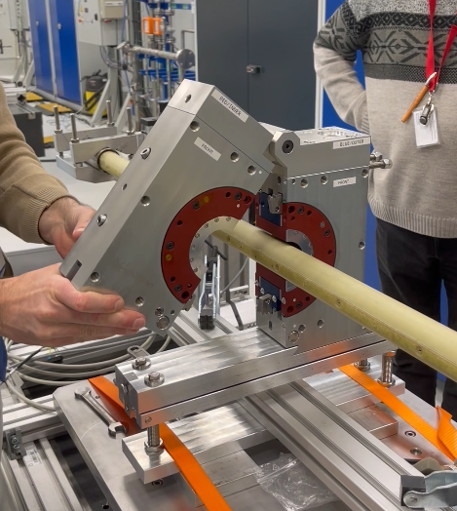
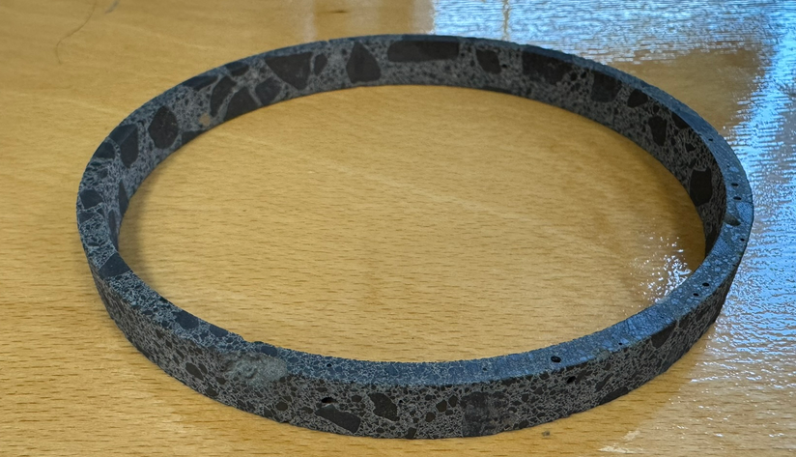
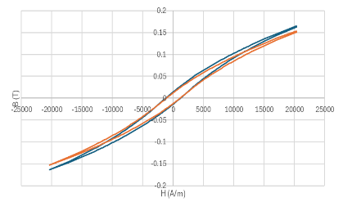
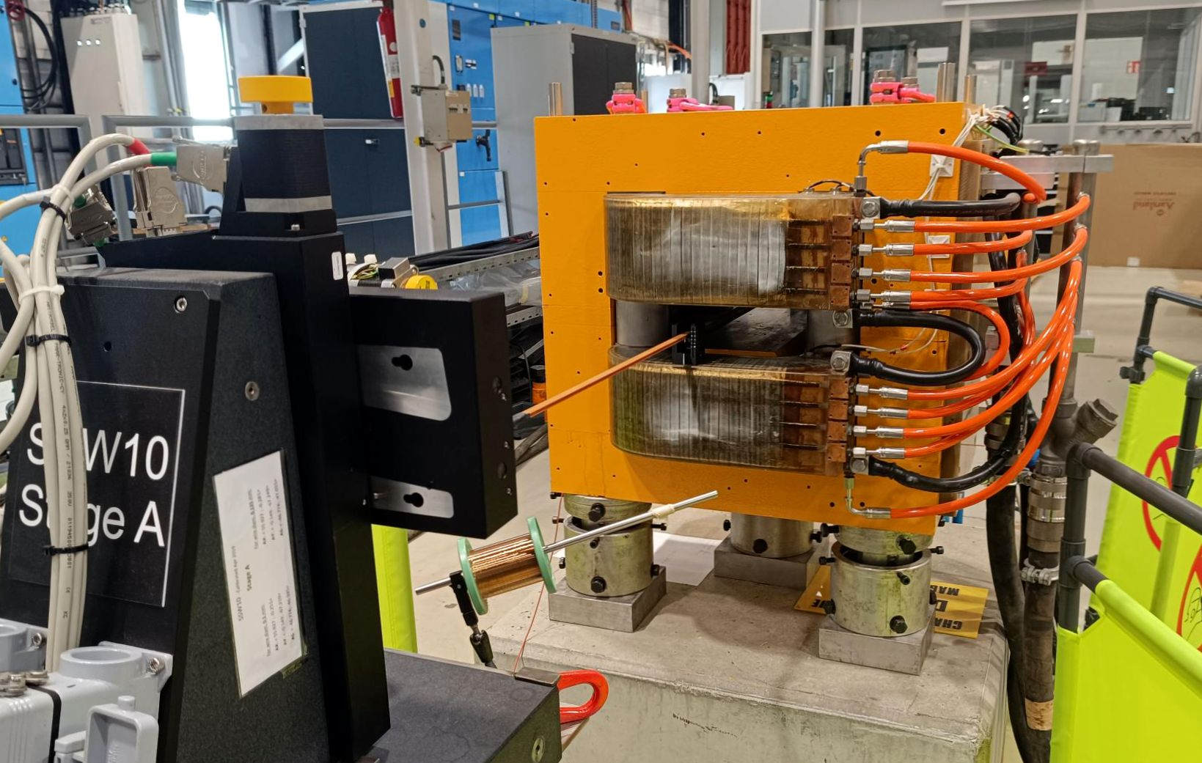
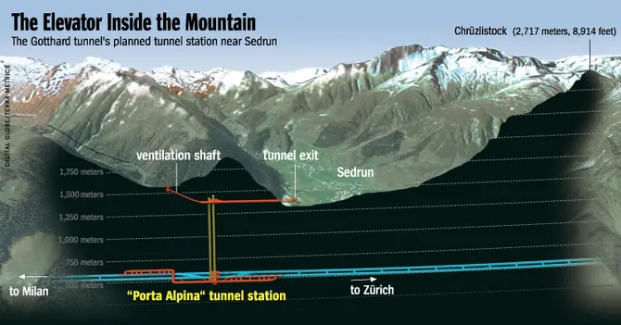
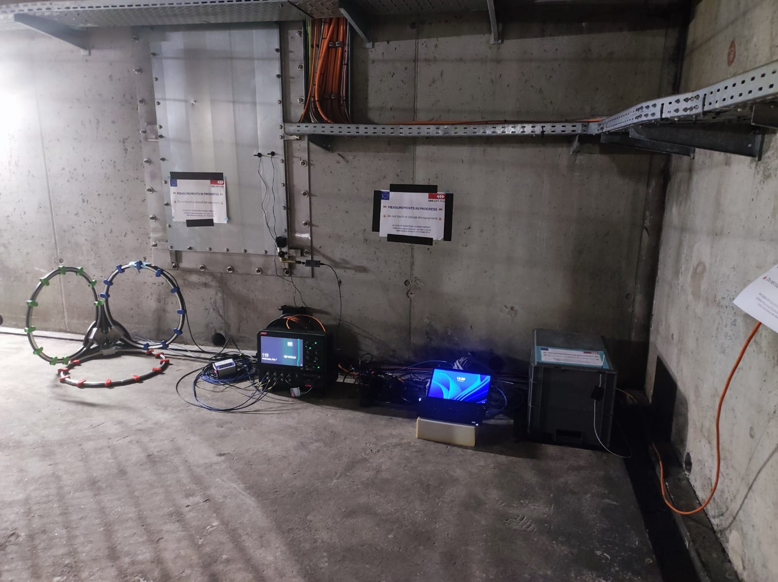
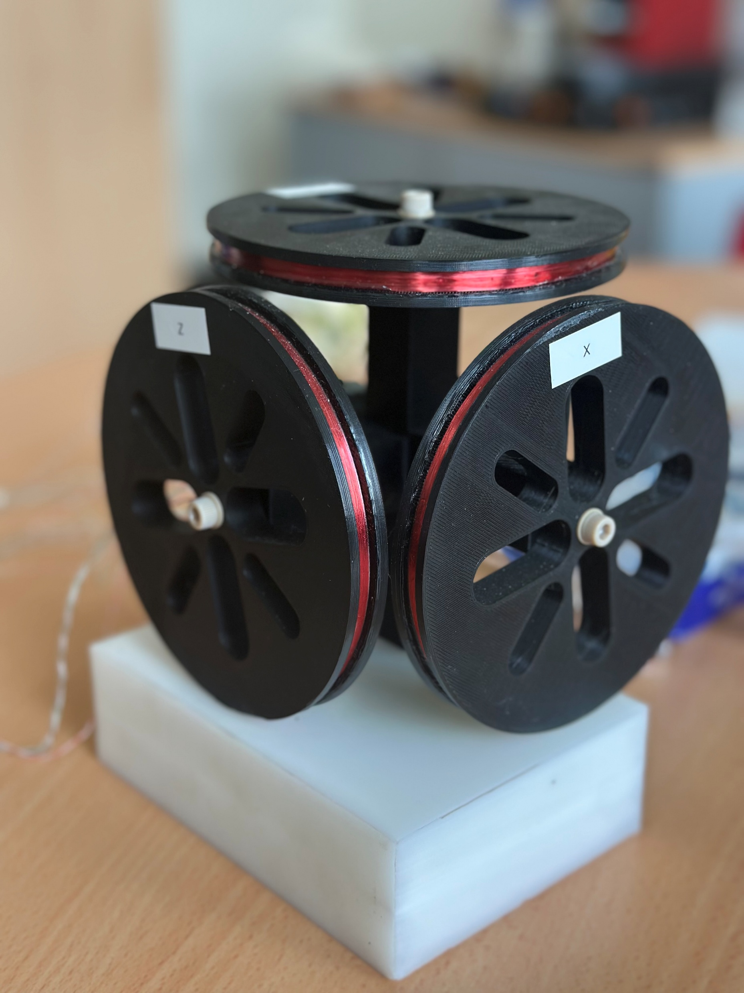
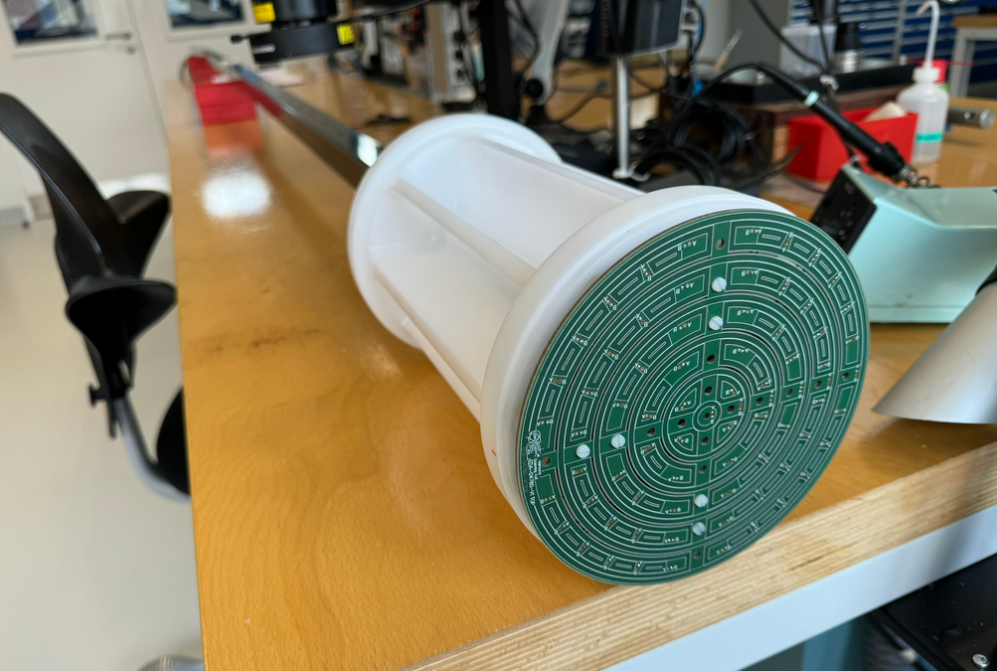
Other highlights
standard measurements of refurbished magnets
are always our baseline job …
tunable PMQ quad
iron-filled concrete
… with occasional more exotic clients !
magnetic background measurements
AION atom interferometry experiment
preparations for AD e-cooler

Slide 18
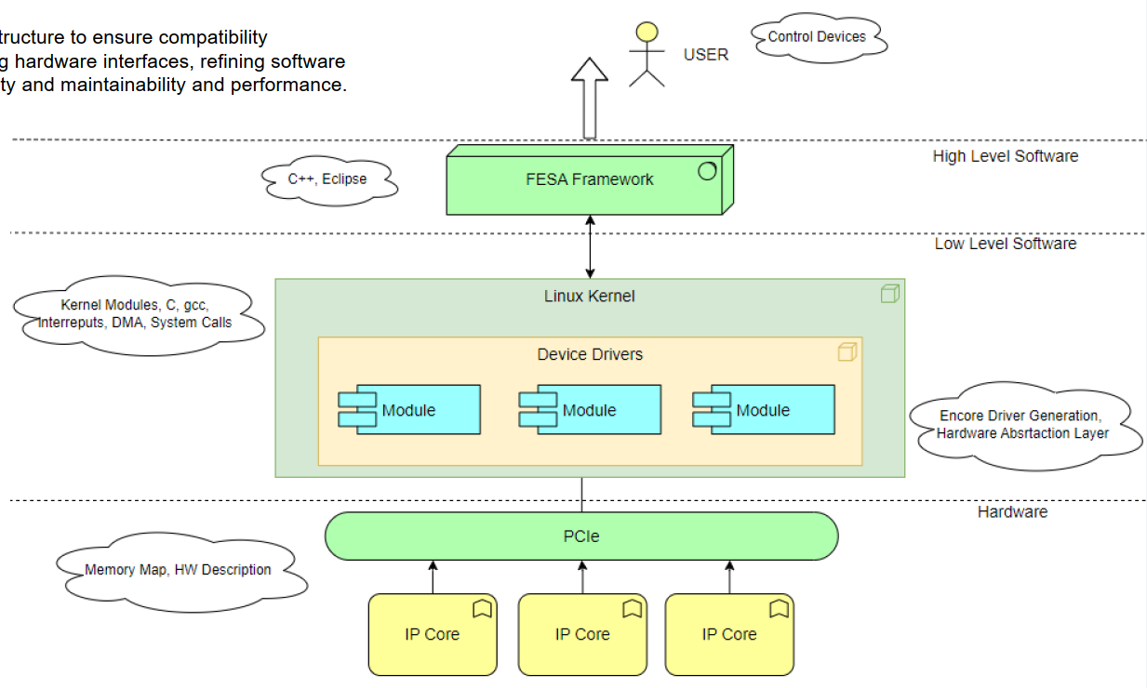
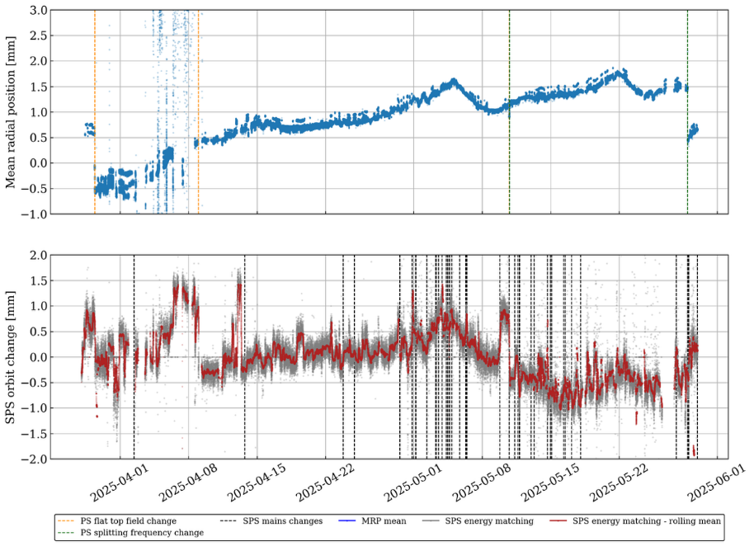
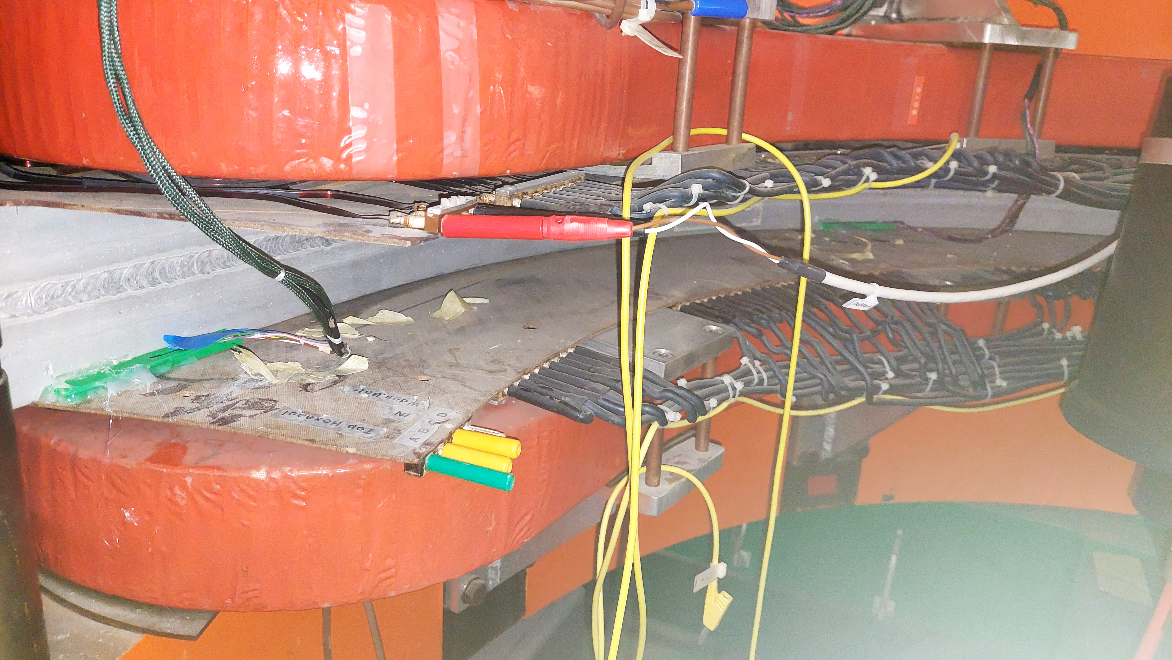

B-trains / real-time field monitoring
critical B-train
software update for Debian Linux
(FESA C++ classes,
device drivers)
medium-term beam instabilities still observed
(temperature effects ?)
ISOLDE HRS as a testbed for next-gen Baby B-trains
Notes:
ISOLDE HRS magnetic diagnostics

Slide 19




Modelling, Acquisition and Workflow Software
Python script framework for glueing together magnet design tools and DB
New ROXIE release (version 25.1.0.b1)
- Eddy Currents simulations on conductive materials
- Visualization of B-H curves (μr-H and B-H) material data
- Display Design Variables results for all Optimization Algorithms
- Bugfixes and small additions
RAT – SC design software
1-year license acquired by the group for evaluation
SM18 String e-MIP: production version deployed
and used by the team to follow up activities.
Notes:
Modelling and acquisition/control spoftware

Slide 20
Conclusions

Slide 21


Conclusions
Here and now:
Thanks, cheers and bon appetit !
TE-MSC Group’s BBQ
8th of July at the Prevessin BBQ area (9401/R-000) starting at 11:00.
Register at : https://indico.cern.ch/event/1549585/
before 28th of June 2024

