Slide 1
3D-projection detector prototypes for DAMSA
Haohui Che (WashU)
Guang Yang (BNL Mentor)

Slide 2

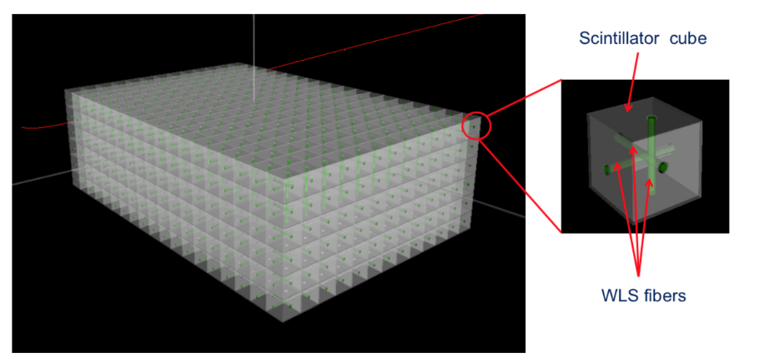
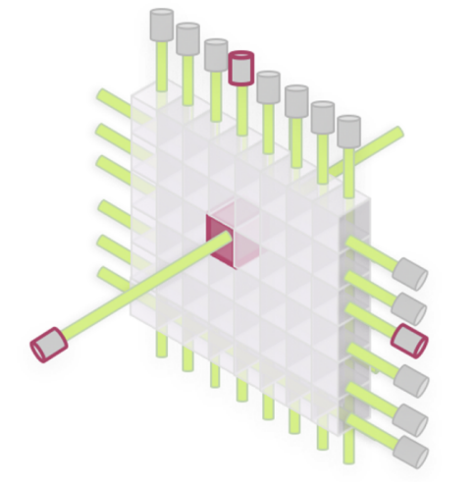
3D-projection scintillator detector (3DSD)
3D array of optically isolated scintillator cubes
Cube size and material can vary. For this talk I will focus on 1cm plastic cube.
3D readout with 3 WLS fibers passing through each cube and connected to MPPCs (multi-pixel photon counters)
Fully active!
Single fiber 0.9 ns timing resolution: Fast timing!
1-cm-scale size:
Fine granularity!
>50 PE/MeV each readout: High light yield!
2018 JINST 13 P02006 NIM A936 (2019) 136-138

Slide 3
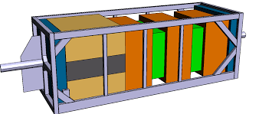
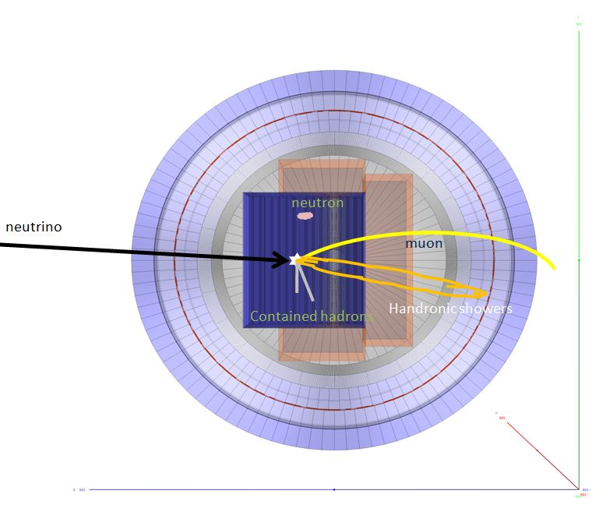
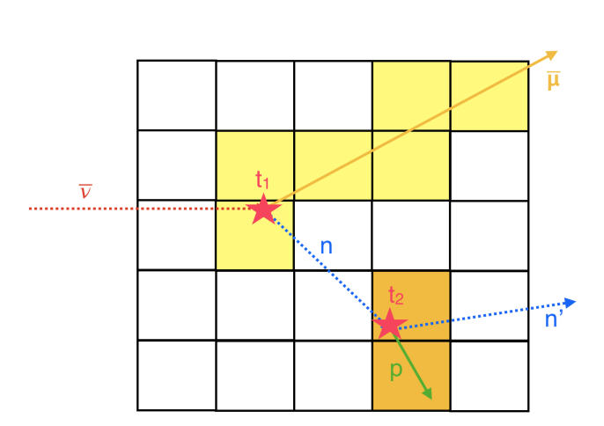
In neutrino experiments - serving as target + tracker + calorimeter
SuperFGD in T2K near detector (being built)
3DST in DUNE near detector (proposed)
Not only tagging, this detector can measure the neutron kinematics!

Slide 4
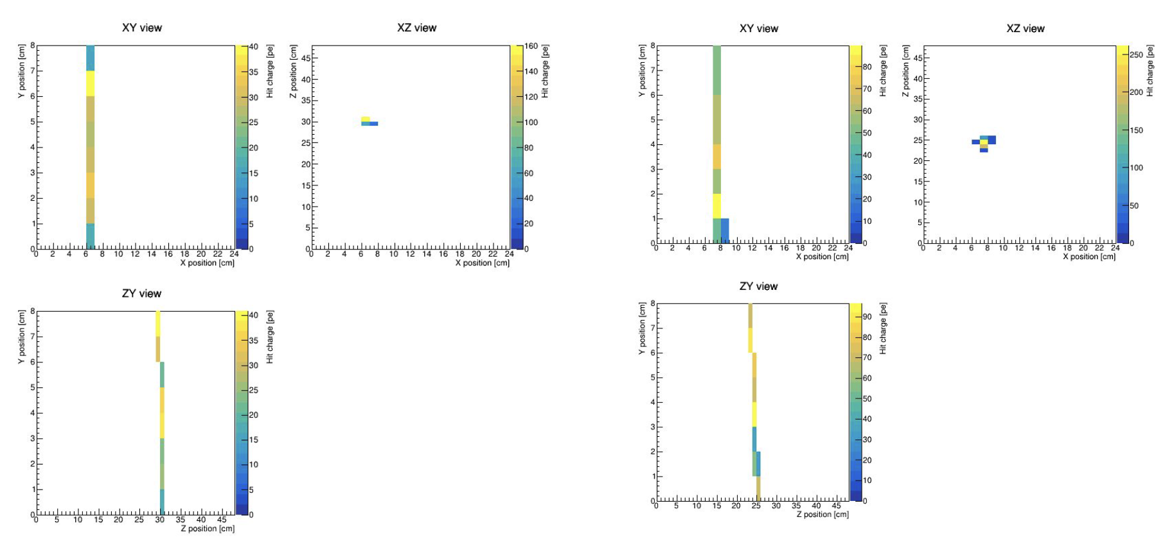
Data (Cosmic muon)

Slide 5

Trigger and Spill system
$$hitTimefromSpill=$$
$$4000×GTrigTime−4×spillTimeGTag+leadTime$$
0
1
2
3
4
5
6
7
G_{lobal}Tag
(int, 10𝜇s)
0
leadTime
(int, 2.5𝜇s)
spillTimeGTag
(int, 10ns)
hitTimefromSpill
(int, 2.5ns)
Spill = External Trigger
GTrigTime
(int, 10𝜇s)

Slide 6
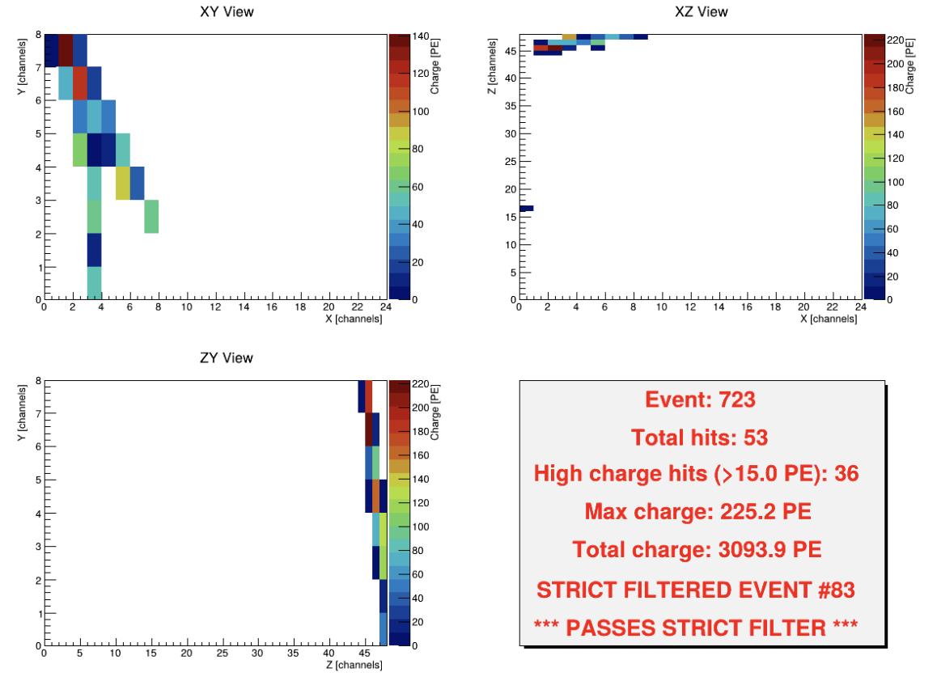
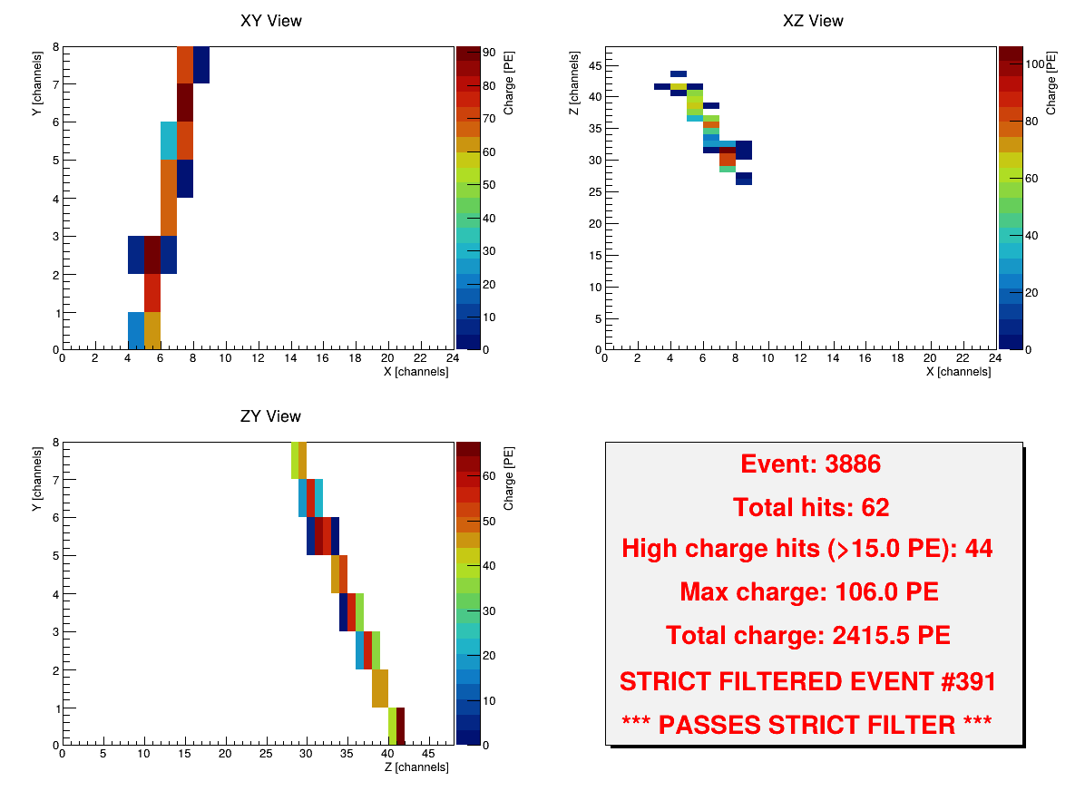
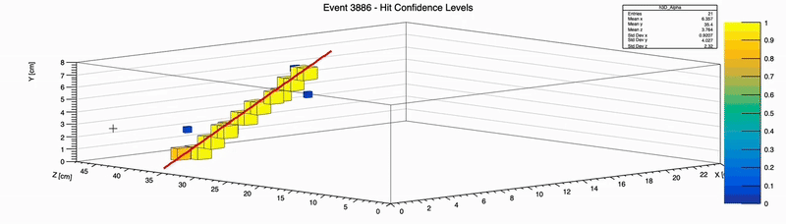
Analysis flow
slot0.daq
TDMunpack
unpack
Calibration
EventStructure_12free
feb#.daq
slot1.daq
raw.root
calib.root
events.root
slot2.daq
…
event_display.root
EventDisplayLite
GroupRes.root
3D_EventTrajectory
3D_AllEvents
Event_PNG → event#.png

Slide 7
Event Selection
Spill 0
Group the seed
List of 2D hits
Sort by time
Filter >20PE
List of 2D hits >20PE (Seeds)
Select first seed
Check 10ticks b/a for seeds
Y/N
Make Event0
Make Event+1
Check smaller than Spill size-1
Select first seed (unused)
Mark all hits as used
Check for hits in seed group range
Y/N
Spill +1
Event 0
Add seeds and hits to event
Filter >15PE
Check if size > 17
Event Discarded
events.root
Event 0
List of hits >15PE
Y/N
Events 0-n
Plot Three View Histogram

Slide 8
Voxel reconstruction
Hit0
(XY)
Hit1
(XZ)
Hit2
(ZY)
.
.
.
.
.
.
.
.
.
Iterative matching between XZ hits
Hit0
(XY)
Get X
Potential Coinc. Hits (XZ)
Get Y
Get Z
Potential Coinc. Hits (ZY)
Y/N
Unused hits list
Iterative matching between XZ hits
Get Z
Iterative matching
(XZ to ZY)
Hits released
Store Full view hit
Hits marked used
Next HitA (XY)
Full view hits list
All XY Hits checked
Some additional nuance not included
Dual view hits matching

Slide 9
Dual view hits matching
Unused
HitA
(XY)
Iterative matching between XZ hits
Mark hits as used
Get X
Matched Hits (XZ)
2 View Hits list (XY-XZ)
Next HitA (XY)
Non- Matching XZ
All XY Hits checked
Unused Hits list
Hits Released
Mark hits as used
2 View Hits Matching (XY-ZY)
2 View Hits list (XY-ZY)
All XY Hits checked
Mark hits as used
2 View Hits Matching (ZY-XZ)
2 View Hits list (ZY-XZ)

Slide 10
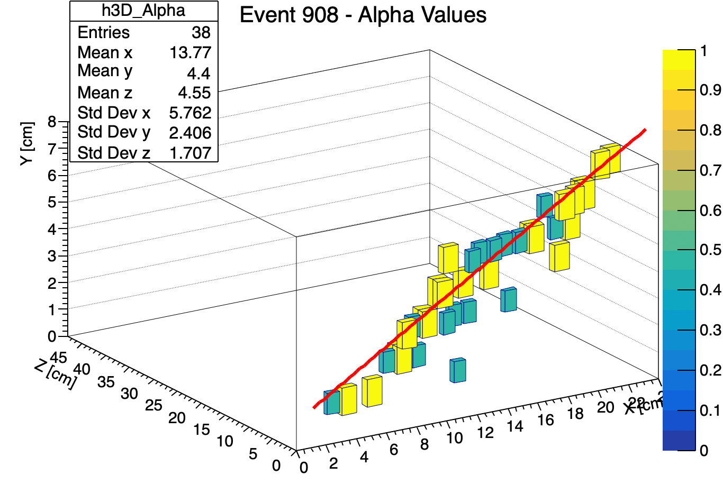
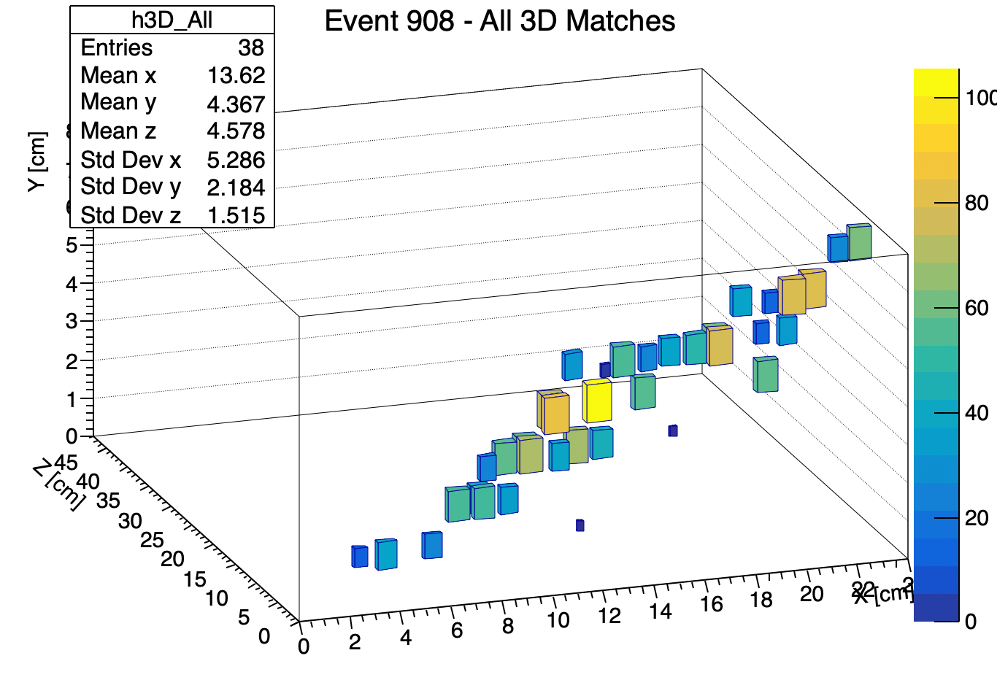
Pre resolve results

Slide 11
Dual View Hits Resolution
Hit0
(FV)
Hit1
(PV XY-XZ)
Hit2
(PV XY-ZY)
Hit2
(PV ZY-XZ)
Hit1
(PV)
.
.
.
.
.
.
.
.
.
.
.
.
Identify Missing View
Hits-Missing view match
Check XY View Overlap
Hit0
(FV)
Group XY Overlapped Hits
Loop through PV hits
Check XZ View Overlap
Loop through PV hits
Check if missing view = overlapped view
Resolve missing view timing as Overlapped FV
Check ZY View Overlap
Group XZ Overlapped Hits
Group ZY Overlapped Hits
Loop through PV hits
Calculate max time difference between views for PV
Charge interpolation
h3D_Alpha TTree
h3D_All TTree
Assign Confidence level with dT

Slide 12
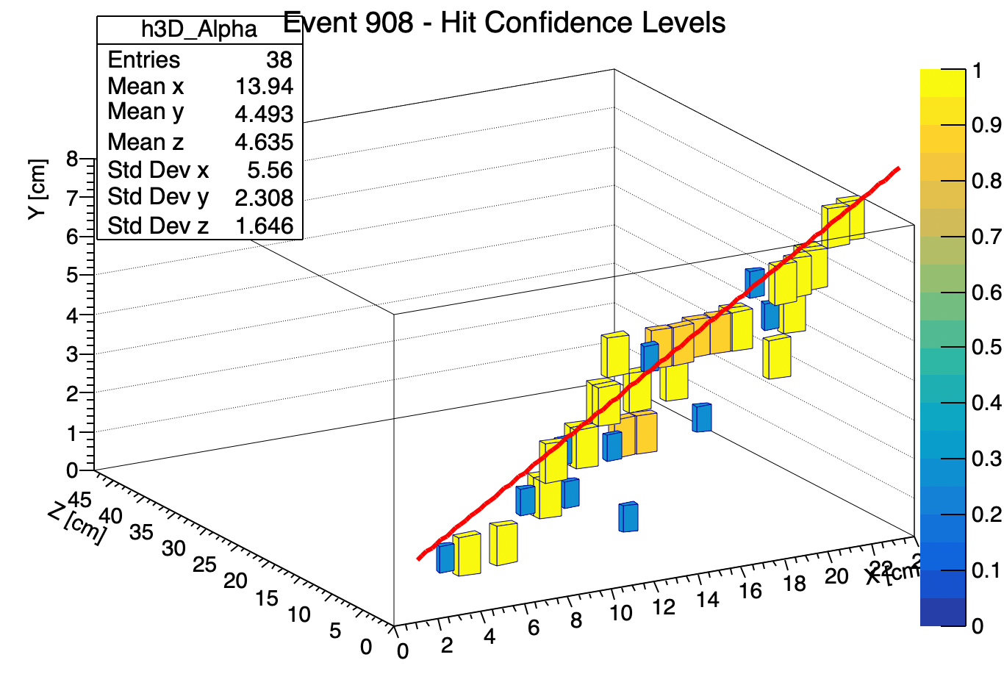
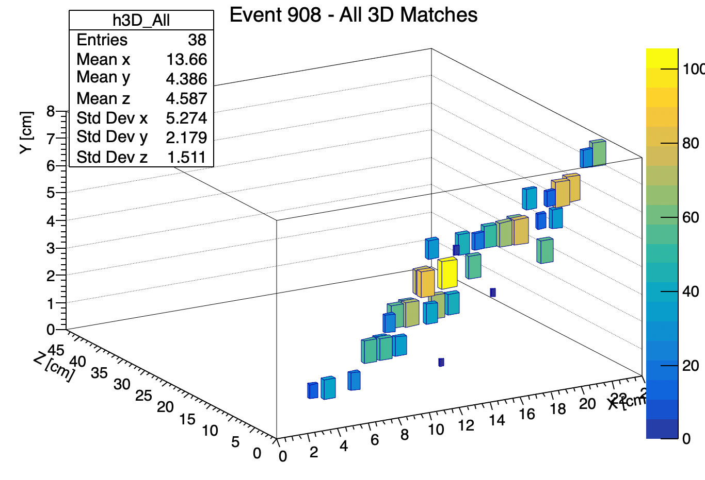
Post resolve results

Slide 13
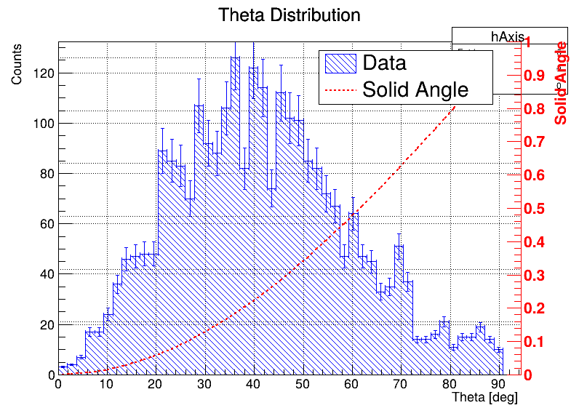
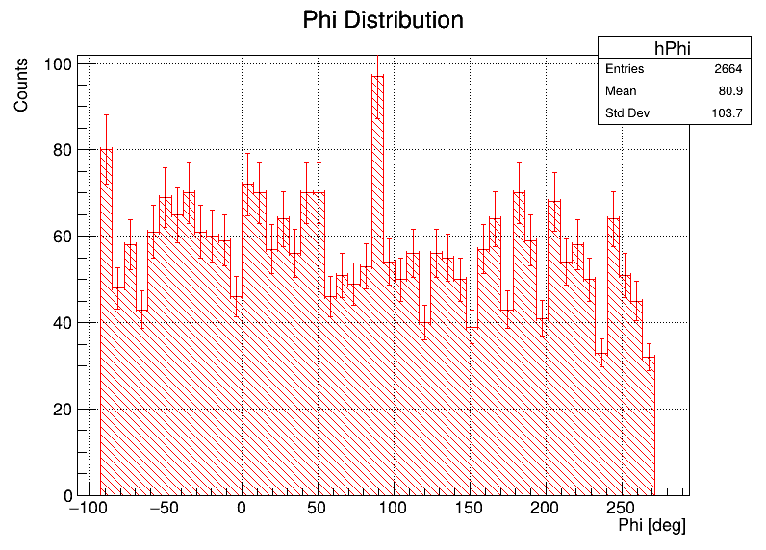
Theta Phi distribution
Match Expectations!
Theta drops off near 0 (Straight down) because of solid angle effects
10% error bar to account for multi-tracks and split/bent/decay events

Slide 14
Thank You!
Haohui Che

