Slide 1


Performance and reliability evaluation of Nb₃Sn MQXFB quadrupoles for the
HL-LHC at midpoint production
F.J. Mangiarotti, G. Willering, D. Duarte Ramos, L. Fiscarelli, S. Izquierdo Bermudez, S. Juberg, A. Milanese, G. Ninet,
G. Pichon, H. Prin, P. Rogacki, E. Todesco
2025.07.05 -- 29th International Conference on Magnet Technology -- Sat-Mo-Or6-01

Slide 2
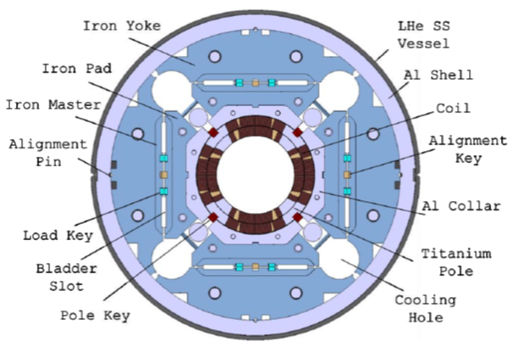
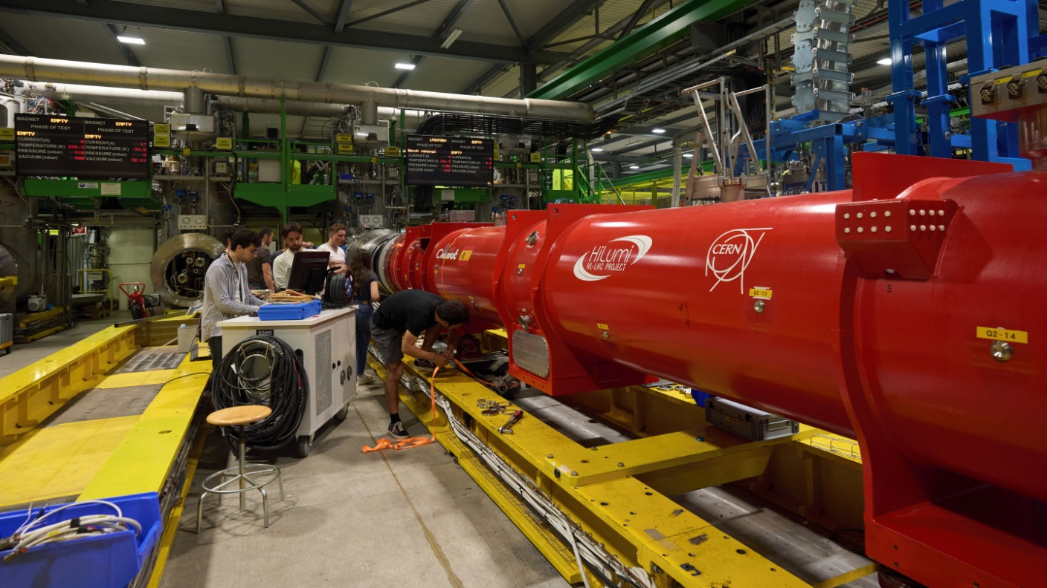
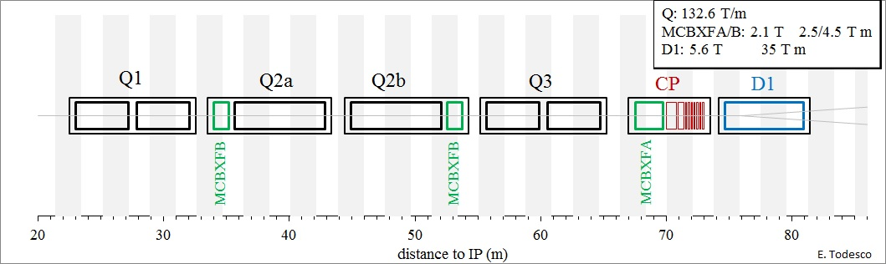
MQXFB quadrupoles for HL-LHC
MQXFB: inner triplet quadrupoles in the Q2 for HL-LHC
Nb₃Sn superconductor
11.3 T peak field
150 mm aperture

Slide 3

Test timeline of MQXFB magnets
Series magnets for HL-LHC
Test results from BP1 and BP2 presented in MT27:
https://doi.org/10.1109/TASC.2022.3157574

Slide 4
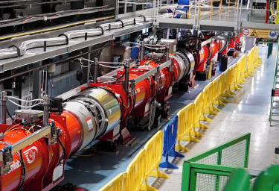
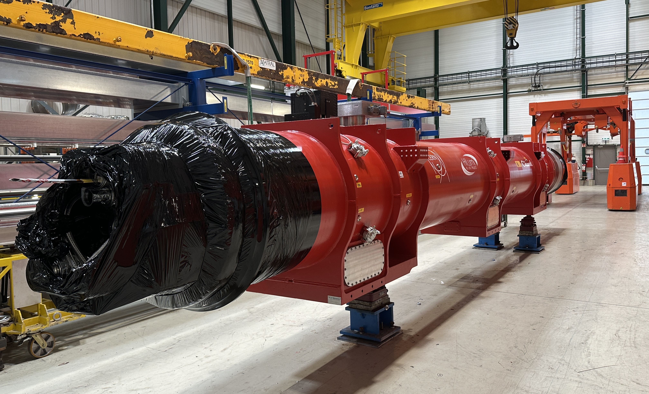
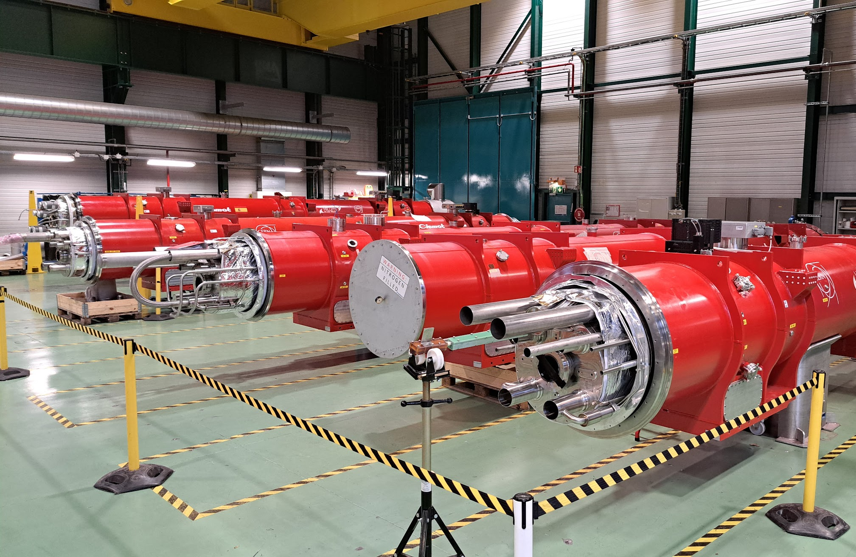
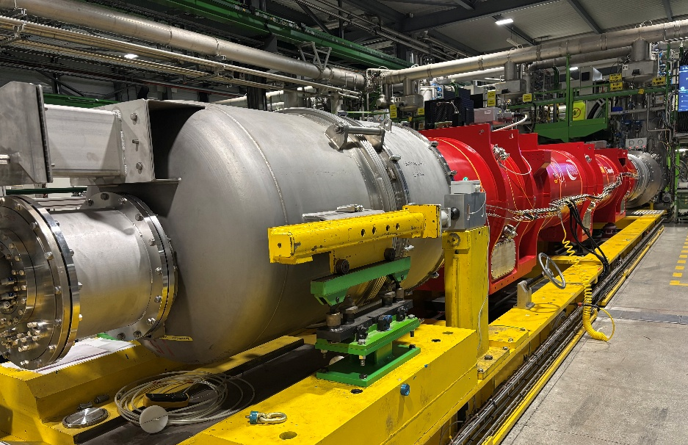
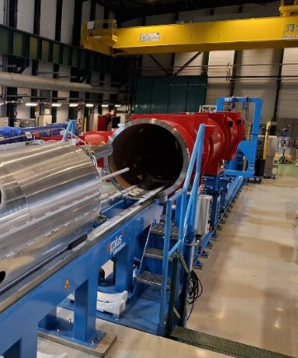
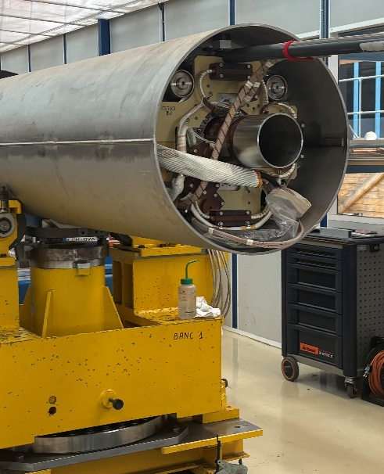
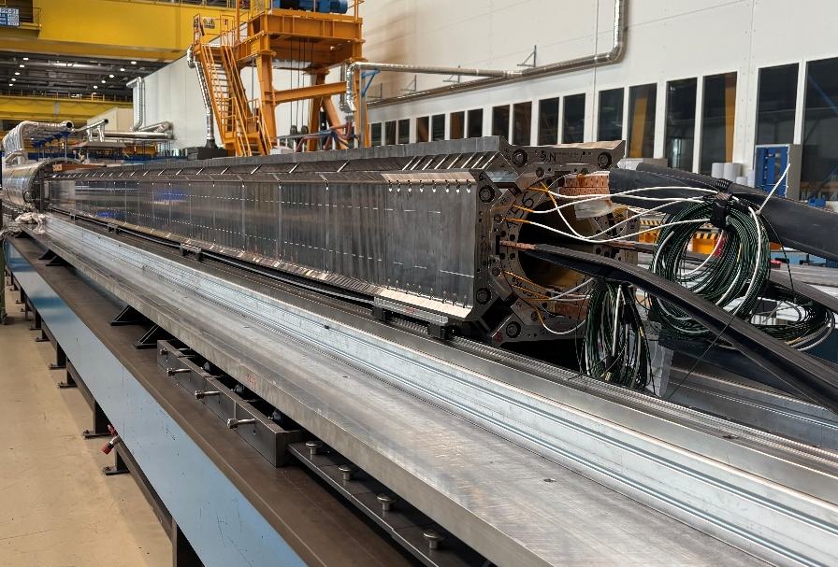
Production status of MQXFB
MQXFB05: phase III cryostating ✓
MQXFB03: phase II cryostating ✓
MQXFB04: phase II cryostating ✓
MQXFB06: phase II cryostating ✓
MQXFBP2 & BP3 installed in the string
MQXFB07: test just finished ✓
MQXFB08: cryostating
MQXFB09: cold mass
MQXFB10: magnet assembly
2 more magnets (spares) to build (B11-B12)

Slide 5
Features of the qualification test plan
Performance qualification
  Training to nominal current + 300 A
  Ramp rate studies at 1.9 and 4.5 K
  V-I measurements at 4.5 K
Endurance verification
  Quench at nominal current
  Current cycling
  Long duration flat-top operation
  Thermal cycling
Geometric and magnetic measurements
  Field quality, field strength
  Field angle and magnetic center
Electrical quality assurance
Main topic of this presentation
Will be discussed in a future contribution
Will be briefly mentioned today

Slide 6
Example test campaign (first cool down)
400
Cool down
Electrical tests
Weekend
Protection
verification
Training
Weekend
Training
4.5 K powering
Corrector training
Endurance tests
Magnetic
measurements
Electrical tests
& Warm up
100
40
Temperature [K]
10
4
1
17.5
Current
MQXFB [kA]
0
2000
1 week
Current
corrector [A]
0

Slide 7
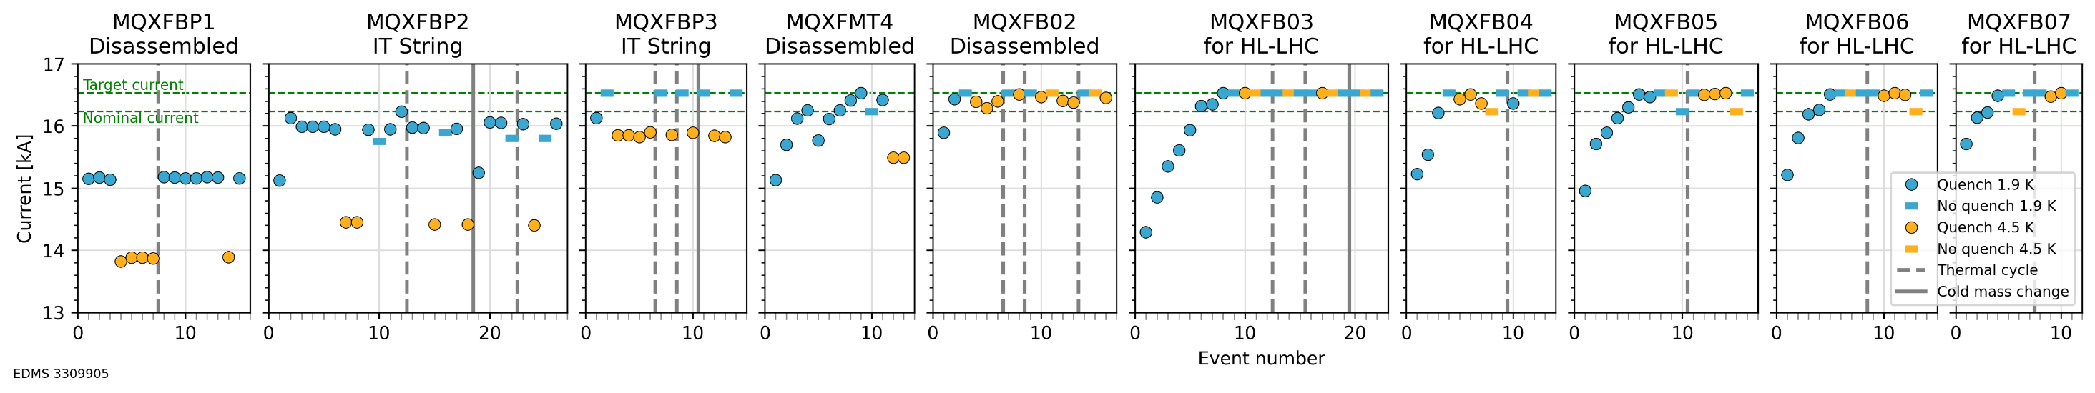
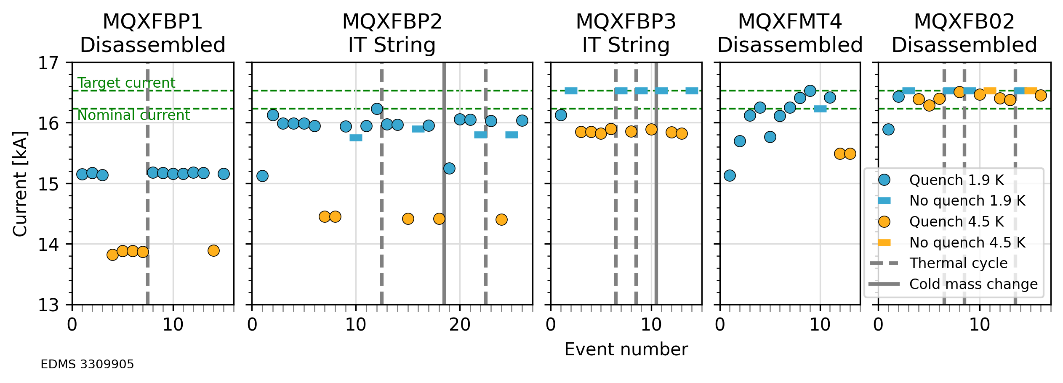
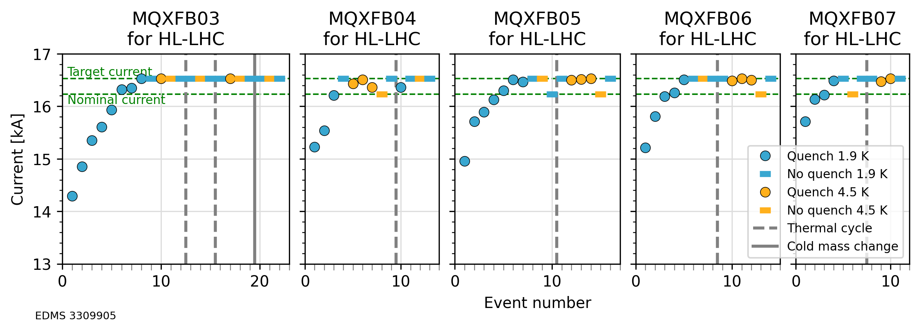
Training of all MQXFB so far
Prototypes, pre-series
Series magnets
Prototypes showed a very clear limitation at 1.9 and 4.5 K, at the inner layer pole turn near the mechanical center of the magnet. This limitation was partially solved for the pre-series magnet (B02), and no longer affected series magnets since B03
In all series magnets, once training is finished, there is no retraining to nominal current.
Behavior before and after thermal cycle, or even cold mass change, is always the same.
From B03 onwards some quenches near target current at 4.5 K were observed. These are due to low training margin at 1.9 K, and the signature does not repeat.
Prototypes, pre-series
Series magnets

Slide 8
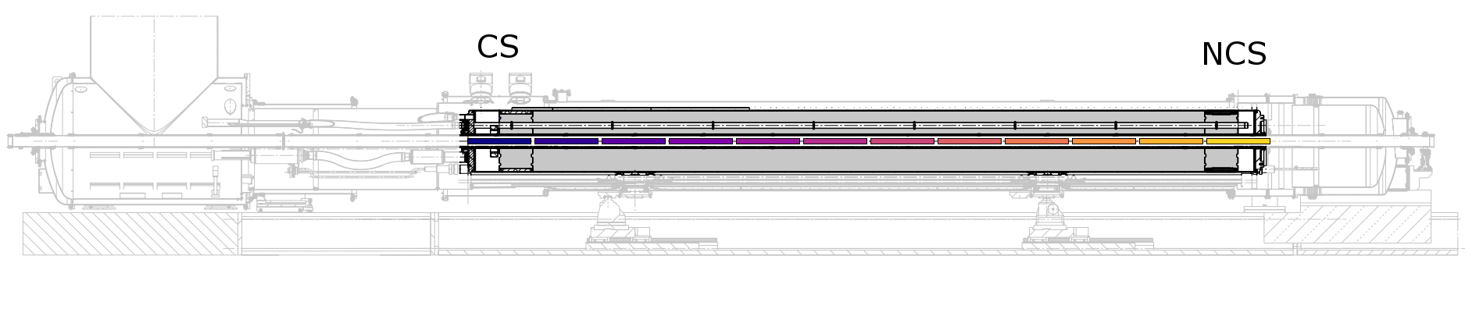
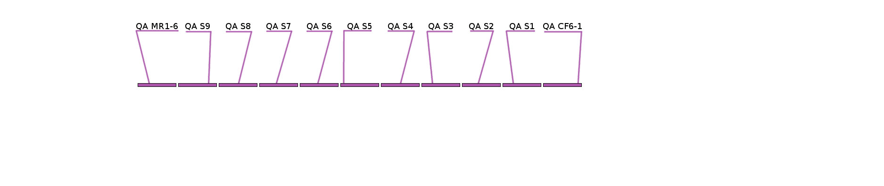
Longitudinal quench location
#
Training
Limit 1.9 K
Limit 4.5 K
Prototypes and pre-series (left):
Short training
Performance limitation near the mechanical center
Series magnets (right):
Longer training, mainly on the heads
No performance limitation
4
1
1
3
BP1
B03
1
1
1
5
BP2
B04
1
1
2
1
2
1
1
1
1
BP3
B05
1
1
4
2
2
3
2
1
1
MT4
B06
1
1
1
2
1
1
1
B02
B07

Slide 9
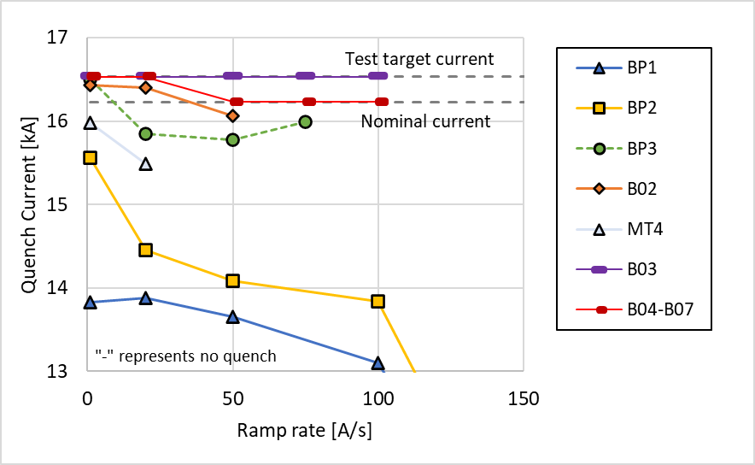
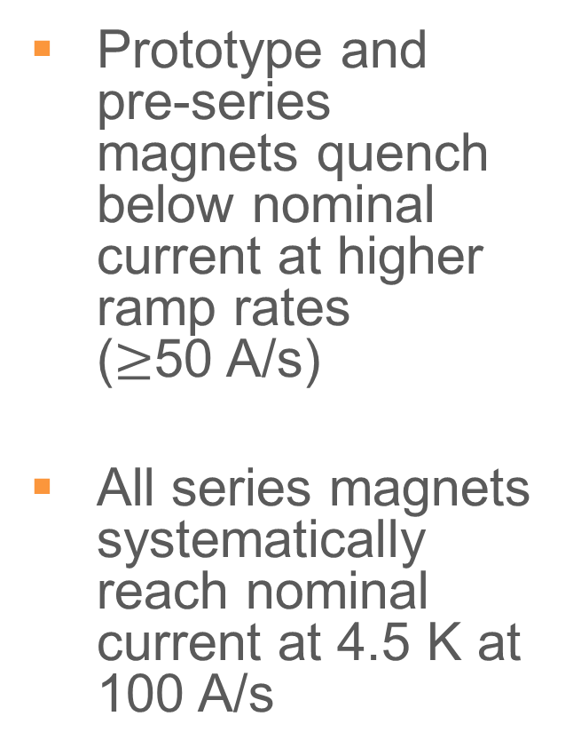
Ramp rate dependency at 4.5 K
Prototype and pre-series magnets quench below nominal current at higher ramp rates
($≥$50 A/s)
All series magnets systematically reach nominal current at 4.5 K at 100 A/s

Slide 10
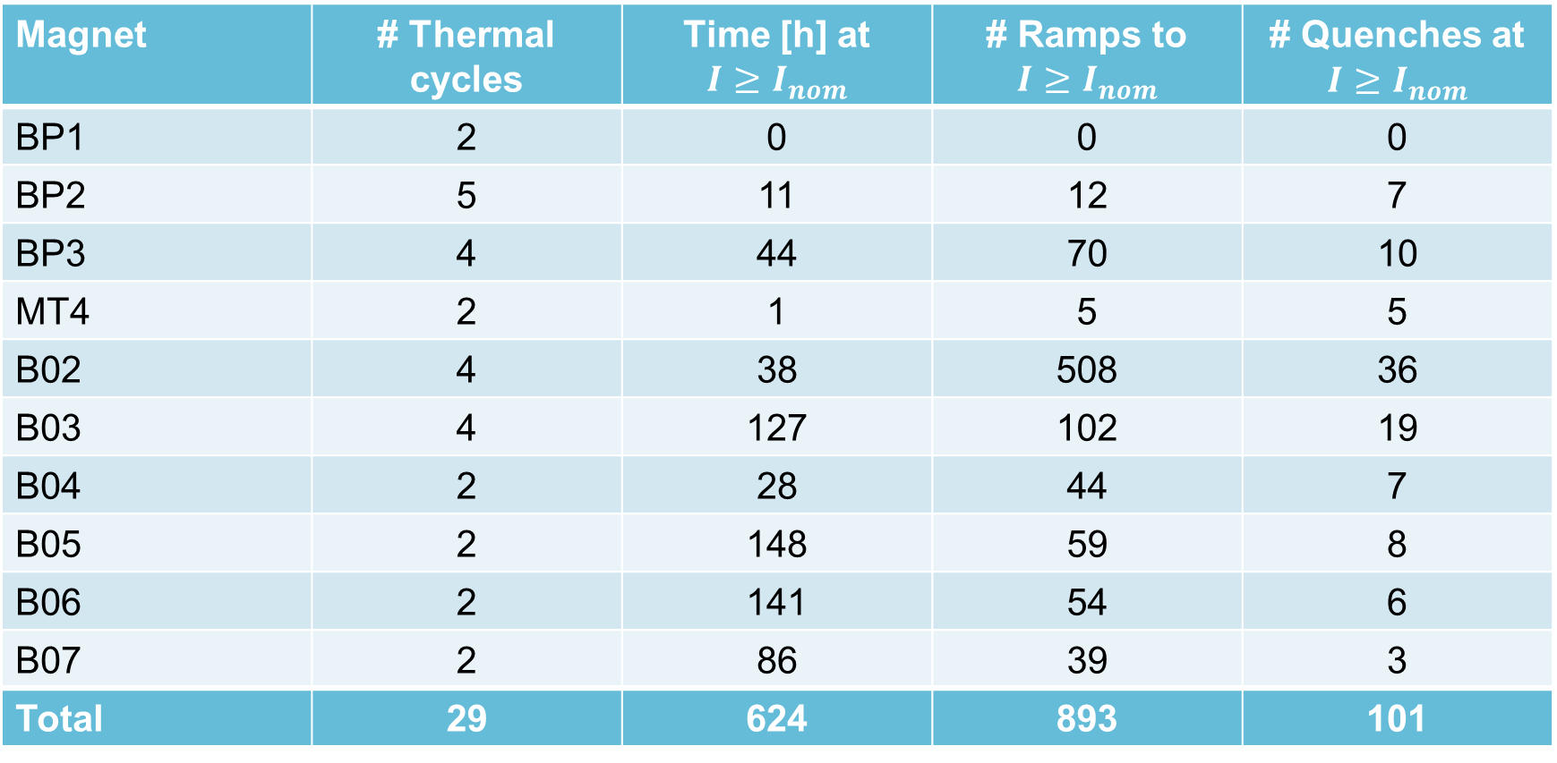
Endurance testing
Magnet | # Thermal cycles | Time [h] at $$I≥I_{nom}$$ | # Ramps to $$I≥I_{nom}$$ | # Quenches at $I≥I_{nom}$
BP1 | 2 | 0 | 0 | 0
BP2 | 5 | 11 | 12 | 7
BP3 | 4 | 44 | 70 | 10
MT4 | 2 | 1 | 5 | 5
B02 | 4 | 38 | 508 | 36
B03 | 4 | 127 | 102 | 19
B04 | 2 | 28 | 44 | 7
B05 | 2 | 148 | 59 | 8
B06 | 2 | 141 | 54 | 6
B07 | 2 | 86 | 39 | 3
Total | 29 | 624 | 893 | 101
No change of behavior in any case after thermal cycle, cyclic loading or quenches
No quench during flat-top operation in any case

Slide 11
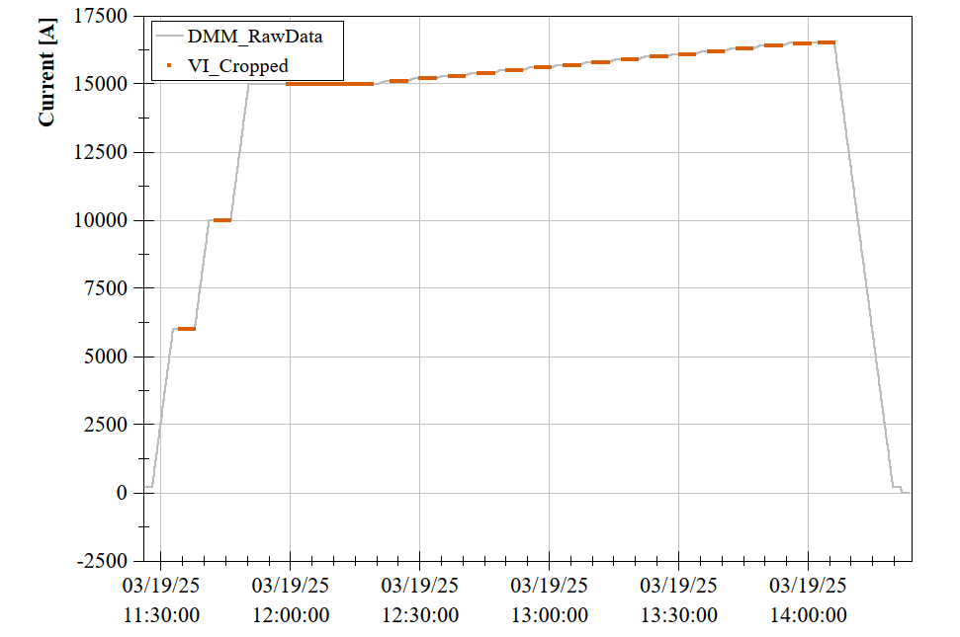
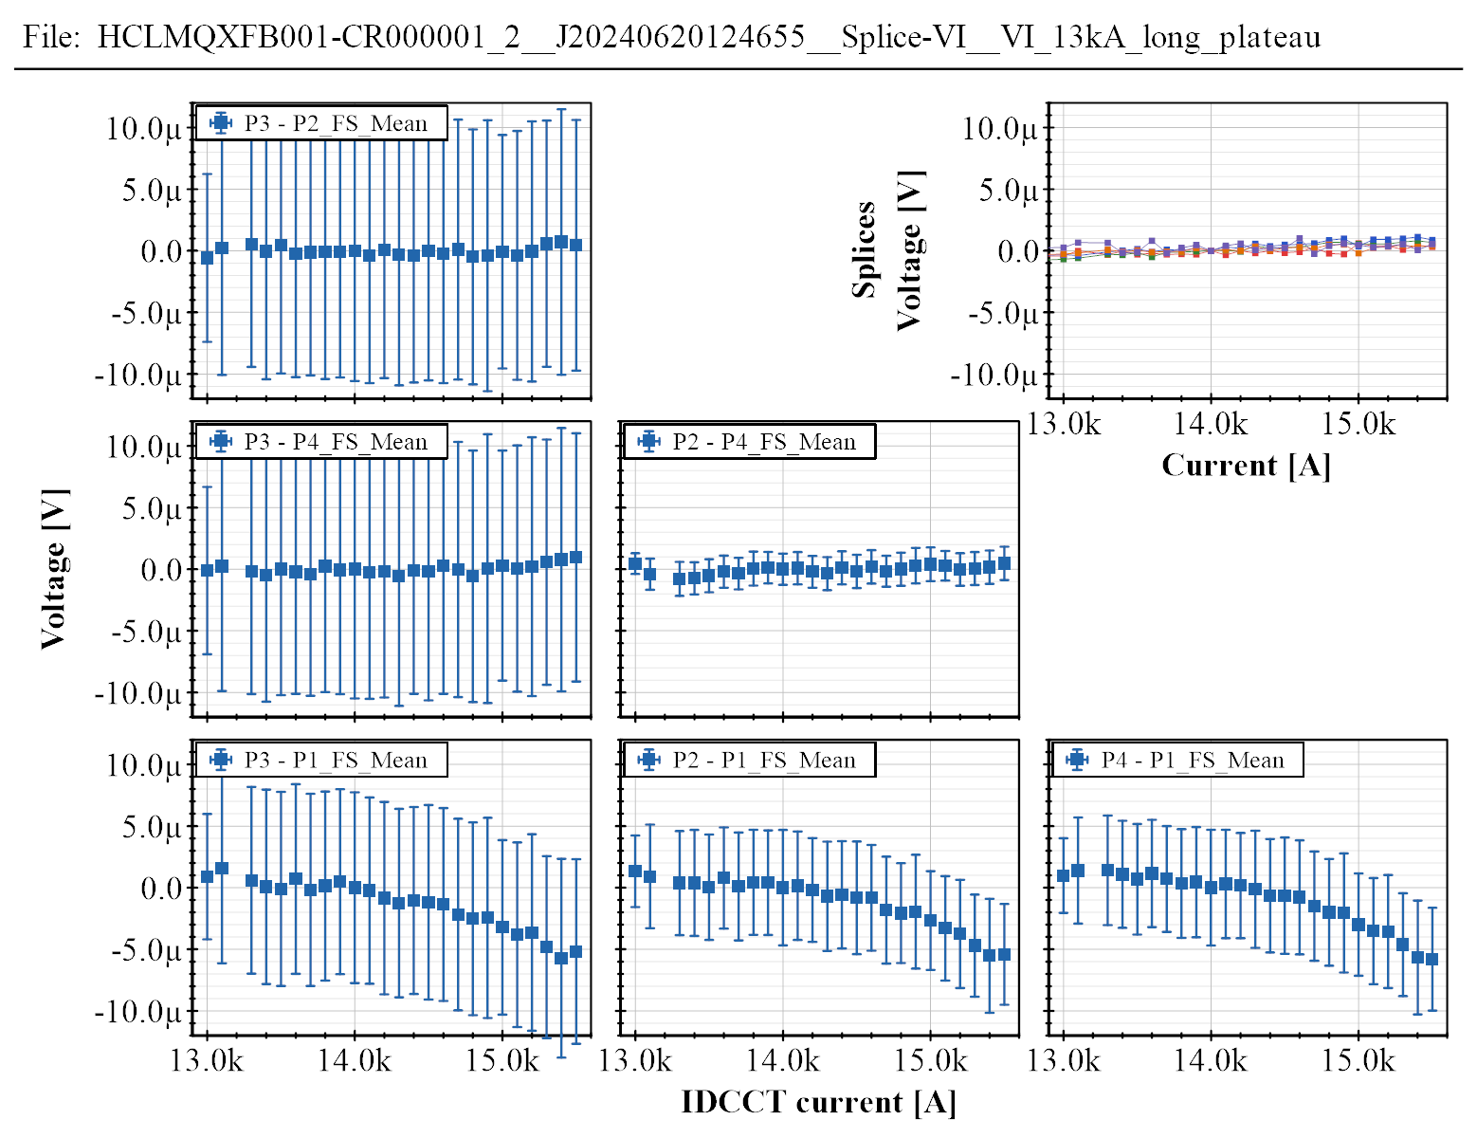
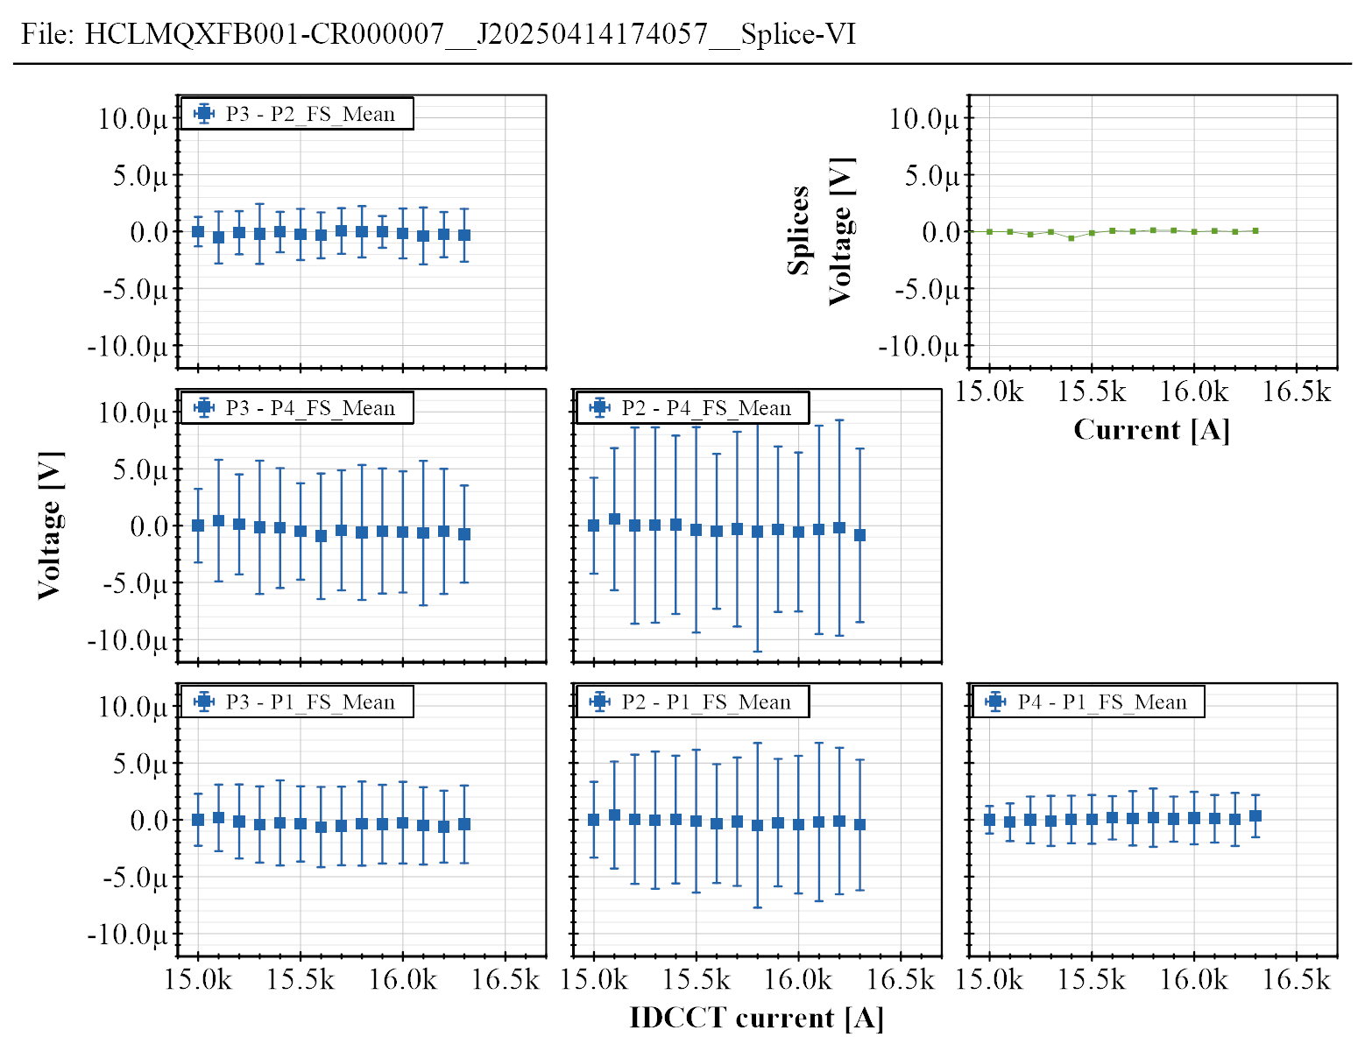
V-I measurements at 4.5 K
A stair-step current cycle is done on the magnet, while measuring the coils’ voltage
The average voltage and error is calculated at each current plateau
All combinations of pairs of coils are compared to remove the common-mode noise
In BP2, a SC-normal transition is visible
From BP3 onwards, the V-I plot is always “flat”
BP2
B06

Slide 12
Electrical quality assurance
Low voltage mainly as reference for future tests
  E.g. continuity, v-taps resistance, impedance vs frequency, etc
High voltage (Hi-Pot) for qualification
  Useful for detection non-conformities:
    BP2: short main circuit to ground: busbar insulation problem (repaired)
    BP3: short main circuit to one QH strip: defective QH PCB (regraded)
    B03: short main circuit to ground: CLIQ feedthrough insulation weakness (repaired)
    B04—B07: no non-conformities detected

Slide 13
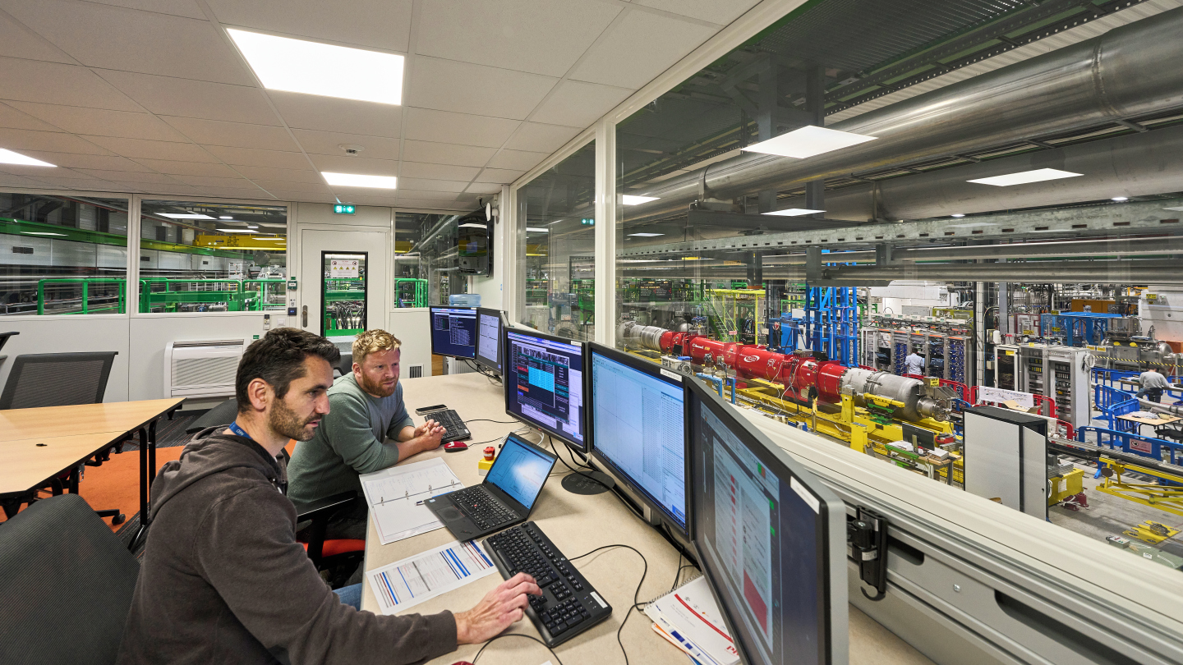
Summary
We have already tested 50 % of the MQXFB in the final configuration for HL-LHC
  (in addition to prototypes and disassembled magnets)
So far, all Q2 cryoassemblies for HL-LHC passed the acceptance criteria
Extensive testing and data analysis gives good confidence in the long-term reliability of the magnets, beyond the acceptance criteria

