Slide 1


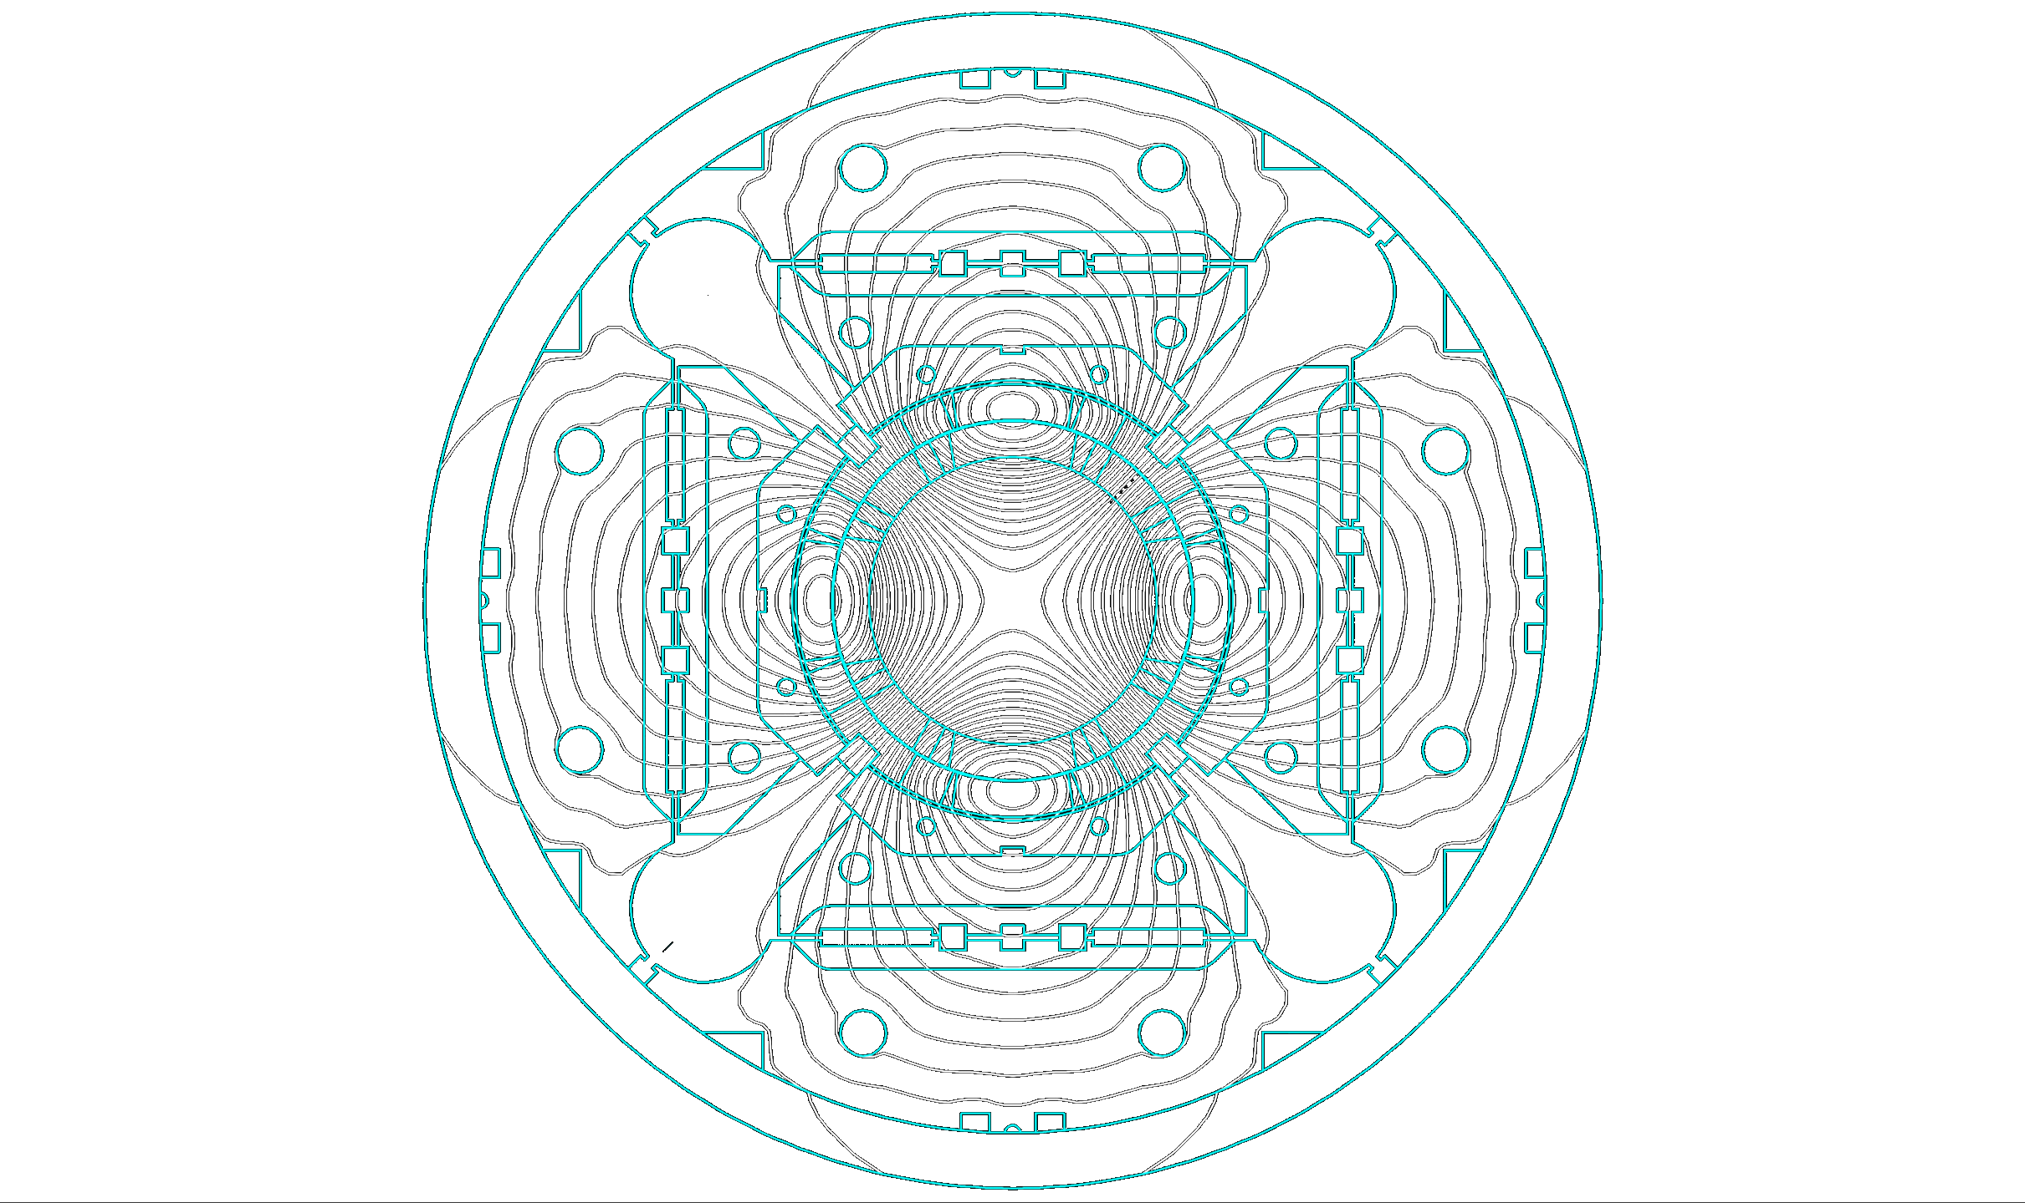
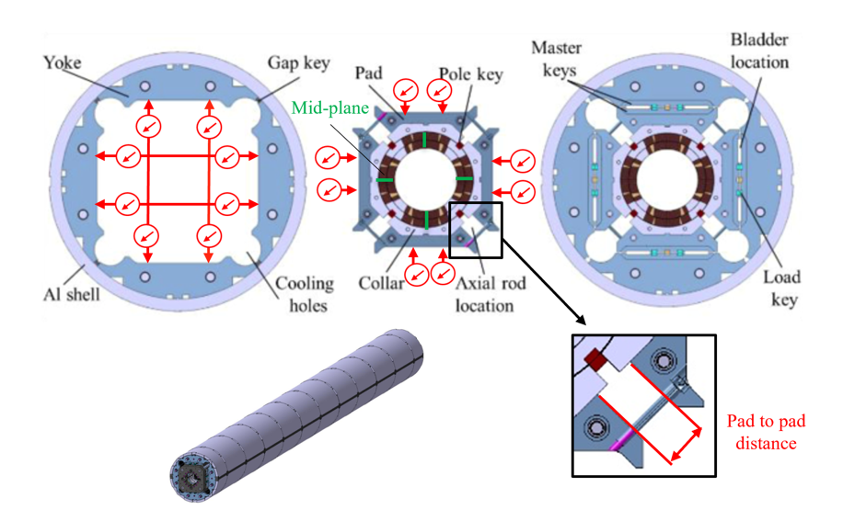
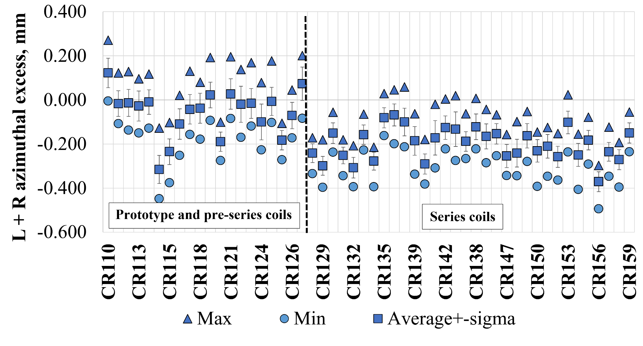
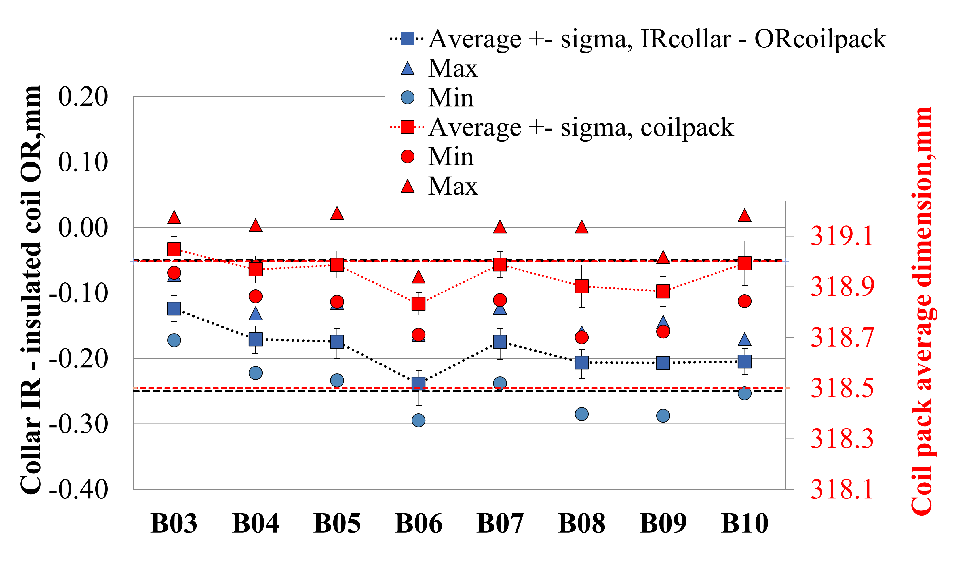

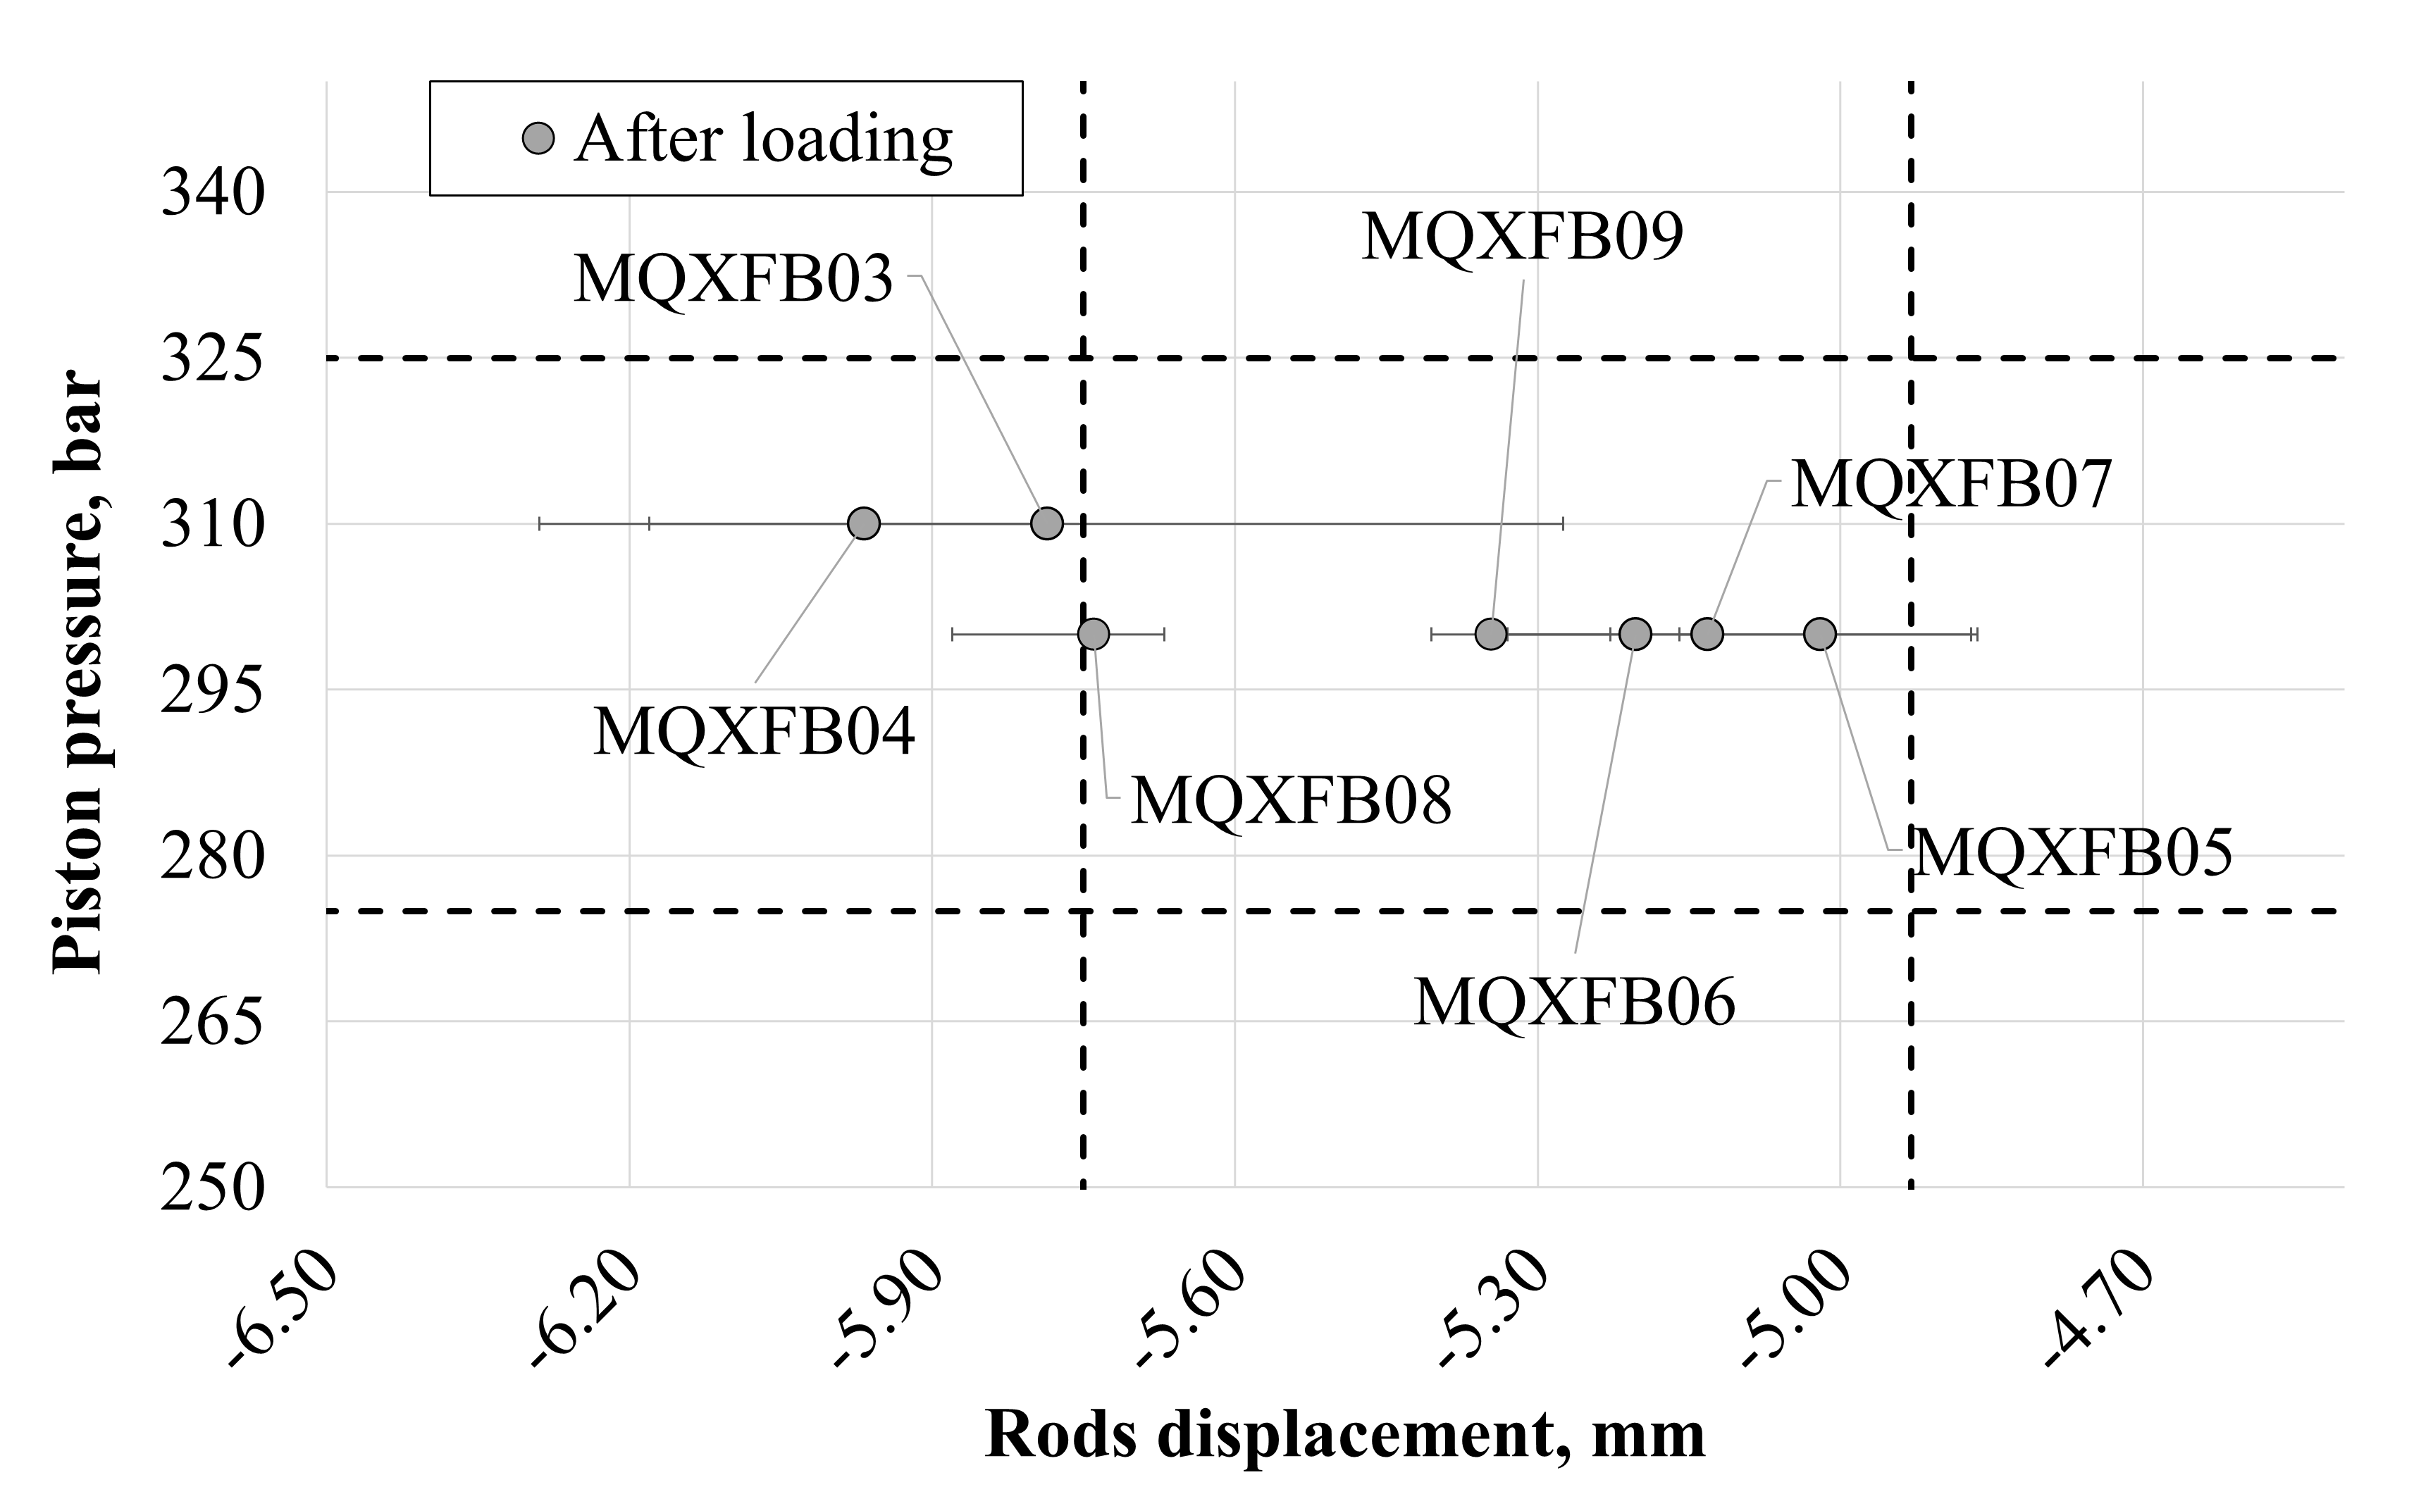
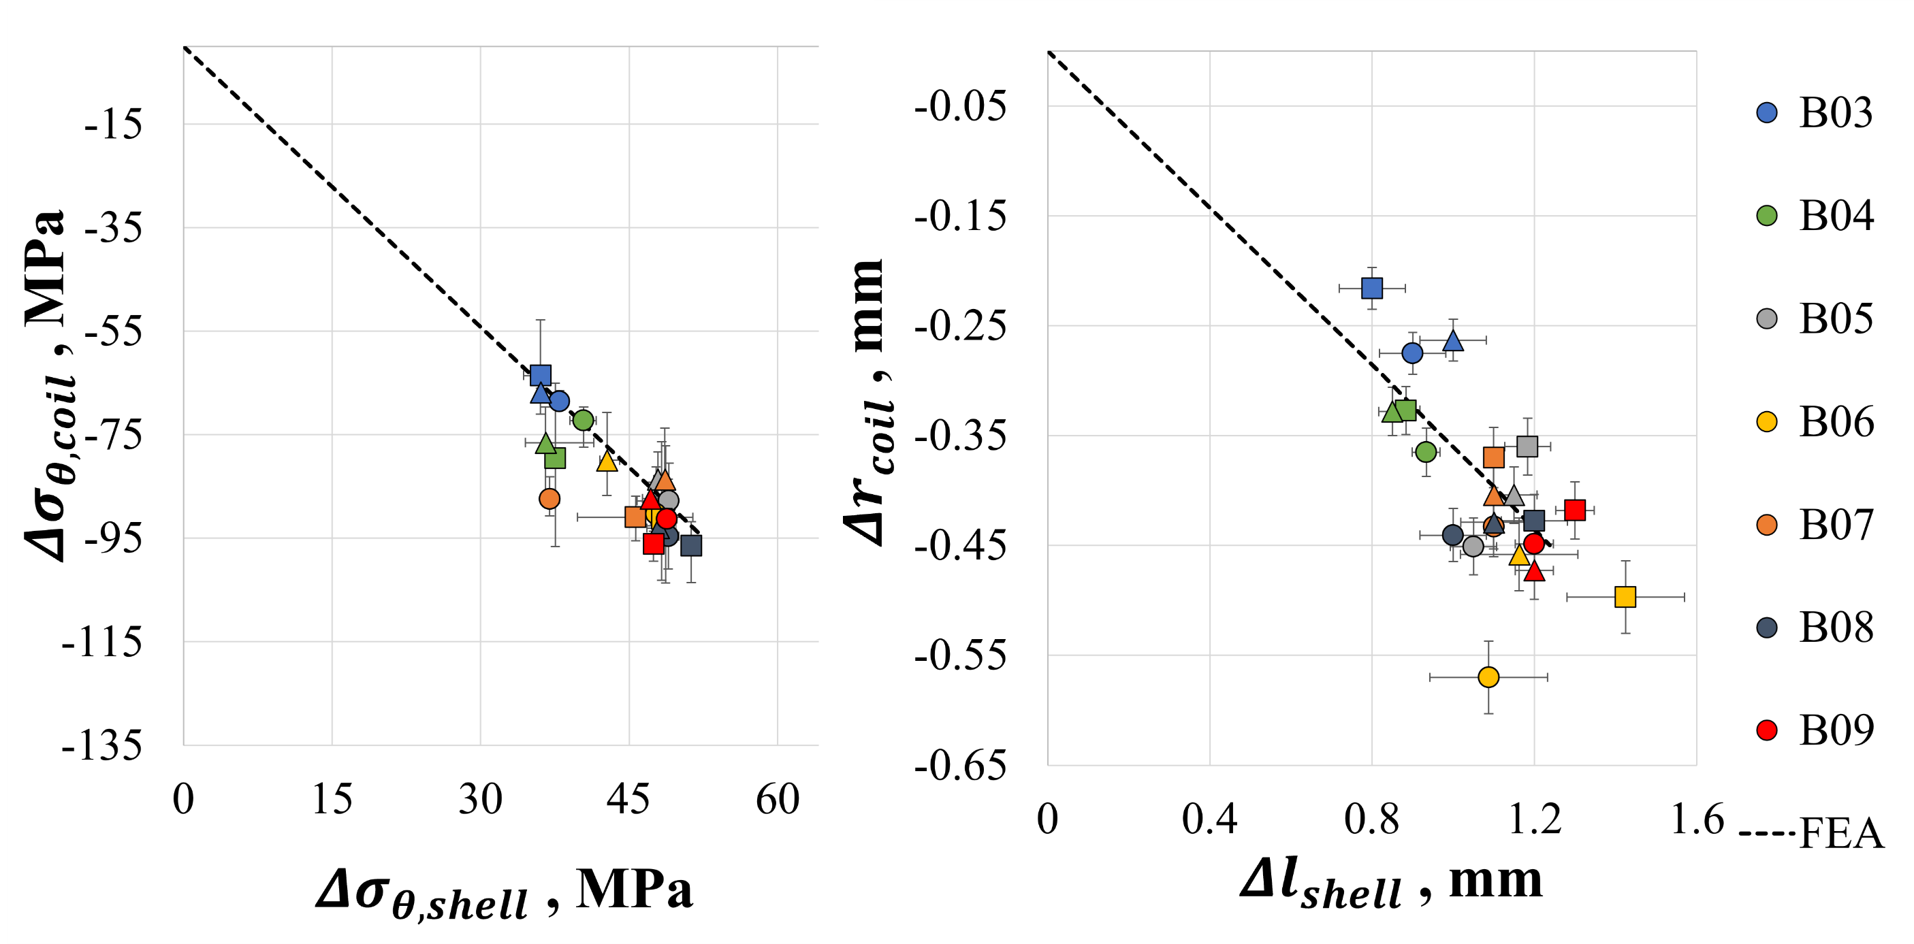
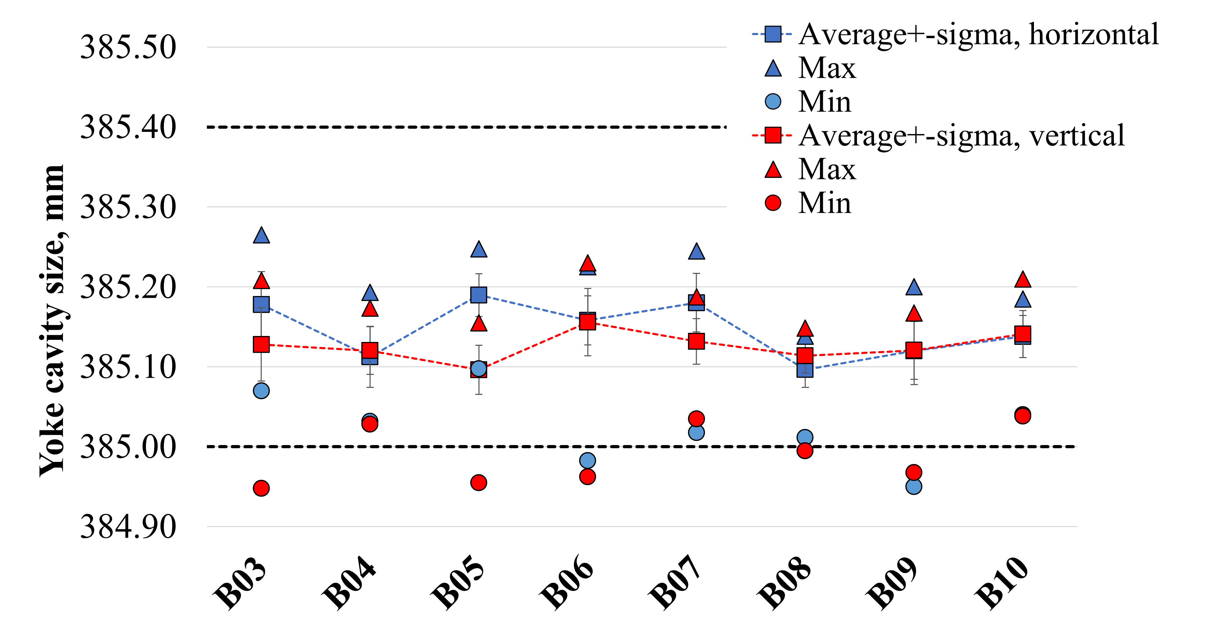
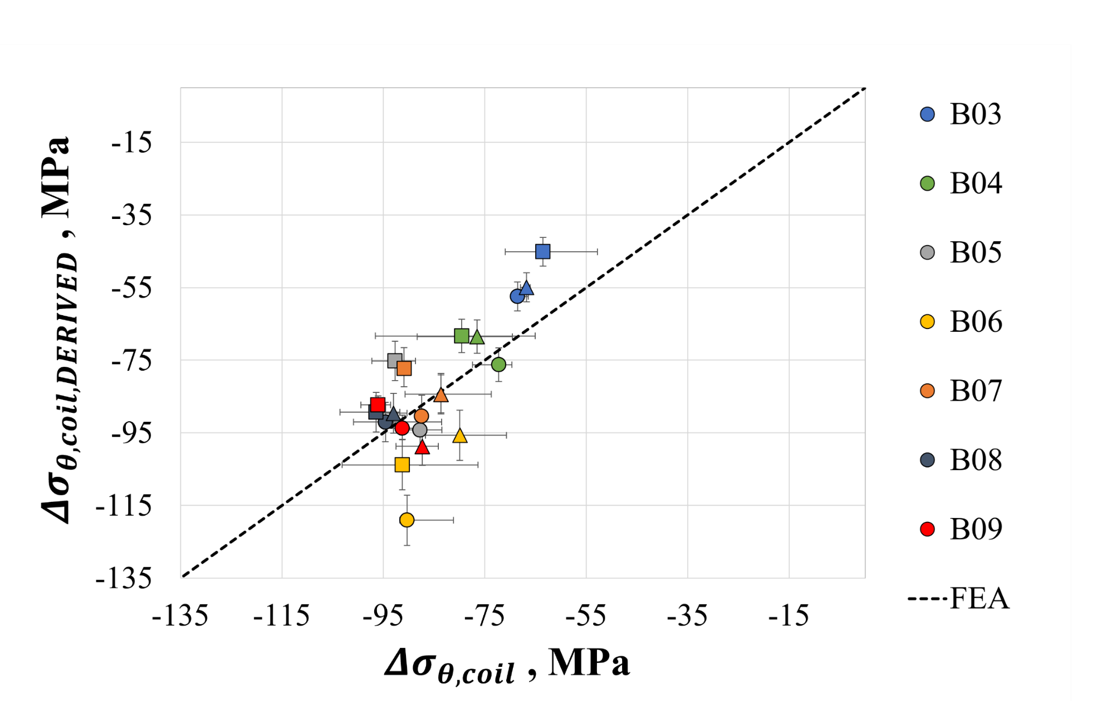
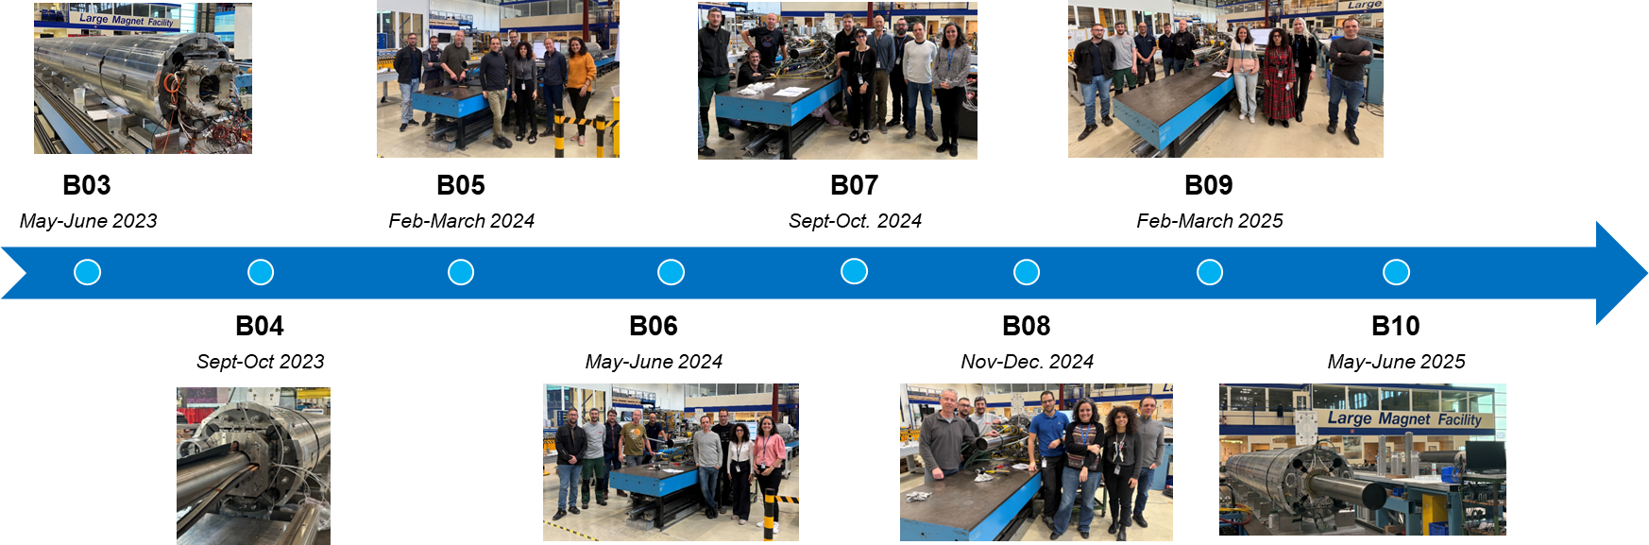

Assembly of the Nb₃Sn MQXFB Quadrupole for HL-LHC
P. M. Quassolo¹, P. Ferracin² , J. Ferradas Troitino^{1,} S. Izquierdo Bermudez¹ , N. Lusa¹,, S. Mugnier¹ and S. Triquet¹
Presentation ID: Wed-Af-Po.03-01
¹ CERN, European Organisation for Nuclear Research, Switzerland
² Lawrence Berkeley National Laboratory, USA
The High-Luminosity LHC (HL-LHC) project aims to upgrade the existing LHC machine to increase its integrated luminosity by a factor of ten. A key aspect of this upgrade is the inner triplet (or low-β) quadrupole magnets, the MQXF, which utilise Nb3Sn superconducting magnet technology and reach a conductor peak field of 11.3 T. The MQXFB version, manufactured at CERN, has a magnetic length of 7.2 m, making it the longest Nb3Sn accelerator magnet ever realised. A total of ten MQXFB series magnets are needed for HL-LHC (eight to be installed, and two spares). The mechanical structure is based on an aluminium shell, pre-tensioned at room temperature with a system of water-pressurised bladders and keys, which ensure the pre-stress of the coil-pack. The coil pre-load increases after cool-down to 1.9 K thanks to the larger thermal contraction of the aluminium shrinking cylinder compared to the rest of the magnet components. Since this structural design is used for the first time in an accelerator magnet, the accumulated experience of assembling 80% of the magnets provides valuable insights for the potential application of Nb3Sn technology in future colliders. This paper analyses the main measurements for the mechanical assembly of the MQXFB series magnets and assesses the reproducibility of the production.
The external dimension of the coil pack is measured with LVDTs.
An average offset of 100 μm is observed between the measured coil pack average dimension and the expected value based on coil CMM measurements and the shimming plan
The two independent measurements present very good agreement, confirming the reliability and repeatability of the fabrication
I – mqxfb magnet assembly
III – Coil pack sub-assembly
VI – axial loading
Low-β quadrupole magnet for the HL-LHC upgrade
Before the coil pack assembly, the coils are measured using a FARO® arm portable CMM
Series production coils are 200 μm smaller than nominal in the azimuthal direction
The external dimension of the coil pack is measured with LVDTs.
The two independent measurements present very good agreement
Axial loading is achieved by applying a controlled tensile force to the support rods using a hydraulic piston system. It is monitored using strain gauges on the rods. The strain target for the rods: 650 ± 50 µstrain after loading.
The equivalent targets for pressure and are:
Pressure target: 300 ± 25 bar
Displacement target: -5.33 ± 0.4 mm
Yoke shell sub-assembly
Coil pack sub-assembly
Magnet loading
  Azimuthal loading
  Axial loading
VI – Azimuthal loading
II – Yoke shell sub-assembly
Azimuthal loading is monitored via the transfer function (TF) that shows the pole stress vs the shell stress.
I – Yoke – shell & coil - pack
Geometrical parameters used to assess the azimuthal preload:
Increase in the aluminium shell developed length during loading
$$Δ_{l_{shell}}=l_{shell_{after loading}}−{l_{shell}}_{before loading}$$
Variation of the radial dimension of the coil
$Δ_{r_{coil}}=\left(r_{i_{collar}}−r_{o_{insulated coil}}\right)+interf_{loading}+c$
c is a calibration constant $(c=0.156$)
The cavity dimensions are measured with LVDTs, along the length for a total of 76 measurements.
The difference between vertical and horizontal is less than 100μm
V – conclusions
MQXFB magnet series production exhibits high reproducibility and precision.
Azimuthal coil pre-stress is controlled within a 10 MPa margin of the target pre-load condition.
With 80% of the MQXFB magnets assembled, results confirm that simple geometrical measurements can effectively ensure azimuthal and axial pre-load specifications are met throughout the production
Coil/shell stress can be derived from geometrical measurements and the FE model.
The derived coil stress (∆σ_{θ,coil, DERIVED}) is within 10 MPa of the measured value with mechanical instrumentation (∆σ_{θ,coil}).

