Slide 1
Status of Series Production and Cold Test Results of the First Series High Luminosity LHC Main Bending Recombination Dipole Magnets
A. Pampaloni
S. Farinon, A. Bersani, B. Caiffi - INFN Genova
S. Izquierdo Bermudez, E. Todesco, D. Duarte Ramos, L. Fiscarelli, A. Foussat, F. Mangiarotti, M. Pentella, H. Prin, G. Willering – CERN
On behalf of CERN – INFN WP3 Collaboration for D2 construction for HL-LHC

Slide 2
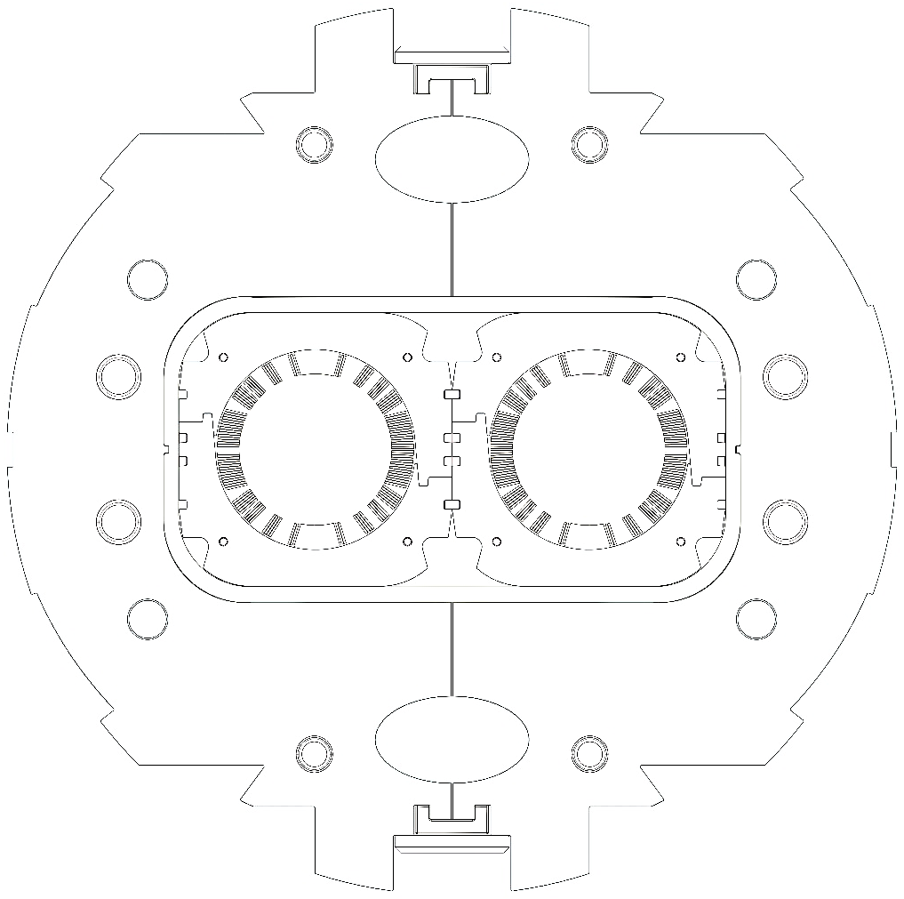
Outline
Introduction to High Luminosity LHC
Main characteristics of the MBRD (aka D2)
Status of the series magnets production:
  Coils coupling strategy and shimming plans
  MBRD2
    Cold test results: Powering cycles
    Cold test results: Training and quench protection
    Expected field quality at nominal condition
  MBRD1
  MBRD4
  MBRD3
Overall schedule
Conclusion

Slide 3
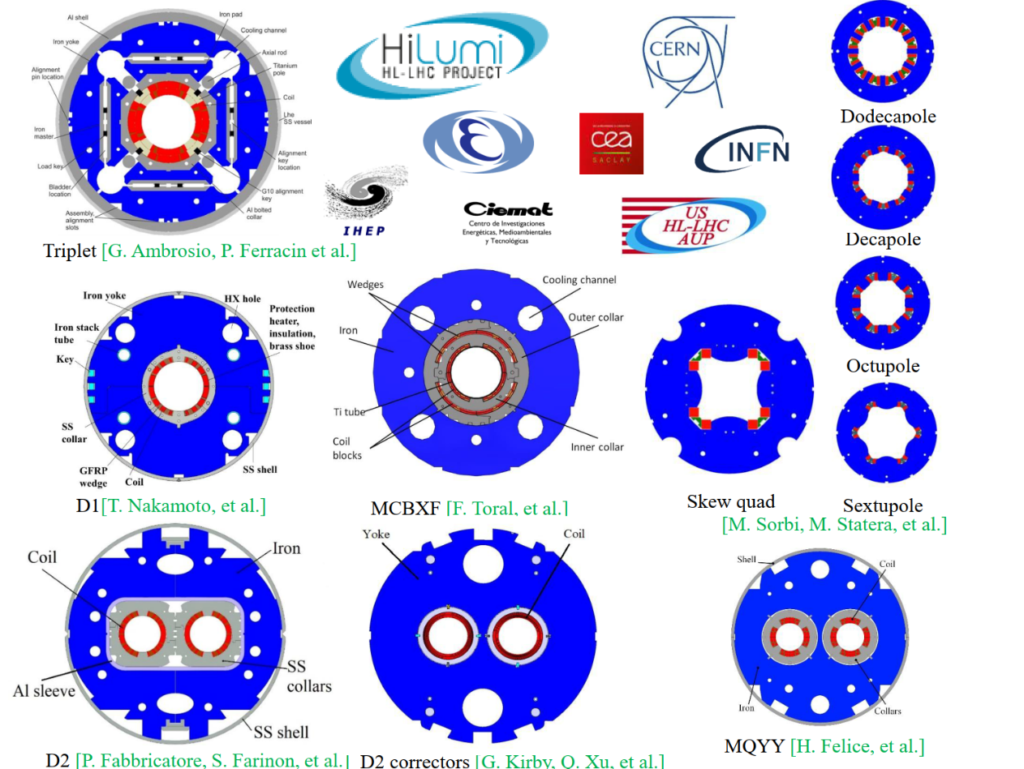
HL-LHC Zoo
The main goals of HL-LHC are to increase:
    the instant LHC luminosity by a factor of 5;
    the integrated LHC luminosity by a factor of 10.
This is achieved by replacing 100 magnets of 11 different types.

Slide 4

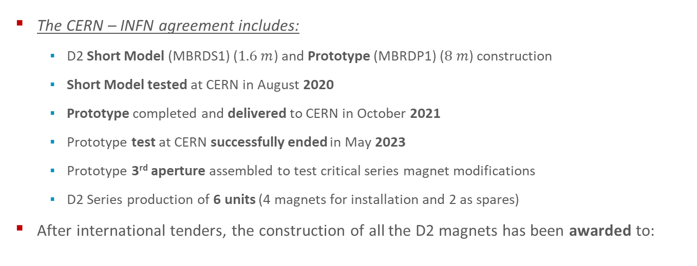
The HL-LHC D2 Agreement
The CERN – INFN agreement includes:
    D2 Short Model (MBRDS1) ($1.6 m$) and Prototype (MBRDP1) ($8 m$) construction
    Short Model tested at CERN in August 2020
    Prototype completed and delivered to CERN in October 2021
    Prototype test at CERN successfully ended in May 2023
    Prototype 3rd aperture assembled to test critical series magnet modifications
    D2 Series production of 6 units (4 magnets for installation and 2 as spares)
After international tenders, the construction of all the D2 magnets has been awarded to:
Series Production Plan
# magnets | # apertures | # coils
4 series | 8 | 16
2 spares | 4 | 8
Total = 6 | Total = 12 | Total = 24

Slide 5
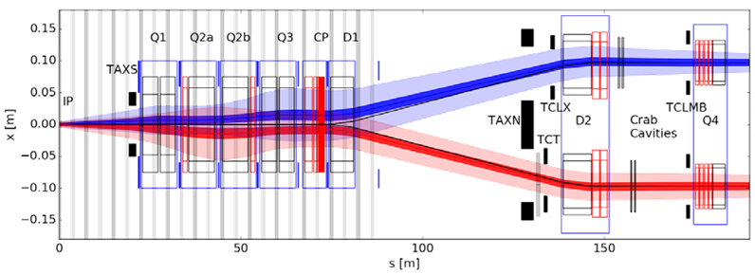
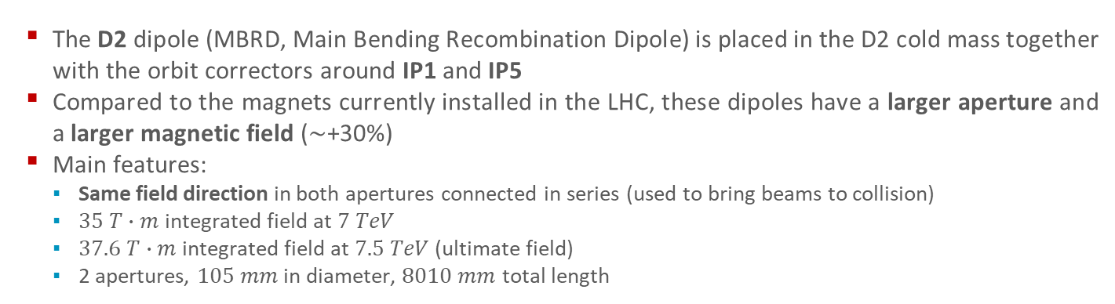
D2 Layout and Function
  The D2 dipole (MBRD, Main Bending Recombination Dipole) is placed in the D2 cold mass together with the orbit correctors around IP1 and IP5
  Compared to the magnets currently installed in the LHC, these dipoles have a larger aperture and a larger magnetic field ($\sim$+30%)
  Main features:
    Same field direction in both apertures connected in series (used to bring beams to collision)
    $35 T∙m$ integrated field at $7 TeV$
    $37.6 T∙m$ integrated field at $7.5 TeV$ (ultimate field)
    2 apertures, $105 mm$ in diameter, $8010 mm$ total length

Slide 6
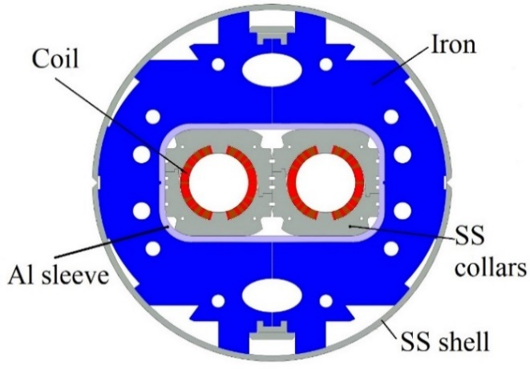
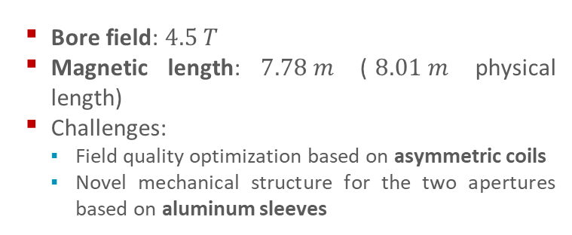
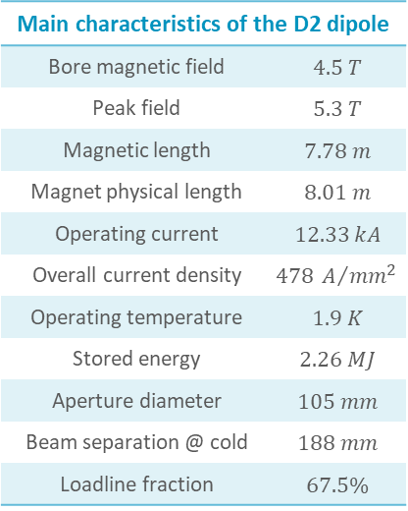
D2 Cross Section
  Bore field: $4.5 T$
  Magnetic length: $7.78 m$ ($8.01 m$ physical length)
  Challenges:
    Field quality optimization based on asymmetric coils
    Novel mechanical structure for the two apertures based on aluminum sleeves
Main characteristics of the D2 dipole
Bore magnetic field | $$4.5 T$$
Peak field | $$5.3 T$$
Magnetic length | $$7.78 m$$
Magnet physical length | $$8.01 m$$
Operating current | $$12.33 kA$$
Overall current density | $$478 A/{mm^{2}}$$
Operating temperature | $$1.9 K$$
Stored energy | $$2.26 MJ$$
Aperture diameter | $$105 mm$$
Beam separation @ cold | $$188 mm$$
Loadline fraction | $$67.5\%$$

Slide 7
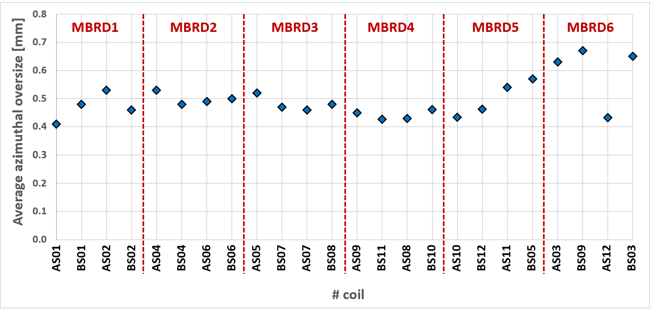
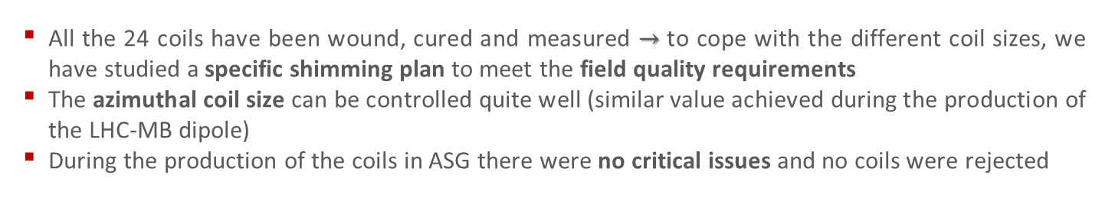
Coil Coupling Strategy and Shimming Plans
  All the 24 coils have been wound, cured and measured $→$ to cope with the different coil sizes, we have studied a specific shimming plan to meet the field quality requirements
  The azimuthal coil size can be controlled quite well (similar value achieved during the production of the LHC-MB dipole)
  During the production of the coils in ASG there were no critical issues and no coils were rejected

Slide 8
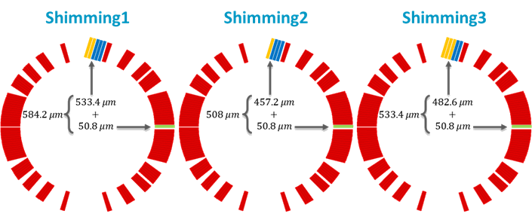
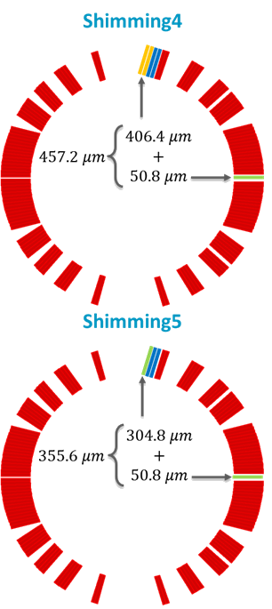
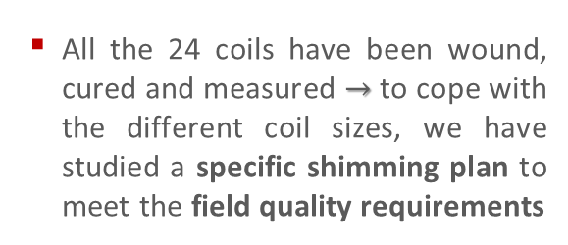
Coil Coupling Strategy and Shimming Plans
  All the 24 coils have been wound, cured and measured $→$ to cope with the different coil sizes, we have studied a specific shimming plan to meet the field quality requirements
Coil type | Min [mm] | Max [mm] | Avg [mm] | # AP | # Shimming | # Mag
AS01 | 0.34 | 0.47 | 0.41 | AP01 | Shimming1 | MBRD1
BS01 | 0.39 | 0.60 | 0.48
AS02 | 0.47 | 0.64 | 0.53 | AP02 | Shimming2
BS02 | 0.31 | 0.55 | 0.46
AS04 | 0.37 | 0.61 | 0.53 | AP03 | Shimming2 | MBRD2
BS04 | 0.42 | 0.60 | 0.48
AS06 | 0.41 | 0.59 | 0.49 | AP04 | Shimming2
BS06 | 0.36 | 0.66 | 0.50
AS05 | 0.42 | 0.61 | 0.52 | AP05 | Shimming2 | MBRD3
BS07 | 0.42 | 0.54 | 0.47
AS07 | 0.37 | 0.55 | 0.46 | AP06 | Shimming3
BS08 | 0.41 | 0.59 | 0.48
Coil type | Min [mm] | Max [mm] | Avg [mm] | # AP | # Shimming | # Mag
AS09 | 0.39 | 0.55 | 0.45 | AP07 | Shimming1 | MBRD4
BS11 | 0.37 | 0.52 | 0.43
AS08 | 0.34 | 0.52 | 0.43 | AP08 | Shimming1
BS10 | 0.36 | 0.58 | 0.46
AS10 | 0.37 | 0.52 | 0.43 | AP09 | Shimming1 | MBRD5
BS12 | 0.42 | 0.57 | 0.46
AS11 | 0.47 | 0.62 | 0.54 | AP10 | Shimming4
BS05 | 0.42 | 0.68 | 0.57
AS03 | 0.56 | 0.70 | 0.63 | AP11 | Shimming5 | MBRD6
BS09 | 0.56 | 0.81 | 0.67
AS12 | 0.34 | 0.52 | 0.43 | AP12 | Shimming4
BS03 | 0.52 | 0.82 | 0.65

Slide 9
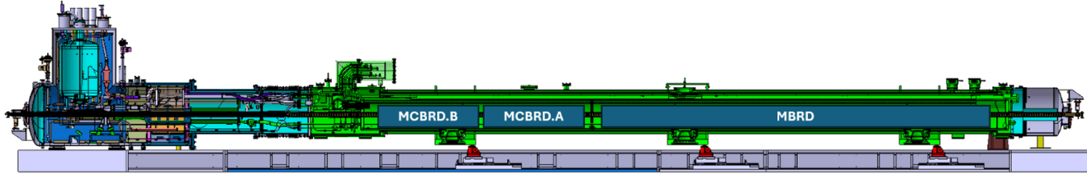
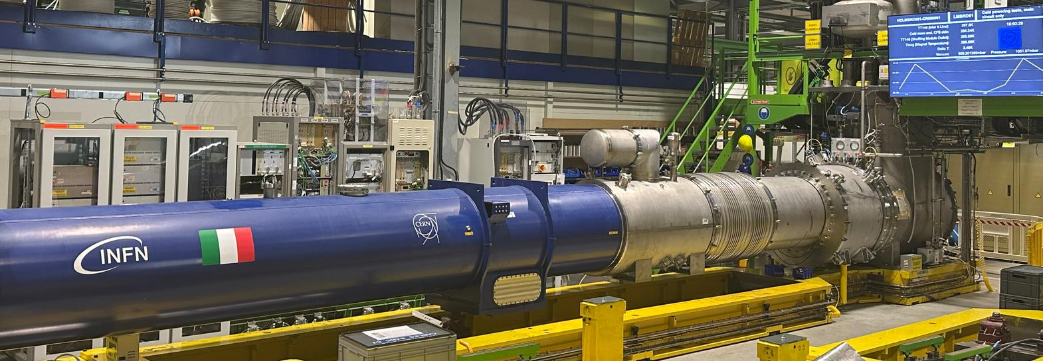
MBRD2
  MBRD2 arrived at CERN in April 2024
  It successfully passed all the reception tests and it was accepted by CERN
    It is the first MBRD magnet to be assembled in the D2 cold mass
  The magnet was tested in June 2025 and reached ultimate current without quenching in the 1st cool-down
  Due to a problem of interference between beam tube and anti-cryostat, the magnetic measurements could not be carried out in the 1st cool-down
    they will be carried out during the 2nd cool-down which will take place at the end of August 2025

Slide 10
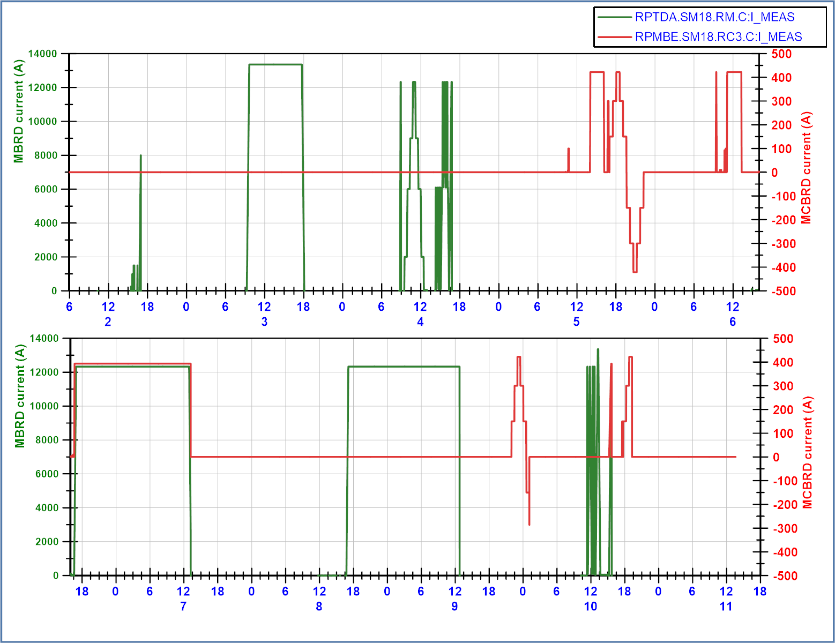
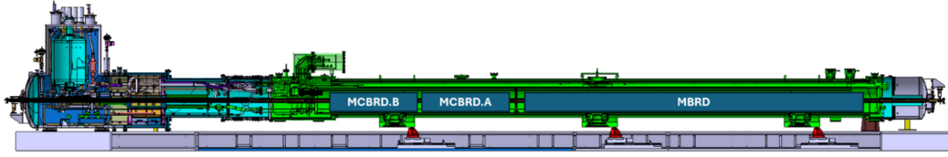
MBRD2 Cold Tests: Powering Cycles
  MBRD2 powering performed during 1st cool-down:
    8 kA QH discharge
    Ultimate current 8 hour plateau
    50 A/s to nominal, followed by -150 A/s slow power abort
    Splice cycle to nominal current
    Five AC-loss cycles from 0 to 6 kA, 10 to 100 A/s
    Five AC-loss cycles from 6 kA to nominal, 10 to 100 A/s
    Ramp to nominal followed after 3 minutes by QH reference discharge
    20 hour flattop at nominal current, with nominal current in MCBRD.B
    19h40 flattop at nominal current
    Five AC-loss cycles from 0 kA to nominal at 10 to 100 A/s
    Powering to ultimate for 5 minutes
    Powering to nominal for 6 minutes, followed by -150 A/s slow power abort
  MBRD2 reached ultimate current 2 times
  MBRD2 reached nominal or higher current 18 times
Courtesy of G. Willering

Slide 11
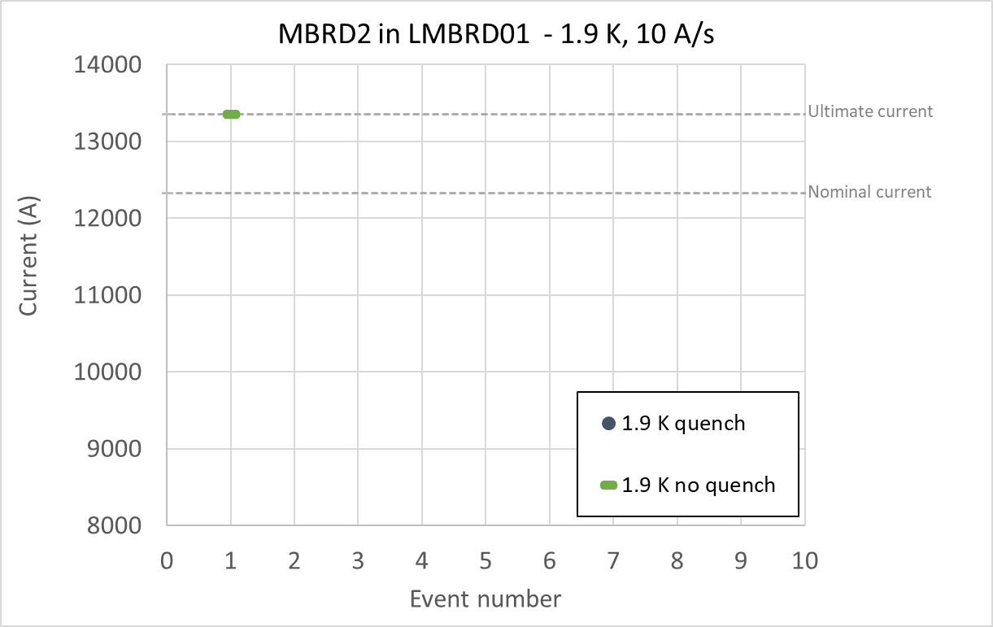
MBRD2 Cold Tests: Training and Quench Protection
  MBRD2 reached ultimate current 2 times without quenches
  MBRD2 reached nominal or higher current 18 times without quenches
  The quench heaters fired ~90 times (~33 with a current ≥ 8 kA)
Courtesy of G. Willering

Slide 12
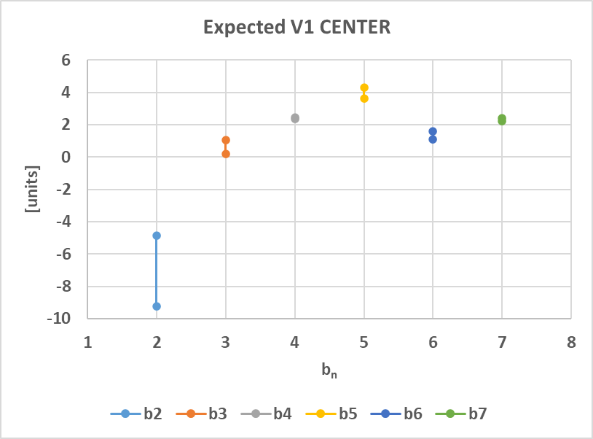
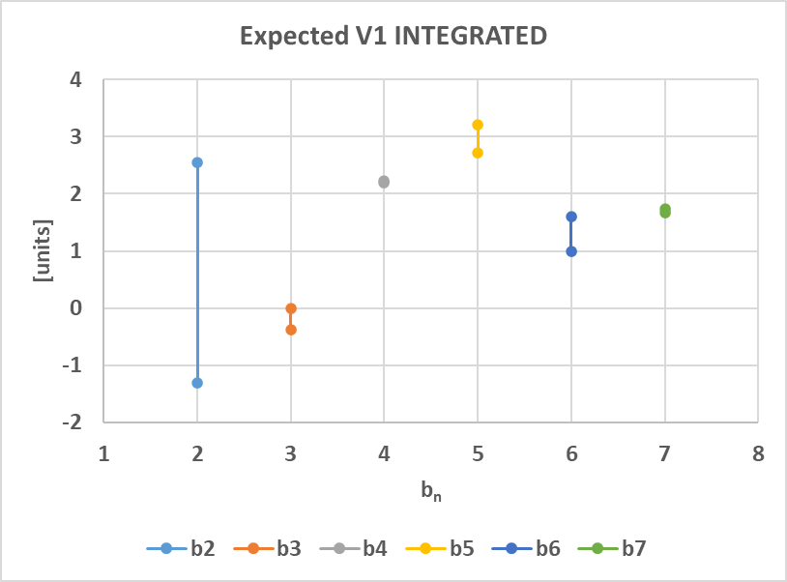
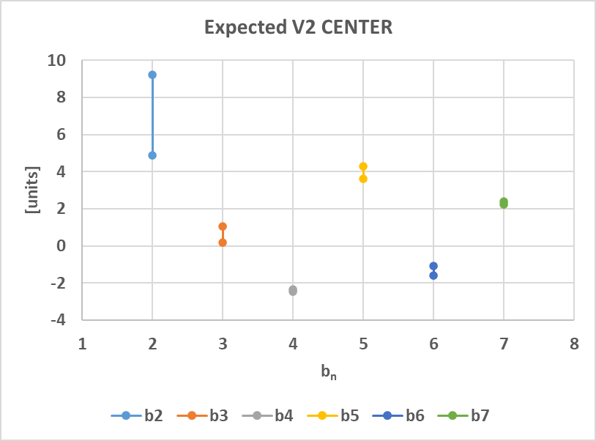
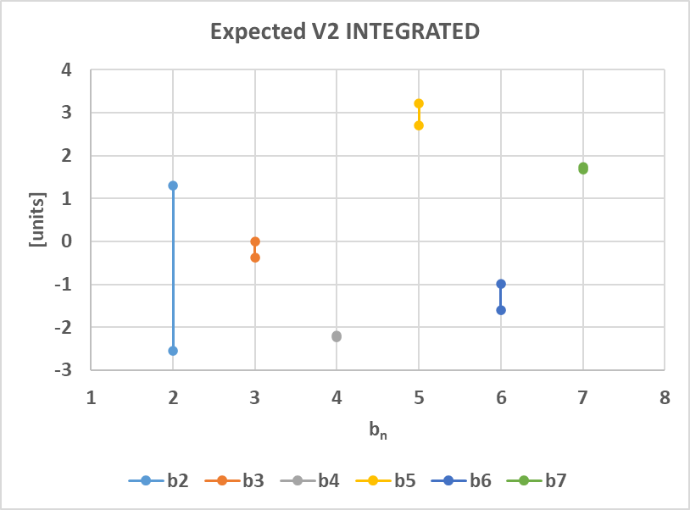



Expected Field Quality of MBRD2
  The expected field quality at nominal operation has been evaluated using prototype at cold and series at warm measurements
$$Expected=Simu+∆$$
$$∆_{proto @ cold}=Meas −Simu$$
$$∆_{series @ warm}=Meas −Simu$$
  At the end of the 2nd cool-down, we will be able to validate our estimates and have a more precise indication for the expected field quality at nominal conditions for the remaining magnets in the series

Slide 13
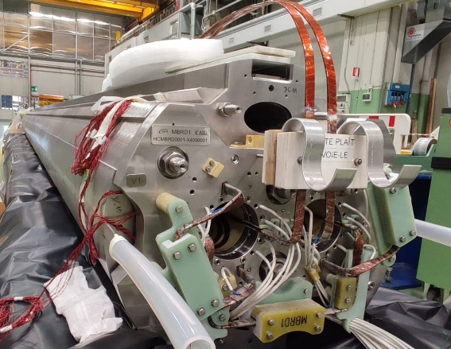
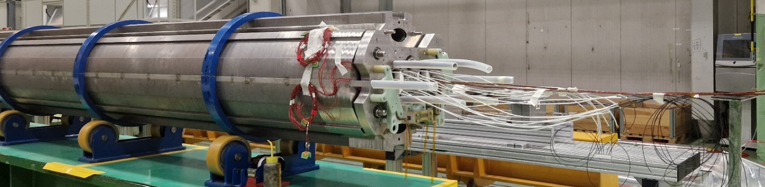
MBRD1
  MBRD1 arrived at CERN in October 2023
  After the electrical tests at high voltage (3.1 kV), a short circuit to ground of the quench heater YT112 was revealed
  The MBRD1 was temporarily reassembled to be shipped back to ASG for repair
    It was delivered to ASG in July 2024
  MBRD1 was repaired in ASG with the highest priority
  MBRD1 was delivered back to CERN in October 2024
    it is currently being integrated into the cryostat
  MBRD1 will be the second magnet to be tested in the D2 cold mass

Slide 14
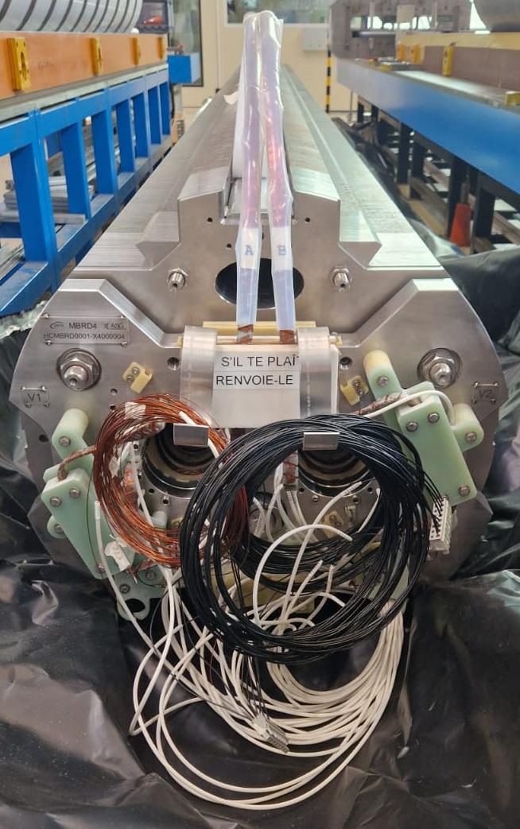
MBRD4
  MBRD4 was delivered to CERN in May 2025
  Upon receipt two issues were identified:
    Insulation damage of the conductors in the heads in coils BS11 (V1 Up) and AS08 (V2 Up)
    Misalignment of about 2 mm of the end plate on the connection side
  ASG sent personnel to CERN to:
    Repair the insulation according to the agreed procedure
    Restore the alignment of the end plate
  After the repair operations, MBRD4 successfully passed all reception tests and was accepted by CERN
    it is ready to be assembled in the D2 cold mass and to be tested after the cold test of MBRD1

Slide 15
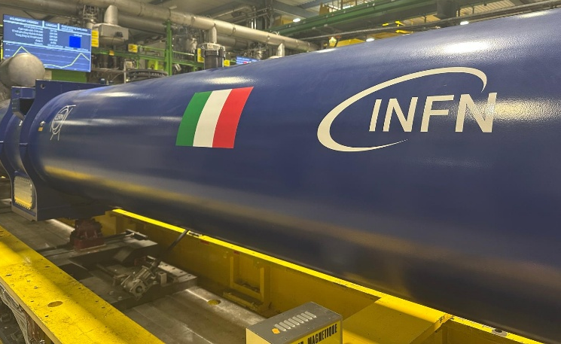
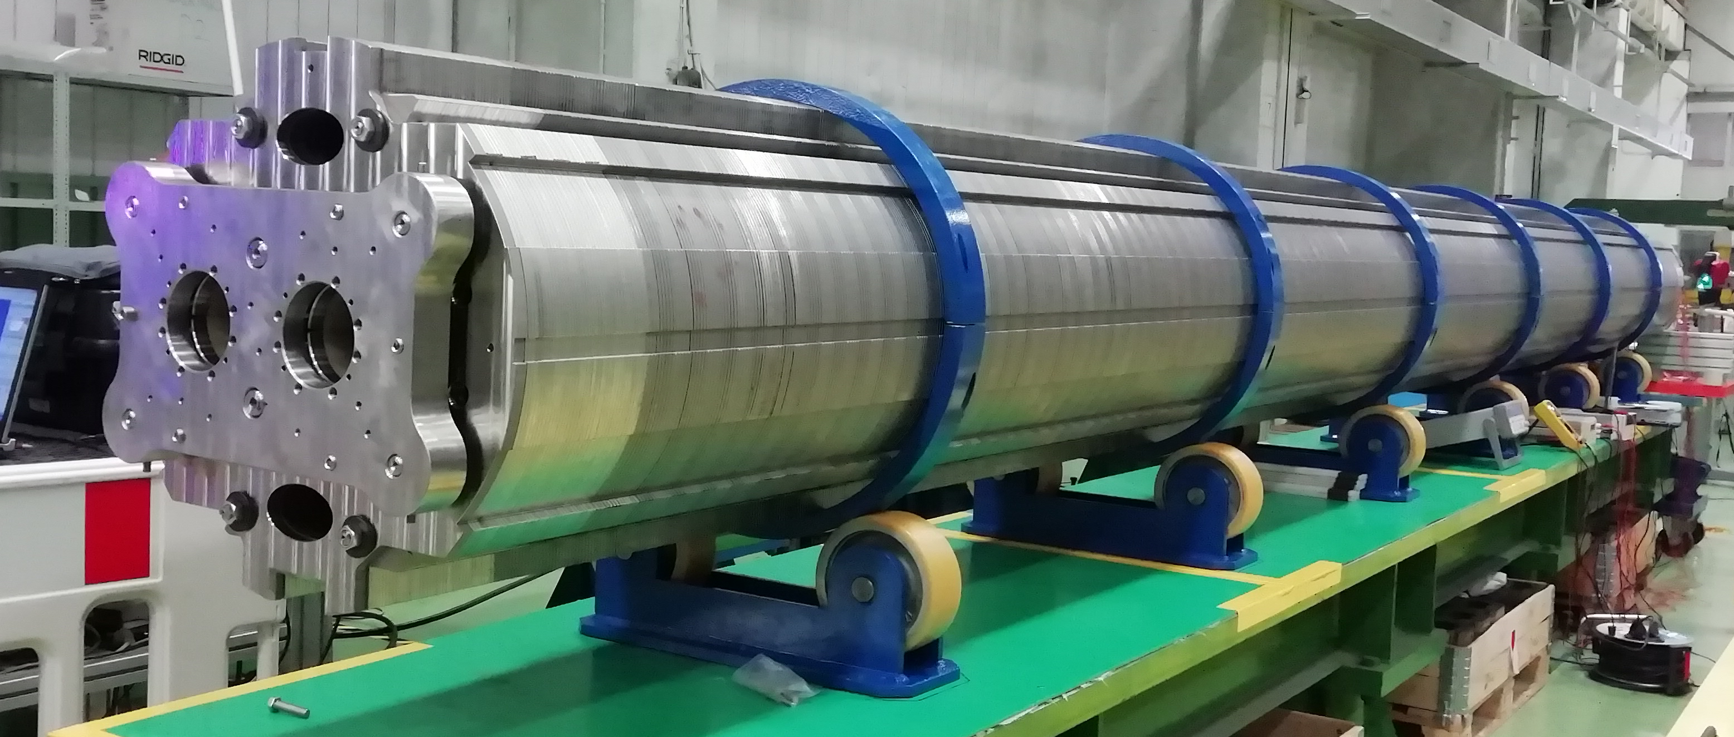
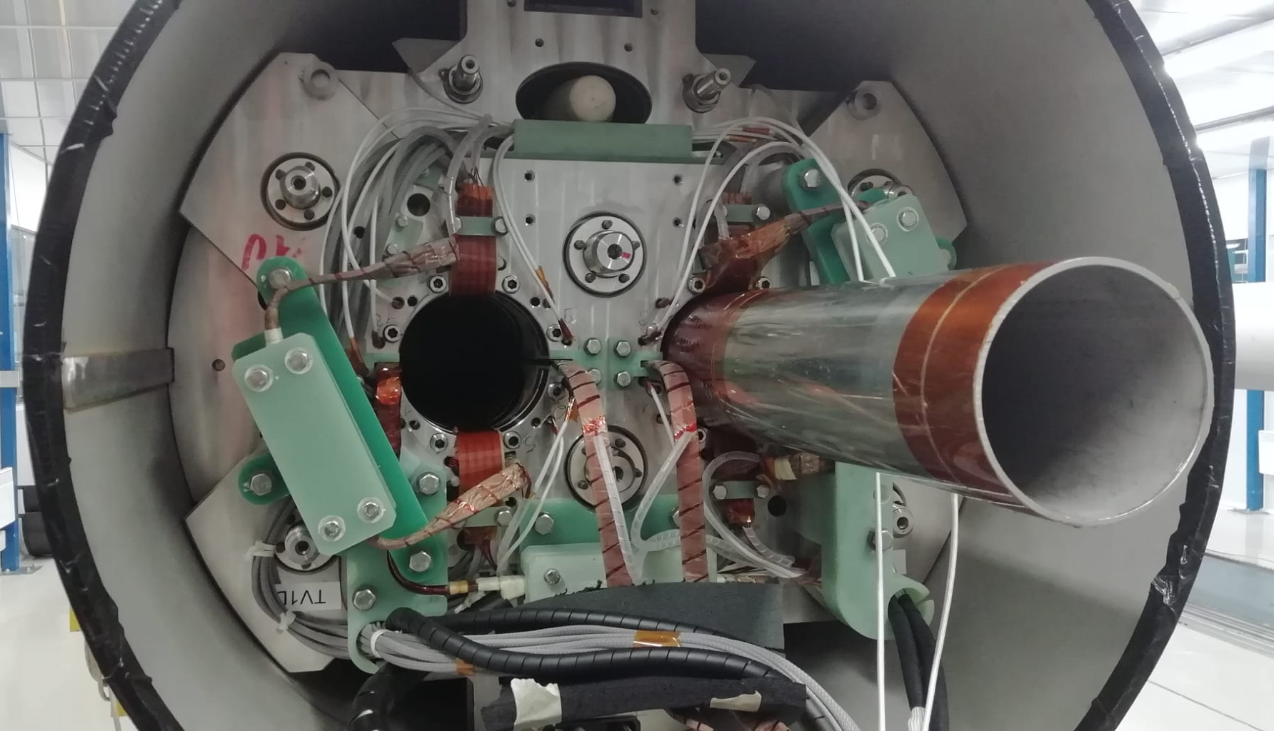
Overall Schedule
  MBRD1 was delivered in October 2024
  MBRD2 was delivered in April 2024
  MBRD3 is being assembled in ASG and will be shipped in September 2025
  MBRD4 was delivered in May 2025
  MBRD5 will be shipped in December 2025
  MBRD6 will be shipped in March 2026

Slide 16
Conclusion
  The first three series magnets were delivered to CERN
    MBRD2 is in the cold test phase at CERN
    MBRD1 is waiting for cryostat integration
    MBRD4 has just been delivered to CERN and successfully accepted
  The series production of the remaining magnets is scheduled to finish by beginning of 2026
  Cold tests conducted so far on MBRD2 are showing excellent magnet behaviour with the achievement of the ultimate current without quench

Slide 17
THANKS FOR YOUR ATTENTION

Slide 19
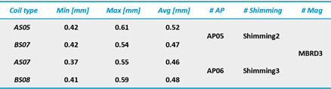
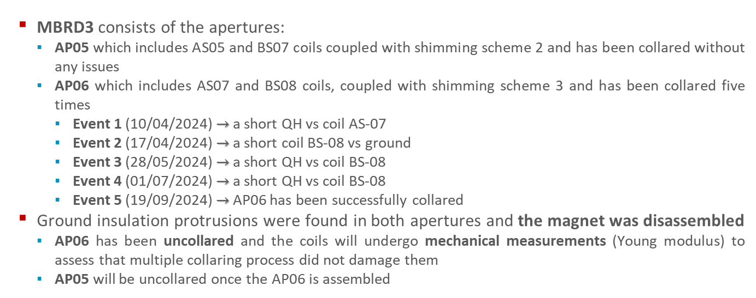
MBRD3
  MBRD3 consists of the apertures:
    AP05 which includes AS05 and BS07 coils coupled with shimming scheme 2 and has been collared without any issues
    AP06 which includes AS07 and BS08 coils, coupled with shimming scheme 3 and has been collared five times
      Event 1 (10/04/2024) $→$ a short QH vs coil AS-07
      Event 2 (17/04/2024) $→$ a short coil BS-08 vs ground
      Event 3 (28/05/2024) $→$ a short QH vs coil BS-08
      Event 4 (01/07/2024) $→$ a short QH vs coil BS-08
      Event 5 (19/09/2024) $→$ AP06 has been successfully collared
  Ground insulation protrusions were found in both apertures and the magnet was disassembled
    AP06 has been uncollared and the coils will undergo mechanical measurements (Young modulus) to assess that multiple collaring process did not damage them
    AP05 will be uncollared once the AP06 is assembled

