Slide 1

Pushing the Limits: Advanced SiC Detectors for Operation in Harsh Environments

Slide 2
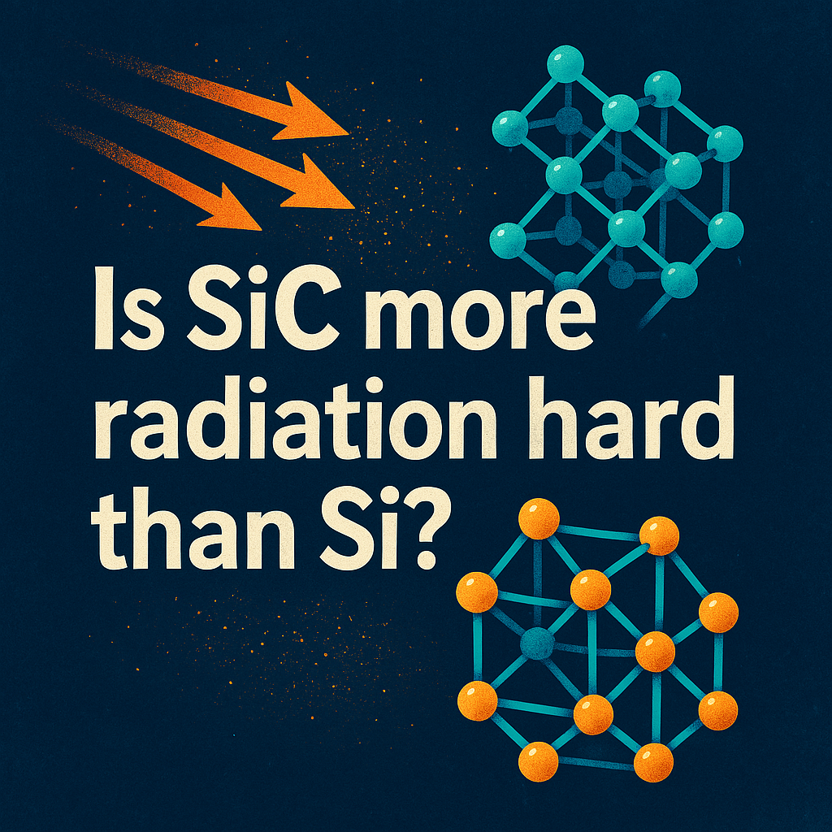


Slide 3


The answer at the end of the talk!

Slide 4
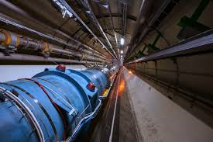
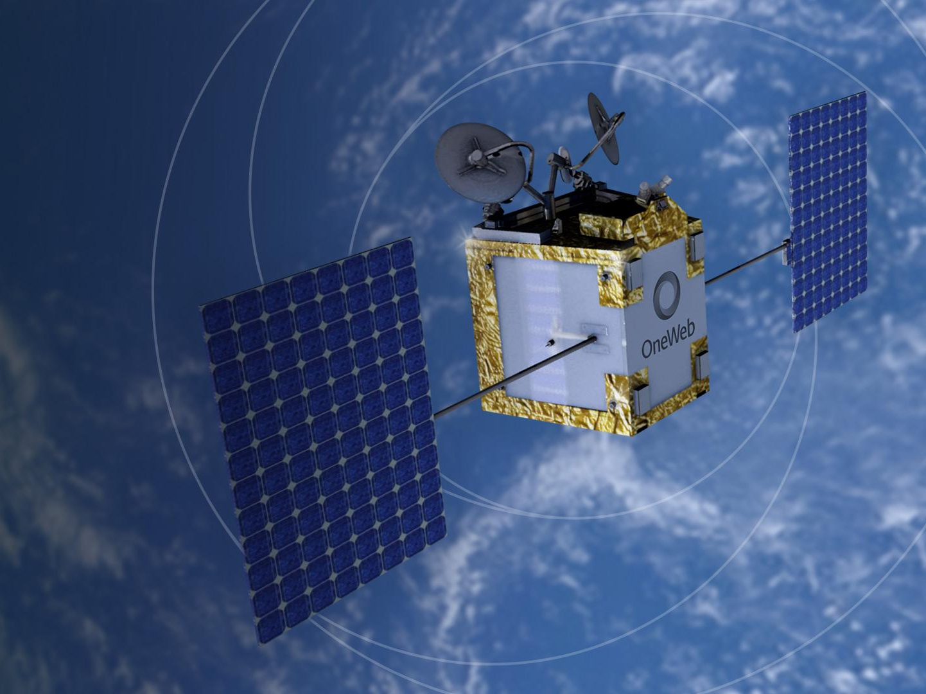

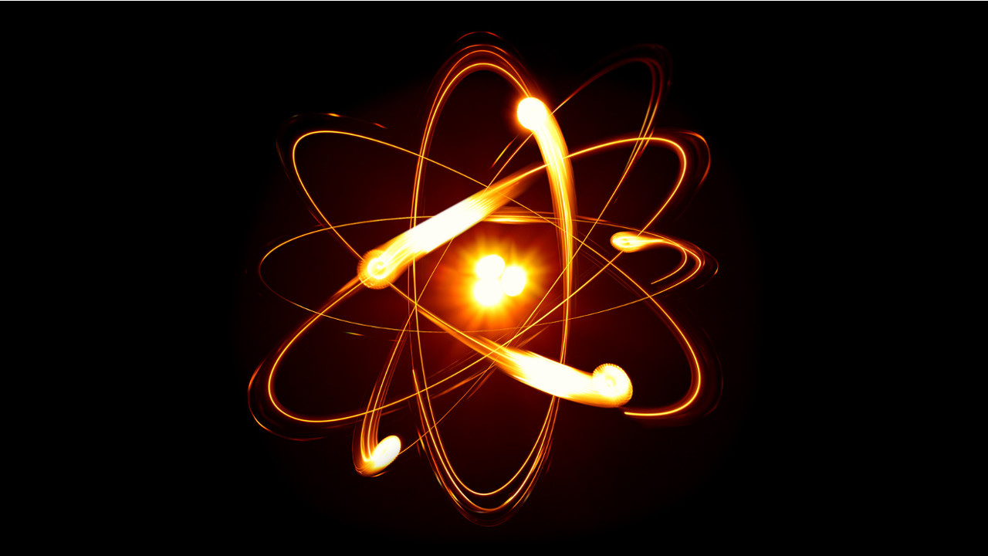
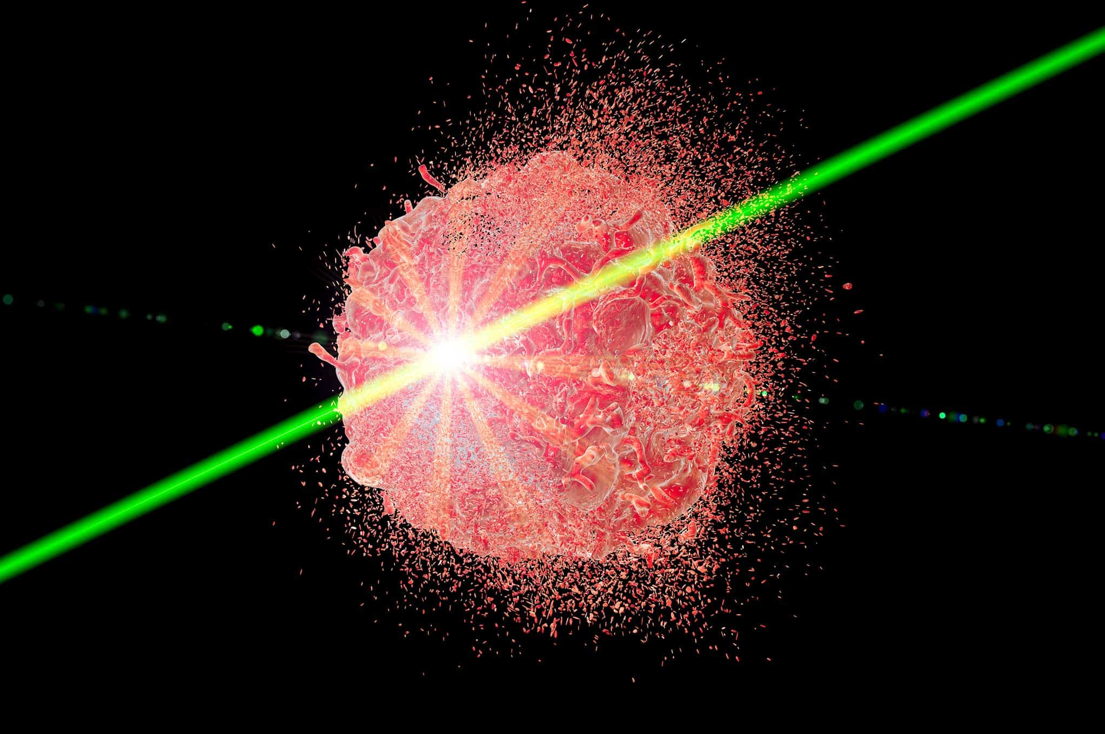
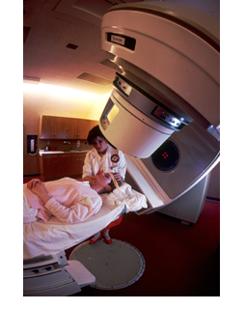
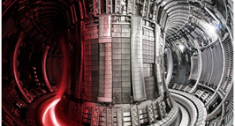
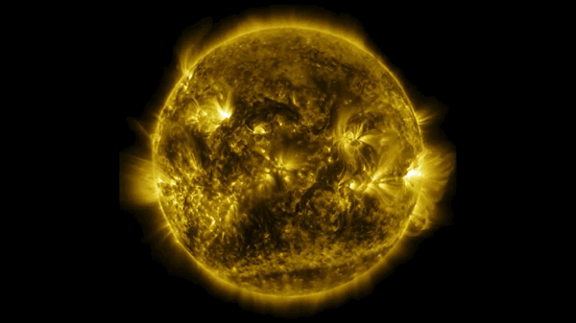
Main potential applications in harsh environments
SiC Radiation detectors
High Energy Physics
Fusion
Space
Medical dosimetry
Nuclear Physics
HEP
Space
Nuclear Physics
https://protomag.com/medical-history/flash-radiotherapy-finally-way/
Radiotherapy
Plasma diagnostic
in Fusion reactors

Slide 5
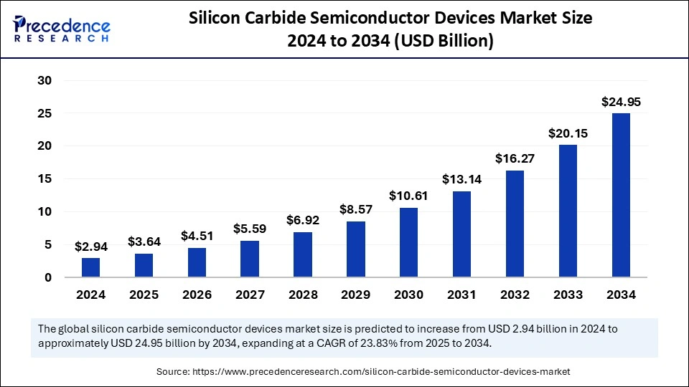
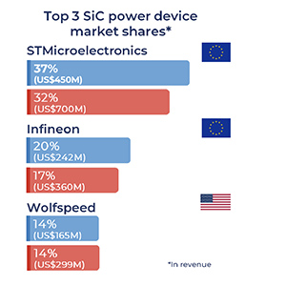
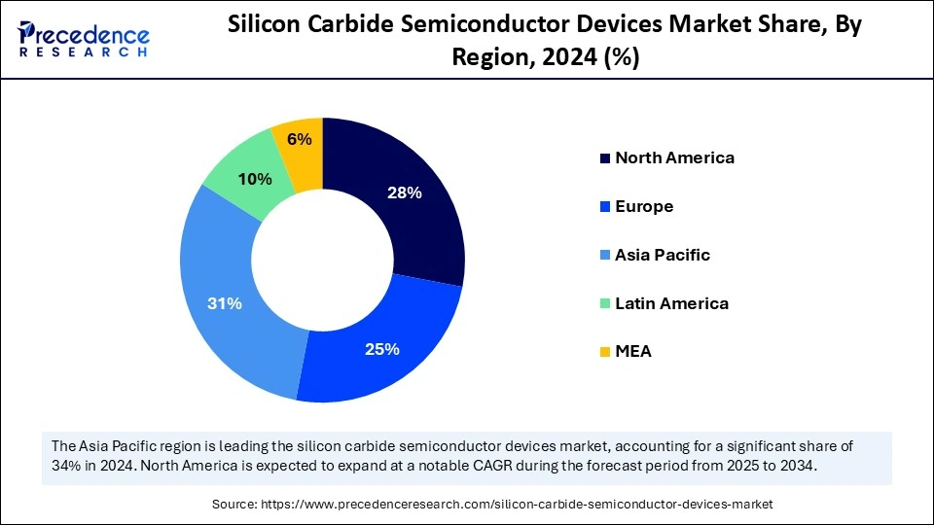
Silicon carbide is expected to improve energy efficiency in key sectors of the economy. Europe has many large companies leading this technology.
SiC devices are widely used in fields such as rail transit, ultra-high voltage power grids, charging stations, photovoltaic power generation, new energy vehicles, high-speed trains, consumer electronics, and more.
https://www.precedenceresearch.com/silicon-carbide-semiconductor-devices-market

Slide 6
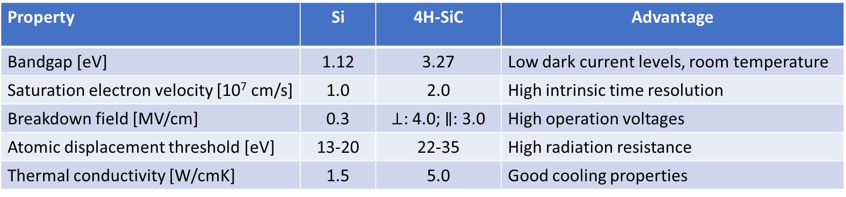
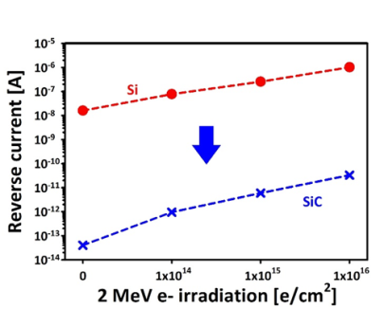
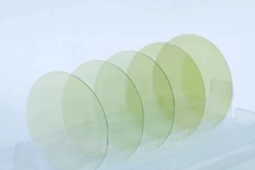
Why use SiC radiation detectors?
Same area
150mm wafers
Insensitive to visible light
F Nava et al 2008 Meas. Sci. Technol. 19 102001
J.M. Rafí et al 2018 JINST 13 C01045

Slide 7
Few comments
Very recently Silicon-Carbide 2um CMOS technology is available in the EUROPRACTICE portfolio, provided by Fraunhofer IISB.
Epitaxial layer thickness is limited by increasing defect density (< 250 μm) -> kV for full depletion…
Standard wafer size is 150mm but now it is possible to find high quality 200mm wafers.
R&D necessary to understand radiation hardness for specific applications. Defect engineering is not clear for high neutron or ion fluences.
Low charge generation (Ionization energy) per μm and MIP SiC: 57eh; Si: 80 – 90eh -> Gain may be necessary for mips.
Simulation very well established for power devices, no very accurate for detectors *.
Most advanced microelectronic processes are available for SiC, and large-scale production may be feasible within European industries—provided there is sufficient interest.
* Review: https://arxiv.org/pdf/2410.06798

Slide 8
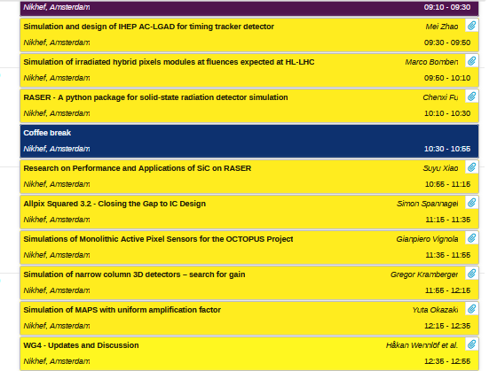
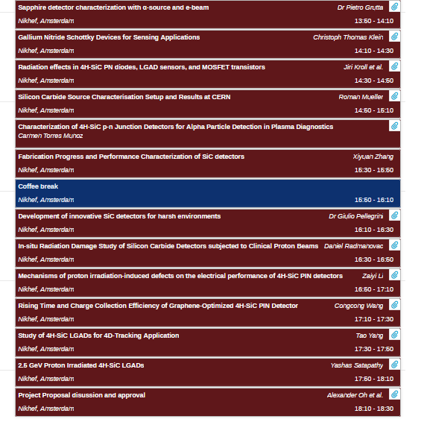
High Energy Physics experiments
Large interest from the DRD3 communities.
Last meeting on 2-6 June 2025 in Amsterdam, https://indico.cern.ch/event/1507215/

Slide 9
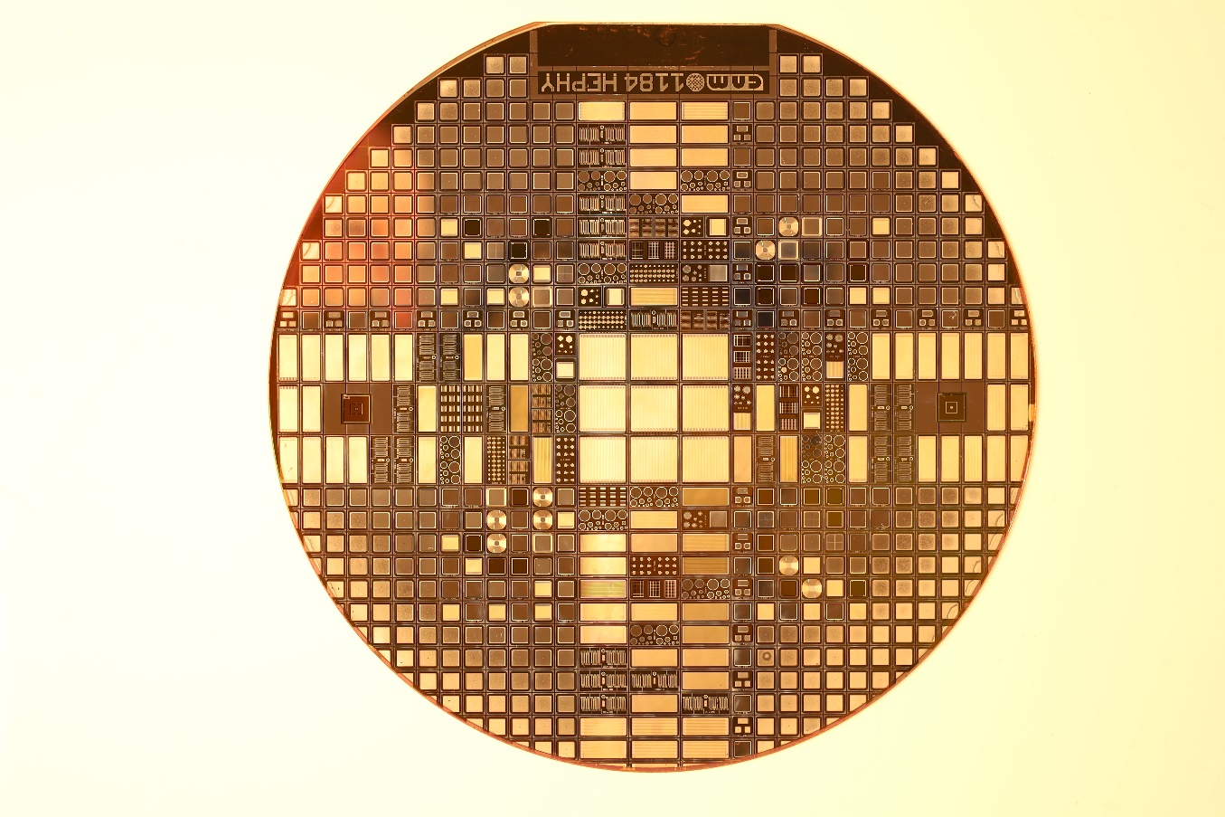
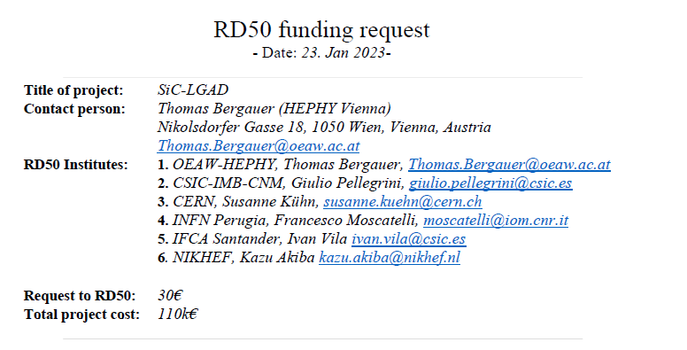
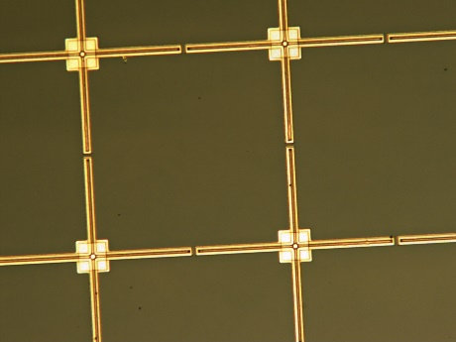
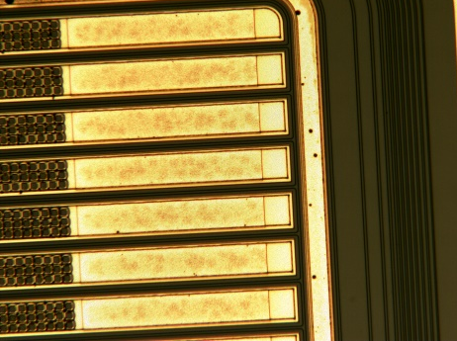
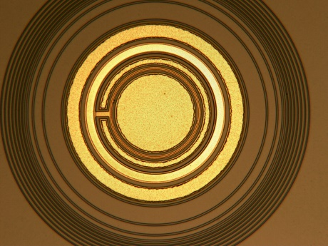
HEP
Fabrication run RD50 project
Second fabrication completed. Three wafers fabricated:
one with 50 µm thick epitaxial layer,
one with 100 µm thick epitaxial layer,
and one dummy wafer (high doped substrate).
Details on the design were presented by S. Weid, 2nd DRD3 workshop

Slide 10
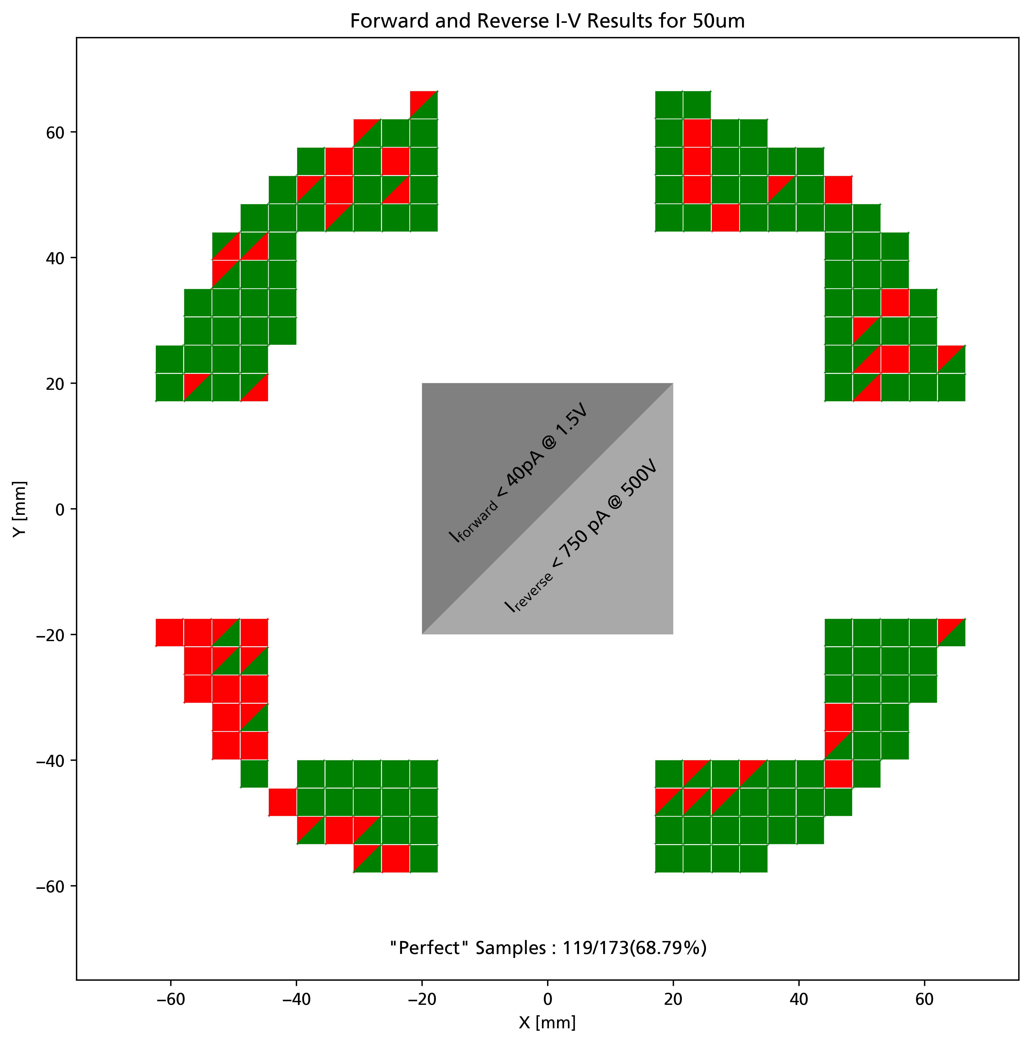
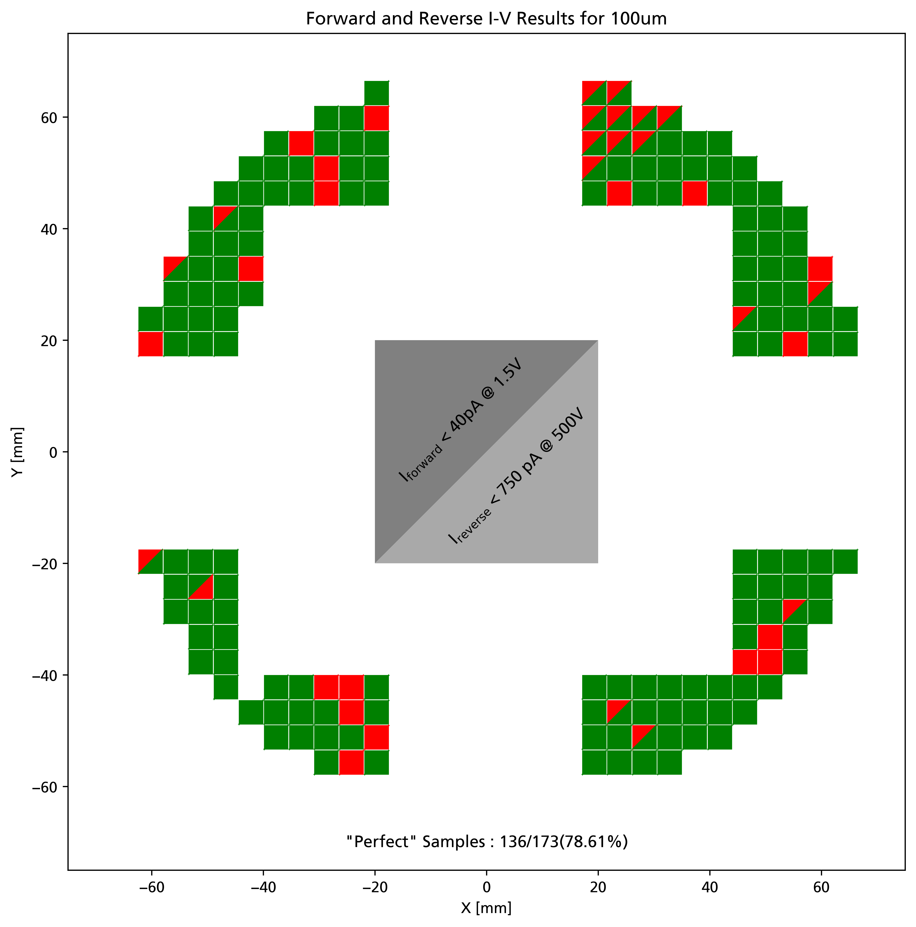
Mapping and yield
Full depletion voltages:
50um ≈ 300V
100um ≈ 2200V
Yield 68.8%
Yield 78.6%

Slide 11
Charge collection vs Fluence (1)
RD50 collaboration in 2003 already demonstrated the lost of charge collection in SiC and GaN detectors exposed to high neutron fluences.
They also attempted to use triode (transistor-based) detector structures to achieve gain, but without success (M. Bruzzi on behalf of the RD50 Collaboration – IEEE NSS MIC 2003, October 19-24, 2003).
New high-quality SiC material !
J.M. Rafí et al., 10.1109/TNS.2020.3029730

Slide 12
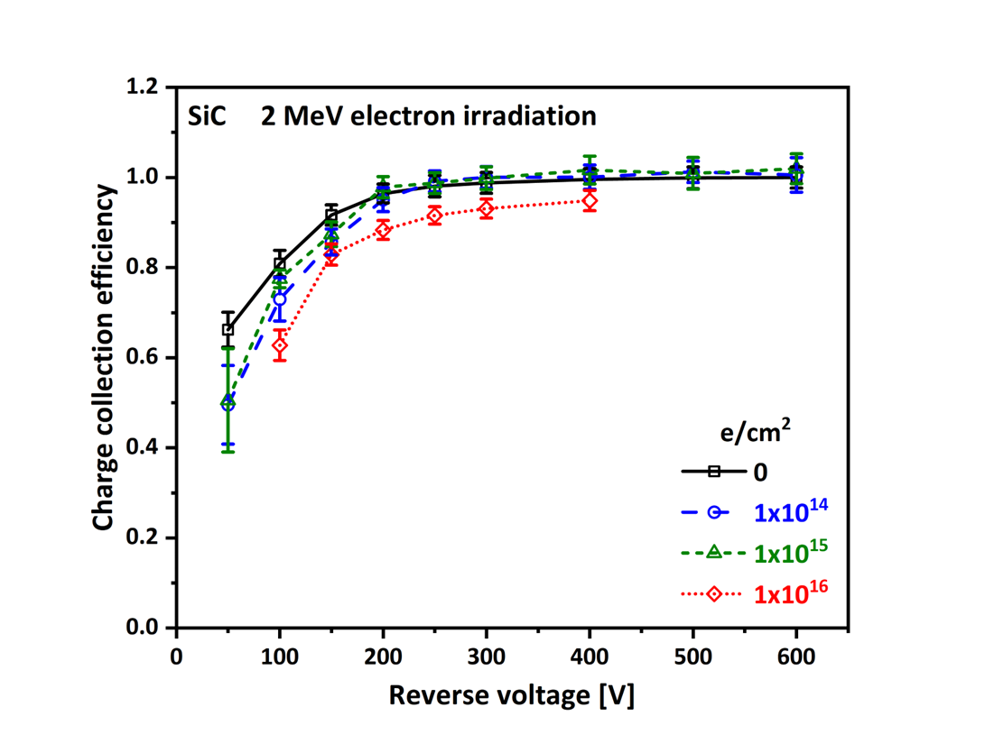
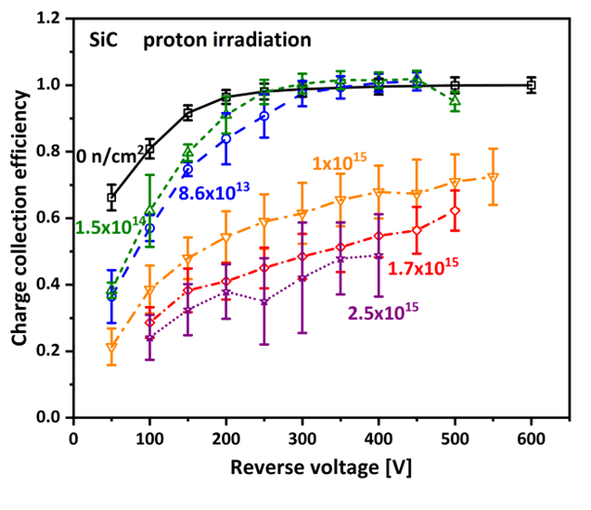
Charge collection vs Fluence (1)
RD50 collaboration in 2003 already demonstrated the lost of charge collection in SiC and GaN detectors exposed to high neutron fluences.
They also attempted to use triode (transistor-based) detector structures to achieve gain, but without success (M. Bruzzi on behalf of the RD50 Collaboration – IEEE NSS MIC 2003, October 19-24, 2003).
New high-quality SiC material !
Same results!
J.M. Rafí et al., 10.1109/TNS.2020.3029730

Slide 13
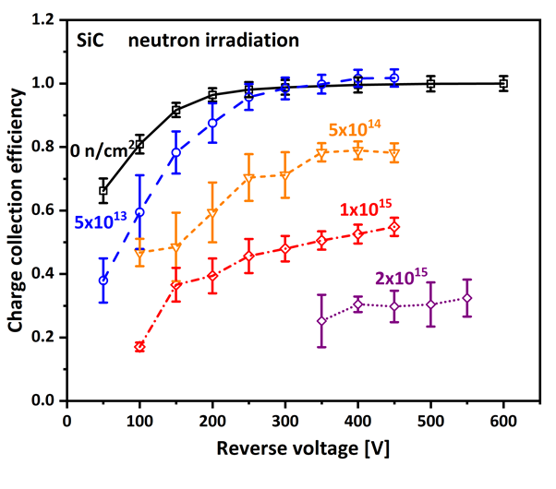
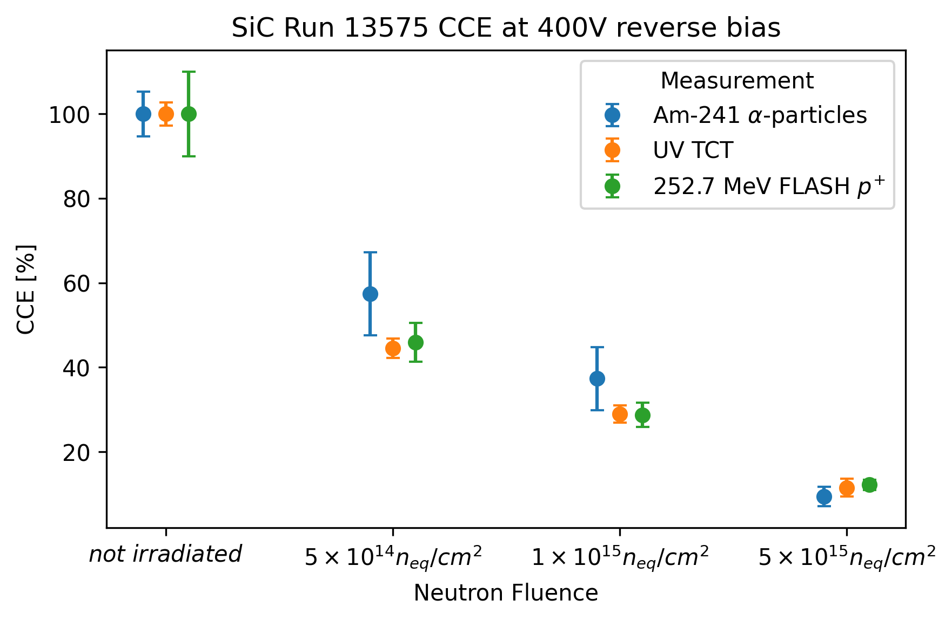
Charge collection vs Fluence (2)
2x10¹⁵ n_{eq} cm⁻²
Silicon
G. Casse, et al., Update on Thin Silicon Detectors Results. 21st RD50.
T. Bergauer, RD50 workshop
Note: all SiC measurements at room temperature!
Much higher bias may be needed to recover the charge! Problems with the electronics.
J.M. Rafí et al., 10.1109/TNS.2020.3029730

Slide 14
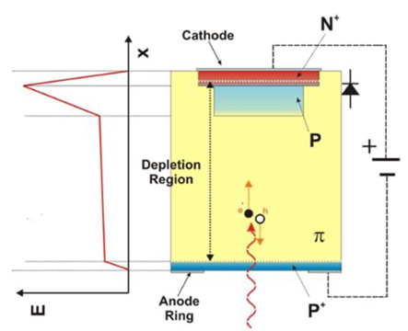
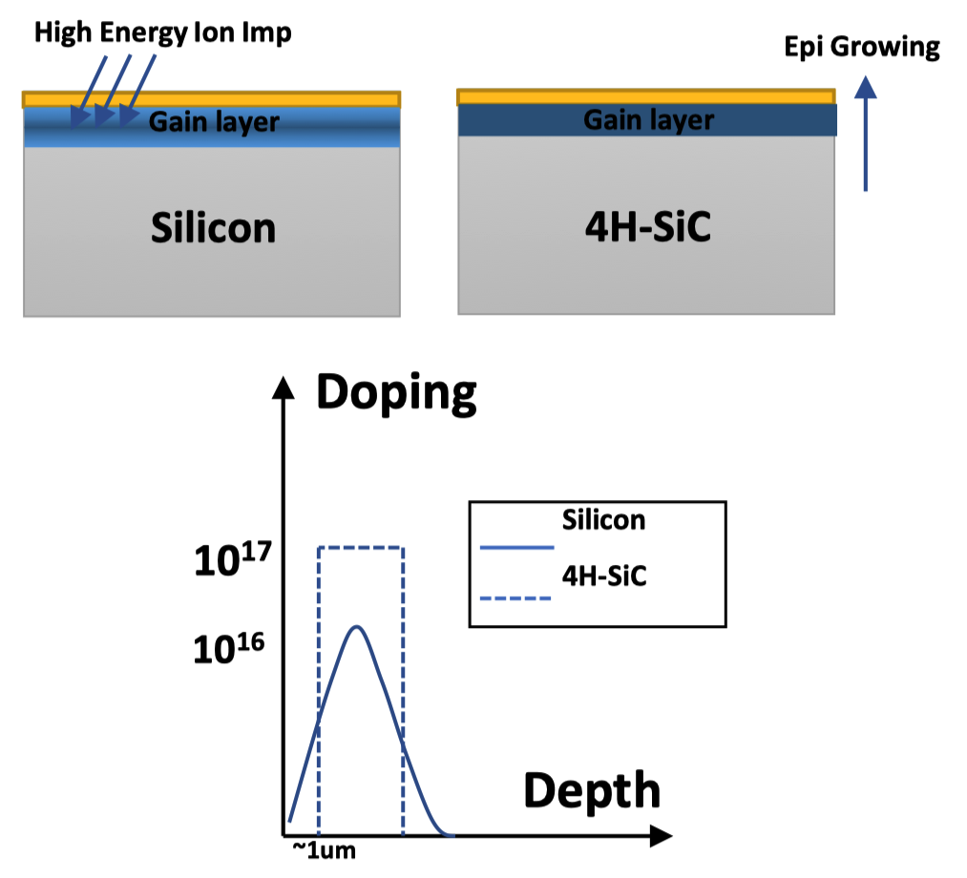
How can we turn SiC into a better detectors?
Silicon
SiC LGAD -> like silicon it is possible to implement a multiplication layer to mitigate the small signal before and after irradiation.
Impact ionization in multiplication layer produces gain → larger signals.
Challenges:
Creation of deep gain layer very difficult to achieve by “normal” ion implantation (as usually done for Si-LGAD).
Gain layer could be implemented during epitaxial growth
involvement of wafer supplier necessary in formation of gain layer
We know that wafer supplier can grow sandwich of N-/P layers.
Alternative: high-energy implantation (tens of MeV).
G. Pellegrini et al.,
10.1016/j.nima.2014.06.008
Yang Tao, 39th RD50 workshop

Slide 15
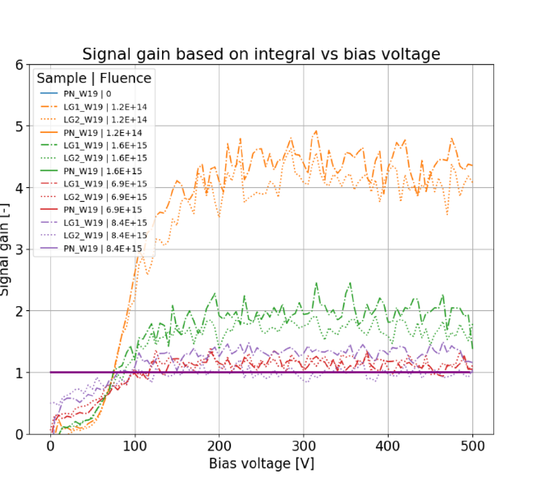
However: Gain is lost after irradiation!
Jiri Kroll et al., Radiation effects in 4H-SiC PN and LGAD, 3rd DRD3 workshop.
Gain calculated as a ratio of TCT signal amplitudes/integrals between LGAD1 (LGAD2) and no-gain PN diode irradiated to the same total fluence.

Slide 16
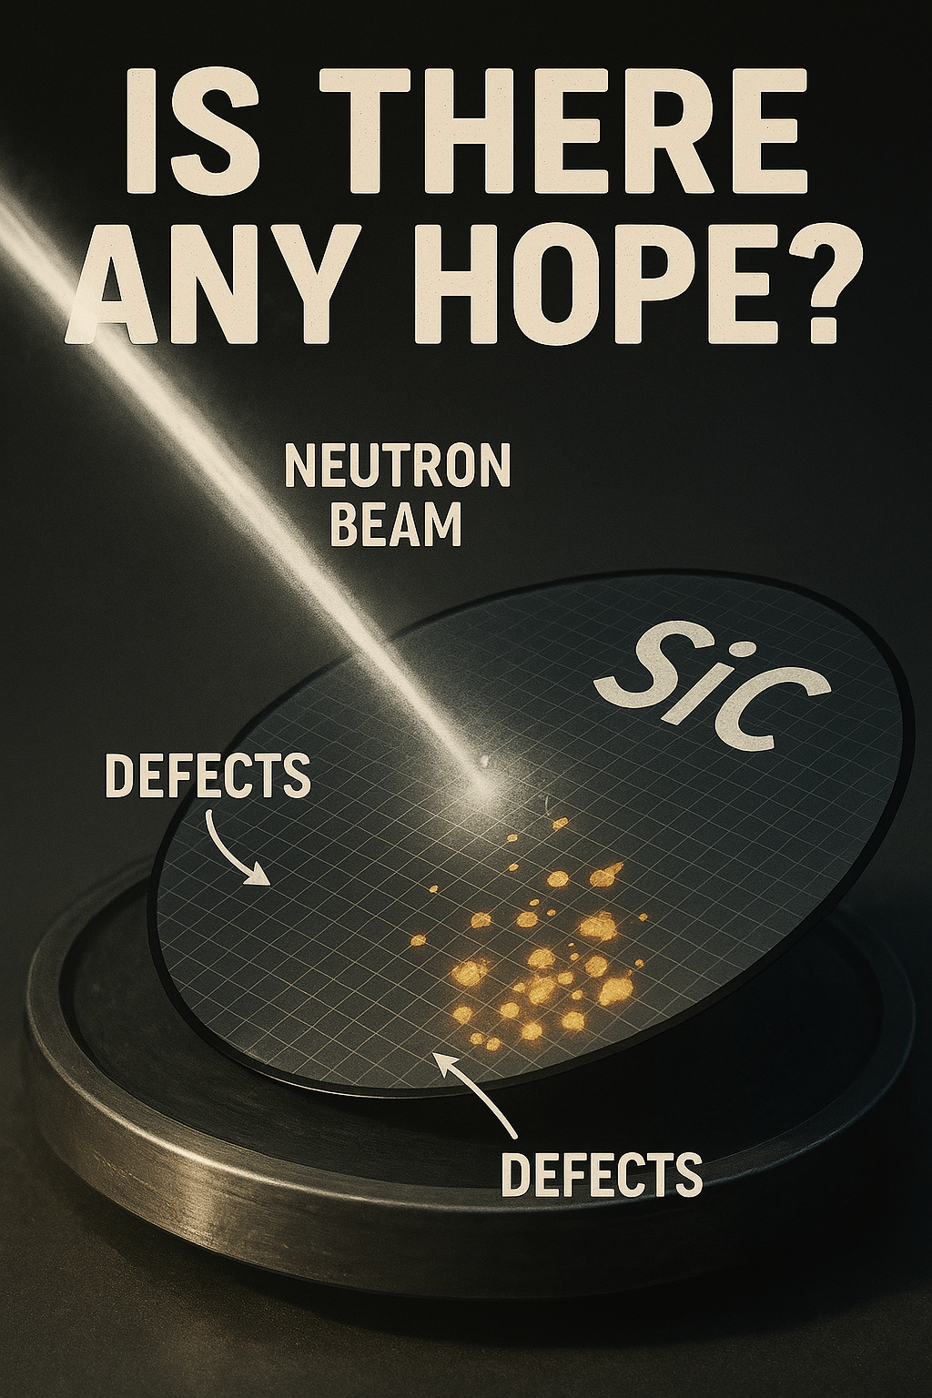

Slide 17
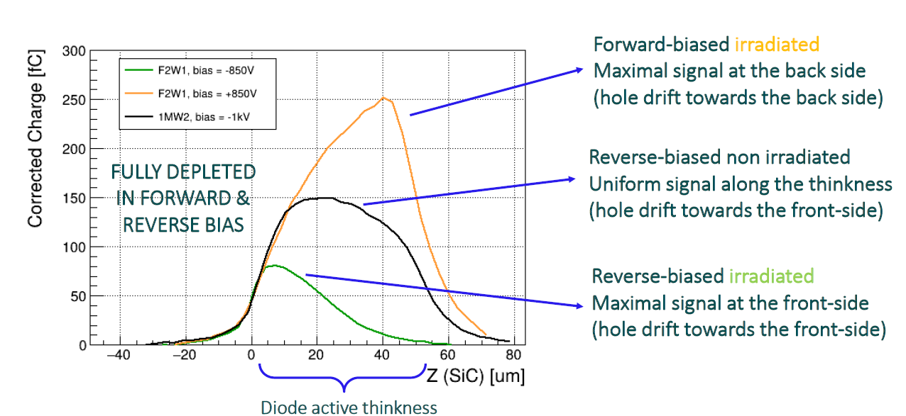
Signal multiplication in irradiated SiC p-n diodes
TPA-TCT z-scan of irradiated sample
Indication of hole multiplication due to a high electric field deep into the active thickness
Φ=10¹⁵ n_{eq} /cm² at ATI in Vienna
P++
N++
I.Vila, 2nd DRD3 workshop, CERN, December 5th, 2024.

Slide 18
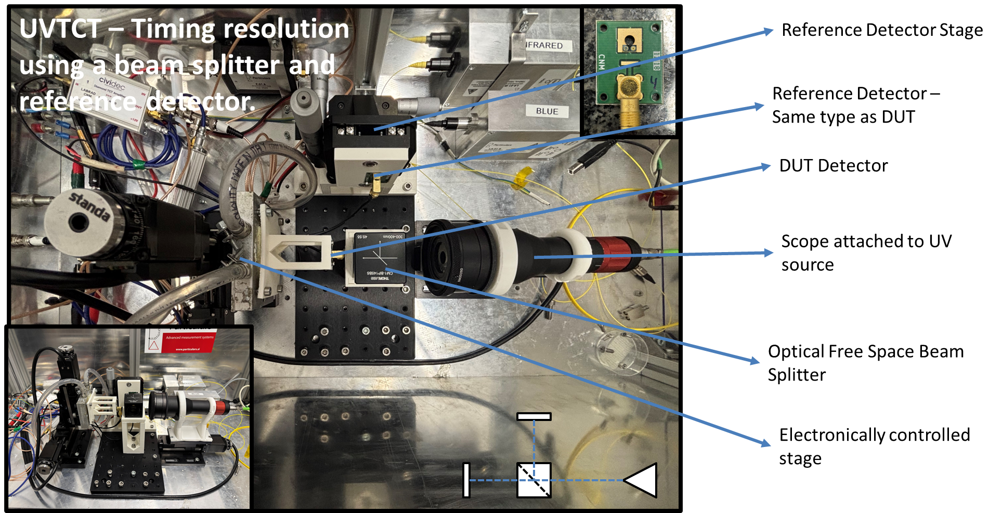
Timing resolution
-TCT measurements with UV laser, Signal equiv. to 5.5MeV alpha in SiC show time resolution of 10ps.
Comparison made between 50um thick 1mm DUT detector and Reference detector.
G. Pellegrini et al, 3rd DRD3 workshop
-MIP measurements shows time resolution of 94ps with 5x5mm² diodes at 500V.
-T. Yang et al., 10.3389/fphy.2022.718071

Slide 19
Conclusion HEP
Si retain much more charge after irradiation but requires cooling even at very low fluences.
Gain is lost after irradiation; defect engineering may help to mitigate the negative effect (DRD3 WG3).
IBIC and TPA TCT show high signal when operated in forward bias -> holes multiplication (DRD3 WG5).
Can we engineer (smarter design) this effect to harness it for practical applications?
Time resolution is better for SiC than Si (without gain) but more measurements are necessary after irradiation and gain is very likely to be necessary for 4D tracking.

Slide 20
Nuclear Physics

Slide 21
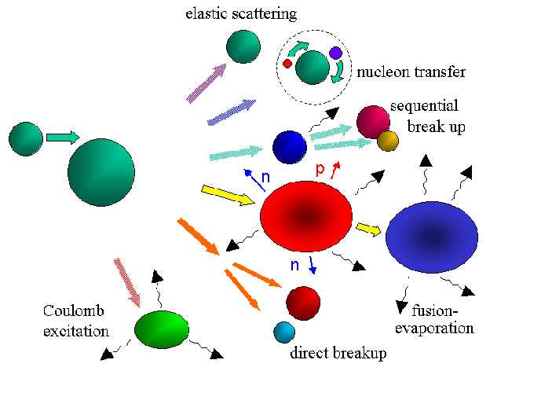
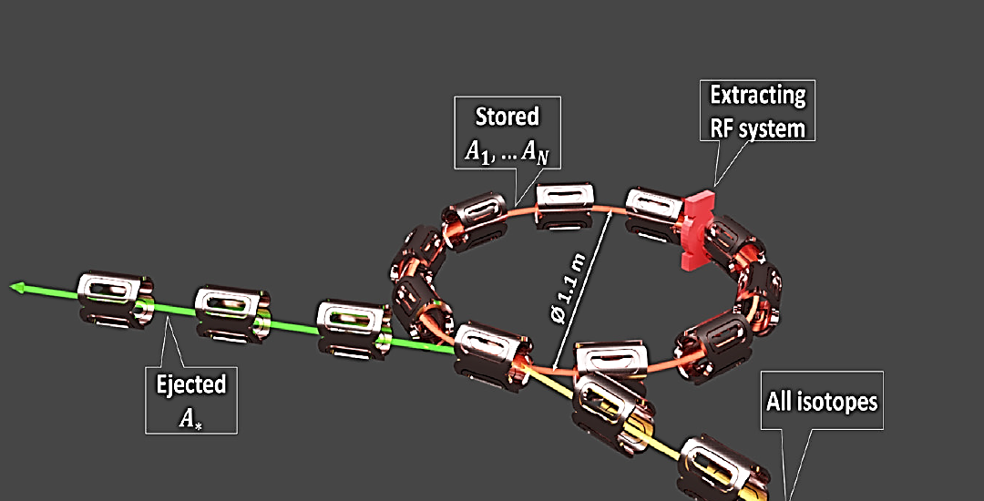
Nuclear physics: ISRS (ISOLDE Superconducting Recoil Separator)
ISRS consists of a superconducting storage ring that enables mass identification of nuclei via time-of-flight measurements. The decays of exotic nuclei can be observed by detecting particles or photons using high-resolution detection systems.
System requirements:
The SiC detectors are a promising tool not just for a focal plane, but also as beam monitor and/or tagging system (till 1x10⁻⁷ pps).
ΔE = 30 keV Δt < 1 ns
No cooling

Slide 22
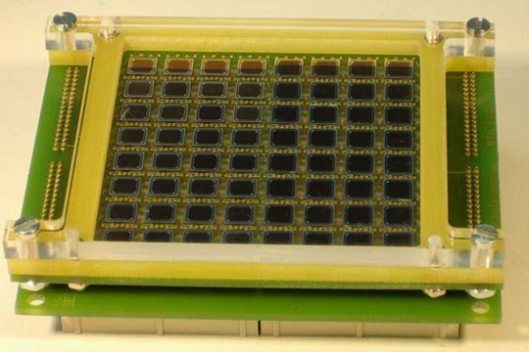
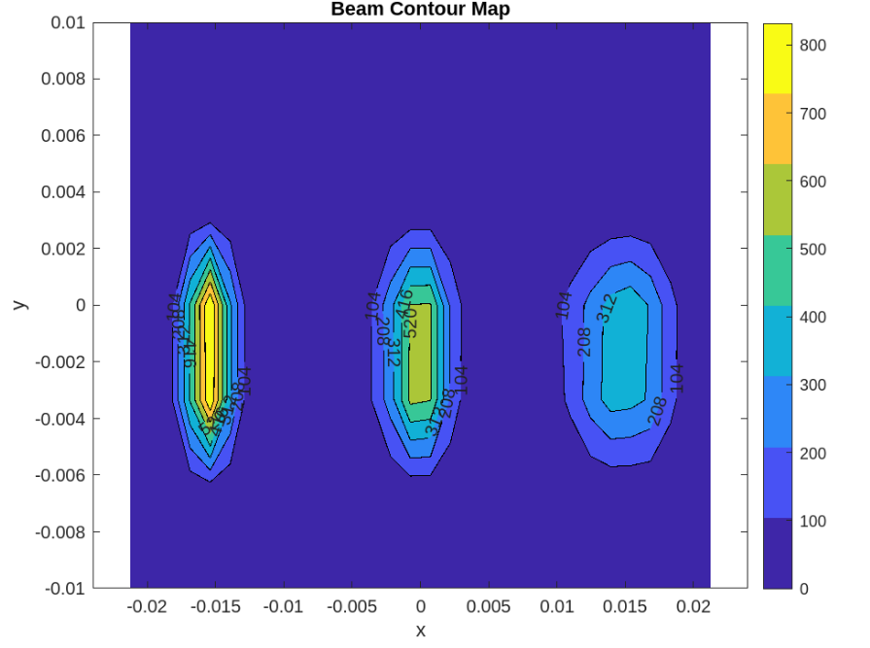
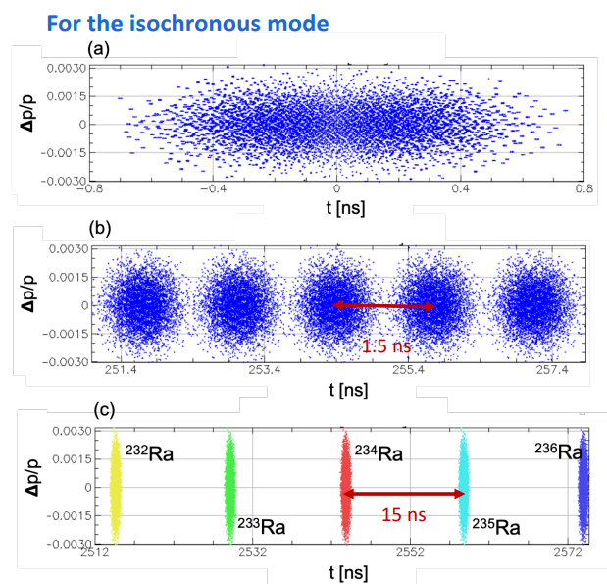
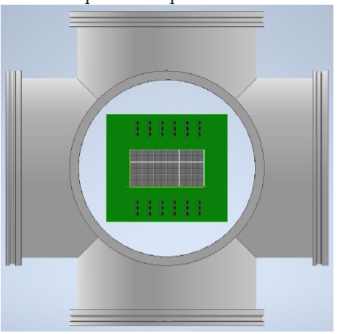
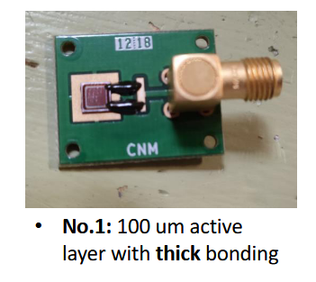
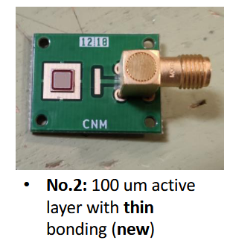
Collaboration with the IEM-CSIC, Madrid
Silicon prototype
ISRS Focal plane detectors:
Linear spectrometer mode
SiC detection technology
SiC prototypes developed by
CNM-IMB Barcelona

Slide 23
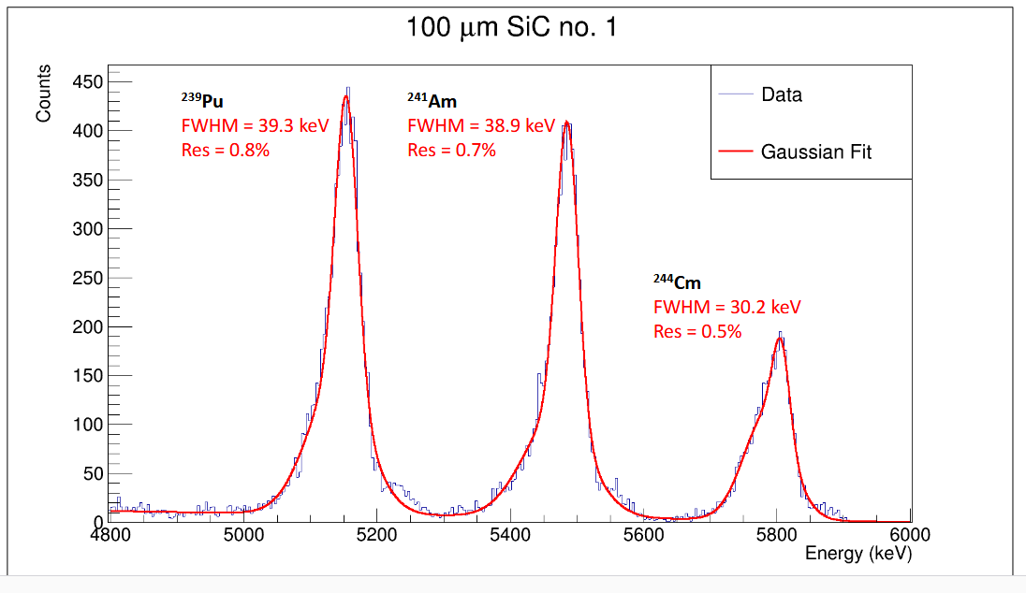
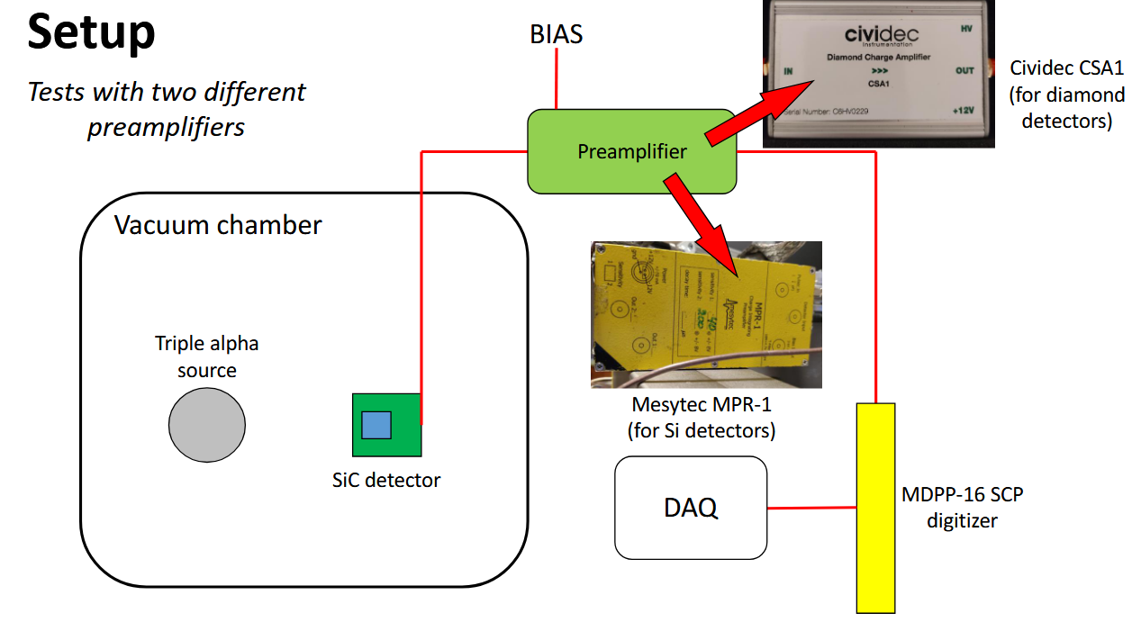
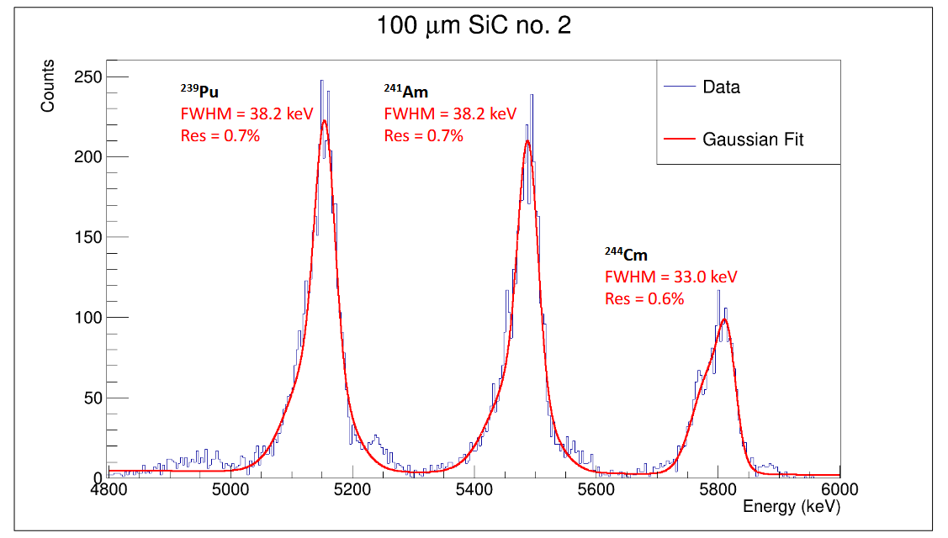
Preliminary results
Good energy and time resolutions:
30 keV at 5.8 MeV
Expected time resolution: tens of ps.
Irradiation campaign ongoing (lower fluences than HL-LHC).

Slide 24
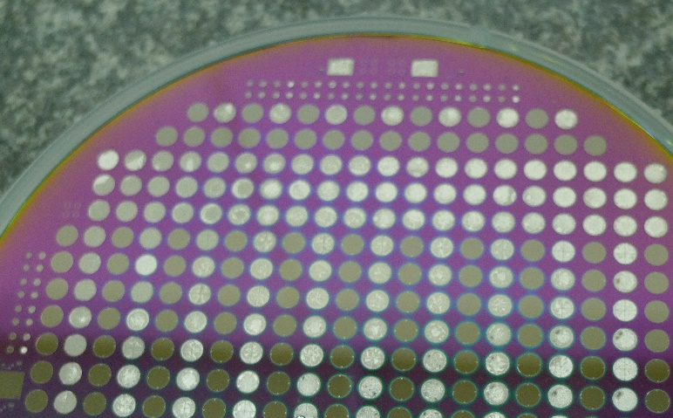
Conclusion for Nuclear experiments
SiC offers lower leakage current and better timing resolution compared to Si.
Signal amplitude is not an issue, as ions produce a large signal.
Cooling is not required.
A new batch of detectors is nearly ready for testing with ion beams.
One wafer will be thinned to 100um.

Slide 25
Radiotherapy

Slide 26
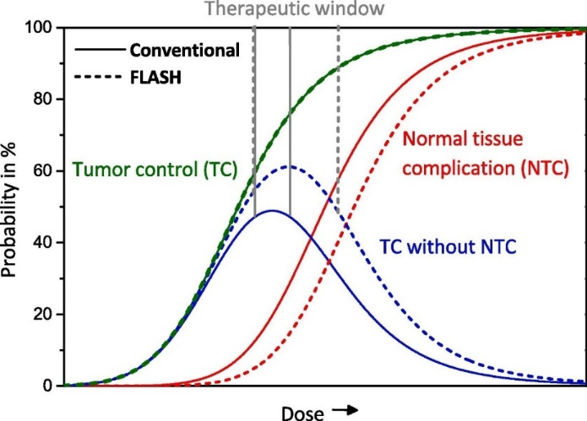
Flash radiotherapy
FLASH effect (Favaudon et al., Sci Transl Med 6 (2014)):
Irradiations with Ultra-High Dose Rate (UHDR) pulsed radiation reduce adverse effects in healthy tissues
Therapy doses typically range from 45 to 60 Gy divided into several fractions
With FLASH it is possible to treat radioresistant tumours with higher dose.
FLASH dose rate ≥ 40 Gy/s (conventional radiotherapy ≈ 0.05 Gy/s)
Vozenin et al., Clin Cancer Res 25 (2019)
Schüller et al., Physica Medica 80 (2020)

Slide 27
FLASH conditions
Motivation: FLASH radiotherapy
w | pulse width | [0.5 – 2.2] µs
f | pulse repetition frequency | [10 – 200] Hz
D*_{p} | dose-rate in pulse | [10³ – 5 · 10⁶] Gy/s
D_{p} = D*_{p} · w | dose per pulse | [10⁻³ – 5] Gy
D *_{m} = D*_{p} · w · f | mean dose-rate | [10⁻² – 1000] Gy/s
1 Gy in water of 160 MeV protons ≈ 1E9 p/cm2
Saturation of conventional active dosimeters (gas and silicon)
Need real-time, precise, radiation hard dosimeters
per pulse of ~1µs
(dose = fluence × mass stopping power)
Notes:
1 Gy in water

Slide 28
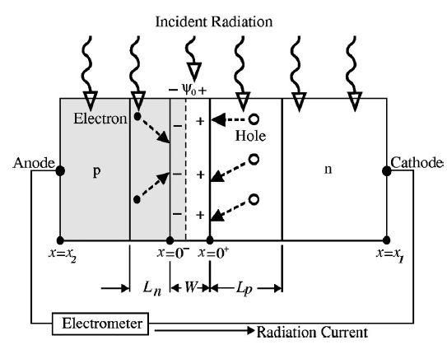
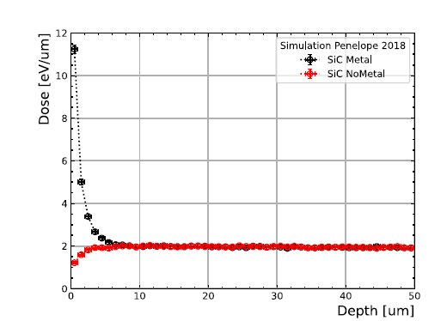

Semiconductor diode dosimeters
p–n (or Schottky) junction in:
Current mode operation
Unbiased conditions
The radiation-induced current is measured by an electrometer
The current is proportional to the dose rate and its integration provides the absorbed dose in the semiconductor
Shi et al., Med Phys 30 (2003)
I. Lopez, Nature Scientific Reports |, First use of silicon carbide detectors with graphene‑enhanced contacts for medical dosimetry

Slide 29
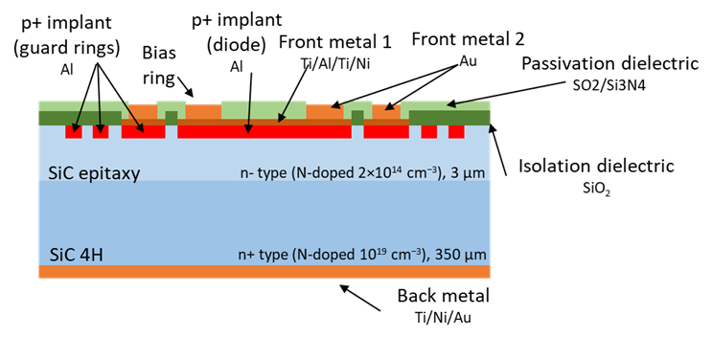
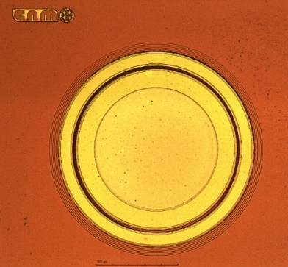


SiC diodes for FLASH dosimetry
P-N junction implanted diodes
4H-SiC, 100 mm wafers
3 µm high resistivity n-type doped epilayer
1 and 2 mm diameter with multi guard ring structures
Technology based on our SiC power diodes
Adapted for radiation detection with high temperature processes and optimized metal contacts
Patented technology

Slide 30



Electrical tests
Large single diodes
Reverse I-V
Forward I-V

Slide 31


Dosimetry of FLASH electrons (2)
Dosimetry of FLASH: electrons
Detector linearity
Response independent both of Dose Per Pulse (DPP) and of instantaneous dose rate
SiC diode
1 mm diameter
Encapsulation by PTW
Without external bias
SiC
PTW’s microSilicon
SiC diode in water phantom at PTB
20 MeV FLASH electrons at PTB reference beam (Germany)
C. Fleta et al., Phys Med Biol 69 (2024) 095013
Notes:
Response independent both of DPP and of instantaneous dose rate

Slide 32

Dosimetry of FLASH electrons (3)
Long-term radiation hardness
Temperature depencence of sensitivity
(initial irradiation of SiC diode (10s kGy) not shown)
Linear decrease of sensitivity of 0.018% / kGy of 20 MeV electrons
Sensitivity reduction of –0.08% /°C
Better than most commercial Si diodes + opposite trend.
→ Not as radiation hard as diamond, much better than commercial silicon diodes
Notes:
Advantage -> does nto require calibration

Slide 33



Radiation hardness with FLASH protons (1)
Dosimetry of FLASH: Protons
1 and 2 MeV protons at CNA (Sevilla)
FLASH beam structure: 1-10 ms pulses, 500 Hz – 10 kHz, up to 5.6 Gy per pulse (4.6 MGy/s)
30 µm diameter planar microdiodes
To Electrometer
SiC dosimeter
To Brookhaven current
integrator
UNPUBLISHED DATA – DO NOT COPY OR DISTRIBUTE
Vacuum chamber
Sample holder
Pulsed beam current measured to calculate dose
M.C. Jiménez-Ramos et al., submitted to IEEE Trans Radiat Plasma Med Sci

Slide 34

Radiation hardness with FLASH protons
Radiation hardness with FLASH protons (3)
Commercial silicon dosimeter:
-5 %/kGy with 62MeV protons
NIEL/LET (62 MeV/2MeV) ≈ 1.3
Diode #2
Diode #1
-1.34 %/kGy
UNPUBLISHED DATA – DO NOT COPY OR DISTRIBUTE
-0.04 %/kGy
L. Raffaele et al., NIMA 891 (2018)
NIEL/LET (62 MeV/2MeV) = 1.3
62 MeV protons cause 1.3 times more damage than 2 MeV for the same dose
Notes:
NIEL/LET (62 MeV/2MeV) = 1.3
62 MeV protons cause 1.3 times more damage than 2 MeV for the same dose

Slide 35

Radiation hardness with FLASH protons (4)
Diode #2
Diode #1
UNPUBLISHED DATA – DO NOT COPY OR DISTRIBUTE
UNPUBLISHED DATA – DO NOT COPY OR DISTRIBUTE
Linear behaviour for FLASH dose rates is maintained after irradiation

Slide 36






DOSImetry monitor for FLASH therapy
SiC microdetector array development and electronics -> ≈400 channels with an area of 20 x20 cm².
For treatment verification before patient irradiation
Like IBA MatriXX ionization chamber
Arrays of diodes: 0.6 x 0.6mm².
3um epitaxy Thickness.
C. Guardiola & C. Fleta (IMB-CNM-CSIC)

Slide 37




Different technologies
Arrays of Microdiodes
10 to 30 µm diameter
For dosimetry and microdosimetry with 2D spatial resolution
Planar and 3D (“mesa”) configurations

Slide 38




Trenched and planar microdiodes
Breckdown down to 30-40V due to curvature

Slide 39



Wafer mapping (1mm diodes)
4.2 cm
13.2 cm
(In white: rejected diodes, with I@(-10V) > 10 pA. Total 65/1140 = 5.7%)
Breakdown at 300-350 V

Slide 40
Conclusion for FLASH dosimetry
Sensors can be operated without external bias
Signal linearity of SiC is one order of magnitude higher than commercial Si diodes.
Linear performance is maintained after MGy doses
Sensitivity reduction due to temperature is better than commercial Si diodes
Sensitivity degradation with dose slower than for commercial Si diodes -> less need for re-calibration

Slide 41
Plasma diagnostic
in Fusion reactors

Slide 42
Fusion: plasma diagnostic
Long pulse operations (LPO) open a new era of expertise, training (e.g. physics and engineer) & collaborations for radiation-hardened detectors.
See talk of Luis Felipe Delgado Aparicio at the DRD3 workshop June 3rd , 2025.
X-rays: dominant source of radiation (hn=hc/l~T_{e}):
100 eV<T_{e}<20 keV ⇒ 0.5 Å < l <130 Å ⇒ X-rays!
20 keV< E_{e}< 200 keV ⇒ SXR to HXR
D-T reaction produce suprathermal alpha particles (3.5 MeV). These alphas are essential for self-heating of the plasma.
Neutron emission is directly proportional to the fusion reaction rate of deuterium-tritium (D-T) reactions, which produce 14.1 MeV neutrons.

Slide 43




Need to develop radiation-hardened sensors and electronics for this harsh enviroment
ITER
DT
Main issues: circumvent gamma- and neutron-induced noise, T- and B-limitations, as well as define LIFETIMES!
1 MW of DT neutrons: ~4.4×10¹⁷ n/s
For d=15 m ⇒ F_{n} ~ 1.5×10¹⁰ n/cm²/s
Δt=5-10 s ⇒ ~ 10¹¹ n/cm²/shot
Si-detectors:
Used due to the availability of good quality homogeneous material and high charge carrier transport properties. Can only withstand 10¹²-10¹³ n_{eq}/cm².
Lifetimes shortened:
neutron damage
Survivability at high temperatures (200-300ºC)
Forced to look for new solutions compatible with CERN’s very-high-luminosity experiments (up to 10¹⁶-10¹⁷ n_{eq}/cm² ???).

Slide 44



Measurement at high temperature SiC diodes
M.C. Jiménez-Ramos et al., https://doi.org/10.1016/j.radphyschem.2023.111283

Slide 45

Irradiation at high temperature
C.Torres-Muñoz et al., 3rd DRD3 workshop, 2-6 June 2025, Amsterdam

Slide 46

CCE versus voltage and irradiation T
C.Torres-Muñoz et al., 3rd DRD3 workshop, 2-6 June 2025, Amsterdam

Slide 47
Conclusion Fusion
SiC detector can be operated at high temperature.
SiC detector response improves when irradiated at higher temperatures
Operating the device in high-temperature environments results in less spectrometric degradation compared to room temperature, effectively extending the device’s lifetime.
Urgent need of rad-hardened sensors for long pulse operations.
Need better neutron monitors for DD and DT (2.5 vs 14.1 MeV): flux and spectra

Slide 48
Is SiC more radiation hard than Si detectors?

Slide 50




Acknowledgement
Funding:
This project has received funding from the European Union’s Horizon Europe research and innovation programme under grant agreement No 101075672, FOR2ENSICS Project.
UHDPulse: the EMPIR programme cofinanced by the Participating States and from the European Union's Horizon 2020 research and innovation program (18HLT04).
This work has been funded by the Spanish Ministry of Science and Innovation (MCIN/AEI/10.13039/501100011033/) and by the European Union’s ERDF program “A way of making Europe”. Grant references: PID2021-124660OB-C22.
NEWDOSI: Desarrollos tecnológicos para nuevos detectores de estado solido para dosimetría avanzada (PID2021-123484OB-I00).
CARACTERIZACION: Caracterización de dosímetros avanzados fabricados en el IMB-CNM para aplicaciones médicas (202250I185).
Microdetectors for medical applications. Proyectos Intramurales Especiales CSIC (20225AT008).
Dosimetry monitor for FLASH therapy. LaCaixa foundation (HR23-00718)

Slide 51

Microprobe beam line at CNA

Slide 52




Fast neutron detection with SiC
Protons deposit energy over the detection threshold of 0.7 MeV.
Experimental setup CNA
SiC detectors
Measurements with cuasi-monoenergetic
fast neutrons (HiSPANoS CNA)
Measurements with AmBe source SiC+Polyethylene (Bariloche Atomic Center -Argentina)
The total deposited energy (red curves) is the sum of the energy produced by the recoil nuclei of 28Si and 12C and also of the protons generated after the interaction of fast neutrons and the plastic holder that surrounds the Detector.
Pérez, Martín, et al. "Characterization of new silicon carbide neutron detectors with thermal and fast neutrons." Nuclear Instruments and Methods in Physics Research Section A: Accelerators, Spectrometers, Detectors and Associated Equipment 1069 (2024): 169968.

Slide 53




SiC vs Si test at IEM-CSIC:
Mesytec MPR-1, Cividec (for diamond module) along to DAQ-Mesytec and Maestro Multichannel
Comparison between ORTEC chain + Maestro data taking Mesytec digitizer for SiC and Si detector. Both cases use the MPR-1 readout
MPR-1 + ORTEC 671 Amp on Maestro

Slide 54


Slide 55
Therapy doses typically range from 45 to 60 Gy. Typically, these doses are divided into multiple smaller doses that are given over a period of one to two months. The total radiation dose is usually divided into several fractions. For most patients who require radiation therapy, the total dose is broken up into daily doses of five times a week for a total period of five to eight weeks

Slide 56

Cross-section of the proposed N-LGAD structure in SiC. It is designed to optimize
the multiplication of hole charges

