Slide 1
System Simulation
Marie Faure
27th June 2025
SY-BI-PM

Slide 2
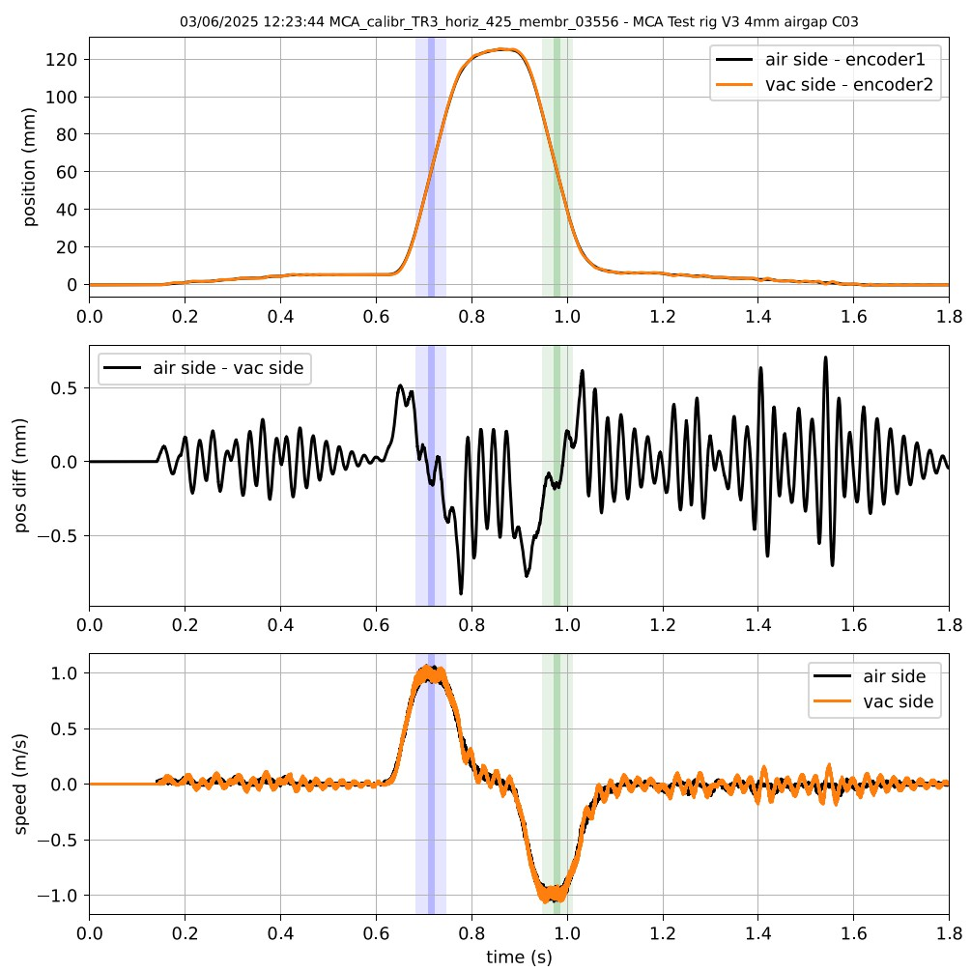
Problematic
Vibrations on the vacuum side:
Causes:
  1st part: stepped forces due to hardware constraints
  Before the beam: sudden force change at the beginning of the “real” trajectory, the inertia of the leader magnet produces a relevant gap between the 2 magnet assemblies, forcing the vacuum side magnet to catch up
  Lower vibrations while crossing the beam, still to be avoided here (constant speed, decreasing acceleration)
→ How to limit these vibrations? (especially crossing the beam?)
Notes:
Transition: Let's break down how a linear Beam Wire Scanner works

Slide 3
Avoiding vibrations
Predict the vibrations depending on the position of the air-side magnet assembly
Compensate these vibrations with the force and motion of the air-side magnet
Understand the force between the 2 magnets to determine the equations of motion
Previous work => determined that system is 2nd order
Let’s go into the determination of the position of the air vacuum based on the generated trajectory tables
Notes:
Transition: Let's break down how a linear Beam Wire Scanner works

Slide 4
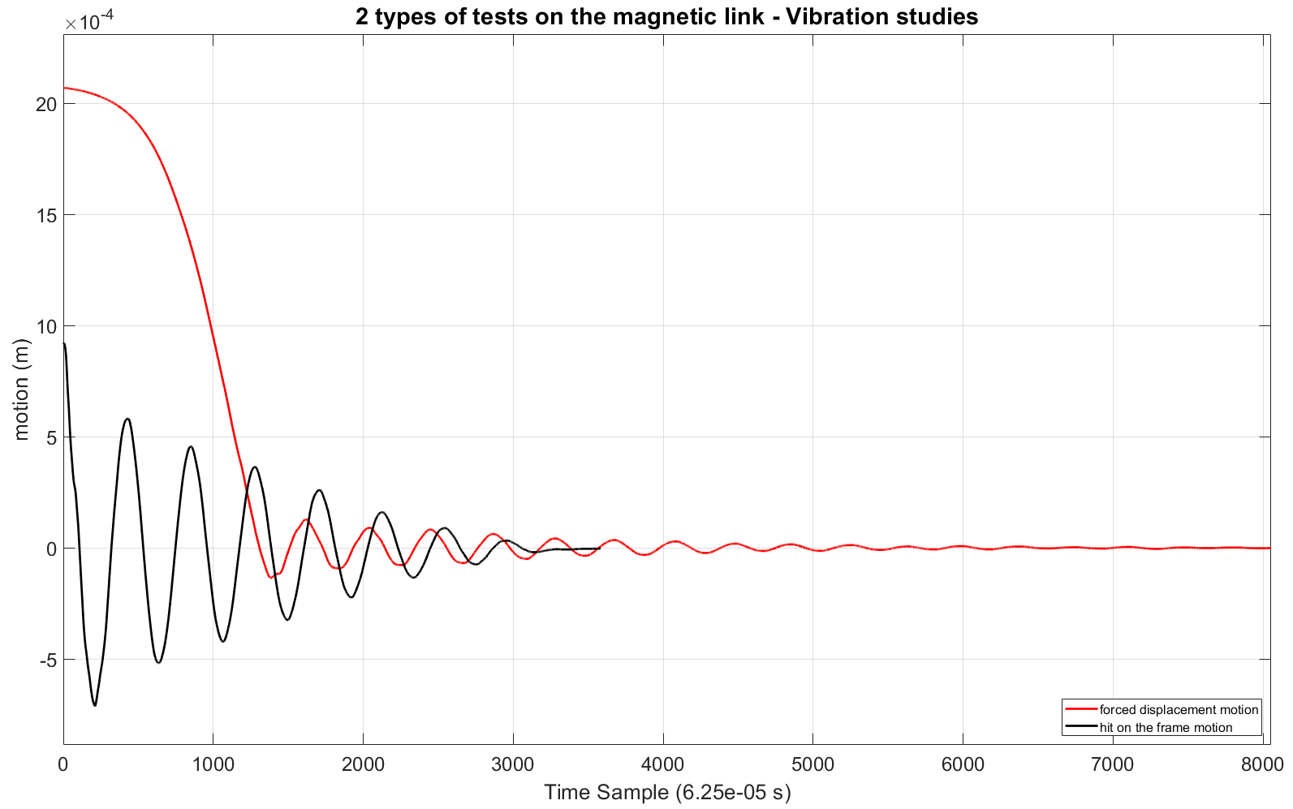










2 magnets assemblies
Get the pure vibration of the system: hit the frame, forced gap then release
Tests :
$$y$$
$$magnet assembly 1$$
$$X_{1}(t)$$
$$r$$
$$d$$
$$x_{2}$$
$$x$$
$$x_{1}$$
$$X_{2}(t)$$
$$magnet assembly 2$$
Notes:
Transition: Let's break down how a linear Beam Wire Scanner works

Slide 5
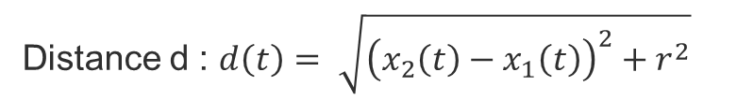

2 magnets assemblies
Forces :
Distance d : $d\left(t\right)= \sqrt{{\left(x_{2}\left(t\right)−x_{1}\left(t\right)\right)}^{2}+r^{2}}$
$$y$$
Magnetic force : $F_{mag}=−\left(k∗\frac{x_{2}−x_{1}}{\sqrt{{\left(x_{2}−x_{1}\right)}^{2}+r^{2}}}\right)=−\frac{k\left(x_{2}−x_{1}\right)}{d\left(t\right)}$
$$magnet assembly 1$$
$$X_{1}(t)$$
Damping function : $f=c∗(\dot{x_{2}}−\dot{x_{1}})$
$$r$$
$$d$$
Equation of motion vacuum side: $m_{2}∗\ddot{x_{2}}=F_{mag} −f$
$$x_{2}$$
$$x$$
$$x_{1}$$
$$X_{2}(t)$$
$$magnet assembly 2$$
Notes:
Transition: Let's break down how a linear Beam Wire Scanner works

Slide 6
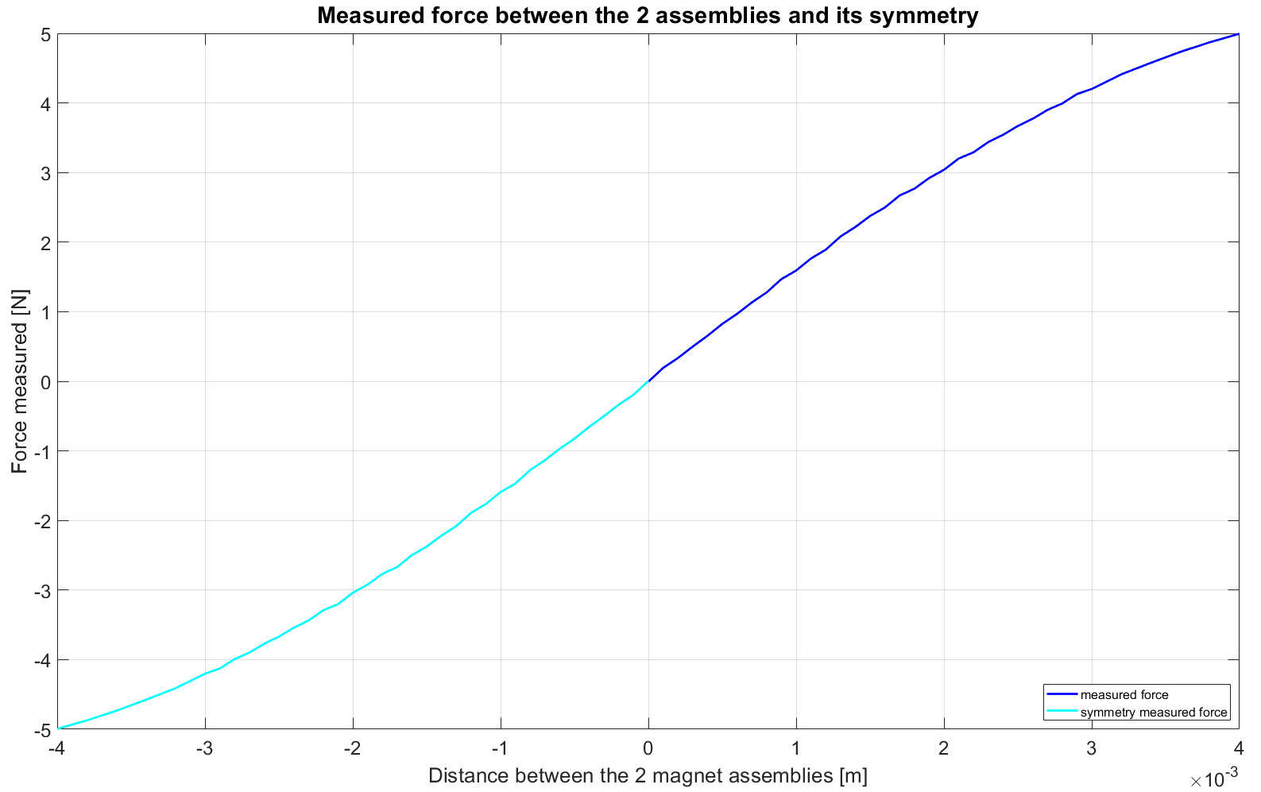
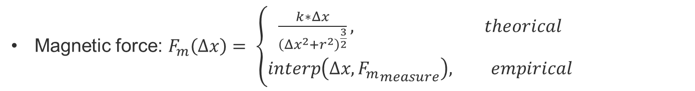
Finding Forces coefficients
Empirical and theoretical magnetic force
$c, k$ estimator :
Magnetic force: $F_{m}\left(Δx\right)= \left\{\begin{aligned}\frac{k∗Δx}{{\left(Δx^{2}+r^{2}\right)}^{\frac{3}{2}}}, theorical \\ interp\left(Δx, {F_{m}}_{measure}\right), empirical\end{aligned}\right.$
Notes:
Transition: Let's break down how a linear Beam Wire Scanner works

Slide 7
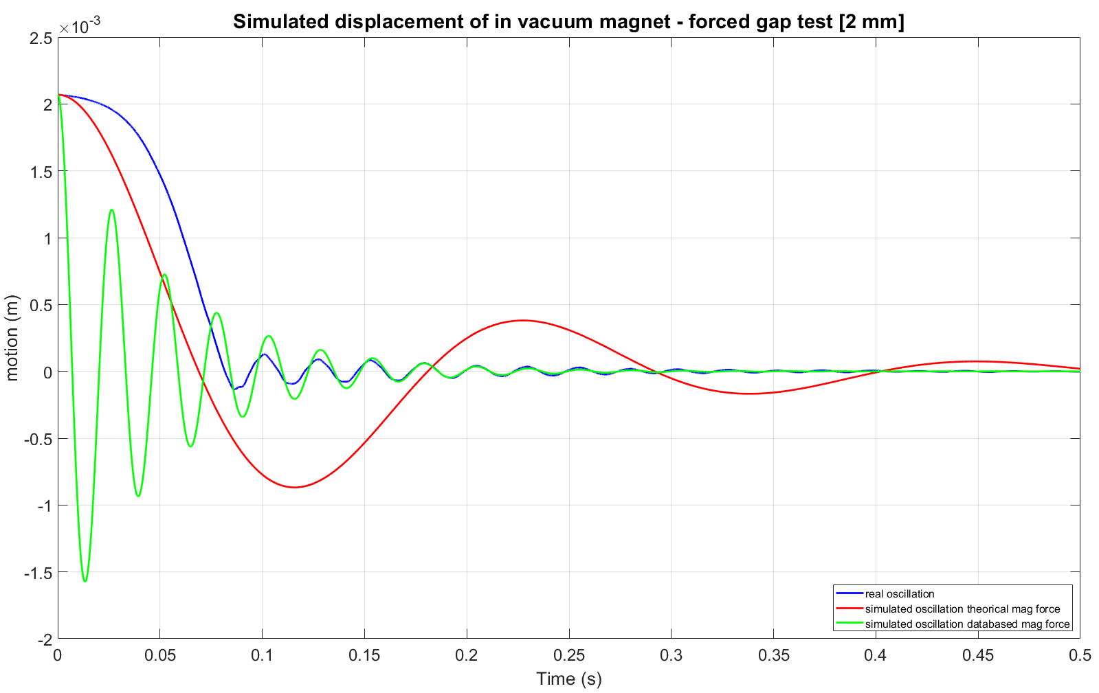
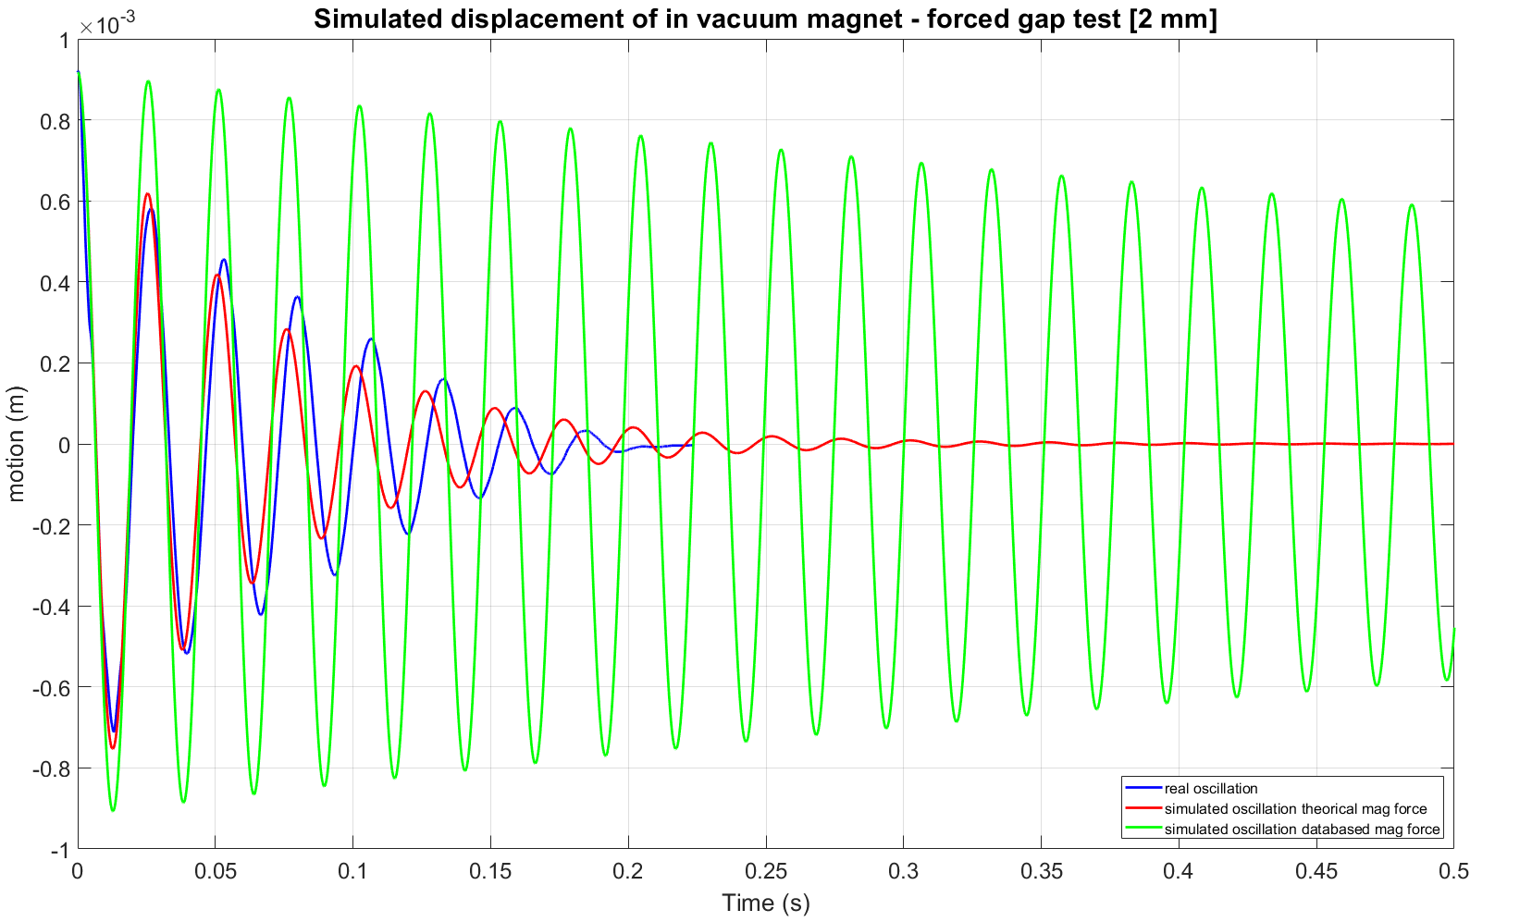
Finding Forces coefficients
Empirical and theoretical magnetic force
$c, k$ estimator :
Calculation of the residuals of the motion equation, and with lsqnonlin on MATLAB, estimate $c$and $k,$minimizing the error
Parametrization: mass, distance between the magnet (y-axis)
Notes:
Transition: Let's break down how a linear Beam Wire Scanner works

Slide 8
Next steps
Try on lifetime tests
Modify the generated trajectories adequately
  Avoid exciting frequencies
  Compensating them if not avoidable
Notes:
Transition: Let's break down how a linear Beam Wire Scanner works

Slide 9
Thank you for your attention!
Any questions?

