Slide 1
HEARTS Leaders Meeting #7
27 August 2025
https://indico.cern.ch/event/1563715/
S. Gerardin - UniPD

Slide 2

Tasks & Objectives
Project goal is to provide >100 MeV/n heavy ion beams to space users, to mimic the effects of Galactic Cosmic Rays (GCR) at ground level
penetration levels large enough to enable electronics testing in air, without the need of special preparation and at board and box level
essential for the exploitation of high-end microelectronics technology in space, for e.g. onboard Artificial Intelligence or Big Data processing applications
Purpose of WP5: study of radiation effects induced by VHE heavy ions on a set of technologies representative of current state-of-the-art COTS electronics
Comparison with standard-energy heavy ions.
A hierarchical approach, based on three levels of complexity, will highlight different levels of details
2
2

Slide 3
WP5 Tasks
5.1 Final review of VHE ion beam requirements for SEE testing COMPLETED 
5.2 Analysis of ionization response in a PIN diode for beam quality assessments COMPLETED
From 1st year
5.3 Suitability of the proposed VHE ion beams for 3D integrated device structures IN PROGRESS
5.4 Validation of the VHE ion beams for industrial use with TRL 6-7 achievement IN PROGRESS
From 2nd year
5.5 Qualification of high-complexity devices IN PROGRESS
5.6 Board-level testing IN PROGRESS
From 3rd year
2
3

Slide 4
WP5 Timeline
Extension due to beam time availability at GSI
2
4

Slide 5
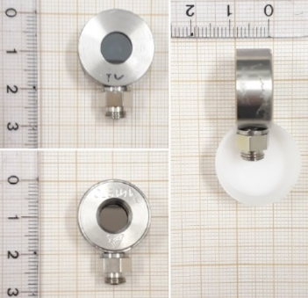
Task 5.2 - Analysis of Ionization Response in a PIN diode for Beam Quality Assessments: Description of Work
Partners: UNIPD, M1-24
PiN diode: simple and effective structure to study heavy ion beams. It provides precise measurements of energy deposition in semiconductor materials. Diagnostic tool to assess the quality of the provided beam in terms of purity and energy straggling (e.g. with degraders)
D5.2 (M24) Beam Quality
D5.5 (M48) Impact of beam energy in SEE testing
2
5

Slide 6
Task 5.2 - Analysis of Ionization Response in a PIN diode for Beam Quality Assessments: Status and Plans
UniPD experimental setup
Measurements at HEARTS@CERN and GSI Cave A completed in June 2025.
D5.2 (M24) Beam Quality
D5.5 (M48) Impact of beam energy in SEE testing
2
6

Slide 7
Task 5.2 – Experimental Results
Measured deposited energy vs LET stated by facility
HEARTS@CERN
GSI Cave A
D5.2 (M24) Beam Quality
D5.5 (M48) Impact of beam energy in SEE testing
2
7

Slide 8
Task 5.2 - Analysis of Ionization Response in a PIN diode for Beam Quality Assessments: Status and Plans
Very good correlation between centers of measured energy peak and LET stated by facility
Very tight energy spreads when degraders are not used (few %), appreciably larger with degraders
Task completed
Deliverable D5.2 “VALIDATION OF BEAM PARAMETER QUALITY OF CERN AND GSI INFRASTRUCTURES FOR TESTING OF ELECTRONICS” successfully delivered in July/August 2025
D5.2 (M24) Beam Quality
D5.5 (M48) Impact of beam energy in SEE testing
2
8

Slide 9
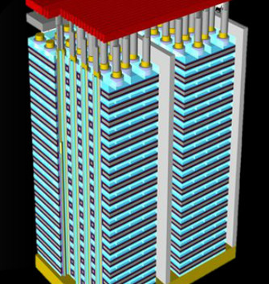
Task 5.3 - Suitability of the Proposed VHE Ion Beams for 3D Integrated Device Structures: Description of Work
Partners: UNIPD, M12-36
3D NAND Flash memories, the first and most successful example of 3D integration in the semiconductor industry, are an ideal test vehicle
Devices with hundreds of layers are now available and increasing, reaching tens of microns of thicknesss.
VHE heavy ions are extremely useful for these technologies
D5.3 (M36) Beam suitability for 3D structures
D5.6 (M48) SEE qualification guidelines for high complexity devices and board level testing
D5.5 (M48) Impact of beam energy in SEE testing
2
9

Slide 10
Task 5.3 - Suitability of the Proposed VHE Ion Beams for 3D Integrated Device Structures: Experimental Campaign
Experimental Campaign at CERN
Carried out a full irradiation campaign in November 2024
8 Floating Gate Devices irradiated at 3 LET and 3 angles (0, 45°, 85°)
Post-rad measurements completed
8 Replacement Gate Devices irradiated at 3 LET and 3 angles (0, 45°, 85°)
Post-rad measurements ongoing
1 Active FG Device irradiated at multiple LET and angles
Due to lack of beam time, only one FG device could be irradiated at GSI
Analysis is ongoing and Deliverable D5.3 “Suitability of the proposed VHE beams for 3D integrated device structures” is on track to be delivered before the end of the year
2
10

Slide 11
Task 5.4 - Validation of the VHE Ion Beams for Industrial use with TRL 6-7 Achievement: Description of work
Partners: Airbus DS/TESAT, CERN, M-12-36
VHE SEE testing on devices which have already been characterized by the ADS or CERN at standard-energy heavy ion test facilities (e.g., UCL, RADEF)
Previous tests carried out according to ESCC 25100 (package lid removal)
Broad range of technologies have been tested or will be tested:
High power diodes (Silicon or SiC)
A stacked memory
all the dies will be tested as opposed to only the top die as customary with standard energy ions
High-complexity device
D5.4 (M36) Verification of beam parameter requirements
D5.5 (M48) Impact of beam energy in SEE testing
D5.6 (M48) SEE qualification guidelines for high complexity devices and board level testing
2
11

Slide 12
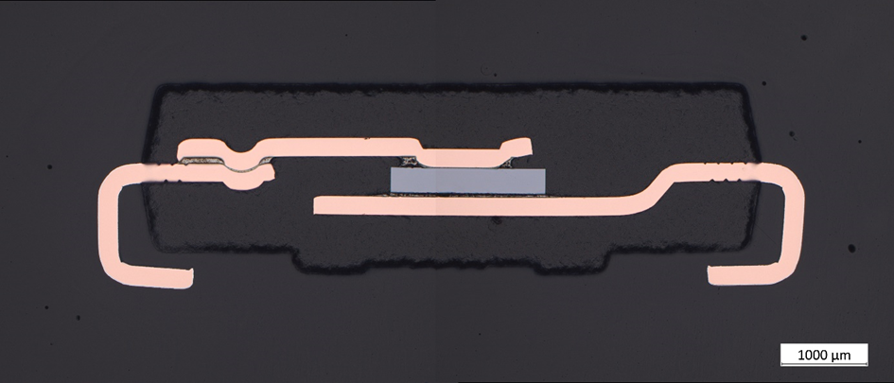
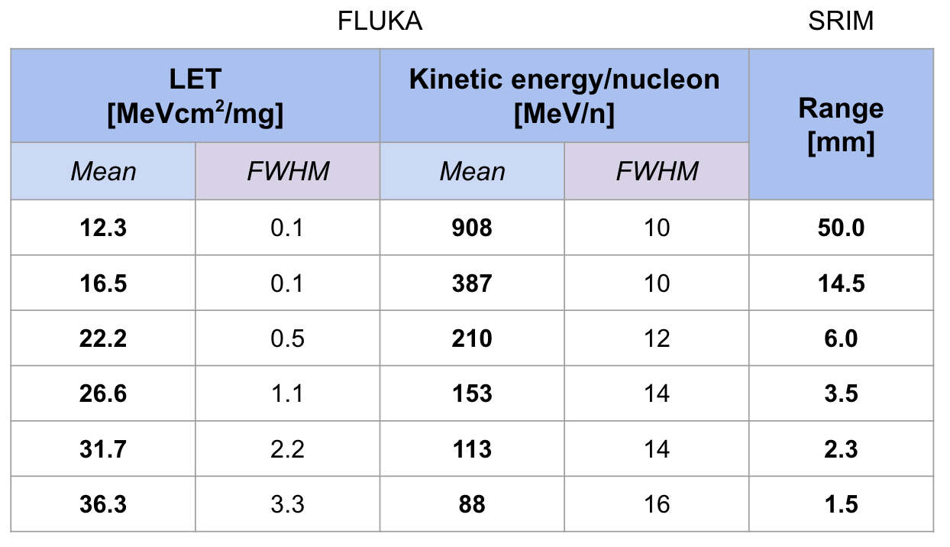
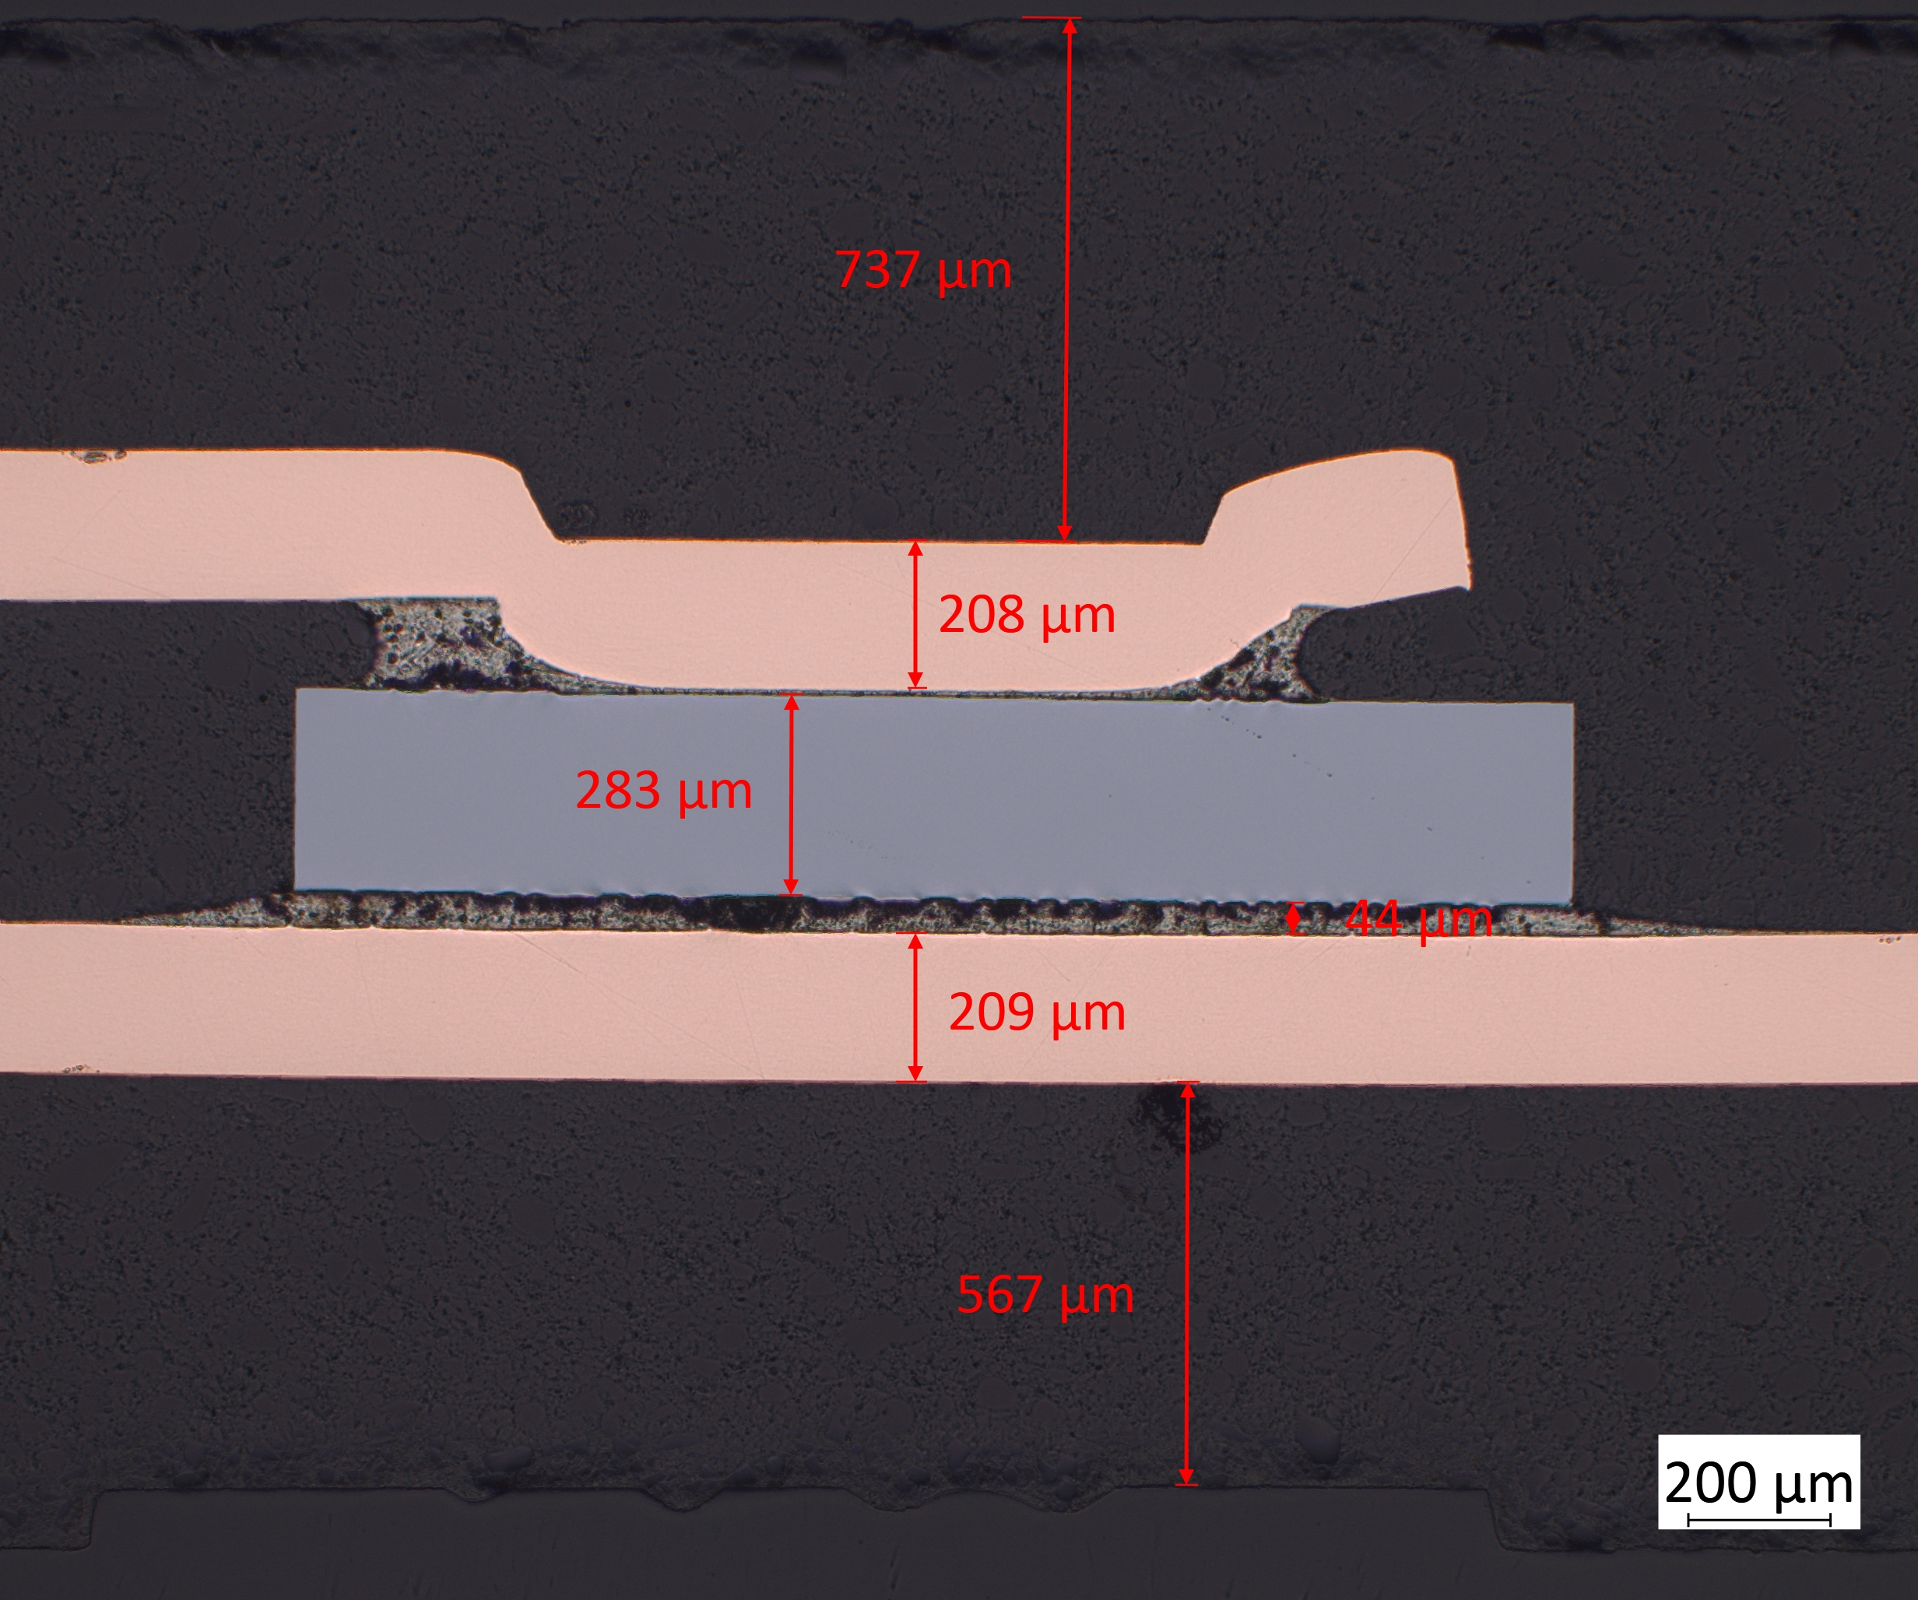
Task 5.4 - Validation of the VHE Ion Beams for Industrial use with TRL 6-7 Achievement : Status and Plans
First “family” addressed power devices and SEB/SEGR
200V Si Schottky Diode NRVBS4201 (ON SEMI) tested for destructive SEE
Used Ion (lead) as per table:
D5.4 (M36) Verification of beam parameter requirements
D5.5 (M48) Impact of beam energy in SEE testing
D5.6 (M48) SEE qualification guidelines for high complexity devices and board level testing
2
12

Slide 13
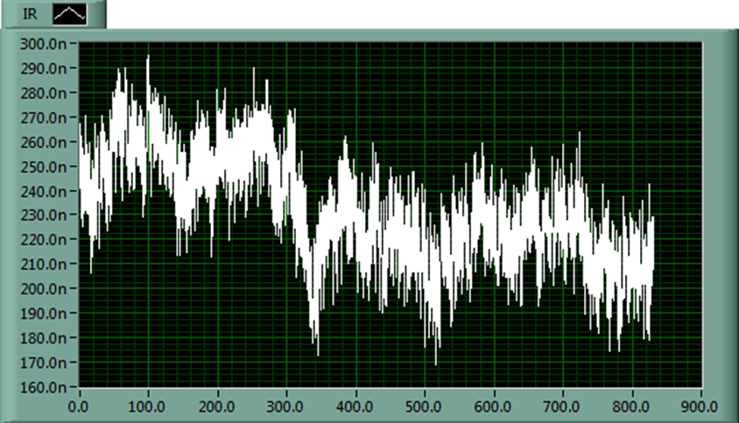
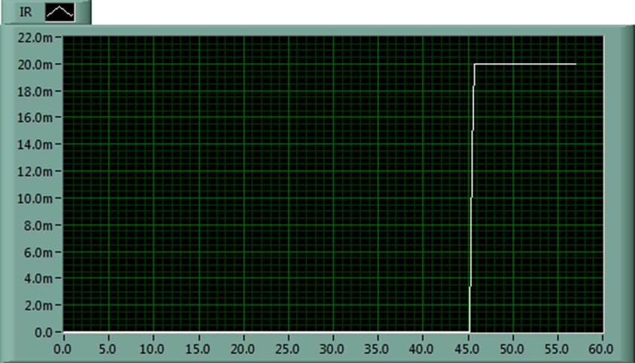
Task 5.4 - Validation of the VHE Ion Beams for Industrial use with TRL 6-7 Achievement : Status and Plans
200V Si Schottky Diode NRVBS4201 (ON SEMI) tested for destructive SEE
Voltage increased step by step until failure
Example @ LET=36 MeV.cm²/mg, sample 1
Vr=130V Vr=140V
D5.4 (M36) Verification of beam parameter requirements
D5.5 (M48) Impact of beam energy in SEE testing
D5.6 (M48) SEE qualification guidelines for high complexity devices and board level testing
2
13

Slide 14
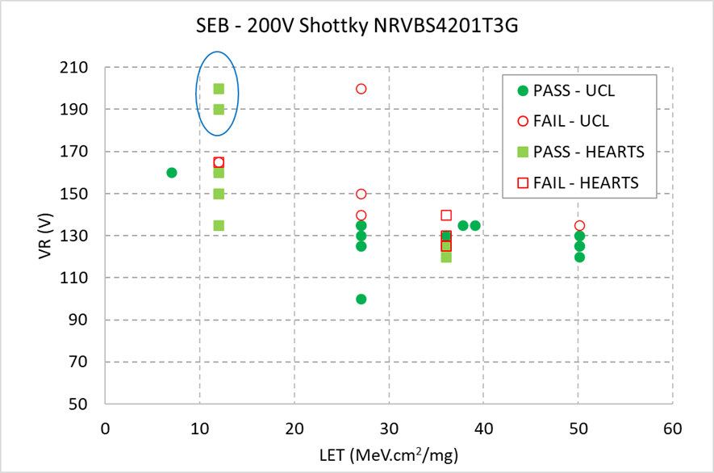
Task 5.4 - Validation of the VHE Ion Beams for Industrial use with TRL 6-7 Achievement : Status and Plans
200V Si Schottky Diode NRVBS4201 (ON SEMI)
Comparison with previous data
Test outcomes need more analysis however threshold voltage consistent with existing data for LET = 36.3
D5.4 (M36) Verification of beam parameter requirements
D5.5 (M48) Impact of beam energy in SEE testing
D5.6 (M48) SEE qualification guidelines for high complexity devices and board level testing
2
14

Slide 15
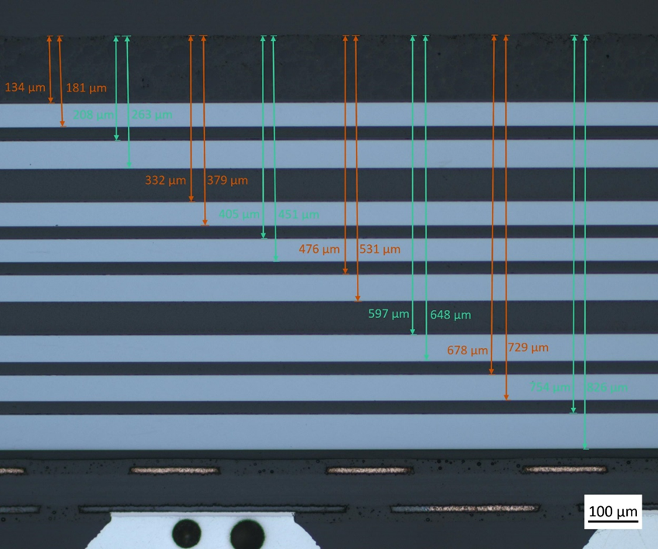
Task 5.4 - Validation of the VHE Ion Beams for Industrial use with TRL 6-7 Achievement : Status and Plans
Second “family” is memory NAND flash MT29F256G08AUCAB
Same LETs used as for diodes
D5.4 (M36) Verification of beam parameter requirements
D5.5 (M48) Impact of beam energy in SEE testing
D5.6 (M48) SEE qualification guidelines for high complexity devices and board level testing
2
15

Slide 16
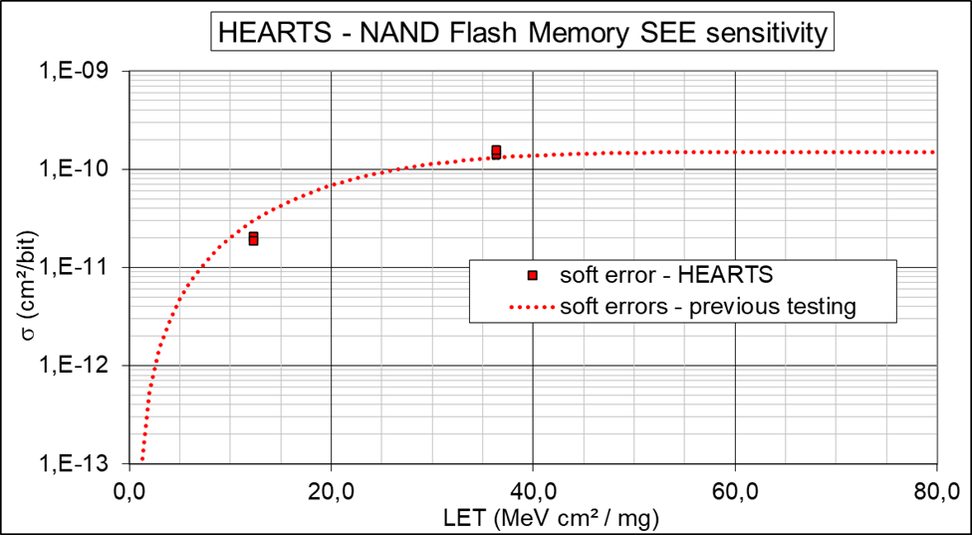
Task 5.4 - Validation of the VHE Ion Beams for Industrial use with TRL 6-7 Achievement : Status and Plans
Second “family” is memory NAND flash MT29F256G08AUCAB
Same LETs used as for diodes
SEE originates from the 8 memory dies
D5.4 (M36) Verification of beam parameter requirements
D5.5 (M48) Impact of beam energy in SEE testing
D5.6 (M48) SEE qualification guidelines for high complexity devices and board level testing
2
16

Slide 17
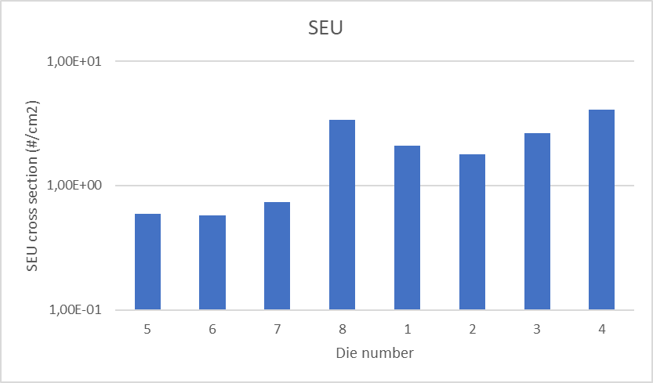
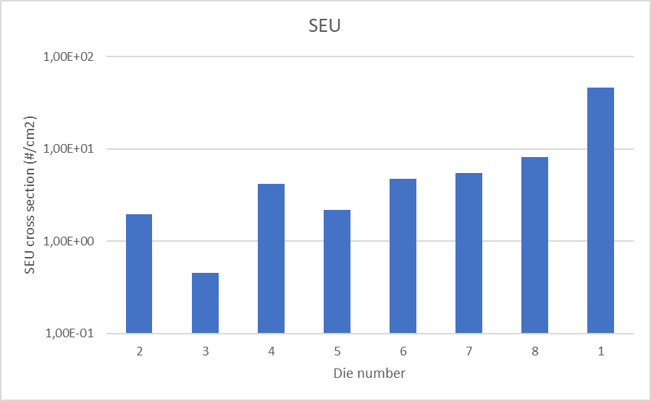
Task 5.4 - Validation of the VHE Ion Beams for Industrial use with TRL 6-7 Achievement : Status and Plans
Second “family” is memory NAND flash MT29F256G08AUCAB
SN2 / LET(s)=12 MeV.cm².mg⁻¹ SN1 / LET(s)=36 MeV.cm².mg⁻¹
In-depth analysis on-going
D5.4 (M36) Verification of beam parameter requirements
D5.5 (M48) Impact of beam energy in SEE testing
D5.6 (M48) SEE qualification guidelines for high complexity devices and board level testing
2
17

Slide 18
Task 5.4 - Validation of the VHE Ion Beams for Industrial use with TRL 6-7 Achievement : Status and Plans
Third “family” prone to a different approach
Test of DDR4 memories protected by an ECC implemented on NG ULTRA
Technical discussions started with CERN to organize 2025 test campaign
D5.4 (M36) Verification of beam parameter requirements
D5.5 (M48) Impact of beam energy in SEE testing
D5.6 (M48) SEE qualification guidelines for high complexity devices and board level testing
2
18

Slide 19
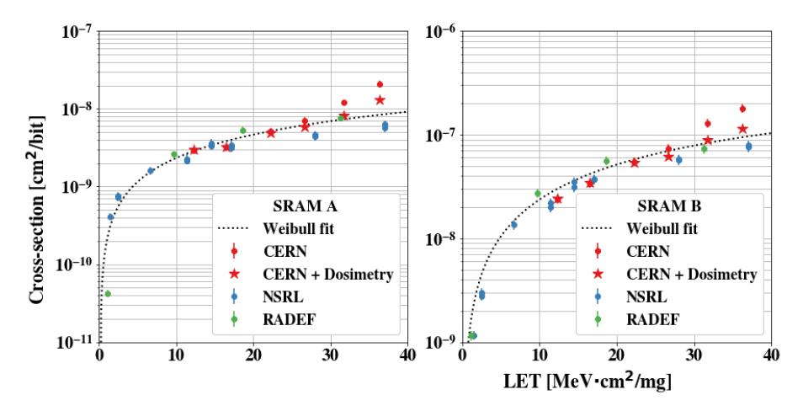
Task 5.4 - Validation of the …: NSREC 2025 data from HEARTS@CERN 2024: SEU
D5.4 (M36) Verification of beam parameter requirements
D5.5 (M48) Impact of beam energy in SEE testing
D5.6 (M48) SEE qualification guidelines for high complexity devices and board level testing
2
19

Slide 20
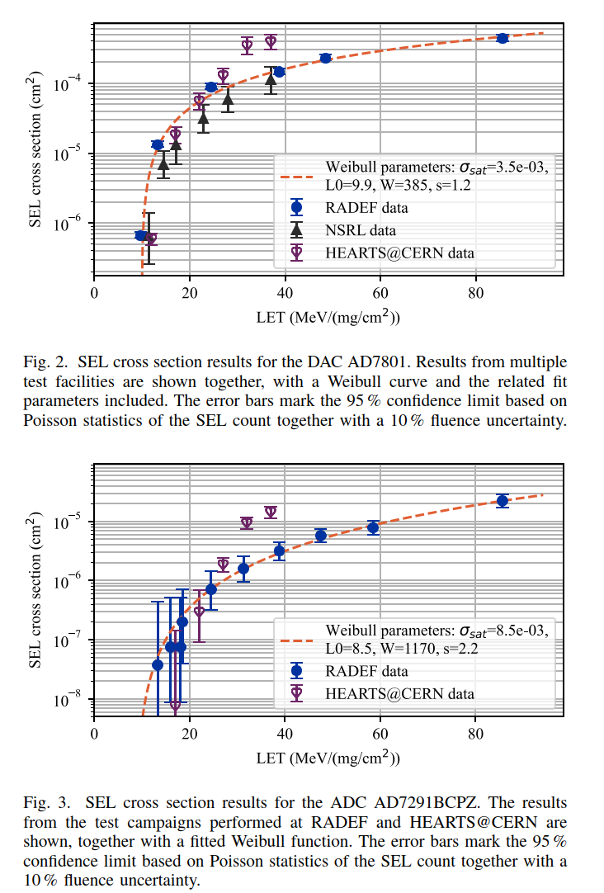
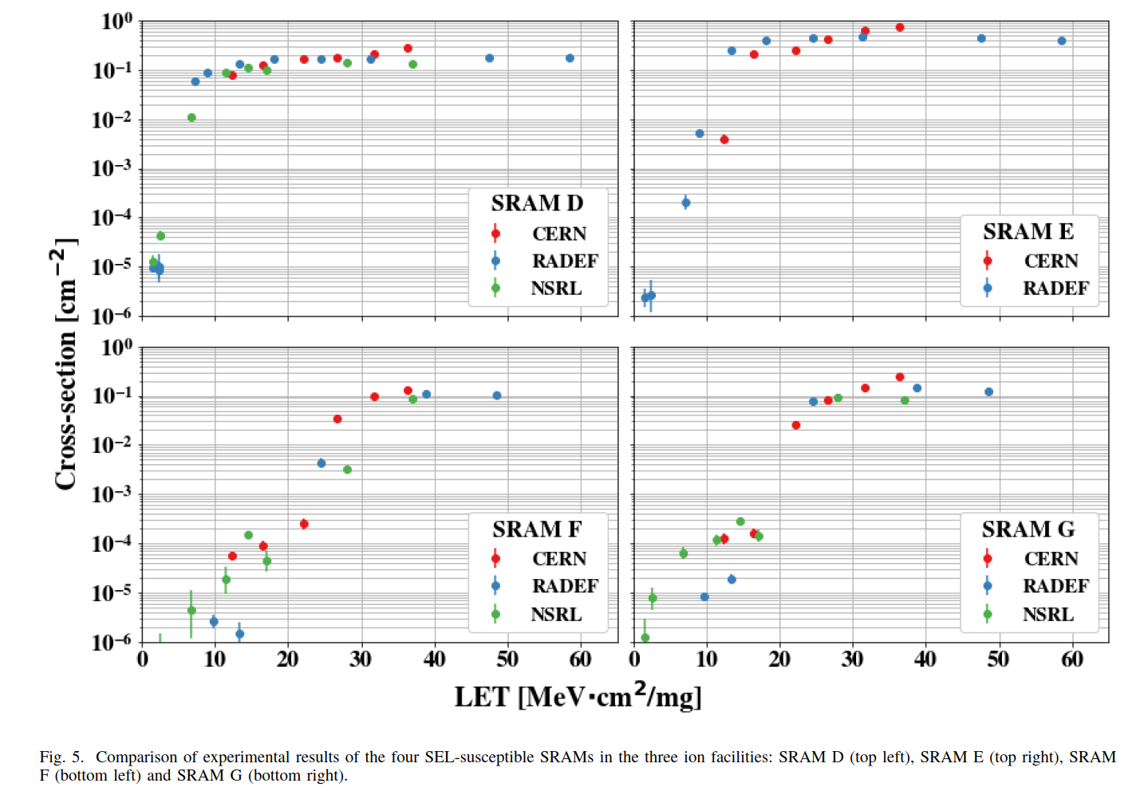
Task 5.4 - Validation of the …: NSREC 2025 data from HEARTS@CERN 2024: SEU
D5.4 (M36) Verification of beam parameter requirements
D5.5 (M48) Impact of beam energy in SEE testing
D5.6 (M48) SEE qualification guidelines for high complexity devices and board level testing
2
20

Slide 21
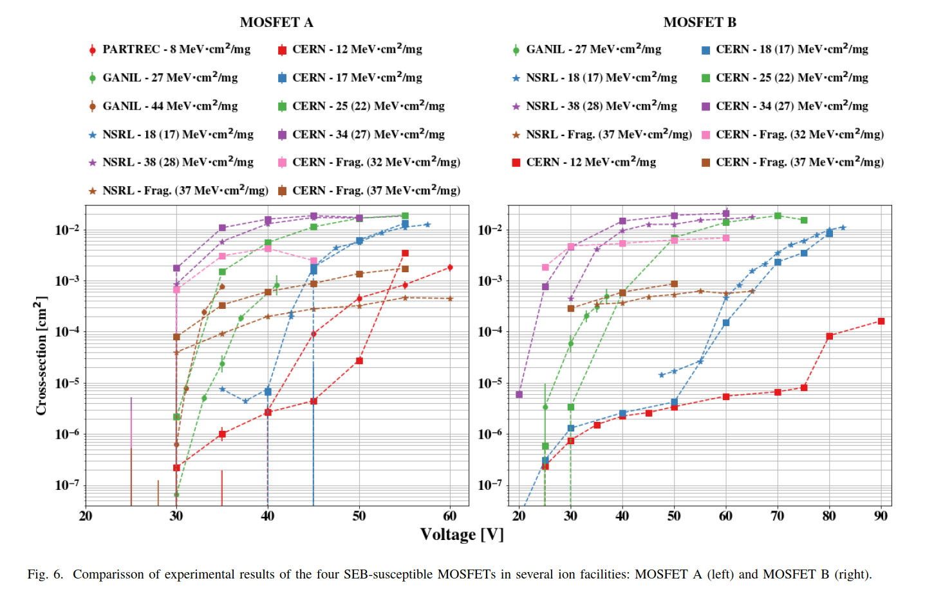
Task 5.4 - Validation of the …: NSREC 2025 data from HEARTS@CERN 2024: SEU
D5.4 (M36) Verification of beam parameter requirements
D5.5 (M48) Impact of beam energy in SEE testing
D5.6 (M48) SEE qualification guidelines for high complexity devices and board level testing
2
21

Slide 22
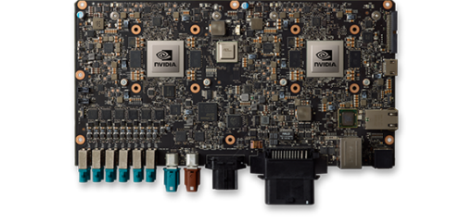
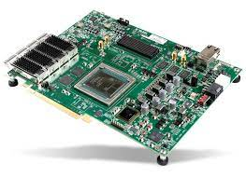
Task 5.5 - Qualification of High-complexity Devices: Description of Work
Partners: UNIPD, TAS, M24-48
Graphical Processing Units (GPUs) and Field Programmable Gate Arrays (FPGAs) are two key enablers for on-board artificial intelligence
Heavy-ion SEE qualification is very complex because of the very high power-consumption (standard energy ions require in-vacuum irradiations) -> in air irradiation is key
UNIPD will perform a test campaign on a GPU
TAS will perform a test campaign on a FPGA
The results will be used together to compile recommendations and guidelines about SEE testing with very high energy ion beams
D5.5 (M48) Impact of beam energy in SEE testing
D5.6 (M48) SEE qualification guidelines for high complexity devices and board level testing
2
22

Slide 23
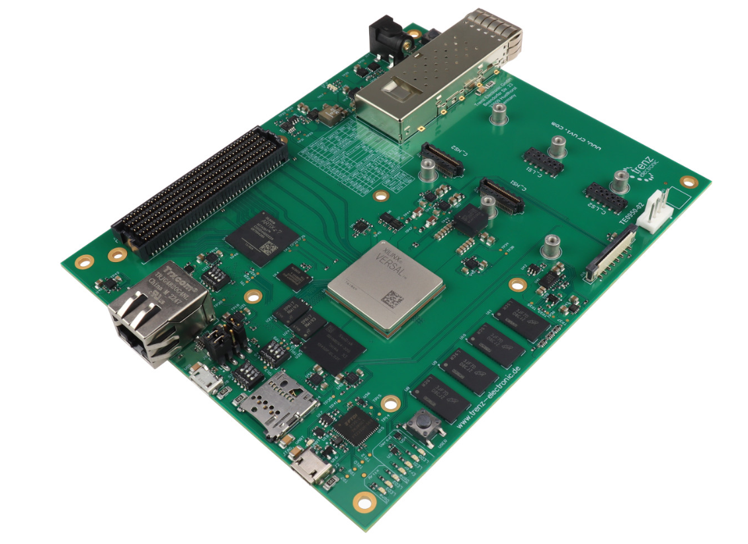
Task 5.5 - Qualification of High-complexity Devices: Status and Plans
Device is the VERSAL Edge FPGA SoC device family: VE2302.
Device is based on 7nm FinFET technology from TSMC foundry.
The older generation, i.e. Versal CORE, has been widely tested and, being the technology the same, we can quickly compare the test results to establish goodness of test approach.
Use cases to test CRAM are developed, DSP test under evaluation, no AI-E test foreseen at the moment.
Test under development by M. Abdullahi (PhD, GSSI) and A. Portaluri (TAS)
D5.5 (M48) Impact of beam energy in SEE testing
D5.6 (M48) SEE qualification guidelines for high complexity devices and board level testing
2
23

Slide 24
Task 5.5 - Qualification of High-complexity Devices: Status and Plans
UNIPD is selecting a suitable platform and perform preliminary test campaigns
NVIDIA Jetson line of AI accelerators appears as the most promising candidate
CPU + GPU in one chip, with full framework for AI computing
Preliminary tests carried out at ChipIr (UK) on some Jetson Nano boards
A possible different option is emerging in collaboration with STMicrolectronics-Italy
STM32 micro with AI accelerator
To be performed in 2026
D5.5 (M48) Impact of beam energy in SEE testing
D5.6 (M48) SEE qualification guidelines for high complexity devices and board level testing
2
24

Slide 25
Task 5.6 - Board-level testing: Description of Work
Partners: TAS, M24-48
Board-level testing can enable the qualification of several devices by irradiating them simultaneously under the same beam.
In some cases, and thanks to the properties of VHE ion beams, it can even be envisaged to test more complex systems that are made of a few electronic boards stacked on top of one another.
The task will consist of testing electronic boards enabling power conditioning functionalities, which may be particularly sensitive to radiation.
The objective of the task will be that of defining a methodology for testing these kinds of boards with a VHE ion beam that will be integrated in the guideline.
D5.6 (M48) SEE qualification guidelines for high complexity devices and board level testing
2
25

Slide 26
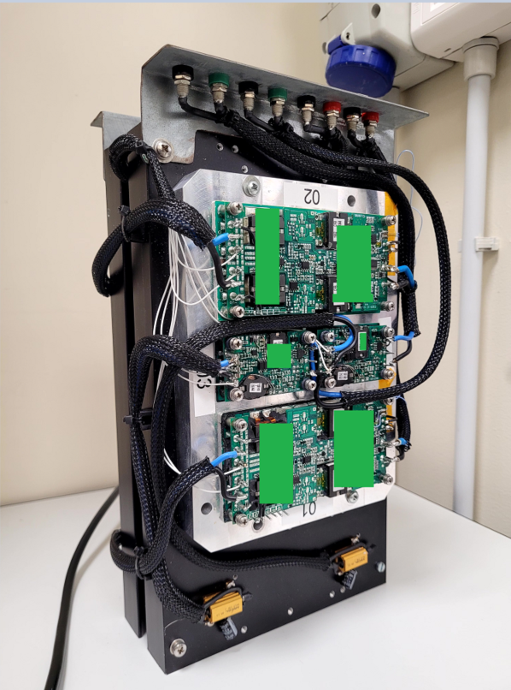
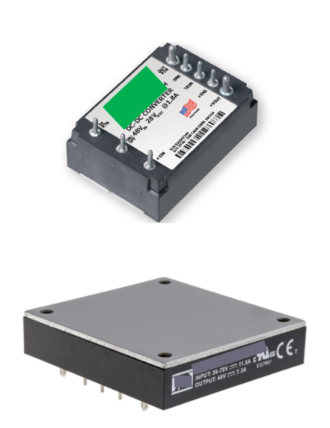
Task 5.6 - Board-level testing: Status and Plans
Device under trade-off for testing are DC/DC converters.
DC/DC converter with high power density w.r.t. footprint are not so common in the space market.
On the other hand they are a need in payload architecture where the same module type is implemented recursively to build large structures (like SAR for earth observation).
Test under development by G. Fontanella (PhD, GSSI).
The first choice for this application are commercial DC/DC converters available in TAS:
All DC/DC are Si based
Standard brick dimension
6 part number selected available with high voltage input:
34V / 75V Vin, 28V Vout, 1.8 A and 21.5 A.
34V / 75V Vin, 3.3V Vout, 30 A.
48V Vin, 24V Vout, 350 W.
24V Vin, 100W.
24V Vin, 400W.
D5.6 (M48) SEE qualification guidelines for high complexity devices and board level testing
2
26

Slide 27
Task 5.6 - Board-level testing: Description of Work
Partners: TAS, M24-48
Board-level testing can enable the qualification of several devices by irradiating them simultaneously under the same beam.
In some cases, and thanks to the properties of VHE ion beams, it can even be envisaged to test more complex systems that are made of a few electronic boards stacked on top of one another.
The task will consist of testing electronic boards enabling power conditioning functionalities, which may be particularly sensitive to radiation.
The objective of the task will be that of defining a methodology for testing these kinds of boards with a VHE ion beam that will be integrated in the guideline.
D5.6 (M48) SEE qualification guidelines for high complexity devices and board level testing
2
27

Slide 28
Task 5.6 - Board-level testing: Status and Plans
Device under trade-off for testing are DC/DC converters.
DC/DC converter with high power density w.r.t. footprint are not so common in the space market.
On the other hand they are a need in payload architecture where the same module type is implemented recursively to build large structures (like SAR for earth observation).
The first choice for this application are commercial DC/DC converters available in TAS:
All DC/DC are Si based
Standard brick dimension
6 part number selected available with high voltage input:
34V / 75V Vin, 28V Vout, 1.8 A and 21.5 A.
34V / 75V Vin, 3.3V Vout, 30 A.
48V Vin, 24V Vout, 350 W.
24V Vin, 100W.
24V Vin, 400W.
D5.6 (M48) SEE qualification guidelines for high complexity devices and board level testing
2
28

Slide 29
Conclusions
Task | Status
5.1: Final review of VHE ion beam requirements for SEE testing | Beam requirements have been discussed. Task has been completed with deliverable D5.1.
5.2: Analysis of Ionization Response in a PIN diode for Beam Quality Assessment | PIN diode setup has been used to assess beam quality at HEARTS@CERN and GSI cave A. Task has been completed with deliverable D5.2.
5.3: Suitability of the Proposed VHE Ion Beams for 3D Integrated Device Structures | In progress. Second set of high-energy heavy ion experiments on 3D NAND Flash have been carried out. Analysis on ongoing. On track for end-of-the year deliverable.
5.4: Validation of the VHE Ion Beams for Industrial use with TRL 6-7 Achievement | ADS has tested diodes and NAND Flash at IRRAD.
5.5: Qualification of High-complexity Devices | TAS has identified test vehicles and is working on setup.
5.6: Board-level testing | TAS has identified test vehicles and is working on setup.
2
29

