Slide 1
HEARTS WP Leaders Meeting #7 Governing Board Meeting #2
27 August 2025
https://indico.cern.ch/event/1563715/
Thomas Brent
WP2

Slide 2
WP Milestones and Deliverables
Deliv. No. | Deliverable name | Due date | Status
D2.3 | Knowledge transfer turnover report | 2025-12-31 | Pending
D2.4 | Final report on communication, dissemination, outreach and exploitation | 2026-12-31 | Pending

Slide 3


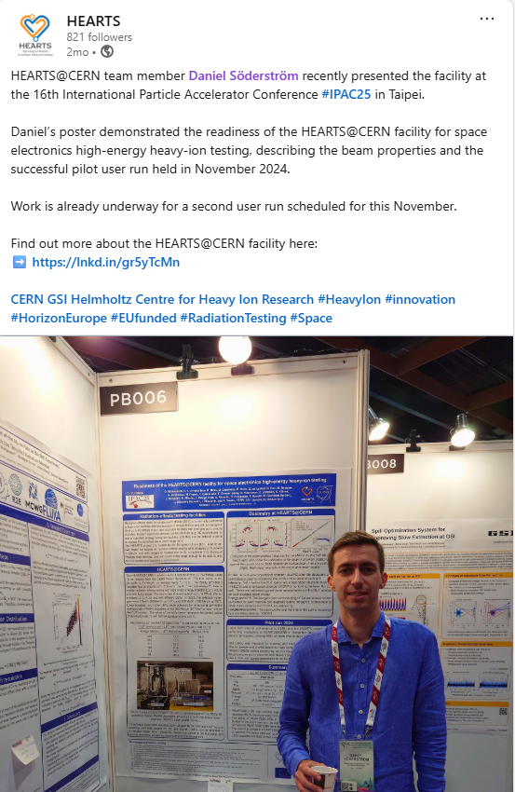
Comms: LinkedIn

Slide 4
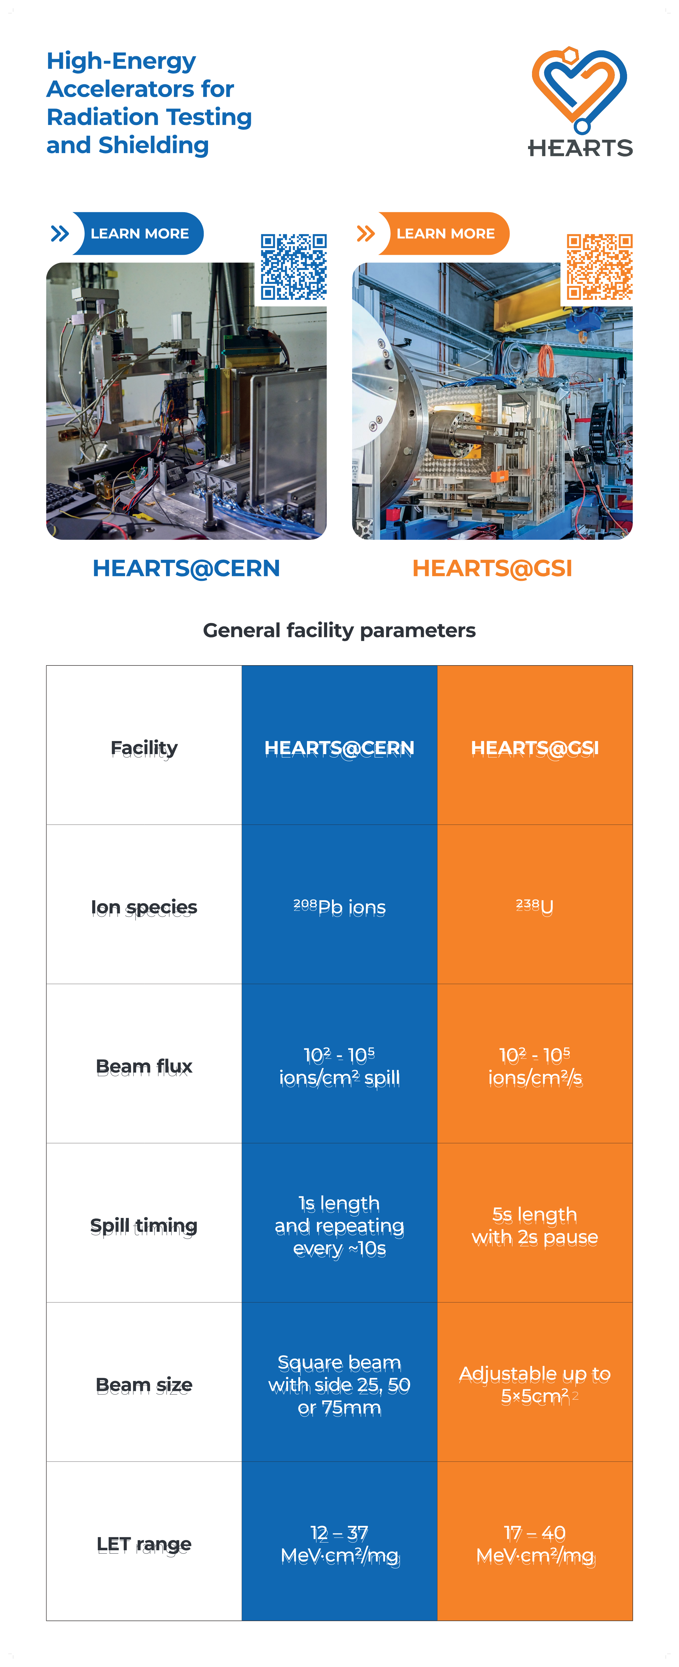
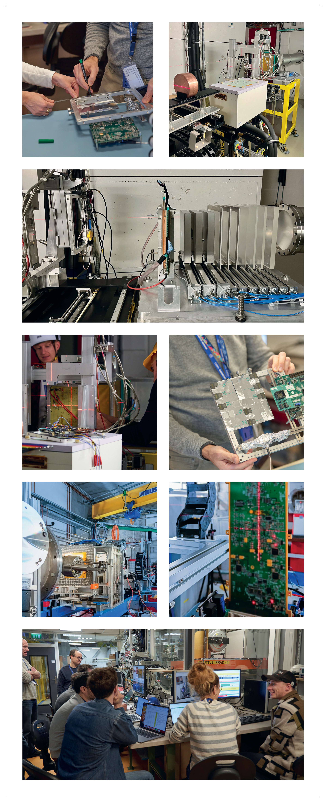



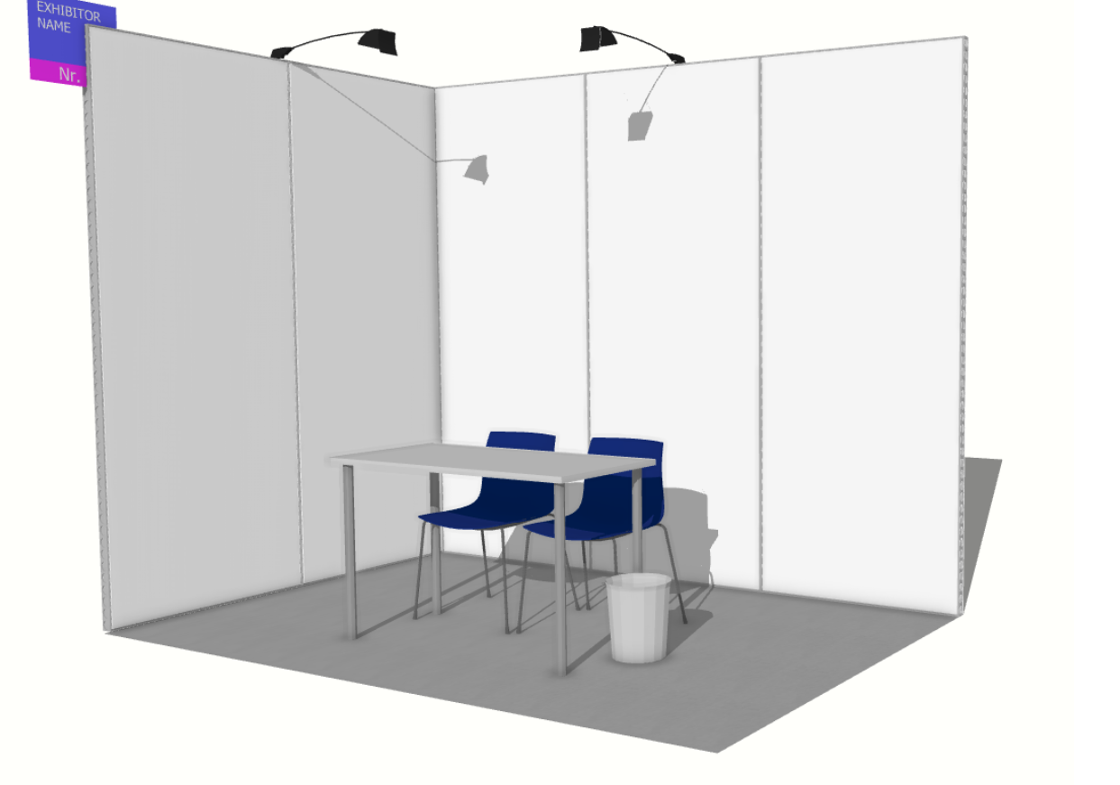
Comms: RADECS booth

Slide 5


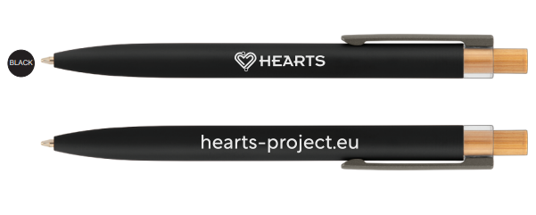


Comms: RADECS goodies

Slide 6
Short-term plans
Social media campaign to advertise CERN November run
Series of posts about RADECS
Complete KT report
Challenge
I will be on holiday between Oct 3 – Oct 24

Slide 7
Thank you for your attention!
Questions?

