Slide 1




Monte carlo request involving searches of diphoton resonances in association with $τ^{+}τ^{−}$/ 2 $b$ – jets at electroweak scale in atlas detector at the lhc
Presenter: Njokweni Mbuyiswa
In collaboration with Kutlwano Makgetha, Vuyolwethu Kakancu, Paballo Ndhlovu, Kgothatso Ntumbe, Puthi rapheeha, Mukesh Kumar, Rachid Mazini and Bruce Mellado

Slide 2
OUTLINE
Multilepton anomalies and Diphoton excess
Simplified Model
Work plan
Signal MC Generation and Validation
Progress and Future Work

Slide 3
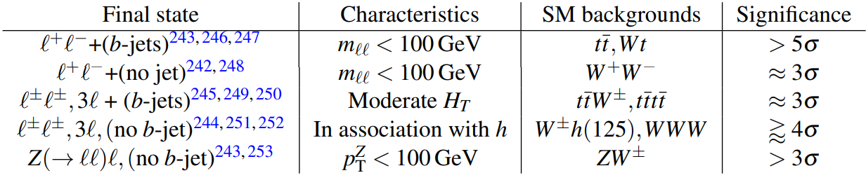
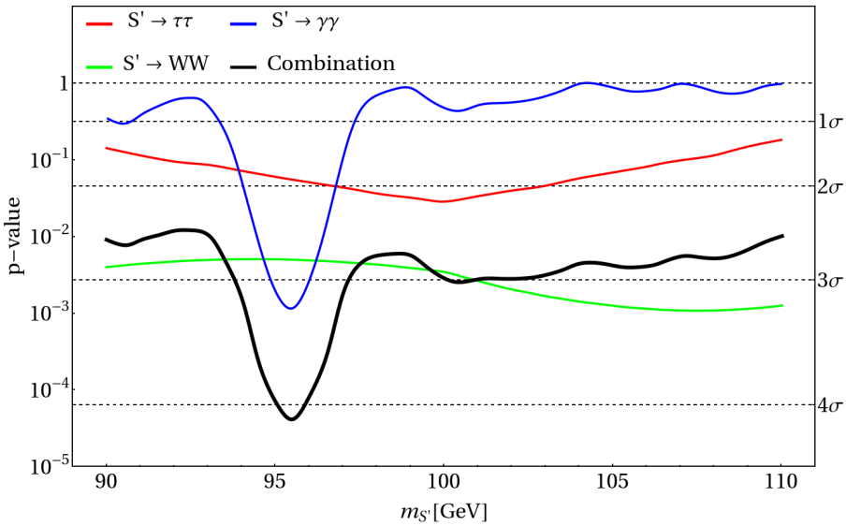
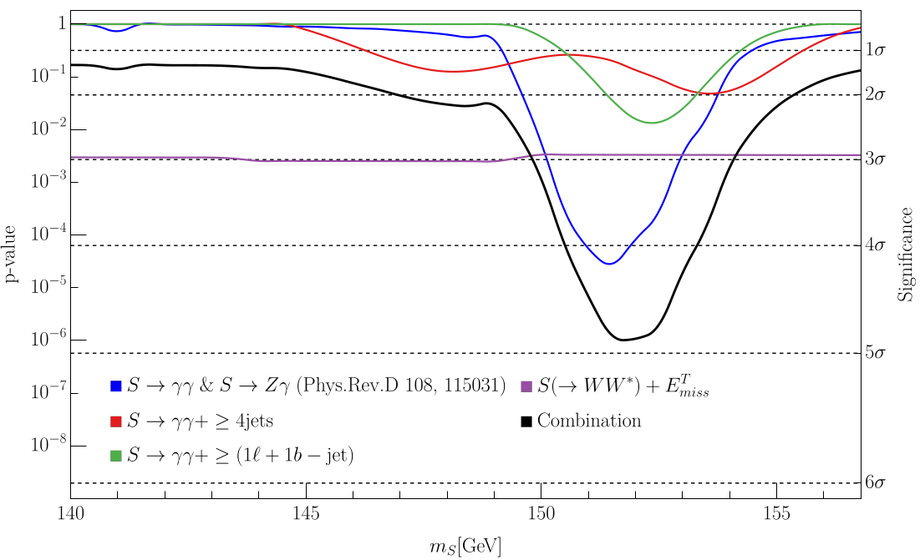
Multilepton anomalies and Diphoton excesses
Nat Rev Phys 6, 294–309 (2024). https://doi.org/10.1038/s42254-024-00703-6

Slide 4
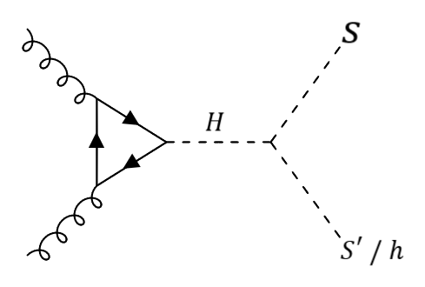

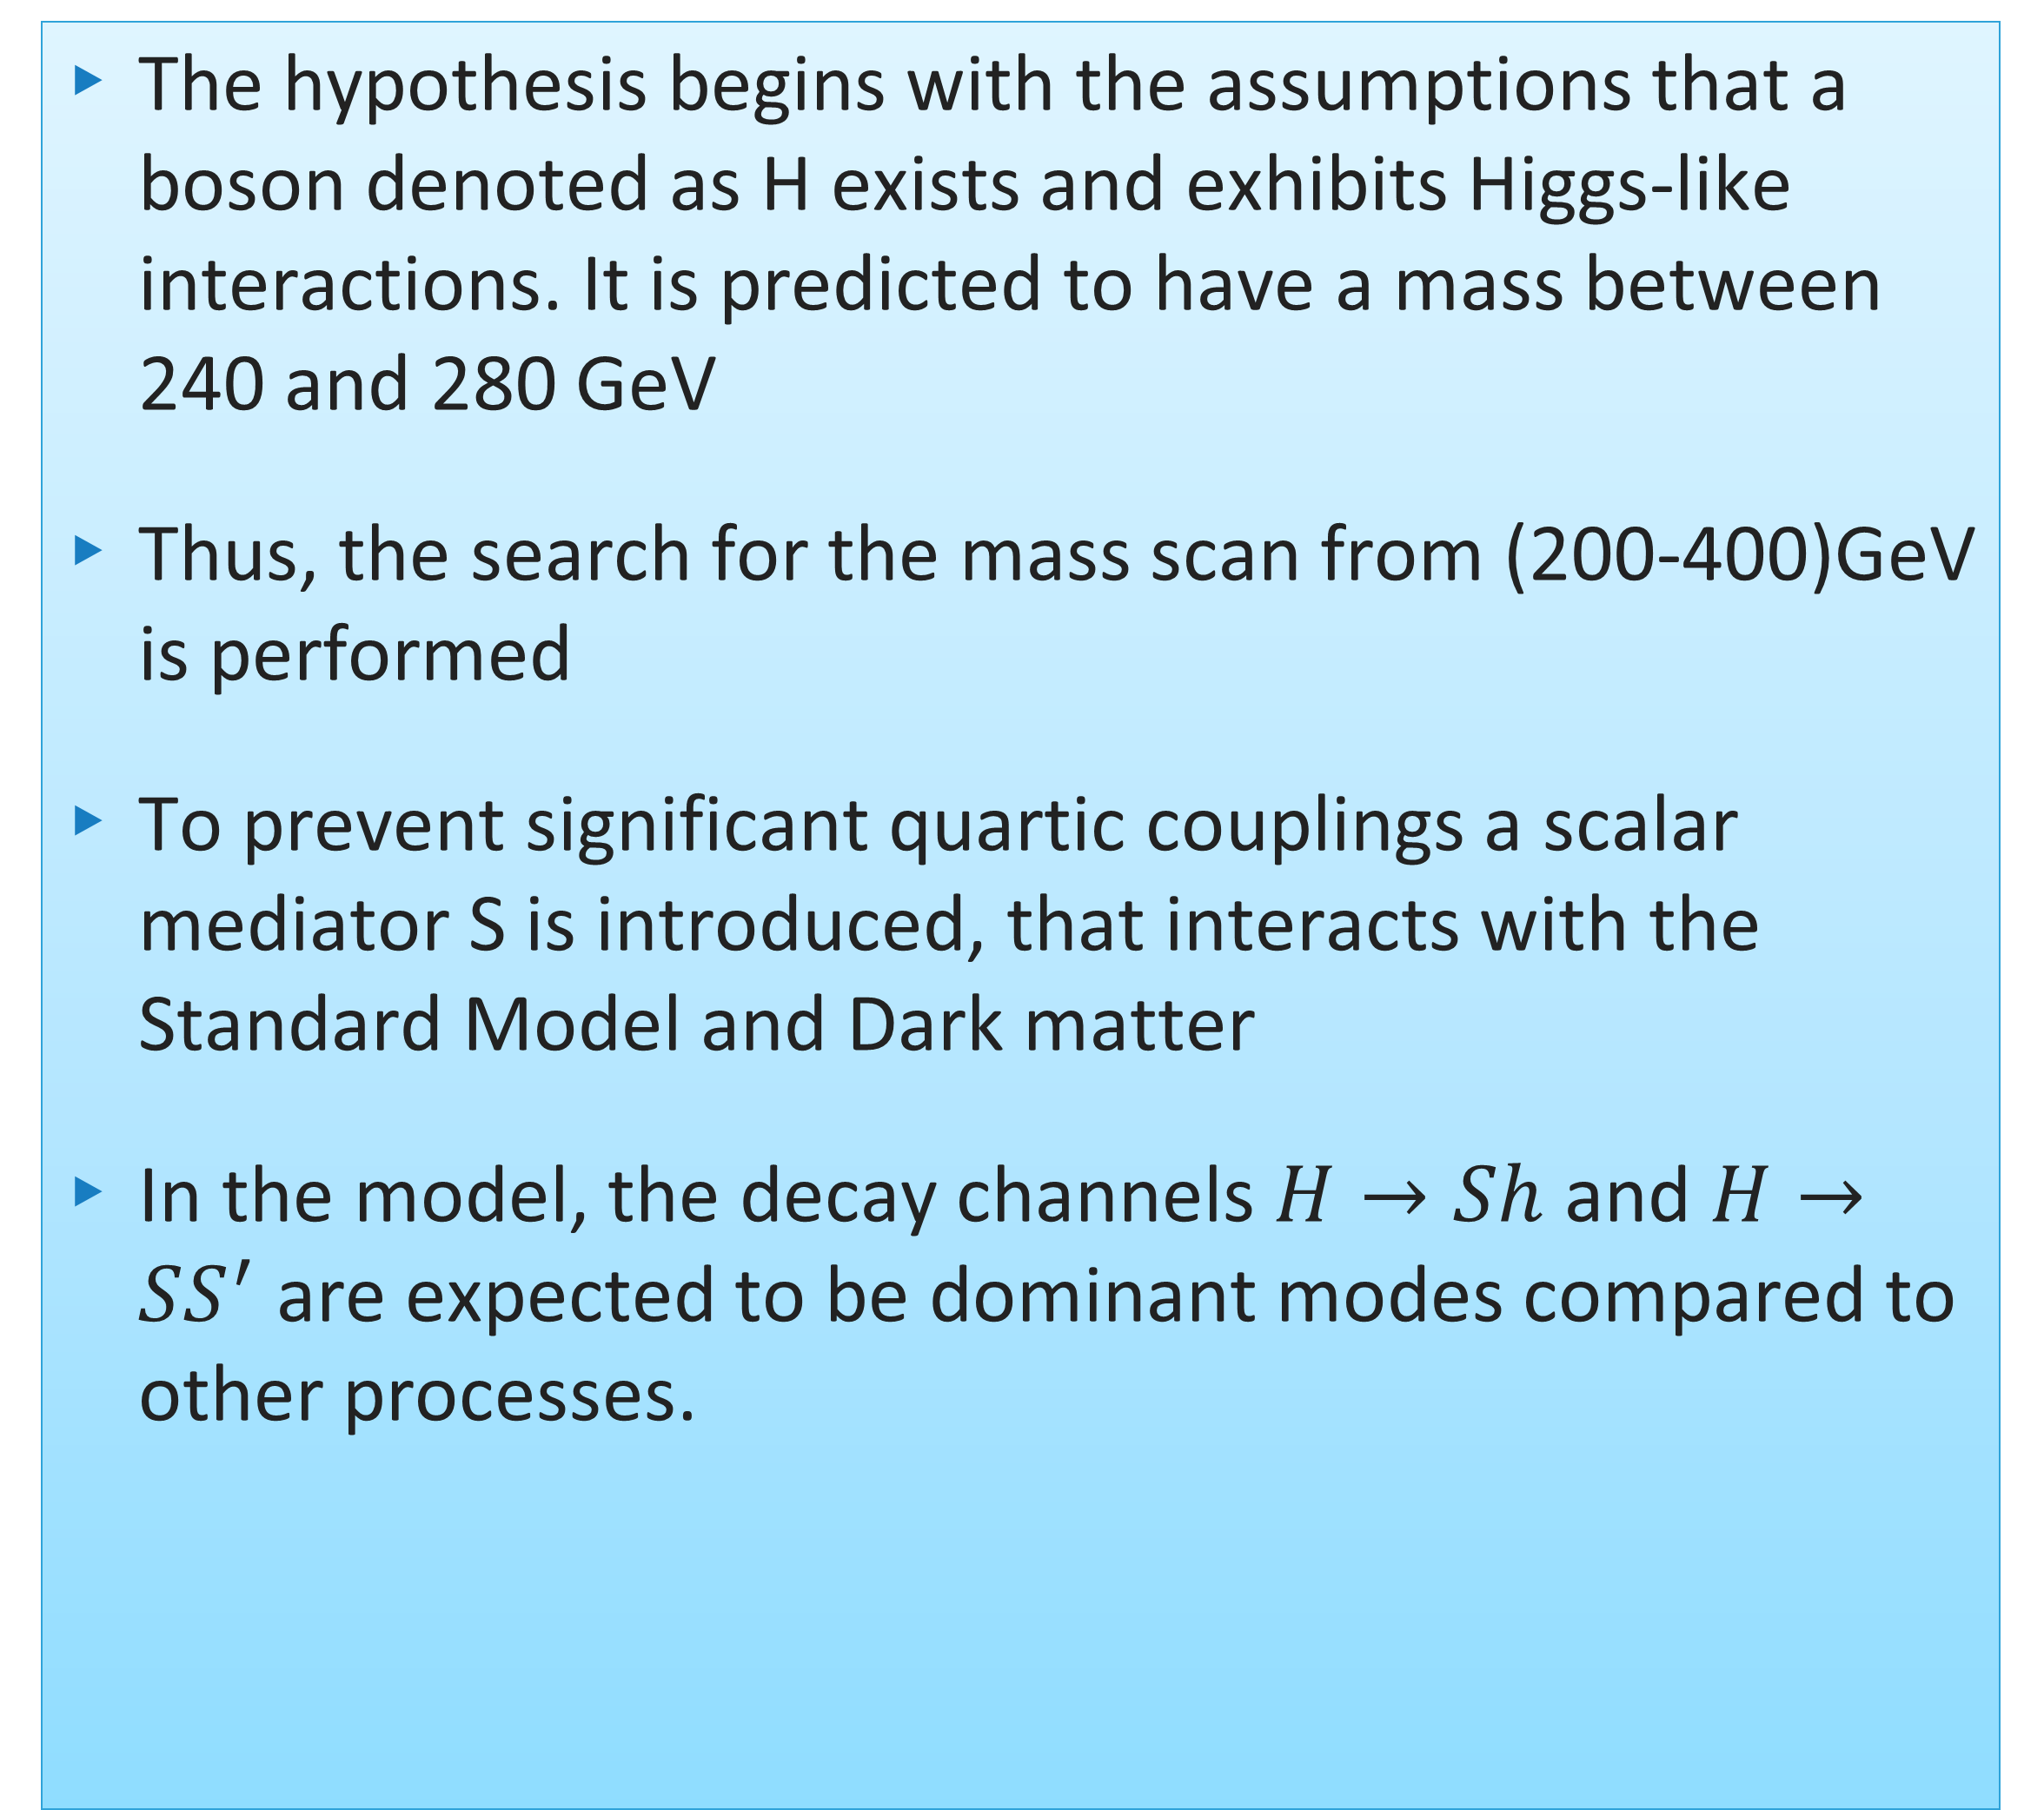
Simplified model
The hypothesis begins with the assumptions that a boson denoted as H exists and exhibits Higgs-like interactions. It is predicted to have a mass between 240 and 280 GeV
Thus, the search for the mass scan from (200-400)GeV is performed
To prevent significant quartic couplings a scalar mediator S is introduced, that interacts with the Standard Model and Dark matter
In the model, the decay channels $H→Sh$ and $H→SS^{′}$ are expected to be dominant modes compared to other processes.
2HDM+S model, Eur.Phys.J.C 76 (2016) 10, 580

Slide 5
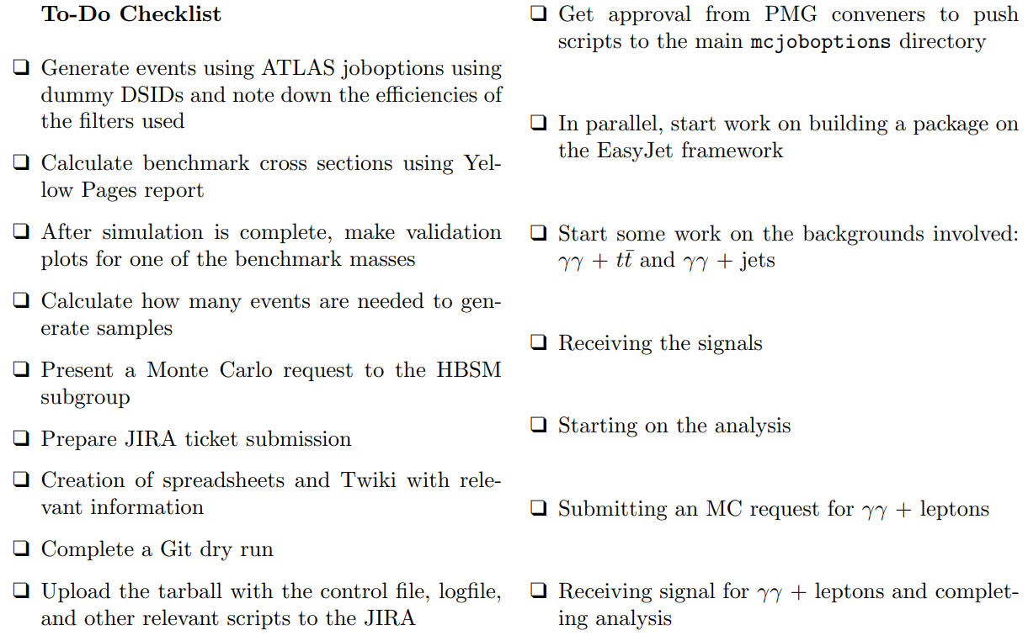
Work plan

Slide 6
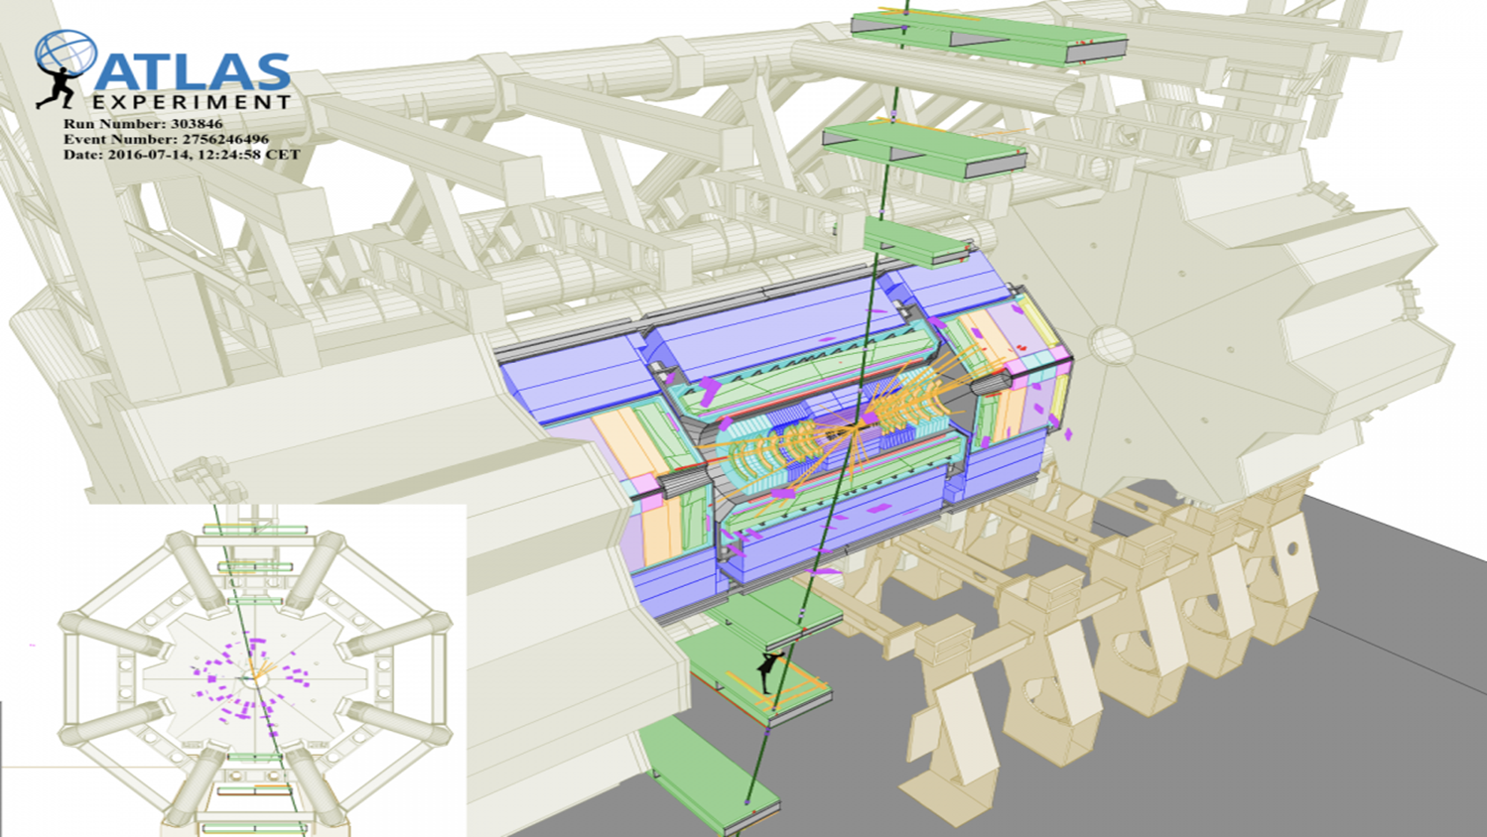
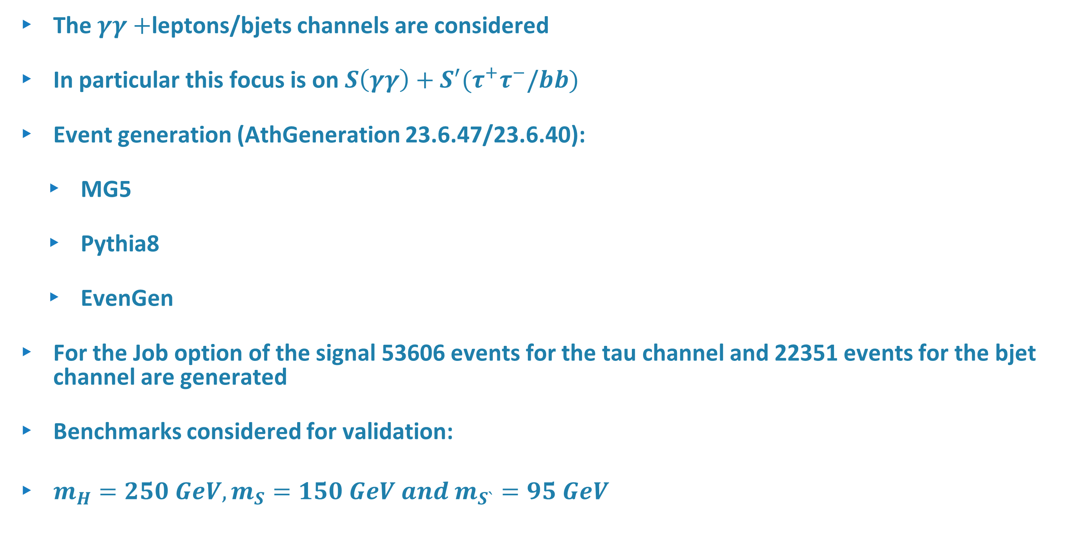
MC Event generation
The $γγ+$leptons/bjets channels are considered
In particular this focus is on $S\left(γγ\right)+S^{′}(τ^{+}τ^{−}\text{/}bb)$
Event generation (AthGeneration 23.6.47/23.6.40):
  MG5
  Pythia8
  EvenGen
For the Job option of the signal 53606 events for the tau channel and 22351 events for the bjet channel are generated
Benchmarks considered for validation:
$m_{H}=250 GeV, m_{S}=150 GeV and m_{S`}=95 GeV$
Truth Level
Now to obtain the truth level file the following steps are taken
Athena release 25.0.9 is used
Derivation_tf.py algorithm is used
Output file—TRUTH1 level root file

Slide 7
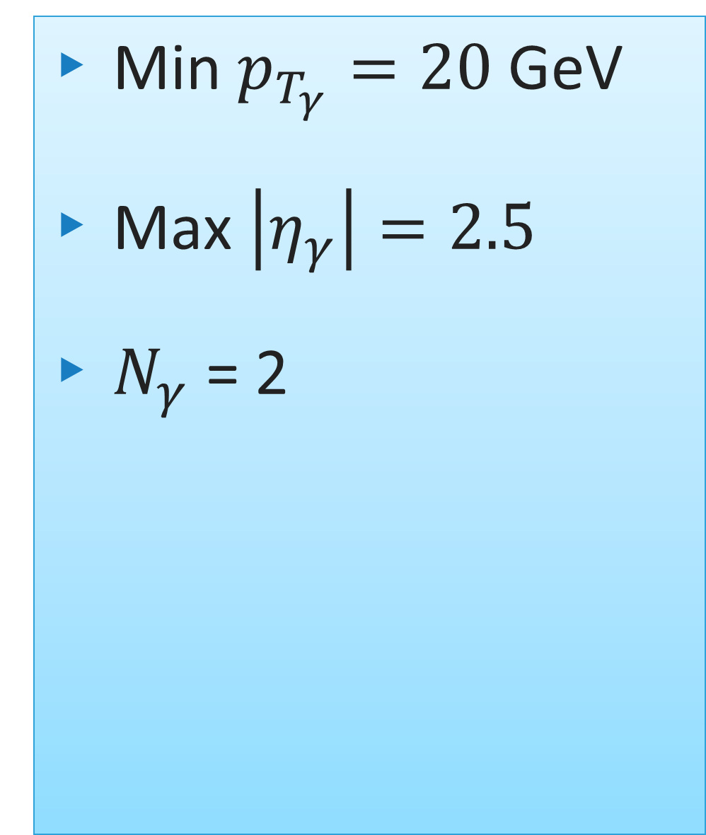
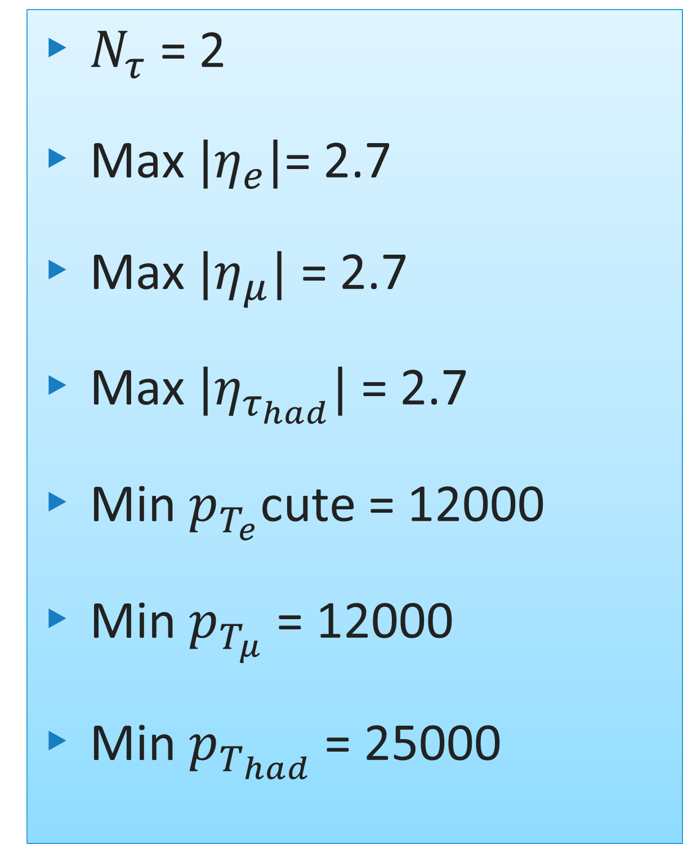
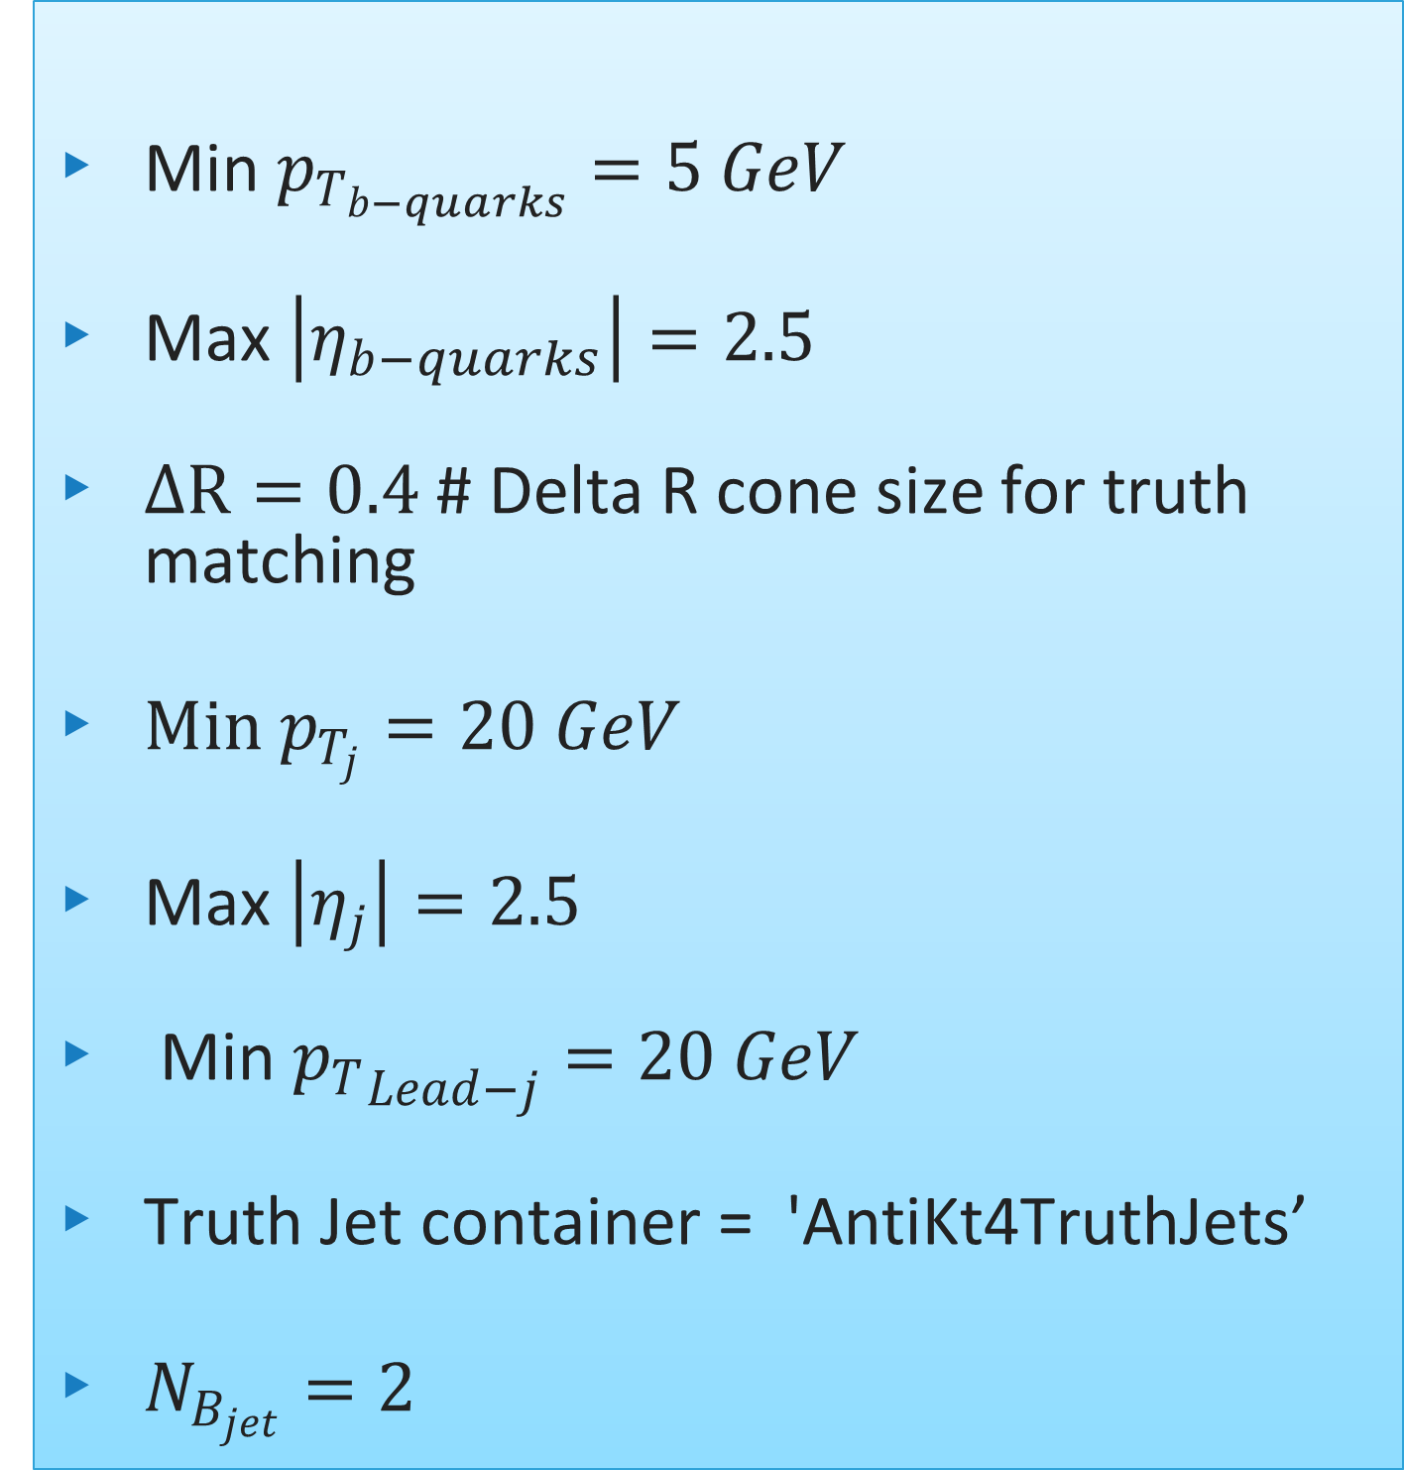
Benchmark cross sections and filters
$$σ_{Total}=σ_{gg→H}×Br\left(H→SS`\right)×Br \left(S→γγ\right)×Br\left(S`→τ^{+}τ^{−}\text{/}bb^{\sim }\right)$$
Min $p_{T_{b−quarks}}=5 GeV$
Max $\left|η_{b−quarks}\right|=2.5$
$ΔR=0.4$ # Delta R cone size for truth matching
$Min p_{T_{j}}=20 GeV$
Max $\left|η_{j}\right|=2.5$
Min ${p_{T}}_{Lead−j}=20 GeV$
Truth Jet container = 'AntiKt4TruthJets’
$N_{B_{jet}}=2$
$N_{τ}$ = 2
Max $|η_{e}|$= 2.7
Max $|η_{μ}|$ = 2.7
Max $|η_{τ_{had}}|$ = 2.7
Min $p_{T_{e}}$cute = 12000
Min $p_{T_{μ}}$ = 12000
Min $p_{T_{had}}$ = 25000
Min $p_{T_{γ}}=20$GeV
Max $\left|η_{γ}\right|=2.5$
$N_{γ}$ = 2

Slide 8
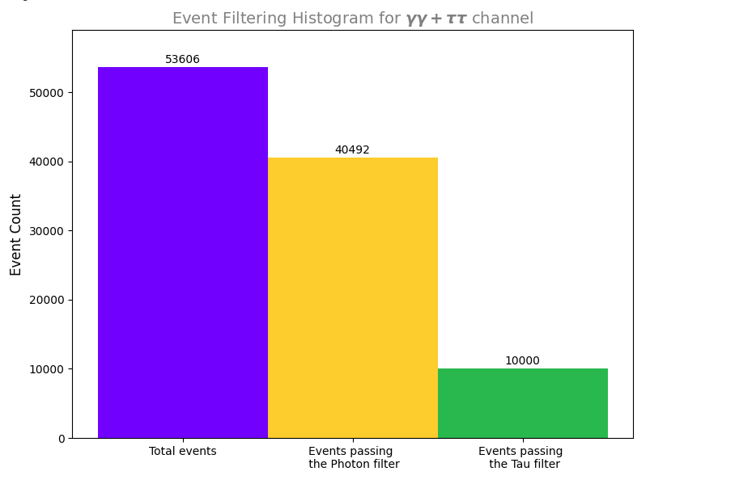
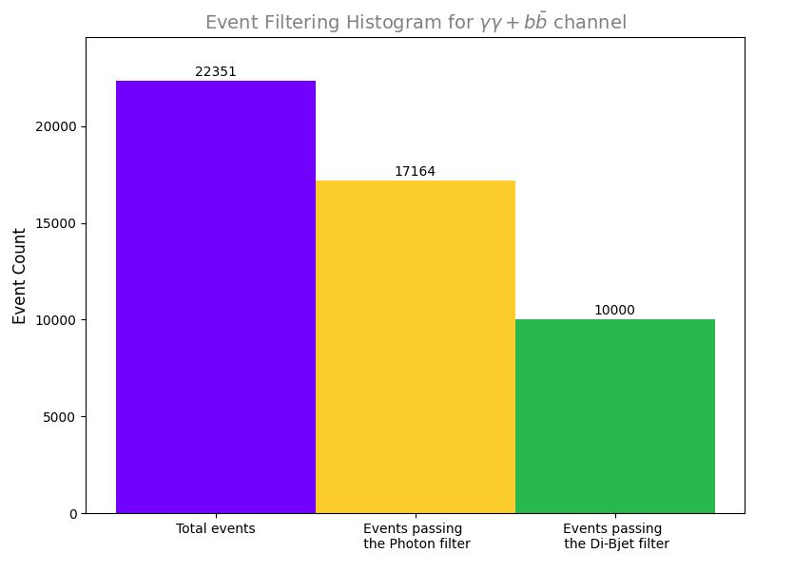
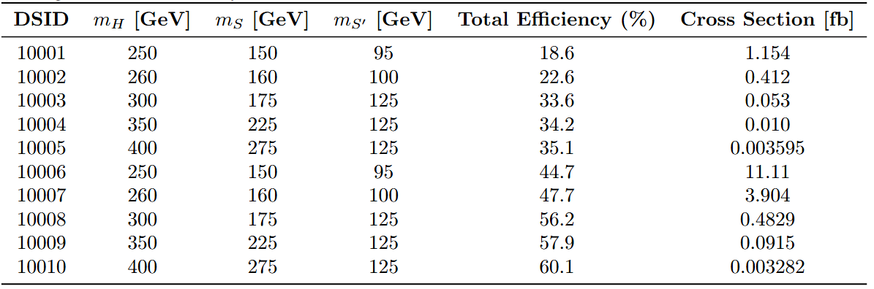
Benchmark cross sections and filters
Total Filter Efficiency =0.186546
Total Filter Efficiency =0.447407

Slide 9
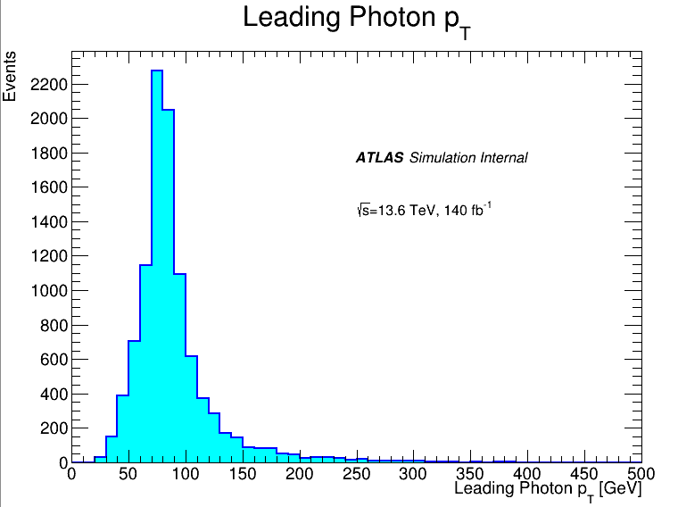
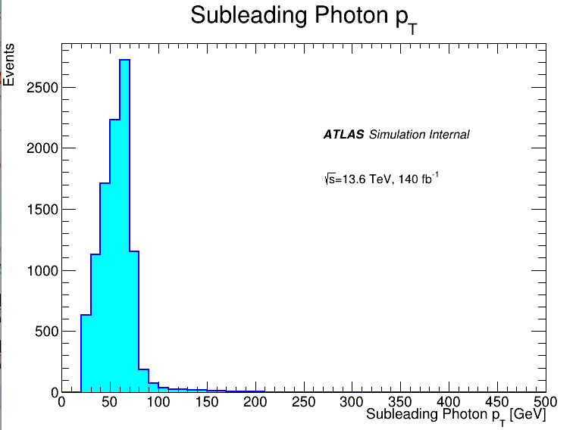

VALIDATION DISTRIBUTIONS
$${PT}_{min}=20 GeV$$
gg → H (250GeV) → S (150 GeV) S’(95GeV)

Slide 10
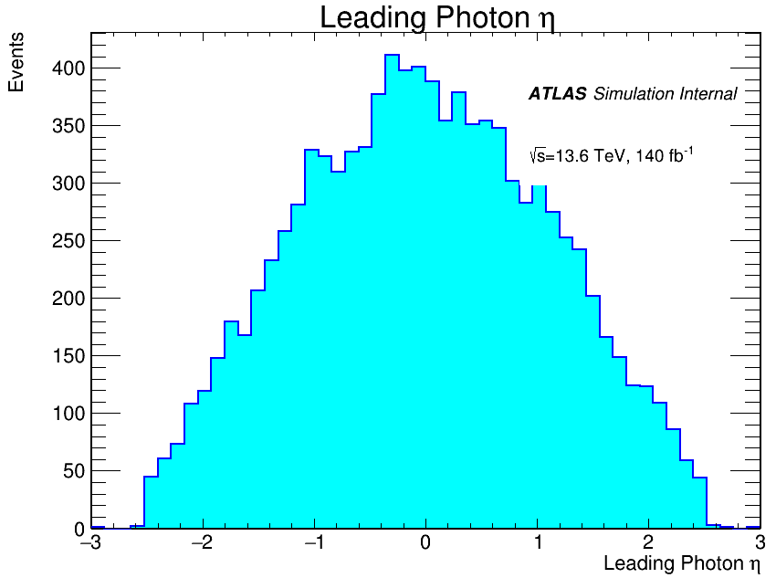
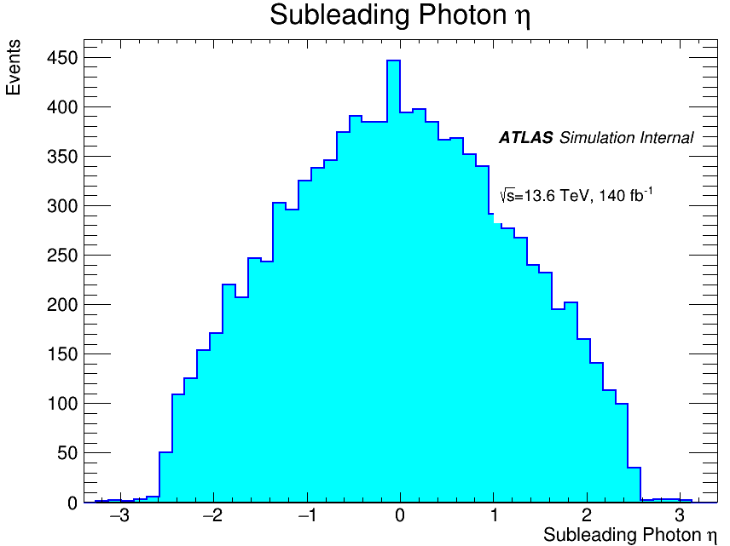

VALIDATION DISTRIBUTIONS
$η_{photon}=2.5$

Slide 11
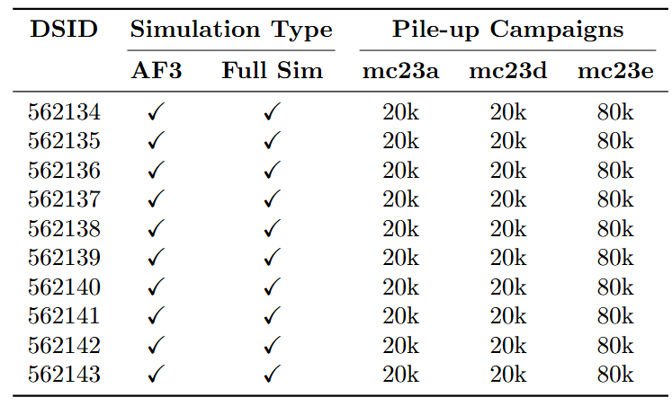
PILE-UP CAMPAIGNS
240k events requested
Full Sim:
Mc23a = 20k
Mc23d = 20k
Mc23e = 80k
AF3:
Mc23a = 20k
Mc23d = 20k
Mc23e = 80k

Slide 12
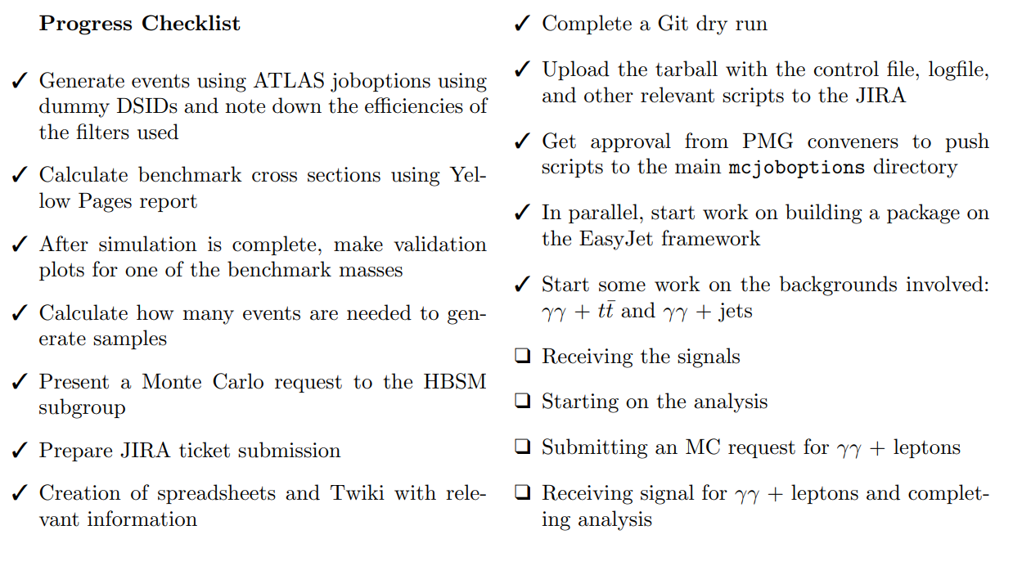
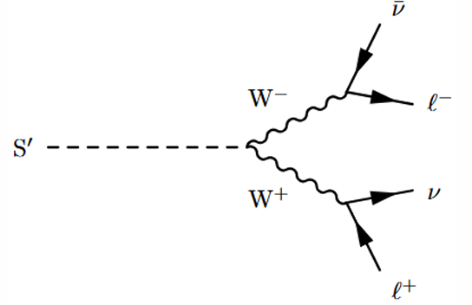
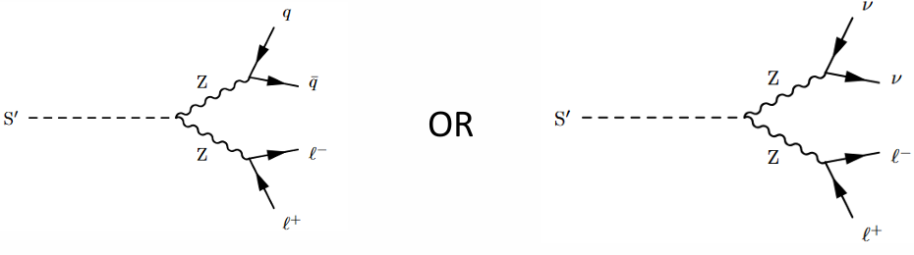
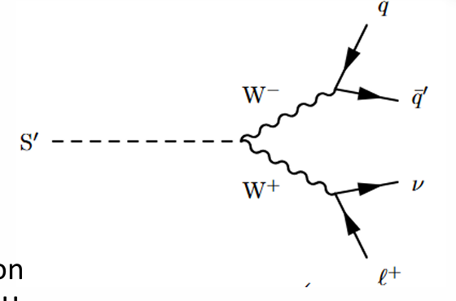
Progress and Future work

Slide 13


