Slide 1
Superconducting Magnet Technology general section meeting
CERN, 4th March 2025
E. Todesco
CERN, Geneva Switzerland

Slide 2
Organigram as of July 2025
15 staffs (+4), 14 fellows and associates (total 29+4), and 6.5 industrial support [we were 15 staff + 16 fellows and associates in April 2024]
  Total 21 for Magnet Lab and Engineering (plus 5.5 industrial support)
  Total 12 for Polymer and HV lab (plus 2 industrial support)
              Newcomers in red
  A. Foussat replacing E. Todesco as SL in case of absence
  A. Haziot replacing J. C. Perez in 927 in case of absence
  S. Clement replacing R. Piccin in Polylab in case of absence
Engineering
Arnaud Foussat
Ariel Haziot
Mikko Karppinen
Alejandro Carlon
(new position)
Juan Carlos Perez
Keiran Geiger (FELL)
Nicola Sala (FELL)
Elena Fernandez Mora (GRAP)
Gonzalo Hernando (GRAP)
Federico Ben el Caid (GRAE)
Nicolas Peray (TEMC)
Sachin Gowrishankar (TECH)
Ignacio Perez (GRAP)
Vendela Roxenborg (GRAE)
Magnet lab
Juan Carlos Perez
Nicholas Lusa (from 9.25)
Winding & Assembly
Dominique Cote
Carlos Fernandes
Gregory Maury
(new position)
Mechanical workshop
(new position)
Polymer and HV lab
Roland Piccin
POLAB Operation & Services
Sébastien Clement
Cedric Urscheler
Instrumentation & Electrical Tests
Francois-Olivier Pincot
Pavan Chaganti
Dielectric materials R&D
Christian Scheuerlein
Javier Osuna (FELL)
Vincent Schenk (GRAP)
Enrico Lanzoni (TRNE)
Daphne Beaujoint (GRAE)
Filip Louka (TECH)

Slide 3
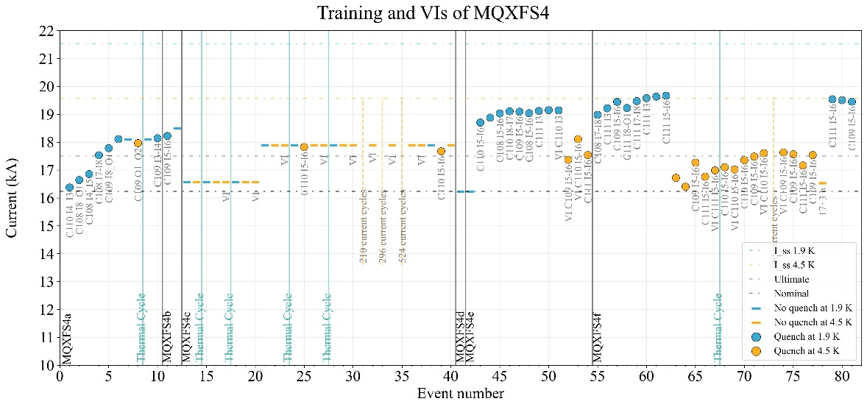
Who’s coming, who’s leaving
Joining the section
  Daphne Beaujoint (GRAE) (with R. Piccin)
  Filip Louka (TECH) (with C. Schuerelin)
Main activities
  Three nested correctors delivered
  MQXFS4f reloaded and tested
  Fusillo delivered
  SMC delivered, ESC and eCLIQ tested
For next six months
  Reassembly of RMM with fishbone, and with new coils
  MQXFS4 program : two/three more tests
  SMC with wax
  Assembly ISAAC
  Support to assembly R2D2 in CEA

Slide 4
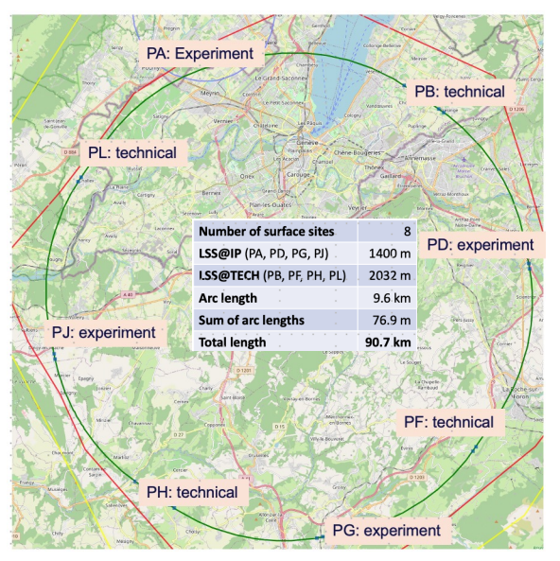
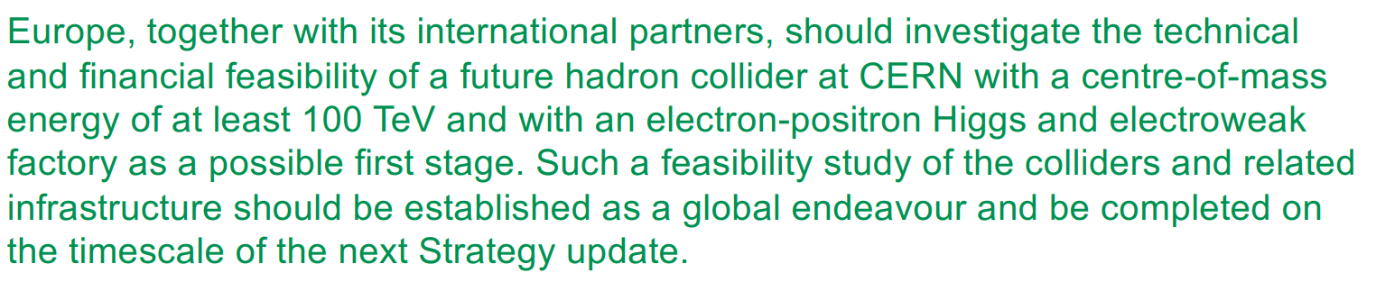
Venice workshop
Workshop to define the European Strategy for Particle Physics
  An event that takes place every five years
  https://agenda.infn.it/event/44943/
  Previous statement in favour of FCC-ee/hh program
  FCC-ee from 2045: a collider of electron and positron
    This needs resisitve magnets
    Plus superconductinve magnets in the interaction region
    The section is not (yet) involved on this – A. Foussat acted as linkperson – we will se how the engagement of the group evolves
  FCC-hh from 2070: a collider proton-proton
    This requires 14 T magnets (see next slide)
FCC location, F. Gianotti talk

Slide 5
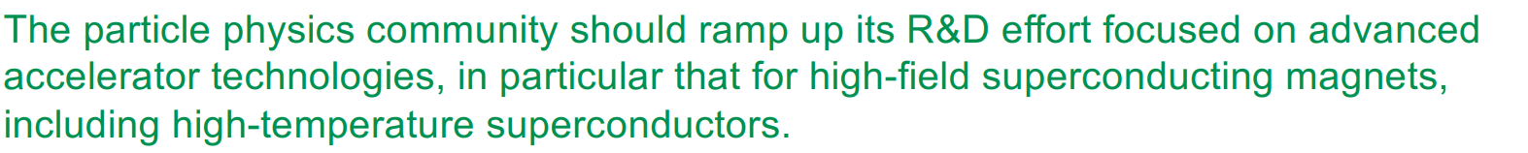
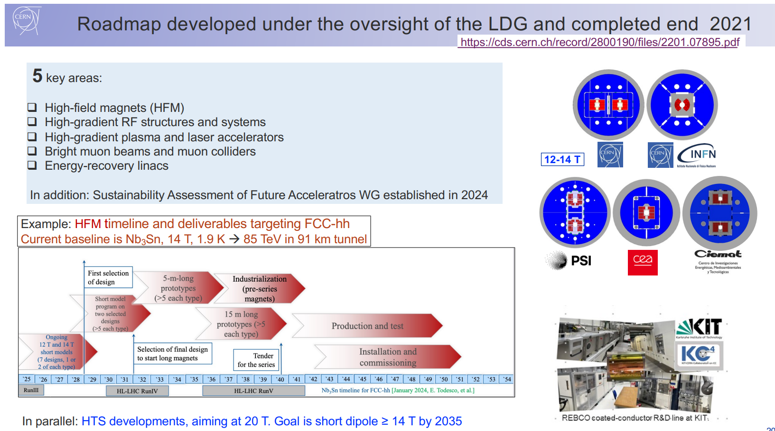
Venice workshop
The last ESPP also supported strongly the R&D on magnets
Main changes:
  The 100 TeV paradigm is abandoned – now the baseline is 85 TeV and 14 T dipole field
  An option of FCC-hh without FCC-ee is also considered, as presented in 2024, with possible beam commissioning of FCC-hh as early as 2050
We have no time to lose !
HFM roadmap, F. Gianotti talk

Slide 6
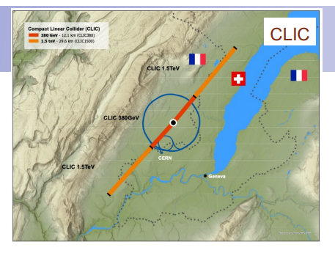
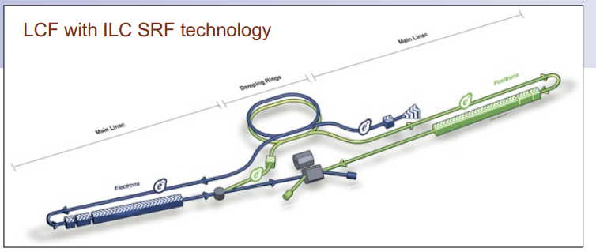
Venice workshop: other options
CLIC
  CERN flagship on novel RF technologies
  Compact linear collider, 1.5 TeV with 30 km
  Based on a novel technology providing 100 MV/m
    100 MV/m * 15 km = 1.5 TeV
ILC
  Linear collider with standard technologies (30 MV/m)
  Japan has been interested since long time, but the study is far to become a project
CLIC location, F. Gianotti talk
ILC sketch, F. Gianotti talk

Slide 7
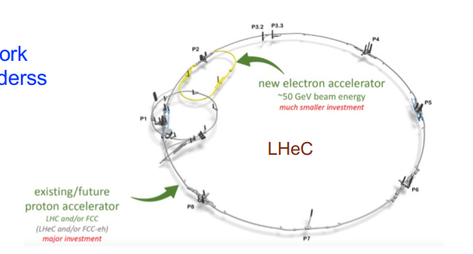
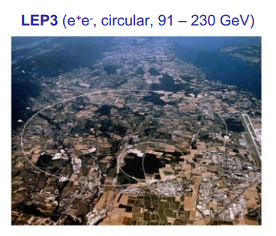
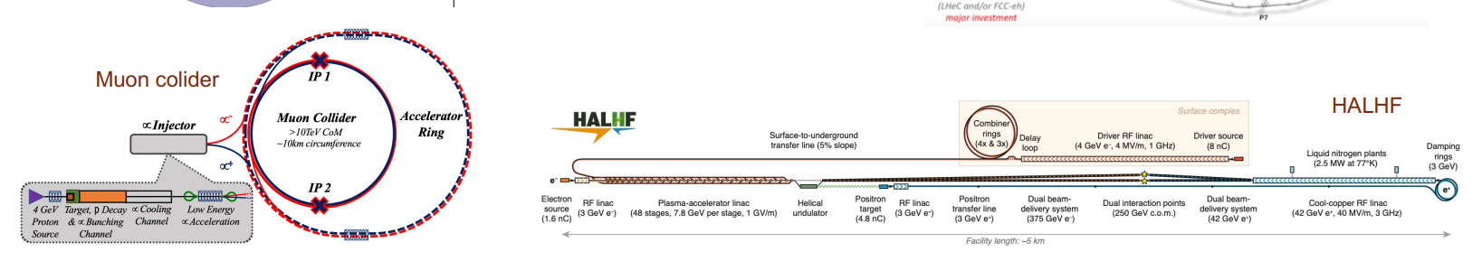
Venice workshop: other options
LHeC
  A 50 GeV electron accelerator to shoot on LHC protons
  Physics of lepton + hadron as in HERA
LEP3
  A collider electron positron at
  A higgs factory in the LHC tunnel – an improved version of LEP
    But with a set of very challenging parameters, to get good luminosity
Muon collider
  Accelerating muons rather than electrons (heavvier, less synchroton radiation)
  They decay rapidly, so they have to be accelerated very rapidly
  Old idea, many technological challenges
MuCol sketch, F. Gianotti talk

Slide 8
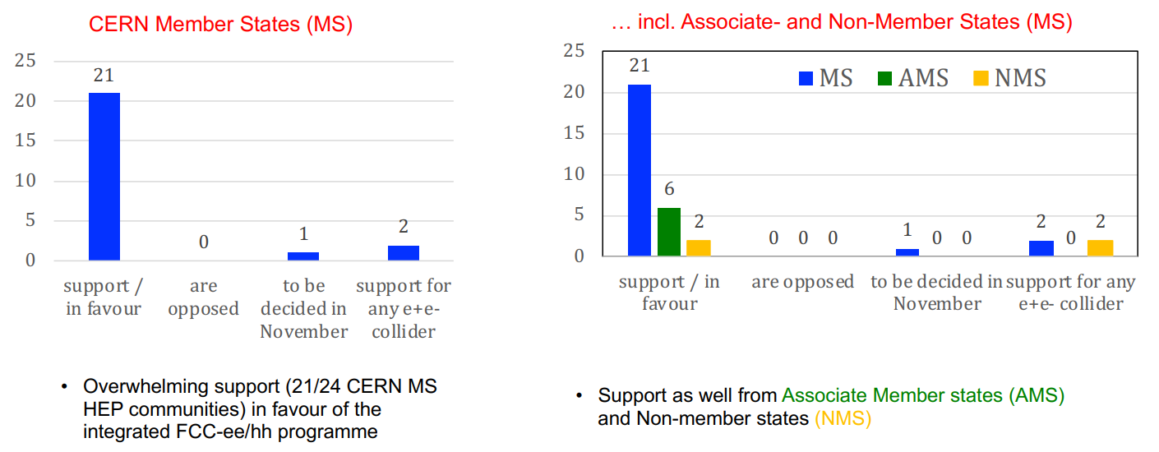
Venice workshop: outcome
Full support to FCC-ee/hh programme
Votes for FCC-ee/hh, K. Jacobs talk

Slide 9
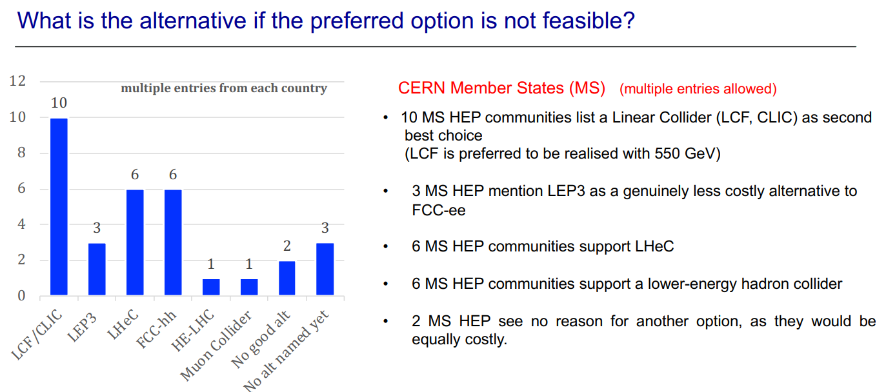
Venice workshop: outcome
What if ?
  Linear option has a relative majority
  The option of FCC-hh is gaining support
  Very little support for muon collider
Votes for alternative scenario, K. Jacobs talk

Slide 10
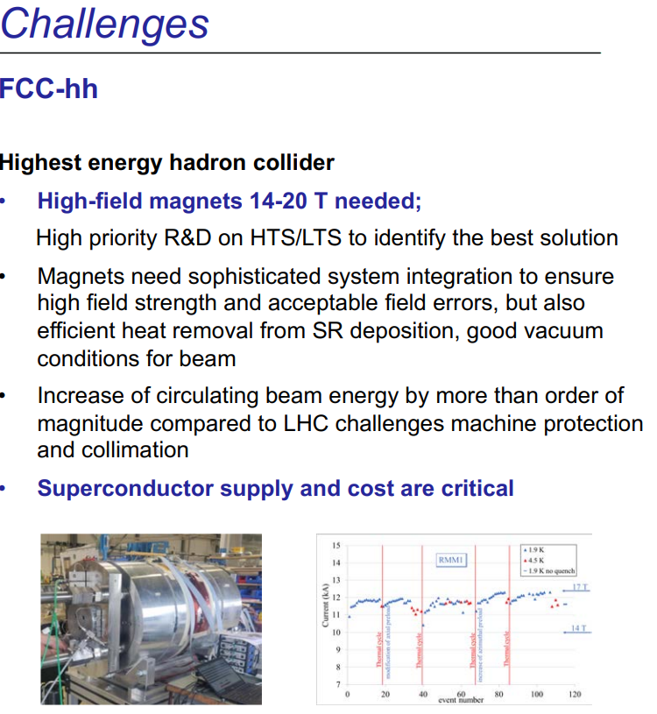
Venice workshop: outcome
The first hardware piece shown in the final slides comes from here !
  The main messages have gone through:
    14 T operational field
    HTS and LTS going in parallel until 2035
    Even in the case of FCC-hh in 2070, strong R&D should be pursuded
Remarks about magnets, K. Jacobs talk

Slide 11
THANKS !

