Slide 1

Introduction - Machining scenarios for LS3:
ATLAS shielding JFC3 and TX1S
JF Section 3 Upper (Octagonal)
O. Boettcher on behalf of WP8
CERN, 23rd March 2021
HL-LHC WP8 meeting

Slide 2
Content overview
Introduction – Machining of ATLAS shielding
Experience from LS2 on JFC machining
Transfer of experience for JFC3 and JFS3U machining in LS3

Slide 3
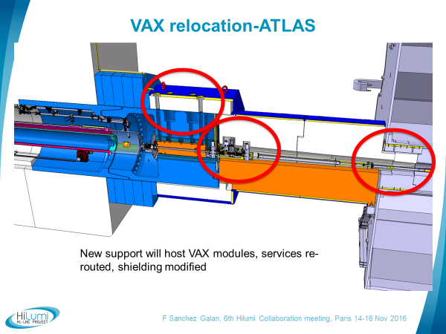
Introduction – Machining of ATLAS shielding

Slide 4
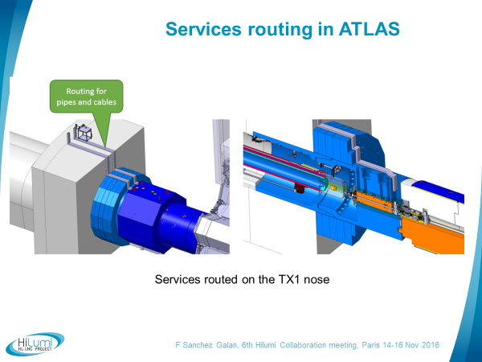
Introduction – Machining of ATLAS shielding

Slide 5
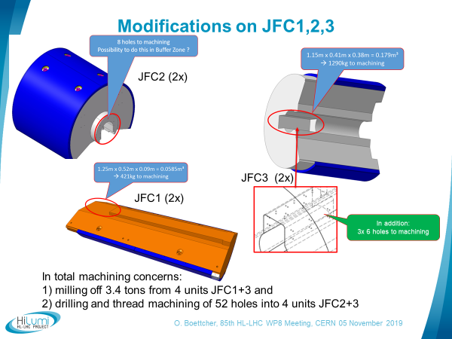
Experience from LS2 on JFC machining
- Specified modifications JFC1,2,3 (6 units) -

Slide 6
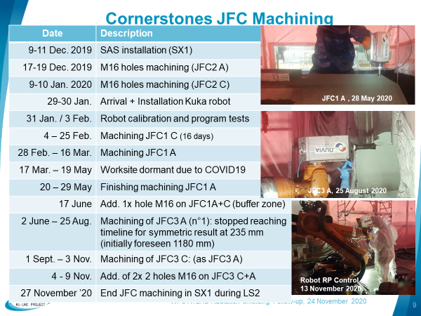
Experience from LS2 on JFC machining
- a full year 2020 project (incl. 2.5 months Covid-19) -
Sept.
Oct.
(from 13 Oct.
in 2x 8h Shift)

Slide 7
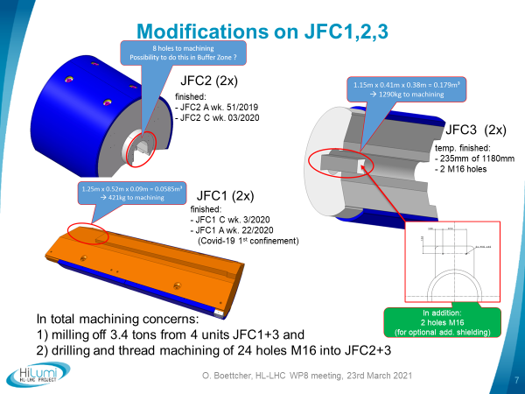
Experience from LS2 on JFC machining
- Realized modifications -

Slide 8
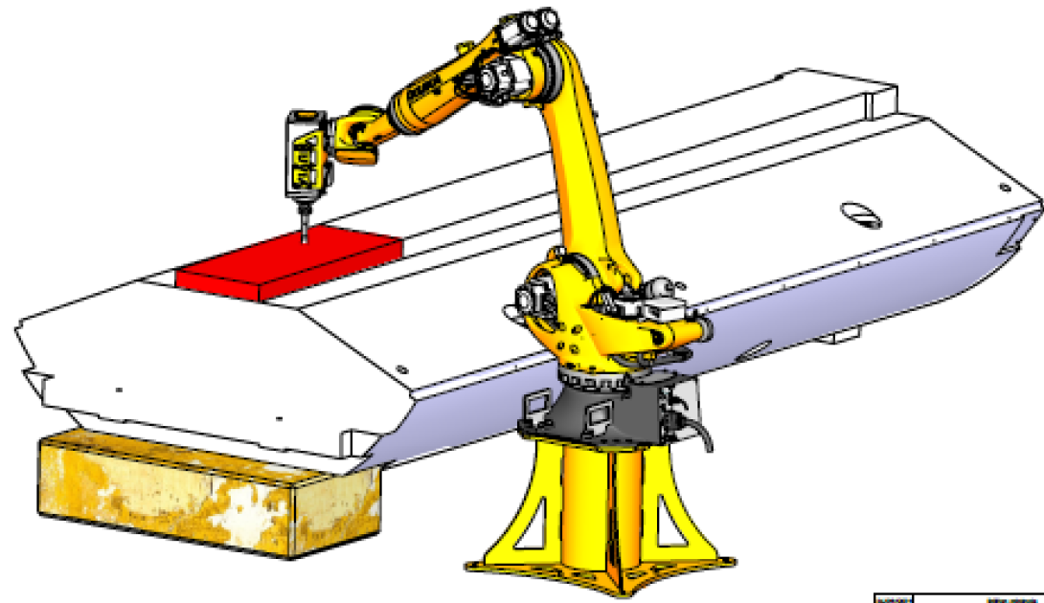
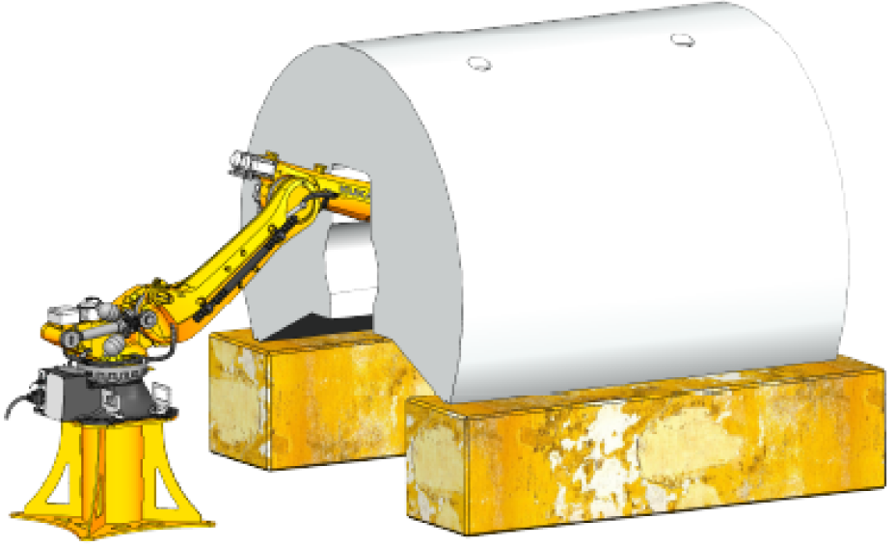
Experience from LS2 on JFC machining
- Results regarding LS3 machining -
X
Each JFC1:
460 kg machined in 15 days ➔ 30.6 kg/day
Each JFC3:
265 kg machined in 60 days ➔ 4.4 kg/day (1day = 8h shift)
In total 1.4 tons milled from 4 JFC1+3 in 150 days (8h shifts):
➔ milling off 2 tons from 2 units JFC3 remain for LS3!!!

Slide 9
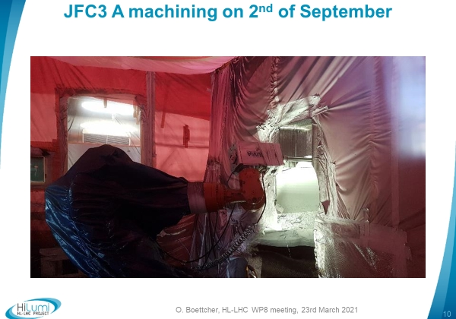
Experience from LS2 on JFC machining
- JFC3 machining process with robot -
The contractor could never solve the challenges and master the process of machining the slot into the JFC3s fully.

Slide 10
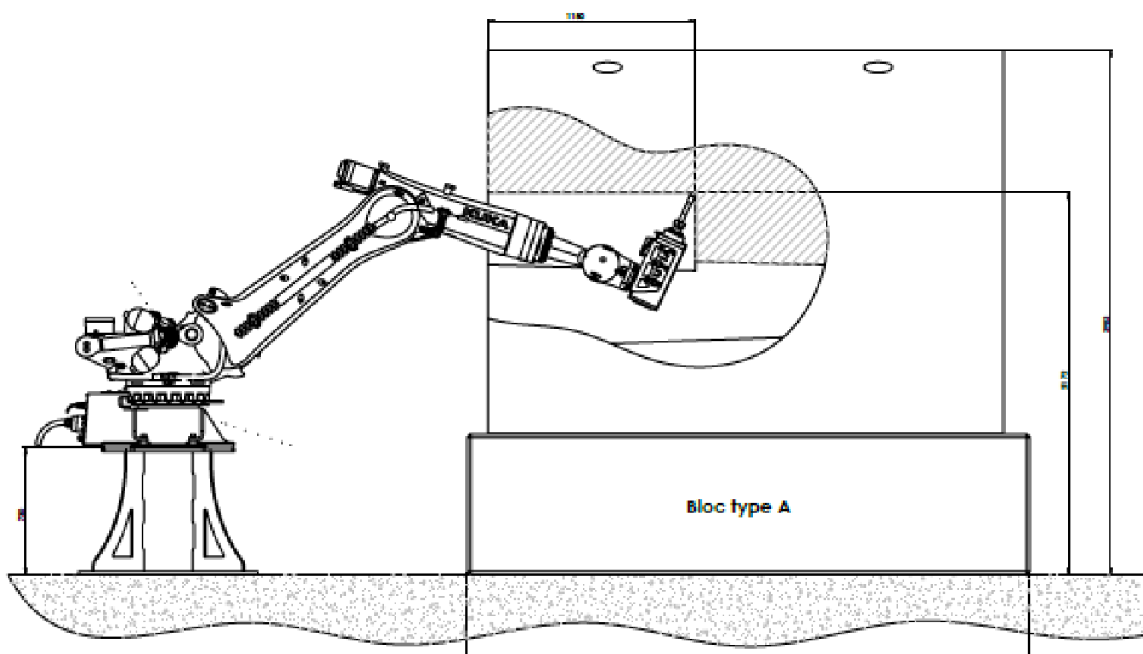
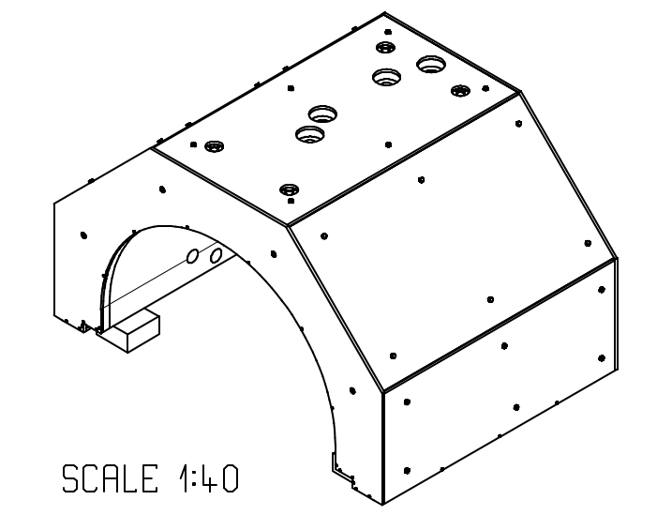
Transfer of experience for JFC3 and JFS machining in LS3
Machining process for JFC3s were by factor 7 slower than for JFC1s .
It seems that the position of the slot to be machined and the orientation of the milling tool were responsible for this difference in machining performance with the robot.
The machining condition for JFS3Us in LS3 will be the same as for JFC3s.
Possibilities to improve the machining process need to be investigated.
The realization of tests are crucial to avoid unexpected long delays of machining ATLAS shielding units in LS3!

Slide 11
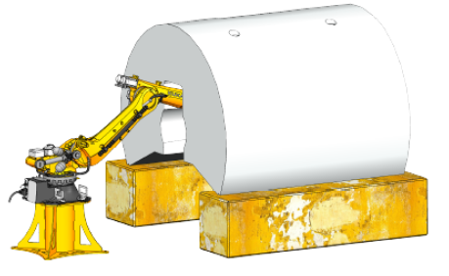
Other considerations
What are the residual doses of JFC3s and JFS3Us in LS3?
(Are these information available? Who provides these data?)
In what time window in LS3, the shielding units would be made available by ATLAS for machining?
What are possible locations for realizing the machining?
Scenarios that need to be studies and discussed:
  Additional costs when machining off ATLAS site?
  Possibilities to automize machining process (e.g. no operators permanently present)?
  Can shielding units be positioned
  alternatively?
  Are there interesting alternatives
  to machining with the robot?

