Slide 1
WP8 – ATLAS MACHINING OPERATIONS
BE-CEM-MRO

Slide 2
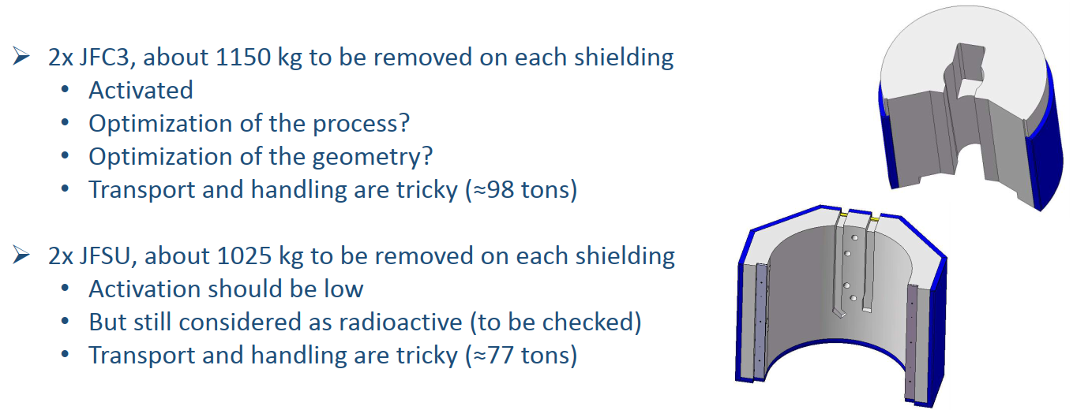
Machining tasks

Slide 3
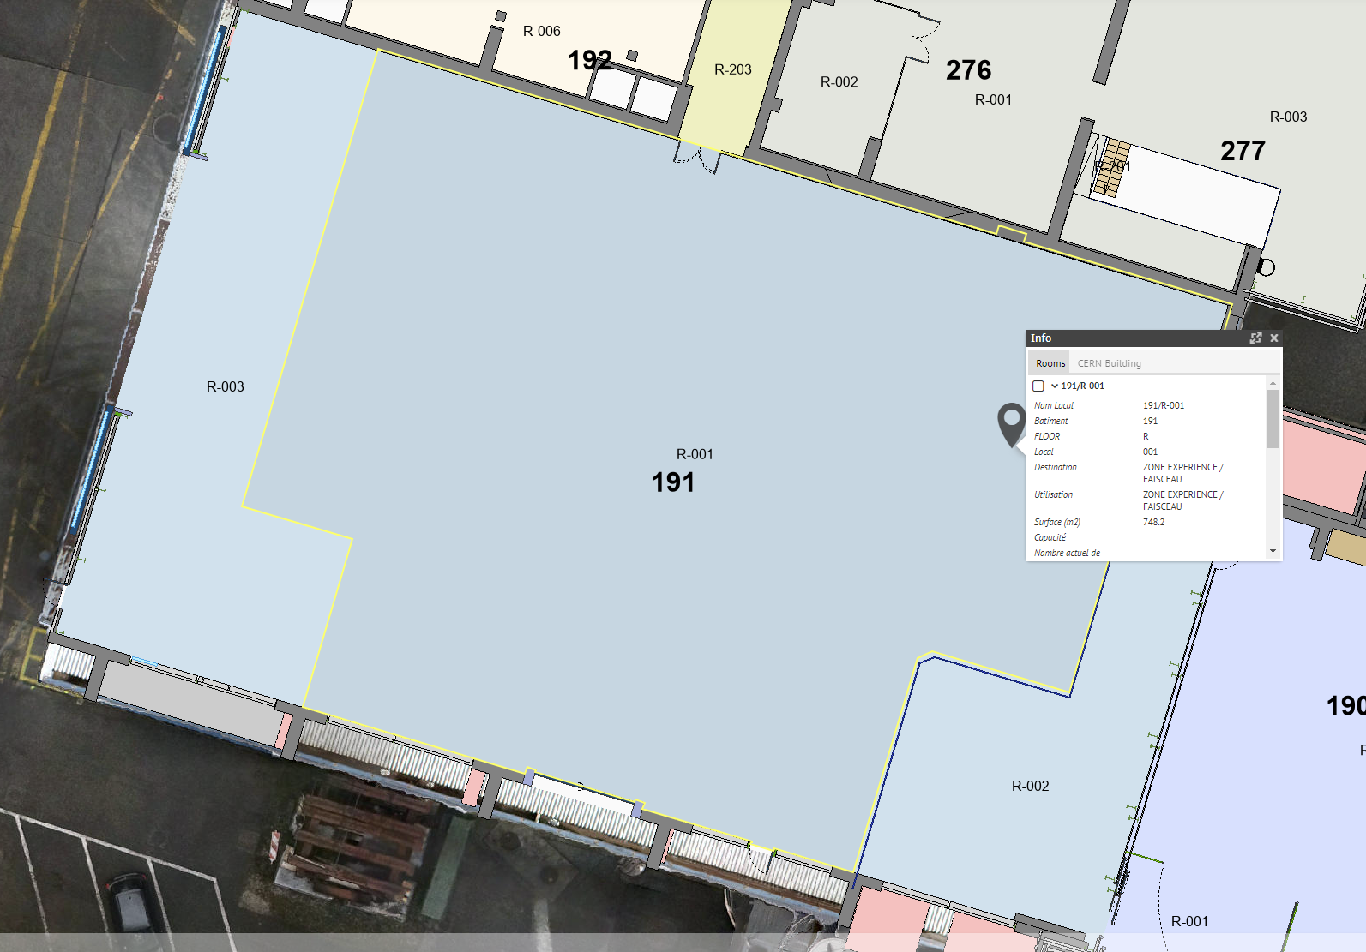
Intervention location
191/R-001

Slide 4
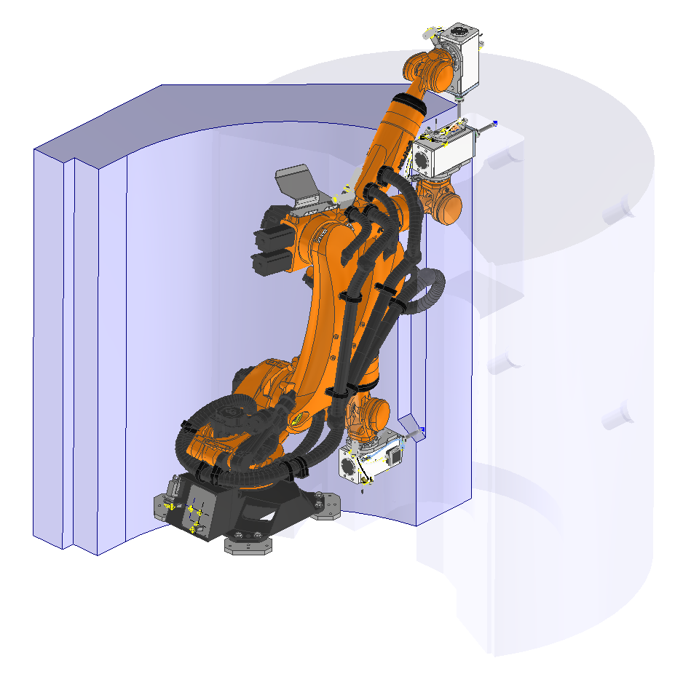
Reachability study
Define the relative position between the robot and the workpiece to:
Optimize the reachability
Increase the milling stability
Minimize the collision risk
Optimize the chips evacuation

Slide 5
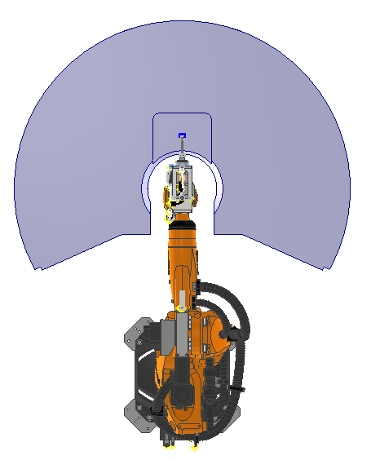
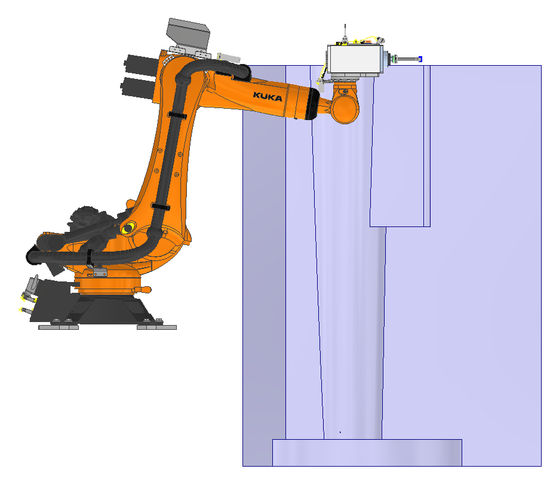
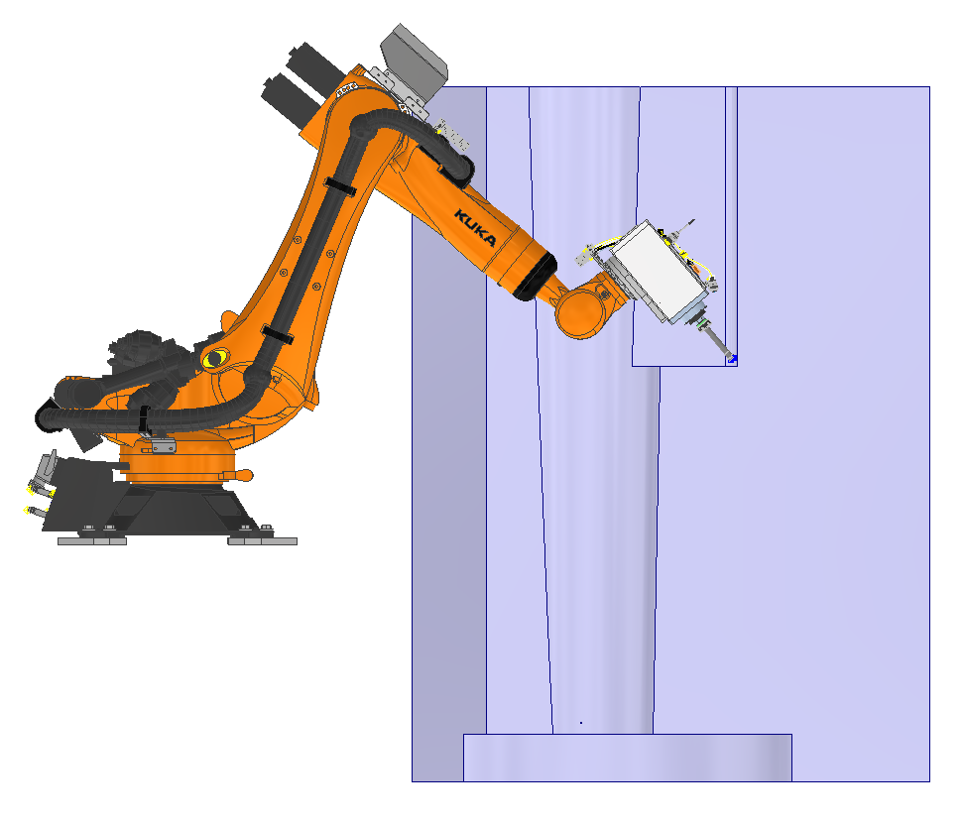
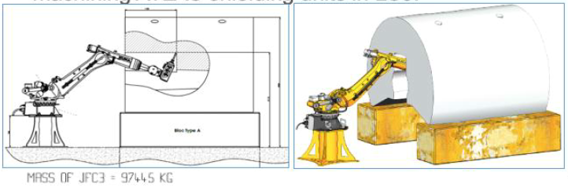
JFC3 machining
Workpiece placement optimization
1000 mm

Slide 6
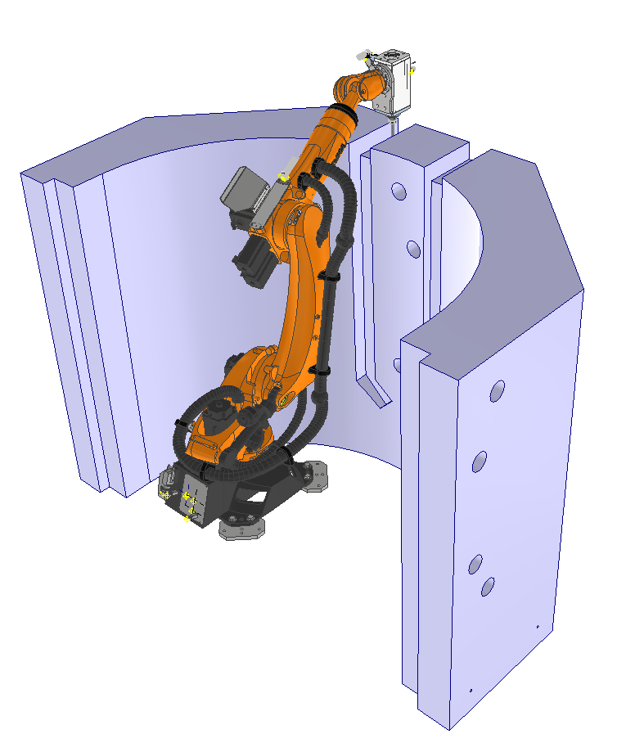
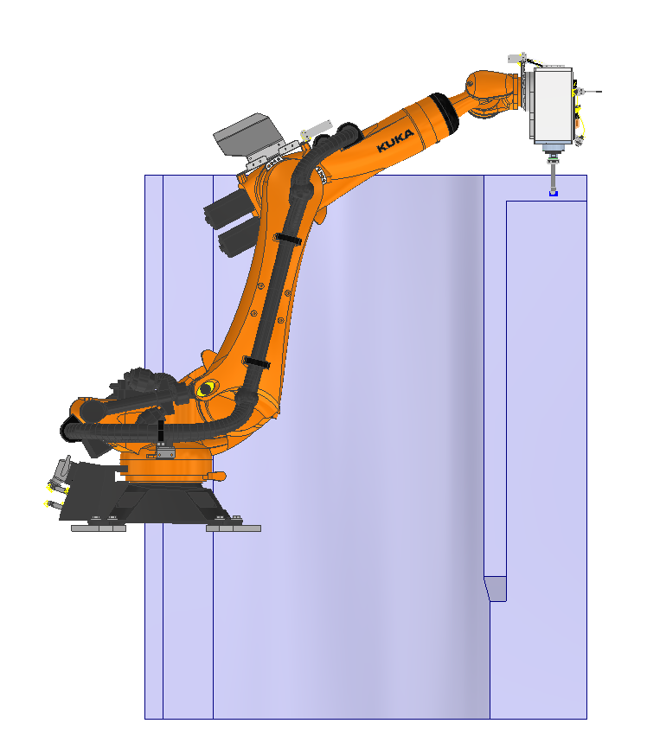
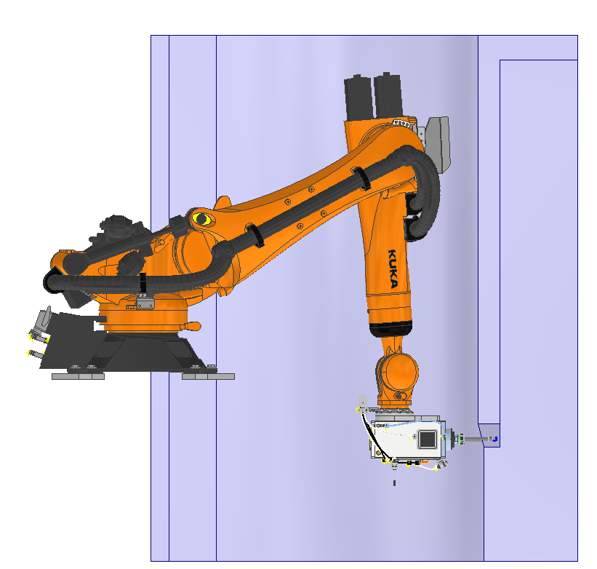
JFSU machining
Workpiece placement optimization
2400 mm
1000 mm

Slide 7
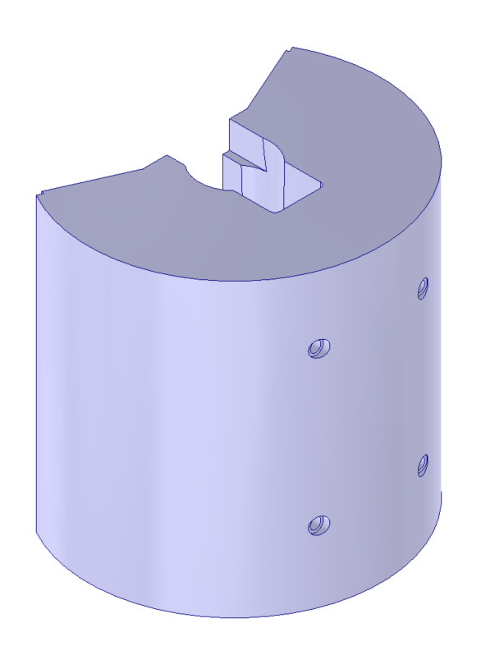
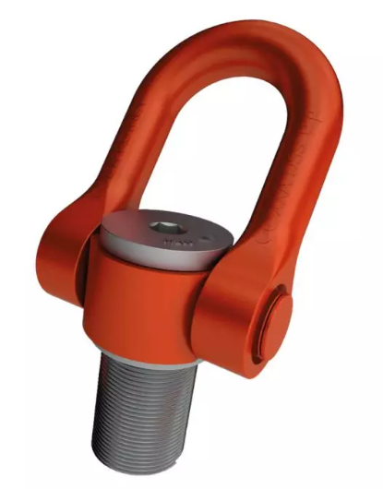
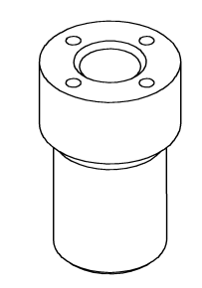
Lifting points
HE has already proposed a solution for rotating the shielding into a vertical position by adding 2 lifting points on the end face
2x M120 lifting points+
Eyebolt spacers
Thanks to Maria Perez Ornedo

Slide 8
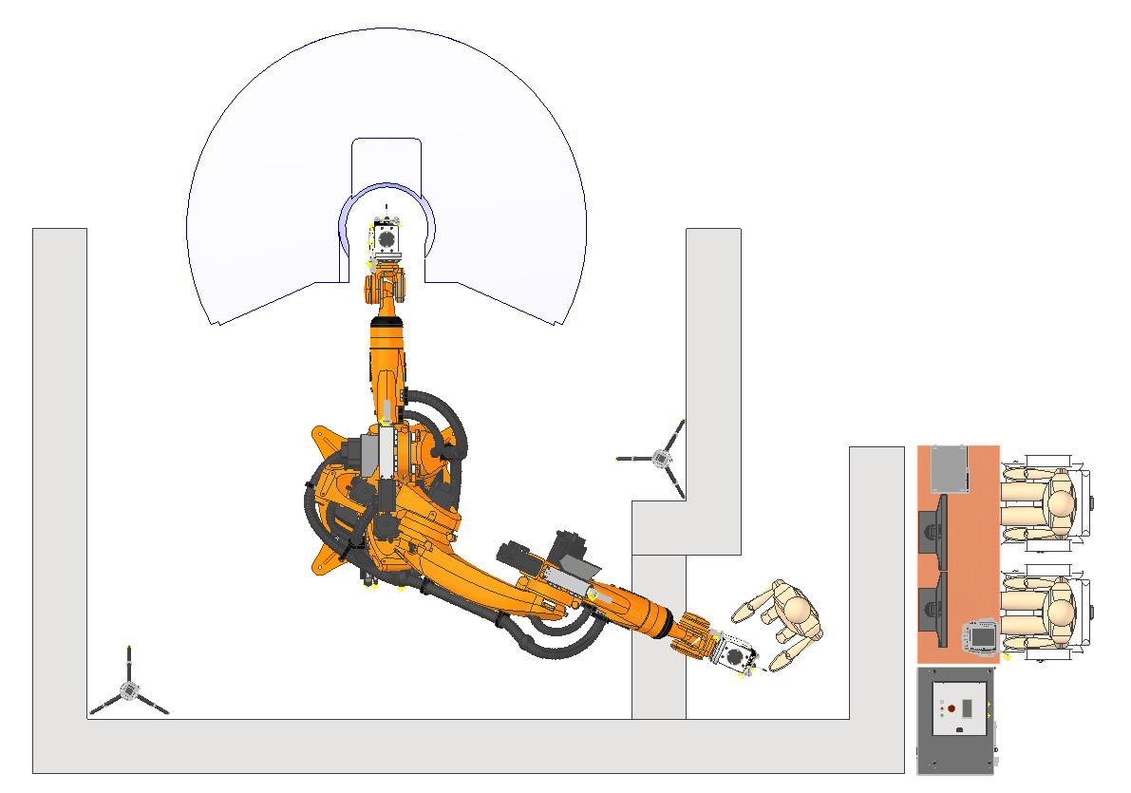
Intervention area
Possible layout
(to be discussed with RP and HE)
Tent?
Control station
(up to 50 m far from the SAS)
Concrete blocks?
Environmental cameras
Kuka and spindle controller
Tool exchange shielded area

Slide 9
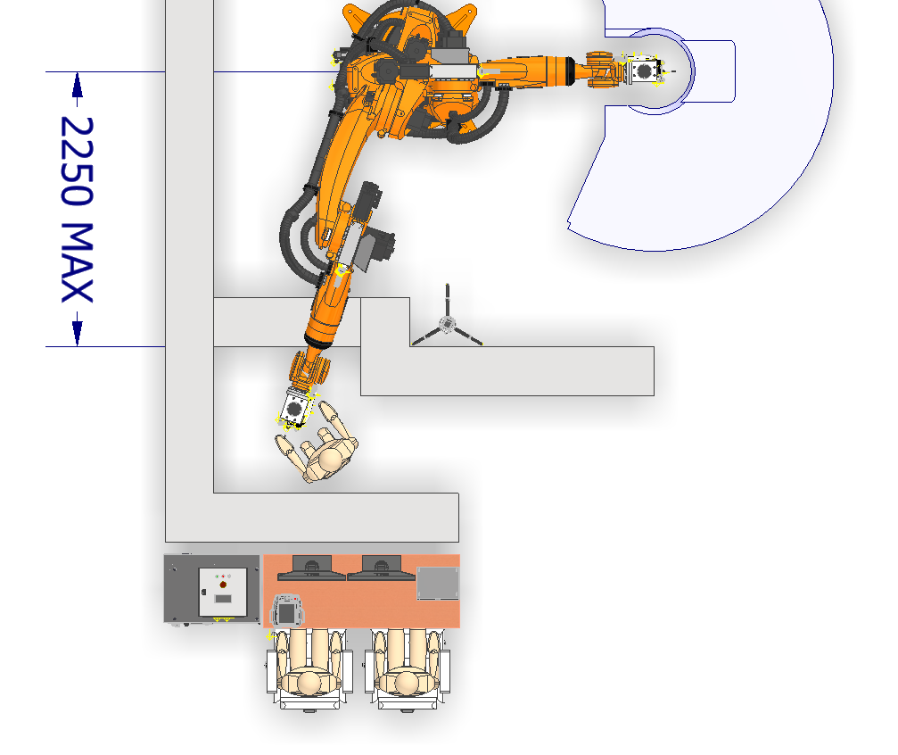
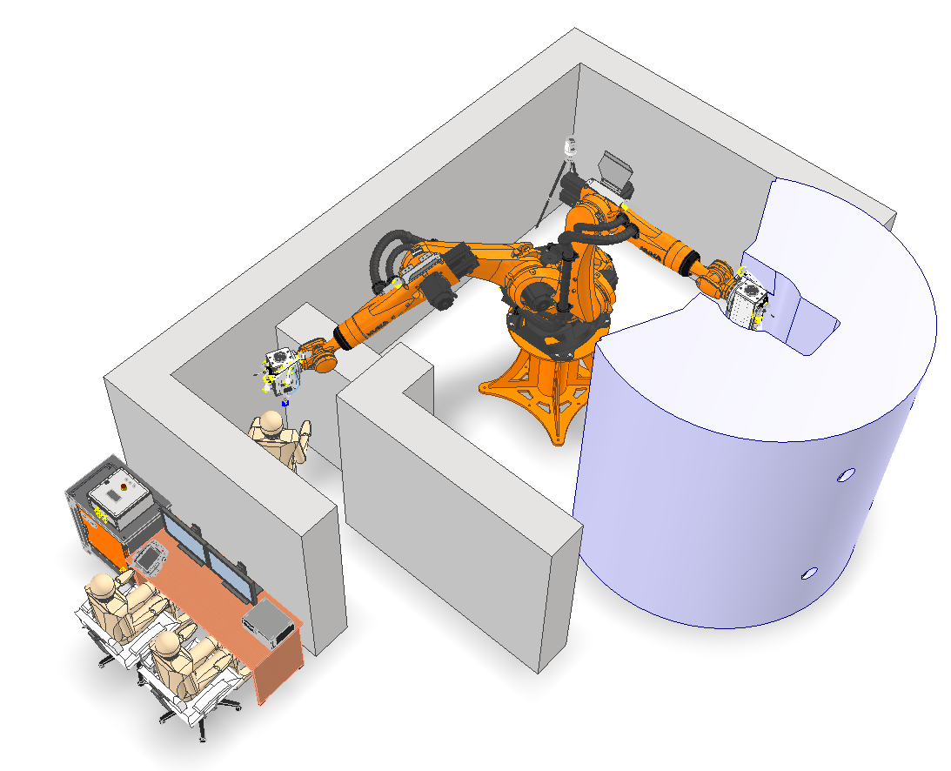
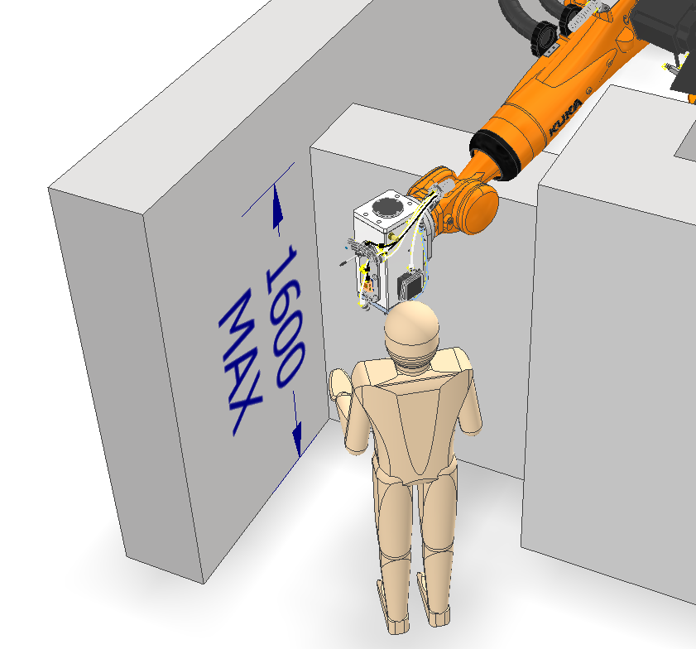
Intervention area
Tool exchange area

Slide 10
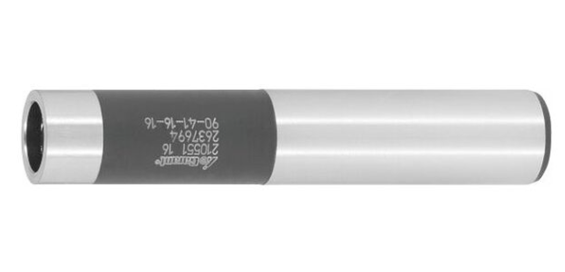
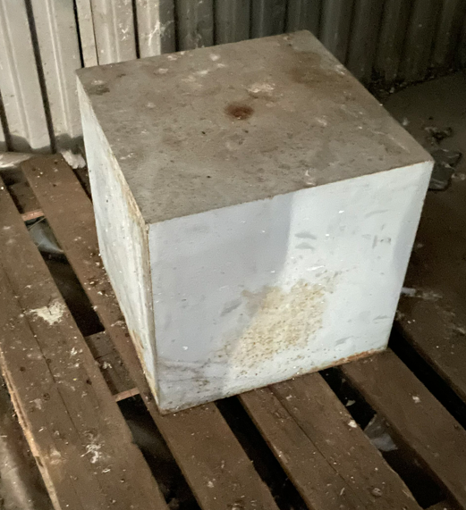
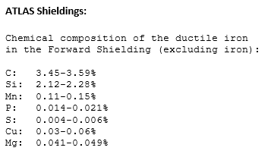
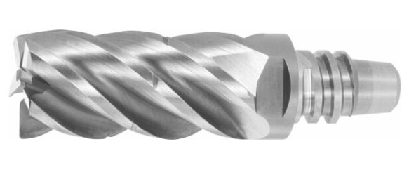
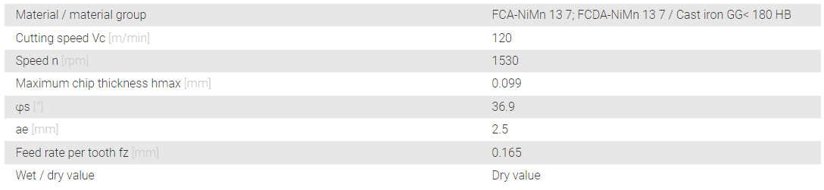
Tool selection
Atlas shielding material and tool choice
25 mm tool extension with anti-vibration system
25 mm TPC milling head with chip separators

Slide 11
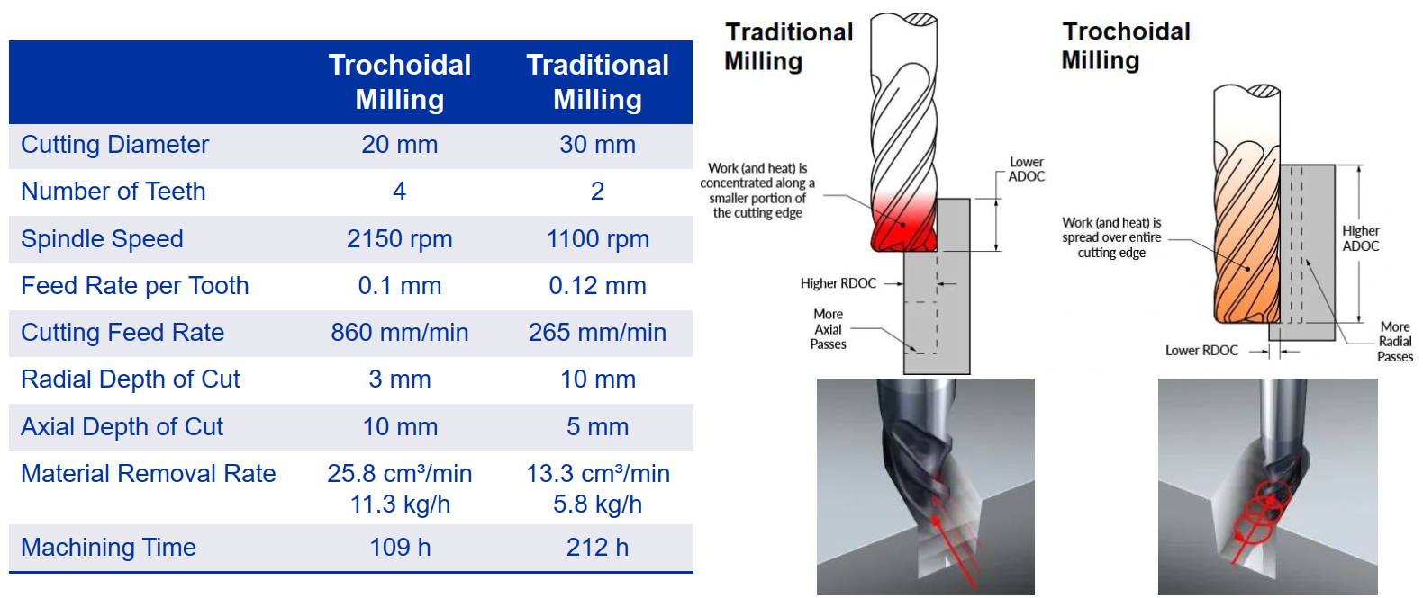
Milling technics

Slide 12
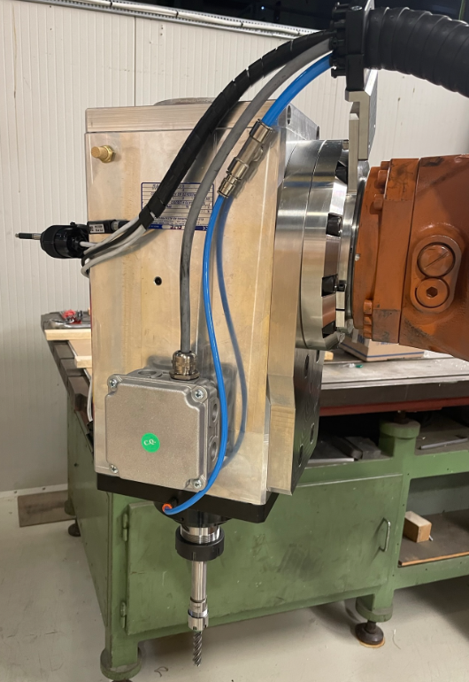
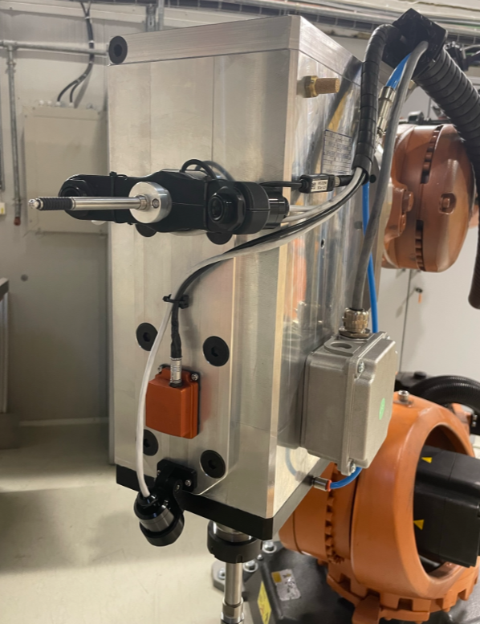
Spindle updates

Slide 13
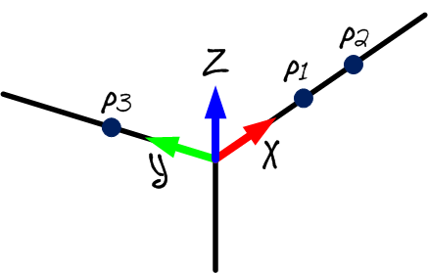
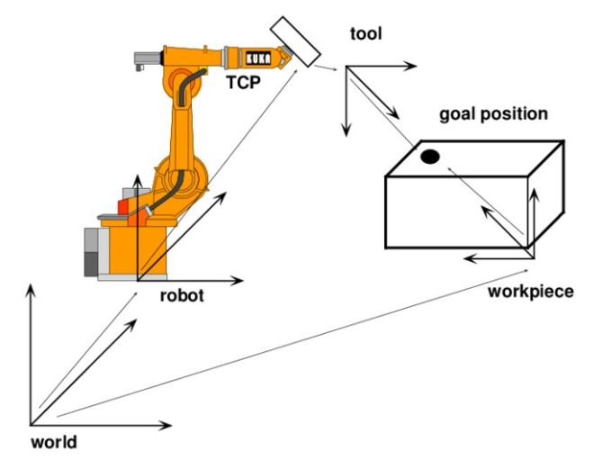
Workpiece calibration
3 points method calibration

Slide 14
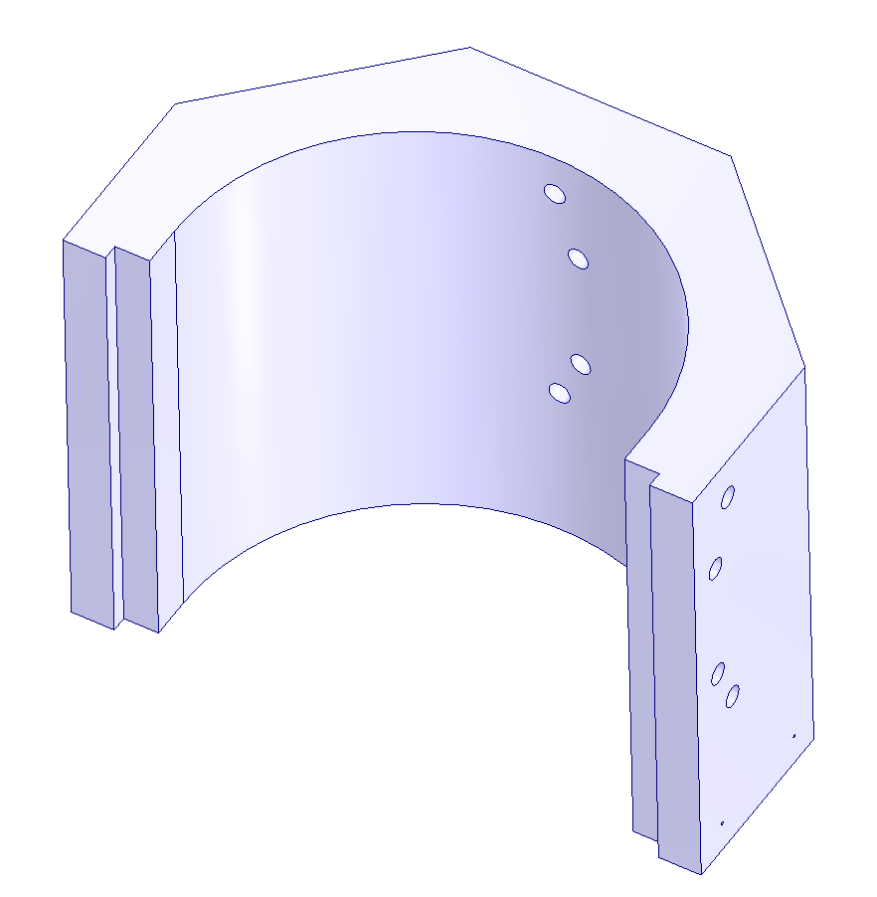
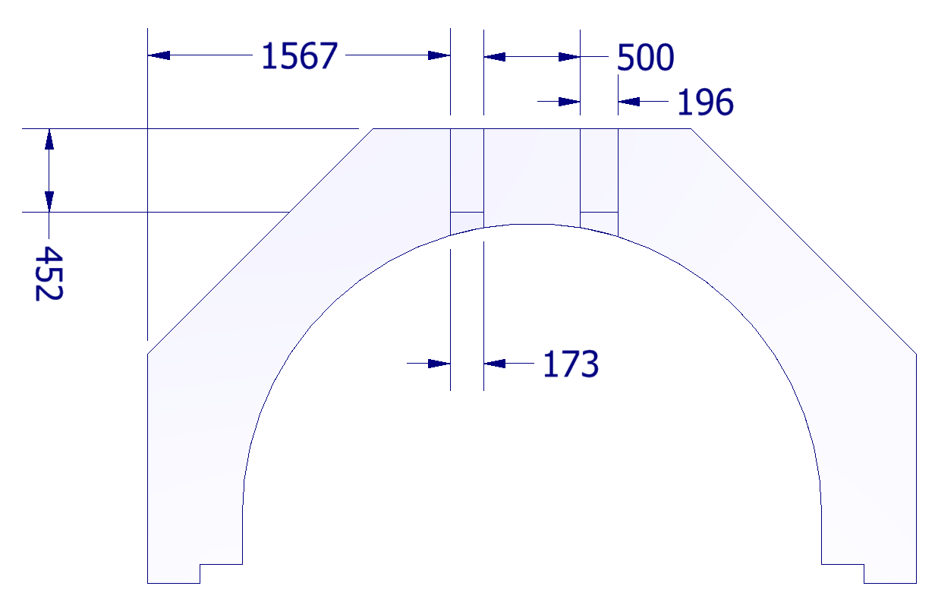
Milling pockets localization
z
Milling pockets localization in the calibrated reference frame
P1
P3
P2
y
y
x
x

Slide 15
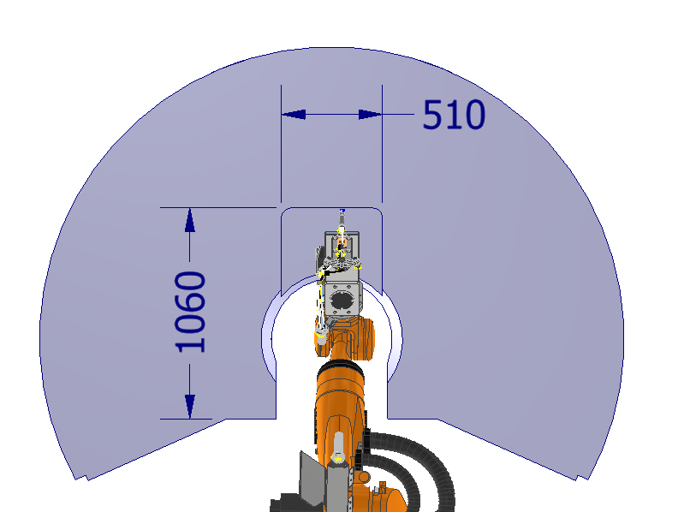
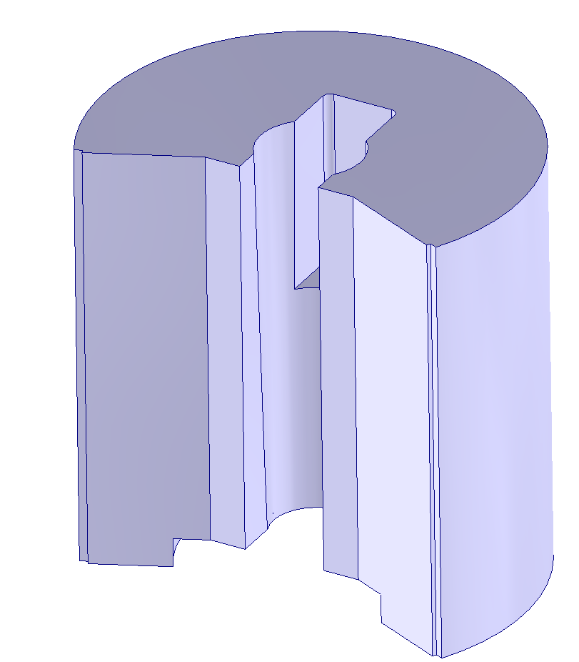
Milling pockets localization
Milling pockets localization in the calibrated reference frame
P3
z
y
P1
y
P2
z
x

Slide 16
Next steps
Check the possibility of installing 2 extra lifting points on the shieldings
Perform milling tests on the shielding sample to optimize the cutting parameters and evaluate the material removal rate (January 2025)
Define the surfaces to be used for the calibration and localization of the milling slots/pockets and the dimensional/geometric tolerances
Start the design the intervention area with RP and HE

