Slide 1
BGI V5 Software Overview

Slide 2
Contents
Timeline
  Tuesday 3 Sept 2024 – Review board
  Thursday 28 Nov 2024 – Review outcome discussion
  Thursday 10 Apr 2025 – Hardware architecture discussion
  … many software meetings …
  06/06 Meeting
  13/06 Meeting
  20/06 Meeting
Architecture Overview
Some Diagrams
Current Progress
Further resources

Slide 3
Review Board Outcomes
“The EMI issues are a significant problem, and we note that the project is taking this seriously and requesting outside expertise from the EMC forum. The related efforts should continue with a high priority.” – We should make sure to work on the EMI issues if possible.
“Other existing frameworks should provide the basis for the BGI solution.” – Software and hardware should use existing and standardised frameworks within CERN.
“We recommend a suitable testbench for gateware test and validation but also for Hardware and Software tests.” – We should make sure testing is more viable with new system.
“Error codes need to be propagated to the user level to clearly identify unsuccessful acquisitions” – The system fails silently too often; errors need to be propagated all the way up to the user.
“The rescheduling of objectives needs to be geared towards a stable operational platform and focus on delivering a definitive architecture and functionality” – We should focus on delivering the final version of the readout.
“We fully support the proposal to move processing from the SoC towards a powerful server computer.” – Processing can be moved away from the SoC.
“We recommend that the OP group takes the lead in preparing a functional specification, in close collaboration with the BI group (BGI team).” – We need a functional spec.
“Due to the likely changes in the data processing architecture, we recommend reducing the deliverables to the machine in the short term. Testing can continue in an expert mode if needed, and delivery of a truly operational instrument should be foreseen when a definitive implementation is more mature.” – We should reduce deliverables to OP and focus on the final readout system.
“We observe that the resources dedicated to the BGI project are limited” – We should be smart about what we decide to work on.

Slide 4
Software issues
• Stability & complexity of current FEC + SoC readout system;
• Limited analysis of Timepix3 data on SoC processor;
(from https://indico.cern.ch/event/1468359/contributions/6182485/attachments/2975999/5238870/BGI-Review-BI-TB-28-Nov-2024.pdf)

Slide 5
Hardware Architecture Discussion Outcomes
Decisions:
The BGI system will not use the ATS SoC module.
Standard FECs with PCIe-based SoC/FPGA mezzanine modules will be used.
The BGI team will select their PCIe mezzanine module.
If feasible, BGI may port to the ATS SoM during LS3.
Develop software on a commercial PCIe board in 2025; plan migration to CEM hardware for LS3.
Prototype system to be demonstrated by end of 2025, maintaining progress toward LS3 readiness.
(from minutes of meeting)

Slide 6
06/06 Software Meeting
Decisions:
Internal Driver to be integrated with BIPXL API in a single layer; Wrapper and Extender stay as separate, all NFS-deployed, no sub-modules
Plan to write architecture doc (wiki → EDMS) by end of June
    Started here, not complete: https://confluence.cern.ch/display/BEBI/BIPXL+V5
    Also, the functional spec had already been started: https://confluence.cern.ch/download/attachments/620372845/BIPXL_Engineering_Specification.docx?version=1&modificationDate=1751315205275&api=v2

Slide 7
13/06 Software Meeting
Decisions:
Startup sequence & detector serial number acquisition to be implemented as next V5 step
Stick with existing FESA class model (max properties + subset usage)
Avoid multiple modes; prefer one mode with toggles for features (e.g. auto reconfig/masking)
    i.e. a flag for OP or EXPERT mode which would contain a lockout
    A flag for fake data mode too
No preprocess raw data (no row/column conversion / no combined timestamp calculation)
Unsolved:
How to implement a “lock out” mechanism for exclusive device access (e.g. reserving)

Slide 8
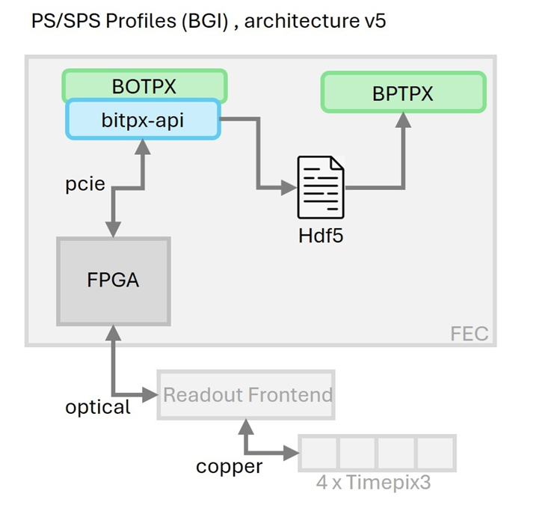
20/06 Software Meeting
Decisions:
Metadata will be saved with acquisition data to capture settings, despite overhead.
Focus remains on Timepix3 for PS and SPS BGIs for now, despite Timepix4 existing.
Third FESA architecture choice
Unsolved:
Start up sequence should allow to be shorter (restart electronics but keep cathode ramped)
How to best break circular dependencies in the Internal Driver and how to reorganize it in general?

Slide 9
Architecture Overview / Decisions
Use standard libraries and frameworks used in BI (highlighted in the review).
    These include but are not limited to:
      EDGE (and Cheby) for the low-level driver (and gateware).
      The EDGE wrapper and extender as part of the BI-SW ecosystem.
      CMW services if compatible with out use case, for example cmw-log.
      FESA
Use HDF5 as a standard file format as part of a group-wide decision.
    All metadata in the file
    No preprocessing
Start from a minimum viable product in the form of a vertical stack.
    Software creates maintenance requirements, so it is better to avoid implementing features until needed.
Use logging and tracing services available to us. Furthermore, propagate errors and warnings to users.
  This was particularly highlighted by the review, as in V4, the users are often left in the dark about why the system is not working.
Ensure we have a full testing environment for both software and hardware and for all layers
    Using GMOCK for this, adding tests to each method as we go.
Using C++ exceptions as opposed to return codes.
Having FESA manage threads instead of doing it in our libraries.
  FESA has much more robust threading capabilities.
  Still, our libraries must be thread-safe, even though the FESA class design should eliminate most concurrency.
In FESA, in addition to publishing at the end of the cycle, we can have a “heartbeat” e.g. once per second for non-BPM (diagnostic) values like the temperatures.
The slow control (power supplies, cooling, etc) will all be controlled in and by the main FESA class to keep everything consistent and to provide failsafe's.

Slide 10
Some diagrams….

Slide 11
Application
HTTP
V4
Utility process
PyJapc
V5
Library
IPbus
Legacy library
Expert GUI (Python – PyQt6)
OP GUI
OP GUI
Files
Fibre
VM
Expert GUI (Python)
BIPXL Expert API (Pybind11 + Python)
VM
FESA (C++)
Device Specific FESA Class (C++)
BIPXL API (C++)
Raw Data (HDF5)
nginx reverse proxy
BIPXL Software Driver (C++)
BIPXL CTL FESA Class (C++)
IPbus ControlHub
BIPXL Core Library (C++)
FEC
EDGE Extender (Semi-Auto)
PS
EDGE Wrapper (Auto-generated)
Event Processing Application (C++)
REST server (Python)
EDGE Driver (Auto-generated)
Pybind11 Python wrapper (C++)
Custom Wishbone module (Python)
FEC
BIPXL Internal Driver (C++)
PL-FPGA
SoC
PL-FPGA
SoC

Slide 12
Application
HTTP
V5
V4
Utility process
PyJapc
Library
IPbus
Legacy library
Expert GUI (Python – PyQt6)
OP GUI
OP GUI
Files
Fibre
Expert GUI (Python)
FESA / UCAP Node / Other Service
BIPXL Expert API (Pybind11 + Python)
VM
Raw Data (HDF5)
FESA (C++)
VM / NFS / Server
BIPXL API (C++)
nginx reverse proxy
BIPXL Software Driver (C++)
BIPXL CTL FESA Class (C++)
BIPXL Core Library (C++)
IPbus ControlHub
FEC
EDGE Extender (Semi-Auto)
PS
EDGE Wrapper (Auto-generated)
Event Processing Application (C++)
REST server (Python)
EDGE Driver (Auto-generated)
FEC
Pybind11 Python wrapper (C++)
Custom Wishbone module (Python)
BIPXL Internal Driver (C++)
PL-FPGA
SoC
PL-FPGA
SoC

Slide 13
V5
Expert GUI (Python – PyQt6)
OP GUI
VM
UCAP Node / Other Service
Raw Data (HDF5)
Device Specific FESA Class (C++)
NFS
Raw Data (HDF5)
BIPXL CTL FESA Class (C++)
BIPXL Core Library (C++)
EDGE Extender (Semi-Auto)
EDGE Wrapper (Auto-generated)
EDGE Driver (Auto-generated)
FEC
PL-FPGA
SoC

Slide 14
Current Progress
Overview of existing functionality
(We will not copy this 1 for 1, we will only implement things that are necessary).
BIPXL CTL FESA Class (C++)
bipxl_gateware_info (very very small)
data_controller
detector_controller
event_assembler
fast_bus
gbt_fpga
gbt_sc
shutter_controller
system_controller
trigger_controller
zcu102_peripherals
4/11 blocks = ~36%
BIPXL Core Library (C++)
EDGE Extender (Semi-Auto)
EDGE Wrapper (Auto-generated)
EDGE Driver (Auto-generated)
FEC

Slide 15
The current plan
Finish a vertical stack to make sure we can communicate with the detectors like this.
Slowly start to flesh out the extender and the Core Library until we have all the functionality we need (and no more).

Slide 16
Some further reading….
Requirements:
OP has written some requirements, so have we.
OP: https://cernbox.cern.ch/external/public/PtA18Vw1yT3d66v/BGI-FS-001.docx
Ours: https://cernbox.cern.ch/s/wD7JNjbZXV37gT7
Specs:
Engineering/Functional Spec: https://confluence.cern.ch/download/attachments/620372845/BIPXL_Engineering_Specification.docx?version=1&modificationDate=1751315205275&api=v2
Architecture overview: Started here, not complete: https://confluence.cern.ch/display/BEBI/BIPXL+V5
Overview of current features: Overview of existing functionality

