Slide 1

Tracing proposals for non-beam components by BE-GM
Anna-Sarah Mezzatesta – HL-LHC Integration Meeting – 04/07/2025

Slide 2
Support of BE-GM for HL-LHC installation
HL-LHC installation will present significant challenges, given the participation of multiple equipment owners and the tight installation tolerances.
Avoid any interferences between equipment and delays in the installation
In response to the HL-LHC project’s request, the BE-GM group proposes to offer its support for the tracing of non-beam elements (out of the BE-GM mandate).
  Significant increase of the tracing requirements
  Need to define a new workflow & Automatise the tracing process that is today still done manually
  Assure an efficient and accurate tracing for an efficient and accurate installation
Equipment owners are responsible for supplying their input and are required to ensure the quality control of the data they provide.

Slide 3
Definition of the tracing requirements
More than 20 discussions organized with Equipment Owners and teams responsible for the installation
Definition of the tracing needs for each of the teams
Gathering the inputs
Tracing proposals according to the robotic solution constraints

Slide 4
Pre-Installation Key Points
BE-GM will perform a 3D scan of the LHC tunnel after deinstallation, the result will be provided to the Integration team to study the offsets between the theoretical tunnel and the real one.
The tunnel floor will be refurbished before tracing
We need a clean and empty tunnel to perform an accurate tracing (no coactivity)

Slide 5
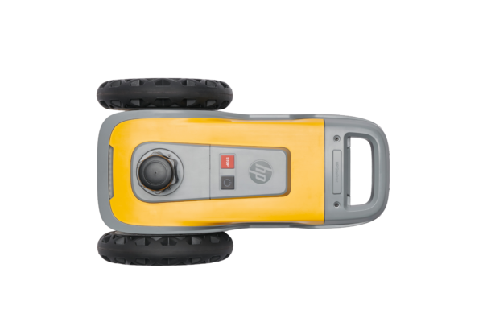
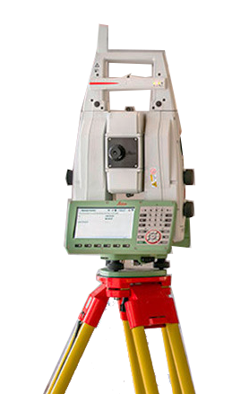
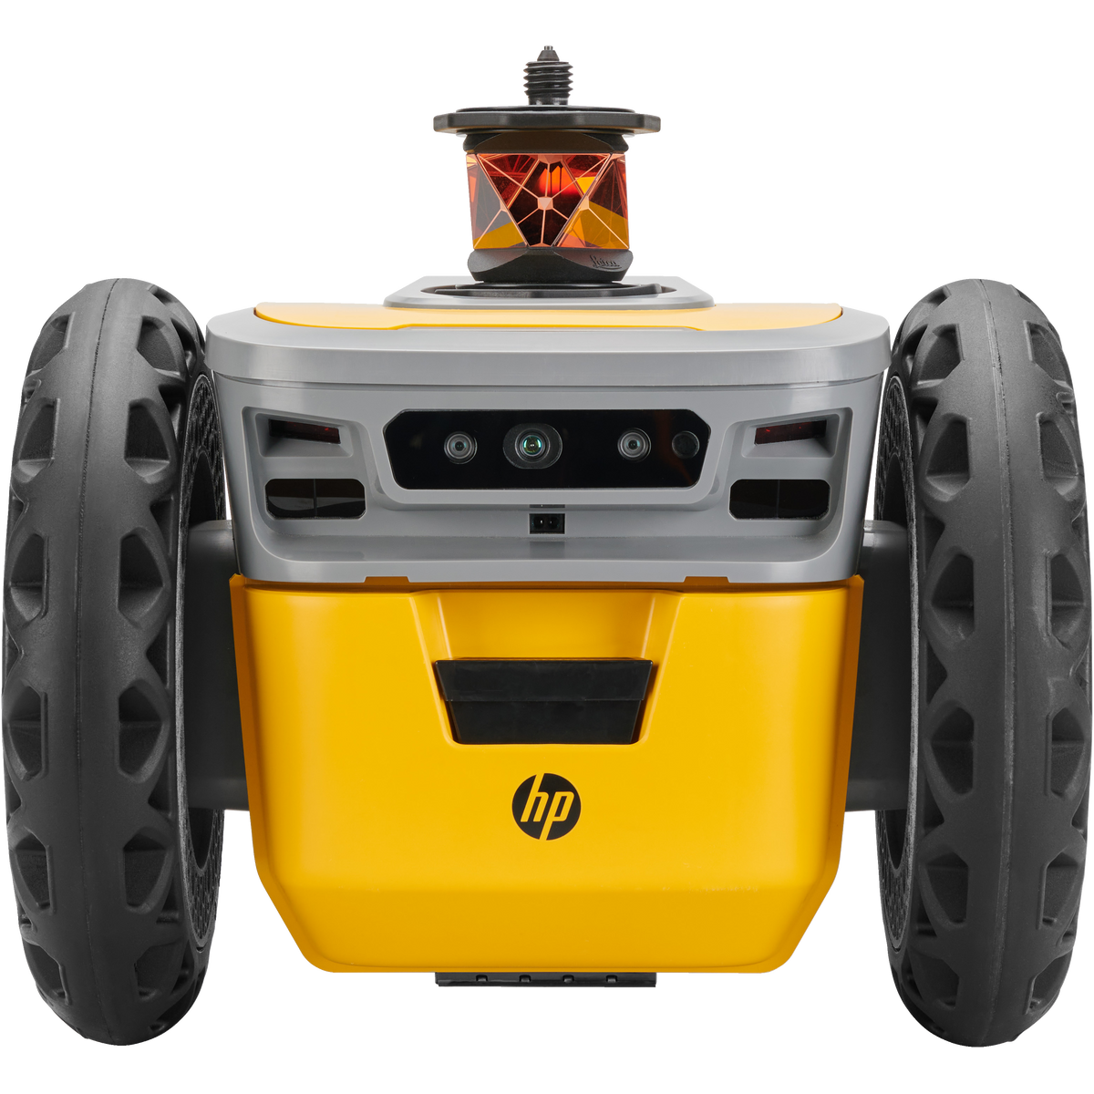
The robotic tracing system : HP SitePrint
How does it work ?
CAD File :
Network points
Obstacles in the area
Elements to print
Link with Total Station
Set Up Total Station
Transmission to the robot
5

Slide 6
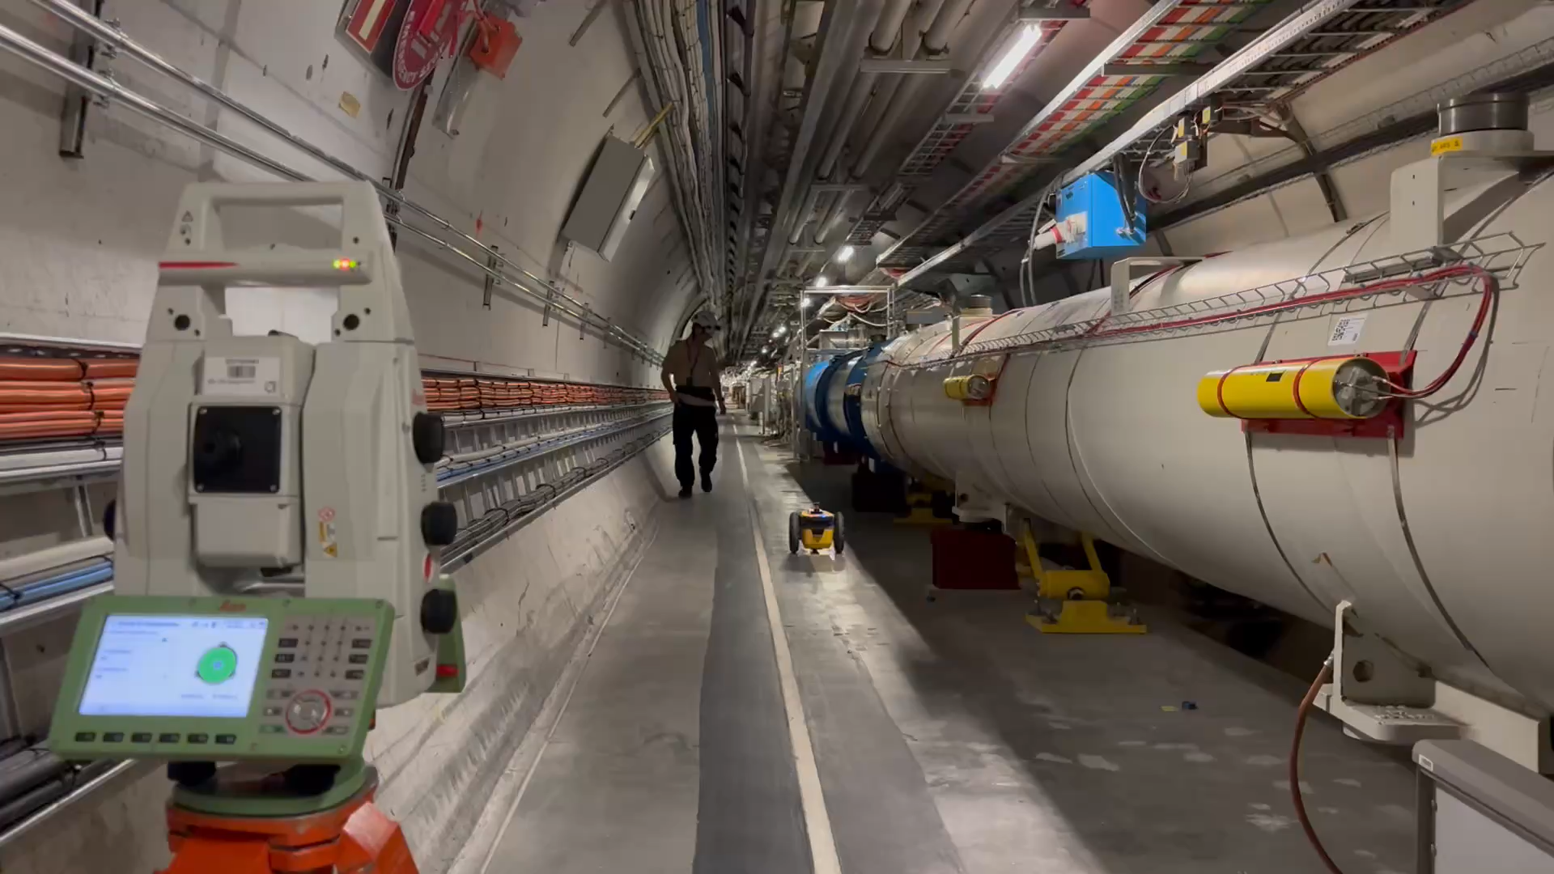

Slide 7
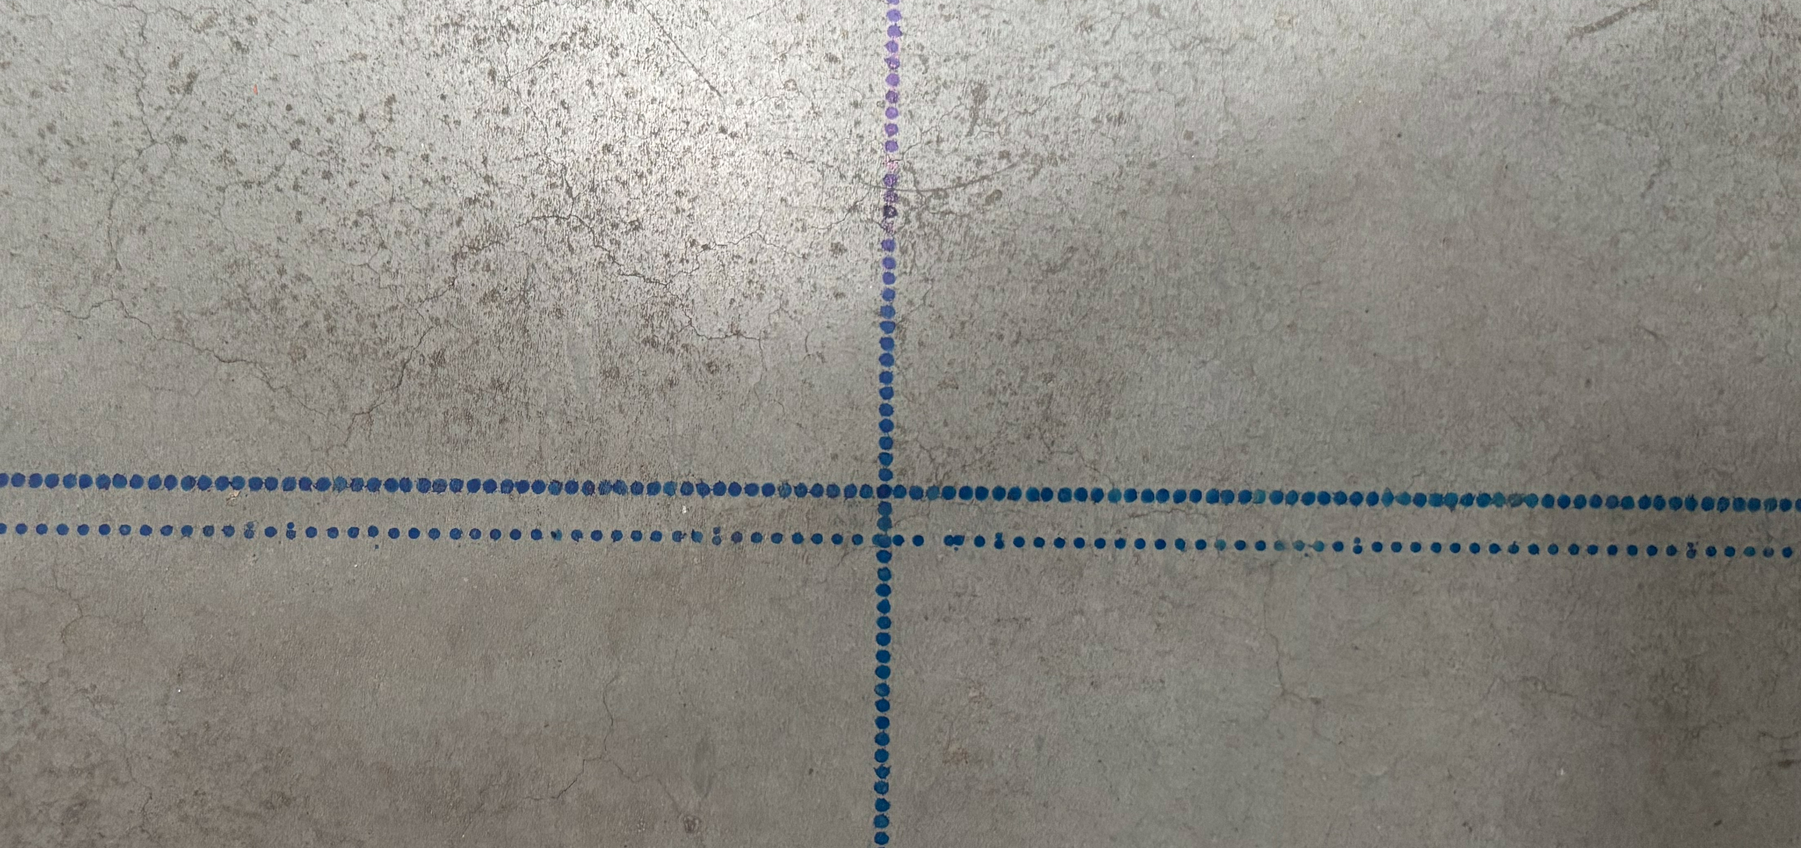
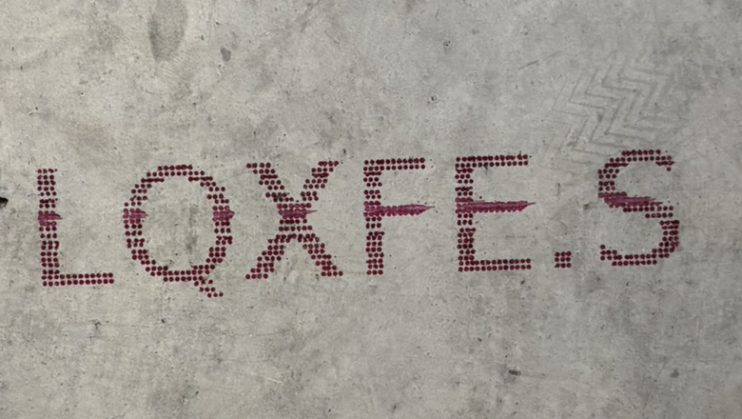
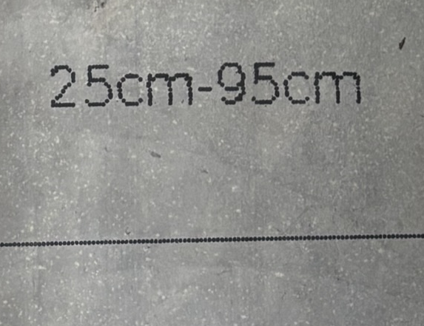
Tracing a line
Tracing texts
From 5 m to 80 m from Total Station
Different inks level and durability
Robot’s demonstration in July !
60 m in 5 minutes

Slide 8
Robotic Solution Constraints
The robot can not mark in the tunnel gutter or ‘caniveau’
The robot can not trace closer than 20 cm from an obstacle
Some of the required points will need to be offset by a minimum of 30 cm to allow a margin
Marking in 2 or 3 colour categories :
BEAM Points
NON-BEAM Points
NON-BEAM Points on the vault

Slide 9
Providing the data for tracing:
Definition of a new workflow for non-beam components
E-O
E-O
Integration team
Selection of the points to trace
In the local model
Vertical projection
Following local gravity and according to the theoretical height of the model
In a model with the tunnel slope
Provide the data to the Integration team in a to be defined format
Offset of the points, if necessary,
In the local model
Conversion in CCS
E-O
Verification of the projected points with the E-O
Integration team
∆z : Theoretical floor – Real measured floor
ROBOTIC TRACING
SURVEY DB
Export of the points to trace in a .csv file

Slide 10
Non-beam-Components
Common References
Elements traced during the first tracing campaign and usable by every team

Slide 11
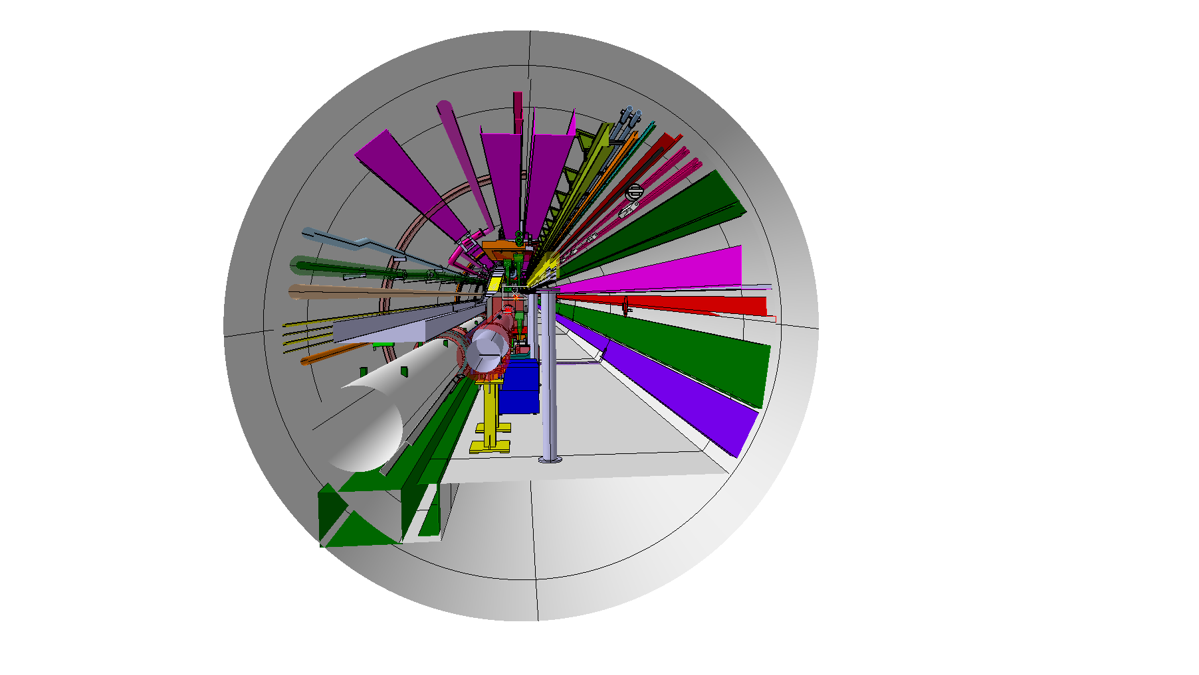
EN-CV
Tracing of common references :
No specific tracing needed. The common references will be traced and can help for the installation.
Demineralized Water pipe
Compressed Air pipe
PPS2 removed
Beam height
Follows the tunnel slope
DCUM from IP (1 or 5) every 5 m
IP5 DCUM 45.000 m
Beam line
Notes:
The following slides for EN-CV illustrated that EN-CV services have very different positions depending on the tunnel section.

Slide 12
EN-EL
Fibers
Tracing of common references :
GSM
No specific tracing needed. The common references will be traced and can help for the installation.
High-voltage cables
Cable trays
Lights
Flat cable
for emergency lights
Goulotte de sécurité
Beam height
Follows the tunnel slope
DCUM from IP (1 or 5) every 5 m
IP5 DCUM 45,000 m
Beam line

Slide 13
Tracing of common references
Relative DCUM from IP every 5 meters :
IP
45.000
40.000
35.000
30.000
25.000
20.000
15.000
10.000
5.000
5.000
10.000
15.000
20.000
25.000
30.000
35.000
40.000
45.000
Naming of the points :
IP5
5L-NAME6
…
5L-NAME2
5L-NAME1
5R-NAMEA
5R-NAMEB
5R-NAMEC

Slide 14
Non-beam-Components
Specific needs

Slide 15
BE-GM-HPA
Tracing for HLS pipe :
No Robot Tracing
The point to trace on the vault are still under discussion
HPA will provide the coordinates of the points in CCS directly to the BE-GM
5R-HLS
5R-HLS
HPA

Slide 16
BE-GM-HPA
Tracing for WPS pillars :
Traced on the floor : One cross for each pillar
HPA
Integration
5R-PWPS

Slide 17
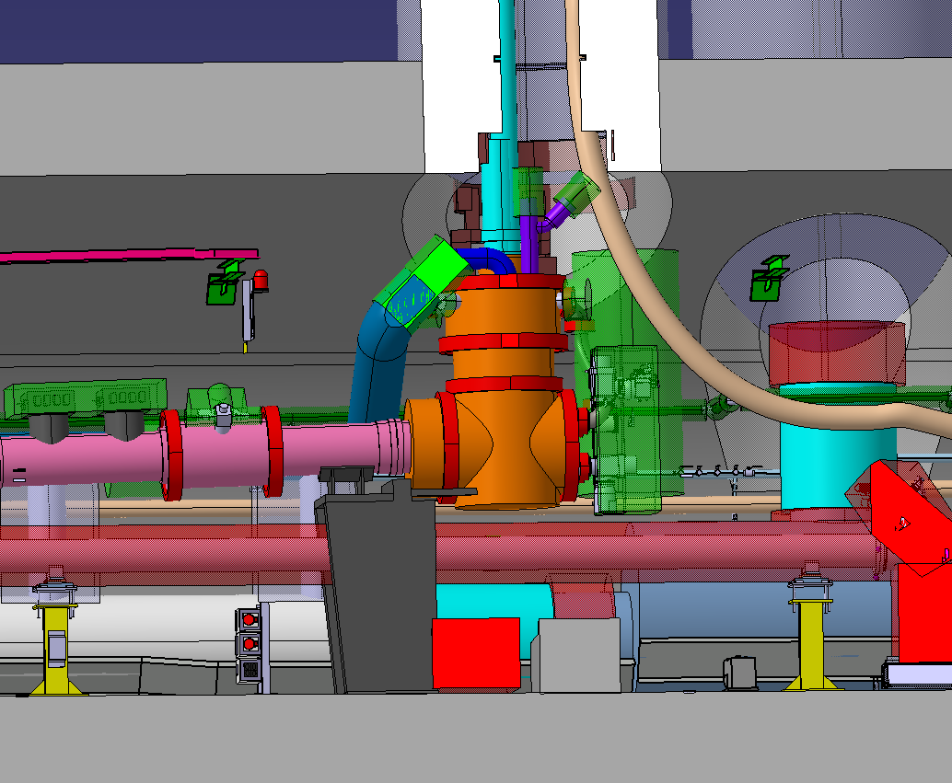
WP6a
Tracing for DXF installation :
Local Vertical
WP6a
Integration
Connexion to DCM
Beamline
IP
5R-SDXF
5R-DXF

Slide 18
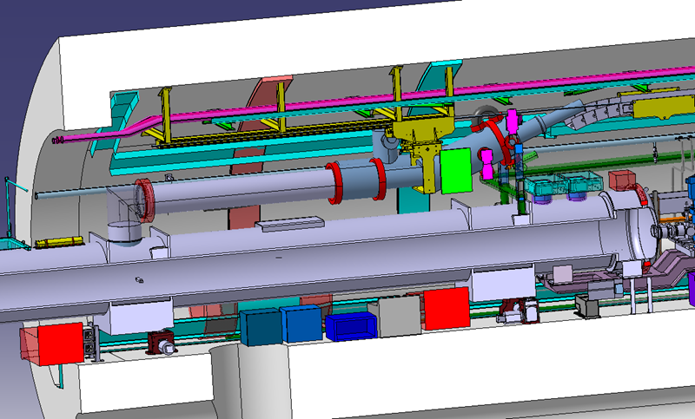
WP6a
Tracing for DFM installation :
WP6a
Integration
Local Vertical
D2
5R-RDFMA
5R-RDFMB
5R-SDFM2
5R-SDFM1
IP
5R-SDFM4
5R-SDFM3

Slide 19
WP6a
Tracing for DXF installation :
5R-DXF
5R-SDXF
3-5 mm
Tracing for DFM installation :
5R-RDFMB
5R-RDFMA
10 mm
5R-SDFM4
5R-SDFM3
5R-SDFM1
5R-SDFM2
Diagrams by Rita Perez Martinez in WP6a tracing questionnaire

Slide 20
TE-CRG
Tracing for QXL external supports :
Traced : Beamline vertical projection
Traced : Reference DCUM points from IP every 5 m
Measured by the robot and provided in digital format : ∆z in mm Theoretical floor – Real measured floor of the tunnel at the DCUM points
+ possibility to use the scan of the tunnel done by BE-GM
Beam height
Follows the tunnel slope
IP5 DCUM 45.000 m
Beam line

Slide 21
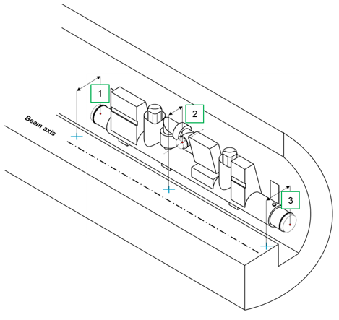
TE-CRG
Tracing for QXL sub-assemblies :
TE-CRG
Integration
Traced : offset and projected vacuum vessel flange at extremities (1) and (3)
Traced : offset and projected jumper interface vacuum vessel flange (2)
For each of these 3 points :
Provided in digital format : ∆z in mm
Theoretical floor – Real measured floor of the tunnel of the points above.
Traced : value of the offset defined by TE-CRG.
The tracing robot can not trace in the gutter or ‘caniveau’ : the points will need to be offset
Offset between the theoretical and the real gutter to be checked
Diagram from Fabio Merli presentation on QXL tracing needs

Slide 22
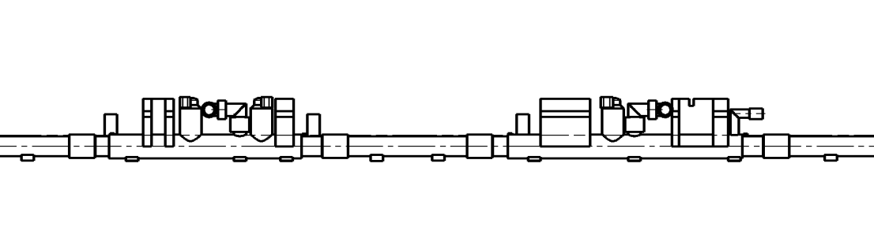
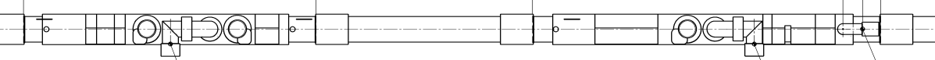
TE-CRG
Tracing for QXL sub-assemblies :
https://edms.cern.ch/document/2678695/AA
TE-CRG
Drawing extracted from the HL-LHC QXL Layout IP1R, this diagram has no scale.
Local Vertical
Integration
Side view
1R-QXLBB_E
1R-QXLBB_J
1R-QXLBB_S
1R-QXLCB_E
1R-QXLCB_J
1R-QXLCB_S
Offset 350 mm
Offset 350 mm
Offset 350 mm
Offset 350 mm
Offset 350 mm
Offset 350 mm
Top view
Gutter edge
min 30 cm
Offset points at least 30 cm from the ‘caniveau’ edge
Beamline

Slide 23
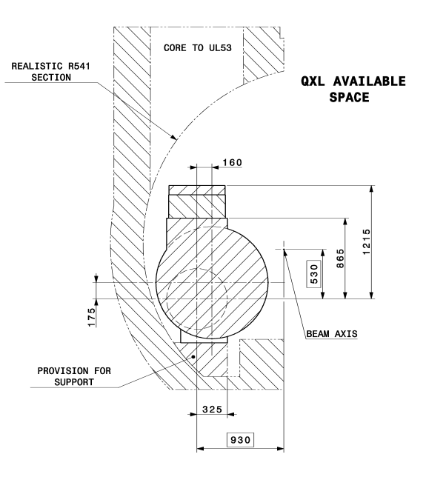
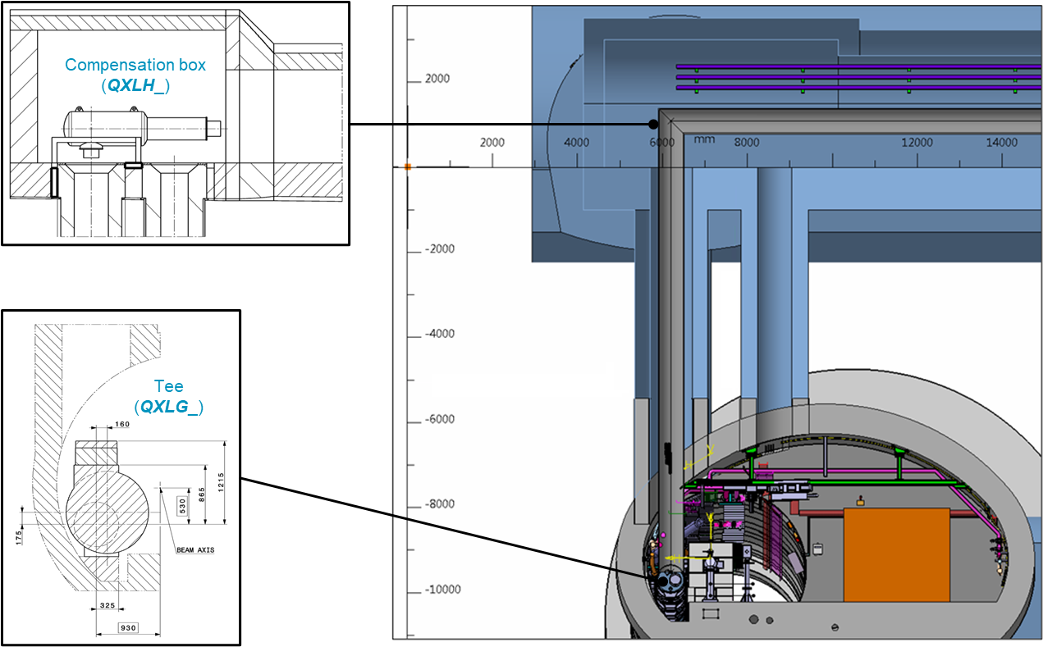
TE-CRG
Local Vertical
Tracing for tee axis installation :
Central axis of the theoretical core
Central axis of the real core
Traced : Beamline vertical projection
Traced : Theoretical centre of the UL-LHC core
Offset defined by TE-CRG and following the tracing workflow
Traced : Real centre of the UL-LHC core
Procedure to measure the real cores to be defined by BE-GM
Offset value defined by TE-CRG
5L-RC
5L-TC
Diagrams from Fabio Merli presentation on QXL tracing needs

Slide 24
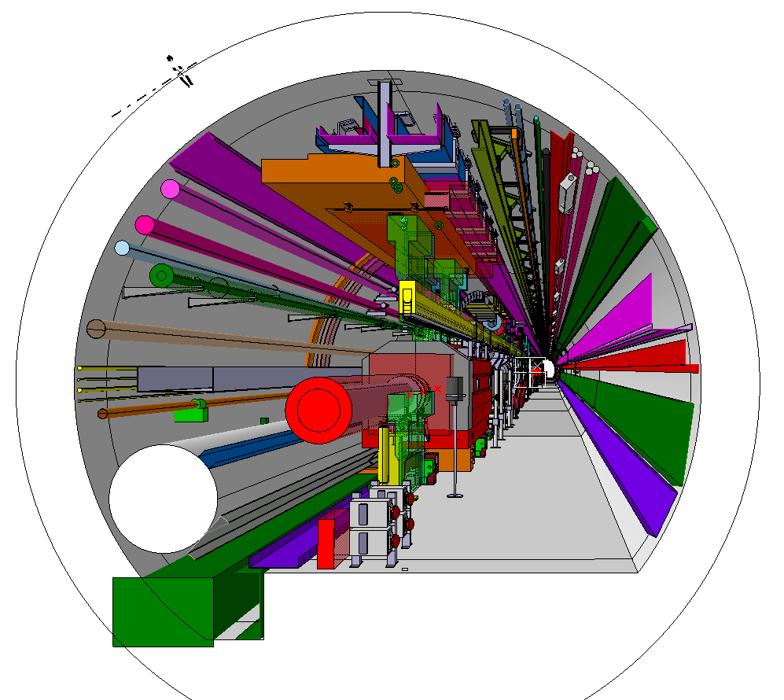
EN-HE
Tracing for TAXN mini-crane :
EN-HE
Integration
Local Vertical
IP
End pillar
5R-TAXNSB
IP
Beginning pillar
5R-TAXNSA

Slide 25
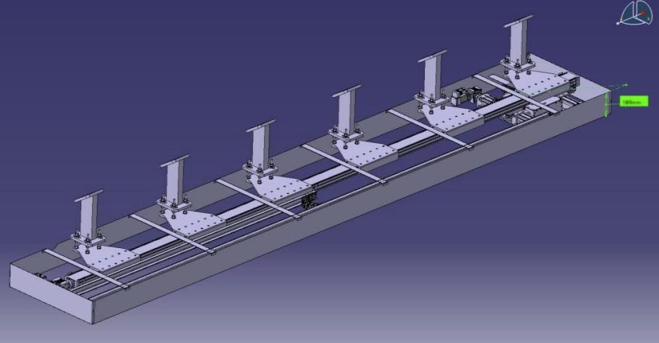
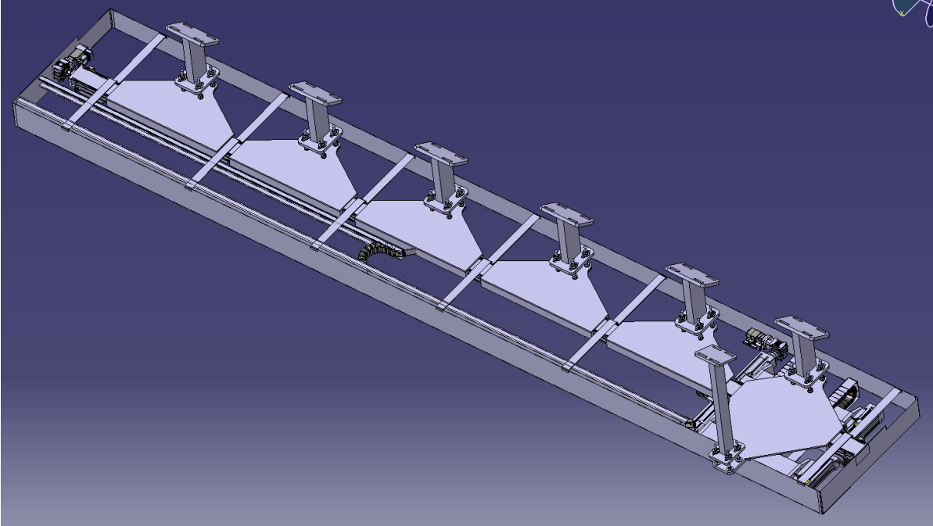
EN-HE
Tracing for TAXN mini-crane :
Mini-crane design 1 :
Mini-crane design 2 :
Beginning pillar
5R-TAXNSA
End pillars
5L-TAXNSC
End pillar
5R-TAXNSB
Beginning pillars
5L-TAXNSA
Beginning pillars 2
5L-TAXNSB

Slide 26
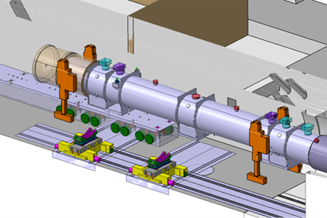
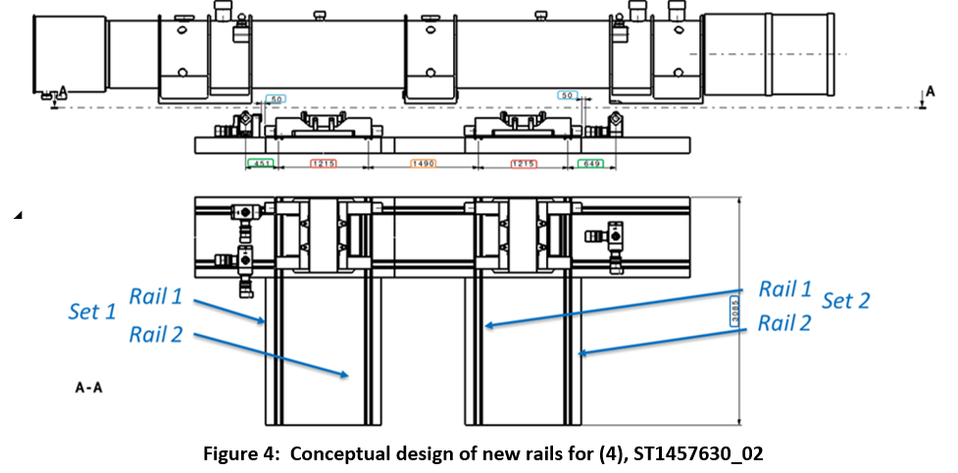
EN-HE
Tracing for rails in the ‘nose’ area:
EN-HE
Tunnel extremity
30 cm
Rail axis
Tunnel extremity
Drawings extracted from ‘MCEW4 - RAILS DE-&INSTALLATION IN THE IT REGION (P1 & P5)’
5R-S1R1B
5R-S1R1A
5R-S1R2B
5R-S2R1B
30 cm
Tunnel extremity
30 cm
5R-S1R2A
The tracing robot can not trace less than 20 cm from an obstacle : the points to trace will be offset from the tunnel extremity by 30 cm.
5R-S2R1A
5R-S2R2B
5R-S2R2A

Slide 27
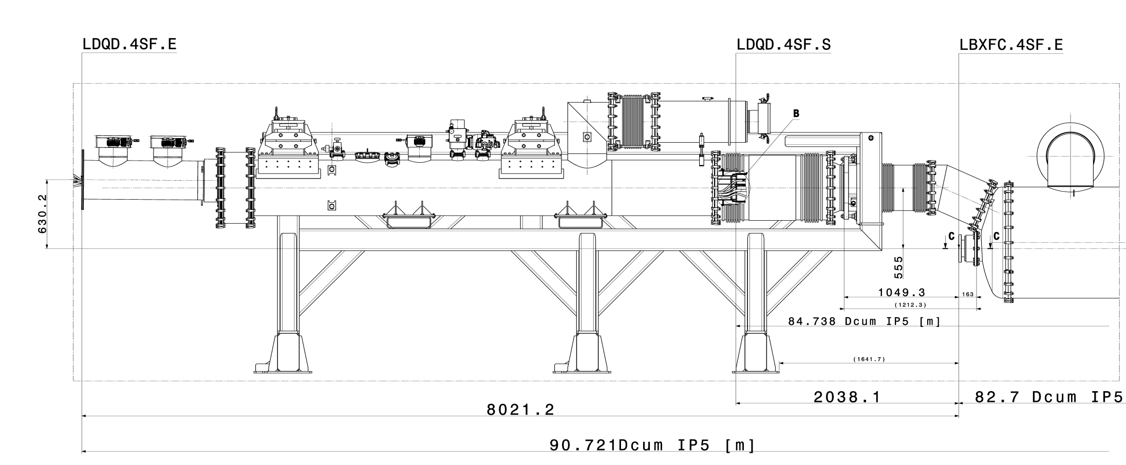
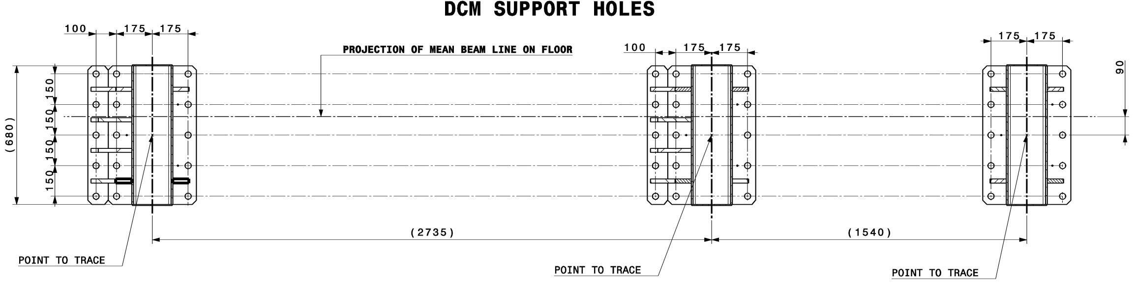
DCM
Tracing for DCM installation :
Local Vertical

Slide 28
DCM
Tracing for DCM installation :
Local Vertical
Beam height
Follows the tunnel slope

Slide 29
Providing the data for tracing:
Definition of a new workflow for non-beam components
E-O
E-O
Integration team
Selection of the points to trace
In the local model
Vertical projection
Following local gravity and according to the theoretical height of the model
In a model with the tunnel slope
Provide the data to the Integration team in a to be defined format
Offset of the points, if necessary,
In the local model
Conversion in CCS
E-O
Verification of the projected points with the E-O
Integration team
∆z : Theoretical floor – Real measured floor
ROBOTIC TRACING
SURVEY DB
Export of the points to trace in a .csv file

Slide 30
Points to discuss
The deviation of the floor tunnel measured with the 3D scan must be communicated to the Equipment Owners : Analyse will be under the responsibility of the Integration Team ?
Data format of the E-O input for integration team : .csv, .txt, catia, dxf
Validation of the projected point coordinates between the integration team and E-O
Naming of the points
Tracing of the absolute DCUM every 10 m : any need ? The relative DCUM will be marked on the floor w.r.t. IP1 / IP5
General feedback about the tracing proposals

Slide 31
Thank you very much for your collaboration and the constructive discussions that helped shape this work !

Slide 32


