Slide 1
A proposal for vacuum envelop for cooling cells
Alexej Grudiev

Slide 2
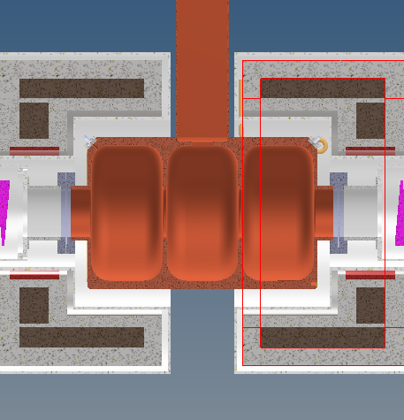
A proposal for vacuum envelop
Vacuum flange on the outside of the cryostat, a la LHC dipole
More space for vacuum ports for pumping and feed-throughs.
The RF cavity assembly do not need to be leak tight.
  Alternative fabrication processes and materials
  Easier integration of ports for pumping, RF tuning, field probes, etc
  No vacuum pressure on RF window, if there are enough holes in the RF cavity
…
Va
cuum
Air

