Slide 1
HL-LHC Signal Cabling
Patch Panels
Technical implementation and cost estimate
Acknowledgments: D. Gameiro (EN-EL-CS), R. Roche (EN-EL-DDO)
G. Girardot (EN-EL-CS)
2025-07-03
218th HL-LHC TCC
Indico 1564851

Slide 2
Contents
Context
Roadmap
Design – Selection of the Patching Solution
Design – Electromagnetic Compatibility
Integration in the UAs
Integration in the ULs
Quality Control
Cost Estimation
Next Actions

Slide 3
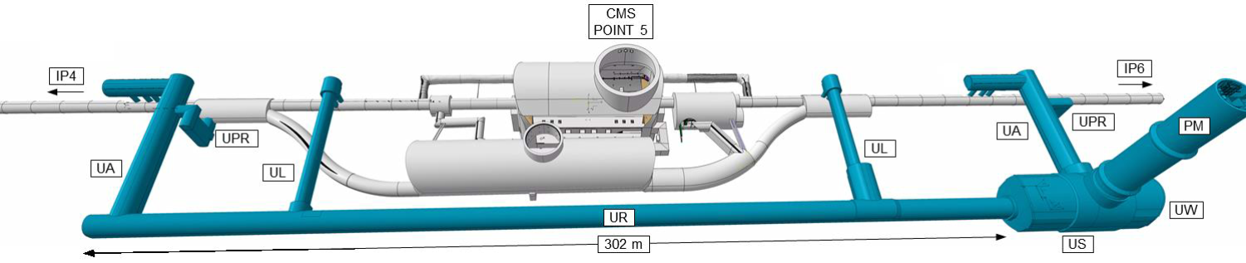
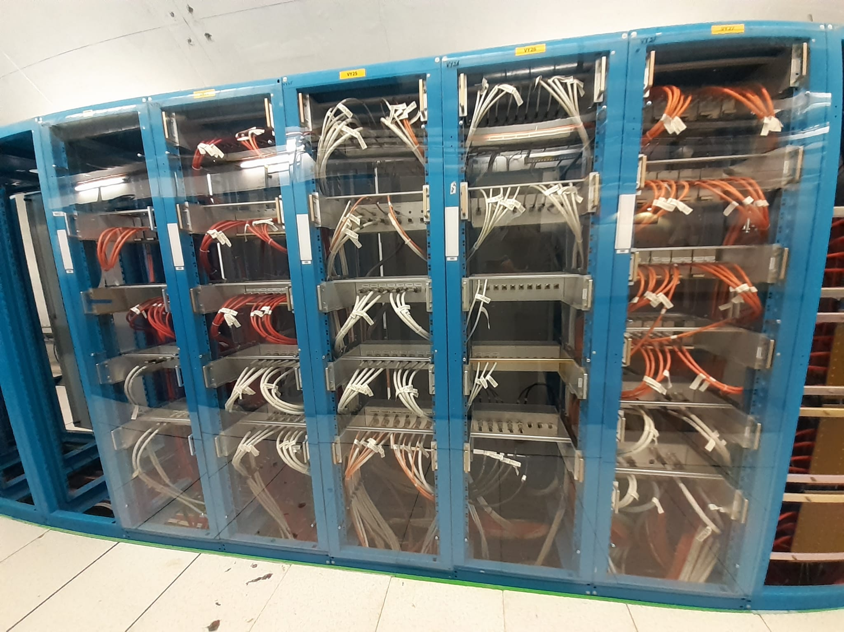
Context
Patch panels ensure interconnection of signal cables.
Implementing patch panels close to the cores allow to shift installation of 335 km from LS3 to Run3-2026 (20wks / half-point).
All the cables identified for the connection solution have been approved by the owners.
Volume to be installed during LS3 is reduced to 670 km.
A
B
Patch Panel
Point5 location of patch panels – similar for Point1
Example: patch panels at point 7 of the LHC (R2E project).

Slide 4
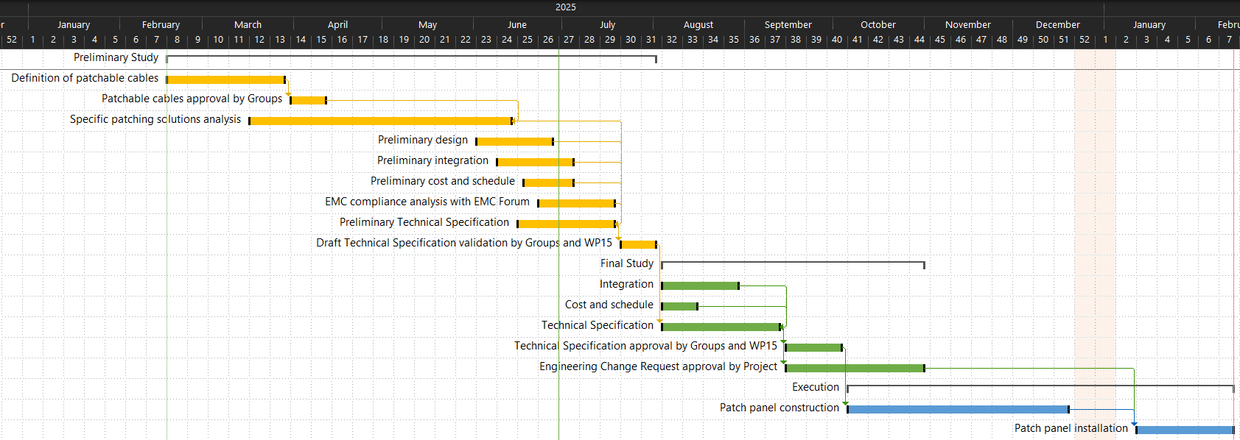
Roadmap

Slide 5
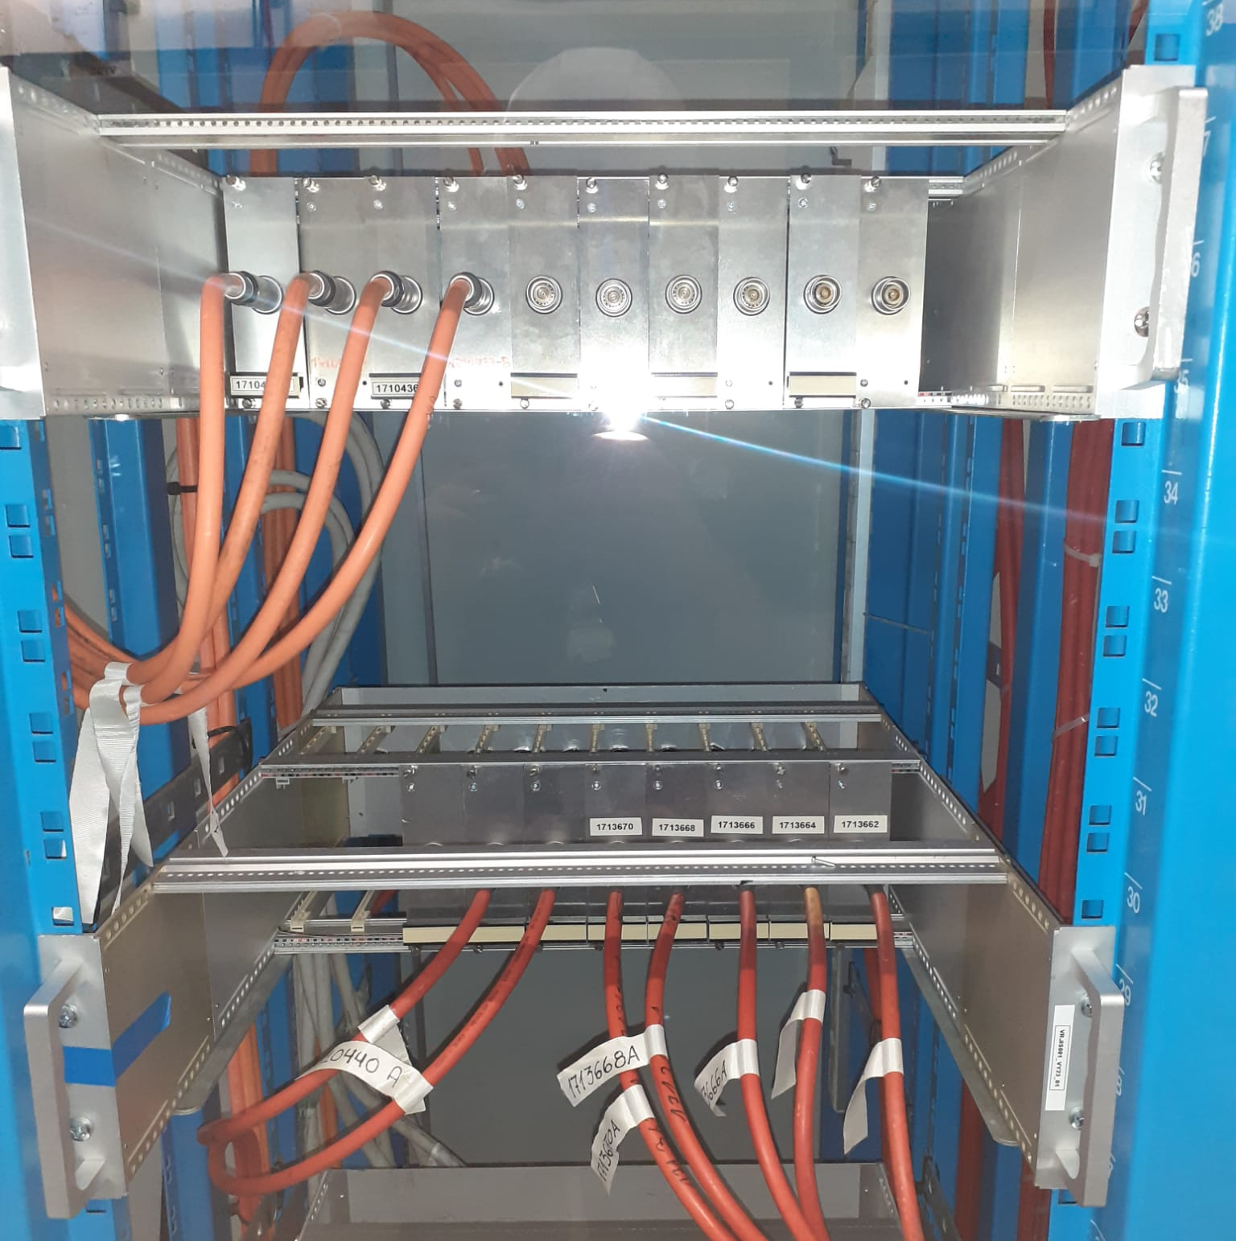
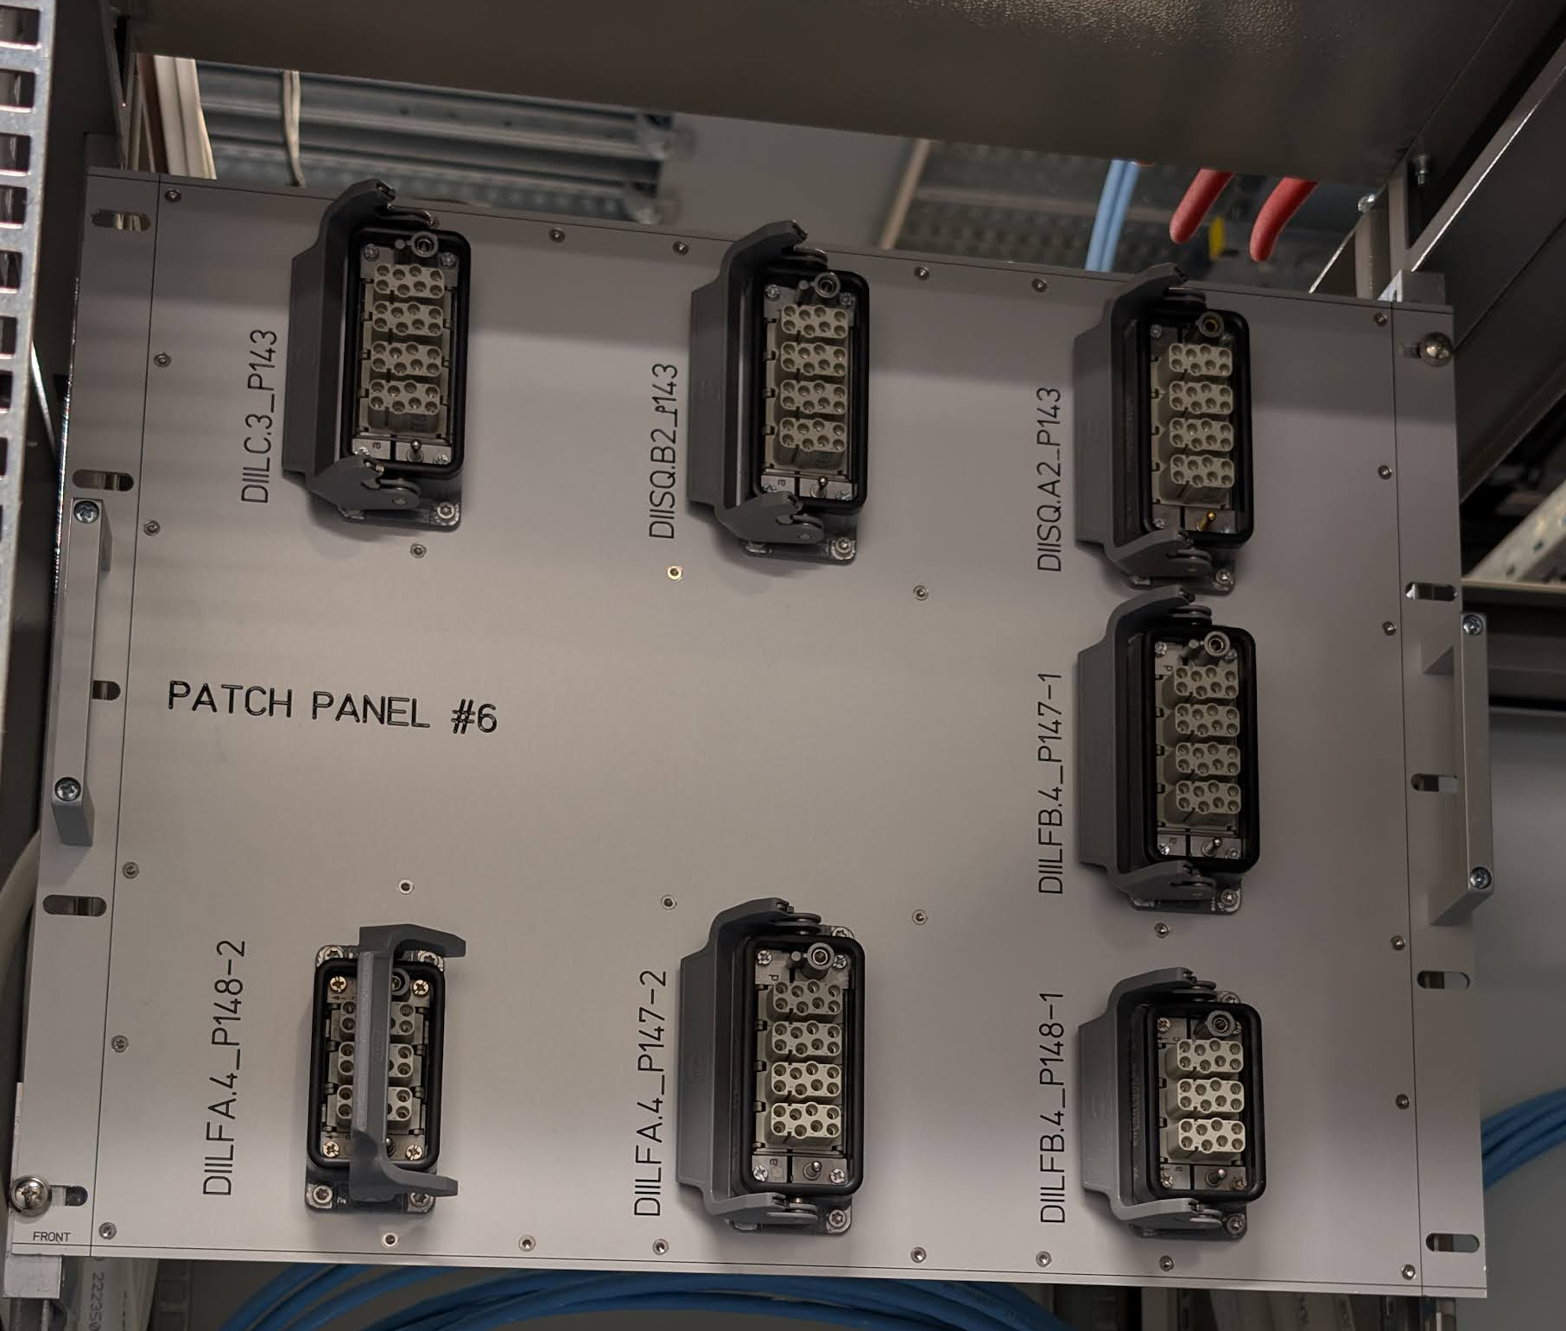
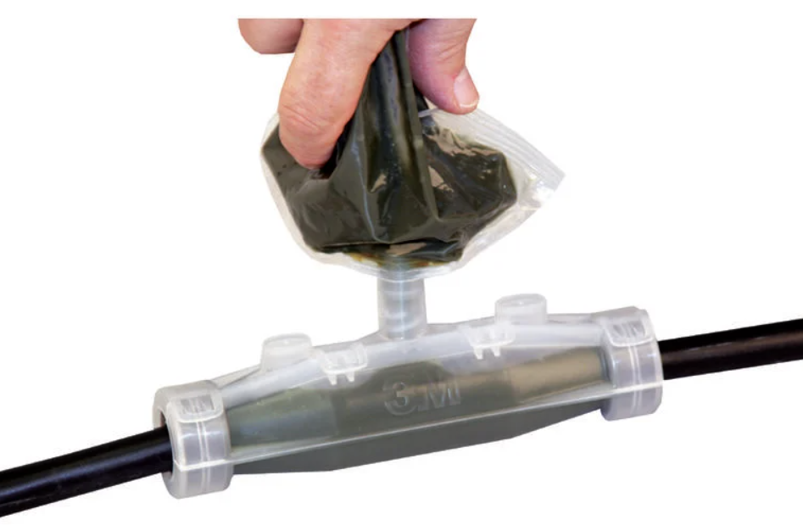
Design – Selection of the Patching Solution
Group | No. of Patchable Cables | Proposed Patching Solution
BE-CEM | 4 | FIP box
BE-GM | 370 | Burndy
EP-CMT | 16 | Burndy
TE-CRG | 388 | Burndy (228) Standard & high-EMC Harting(144) BNC-50 (16)
TE-MPE | 278 | Resin junction (38) high-EMC Harting (240)
TE-VSC | 1062 | Burndy (540) Harting (4) BNC-50 (4) FIP box (8) Special crates (506)
Total | 2118
Discussions with involved groups led to the preliminary approval of the patching solutions (connectors).
Industrial connecting solutions
(high degree of protection, locking system,…).
High-EMC Harting connectors will be used for sensitive TE-MPE and TE-CRG signals.
Assembly and Test procedures will be proposed by EN-EL-CS for Group approval.

Slide 6
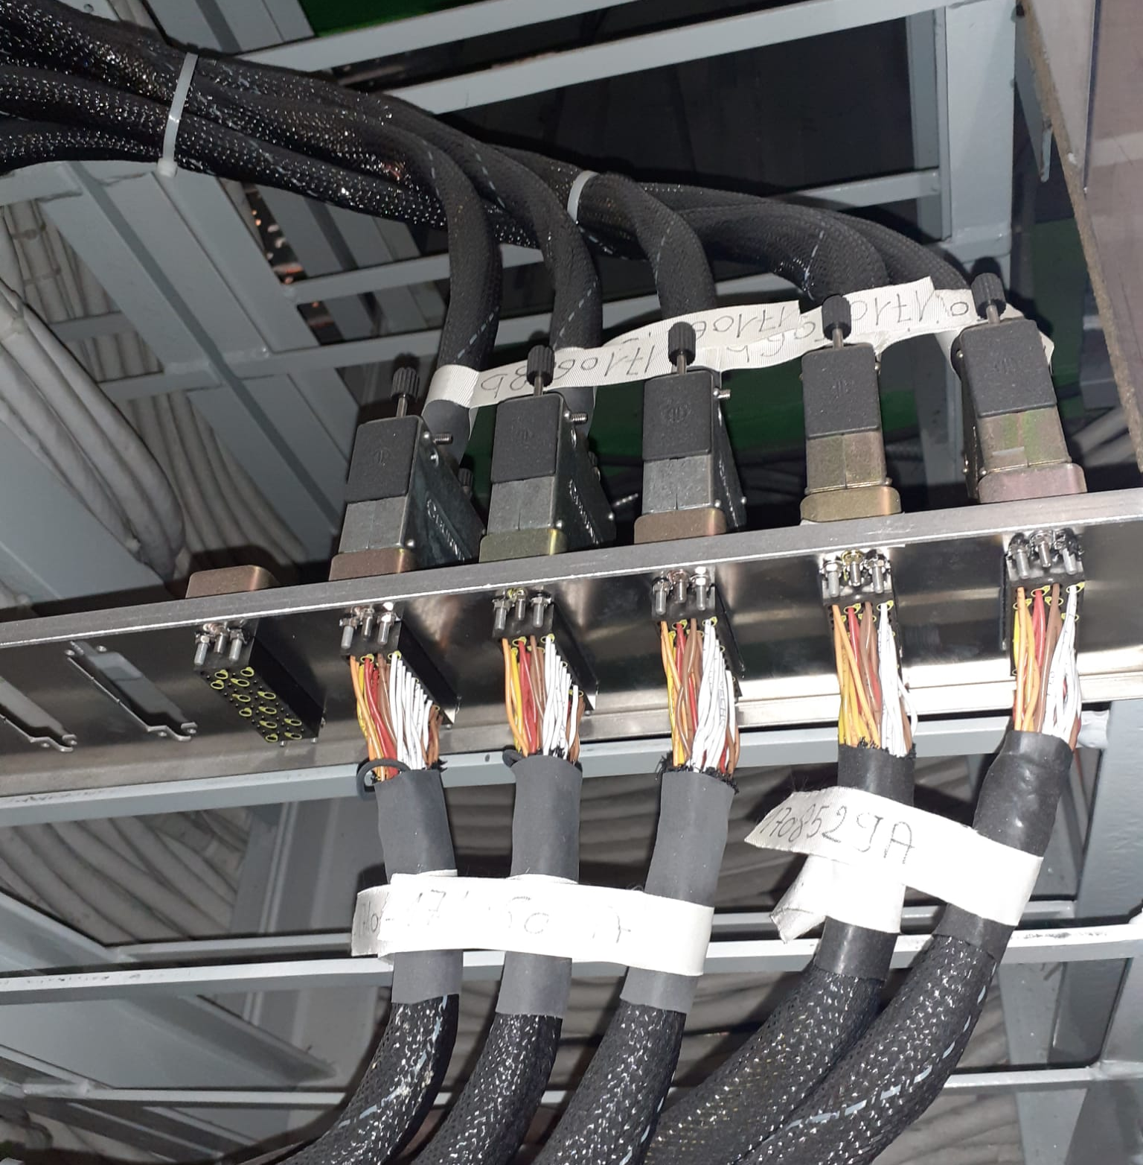
Design – Electromagnetic Compatibility
EMC Working Group, represented by Daniel Valuch, provides expertise guidance.
The selected Harting-based solution has been pre-validated as EMC compliant.
The Burndy-based solution (chassis topology) has been identified as
not conforming to EMC requirements.
    The feasibility of introducing the recommended back shell termination is currently under evaluation.
Some prototype patch panels tests may be carried out at the
CERN’s EMC laboratory.

Slide 7
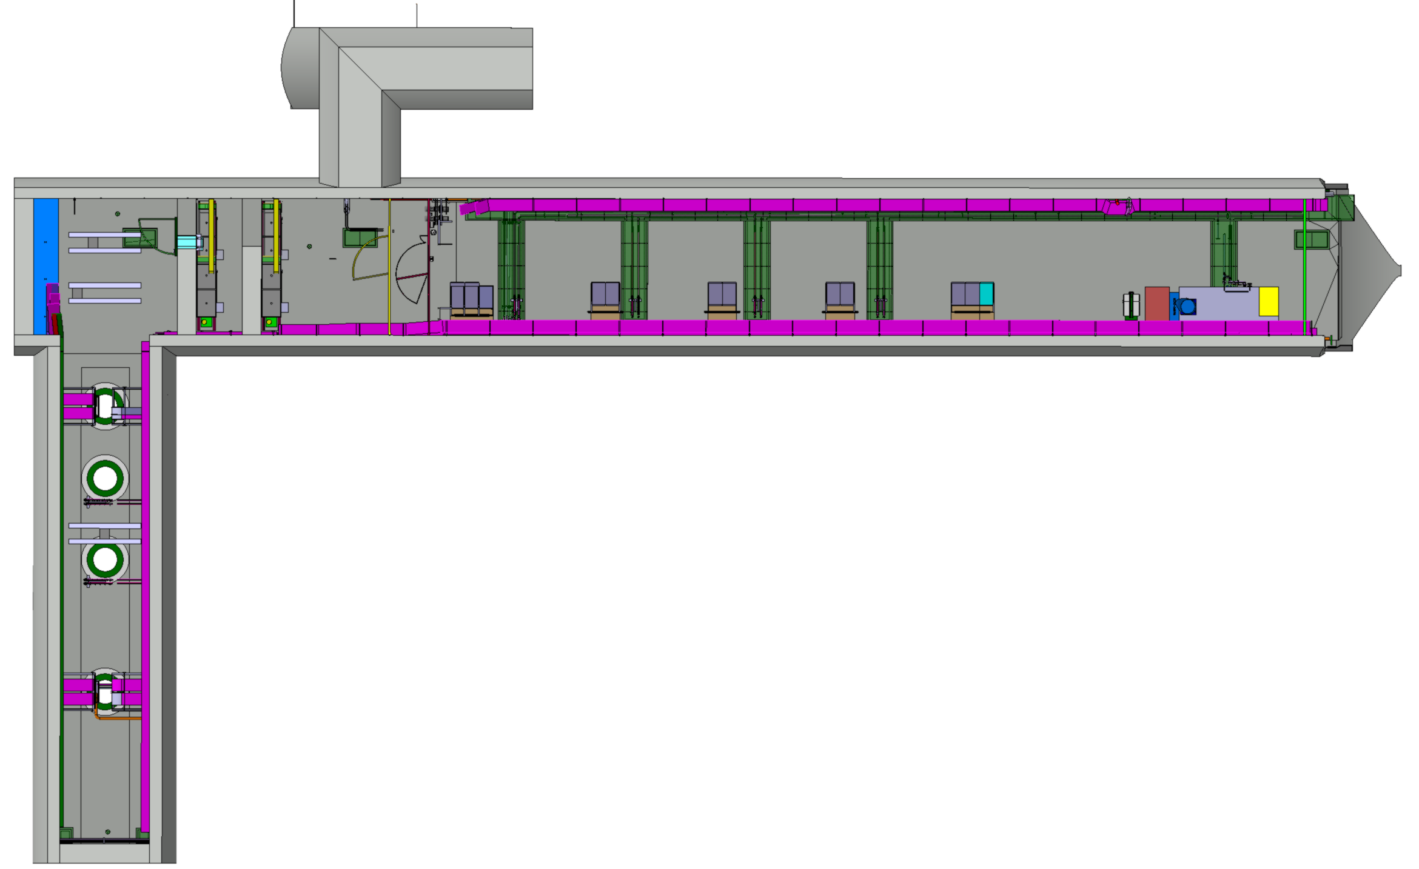
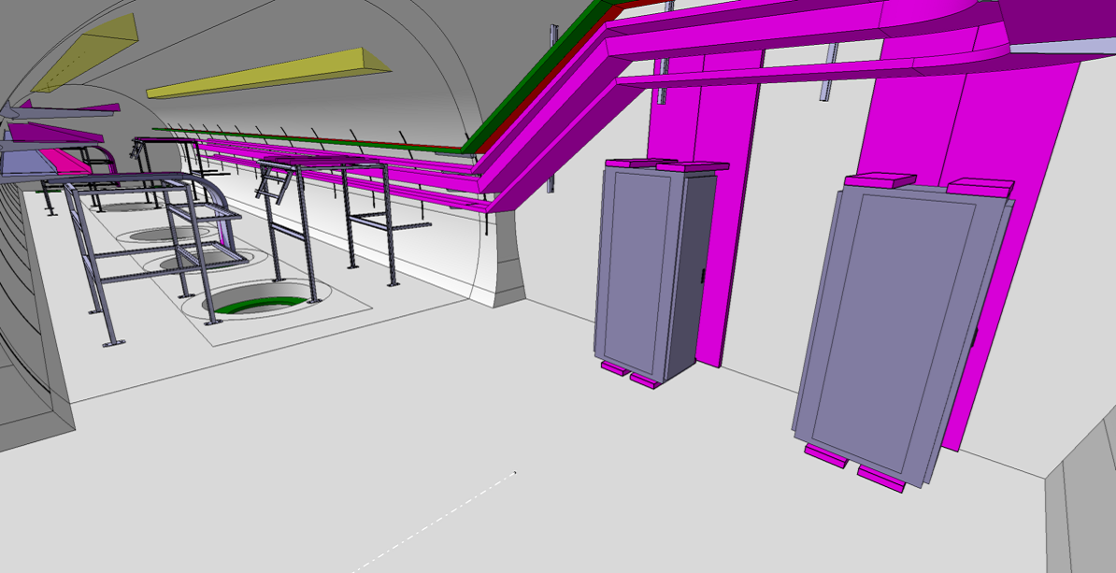
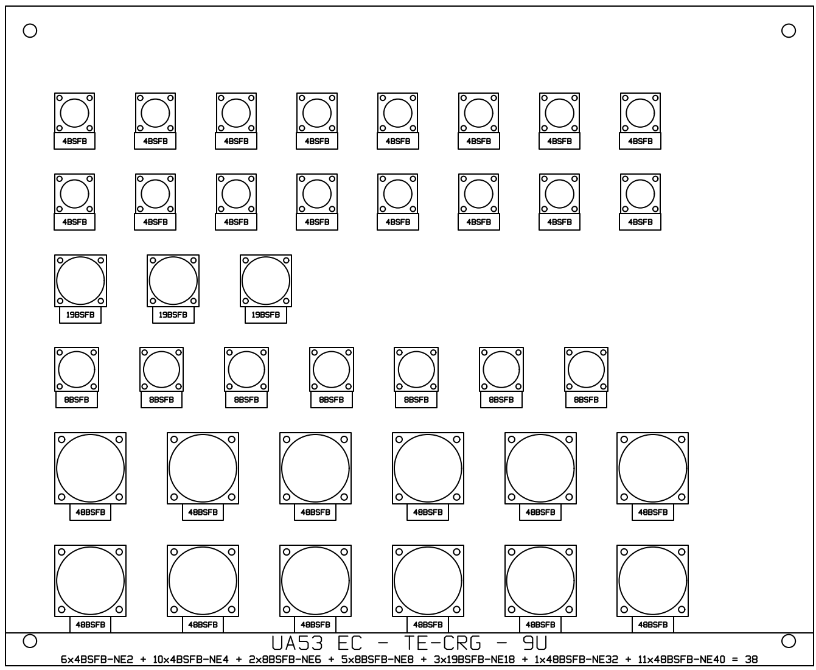
Integration in the UAs
Studies currently focus on the worst-case location, UA53
where 246 cables must be patched.
Two LHC 45U 19” racks (standard) will be installed.
  First Rack exclusively reserved for TE-VSC
    Patch Panel – 15U.
    Special Patch Crates 19” – 30U.
  Second Rack for all the other Groups
    Patch Panel BE-GM + EP-CMT – 11U.
    Patch Panel TE-CRG – 9U
The required Resin-junctions will be attached to the wall, on Cablofil.

Slide 8
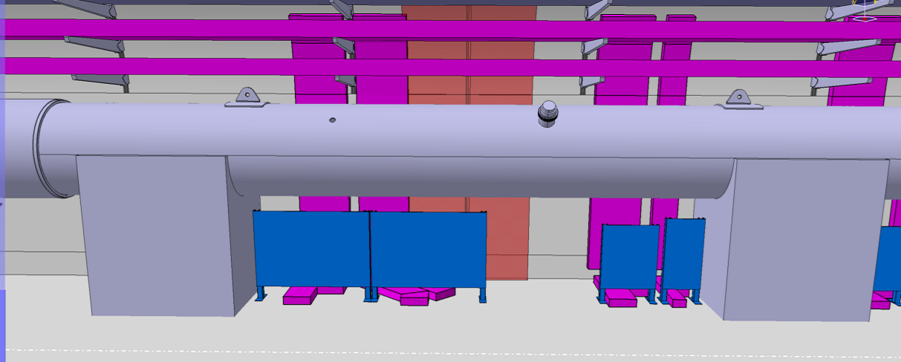
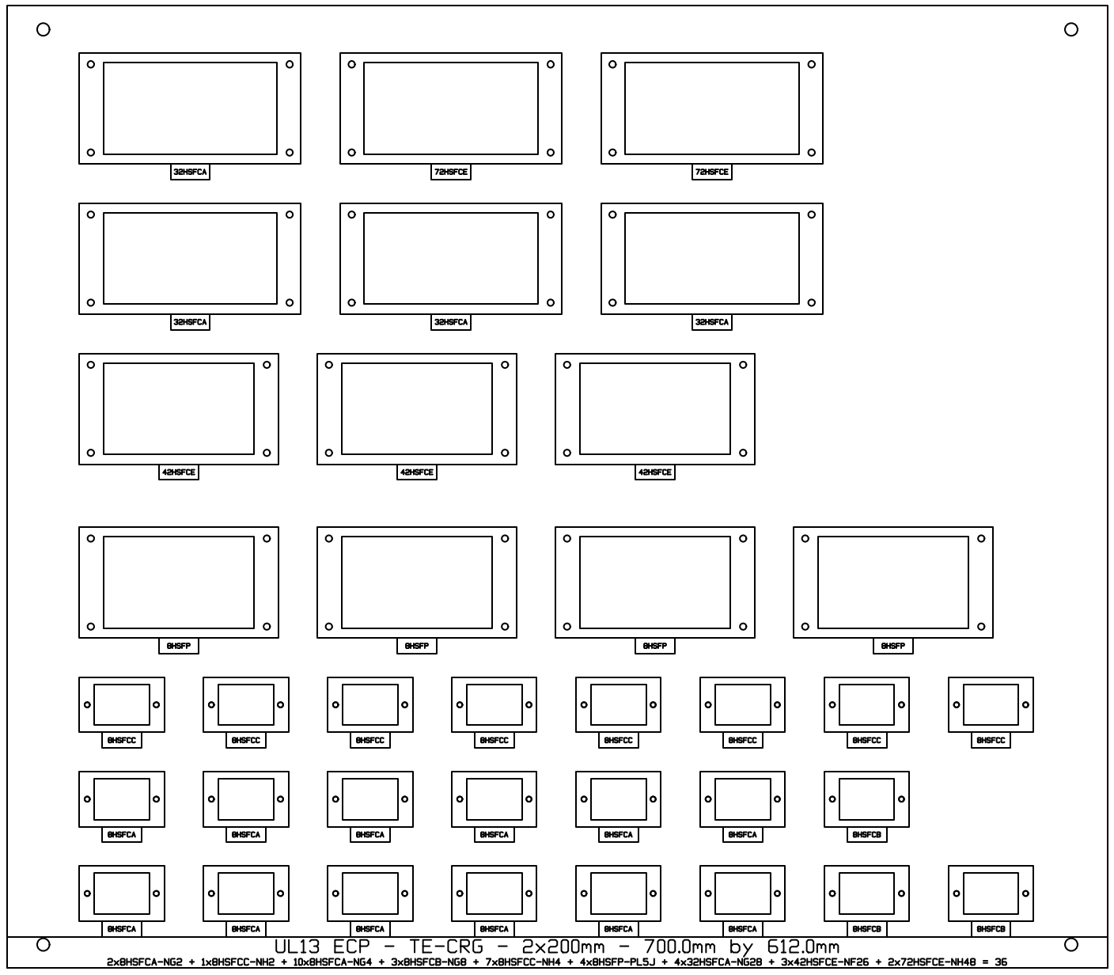
Integration in the ULs
R1
R2
R3
Studies currently focus on the worst-case location, UL17 where 292 cables must be patched.
Patch panels will be located in limited volume available under QXL.
~ H850 mm x D600 mm x L3000mm
  Final QXL integration is needed for the design and implementation
  of the patch panel.
Patch panel plates will be supported by vertical rails.
Rotation system implemented to allow access to the rear side.
Individual patch panels foreseen per Group.
Separate patch panels for EMC-offender cables.
Foreseen FIP boxes and resin-junctions will be attached on the wall and on cable trays.
R1 – EC for BE-GM, TE-CRG, and TE-MPE

Slide 9
Quality Control
Detailed technical documentation (connector datasheet, assembly procedure, grounding, …)
to be approved by the Groups.
Prototype will be manufactured and tested to validate the design.
Each patched cable will be fully tested by EN-EL.
  Test of section A (RUN3).
  Test of section B (LS3).
  Test of section A+B (LS3).
Ownership of the patch panels will be transferred from EN-EL to the respective Groups during the commissioning phase.
→ EN-EL-CS will remain fully available and ready to provide support in case any issues arise.
A
B
Patch Panel

Slide 10
Cost Estimation
Presented costs are for the patch panels scope exclusively.
  TE-VSC Patch Panels cost to be added.
  (Not design and manufactured by EN-EL)
Induced cost saving
  Although the cost of the patch panels has been presented, it should be offset by the savings resulting from performing part of the cabling in a single shift in 2026, instead of two shifts as initially planned for LS3.
  The exact amount of the saving remains to be defined.
Cost Estimation | Material (CHF) | Manpower (€) | Total Cost* (CHF)
Mechanical Works | 11 828 | 11 568 | 22 664
Connectors | 92 842 | 307 507 | 380 884
Cable tests | 0 | 75 093 | 70 340
Additional Cable Lengths | 33 436 | 63 158 | 92 596
Prototyping | TBD
Total | 138 106 | 457 326 | 566 483
*CHF/€ = 0.9367 (EDH rate as of 10/06/2025).

Slide 11
Next Actions
Finalise preliminary study by end-July
  Close open EMC points.
  Get final QXL integration to confirm patch panels design and integration.
  Write technical documentation for Groups approval.
  (connector datasheet, assembly procedure, grounding, …)
Budget finalised by end August
Conduct final study and get groups approval by end-September.
Preform Patch panels assembly for end-December.

