Slide 1



Optimizing Heavy Flavour Tagging: Leveraging Low-p_{T} Tracks for Improved Tagging
Corine M. Smith¹
Emily A. Thompson²
¹University of Central Florida, Orlando, FL, USA 32817
²Lawrence Berkeley National Laboratory, Berkeley, CA, 94704

Slide 2
Introduction:
Can low-p_{T} tracks provide additional, useful information to improve flavour tagging efficiency and background rejection?
This investigation consists of two parts¹⁻³:
Kinematics study
Machine Learning Study
Special tracking algorithm exist that allow for the reconstruction of low-p_{T} tracks
(100 MeV < p_{T} < 500 MeV)¹
GN2 is a transformer based graphic neural network used to tag jets by taking in track information and outputs classification information based on underlying jet physics¹⁻³
¹Low‑pT Tracking in High Pile‑Up Environments with EventIndex
²Fast 𝒃-tagging at the high-level trigger of the ATLAS experiment in LHC Run 3
³Transforming jet flavour tagging at ATLAS

Slide 3
Procedure and Dataset: Track Cuts
Table 1B) Low-p_{T} Track Cuts
Table 1A) Standard Track Cuts
p_{T} min. | 100 MeV
|𝜼| max. | 2.5
d₀ max. | 5.0
𝛔_{d0} | < 3.0 for pT > 250 MeV
Z₀ max. | 5.0
Si hits min. | 6
Si shared max. | 1
Si holes max. | 2
Pixel holes max. | 1
SCT Holes | ≤ 2
Pixel Hits + Dead Modules | ≤ 4
Reconstruct 10M tt̄ events with low-p_{T} tracking information
Apply selections on low-p_{T} tracks to reduce fakes
Reproduce results previously reported on standard tracks with GN2¹
Prepare GN2 algorithm for inclusion low-p_{T} tracks by removing auxiliary tasks¹
Re-train GN2 with low-p_{T} tracks
Compare performance
p_{T} min. | 500 MeV
|𝜼| max. | 2.5
d₀ max. | 5.0
Z₀ max. | 5.0
Si hits min. | 8
Si shared max. | 1
Si holes max. | 2
Pixel holes max. | 1
Dataset: mc23_13p6TeV.601229.PhPy8EG_A14_ttbar_hdamp258p75_SingleLep.recon.AOD.e8514_e8528_s4162_s4114_r16553
¹Transforming jet flavour tagging at ATLAS

Slide 4
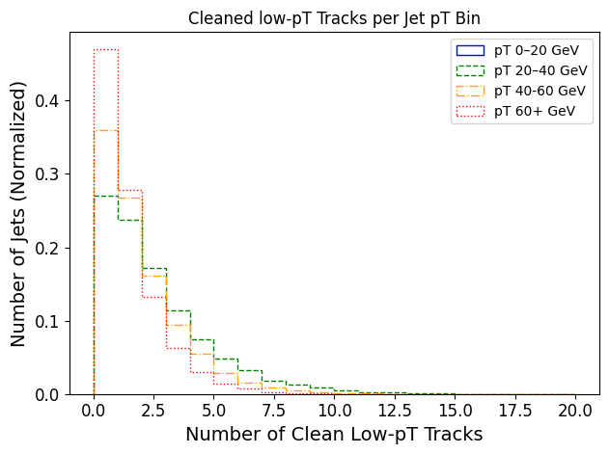
Kinematics Study Low-p_{T} Tracks: Number of Jets Containing Low-p_{T} Tracks
*Low-p_{T} jets contain more low-p_{T} tracks
Fig. 1 Number of clean low-p_{T} tracks per number of Jet

Slide 5
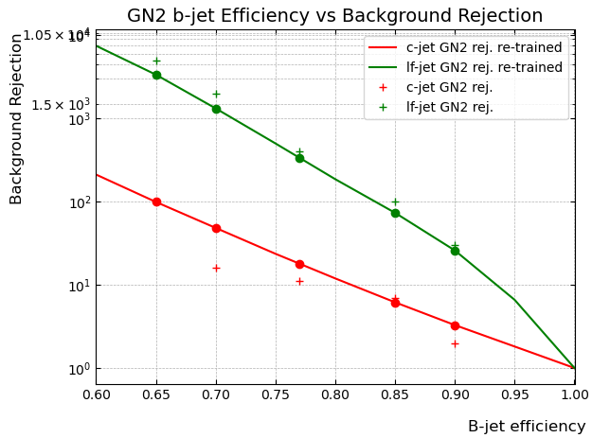
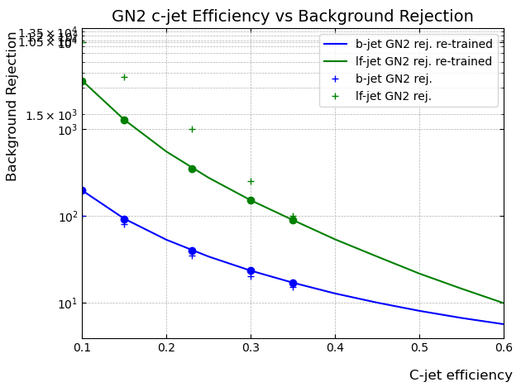
Reproduced GN2 Trained 10M Events: p_{T} > 500 MeV
(A)
(B)
Figs. 2 GN2 trained 10M event dataset containing tracks with p_{T} > 500 MeV¹: A) b-jets, B) c-jets
*Reproduced GN2 re-training on standard p_{T} tracks are in reasonable agreement with those previously reported (shown here by the ‘+’ markers) in literature¹
¹Transforming jet flavour tagging at ATLAS

Slide 6
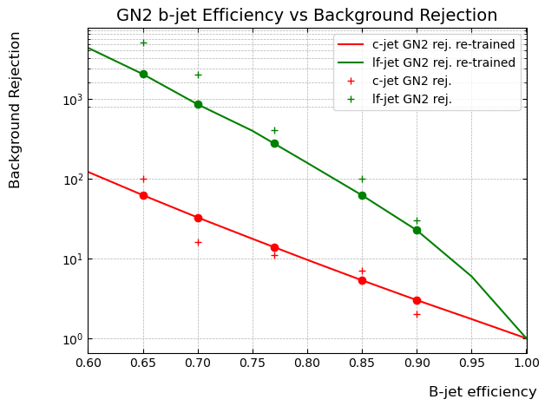
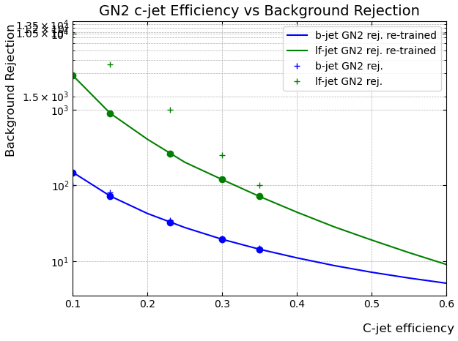
GN2 Trained NTuple 10M Events: p_{T} > 500 MeV with Auxiliary Tasks Removed
(A)
(B)
Figs. 3 GN2 trained 10M event dataset with tracks with p_{T} > 500 MeV¹ and auxiliary truth tasks removed: A) b-jets, B) c-jets
*Removing auxiliary tasks in GN2 results in a mild decrease in performance as expected and reported in literature¹
¹Transforming jet flavour tagging at ATLAS

Slide 7
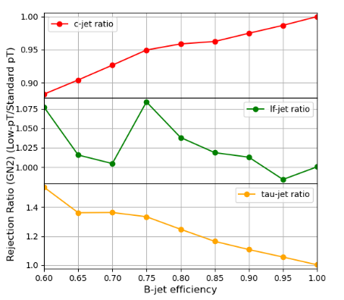
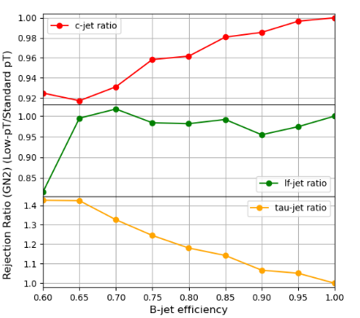
GN2 Trained NTuple 10M Events: B-Jet Efficiency vs. Background Rejection Ratio Rates
Rejection ratio < 1.0 indicates worsening performance, rejection ratio > 1.0 indicates improved performance.
(A)
(B)
(B)
Figs. 4 GN2 trained 10M event dataset of b-efficiency vs background rejection rate ratios on tracks with p_{T} > 100 MeV :
(A) all jet p_{T} included B) jet p_{T} < 30 GeV¹
The ratio is defined as: ratio = jets containing low-p_{T} tracks / jets containing only standard tracks.
¹Transforming jet flavour tagging at ATLAS

Slide 8
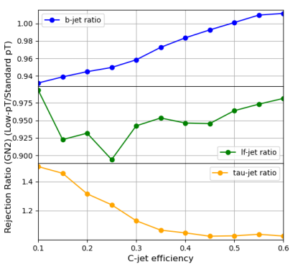
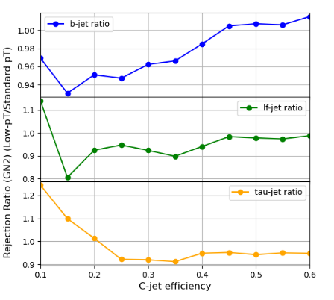
GN2 Trained NTuple 10M Events: C-Jet Efficiency vs. Background Rejection Ratio Rates
Rejection ratio < 1.0 indicates worsening performance, rejection ratio > 1.0 indicates improved performance.
(A)
(B)
Figs. 5 GN2 trained 10M event dataset of c-efficiency vs background rejection rate ratios on tracks with p_{T} > 100 MeV:
(A) all jet p_{T} included B) jet p_{T} < 30 GeV¹
The ratio is defined as: ratio = jets containing low-p_{T} tracks / jets containing only standard tracks.
¹Transforming jet flavour tagging at ATLAS

Slide 9
Conclusion:
*GN2 performance of Tau-jets rejection shows dramatic improvement
(up to ~50%) with the inclusion of low-p_{T} tracking information
*Heavy flavour rejection results are varying and depend on jet p_{T} cuts
Why do the heavy flavour results vary? Some hypotheses on performance results:
Presence of Fake Tracks
Exclusion of Auxiliary Tasks³
Model Interpretation: e.g. noise^{1,2}, uneven data distribution^{1,2}
¹Generative Adversarial Networks
²Denoising Diffusion Probabilistic Models
³Transforming jet flavour tagging at ATLAS
⁴Low‑pT Tracking in High Pile‑Up Environments with EventIndex

Slide 10
Appendix Slides:
GN2 Study:
Fig. 6: B-jet Discriminant
Fig. 7: C-jet Discriminant
Kinematics Study:
Table 2: Kinematics Python Cuts
Fig. 8: p_{T}
Fig. 9: p_{T} + 𝛔_{d0}
Fig. 10: |𝜼|
Fig. 11: SCT Holes
Fig. 12: Pixel Holes
Fig. 13: Pixel Hits + Dead Modules
Fig. 14: Number of Low-pT Tracks in Jets

Slide 11
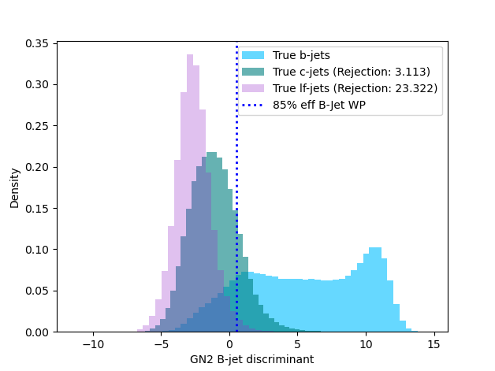
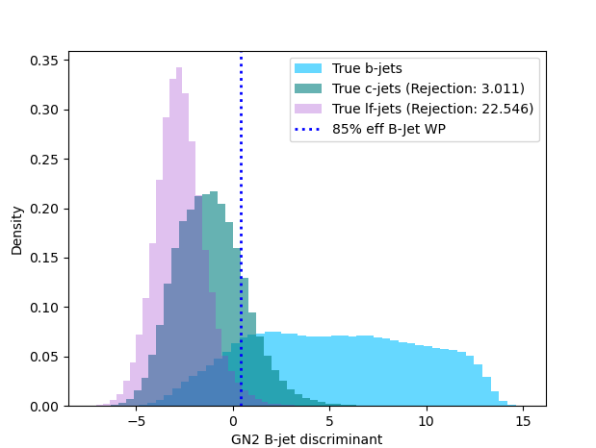
GN2 Trained 10M Events: A) p_{T} > 500 MeV, B) p_{T} > 100 MeV
What effects contribute to the double-peak structure in the b-jet discriminant distribution?
Can this be monopolized to optimize tagging algorithms? Why does the second peak in the combined track data disappear?
(A)
(B)
Fig. 6) GN2 trained 10M event dataset: A) tracks with p_{T} > 500 MeV, B) tracks with p_{T} > 100 MeV

Slide 12
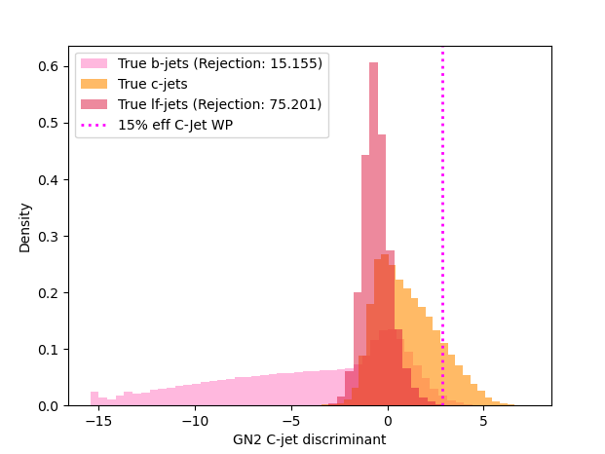
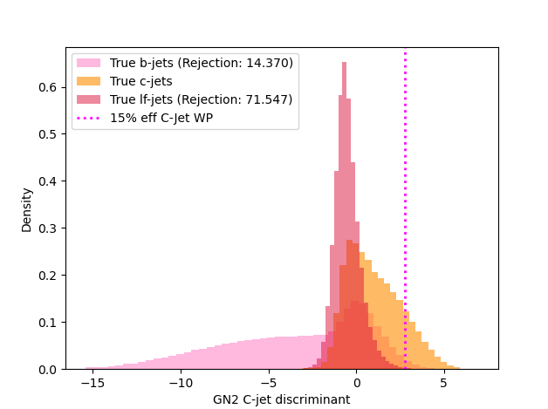
GN2 Trained 10M Events: A) p_{T} > 500 MeV, B) p_{T} > 100 MeV
(A)
(B)
Fig. 7) GN2 trained 10M event dataset: A) tracks with p_{T} > 500 MeV, B) tracks with p_{T} > 100 MeV

Slide 13
Track Cuts:
¹Low‑pT Tracking in High Pile‑Up Environments with EventIndex
Table 2A): Low-pT Track Cuts
A) TDD, B) Python
Table 2B): Low-pT Tracks Passing Cuts in Python
(A)
(B)
p_{T} min. | 100 MeV | > 100 MeV
|𝜼| max. | 2.5 | 2.5
d₀ max. | 5.0 | N/A
𝛔_{d0} | N/A | < 3.0 for pT > 250 MeV
Z₀ max. | 5.0 | N/A
Si hits min. | 6 | N/A
Si shared max. | 1 | N/A
Si holes max. | 2 | N/A
Pixel holes max. | 1 | 0
SCT Holes | N/A | ≤ 2
Pixel Hits + Dead Modules | N/A | ≤ 4
Cut Applied | Number of Low-p_{T} Tracks | Number of Tracks | Percent of Low-p_{T} passing
No Cuts | 127,673 | 629,946 | %100
p_{T} | 127,673 | 629,946 | %100
𝛔_{d0} + p_{T} | 123,517 | 556,693 | ~%97
|𝜼| | 123,517 | 556,693 | ~%97
SCT Holes | 123,517 | 556,693 | ~%97
Pixel Holes | 106,491 | 504,196 | ~%83
Pixel Hits + Dead Modules | 99,543 | 499,112 | ~%83
Table 2C): Standard Track Cuts TDD
r22default-track-cuts.json
r22loose-track-cuts.json
(A)
(B)
p_{T} min. | 500 MeV | 500 MeV
|𝜼| max. | 2.5 | 2.5
d₀ max. | 5.0 | 5.0
Z₀ max. | 5.0 | 5.0
Si hits min. | 8 | 8
Si shared max. | 1 | 999
Si holes max. | 2 | 2
Pixel holes max. | 1 | 1

Slide 14
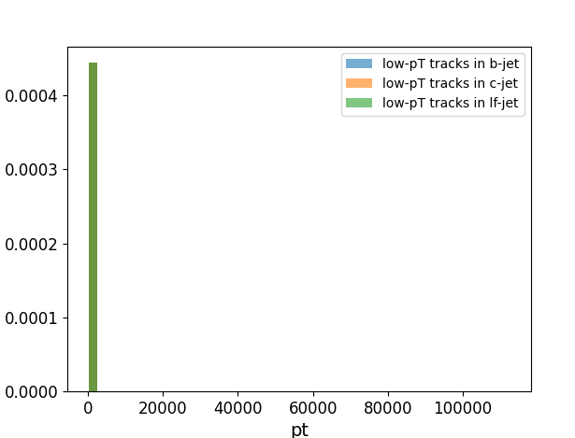
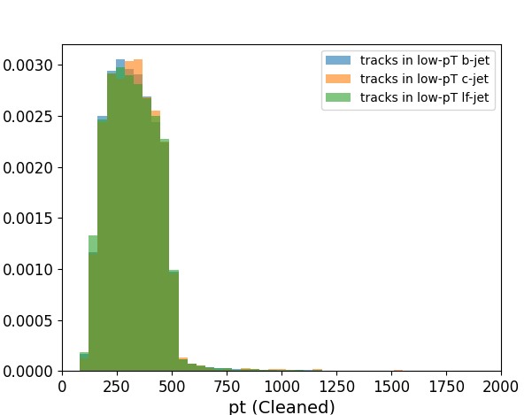
Kinematics Study Low-p_{T} Tracks: Cut Applied on p_{T}
(A)
(B)
Fig. 8) GN2 trained 10M event dataset containing low-p_{T} tracks: A) no cuts applied, B) cuts on p_{T} applied

Slide 15
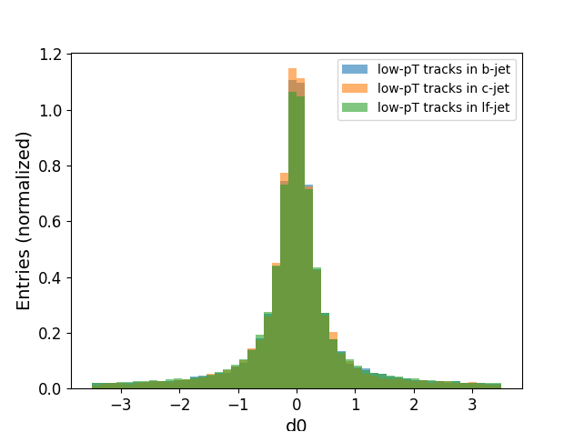
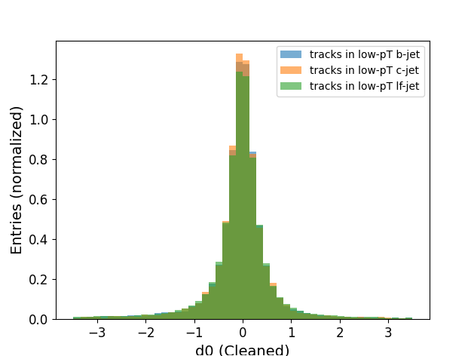
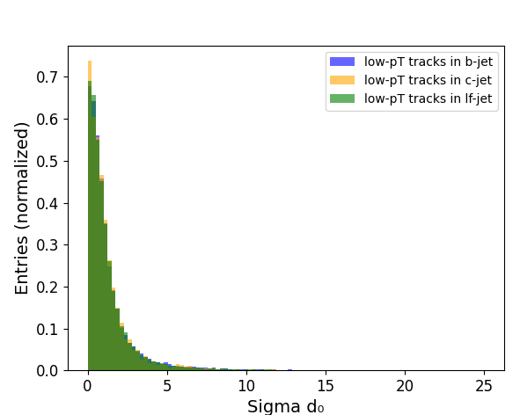
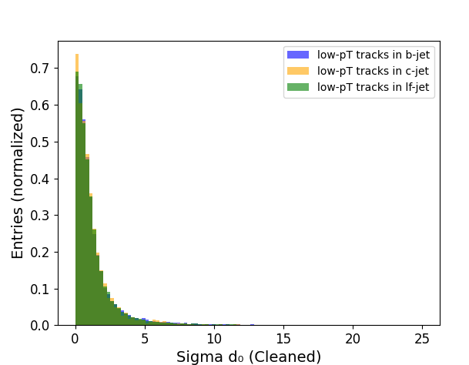
Kinematics Study Low-p_{T} Tracks: p_{T} + 𝛔_{d0}
(9A)
(9B)
(10A)
(10B)
Fig. 9) GN2 trained 10M event dataset containing low-p_{T} tracks: A) no cuts applied, B) cuts on d₀ applied
Fig. 10) GN2 trained 10M event dataset containing low-p_{T} tracks: A) no cuts applied, B) cuts on sigma d₀ applied

Slide 16
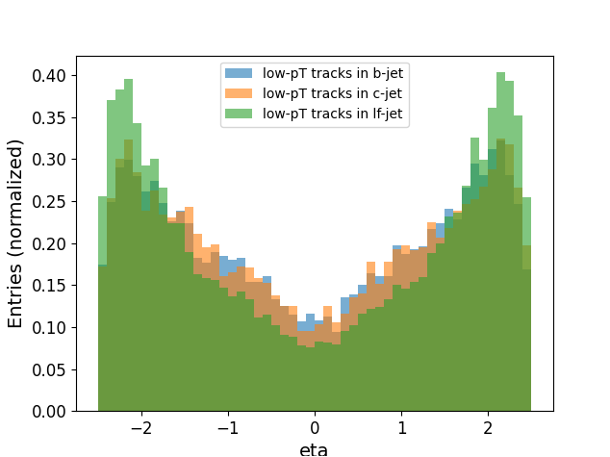

Kinematics Study Low-p_{T} Tracks: |𝜼|
(B)
(A)
Fig. 11) GN2 trained 10M event dataset containing low-p_{T} tracks: A) no cuts applied, B) cuts on |η| applied

Slide 17
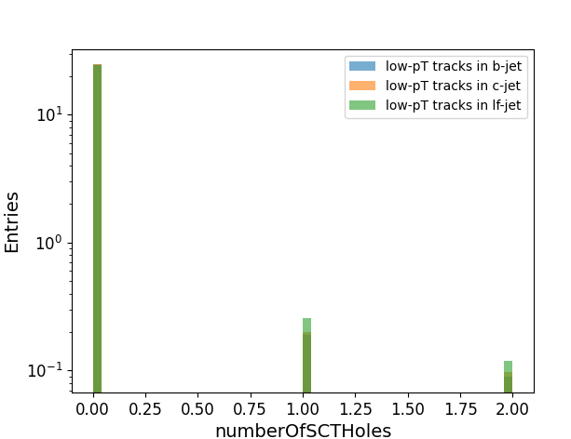
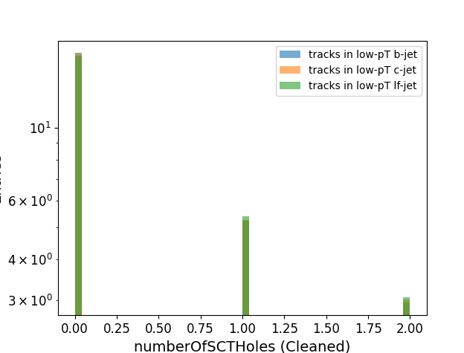
Kinematics Study Low-p_{T} Tracks: Number of SCT Holes
(A)
(B)
Fig. 12) GN2 trained 10M event dataset containing low-p_{T} tracks:
A) no cuts applied, B) cuts on number of SCT holes applied

Slide 18
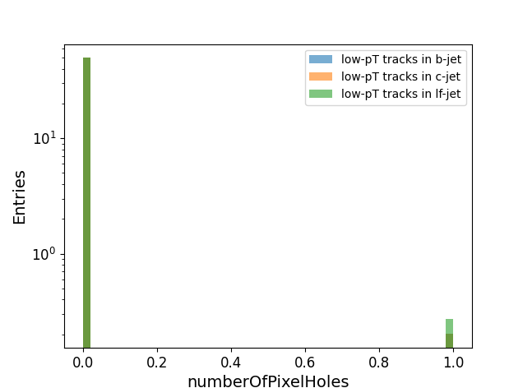
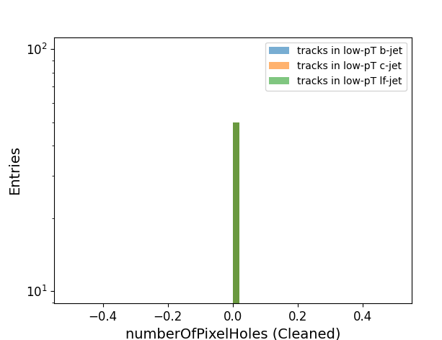
Kinematics Study Low-p_{T} Tracks: Number of Pixel Holes
(A)
(B)
Fig. 11) GN2 trained 10M event dataset containing low-p_{T} tracks:
A) no cuts applied, B) cuts on number of Pixel holes applied

Slide 19
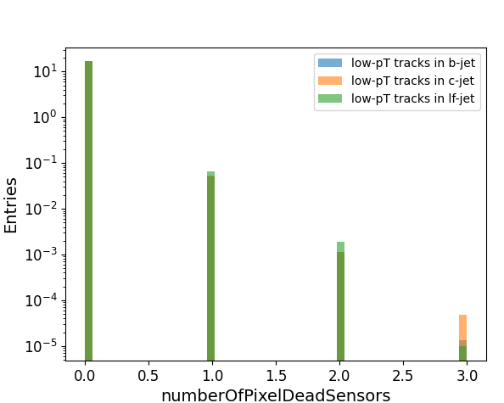
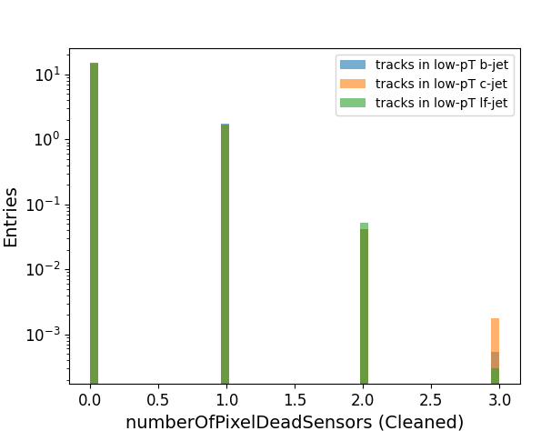
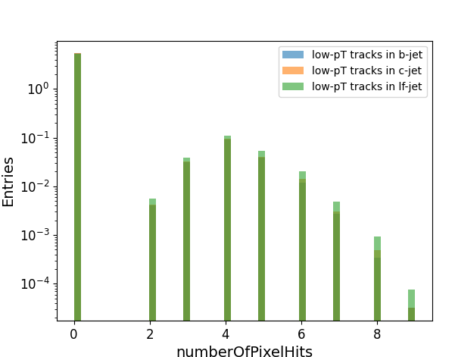
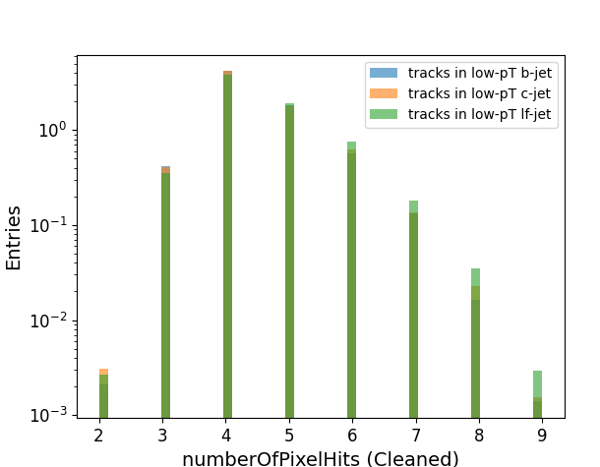
Kinematics Study Low-p_{T} Tracks: Number of Pixel Hits + Number of Dead Modules
(12A)
(12B)
Fig. 12) GN2 trained 10M event dataset containing low-p_{T} tracks:
A) no cuts applied,
B) cuts on number of dead modules applied
Fig. 13) GN2 trained 10M event dataset containing low-p_{T} tracks:
A) no cuts applied,
B) cuts on number of Pixel hits applied
(13A)
(13B)

Slide 20
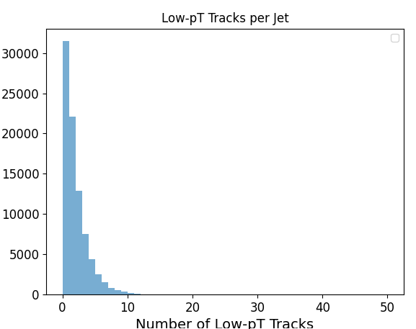
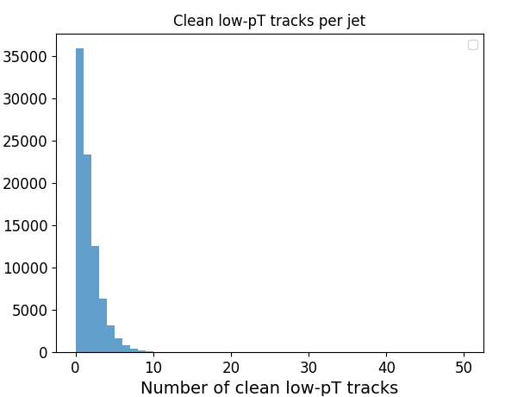
Kinematics Study Low-p_{T} Tracks:Number of Low-p_{T} Tracks per Jet
(A)
(B)
Number of Jets
Number of Jets
Fig. 14) GN2 trained 10M event dataset containing low-p_{T} tracks:
A) number of low-p_{T} tracks with no cuts applied, B) number of low-p_{T} tracks with cuts applied

