Slide 1
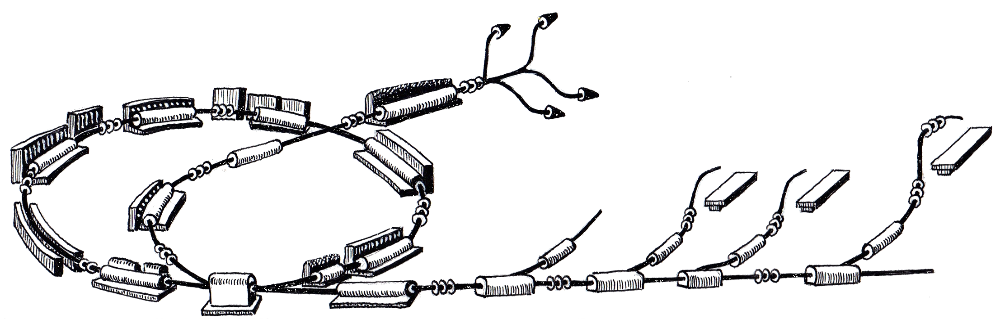
ProShell Procedure Framework Status
MedAustron Control System Week 3
October 3rd, 2011
Roland Moser
R. Gutleber

Slide 2
Scope
Overview of ProShell Procedure Framework
  RunProcedure
Current status
  What was achieved since June 2011
  Plan till October 2011
Summary

Slide 3
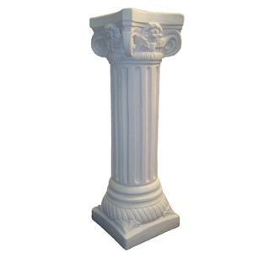
OVERVIEW

Slide 4
ProShell Procedure Framework
provides a graphical user interface that
dynamically loads procedures,
Manages procedures‘ lifecycles,
provides APIs to interact with control system components
  Allocate resources through VAA
  Communicate with resources for control and monitoring purposes

Slide 5
Run Procedure
Loads, edits and saves RunFiles
Executes RunFile on
  Cycle-by-cycle basis
  Sequence-by-sequence basis
Synchronize on MTG events through MAPS

Slide 6
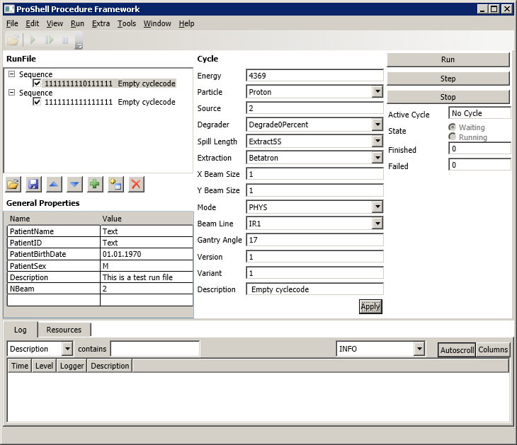
Run Procedure

Slide 7
Run Procedure
RunEditor

Slide 8
Run Procedure
Sequence View
Cycle Editor
Property Editor

Slide 9
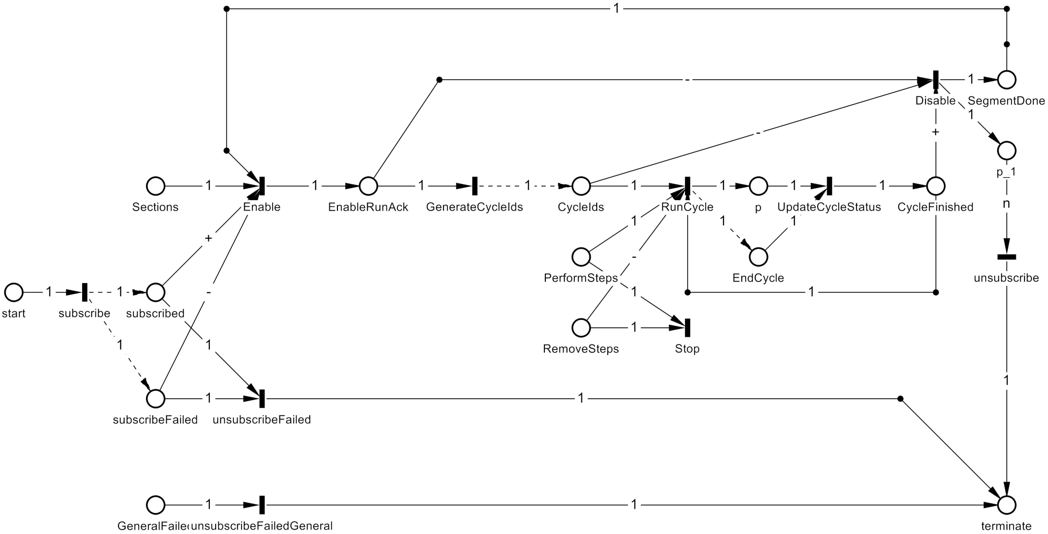
Run Procedure (Petri net)

Slide 10

STATUS

Slide 11
Plan since June 2011
Documentation
  Procedure Developer Manual
  API documentation
  Design Scratchpad integration
Implementation
  Implement revised interfaces
    measurement interface
    user login mechanism
    Configuration locking and mode change
  Integration of Main Timing System
  Integration with Virtual Accelerator Allocator (CTM)
  Integration of Scratchpad mechanism (CTM)
  Integration of MADX into ProShell (MHA)
  Improvements to Petri Net Editor and View (SSA)

Slide 12
Documentation Progress
ProShell Enterprise Architect Model
  Requirements
    Added for external developed components
  Architecture and Design
    Added for external developed components

Slide 13
Implementation Progress
ProShell
  Run procedure for executing cycles through MTG
  PetriNet Improvements (SSA)
    + and – arcs
    Visualization arcs for asynchronous operations
    Visualization improvements for Petrinet execution
  RunFile Editor WPF controls, reader and writer
  Cycle Editor WPF control
Device Hierarchy
  General cleanup necessary for scratchpad integration
  Implement MTG device to
    execute cycles and emit events
    receiving events in non-realtime (MAPS)
  Integrate with MAPS (for measurement acquisition)

Slide 14
Plan since June 2011
Documentation
  Procedure Developer Manual
  API documentation
  Design Scratchpad integration
Implementation
  Implement revised interfaces
    measurement interface
    user login mechanism
    Configuration locking and mode change
  Integration of Main Timing System
  Integration with Virtual Accelerator Allocator (CTM)
  Integration of Scratchpad mechanism (CTM)
  Integration of MADX into ProShell (MHA)
  Improvements to Petri Net Editor and View (SSA)
    Not started
    Slow progress
    Good progress
    Slow progress
    Not started
    Not started
    Good progress
    Not started
    Slow progress
    Not started
    Good progress

Slide 15
Plan till December 2011
Documentation
  Procedure Developer Manual
Implementation
  Implement revised interfaces
    measurement interface
    user login mechanism
    Configuration locking and mode change
  Integration of Main Timing System
  Integration with Virtual Accelerator Allocator (CTM)
  Integration of Scratchpad mechanism

Slide 16
Questions?

Slide 17

ADDITIONAL
SLIDES

