Slide 1
RMS Status
What’s added since last MACS Week

Slide 2
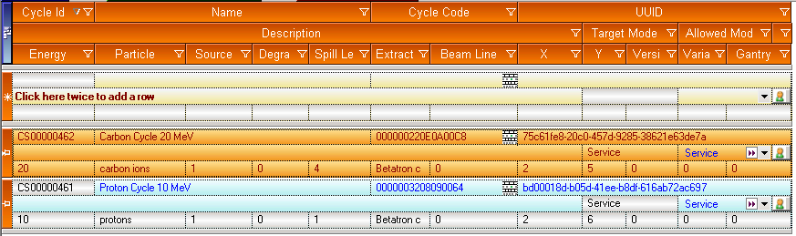
Cycle Codes
Definition of available cycle codes

Slide 3
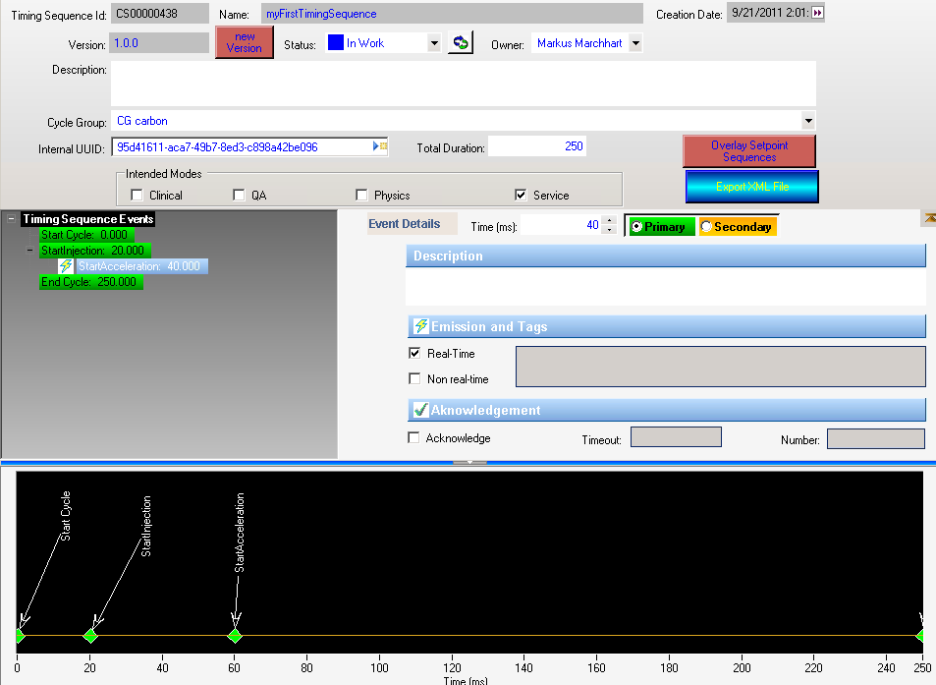
MTG Manager – timing sequences

Slide 4
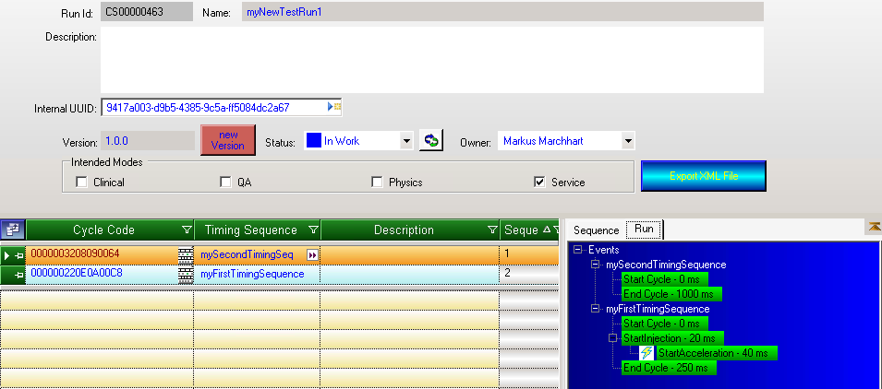
MTG Manager – run definition

Slide 5
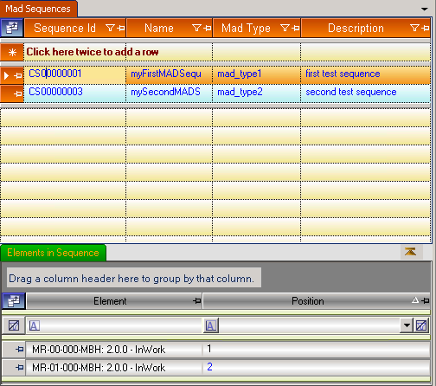
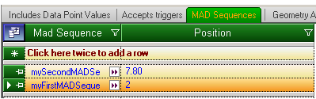
MAD Sequences
Definition of MAD Sequences
Assignment of devices to MAD Sequences

Slide 6
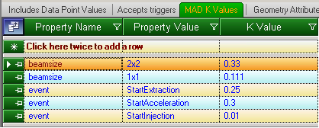
MAD k-values
Assignment of multiple k-values for each individual device

Slide 7
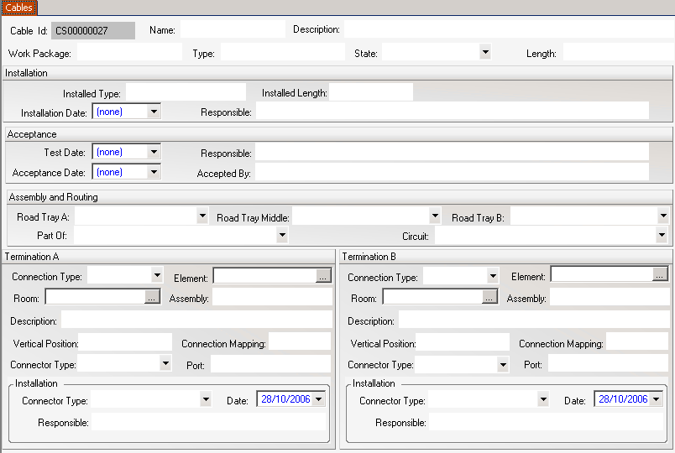
Cable database extension
Cables
Cable Tray Roads
Circuits

Slide 8

Reminder: MACS configuration chain
XML documents for device definition
Database filled from XML documents
Configuration created in RMS
Configuration exported to configuration files
Configuration files are read by the individual systems
MACS
XML
File
RMS
DB
config files
Importer
Exporter

Slide 9
Importer: missing items
Set-point sequences
Timing sequences
Cycle Codes
Cycle Group entries and Cycle Groups
MAD import
Machines

Slide 10
Exporter: missing items
WinCC OA alarm definition
Navigator configuration
MAD export
Setpoint sequence files
Files for MTS (timing sequences, event type identifier
OPC GENI (configuration files)
RF
ProShell

Slide 11
What’s do be done next?
Fill the database
with DATA!

