Slide 1
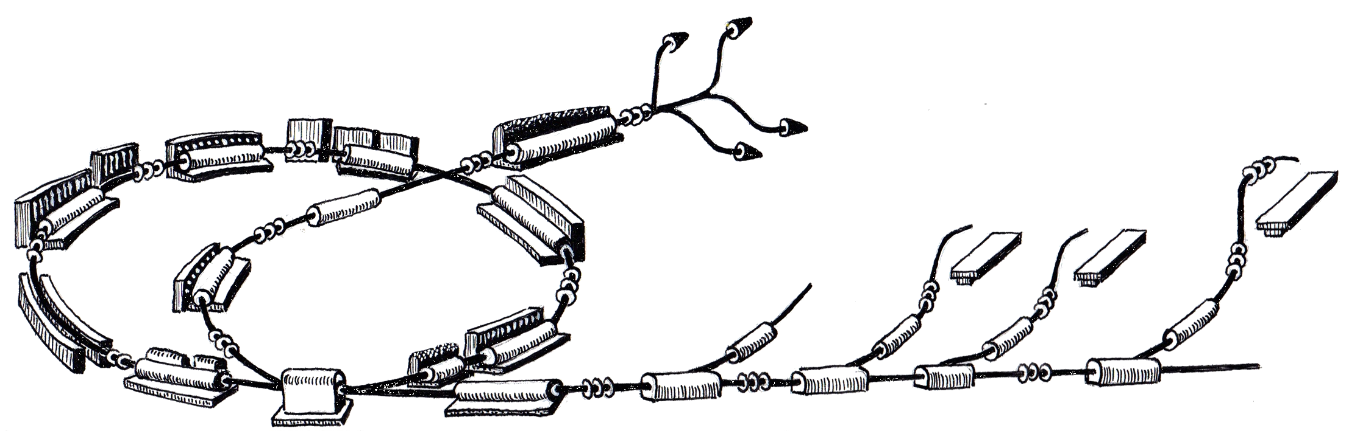
IWeek Achievements

Slide 2

MACS Column

Slide 3
MACS Column
Represents a Vertical cut through the control system
A test setup was assembled in December 2010 with Cosylab in 37-R-023 (MACS /RF lab)
The idea at the time was to:
  To validate if the chosen technology can meet the requirements
  to demonstrate development achievements of the last 3Qs of a year
  to set an example for a device integration
But We kept it alive and use it to validate our and Cosylab’s development to see how all the pieces work together, hence integration week

Slide 4
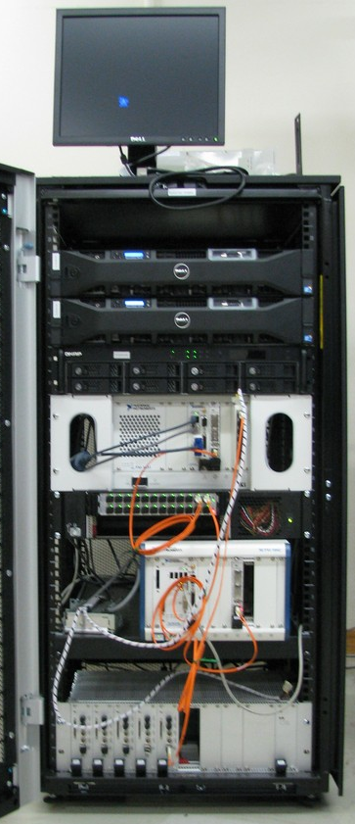
Macs Column Test Setup
FECOS
REDNET
MTS
MTG
MTR
PCC
PCC
FlexRIO
fiber link protocol
FED

Slide 5
Iweek Achievements

Slide 6
Where we are so far
We will have 7 IWeeks this year, roughly one each 2 months, 5done 2 to go.
  February 21st-25th 2011
  April 11th-14th 2011
  May 23rd-27th 2011
  August 8th-12th 2011
  September 19th-23rd 2011
  October 31st - November 4th 2011
  December 12th-14th 2011

Slide 7

IWeek August
XML Device Description
PCC
ScratchPad
Front Panel
MTG
Panel
VAA
Panel
PVSS Control
Panels
`
Tier-1
Multiple instances of PCC in the same crate
Shared Variable Exporter
VAcc WS operation panel
RMS Importer
RMS
RMS Exporter
PVSS
VAA
ProShell
Oracle
Configuration Web Server
MAPS
Tier-2
FECOS
FECOS
FECOS
PCC
MTG
PCC
Tier-3
Optical
Link
EVG
Optical
Link
FED
Family A PCO
CRB
FED
Tier-4

Slide 8
IWeek September
XML Device Description
PCC
ScratchPad
Front Panel
MTG
Panel
VAA
Panel
PVSS Control
Panels
`
Tier-1
FECOS Exporter
Scratchpad functionality
MTS with real time network
  Heartbeat
  Loading of sequences
  Emission of events over REDNET network
  SIM interface to the MTG
First “Run” (Virtual Accelerator, WinCC OA, MTG playing cycles)
RMS Importer
RMS
RMS Exporter
PVSS
VAA
ProShell
Oracle
Configuration Web Server
MAPS
Tier-2
FECOS
FECOS
FECOS
PCC
MTG
PCC
Tier-3
Optical
Link
EVG
Optical
Link
FED
Family A PCO
CRB
FED
Tier-4

Slide 9
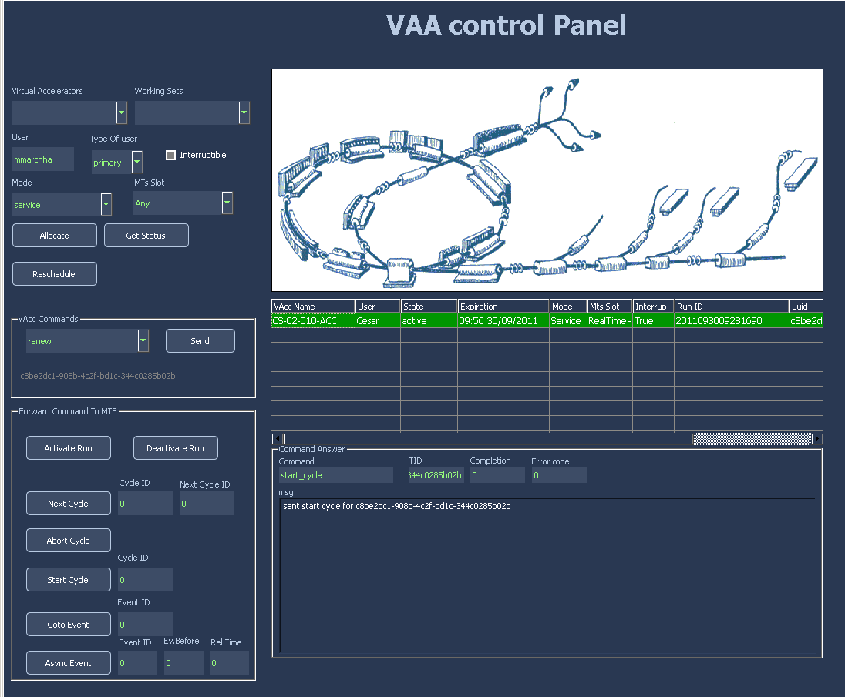
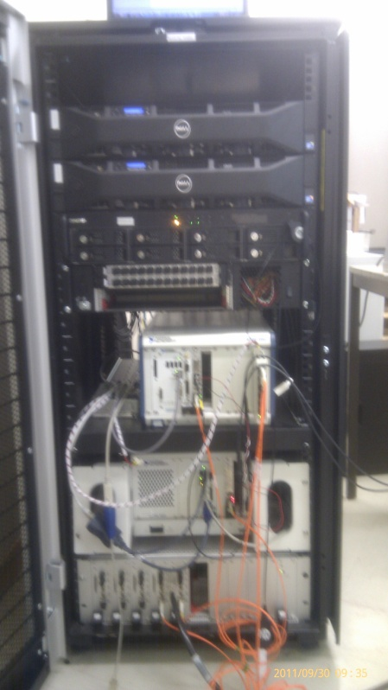
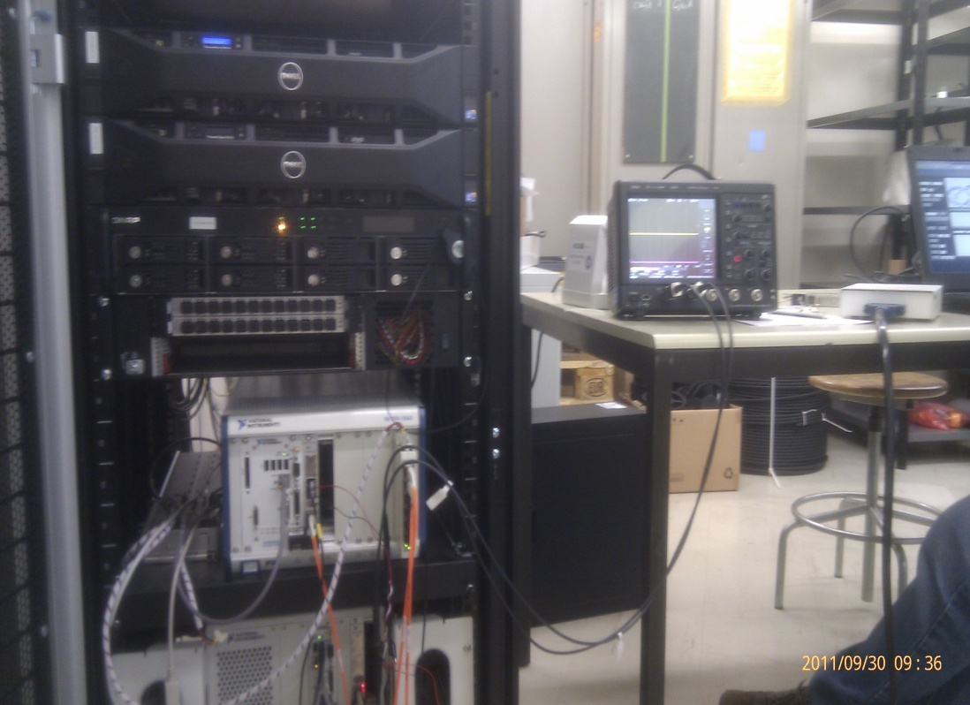
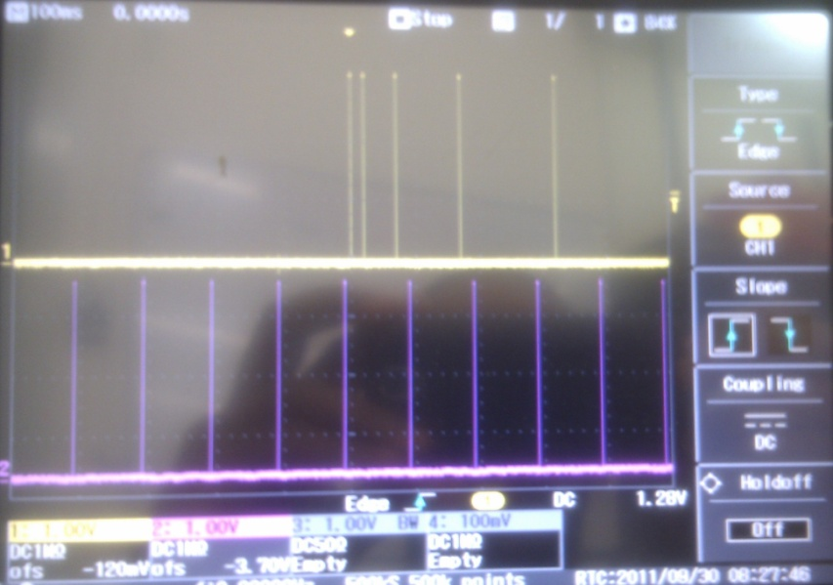
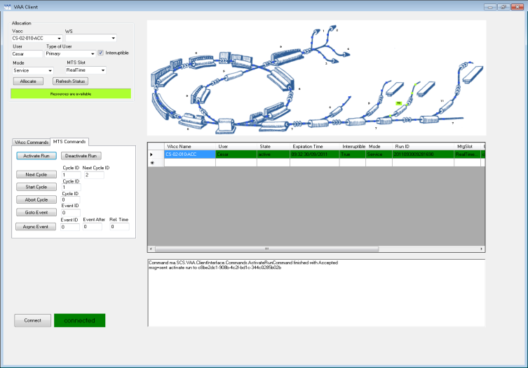
Iweek September

Slide 10
IWeek September
XML Device Description
PCC
ScratchPad
Front Panel
MTG
Panel
VAA
Panel
PVSS Control
Panels
`
Tier-1
RMS Importer
RMS
RMS Exporter
PVSS
VAA
ProShell
Oracle
Configuration Web Server
MAPS
Tier-2
FECOS
FECOS
FECOS
PCC
MTG
PCC
Tier-3
Optical
Link
EVG
Optical
Link
FED
Family A PCO
CRB
FED
Tier-4

Slide 11

Summary

Slide 12
We can export almost all configuration for the iWeek (FECOS, WinCC OA, Shared Variables)
We managed to make a first “Run”
Most of the key pieces of the system are here
  But we never had PCC and MTG working together (next iweek)

Slide 13
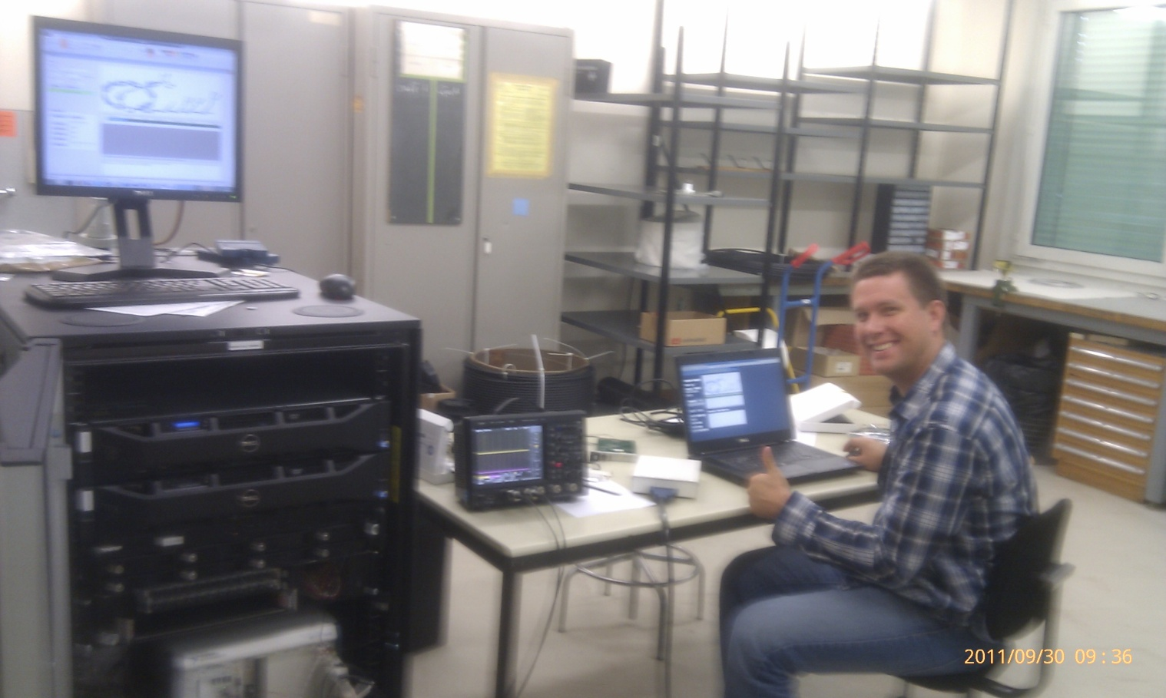
That’s it!

