Slide 1

Power Converter Controller (PCC)
Status overview
Luka Šepetavc luka.sepetavc@cosylab.com
the best people make cosylab

Slide 2
Outline
Quick overview
1) What has been done
2)Work in progress
3) What needs to be done

Slide 3
PCC – quick overview
Notes:
PXI controller runs LabVIEW Real-Time
accepts commands from the PVSS, sequences from the webserver, receives events from the MTG
has FlexRIO FPGA Modules with custom developed Adapter Modules
FEDs connect to the PCC over an real-time optical link
FED has different interfaces to which different types of PCOs connect to
PCC generates single set-points or set-point sequences, takes measurements from PCOs etc.

Slide 4
What has been done – legend
GREEN – task went well
ORANGE – slight issues with the task
RED – show-stopper

Slide 5
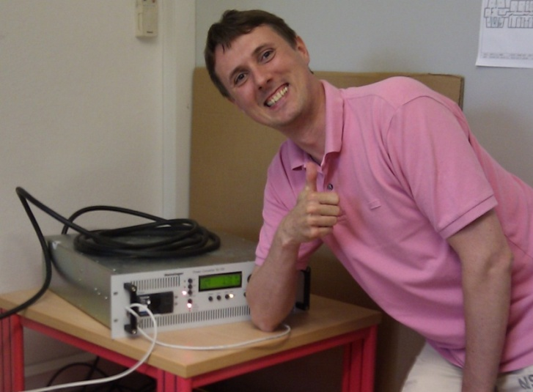
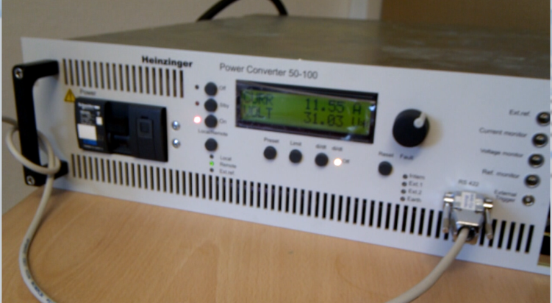
1) What has been done
Family A PCO driver
  applying voltage or current
  acquisition of measurements
  sending and receiving commands
  utilizes the whole MACS column
Notes:
“hidden” bug in a lower communication layer, under the driver

Slide 6
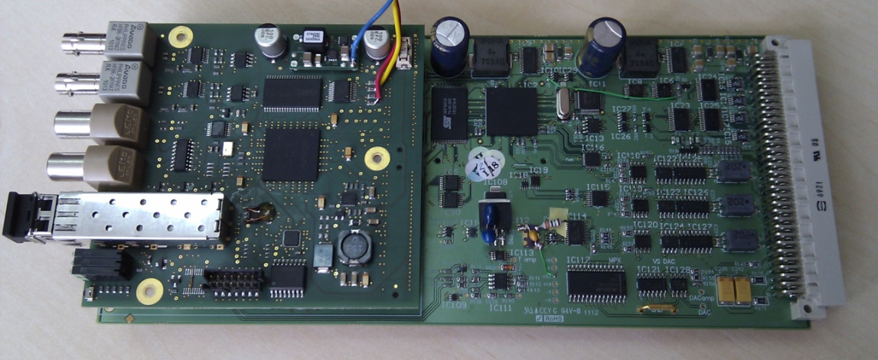
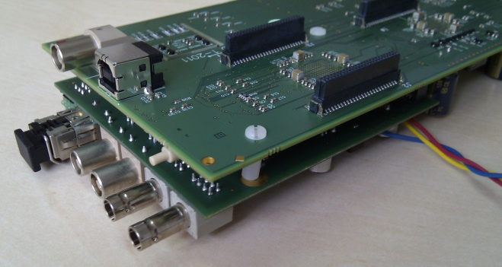
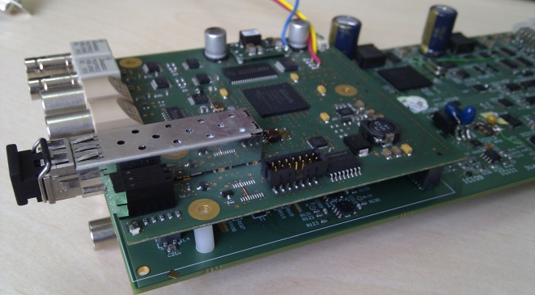
1) What has been done
Successful integration of FED and CRB
  general purpose inputs/outputs
  specialized signals, e.g. triggers...
  parallel interface UHPI (small bug on FED)
FED
CRB
Notes:
found a small bug on FED: 2 signals were missing (not routed to the connector)
-> this will be corrected in the second revision of FED

Slide 7
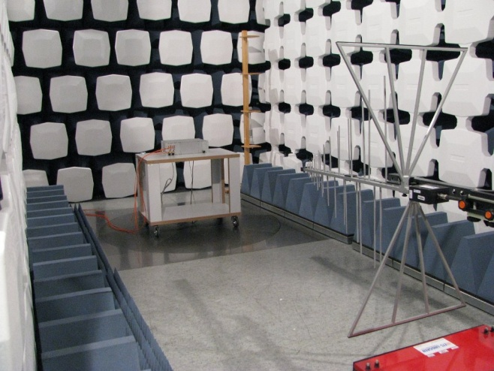
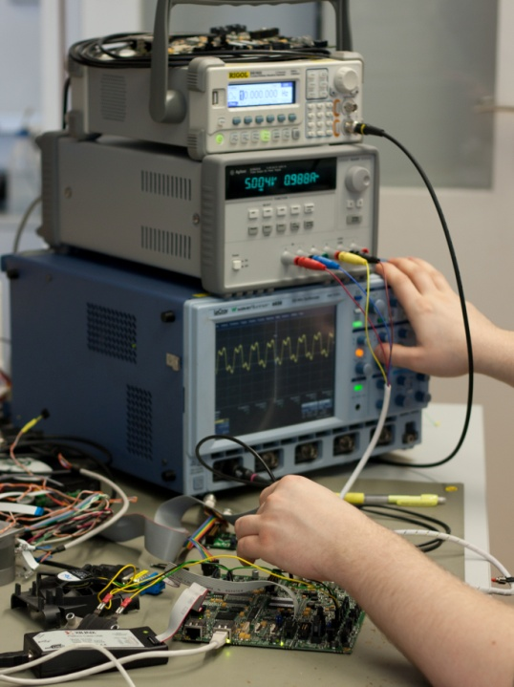
1) What has been done
Electromagnetic compatibility test (EMC)
  tested immunity of Front End Device (FED)
  results are generally positive
  improvements in the second revision (more protection)
Test cases and reports
  carried out tests at Cosylab and CERN
  gradually cover all test cases through iWeeks
FED

Slide 8
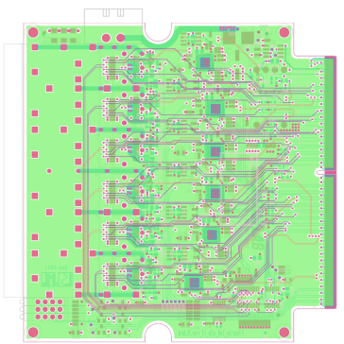
2) Work in progress
Cycle dependent operation
  based on cycles from the timing system
  based on commands (ACTI, PREP...)
  integration of scratchpad
Second revision of hardware
  FED, baseboard, FlexRIO Adapter Module
  revised schematics, PCB design
  prepare for mass production
Transition from LabVIEW RT to Windows
  more suitable for PCC
  defragmentation is possible

Slide 9
3) What needs to be done
Continuous measurements
  buffering
  filtering
  streaming to WinCC
LabVIEW driver for CRB
  define interface and high level protocol
  integrate CRB into PCC and WinCC
  timestamping
Transition from PXI to PXIe
  better performance
Performance tests
  final decision on type and number of crates

Slide 10
Questions
☺

