Slide 1

REDNet - Status overview
Rok Stefanic (rok.stefanic@cosylab.com)
Ziga Kroflic (ziga.kroflic@cosylab.com)
the best people make cosylab
Notes:
REDNET – Real Time Event Distribution Network

Slide 2
Outline
Quick overview
1) What has been done so far
2) What is working
3) What needs to be done

Slide 3
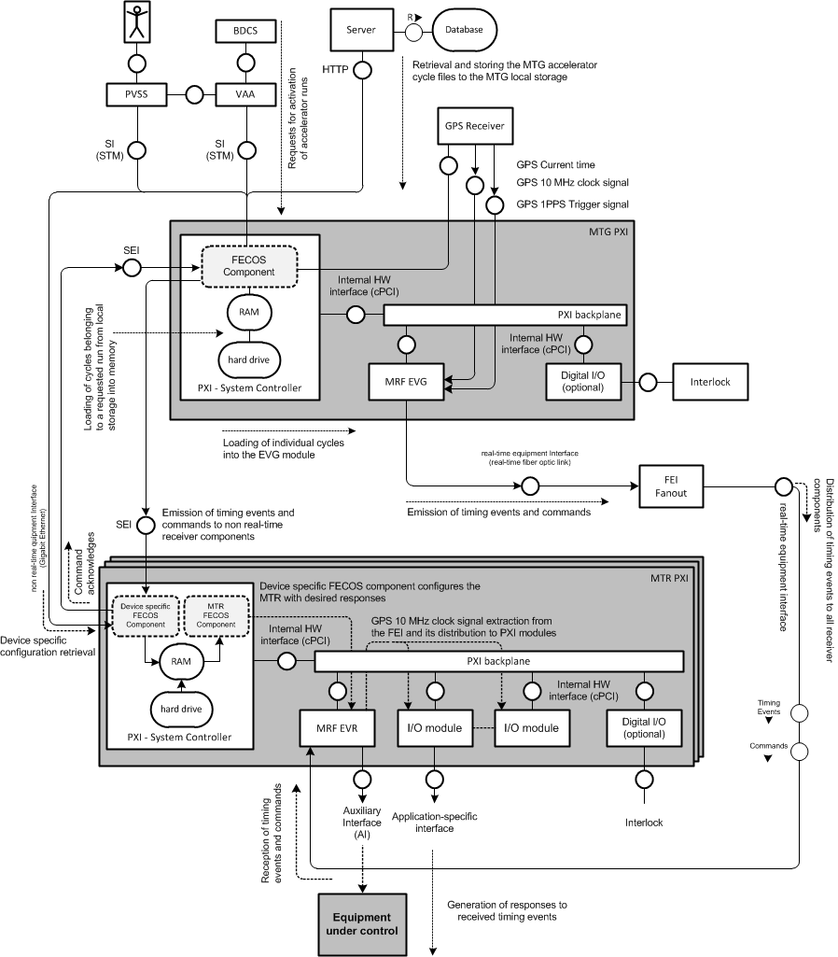
Quick overview
VAA Activates a Run (+ run file)
MTG redistributes the Run file with a list of cycles
MTG Generates timing events from the requested cycle
VAA requests the generation of a cycle from the run list
Receiver components generate responses
(digital signals, irq, triggers…)
Notes:
-VAA (Virtual Accelerator Allocator) – activates run (composed of multiple accelerator cyles, and each cycle of events)
-MTG lets everybody know about what‘s going to happen (which cycles are going to be generated)
-after that MTG receives acknowledgments from all receivers-devices
-VAA requests actual generation of cycles
-MTG start generating cycles by emitting events over fiber optics and MAPS
-MTR generates responses to events (either backplane, GPIOs, software…)

Slide 4
1) What has been done so far
GREEN – task went well
ORANGE – slight issues with the task
RED – task was underestimated, more effort spent

Slide 5
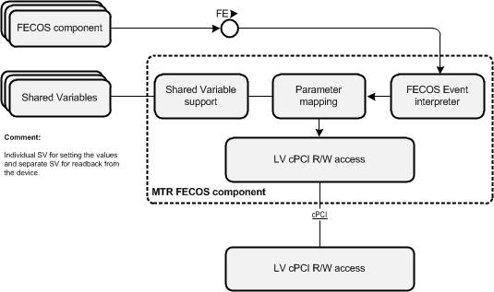
1) What has been done so far
REDNET MTR XML (fml) configuration file
  interface defined via shared variables
Timing receiver SW implementation
  Dynamically loaded FECOS component
  Interface to other FECOS components running on the crate
  Interface to WinCC OA via shared variables(!)
    Interface implemented partially –> Done
  Subscription to responses (AIGPO, STB, STL, Fecos event)
  Acknowledge via MAPS
    Does not work yet due to FECOS/MAPS bug

Slide 6
1) What has been done so far
Timing receiver HW implementation
  Response generation is implemented
    Pulse/toggle on auxiliary interface (4 optic/TTL outputs)
    Pulses on PXI star trigger lines from MRF EVR to other cards
      Debugging and correcting inproper backplane connectors
    Timing event distribution to other cards over PXI shared RT trigger bus on PXI backplane
    Distribution of received timing events to FECOS components
  Command reception must be implemented -> Done
    HW resource issues to store all data associated with ActivateRun
    Solved by introduction of “Lightweight” ActivateRun command
  Revised EVR reset sequence to resolve booting problem
MTR design documentation
  Interfaces and functionality defined, the documentation needs to be updated -> Users manual for subscribing to responses still needs to be documented

Slide 7
1) What has been done so far
REDNET MTG XML (fml) configuration file
  interface defined via shared variables
Timing master SW implementation
  Configuration of component from XML file
  SIM interface
  Cycle generation
    Parsing and execution of timing events from sequence files
    Emission of commands and events over RT and Non-RT link
  Acknowledge mechanism
    Mechanism implemented in MTG, but does not work in the whole system yet because of FECOS/MAPS bug
  Heartbeat

Slide 8
1) What has been done so far
Timing master HW implementation
  Deterministic emission of event sequences for 5 execution slots via RT link
  Emission of commands via RT link
  Emission of heartbeat event via RT link
  Emission of asynchronous events over RT link
  Emission of events via non-RT link
MTG design documentation
  Interfaces and functionality defined, the documentation needs to be reviewed and updated
Test cases
  Done up to functionality needed for last iWeek

Slide 9
2) What is working
Main Timing Receiver
  Generation of responses to received timing events on all interfaces
    Auxiliary interface
    Shared real-time trigger
    Shared trigger lines
    Software IRQ
  SW injection of timing events from LV
    provides generation of timing sequences locally on the receiver
  10MHz clock distribution
    MRF EVR extracts clock signal from optic link and distributes it over PXI backplane to other cards (PCC FlexRIO Modules)
  Full receiver configuration
    by other FECOS components
    from configuration in shared variables and XML

Slide 10
2) What is working
Main Timing Generator
  Full receiver configuration
    from configuration in shared variables
  SIM interface to VAA
  MRF EVG low level device support
    Allows access to registers and memory in MRF EVG FPGA
  Cycle generation
    Emission of event sequences
  Heartbeat

Slide 11
3) What needs to be done
MTG LabView FECOS component
  Dynamic loading of the MTG component
    Not done yet because of unexpected issues
  Synchronous SIM interface enahancements
    Add synchronous counterparts to all SIM commands
    NextCycle with Start Immediately
  MAPS interface to receivers
    MAPS is not working properly yet!
    MAPS messages need to be revised, tags defined
  Acknowledge functionality
    Done but needs to be tested when MAPS is fixed
  Integration with scratchpad
    Because of specifics of timing system, RedNet cannot use FECOS scratchpad service. Scratchpad behaviour needs to be implemented in the MTG

Slide 12
3) What needs to be done
MTG FPGA implementation
  Integration with GPS time module
    Use 10MHz clock reference
    Acquire absolute time
  Time distribution service
MTR FPGA implementation
  Time distribution service
  Timestamping of events
  Propagation delay compensation
PXIe EVR
  Migrate and test MTR FPGA functionality on new PXIe EVR cards

Slide 13
3) What needs to be done
System integration and testing
  Testing with large number of different FECOS components that use REDNET services
  Testing of MTR on Win and RT systems
Documentation
  Continuous update of design documentation
  Adding high level test cases and test cases for new functionalities
  Users manual for subscription of FECOS components to MTR responses
  Review and revise requirements

Slide 14
Thank you for your attention
Questions?

