Slide 1

iLLRF Status overview
Klemen Vodopivec klemen.vodopivec@cosylab.com
the best people make cosylab

Slide 2
Outline
Quick overview
1) What has been done
2) What is working
3) What needs to be done
Notes:
-very quick overview of the system
-see what we have developed
-what remains to be done in future CWOs

Slide 3
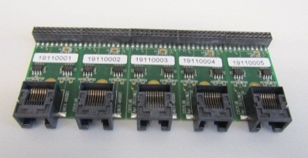
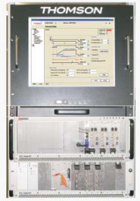
iLLRF – quick overview
iLLRF
ITC component
ILC component
data
MTR
configuration
raw data
MAPS
Thomson LLRF
Trigger interface
TINE server
Notes:
orange: our LV implementation +our HW board is ours
everything else is out of our scope
REDNet modified MTR code for the needs of iLLRF
ITC component configures MTR component so that after every heartbeat event, MTR generates a pulse over HW iface
iLLRF provides two FECOS components: ITC & ILC
IO adapter according to Thomson specification
ILC component, more complex: reads XML, most of properties are SVs, reads values from SVs, writes them into TINE thus configuring Thomson LLRF
raw measurements are send from LLRF to ILC, ILC joins measurements from different channels and sends them to a MAPS server

Slide 4
1) What has been done
GREEN – task went well
ORANGE – slight issues with the task
RED – task was underestimated, more effort spent

Slide 5

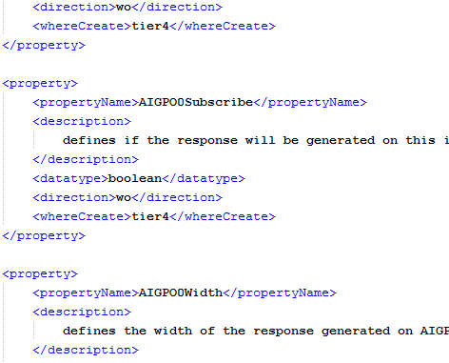
1) What has been done
IO adapter for MTR
  Most of the logic in MTR’s FPGA
  Adapter only transforms signals to Thomson specification
ITC component
  Not yet updated to latest FECOS & MTR changes
ITC XML configuration
  All static variables
Notes:
IO adapter is a voltage level translator to adopt to Thomson’s specs
all properties for ITC component are read from a configuration XML

Slide 6
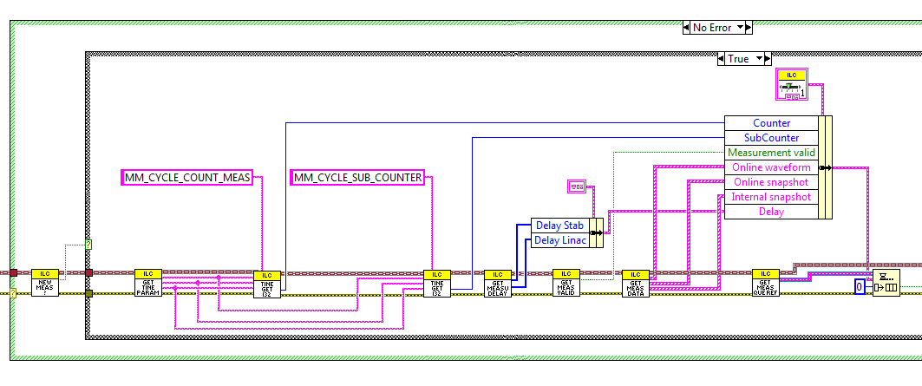
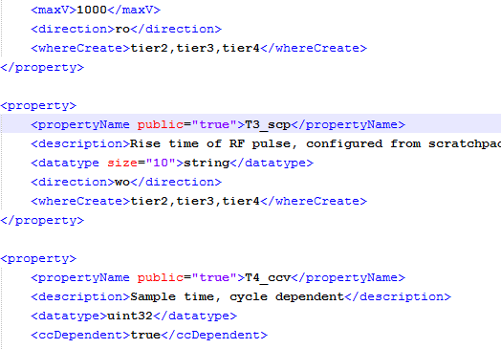
1) What has been done
ILC component
  Error handling
  TINE communication
  Measurement sampling
  Custom commands
ILC XML configuration
  Some static variables
  Most from PVSS
Notes:
-main developed functionality on ILC component are measurements
-TINE comm. – planned an update in CWO-4 (currently polling, async. response in the future)
-we got a TINE server simulator from MA to implement and test TINE communication
-when measurement is detected in TINE it is joined together and sent over MAPS
-custom commands for debug, e.g. send an event with parameters, ILC forwards these events
-ILC is now fully configurable of static and shared variables

Slide 7
2) What is working
Trigger
  MTR handles FECOS event
  IO adapter forwards signal to LLRF
ITC component
  Reads configuration from XML
  Sends FECOS event to MTR
  Forwards heartbeat events
ILC component
  Reads configuration from XML, PVSS
  Configures LLRF through TINE
  Polls for new measurements
  Forwards measurements to MAPS
  Allows custom commanding

Slide 8
3) What needs to be done
Write .doc description for XML configuration
TINE communication enhancements
  support for async detection of new measurements
  support for arrays
Update MAPS message format
Testing
Integration with Thomson LLRF system
Notes:
-integration with Thomson – when will LLRF arrive at CERN? when can we start using and testing it?

Slide 9
That’s all
☺

