Slide 1
Introduction
Trigger
Fast Deflector
E. Septa
Status
AOB
Special Magnets Controls
Status
Tobias Stadlbauer,
Tony Fowler,
Frank Müller
Special Magnets
MedAustron
04 October 2011

Slide 2

Introduction
Trigger
Fast Deflector
E. Septa
Status
AOB
Content
Optical trigger interface
Fast deflector controls and trigger
Electrostatic septa controls
What tasks are planned in 2011
AOB

Slide 3
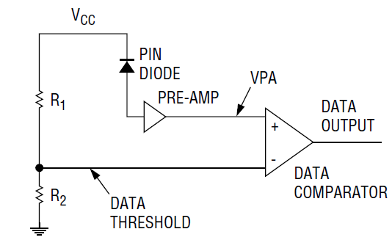
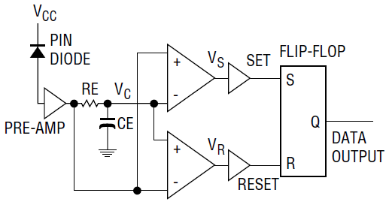
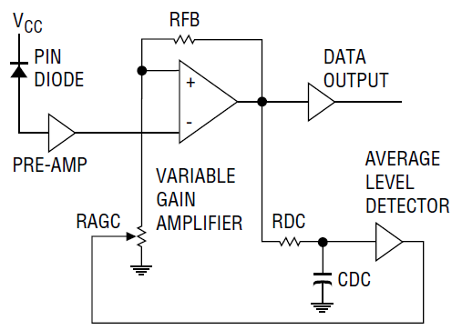
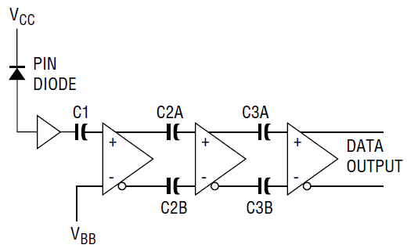
Introduction
Trigger
Fast Deflector
E. Septa
Status
AOB
Different Classes of Fibre Optic Receivers
Follow up by Special Magnets:
According to app. note [2] “Selecting a Fibre Optic Receiver” there are four classes:
Fig. 1 Fixed Threshold Receiver
Fig. 2 Edge Detecting Receiver
Fig. 3 AGC Receiver
(Automatic Gain Control)
Fig. 4 Capacitor Coupled Receiver

Slide 4
Introduction
Trigger
Fast Deflector
E. Septa
Status
AOB
Recommended Fibre Optic Receiver Class
Follow up by Special Magnets:
According to app. note [2] “Selecting a Fibre Optic Receiver” there are four classes:
Recommended
Noise could trigger
Fig. 1 Fixed Threshold Receiver
Fig. 2 Edge Detecting Receiver
Duty cycle must be fixed
Duty cycle must be fixed
Noise could trigger
Fig. 3 AGC Receiver
(Automatic Gain Control)
Fig. 4 Capacitor Coupled Receiver

Slide 5

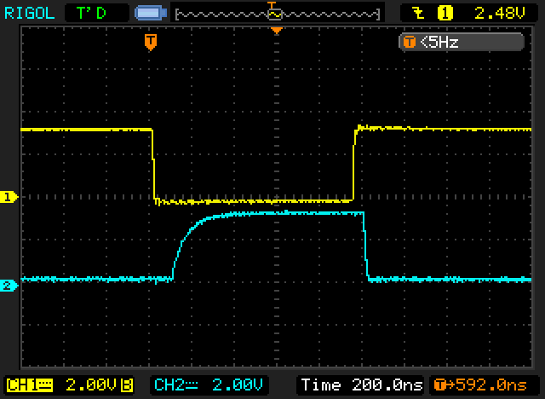

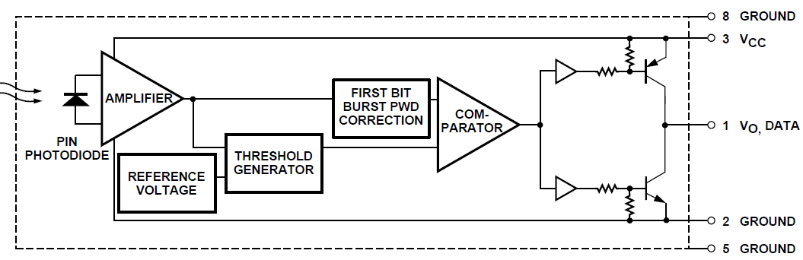
Introduction
Trigger
Fast Deflector
E. Septa
Status
AOB
Comparison of Fibre Optic Receivers
HFBR-2416MZ
Cosylab “noticed quite some issues (jitter)” on the optical receiver HFBR-2416MZ.
No further information available.
This receiver is specified in our tendering documents.
HFBR-2412Z
Cosylab did “tests with different receiver HFBR 2412Z
Status?
blue trace: received signal
HFBR-2528
PSI Solution
Also deployed by Mike Barnes [2] for:
“A 25-kV 75-kHz Kicker for Measurement of Muon Lifetime“
but is not recommended due to the experienced difficulties.

Slide 6
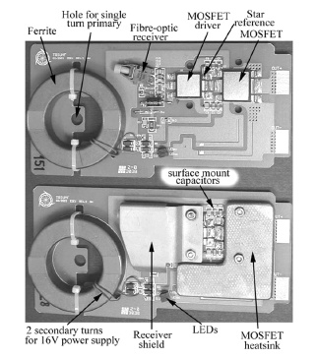
Introduction
Trigger
Fast Deflector
E. Septa
Status
AOB
Shielding of Fibre Optic Receivers
HFBR-2528
Deployed by Mike Barnes [2] for:
“A 25-kV 75-kHz Kicker for Measurement of Muon Lifetime“
but is not recommended due to the experienced difficulties.

Slide 7
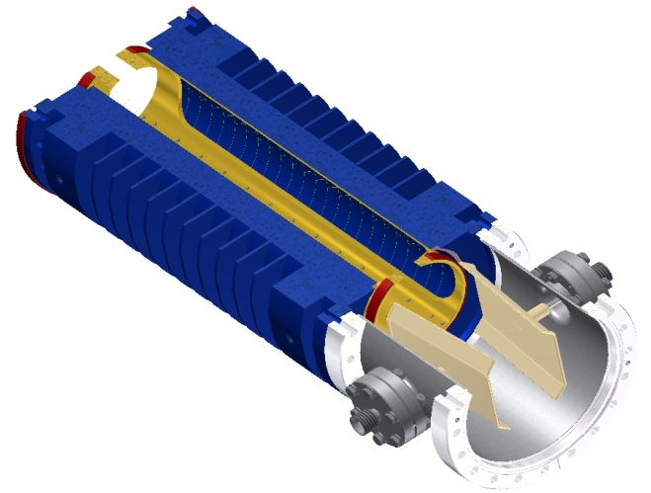
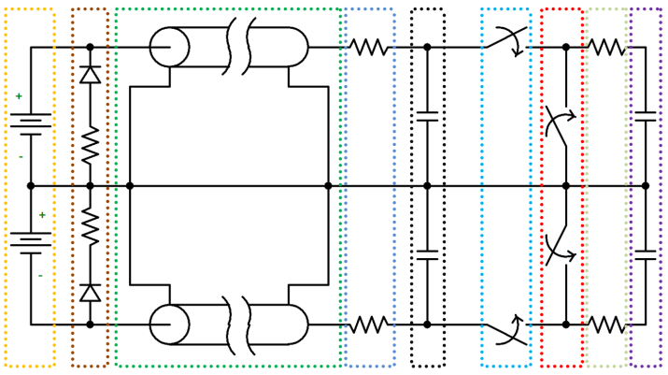
Introduction
Trigger
Fast Deflector
E. Septa
Status
AOB
Fast Deflector with Faraday Cup and Power Supply
Fast deflector and faraday cup
Fast deflector power supply

Slide 8
Introduction
Trigger
Fast Deflector
E. Septa
Status
AOB
Overview of PKF with some Control Signals
2V level detection
HV detection
+
current measurement
→ short circuit and spark detection
DAC set point
DAC set point
or
here
here
temperature
trigger inhibit
5V PS control
fault
timing monitoring
trigger in
ADC measurement
Position dependent on mounting place of p.s.u. (rack or local box)

Slide 9
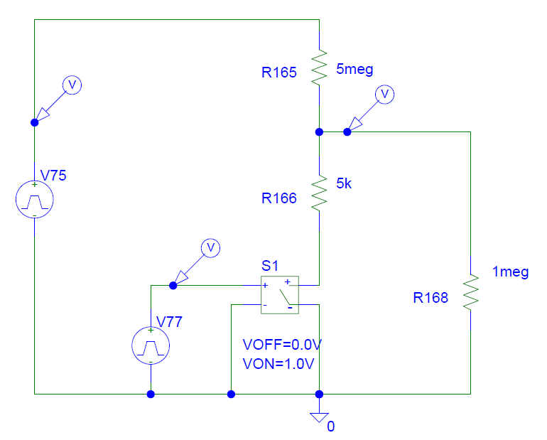
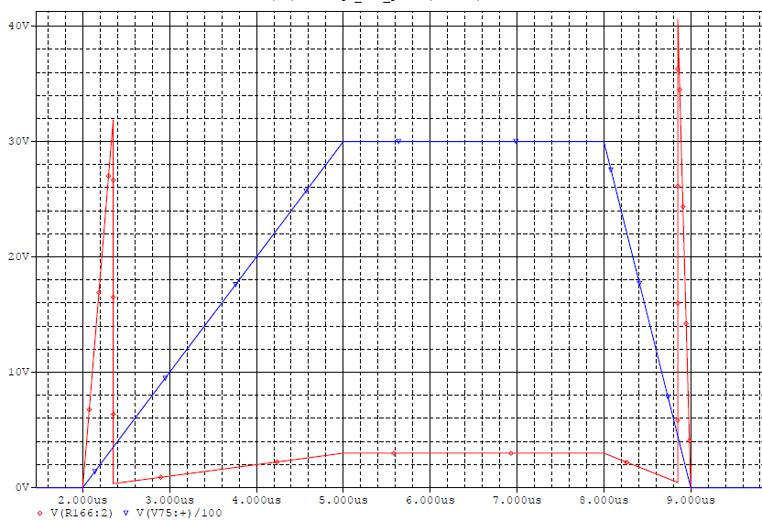
Introduction
Trigger
Fast Deflector
E. Septa
Status
AOB
Active Voltage Dividers
Due to the HV of ±3.5kV for the on state and the LV level of ±2V for the off state, advanced voltage measurements are needed:
active voltage divider [8]
Fig.: blue voltage on plates (peak 3kV), red conditioned signal for further processing (peak 40V)
investigated solutions:
JFET
VDR
H-bridge with optocoupler
OP-Amp
voltage sampling
all active triggered parts must be reliably controlled otherwise components will fail

Slide 10
Introduction
Trigger
Fast Deflector
E. Septa
Status
AOB
PKF Controls
The requirements of the PKF are defined [7]
The development work is in progress:
the technical implementation of the requirements are being studied
tests need to be done in the lab to find suitable solutions
further requirements for the LCS may become evident during development
Thus a flexible and upgradeable LCS is needed which can be easily and quickly adapted by the available resources.
- a good candidate solution is a basic PXI system using LabView RT. This will be implemented for the Linac4 Pre-Chopper and hence we would benefit from reduced development effort.

Slide 11
Introduction
Trigger
Fast Deflector
E. Septa
Status
AOB
Simplified System Architecture
Local Control
generation of test timing
control of all settings
display of status
PKF Hardware
switches
active voltage dividers *
trigger circuits
power supplies
auxiliary devices
PKF
PKF LCS
PCO FED Card
Local Control
BIS
PKF LCS
communication with ACS
monitoring of critical parameters
generate interlocks
inhibit trigger inputs
protect hardware
active voltage divider control
timing control
ADC
DI
DAC
DO
PKF Hardware
MTS

Slide 12
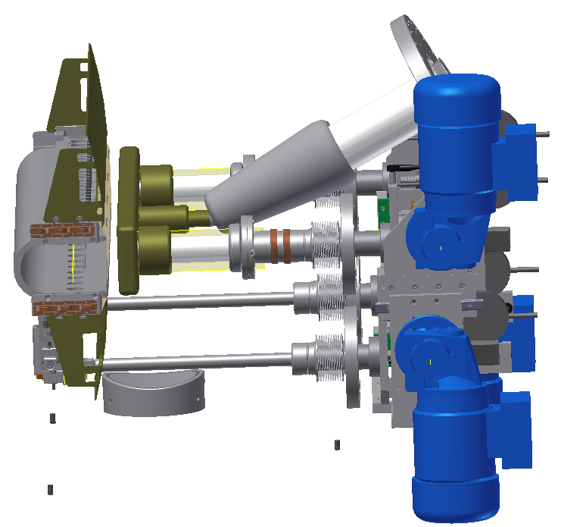
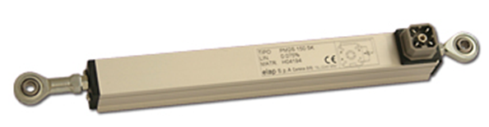
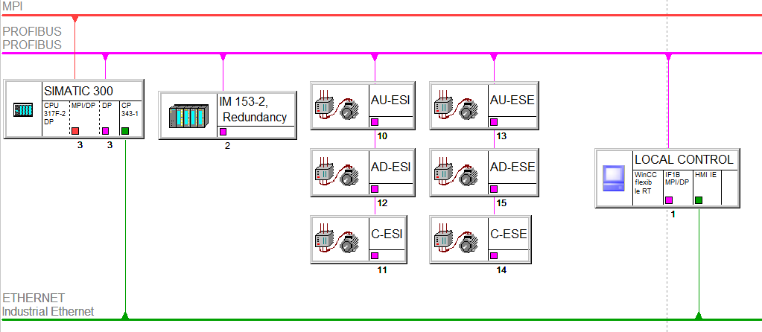
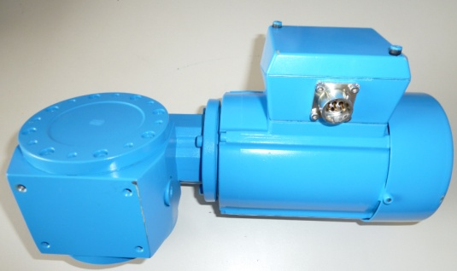
Introduction
Trigger
Fast Deflector
E. Septa
Status
AOB
Simplified System Architecture
ESE without tank
Potentiometer
PLC hardware structure
Motor with gearbox
Hardware to build a simple test bench is available
Requirement document in approval phase
SIMOCODE tests are planned

Slide 13
Introduction
Trigger
Fast Deflector
E. Septa
Status
AOB
What tasks are planned in 2011
MKC risk assessment – impact on controls interfaces
  PKC controls interface
Displacement system for electrostatic septa (PLC) (in progress)
PLC-system for water, temperature (monitoring/interlocking) (in progress)
Fast deflector power supply controls (in progress)
RS422 error detection implementation
Upcoming tasks during production like verification, validation, contract follow up (in progress)
Cables: estimate, planning (in progress)
Design report

Slide 14
Introduction
Trigger
Fast Deflector
E. Septa
Status
AOB
Interfaces
physical connections between power supplies and control system

Slide 15
Introduction
Trigger
Fast Deflector
E. Septa
Status
AOB
References
[1] J. Borburgh, M. Barnes, T. Fowler, M. Hourican, T. Kramer. T. Stadlbauer, Special Magnets - Final Design Report, CERN, 2010 (unpublished).
[2] Honeywell, Application Note, Selecting a Fiber Optic Receiver for your
application
ApplicationNote.pdf
[3] Michael J. Barnes, IEEE, “A 25-kV 75-kHz Kicker for Measurement
of Muon Lifetime“ http://ieeexplore.ieee.org/...
[4] J. Borburgh, et al., “MedAustron Special Magnets - WP description”,
CERN, Geneva, 2009
[5] T. Fowler, T.Stadlbauer “Special Magnets Controls Compendium”,
ES-110114-a-TST-V0.99
[6] BTS-Website: Tasks, Shared Documents, Discussions, Announcements: https://espace.cern.ch/te-dep-abt/Projects/MedAustron/default.aspx
[7] T. Kramer, F. Müller, Fast Deflector Power Converter (PKF),
FS-110624-a-TKR_FMU-0_3_PKF_functional_spec
[8] F. Müller, PSpice simulation results

