Slide 1
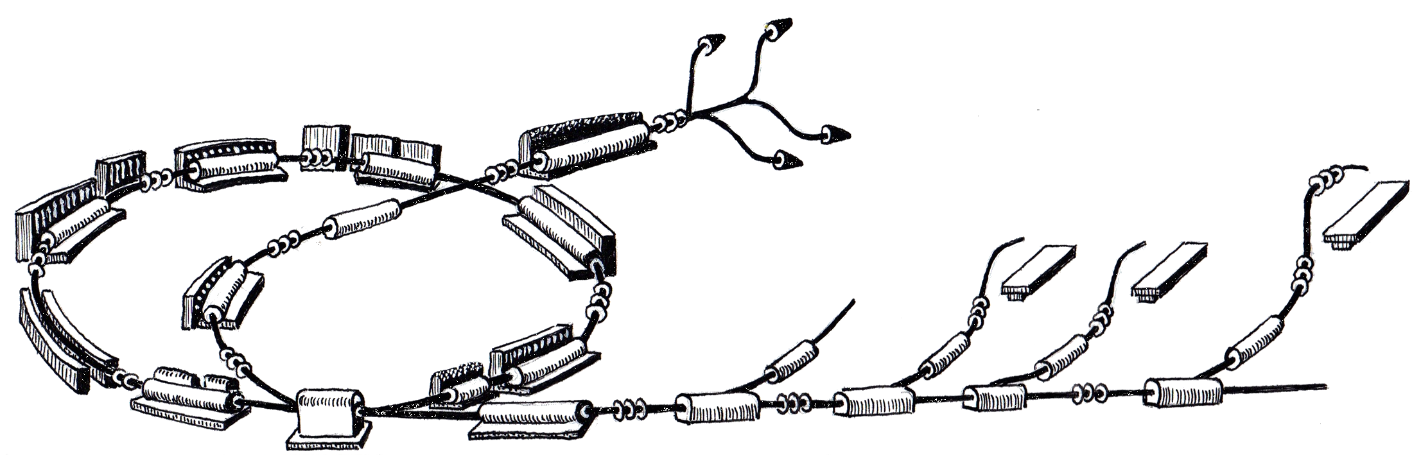
Patrol Control System
Hannes Pavetits
R. Gutleber

Slide 2

Overview
  Why is the PCS needed?
  Scope of the PCS
  Areas protected by the PCS
  Access states of an area
  Hardware / Software

Slide 3
Why is the PCS needed?
  Automation of patrol
  Access control
  Access restriction during beam
  Interlock when access violation (PCS-BIS connection)

Slide 4
Scope of the PCS

Slide 5
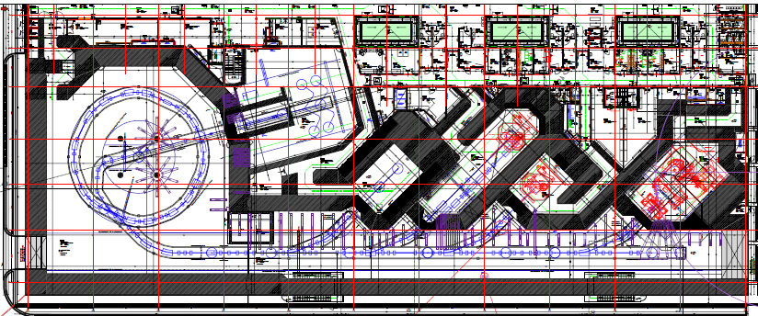

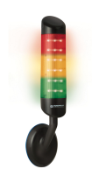
Areas protected by the PCS

Slide 6
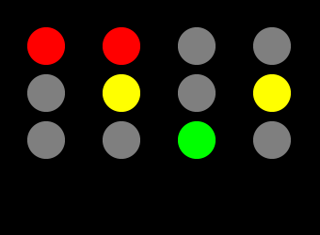
Access states of an area
  NO access – no persons allowed except patient
  Patrol – no persons allowed except patrolling person
  Access – for personnel with dedicated access rights

Slide 7
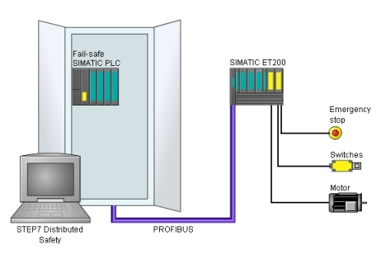
Hardware / Software
Siemens PLC (S7 400)
Distributed Periphery
Digital I/O Modules
Standard PLC programming language
BIS
PROFIBUS
Door sensors
Access system
Visual Indicators
Audio Indicators
Buttons
PCS
Digital I/O signals

Slide 8

Status

Slide 9
September - now
Start of Requirements document
Meetings with RP: patrol procedure, warning lights and consoles
Start defining the layout of the PCS consoles in front of the areas

Slide 10

Outlook
End of Nov: finishing Requirement document PCS
End of 2011: finishing Analysis/Design document PCS
risk analysis of PCS
beginning 2012: start of the PCS-PLC Program

