Slide 2
Access system requirements for B911 doors
C. Ahdida
01/07/2025
EDMS 3317037

Slide 3
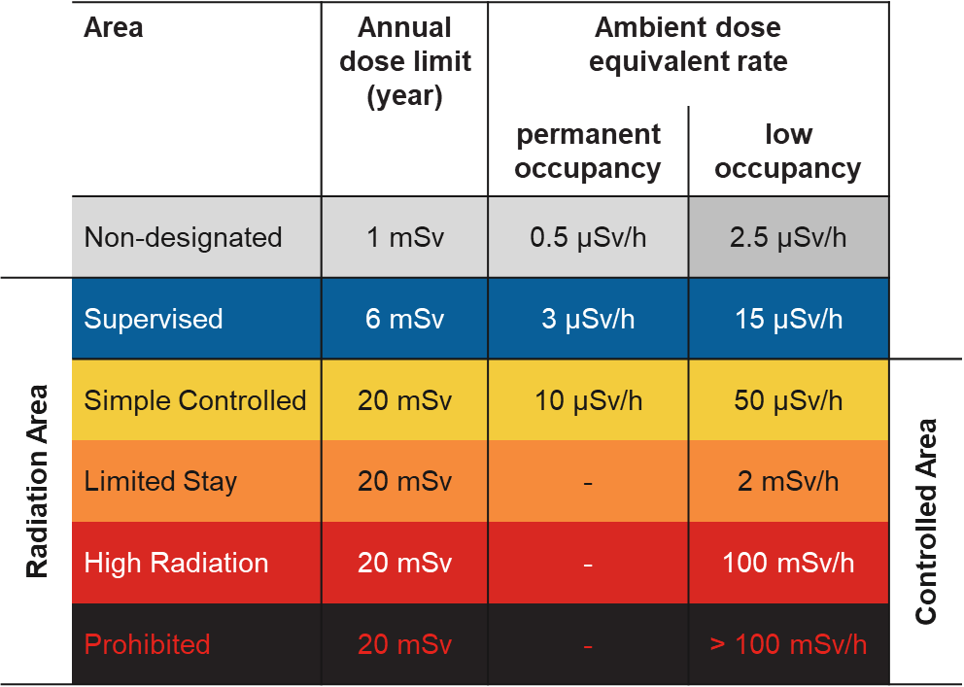
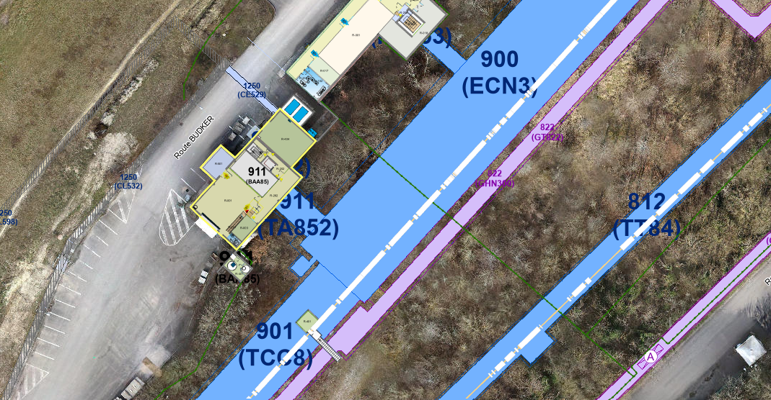
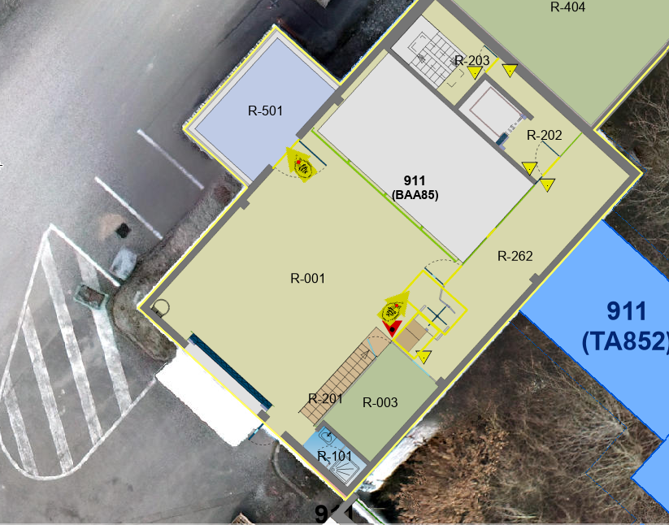
Current access control situation
Prohibited/ Supervised
  Up to LS2, b911/R-001 was classified as a Supervised Radiation Area without any access control
  In LS2 all Supervised Radiation Areas were equipped with dosimeter readers, however following the request from NA62 (F. Duval) b911/R-001 was declassified during LS2 to instead ease access of non-radiation workers to pick up non-radioactive equipment
  Thus, currently the door to access b911 (Non-designated Area) has no access system – neither card reader nor dosimeter reader
  Access to the buffer zone b911/R-501 (Simple Controlled Radiation Area) is handled via a dosimeter reader
  Access to ECN3 (Prohibited during beam operation, otherwise Supervised Radiation Area) is controlled via a PAD/MAD
Simple Controlled
Dosimeter reader
Prohibited/ Supervised
Non-designated
PAD/MAD
No access control

Slide 4
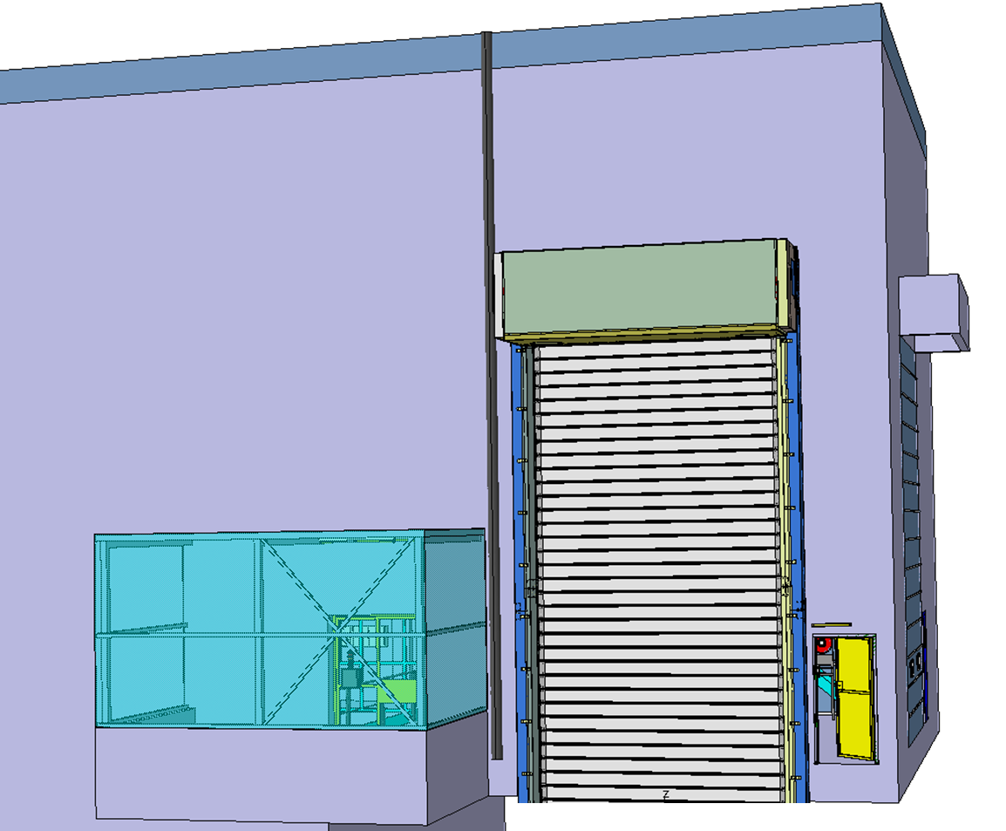
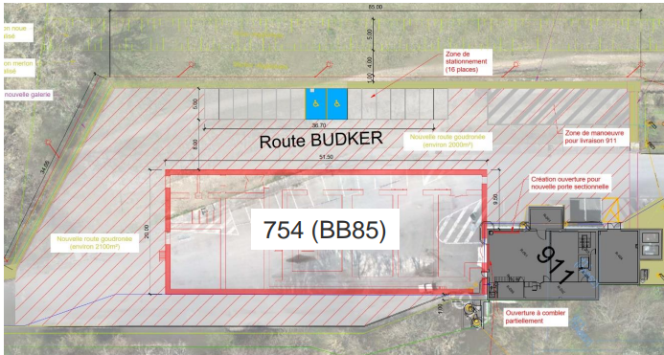
HI-ECN3 access control requirements
New B911 door
  New b911 door is being built to allow future access to the building in view of the construction of BB85
  Pre-LS3 access requirements: new b911 door may be used w/o any access system as situation as of now (Non-designated area)
  LS3 access requirements:
    Request by WP4/5 to temporarily remove ZORA access system (PAD/MAD) to ease dismantling/CE/installation works
    Dismantling phase: since radioactive equipment is still within TCC8/ECN3, the area need to be a Supervised Radiation Area → proposal to classify b911 as Radiation Area and control access via a dosimeter reader at the new b911 door. The old door, must be either fully closed or also equipped with a reader (max. until BB85 works)
    CE/installation works: to ease the works, the area may potentially be classified as a Non-designated area, if the access control container stays in place, no radioactive equipment is left in the zone and concrete samples at location of the SHiP spectrometer magnet are non-radioactive → in this case b911 door could be equipped with a card reader
  BDF/SHiP requirements: b911 should be classified as Supervised Radiation area with dosimeter reader. Access to ECN3/TCC8 is controlled via PAD/MAD
New b911 door in view of construction of BB85
Start of works mid 2027 (first road extension, then BB85 works)

Slide 5
Discussion
  EN/AA: What are the costs related to the proposed b911 door access systems (dosimeter reader, card reader)
  EN/AA: When could we install the dosimeter reader at the new b911 door?
  EN/AA: How long does it take to switch from a dosimeter reader to an access card reader? Are you flexible for it during LS3?
  WP4/5: What is the impact of closing the old b911 door already at the beginning of LS3 (once PAD/MAD is removed)?
  WP4/5/7/SHiP: What is the impact of keeping TCC8/ECN3 as Supervised Radiation Area?
  WP5/EN-AA: How long can we keep the access container in place in TCC8?
  WP6: to take concrete samples in spectrometer area and evaluate potential declassification of LS3

