Slide 1
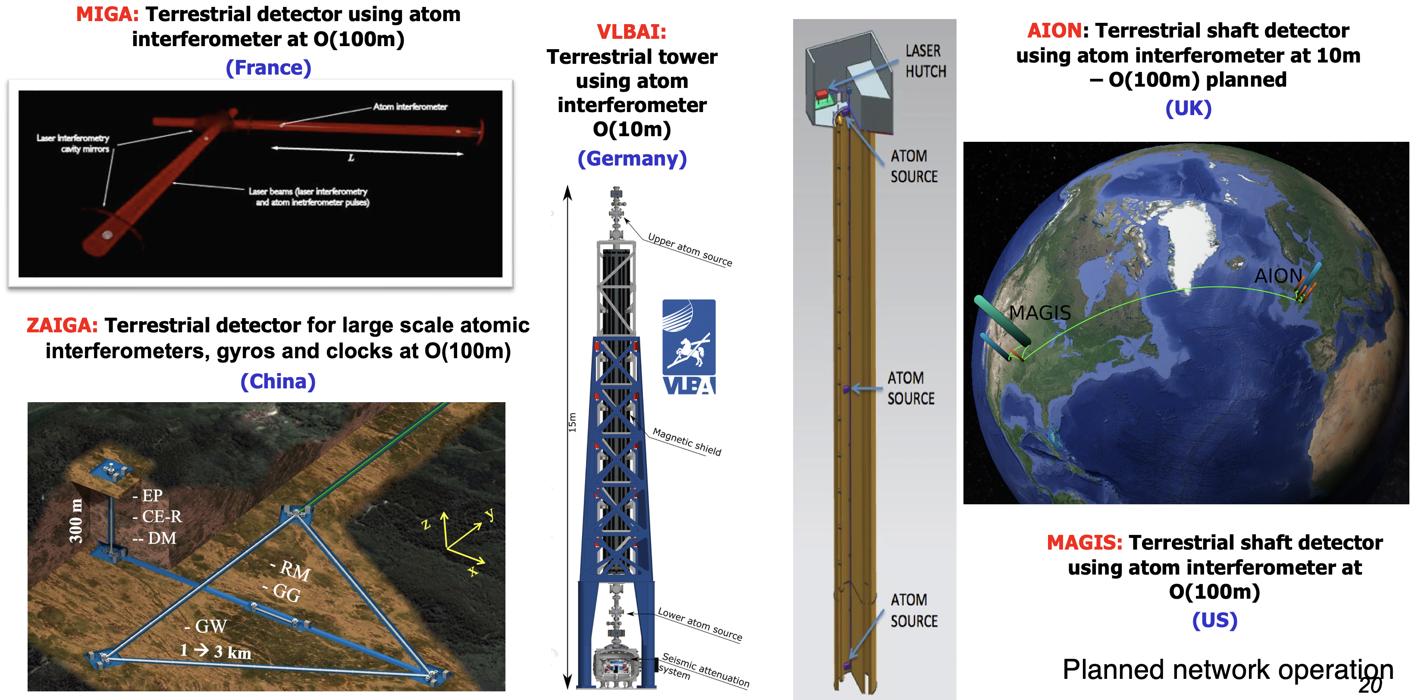


Cold Atom Quantum Technology to Explore Fundamental Physics
A UK Atom Interferometer
Observatory and Network
Oliver Buchmueller,
Imperial College London, Oxford University, Royal Society Leverhulme Trust Senior Research Fellow

Slide 2
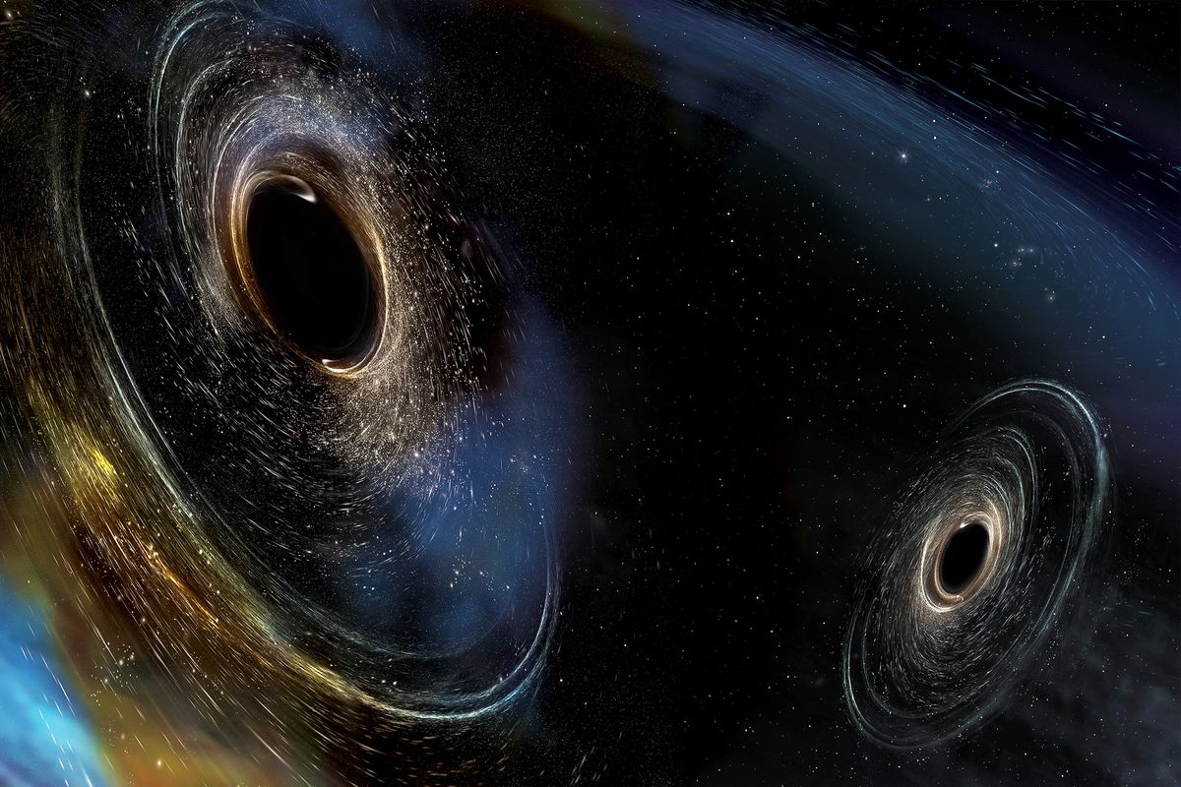
Example of Open Questions in Fundamental Physics
What is dark matter made of?
What is dark energy made of?
Why is there more matter than antimatter in the universe?
How heavy are the neutrinos? What was their role in the formation of the universe?
Is there a quantum theory of gravity that can describe the universe we live in?
What is the number of dimensions in a fundamental theory of nature?
… and many more

Slide 3
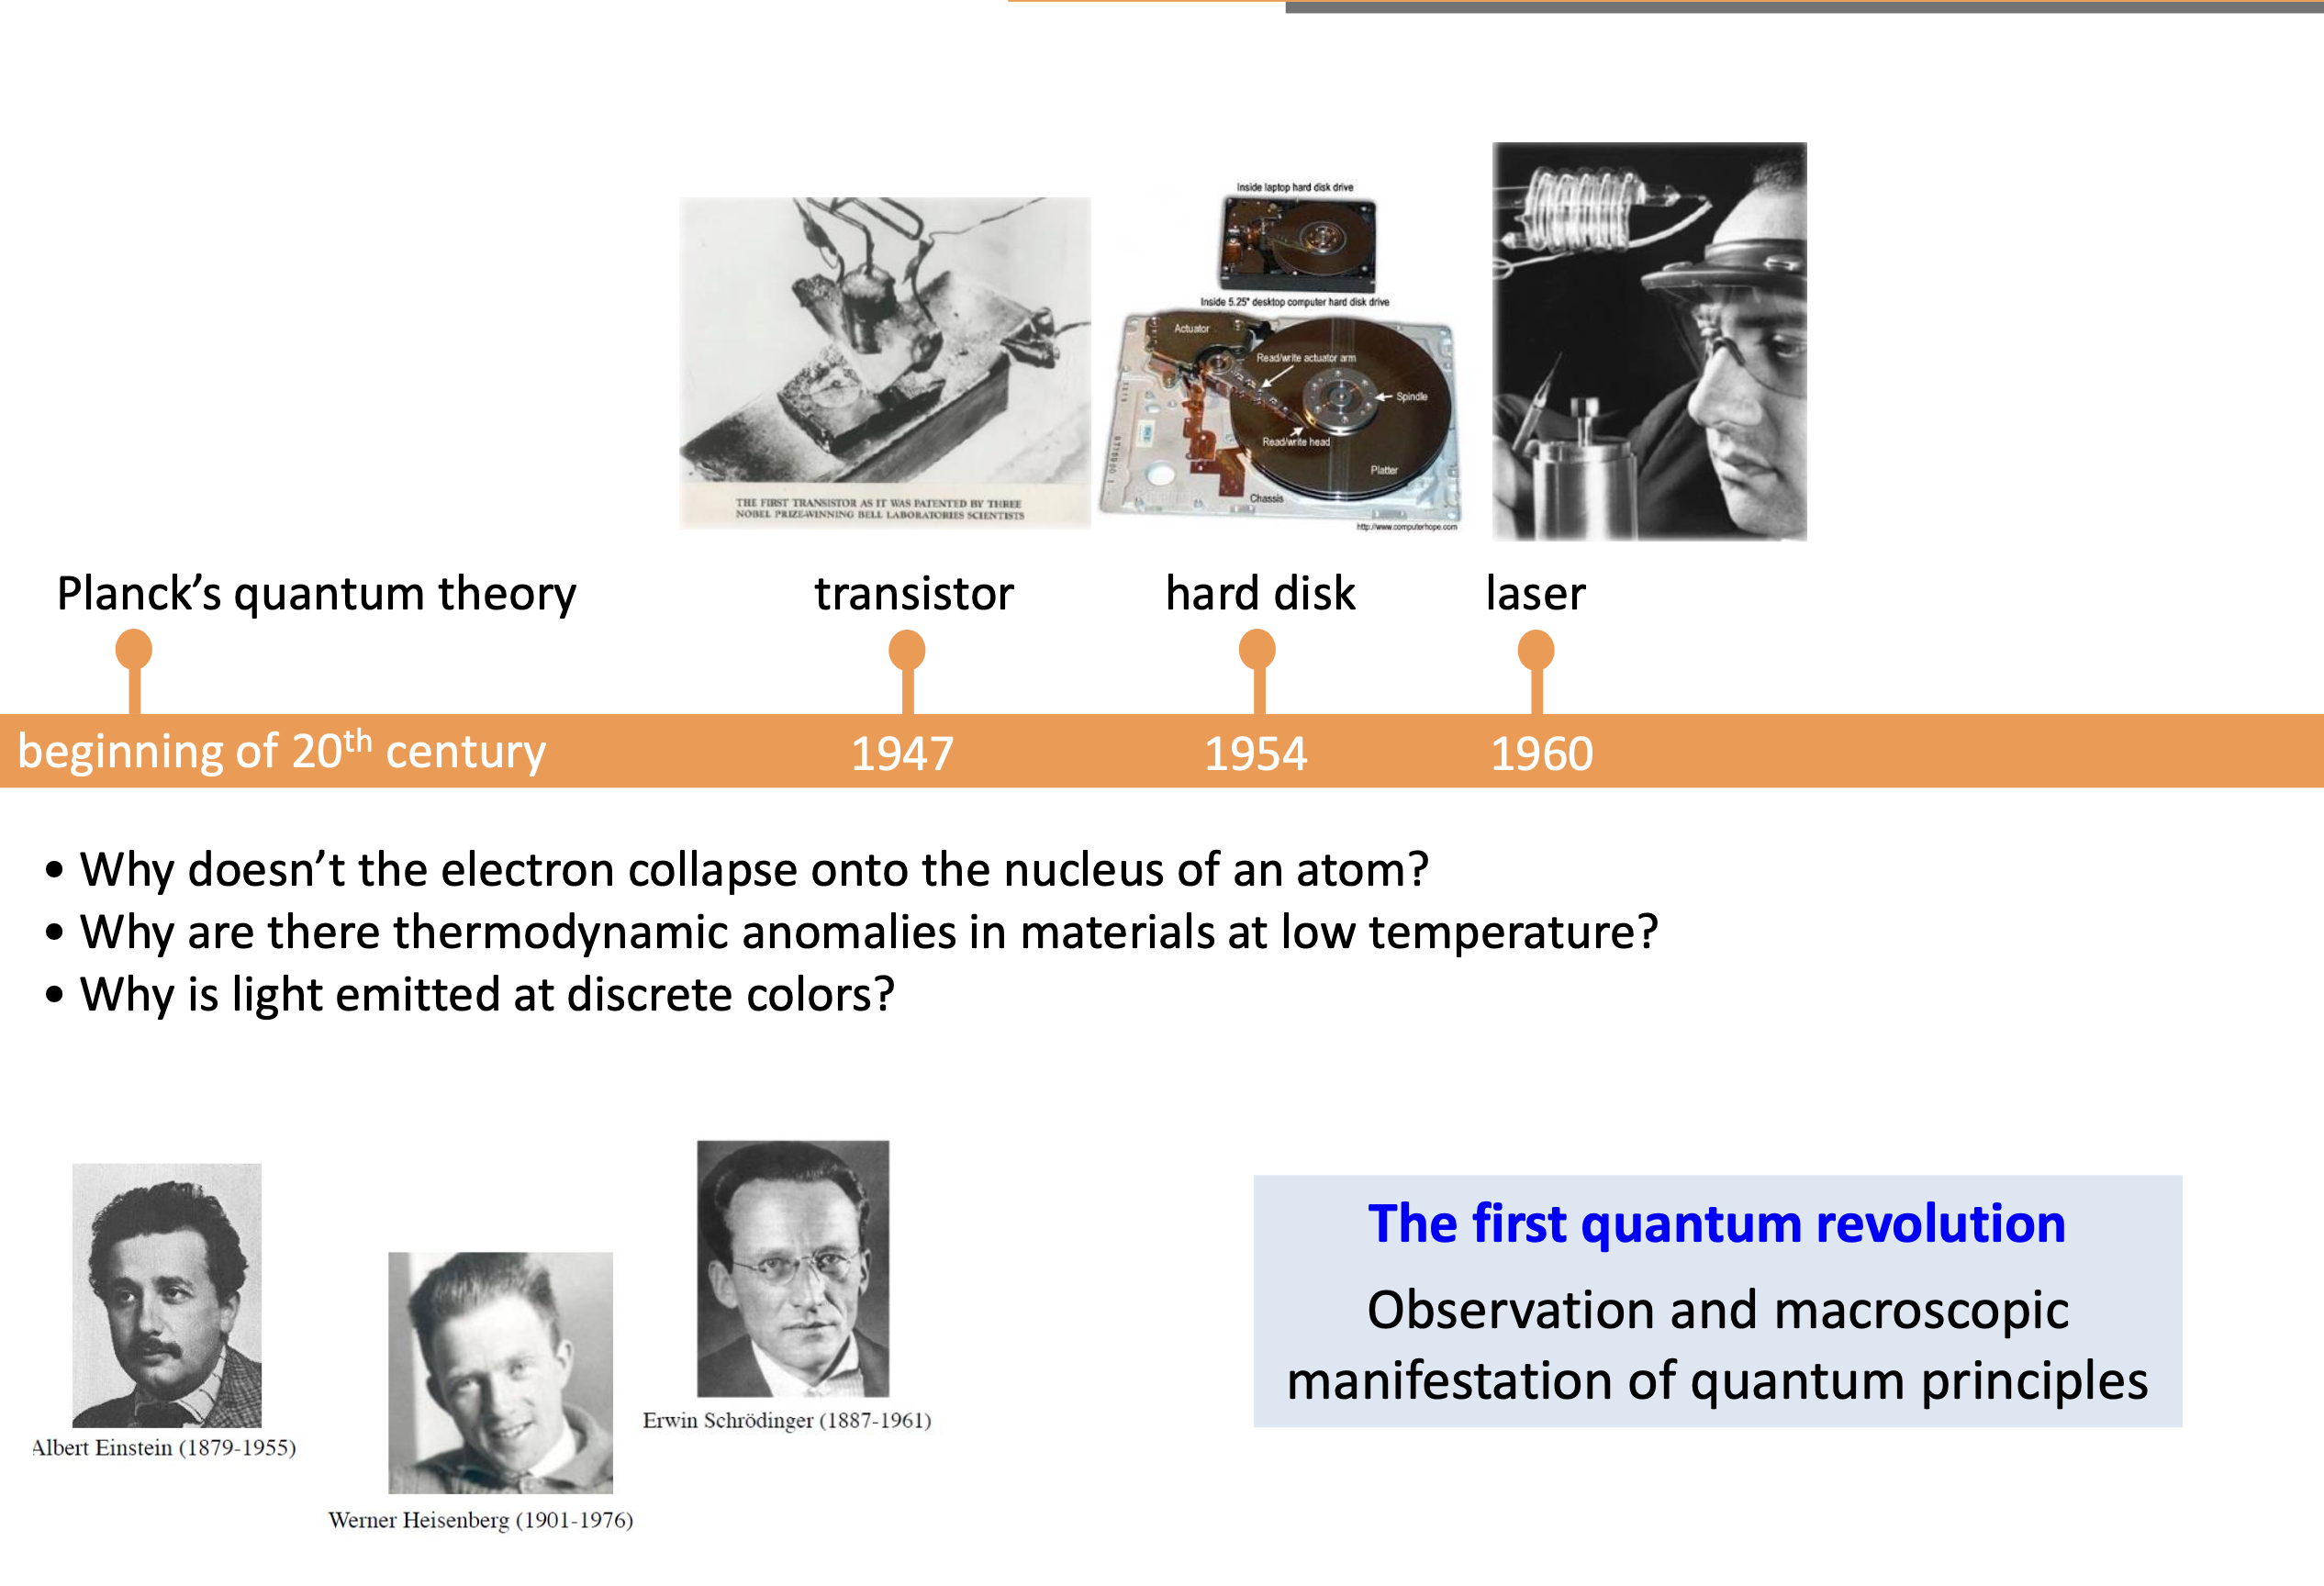
The Centenary of Quantum Mechanics (1925–2025)
… and how the Quantum Revolutions could help addressing them
What is dark matter made of?
What is dark energy made of?
Why is there more matter than antimatter in the universe?
How heavy are the neutrinos? What was their role in the formation of the universe?
Is there a quantum theory of gravity that can describe the universe we live in?
What is the number of dimensions in a fundamental theory of nature?
… and many more

Slide 4
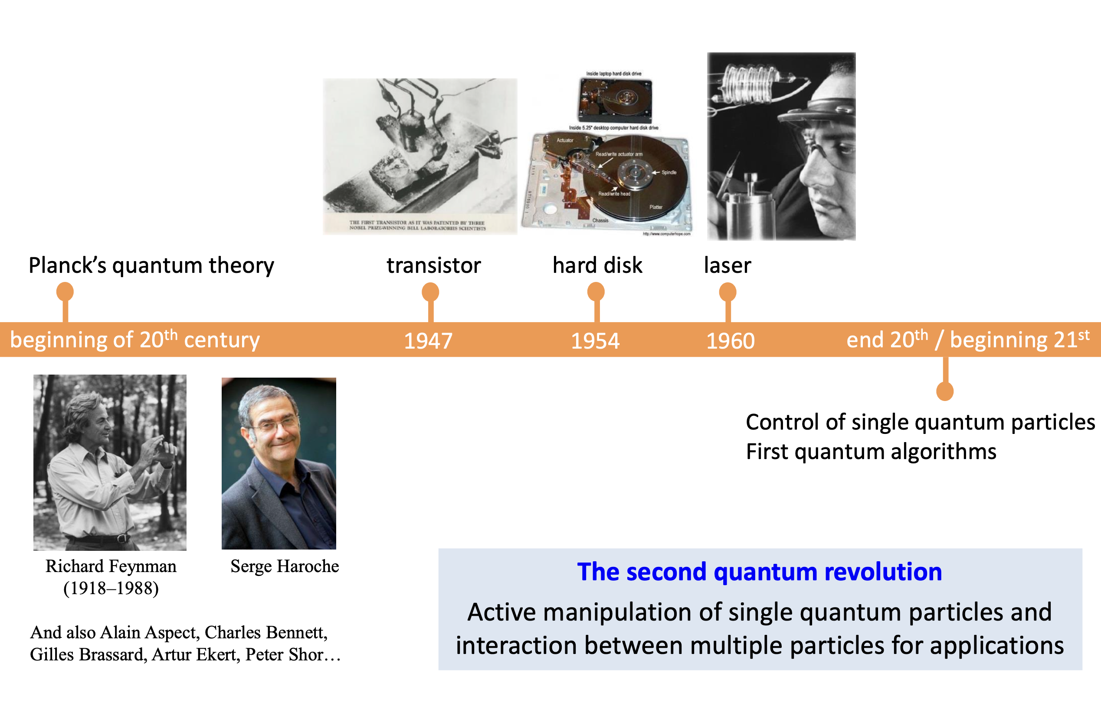
The Centenary of Quantum Mechanics (1925–2025)
… and how the Quantum Revolutions could help addressing them
What is dark matter made of?
What is dark energy made of?
Why is there more matter than antimatter in the universe?
How heavy are the neutrinos? What was their role in the formation of the universe?
Is there a quantum theory of gravity that can describe the universe we live in?
What is the number of dimensions in a fundamental theory of nature?
… and many more

Slide 5
Example of Open Questions in Fundamental Physics
What is dark matter made of?
What is dark energy made of?
Why is there more matter than antimatter in the universe?
How heavy are the neutrinos? What was their role in the formation of the universe?
Is there a quantum theory of gravity that can describe the universe we live in?
What can gravitational waves tell us about the universe and its fundamental laws?
What is the number of dimensions in a fundamental theory of nature?
… and many more

Slide 6
Laser Interferometer Experimental Landscape
LIGO Hanford
LIGO Livingston
GEO600
KAGRA
Notes:
L-shaped interferometers with arms 4km long.

Slide 7
GW detection requires enormous precision
Strain sensitivity h= ΔL/L ~ 10⁻²¹
LIGO Hanford
LIGO Livingston
Virgo
GEO600
KAGRA
Notes:
L-shaped interferometers with arms 4km long.

Slide 8
GW detection requires enormous precision
Strain sensitivity h= ΔL/L ~ 10⁻²¹
So, h=10⁻²¹ implies about 10⁻¹⁹ m change for a GW detector like Ligo/Virgo (km scale)
LIGO Hanford
LIGO Livingston
GEO600
KAGRA
Notes:
L-shaped interferometers with arms 4km long.

Slide 9
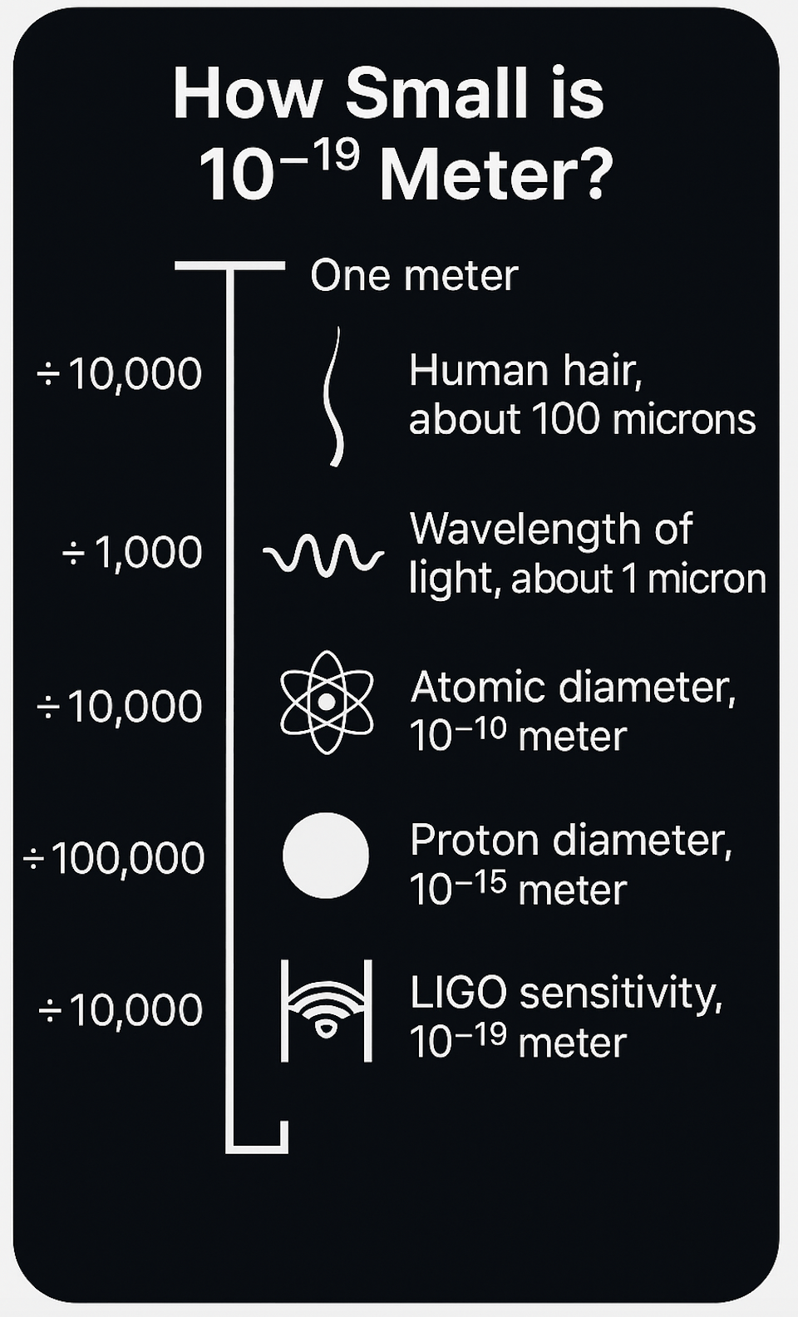
GW detection requires enormous precision
Strain sensitivity h= ΔL/L ~ 10⁻²¹
So, this implies 10⁻²¹ m for 1m and about 10⁻¹⁹ m for a GW detector like Ligo
LIGO Hanford
LIGO Livingston
GEO600
KAGRA
Notes:
L-shaped interferometers with arms 4km long.

Slide 10
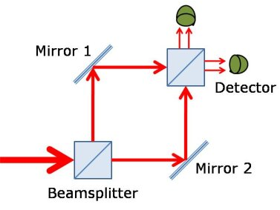
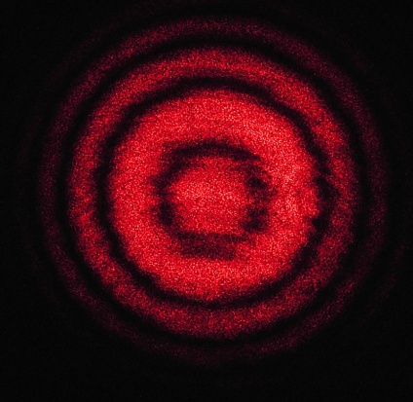
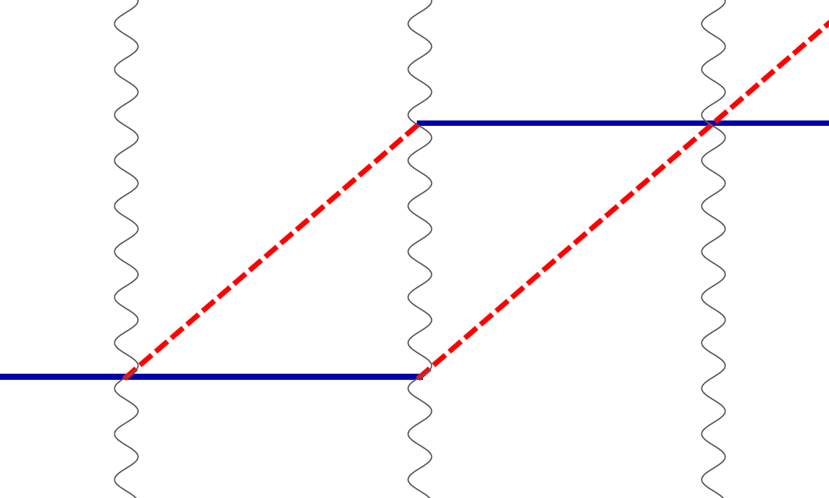
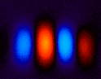
Light vs. Cold Atoms: Atom Interferometry
Light interferometer
Light
Light fringes
Atom interferometer
Beamsplitter
Atom fringes
Atom
Beamsplitter
Mirror
http://scienceblogs.com/principles/2013/10/22/quantum-erasure/
http://www.cobolt.se/interferometry.html

Slide 11
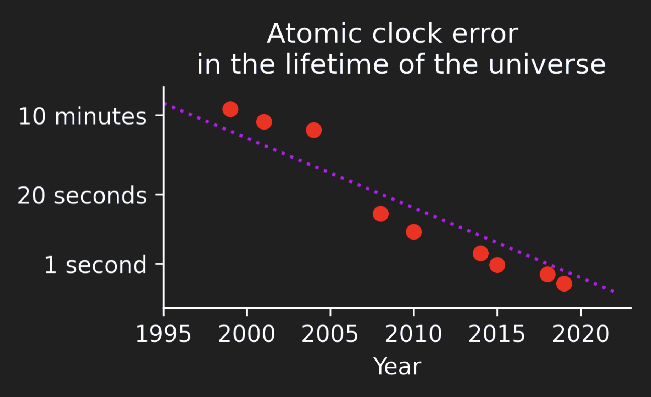
Atom Interferometry and Atomic Clocks
Atomic clocks are incredibly precise.
Their precision is equivalent to losing only 0.5 seconds over the entire 13.7-billion-year lifespan of the Universe.
We harness this unparalleled atomic precision and combine it with atom interferometry to achieve the highest possible accuracy and sensitivity.

Slide 12
Atom Interferometry and Atomic Clocks
Atomic clocks are incredibly precise.
Their precision is equivalent to losing only 0.5 seconds over the entire 13.7-billion-year lifespan of the Universe.
We harness this unparalleled atomic precision and combine it with atom interferometry to achieve the highest possible accuracy and sensitivity.
Atomic clocks are the only quantum technology that has truly achieved quantum advantage.

Slide 13
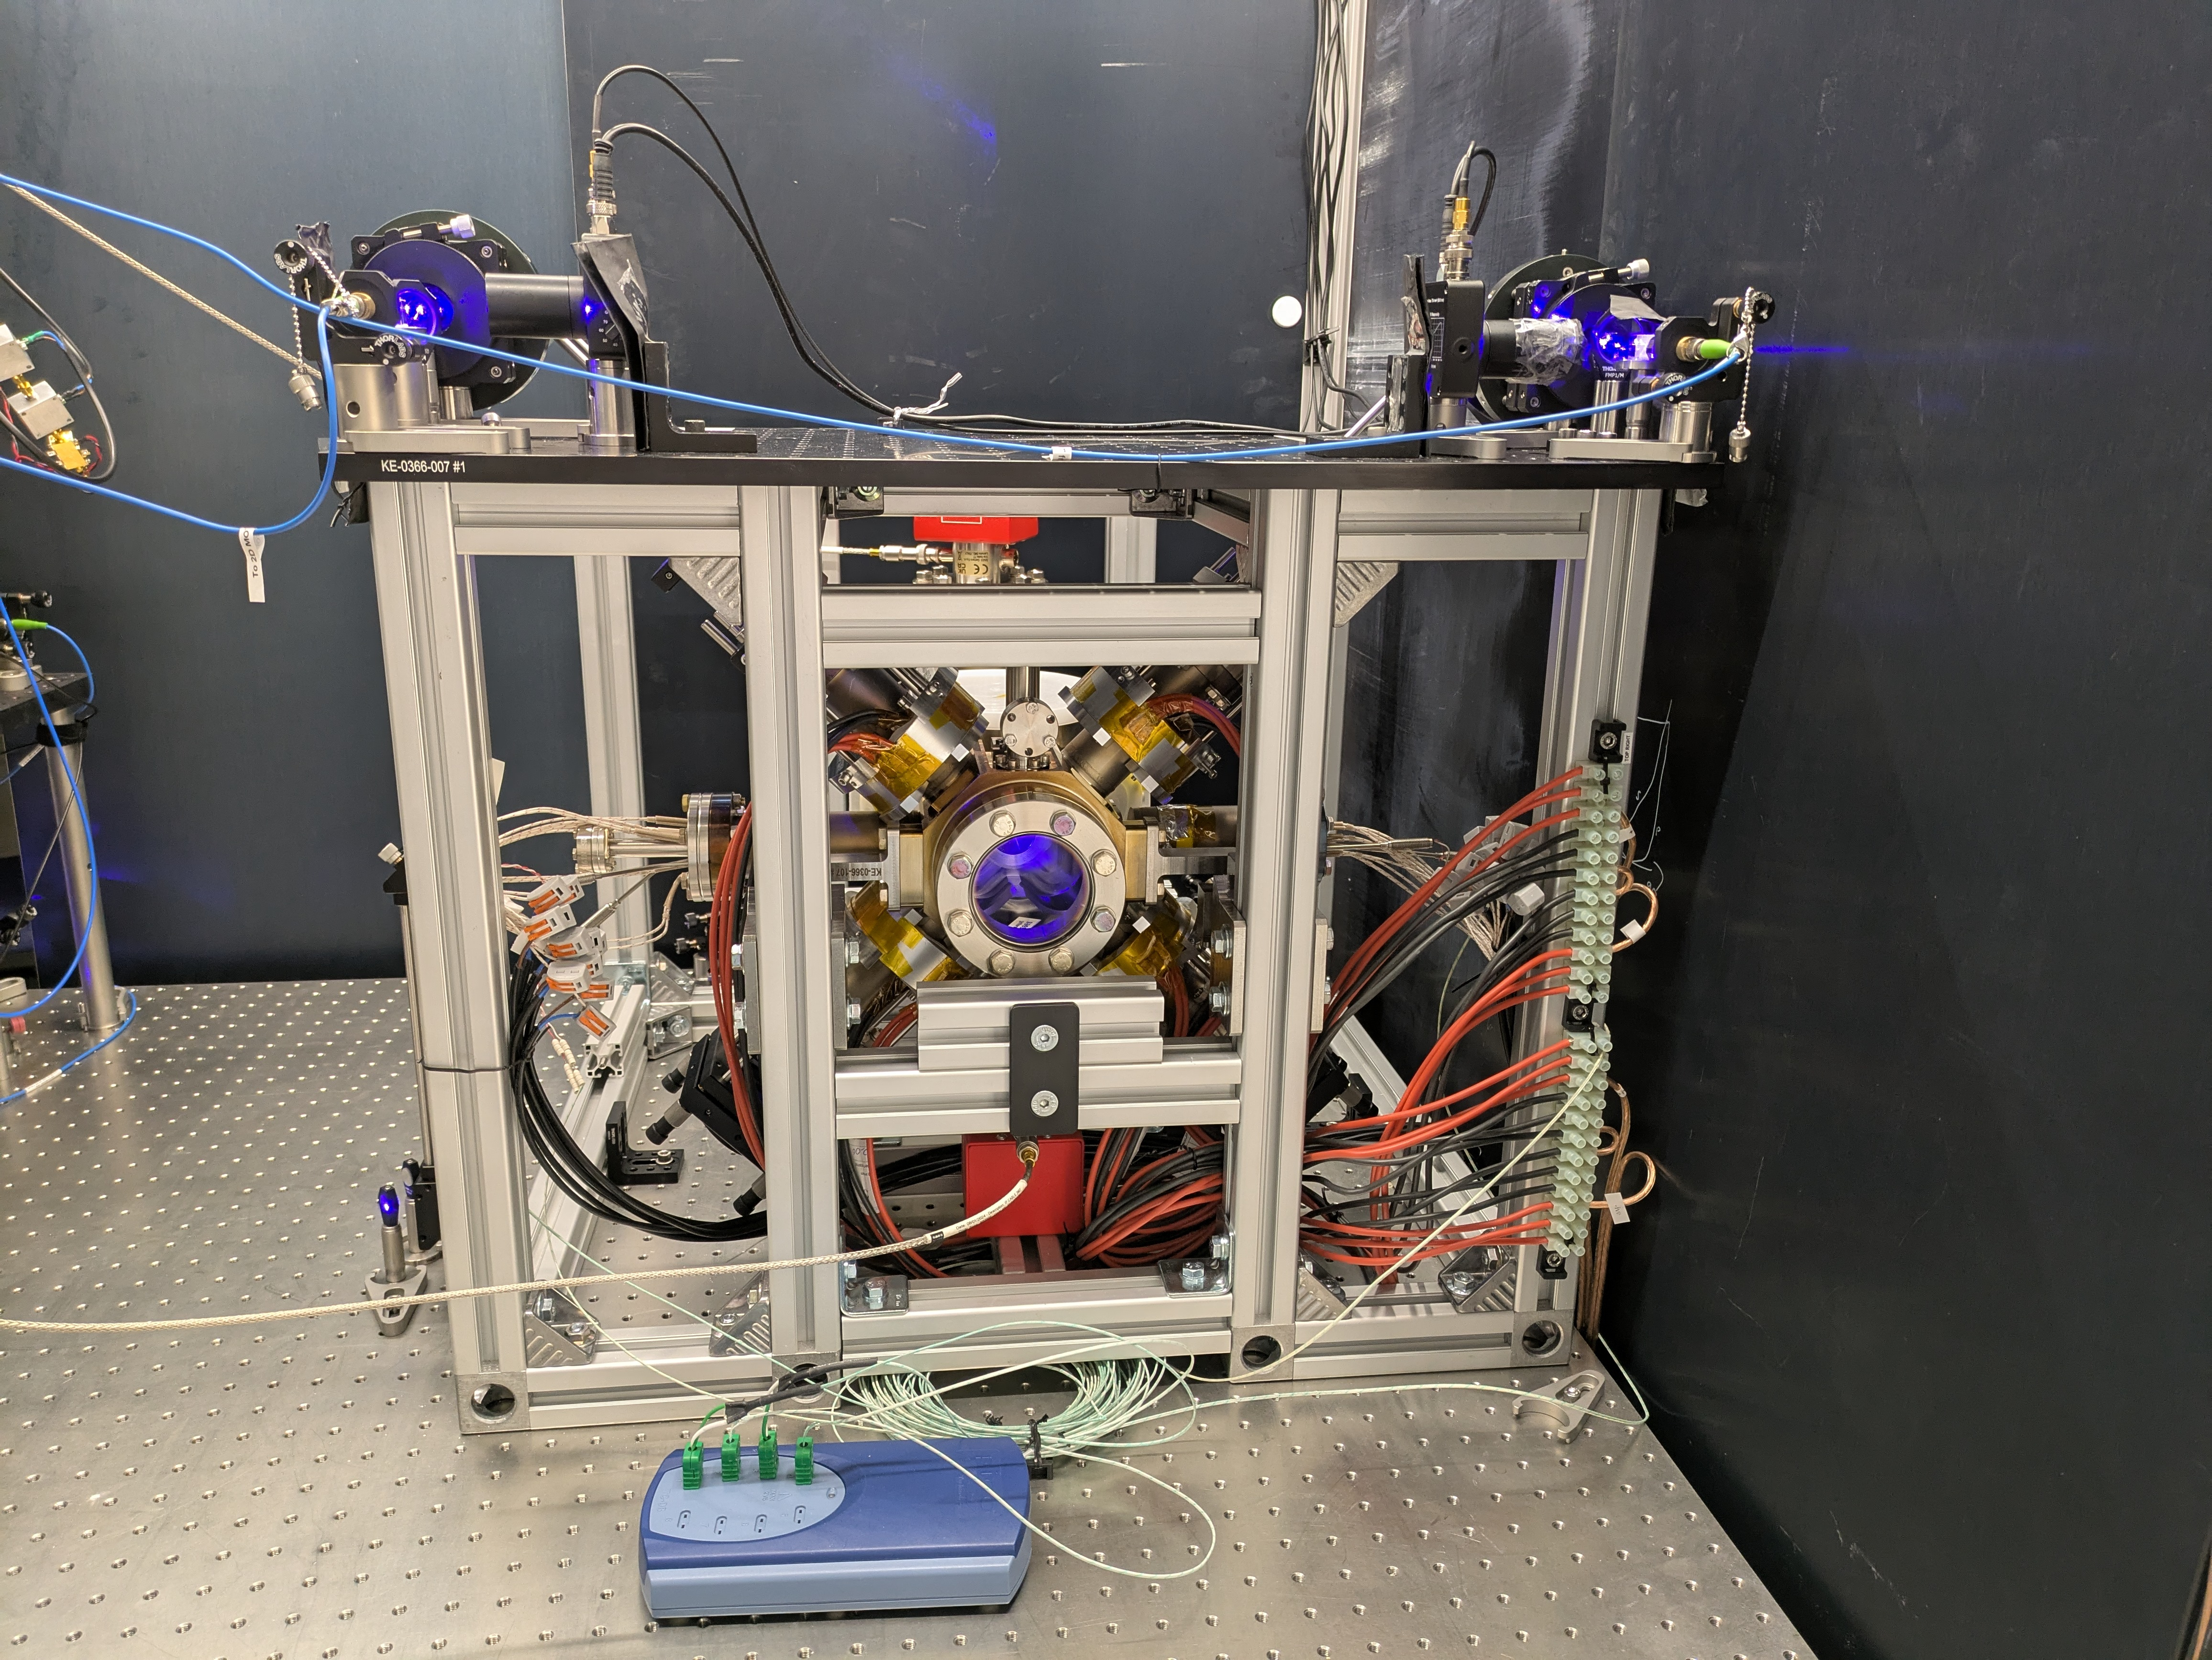
Atom Interferometry and Atomic Clocks
New ultra-high frequency stability Sr clock build in AION Lab at ICL – based on a US-UK design
Atomic clocks are incredibly precise.
Their precision is equivalent to losing only 0.5 seconds over the entire 13.7-billion-year lifespan of the Universe.
We harness this unparalleled atomic precision and combine it with atom interferometry to achieve the highest possible accuracy and sensitivity.

Slide 14
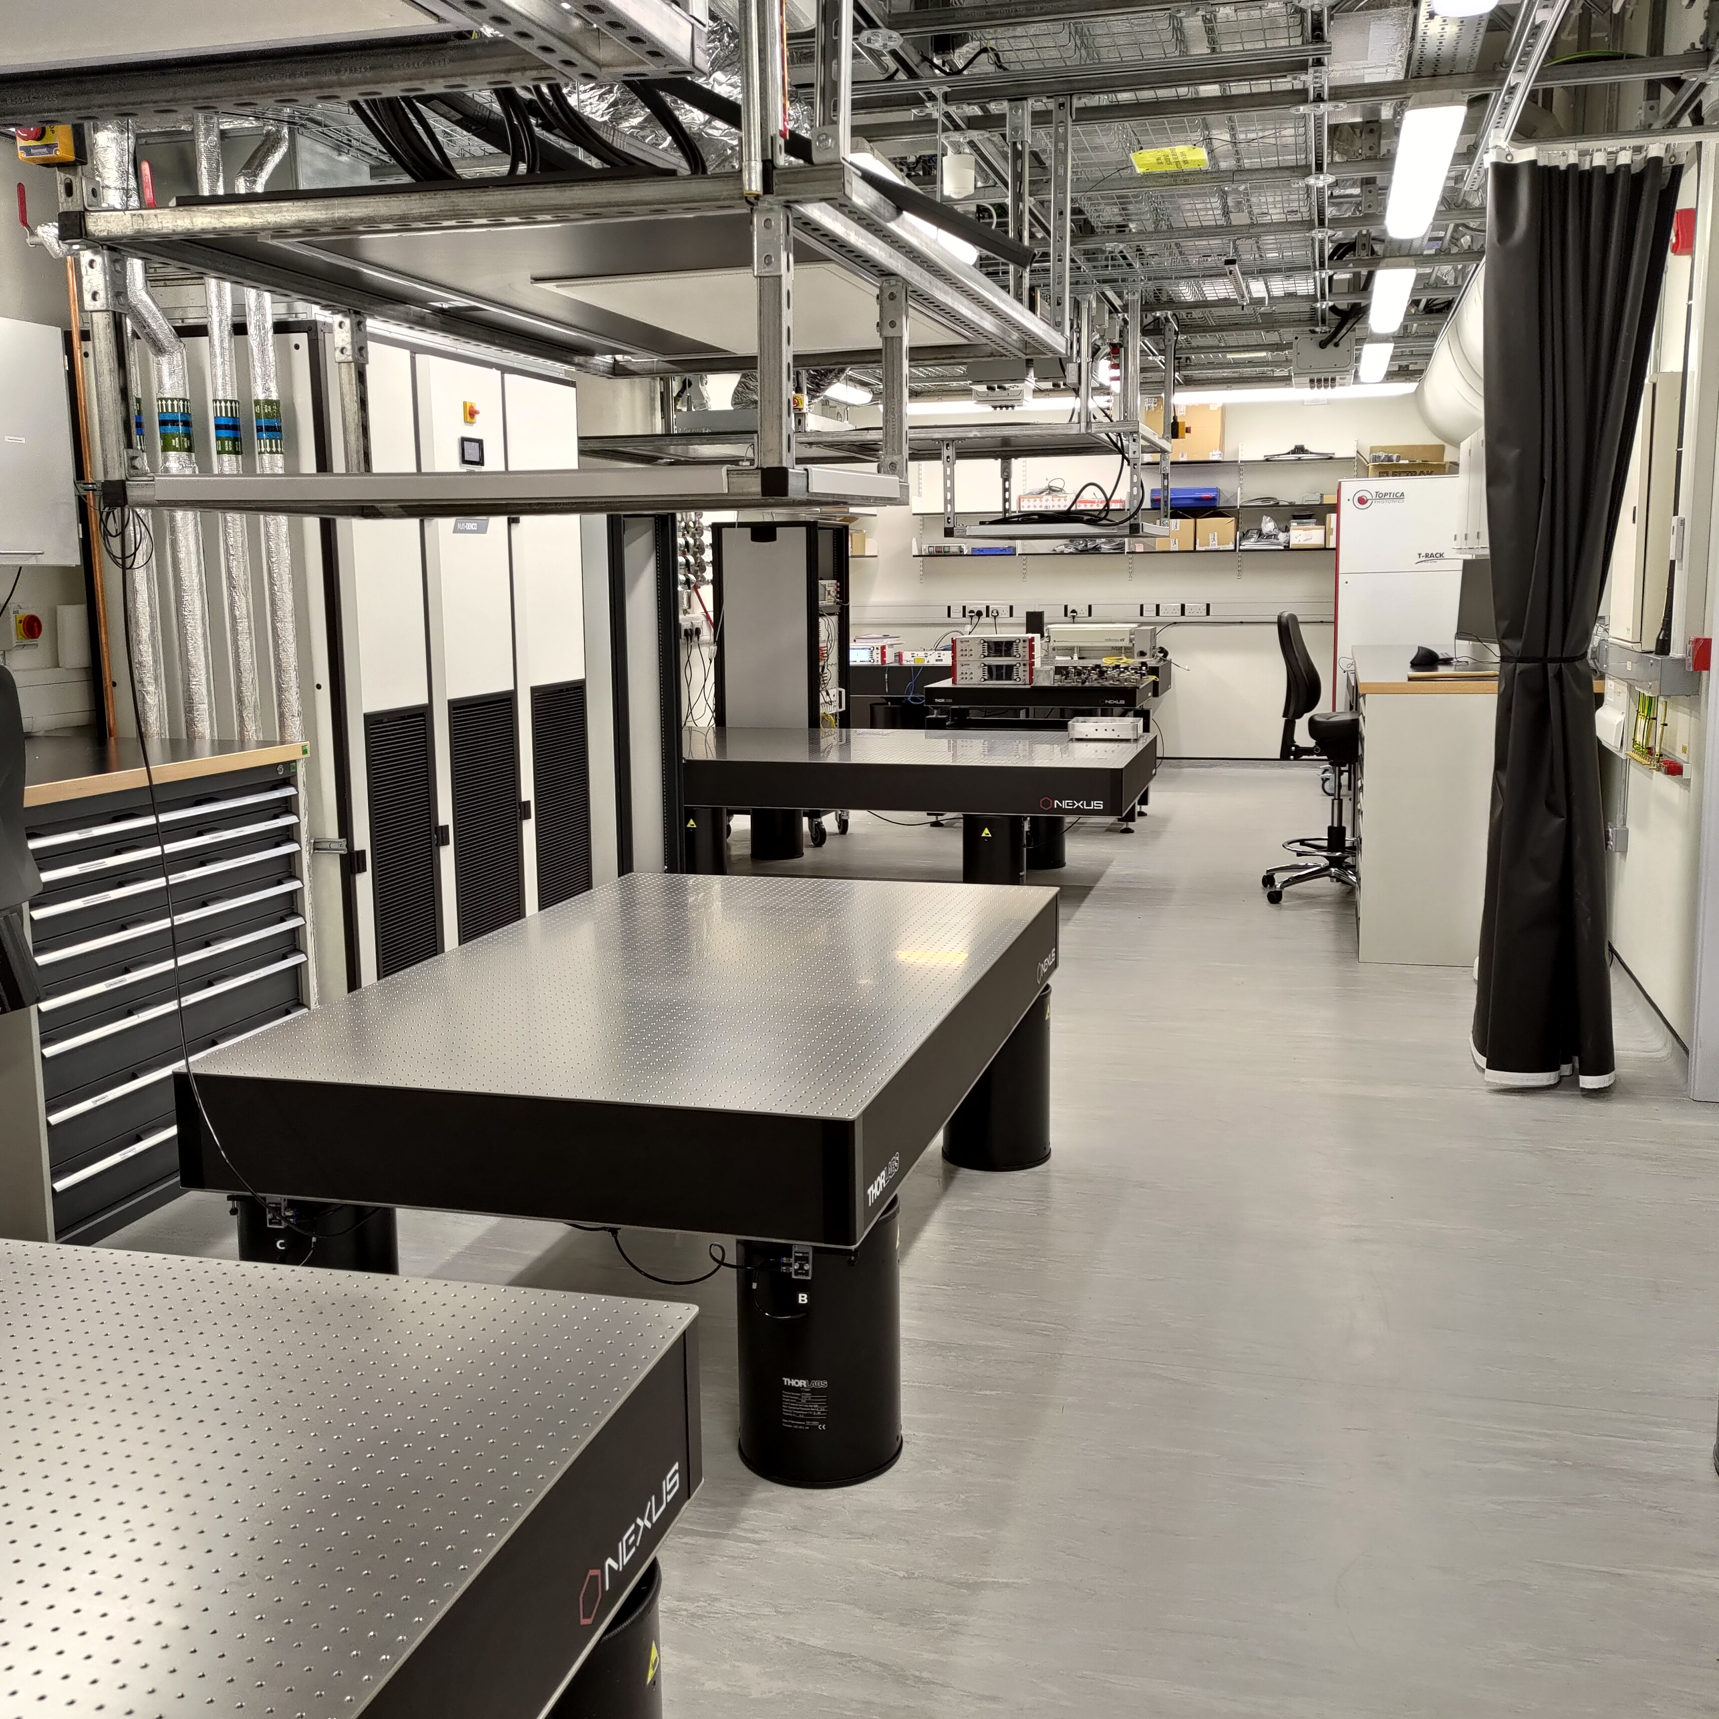
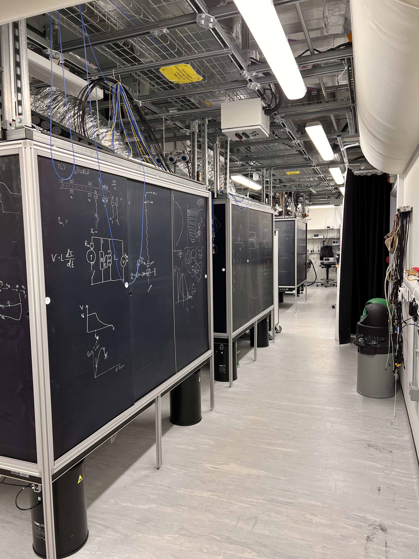
Atom Interferometry and Atomic Clocks
New ultra-high frequency stability Sr clock build in AION Lab at ICL – based on a US-UK design
Atomic clocks are incredibly precise.
Their precision is equivalent to losing only 0.5 seconds over the entire 13.7-billion-year lifespan of the Universe.
We harness this unparalleled atomic precision and combine it with atom interferometry to achieve the highest possible accuracy and sensitivity.
Atom Interferometry
Optical Clock
Handover from
refurbishment
- end 2021 -
Quantum Computer

Slide 15




Simple Example: Two Atomic Clocks
Atom clock
Atom clock
Phase evolved by atom after time T
Time

Slide 16
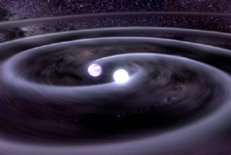


Simple Example: Two Atomic Clocks
GW changes light travel time
Time
Atom clock
Atom clock

Slide 17


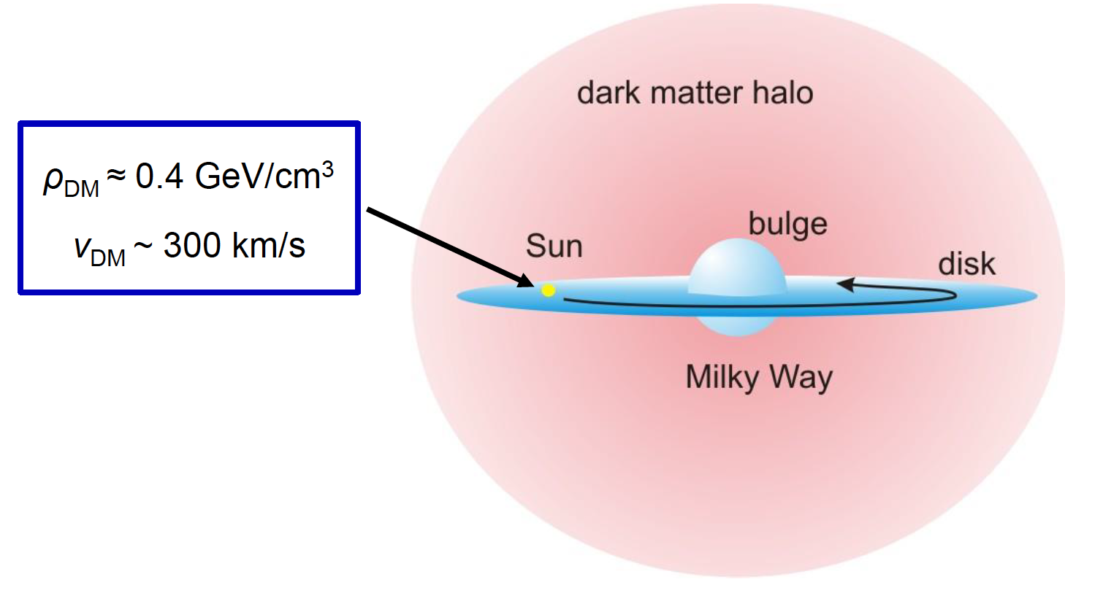
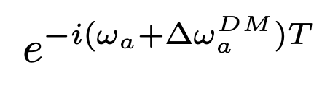
Simple Example: Two Atomic Clocks
DM induced oscillation
Dark matter coupling
Time
DM cloud changes atom frequency
DM coupling
causes time-varying
atomic energy levels:
Time
Atom clock
Atom clock

Slide 18
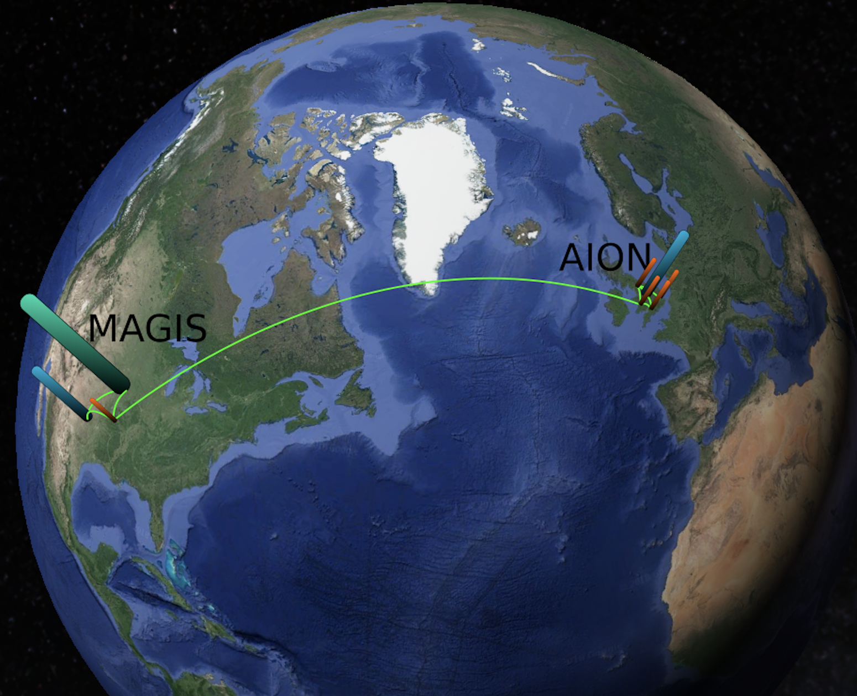
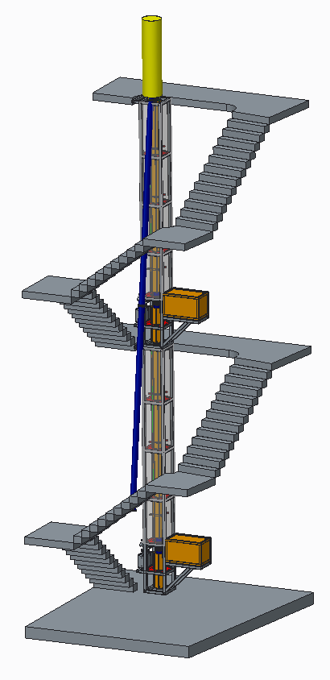
AION Project in the UK
Project executed in national partnership with UK National Quantum Technology Hub in Sensors and Timing, Birmingham, UK,
and international partnership with The MAGIS Collaboration
and The Fermi National Laboratory, US
14.7m
Ground level
AI-10
10.0m
7.7m
5.0m
Feed through to laser lab
To push the state-of-the-art single photon Sr Atom Interferometry, the AION project builds dedicated Ultra-Cold Strontium Laboratories in:
Birmingham, Cambridge, Imperial College, Oxford, and RAL
The laboratories are expected to be fully operational in summer 2023.
L. Badurina et al., AION: An Atom Interferometer Observatory and Network, JCAP 05 (2020) 011, [arXiv:1911.11755]

Slide 19
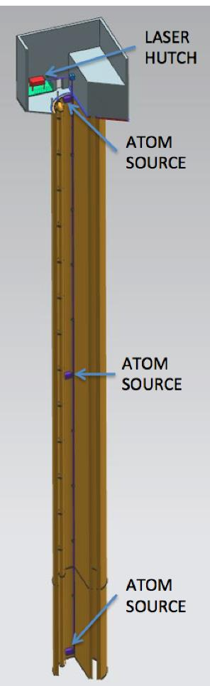
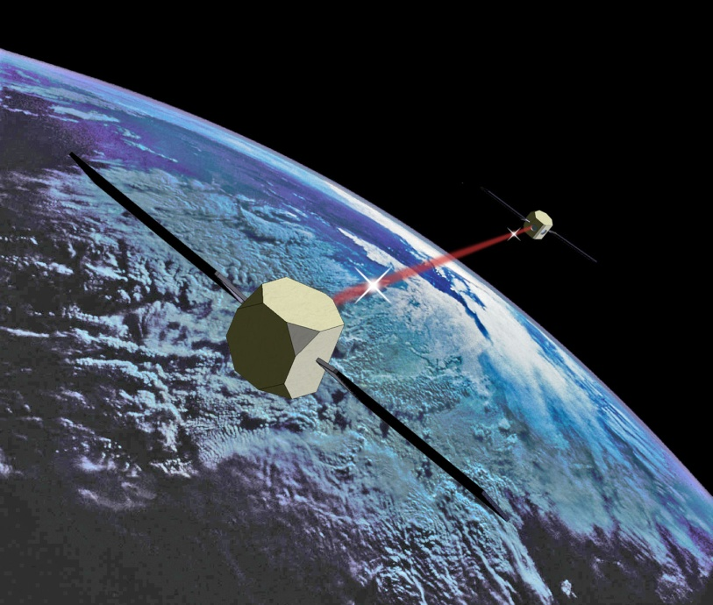
The AION Programme consists of 4 Stages
Stage 1: to build and commission the 10 m detector, develop existing technology and the infrastructure for the 100 m.
Stage 2: to build, commission and exploit the 100 m detector and carry out a design study for the km-scale detector.
AION was selected in 2018 by STFC as a high-priority medium-scale project.
AION will work in equal partnership with MAGIS in the US to form a “LIGO/Virgo-style” network & collaboration, providing a pathway for UK leadership.
Stage 1 is funded with more £15M by the QTFP Programme and other sources and Stage 2 could be placed at national facility in Boulby or Daresbury (UK), possibly also at CERN (France/Switzerland).
Stage 3: to build a kilometre-scale terrestrial detector.
Stage 4: long-term objective a pair of satellite detectors (thousands of kilometres scale) [AEDGE proposal to ESA Voyage2050 call]
AION has established science leadership in AEDGE, bringing together collaborators from European and Chinese groups (e.g. MIGA, MAGIA, ELGAR, ZAIGA).
Stage 3 and 4 will likely require funding on international level (ESA, EU, etc) and AION has already started to build the foundation for it.
L ~ 10m
L ~ 100m
L ~ 1km

Slide 20
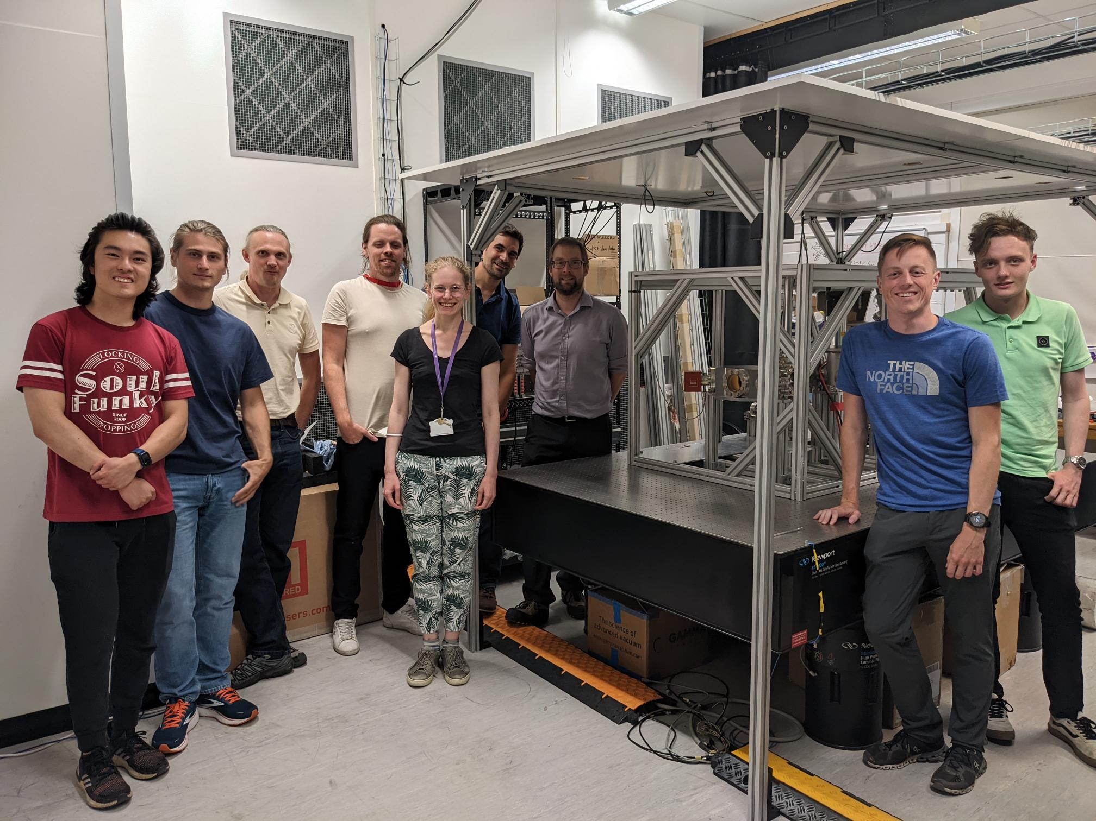
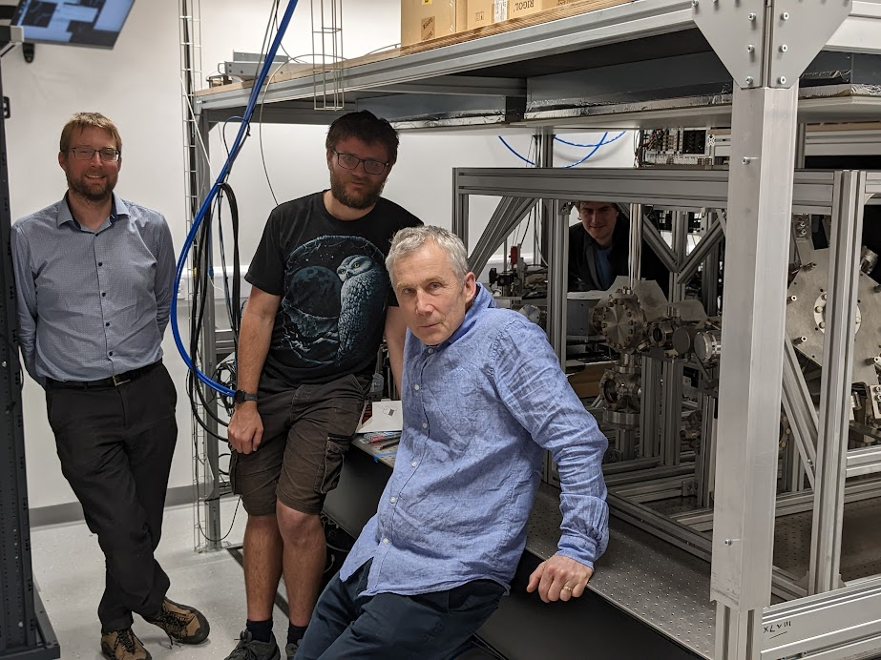
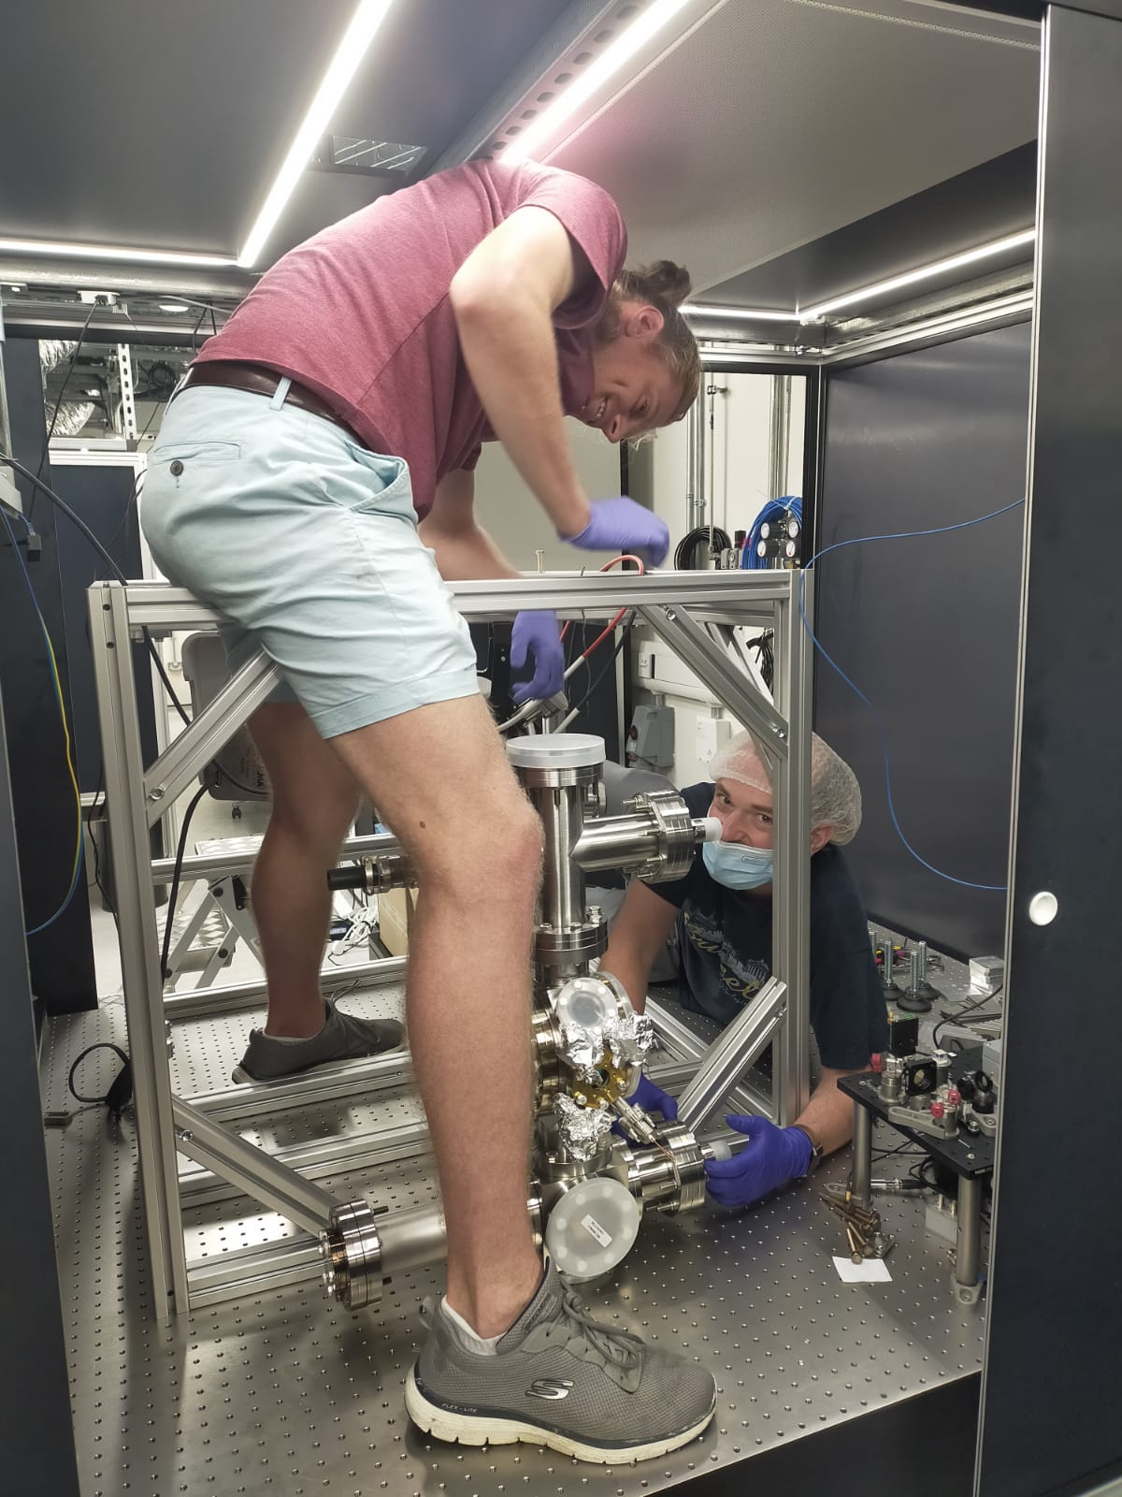
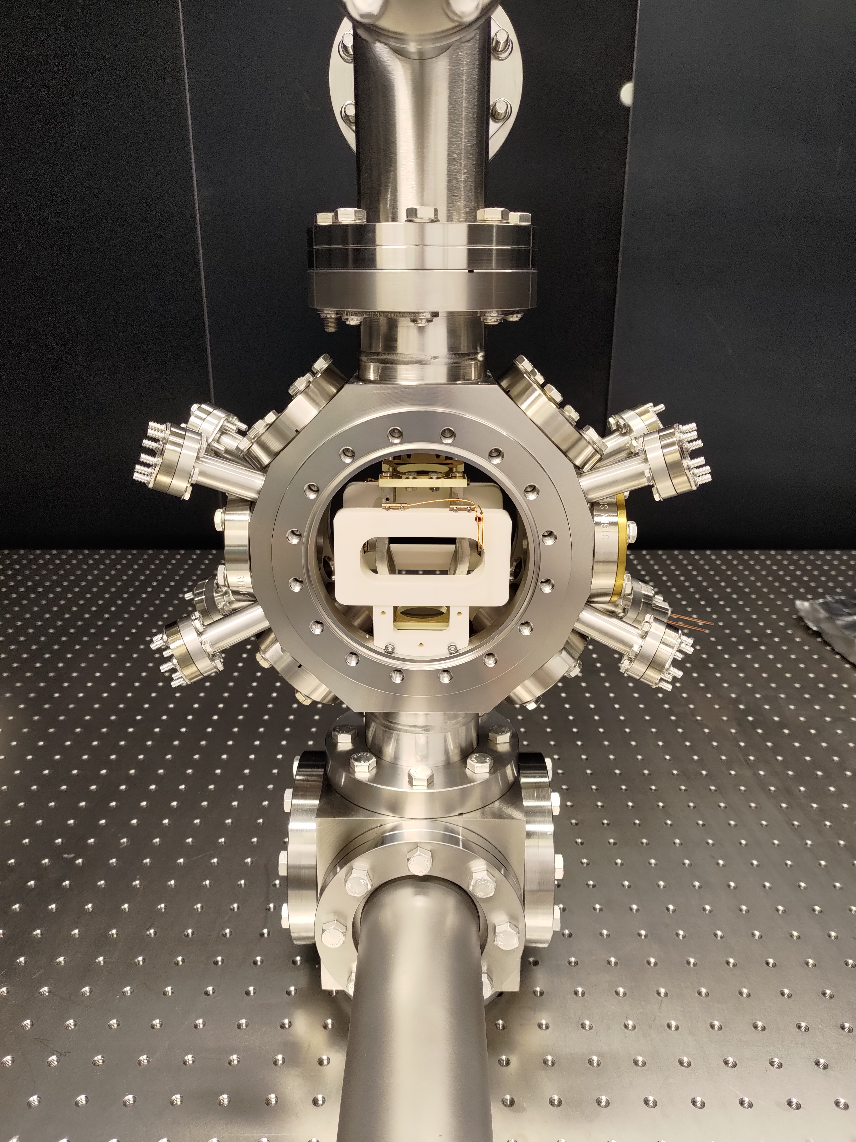
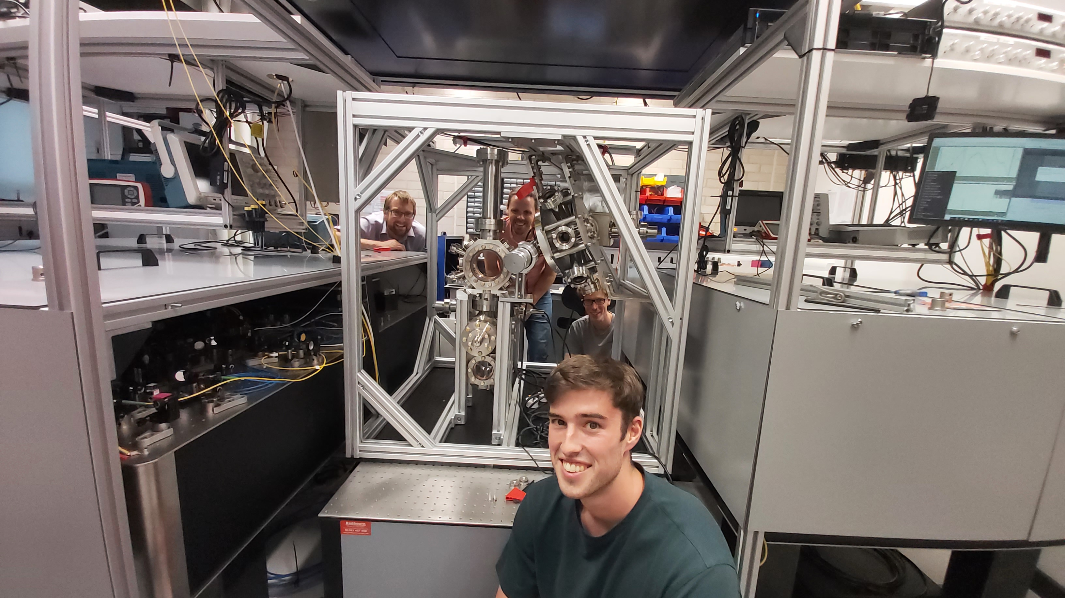
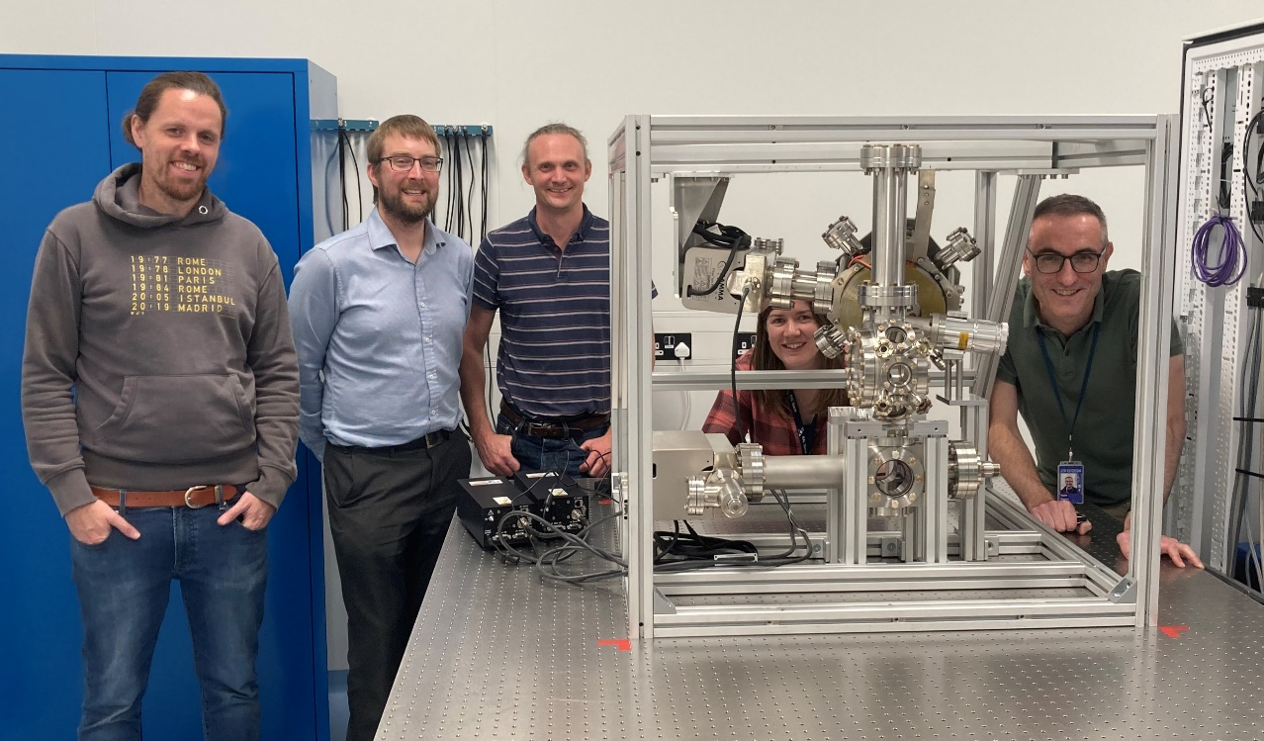
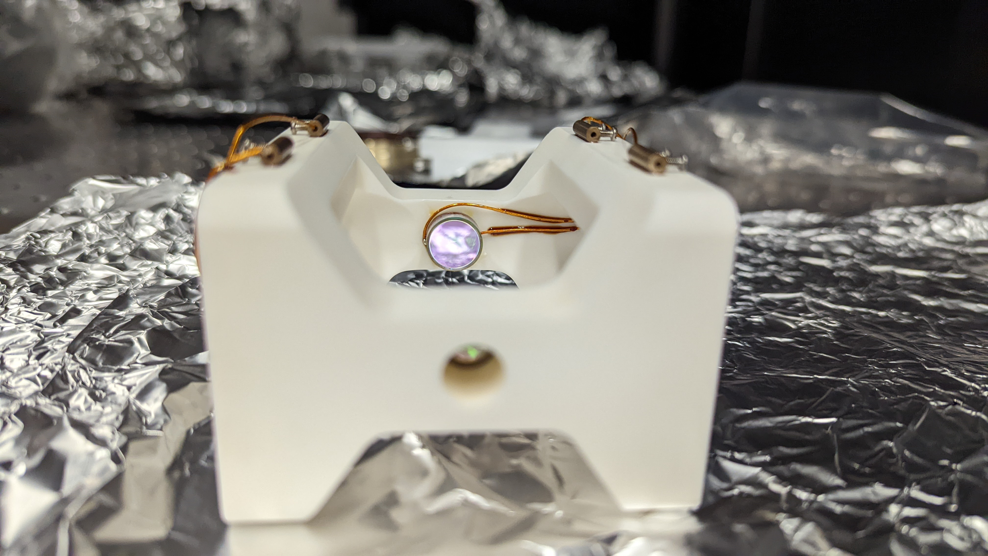
Oxford September 2022
Cambridge July 2022
Imperial July 2022
RAL October 2022
Birmingham July 2022
Centralised design and production [AVS Quantum Sci. 6, 014409 (2024)]
Notes:
Collaborative - unusual for cold atoms project
Groundwork for future large-scale detectors

Slide 21
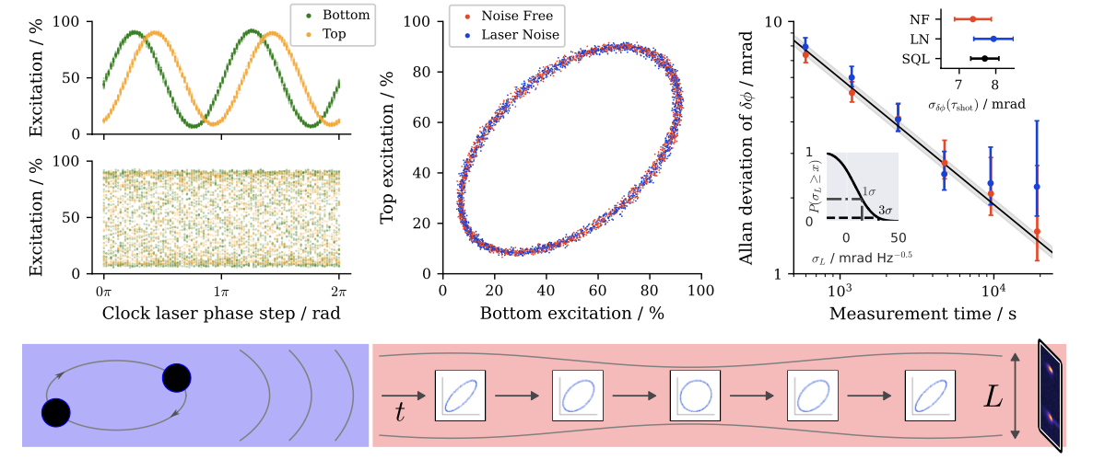
First prototype demonstration of differential measurement technique with free falling Sr87 Atoms - Fall 2024
-- Another World First --
Oxford September 2022
Cambridge July 2022
Imperial July 2022
RAL October 2022
Birmingham July 2022
Atomic Clock + Atom Interferometry = Ultimate Precision
Centralised design and production [AVS Quantum Sci. 6, 014409 (2024)]
Notes:
Collaborative - unusual for cold atoms project
Groundwork for future large-scale detectors

Slide 22
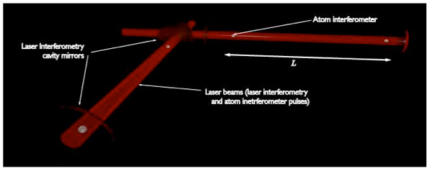
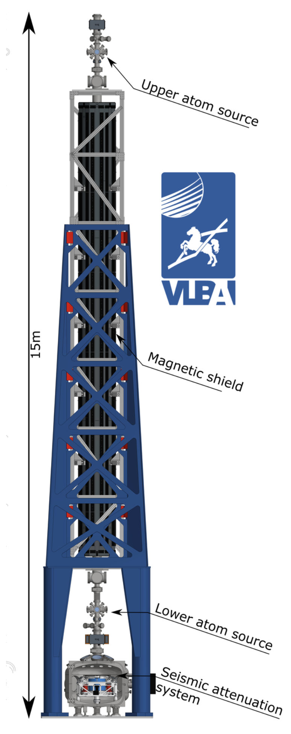
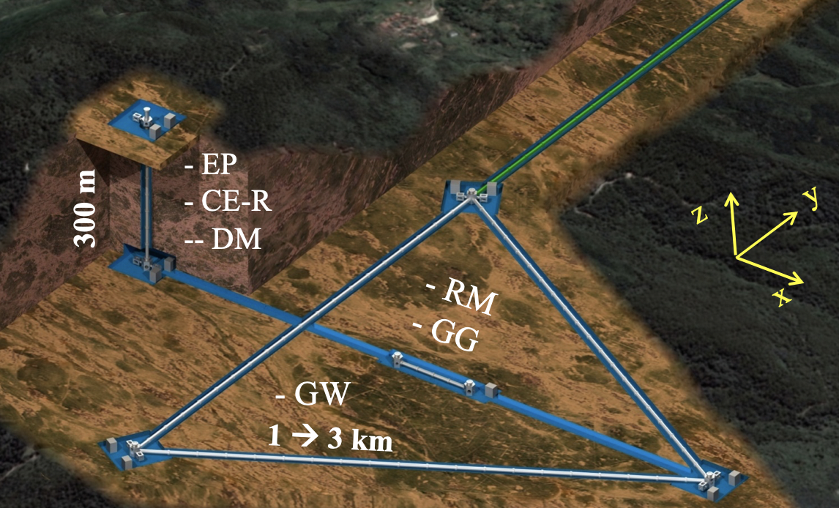
Ground Based Large Scale O(100m) Projects
MIGA: Terrestrial detector using atom interferometer at O(100m)
(France)
AION: Terrestrial shaft detector using atom interferometer at 10m – O(100m) planned
(UK)
VLBAI: Terrestrial tower using atom interferometer O(10m)
(Germany)
ZAIGA: Terrestrial detector for large scale atomic interferometers, gyros and clocks at O(100m)
(China)
MAGIS: Terrestrial shaft detector using atom interferometer at O(100m)
(US)
Planned network operation

Slide 23
Ground Based Large Scale O(100m) Projects
MIGA: Terrestrial detector using atom interferometer at O(100m)
(France)
AION: Terrestrial shaft detector using atom interferometer at 10m – O(100m) planned
(UK)
VLBAI: Terrestrial tower using atom interferometer O(10m)
(Germany)
Examples of large-scale CA projects that act as demonstrators for
GW mid-frequency band and ULDM detectors.
All these projects are represented in the TVLBAI Community.
Each project requires an investment of O(10M+) currency units.
All projects (AION, MAGIS, MIGA, VLBAI, ZAIGA)
are funded by national funding agencies and foundations.
Timeline 2020 to 2030ish
ZAIGA: Terrestrial detector for large scale atomic interferometers, gyros and clocks at O(100m)
(China)
MAGIS: Terrestrial shaft detector using atom interferometer at O(100m)
(US)
Planned network operation

Slide 24
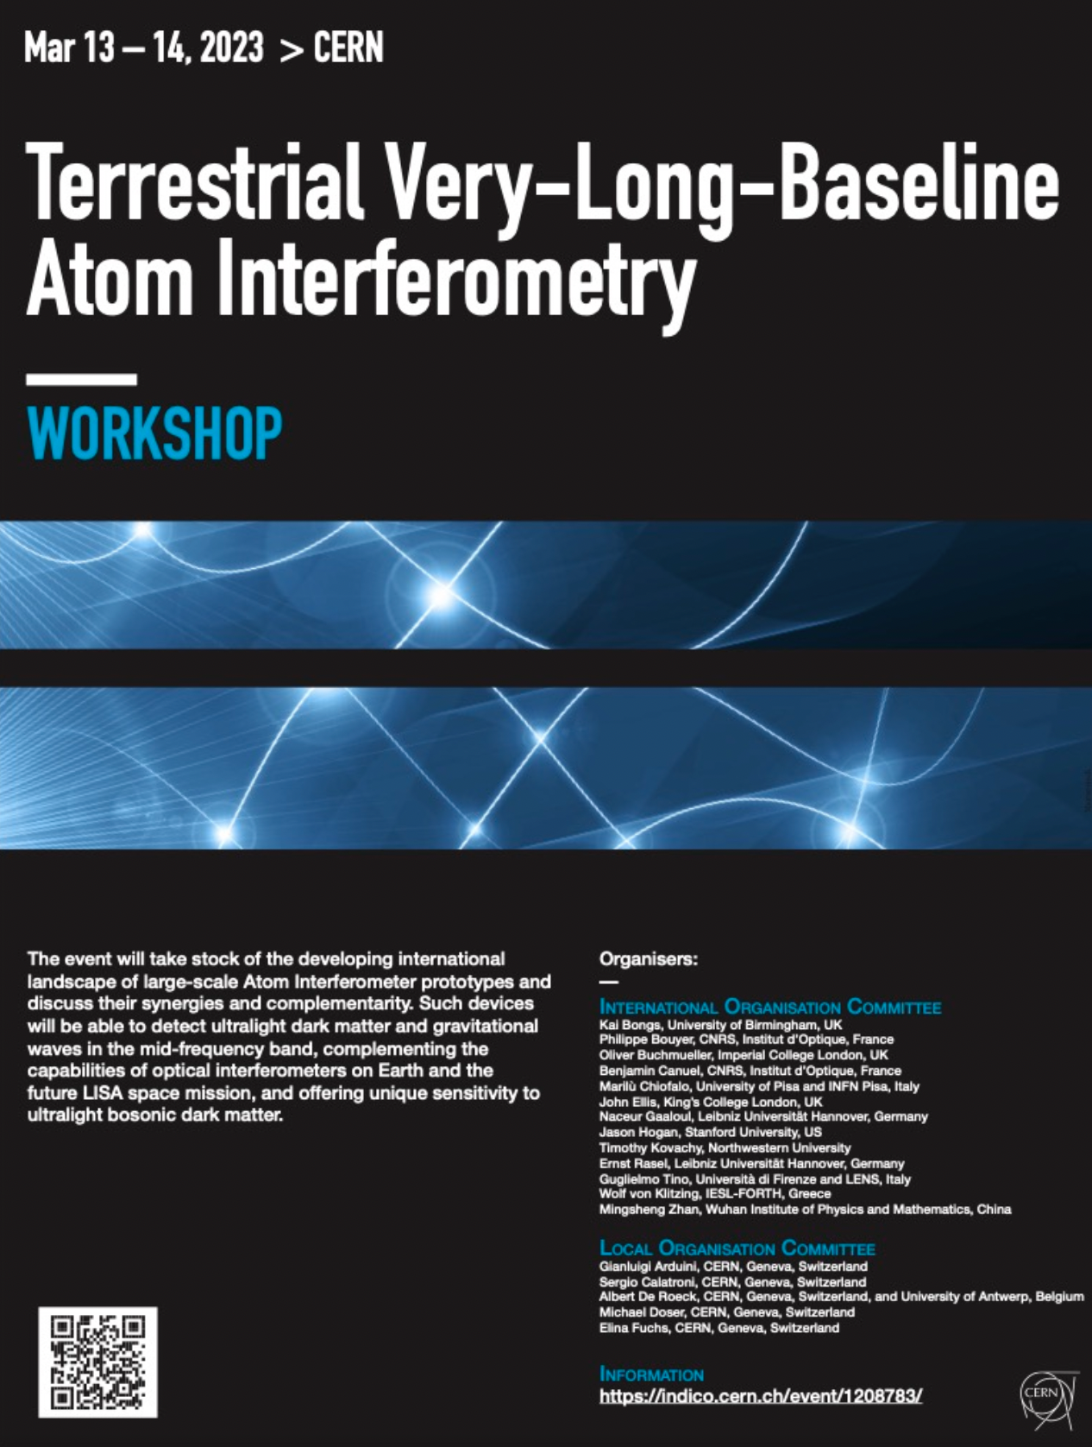
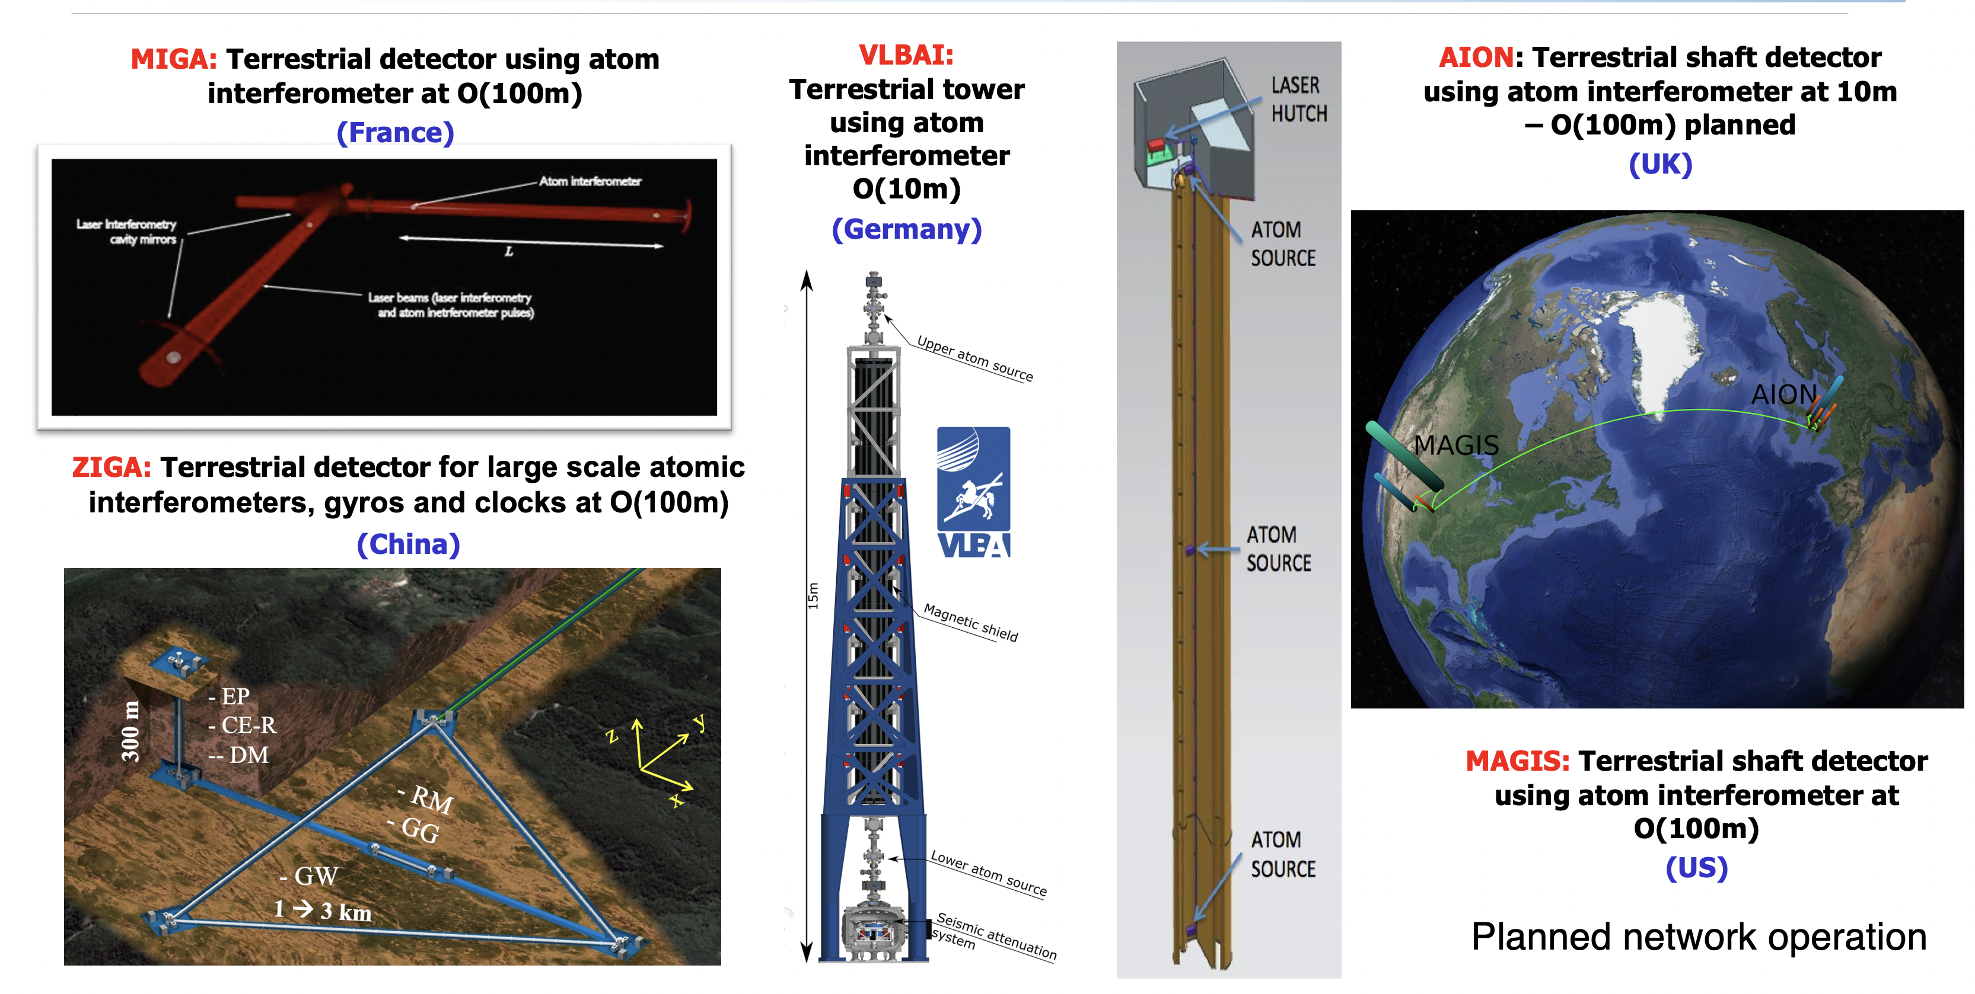



International Organisation Committee
Kai Bongs, University of Birmingham, UK
Philippe Bouyer, CNRS, Institut d’Optique, France
Oliver Buchmueller, Imperial College London, UK
Benjamin Canuel, CNRS, Institut d’Optique, France
Marilù Chiofalo, University of Pisa and INFN Pisa, Italy
John Ellis, King’s College London, UK
Naceur Gaaloul, Leibniz Universität Hannover, Germany
Jason Hogan, Stanford University, US
Timothy Kovachy, Northwestern University
Ernst Rasel, Leibniz Universität Hannover, Germany
Guglielmo Tino, Università di Firenze and LENS, Italy
Wolf von Klitzing, IESL-FORTH, Greece
Mingsheng Zhan, Wuhan Institute of Physics and Mathematics, China
Local Organisation Committee
Gianluigi Arduini, CERN, Geneva, Switzerland
Sergio Calatroni, CERN, Geneva, Switzerland
Albert De Roeck, CERN, Geneva, Switzerland, and University of Antwerp, Belgium
Michael Doser, CERN, Geneva, Switzerland
Elina Fuchs, CERN, Geneva, Switzerland

Slide 25
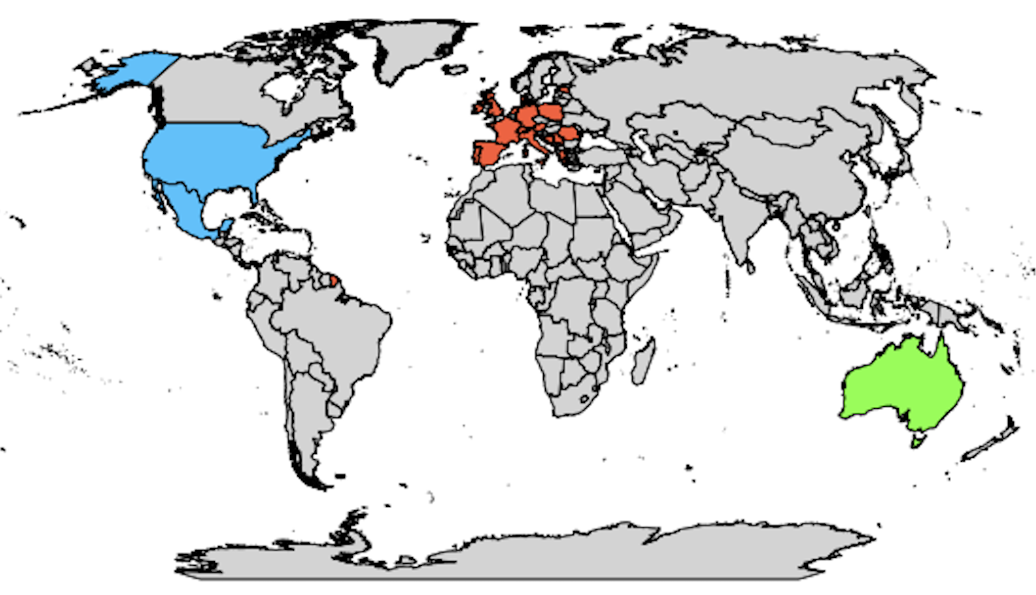
TVLBAI Proto-Collaboration
Austria
Institute of Science and Technology Austria
Bosnia and Herzegovina
University of Sarajevo - Faculty of Science
Denmark
Aarhus University - Department of Physics and Astronomy
Estonia
National Institute of Chemical Physics and Biophysics (KBFI)
France
University of Toulouse III – Paul Sabatier
École Normale Supérieure
Germany
Technische Universität Darmstadt
Leibniz University Hannover
Ulm University
Greece
Laboratory of Theoretical and Computational Physics, National Technical University of Athens (LThCP)
Foundation for Research and Technology – Hellas (FORTH)
Laboratory of Astronomy, Aristotle University of Thessaloniki (AUTH)
Ireland
Tyndall National Institute
Italy
University of Florence – DFA
LENS Laboratory
University of Pisa
Malta
University of Malta
Netherlands
University of Amsterdam
Poland
Space Technology Centre, AGH University of Science and Technology, Krakow
Center for Theoretical Physics, Polish Academy of Sciences (CTP PAS)
University of Warsaw
Portugal
Instituto de Telecomunicações
Romania
Institute of Space Science
Serbia
Institute of Physics Belgrade (IPB)
South East European Network for Mathematical and Theoretical Physics (SEENET-MTP) Centre
Spain
Institute of Theoretical Physics (IFT UAM-CSIC)
Institute of Corpuscular Physics (IFIC), Valencia
Autonomous University of Madrid (UAM)
Institut de Fisica d'Altes Energies (IFAE)
United States
University of Arizona
Johns Hopkins University
Stanford University
Northwestern University
University of Delaware
University of Kentucky
Bates College, Maine
Switzerland
University of Geneva
CERN
University of Neuchâtel
University of Zurich
United Kingdom
Imperial College London
King's College London
University College London (UCL)
University of Birmingham
University of Liverpool
University of Manchester
University of Oxford
University of Southampton
University of Sussex
University of Warwick
UKRI-STFC RAL
Mexico
Autonomous University of Aguascalientes (UAA)
Observers (Under Evaluation)
Germany
German Aerospace Center (DLR)
Iran
Isfahan University of Technology
United States
Fermi National Accelerator Laboratory (Fermilab)
Jet Propulsion Laboratory (JPL)
55 institutions from 21 countries
TVLBAI Chair: Prof. O. Buchmueller
Australia
University of Western Australia

Slide 26
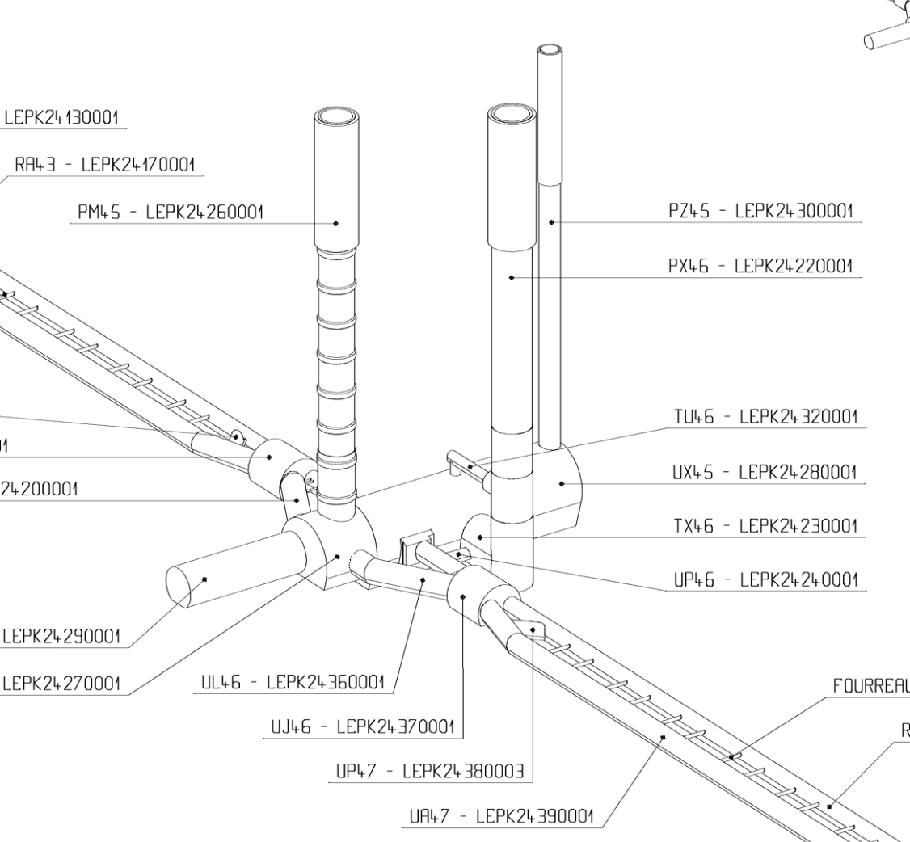
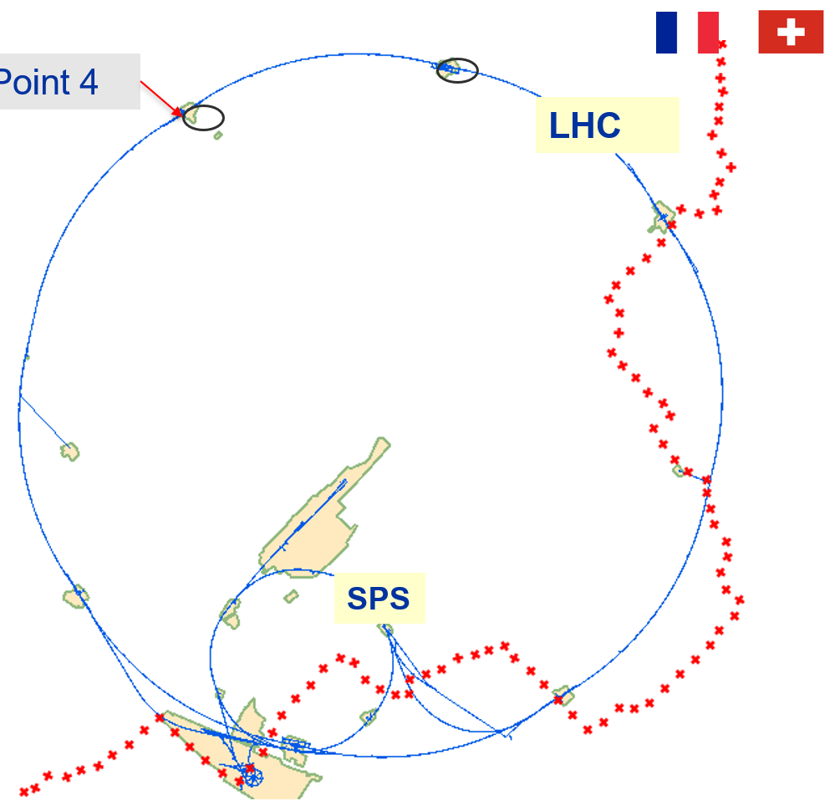
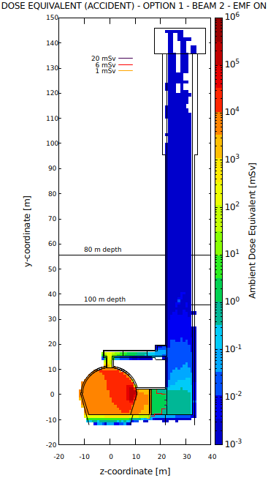
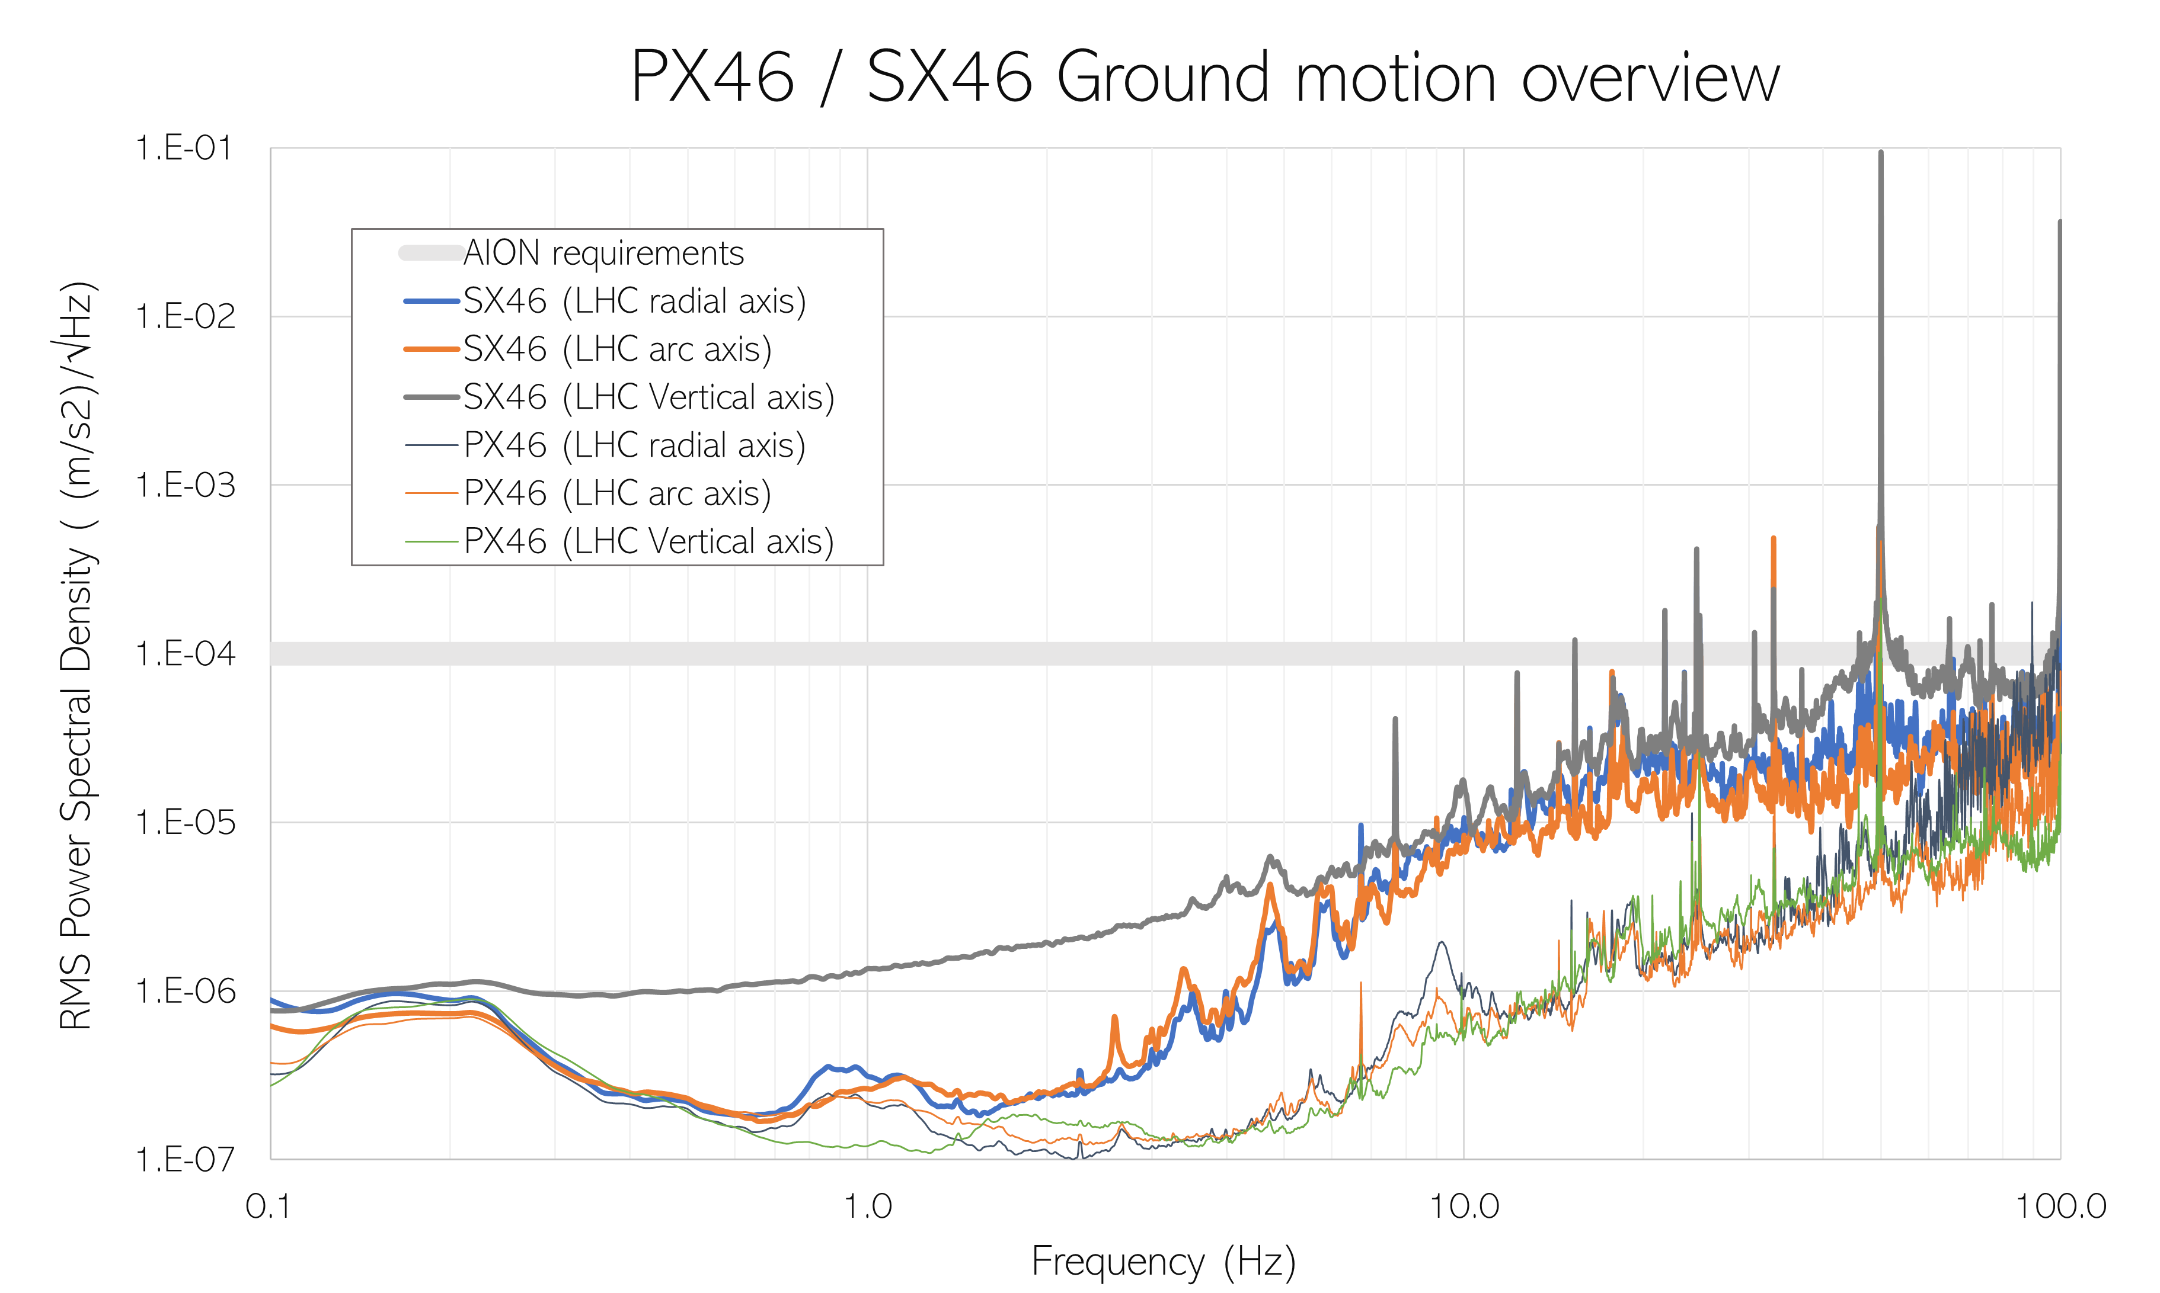
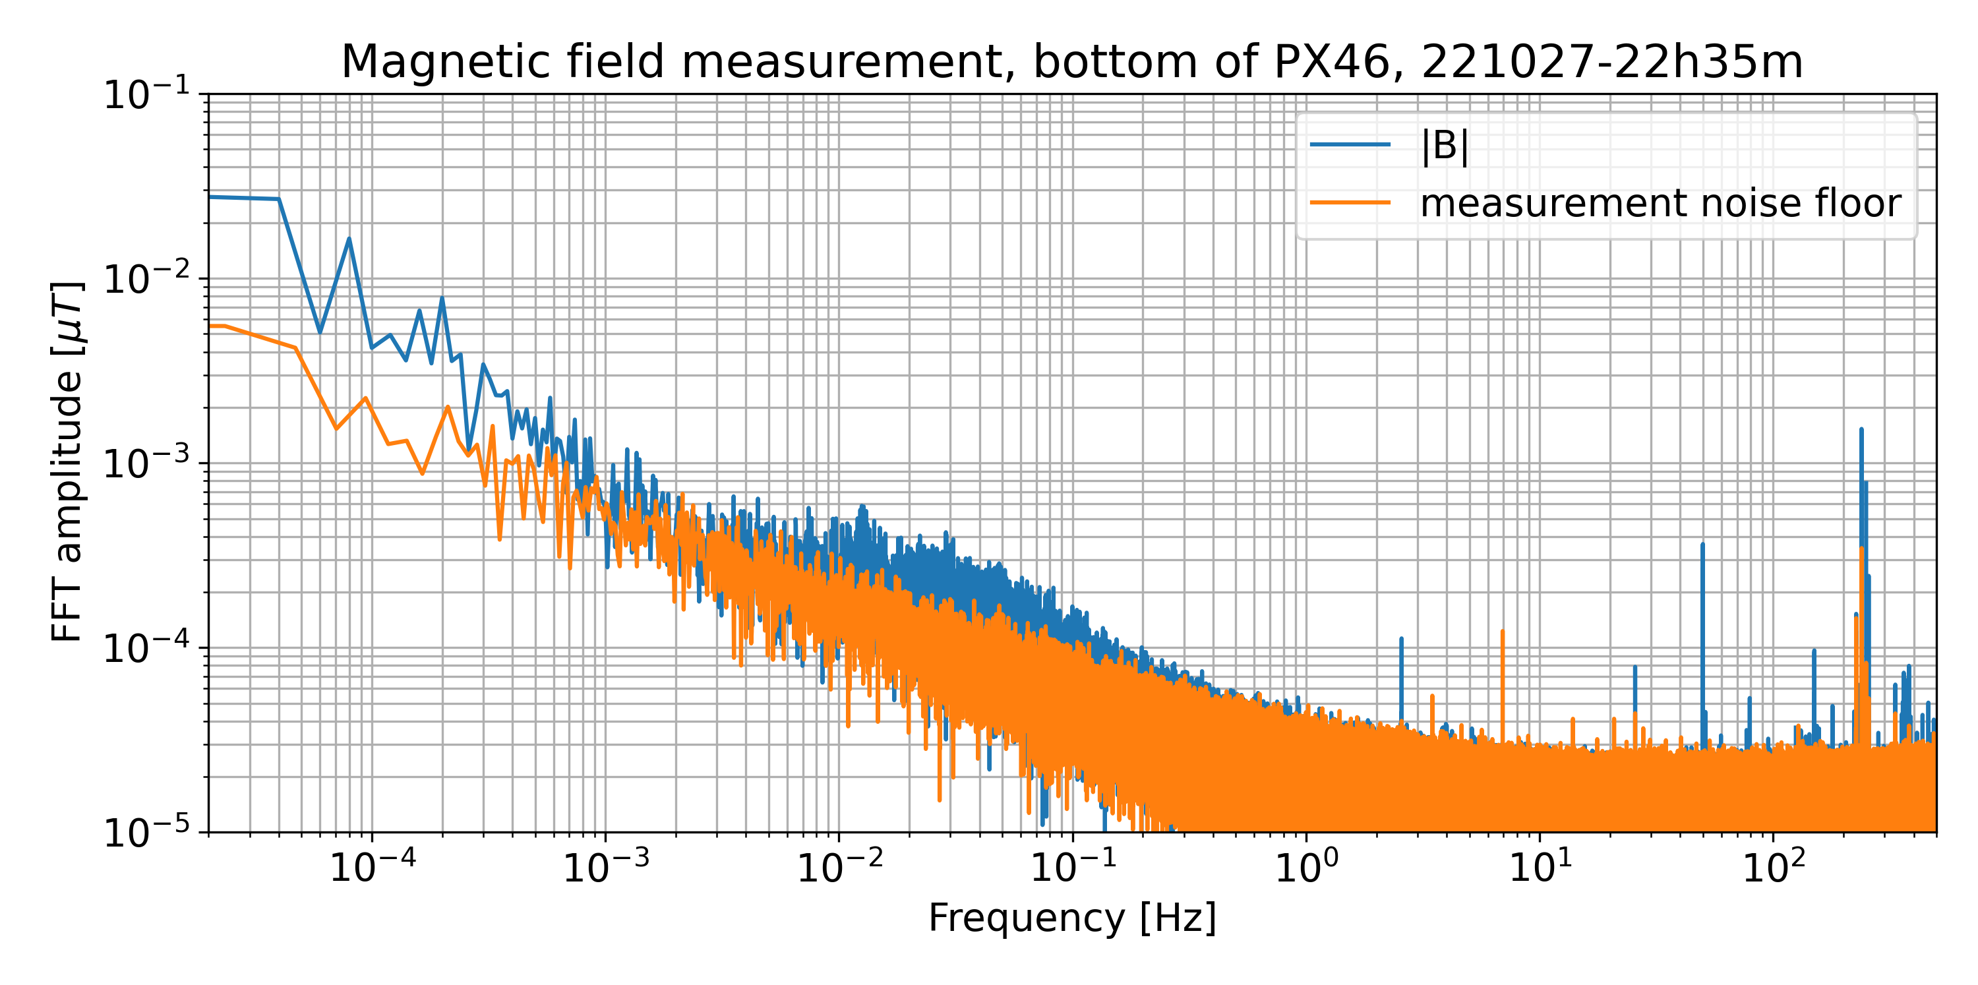
Possible site for a vertical VLBAI at CERN: 140 m deep pit at LHC Pt 4
PX46 – P4 Support shaft
Depth 143m, diameter 10.10m
Dose equivalent – case of beam loss
Shielding wall at the bottom of TX46
LHC beam on
Safety, access, evacuation, etc.: demonstrated feasibility for 365d/y 24h24 access and AION operation, also when the LHC beam is on

Slide 27
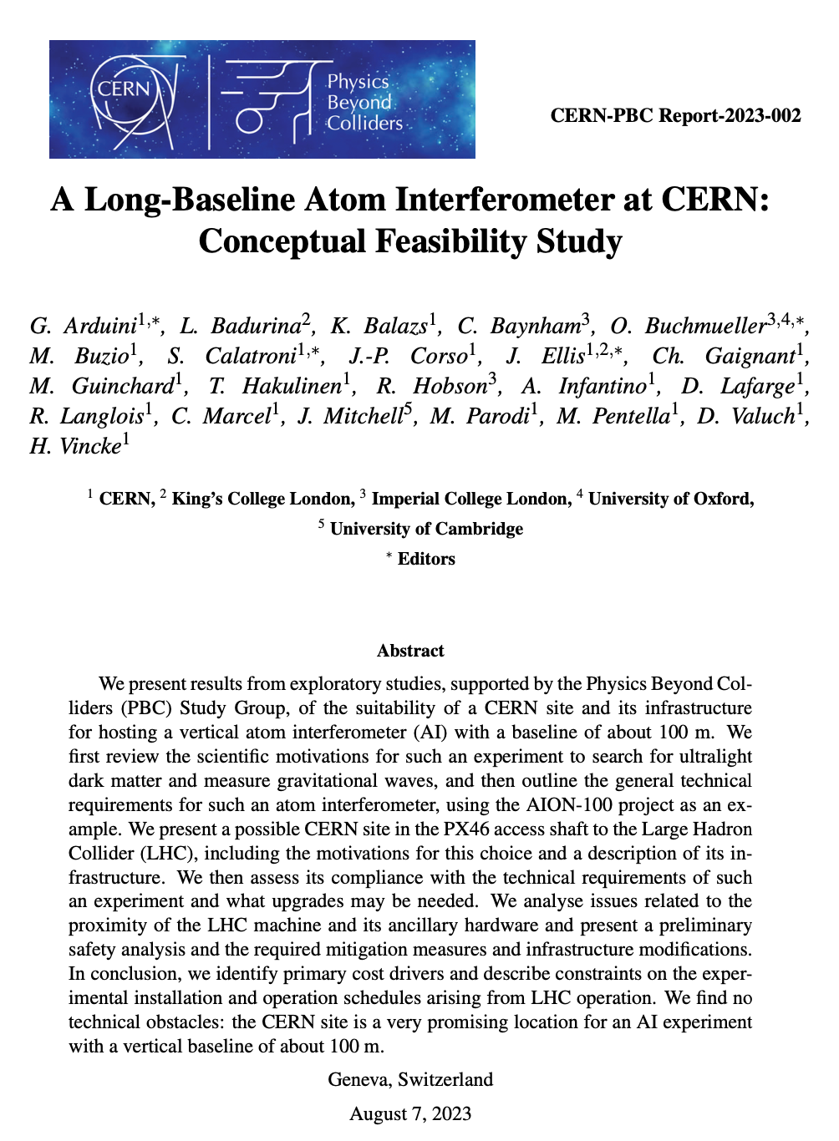
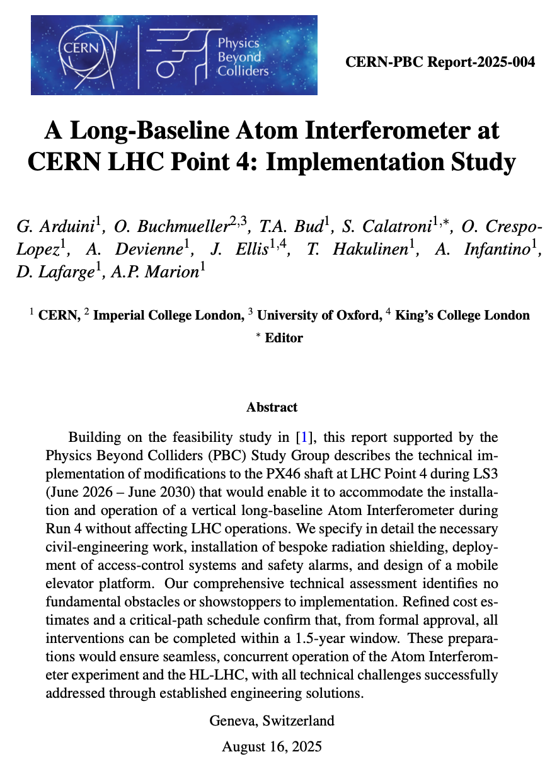
Possible site for a vertical VLBAI at CERN: 140 m deep pit at LHC pt.4
PX46 – P4 Support shaft
Depth 143m, diameter 10.10m
Dose equivalent – case of beam loss
Shielding wall at the bottom of TX46
2025: https://www.arxiv.org/abs/2508.09694
2023: https://arxiv.org/abs/2304.00614
LHC beam on
Safety, access, evacuation, etc.: demonstrated feasibility for 365d/y 24h24 access and AION operation, also when the LHC beam is on

Slide 28
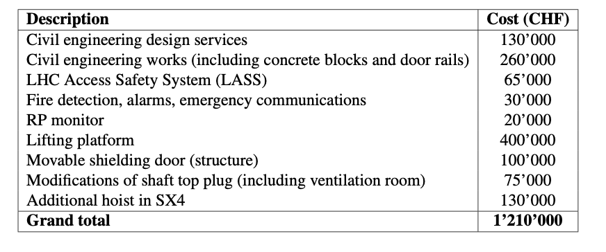
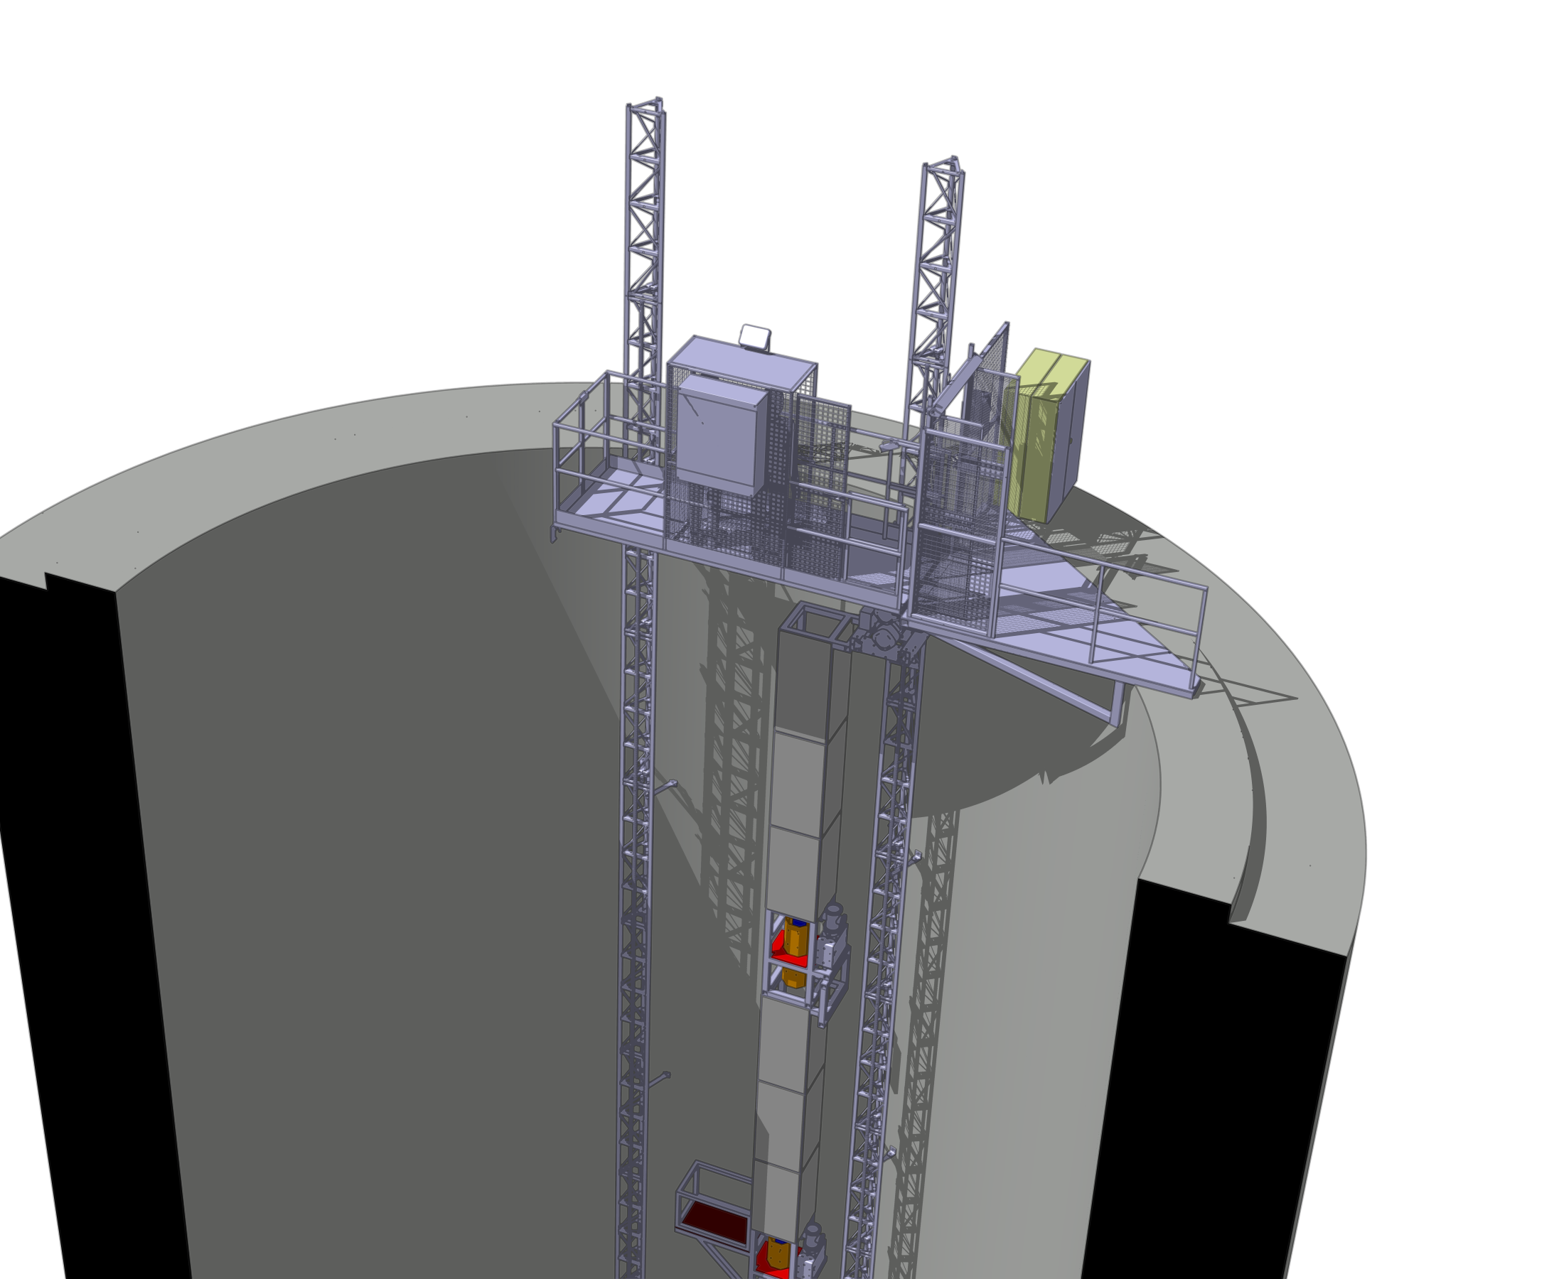
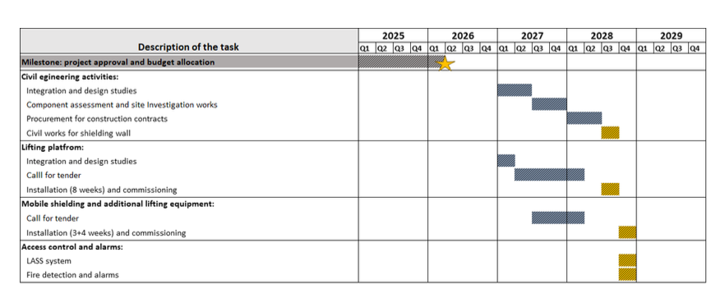
Possible site for a vertical VLBAI at CERN: 140 m deep pit at LHC pt.4
PX46 – P4 Support shaft
Depth 143m, diameter 10.10m
Dose equivalent – case of beam loss
Shielding wall at the bottom of TX46
LHC beam on
Safety, access, evacuation, etc.: demonstrated feasibility for 365d/y 24h24 access and AION operation, also when the LHC beam is on
We have defined a reliable budget and timeline to make the shaft ready for a vertical 100 m atom interferometer project

Slide 29
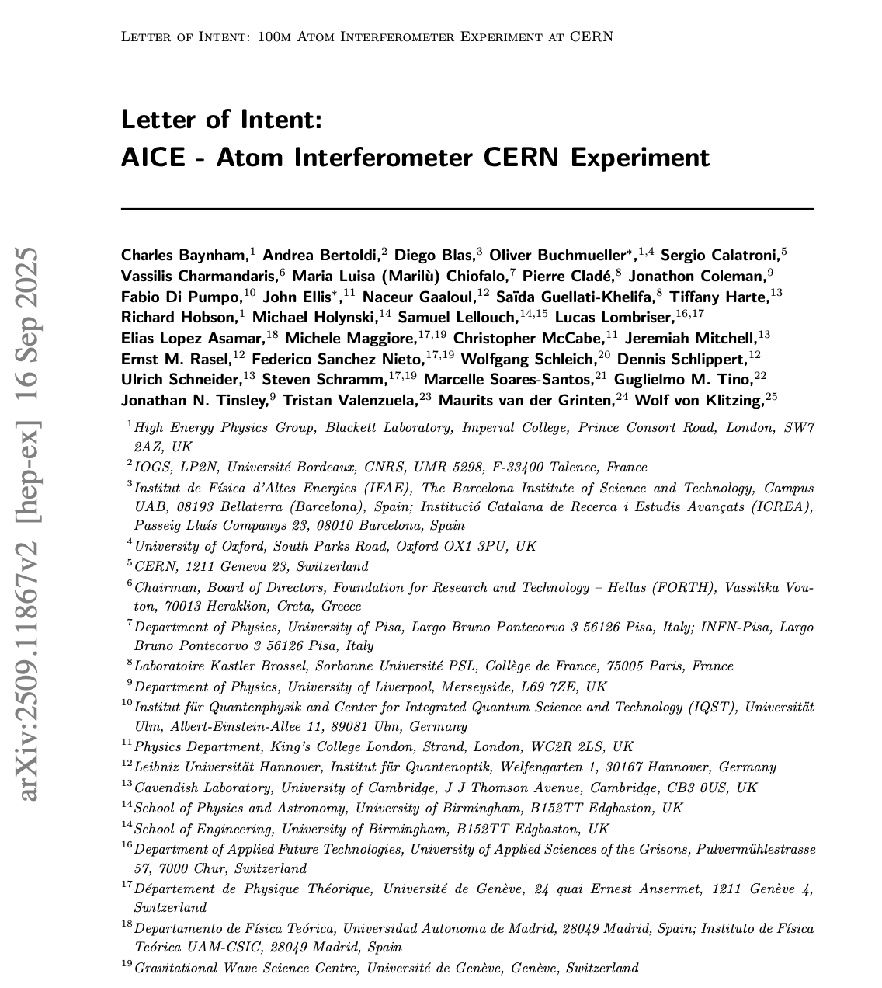
AICE: 100m Atom Interferometer Experiment at CERN
Physics goal: 100 m single-photon atom interferometer to probe ultralight dark matter and open the 0.1–10 Hz mid-band for gravitational waves.
Concept: Vertical UHV tube in PX46; laser lab in SX4; 2→10 atom sources enabling multigradiometer readout and strong noise suppression.
Feasibility & cost: Engineering and safety studies confirm PX46 is fully viable. Required CERN-side works (civil, shielding wall, access/ODH/fire systems, shaft-top upgrades) estimated at ≈1.2 M CHF, well within CERN’s infrastructure mandate.
Community strength: LoI backed by the TVLBAI proto-collaboration (55 institutes / 20 countries). AICE positioned as the European 100 m node toward a global long-baseline network.
CERN alignment: Fits the Physics Beyond Colliders roadmap and the CERN Quantum Technology Initiative; no interference with HL-LHC operations.
Urgency: All PX46 civil-engineering must be scheduled in LS3 (2026–2028).
Decision needed in 2025 to secure inclusion in LS3 planning.
Status: LoI submitted to LHCC; waiting for feedback — informal signals are positive so far.

Slide 30
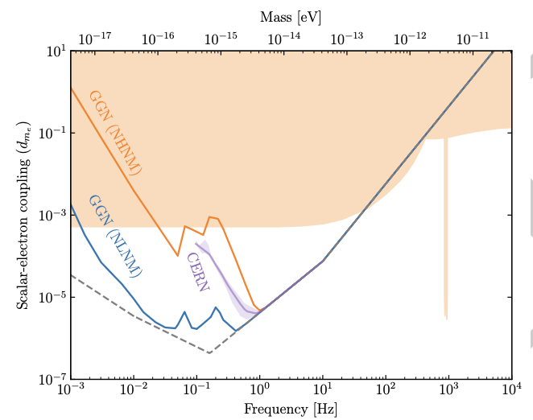
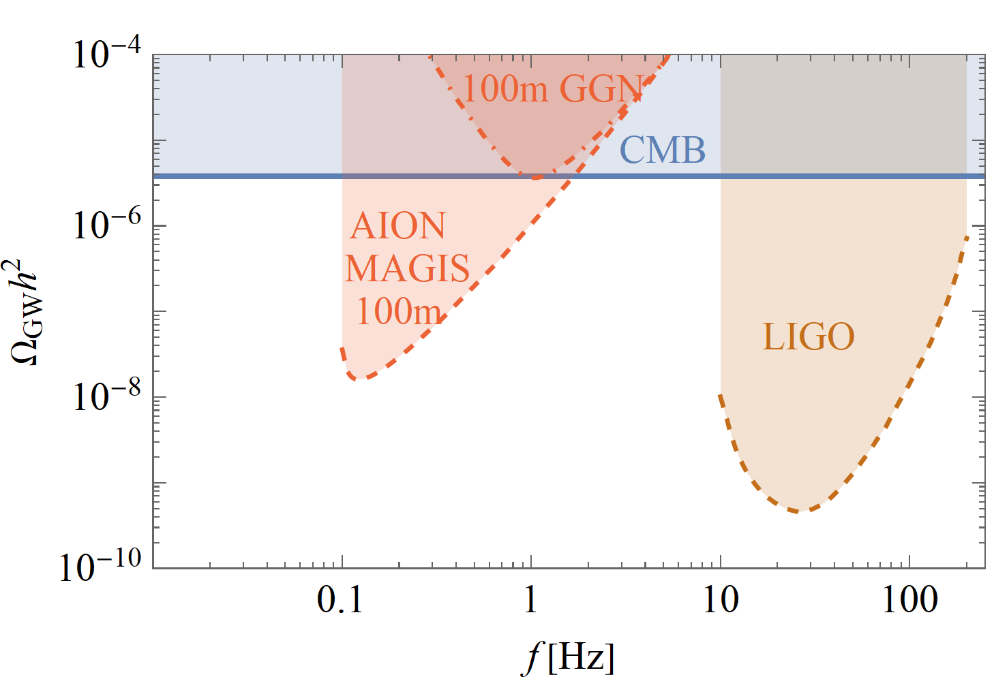
Physics Potential in a Nutshell
Besides probing a large range of new Ultra-Light DM parameter space, a ~100m experiment could also explore new territory for gravitational waves in a yet unexplored frequency range.

Slide 31
4th TVLBAI Workshop February 2-4, 2026
The workshop will take place from 2–4 February 2026 at the Laboratorio Subterraneo de Canfranc (LSC) in Canfranc, Spain:
https://indico.cern.ch/event/1599454/
If you are interested in attending this event in person, please register before January 19th, 2026 at:
https://indico.cern.ch/event/1599454/registrations/
The event will be in a hybrid format, allowing for both in-person and remote participation via Zoom.

Slide 32
Unexplored Mid-frequency Gravitational Waves
THE SCIENCE CASE

Slide 33
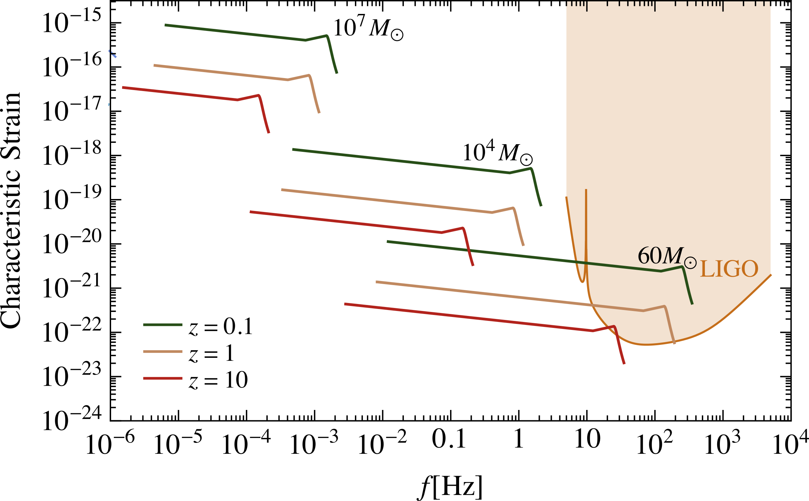
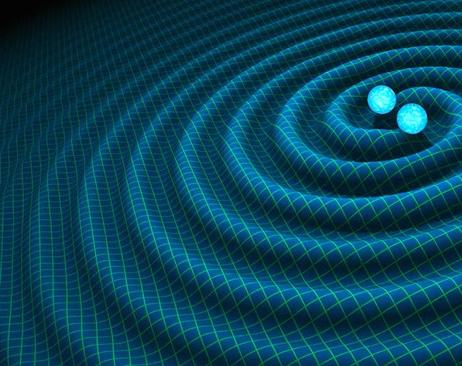
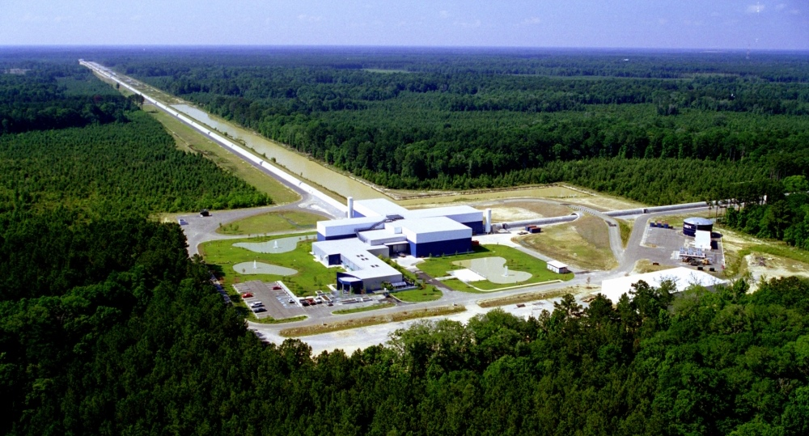

Gravitational wave detectors
https://www.ligo.caltech.edu/image/ligo20160211a
https://sservi.nasa.gov/articles/scientists-detect-first-gravitational-waves/
Time
Notes:
Minimum sensitivity plot – shaded regions
Merger events depicted as lines
Merger evolves from left to right
LIGO first signal in 2015 – yellow star

Slide 34



Gravitational wave detectors
https://www.ligo.caltech.edu/image/ligo20160211a
https://lisa.nasa.gov/archive2011/
https://sservi.nasa.gov/articles/scientists-detect-first-gravitational-waves/
Notes:
Future laser interferometer detectors: LISA (space), ET (bigger, longer)
Mind the gap!

Slide 35

Gravitational wave detectors
Mid-band science
Detect sources BEFORE they reach the high frequency band [LIGO, ET]
Optimal for sky localization: predict when and where events will occur (for multi-messenger astronomy)
Search for Ultra-light dark matter in a similar frequency [i.e. mass] range
https://www.ligo.caltech.edu/image/ligo20160211a
https://lisa.nasa.gov/archive2011/
Mid-Band currently
NOT covered
Notes:
Future laser interferometer detectors: LISA (space), ET (bigger, longer)
Mind the gap!

Slide 36

Gravitational wave detectors
Mid-band science
Detect sources BEFORE they reach the high frequency band [LIGO, ET]
Optimal for sky localization: predict when and where events will occur (for multi-messenger astronomy)
Search for Ultra-light dark matter in a similar frequency [i.e. mass] range
https://www.ligo.caltech.edu/image/ligo20160211a
Multi-100m to km-scale Atom Interferometer (QT) experiments like AION can cover this gap.
Notes:
Here is where my tech comes in: AION-km and AEDGE

Slide 37



Sky position determination
Sky localization precision:
Images: R. Hurt/Caltech-JPL; 2007 Thomson Higher Education
Mid-band advantages
- Small wavelength λ
- Long source lifetime (~months) maximizes effective R
λ
R
Ultimate sensitivity for terrestrial based detectors is achieved by operating 2 (or more)
Detectors in synchronisation mode

Slide 38

AEDGE: Potential Mission Design
Using two cold-atom interferometers that perform a relative measurement of
differential phase shift, a potential mission profile would be using a pair of satellites
separated by a very long baseline L.
Assumed basic parameters:
Pair of satellites in medium earth orbit (MEO)
Satellite separation L = 4.4 x 10⁷ m
A detailed mission outline is provided in:
https://epjquantumtechnology.springeropen.com/articles/10.1140/epjqt/s40507-020-0080-0
and P. W. Graham et al arXiv:1711.02225
Note: as Laser noise is
common-mode suppressed
only two satellites are required

Slide 39

Gravitational wave detectors
Mid-band science
Detect sources BEFORE they reach the high frequency band [LIGO, ET]
Optimal for sky localization: predict when and where events will occur (for multi-messenger astronomy)
Search for Ultra-light dark matter in a similar frequency [i.e. mass] range
https://www.ligo.caltech.edu/image/ligo20160211a
Multi-100m to km-scale Atom Interferometer (QT) experiments like AION can cover this gap.
Experiments that bring QT to space, like AEDGE, can further extend our coverage of this region and beyond.
Notes:
Here is where my tech comes in: AION-km and AEDGE

Slide 40

What does this imply?

Slide 41

What does this imply?

Slide 42
What does this imply?
Exploring the very beginning of our Universe

Slide 43

Search for Ultra-Light Dark Matter

Slide 44
Ultralight scalar dark matter
Ultralight dilaton DM acts as a background field (e.g., mass ~10⁻¹⁵ eV)
+ …
Electron
coupling
Photon
coupling
e.g., QCD
DM scalar field
DM mass density
DM coupling causes time-varying atomic energy levels:
DM induced oscillation
Dark matter coupling
Time
Courtesy of Jason Hogan!

Slide 45



Search for Ultra-Light Dark Matter
Linear couplings to gauge fields and matter fermions
Orders of
magnitude
improvement
over current
sensitivities
AION Collaboration (Badurina, …, JE et al): arXiv:1911.11755; Badurina, Buchmueller, JE, Lewicki, McCabe & Vaskonen: arXiv:2108.02468

Slide 46
Other Fundamental Physics
Ultra-high-precision atom interferometry may also be sensitive to other aspects of fundamental physics beyond dark matter and GWs, though studies of such possibilities are still at exploratory stages.
Examples may include:
The possibility of detecting the astrophysical neutrinos
Probes of long-range fifth forces.
Constraining possible variations in fundamental constants.
Probing dark energy.
Probes of basic physical principles such as foundations of quantum mechanics and Lorentz invariance.
A very exciting new research avenue is ahead of us ….

Slide 47
More on Atom Interferometry Concept

Slide 48
Light vs. Cold Atoms: Atom Interferometry
Light interferometer
Light
Light fringes
Atom interferometer
Beamsplitter
Atom fringes
Atom
Beamsplitter
Mirror
http://scienceblogs.com/principles/2013/10/22/quantum-erasure/
http://www.cobolt.se/interferometry.html

Slide 49
Atom Interferometry Optics using Light
(1) Light absorption:
ħk
v = ħk/m
(2) Stimulated emission:
ħk

Slide 50

Atom Interferometry Optics using Light
(1) Light absorption:
Rabi oscillations
ħk
“Beamsplitter”
“Mirror”
v = ħk/m
(2) Stimulated emission:
ħk
Time

Slide 51




Light Pulse Atom Interferometry
π/2 pulse
“beamsplitter”
Beamsplitter
Position
ћk
π pulse
“mirror”
Atom
Beamsplitter
ћk
Mirror
“beamsplitter”
Time
π/2 pulse
ћk
|p›
Interior view
|p+ћk›
ћk

Slide 52





Light Pulse Atom Interferometry

Slide 53


Possible Phase Shifts
General Relativistic Effects in
Atom Interferometry
Dimopoulos et al,
Phys.Rev.D78:042003,2008

Slide 54


Pi and Pi/2 Pluses – Rabi Oscillation

Slide 55

Mach-Zehnder Atom Interferometer – Phase shift
Assuming no other interactions like gravity, etc.
Atoms at rest:
Space
Path 1
Path 2
Ground state
Exited State
Time

Slide 56

Mach-Zehnder Atom Interferometer – Phase shift
Assuming no other interactions like gravity, etc.
Atoms at rest:
Pi/2 Beamsplitter
Phase Phi 1
Space
Space
Path 1
Path 2
Ground state
Exited State
Time

Slide 57

Mach-Zehnder Atom Interferometer – Phase shift
Assuming no other interactions like gravity, etc.
Atoms at rest:
Pi/2 Beamsplitter
Phase Phi 1
Space
Space
Space
Path 1
Path 2
Ground state
Exited State
Time

Slide 58

Mach-Zehnder Atom Interferometer – Phase shift
Assuming no other interactions like gravity, etc.
Pi Mirror
Phase Phi 2
Pi/2 Beamsplitter
Phase Phi 1
Atoms at rest:
Pi/2 Beamsplitter
Phase Phi 1
Space
Space
Space
Space
Path 1
Path 2
Ground state
Exited State
Time

Slide 59

Mach-Zehnder Atom Interferometer – Phase shift
Assuming no other interactions like gravity, etc.
Pi Mirror
Phase Phi 2
Pi/2 Beamsplitter
Phase Phi 1
Space
Path 1
Path 2
Ground state
Exited State
Time

Slide 60

Mach-Zehnder Atom Interferometer – Phase shift
Assuming no other interactions like gravity, etc.
Pi Mirror
Phase Phi 2
Pi/2 Beamsplitter
Phase Phi 3
Pi/2 Beamsplitter
Phase Phi 1
Space
Port 2
Port 1
Path 1
Path 2
Ground state
Exited State
Time

Slide 61

Mach-Zehnder Atom Interferometer – Phase shift
Assuming no other interactions like gravity, etc.
Pi Mirror
Phase Phi 2
Pi/2 Beamsplitter
Phase Phi 3
Pi/2 Beamsplitter
Phase Phi 1
Space
Port 2
Port 1
Path 1
Path 2
Ground state
Exited State
Time

Slide 62

MZ Acceleration Phase Shift

Slide 63



Different Phase Shifts for Different Interactions

