Slide 1

Quantum Communication Experiments at CERN
QuIC Business Community Summit 25/11/2025
Annick Teepe

Slide 2

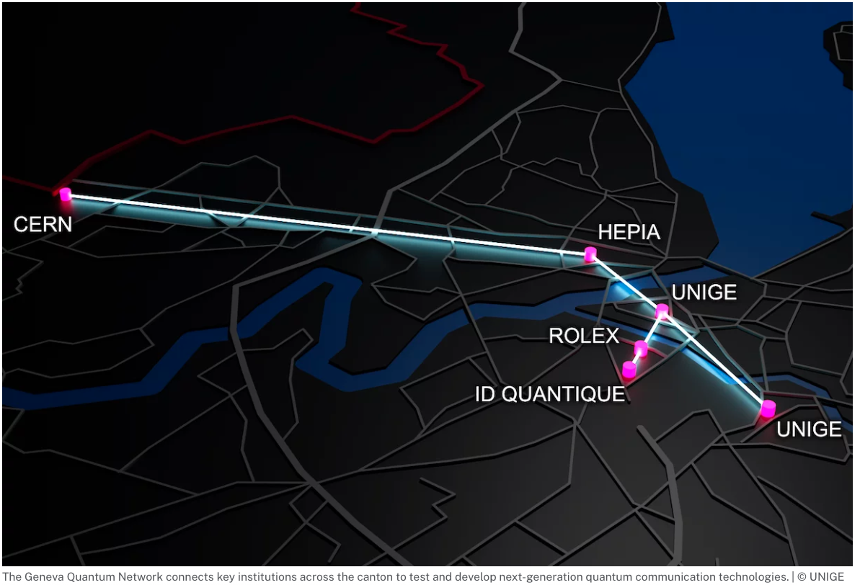
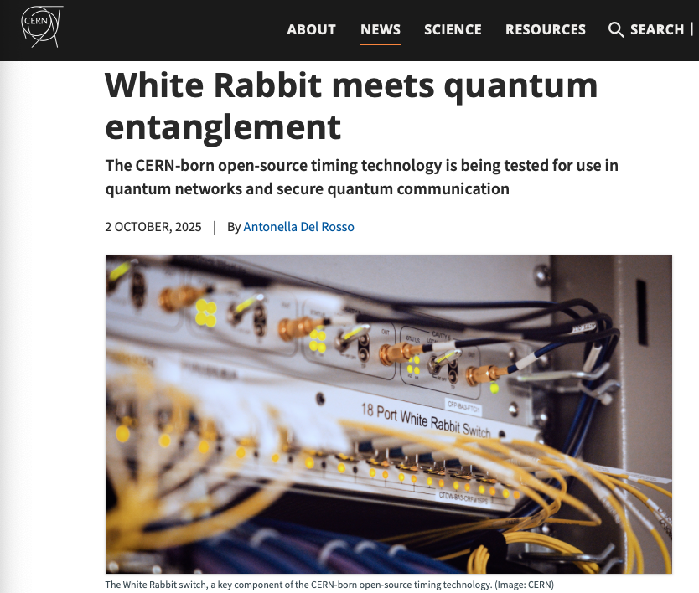
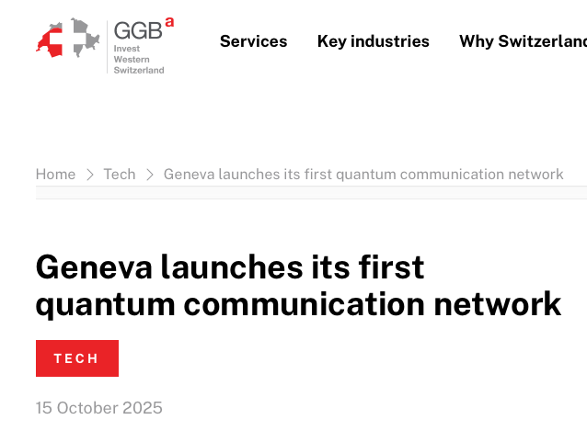
News !

Slide 3
Main challenges in large-scale quantum networks
Transmitting quantum information via photons over long optical fiber links
Photon losses
Synchronisation
Variable transmission conditions
→ transmission time (length changes)
→ polarisation state (vibrations/other)
Work in low-loss wavelength bands
( Telecom C-band & O-band )
Notes:
Espeically losses of photons in visible range are great
Single photon wavepackets can be as short as picoseconds, high-accuracy sync is required
Changes in environment, such as temperature increase which results in length increase

Slide 4


Main challenges in large-scale quantum networks
Transmitting quantum information via photons over long optical fiber links
Photon losses
Synchronisation
Variable transmission conditions
→ transmission time (length changes)
→ polarisation state (vibrations/other)
Quantum-Classical Coexistence
multiplexer
Single photons
Notes:
White Rabbit is ethernet based , classical optical two-way time transfer protocol, providing sub-ns synchronisation accuracy and picosecond-scale precision
Same fiber = Same environmental conditions
→ WR for synchronisation & as probe !

Slide 5


Today: Quantum Networks at CERN
Entanglement distribution of polarisation photon pairs co-existing with White Rabbit synchronization signals on the same optical fiber
15xx nm
15xx nm
White Rabbit Switch
White Rabbit Switch
DWDM
DWDM
Source
1320 nm
1320 nm
785 nm
TimeTagger
TimeTagger
Detection
Detection
Alice
Bob
Notes:
2 node network

Slide 6
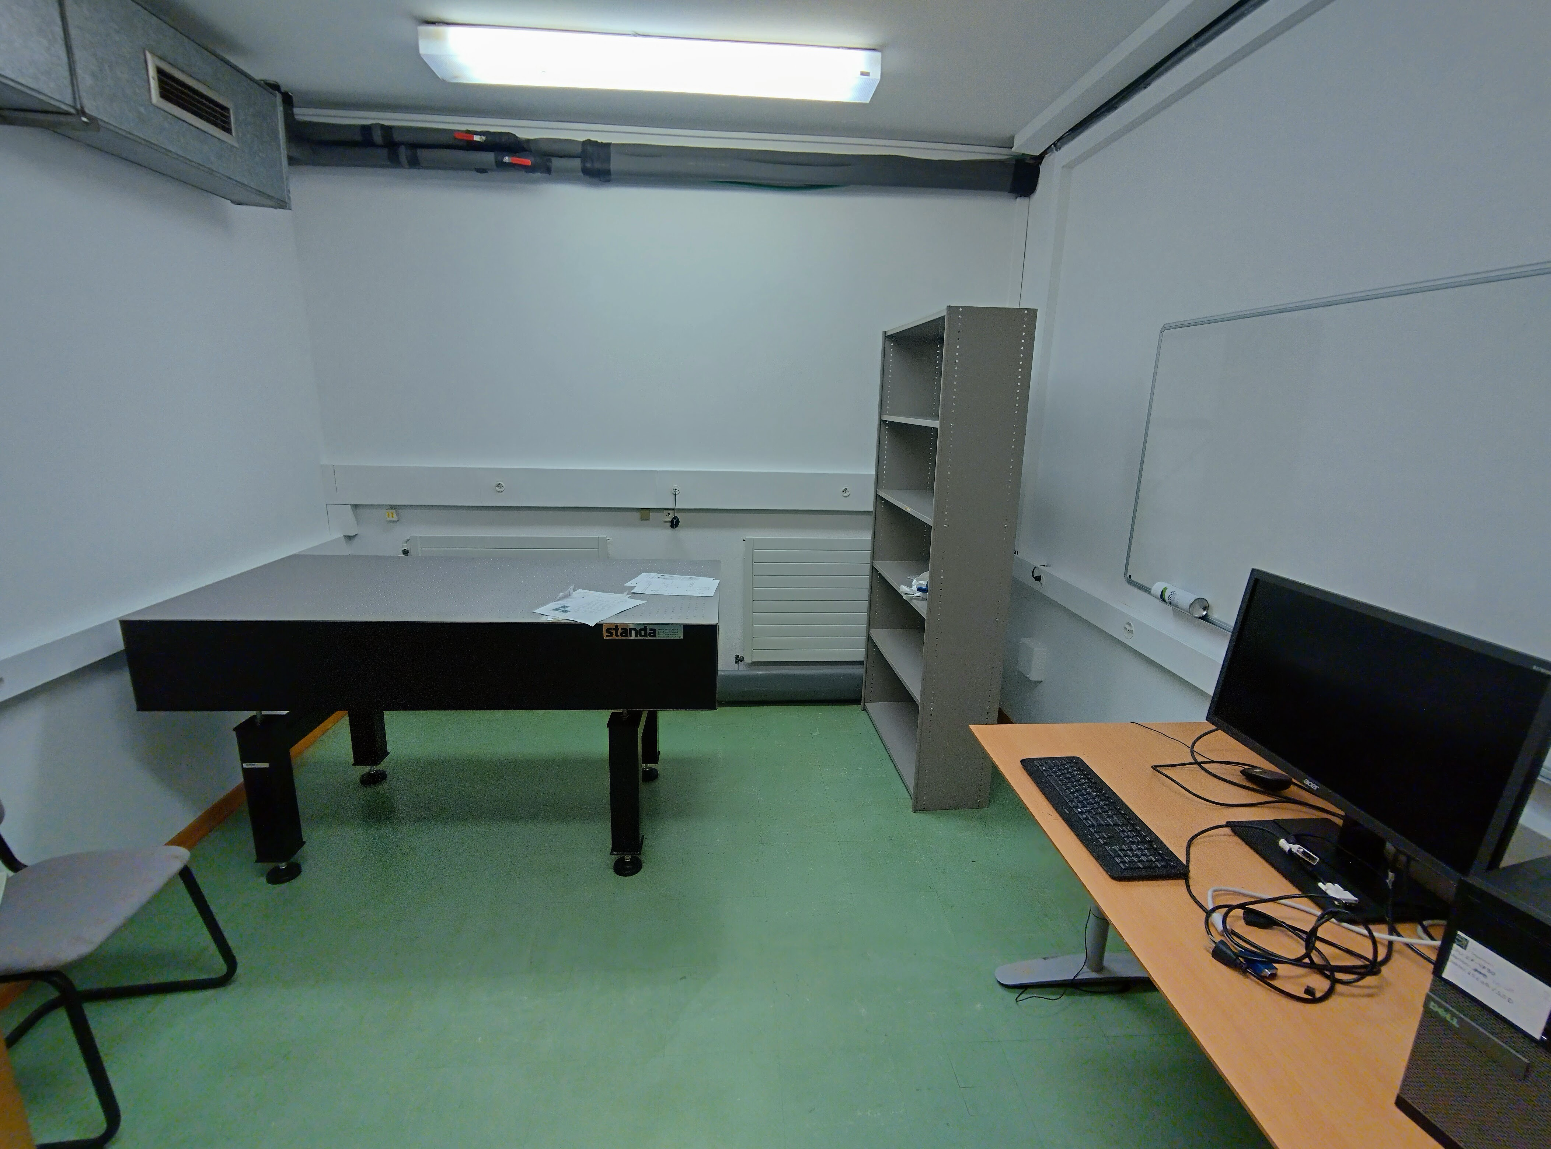
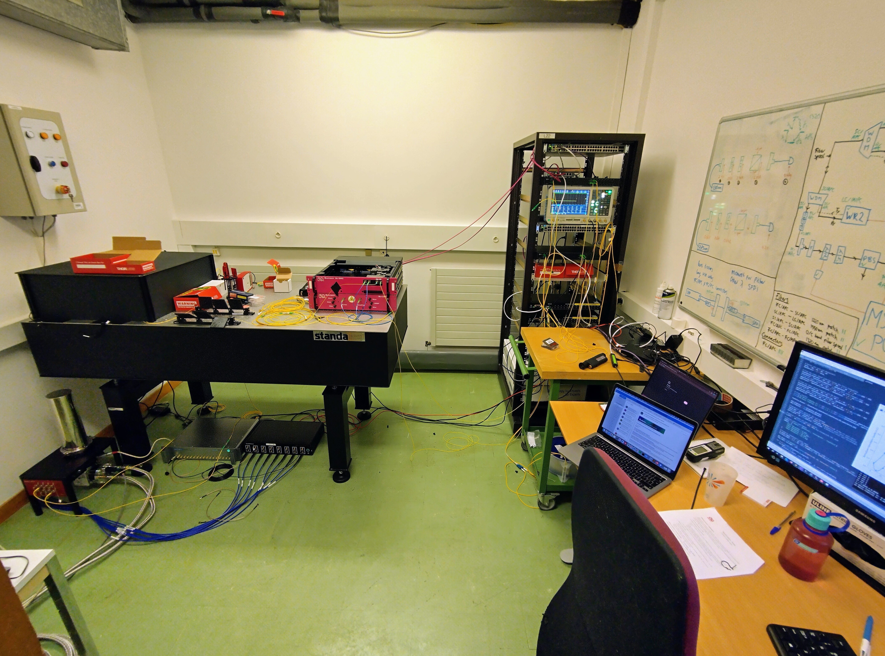
Start at the beginning
Setting up quantum networks lab from scratch!
Notes:
Start at the beginning… An empty room.
Procuring, arranging , installing and testing all equipment
Interlock installation

Slide 7
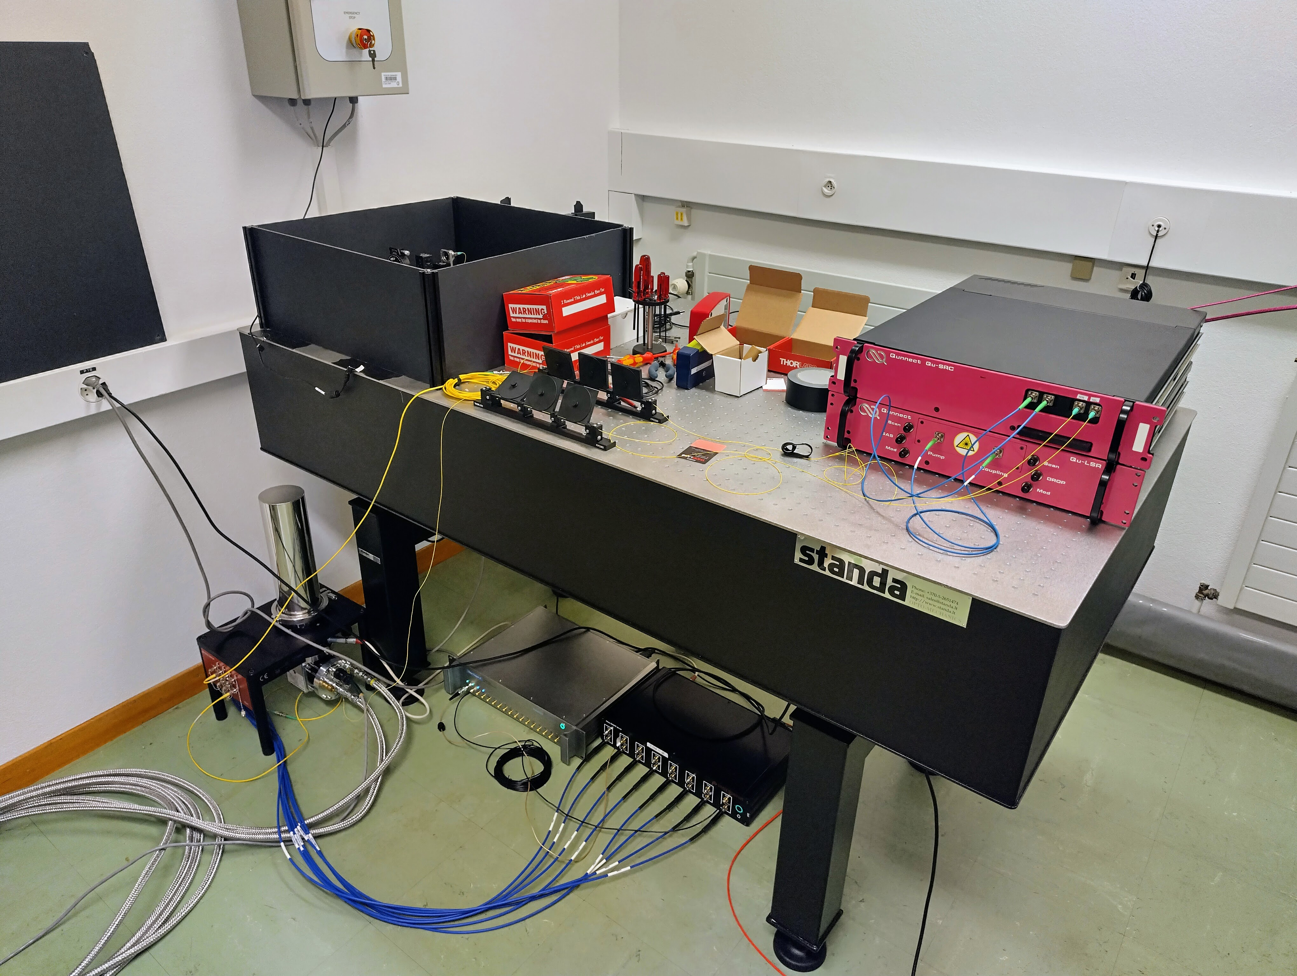


Source and Detectors

Slide 8
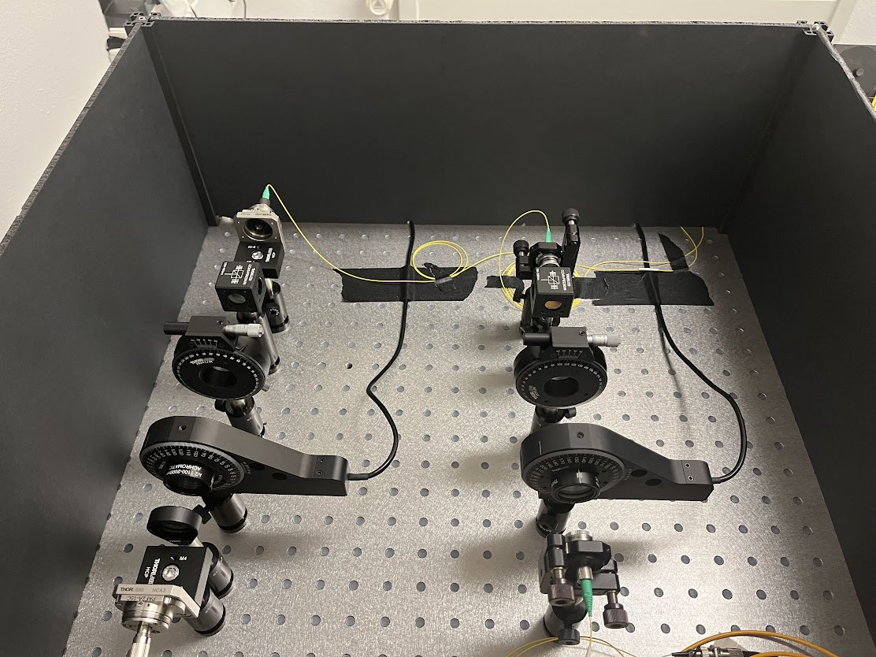

Demonstrating entanglement distribution
Measuring coincidence counts as a function of detection time difference in different polarisation bases
To detectors
Alice
Bob
Fiber coupler
Polarising beamsplitter
Fiber coupler
½ waveplate
Coincidences
Fiber coupler
Laser

Slide 9
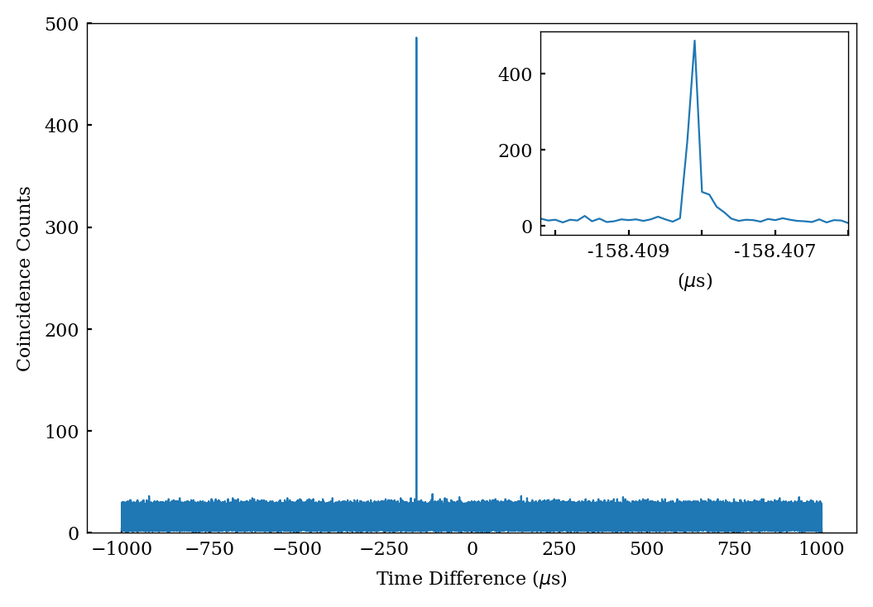
Demonstrating entanglement distribution
Measuring coincidence counts as a function of detection time difference
Coincidences

Slide 10
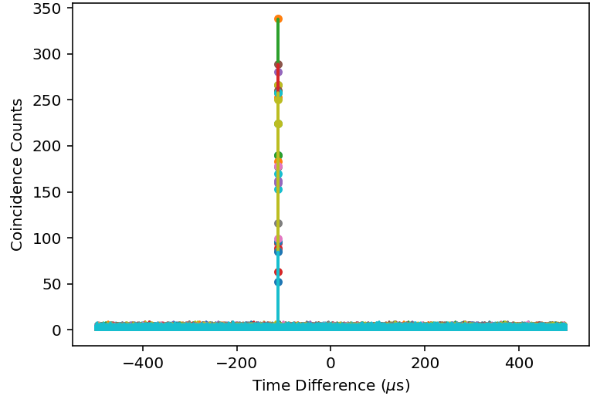


Demonstrating entanglement distribution
Extracting coincidence peak value for different half-wave plate positions
To detectors
Alice
Bob
Fiber coupler
Polarising beamsplitter
Fiber coupler
Fiber coupler
Laser
Alice in range 0 – 180°
Bob @ [0 °, 22.5 °, 45 °, 67.5 ° ]

Slide 11
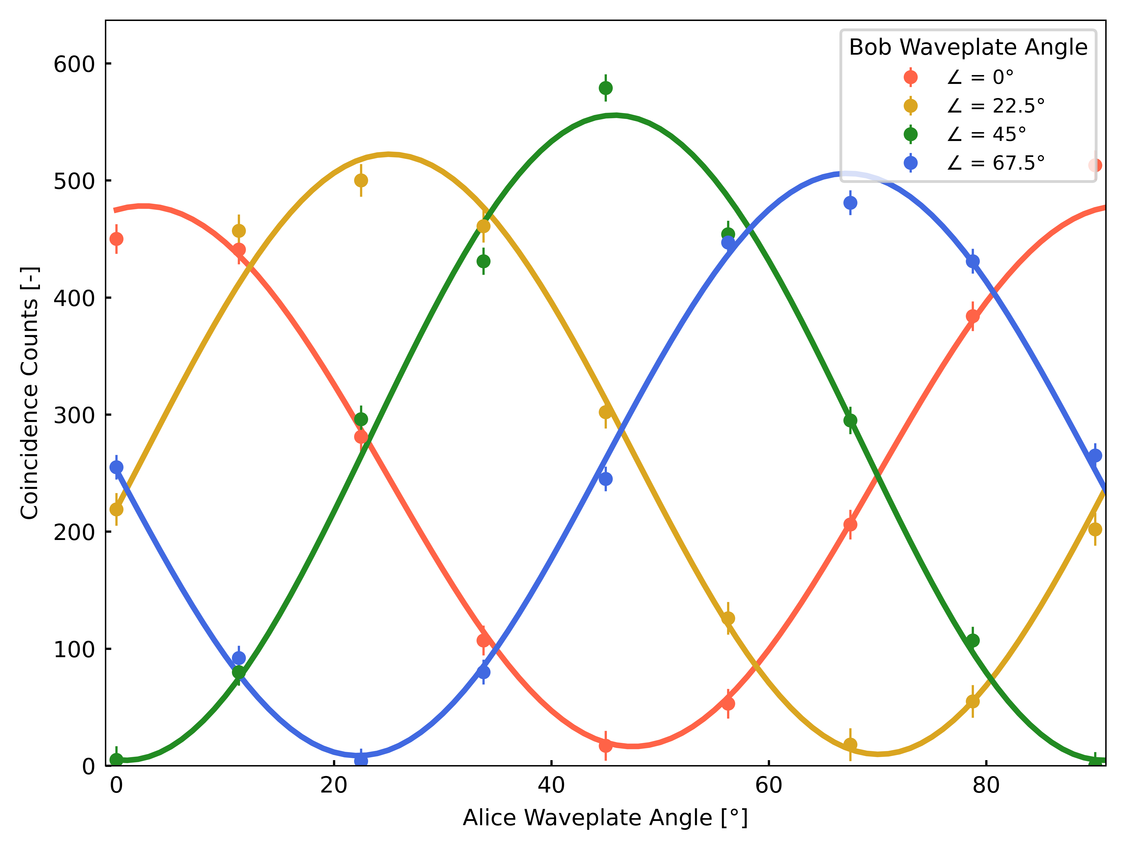
Demonstrating entanglement distribution
CHSH test
Plot coincidence peak value as a function of waveplate position + calculate
5 km of fiberspool
Average visibility
V = 0.97 +/- 0.02
CHSH S-parameter
S = 2.70 +/- 0.04
Maximum S = 2√2 ≈ 2.83
Notes:
Entanglement fringe visibility

Slide 12
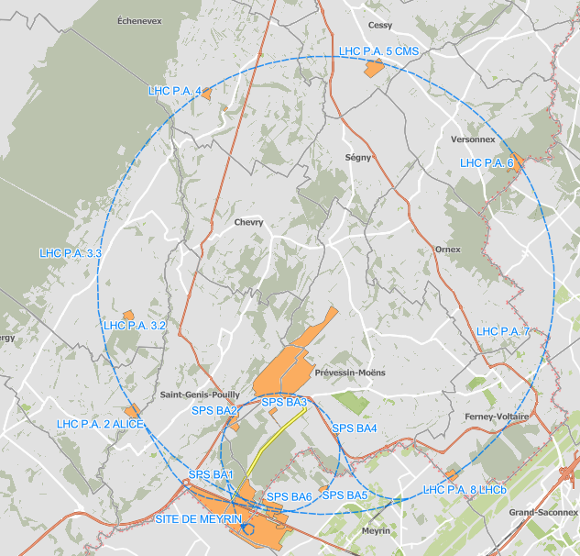

Fiber link (Loop-Back configuration)
29.5km fiber link from lab to CMS site and back
10.94 dB of attenuation (8% transmittance)

Slide 13
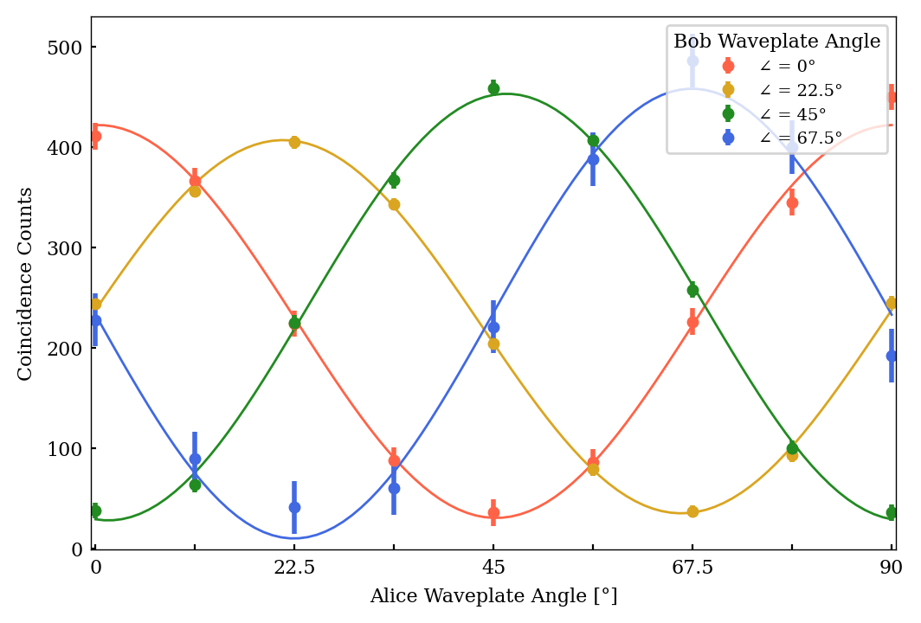
Demonstrating entanglement distribution
CHSH test
29.5 km of real fiber
Average visibility
V = 0.85 +/- 0.01
CHSH S-parameter
S = 2.50 +/- 0.05
5 km of fiberspool
Average visibility
V = 0.97 +/- 0.02
CHSH S-parameter
S = 2.70 +/- 0.04

Slide 14
Outlook
LOOPBACK (Alice & Bob @ CERN)
Quantum-classical coexistence experiments
- monitor WR parameters
- track polarisation state of WR light
Explore effects of different WR wavelengths and powers
- Visibilities and S-parameters (CHSH test)
- Quantum state (full tomography)
TWO-SITE (Alice @ CERN, Bob @ Unige)
Demonstrate metropolitan scale entanglement distribution with WR multiplexed on the same fiber

Slide 15
Quantum Networks at CERN
Entanglement distribution of polarisation photon pairs co-existing with White Rabbit synchronization signals on the same optical fiber
15xx nm
15xx nm
White Rabbit Switch
White Rabbit Switch
DWDM
DWDM
Source
1320 nm
1320 nm
785 nm
TimeTagger
TimeTagger
Detection
Detection
Alice
Bob
Notes:
2 node network

Slide 16
Questions?

Slide 17
