Slide 1
CERN´s Quantum Technology Initiative

Slide 2

CERN Quantum Technology Initiative
How can future quantum technologies contribute to CERN’s scientific mission?
How can CERN’s technologies and expertise contribute to the quantum revolution?
https://quantum.cern

Slide 3
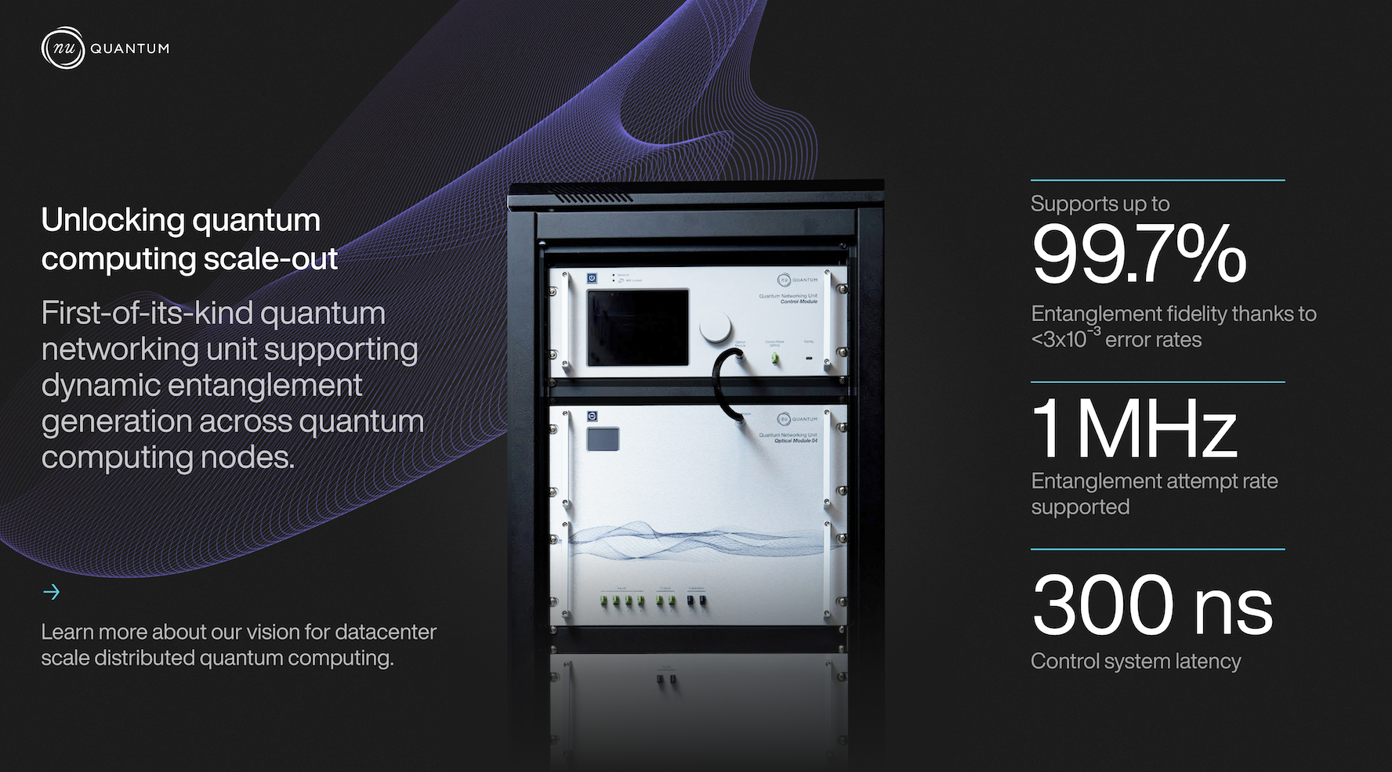

Nu Quantum partners with CERN to adopt White Rabbit timing technology to enable data centre-scale quantum computing networks
https://www.nu-quantum.com/news/nu-quantum-launches-world-first-quantum-networking-unit-for-dynamic-entanglement-to-scale-quantum-datacentres
www.nu-quantum.com/news/nu-quantum-announces-collaboration-with-cern-to-adopt-white-rabbit-timing-technology-to-enable-data-centre-scale-quantum-computing-networks

Slide 4
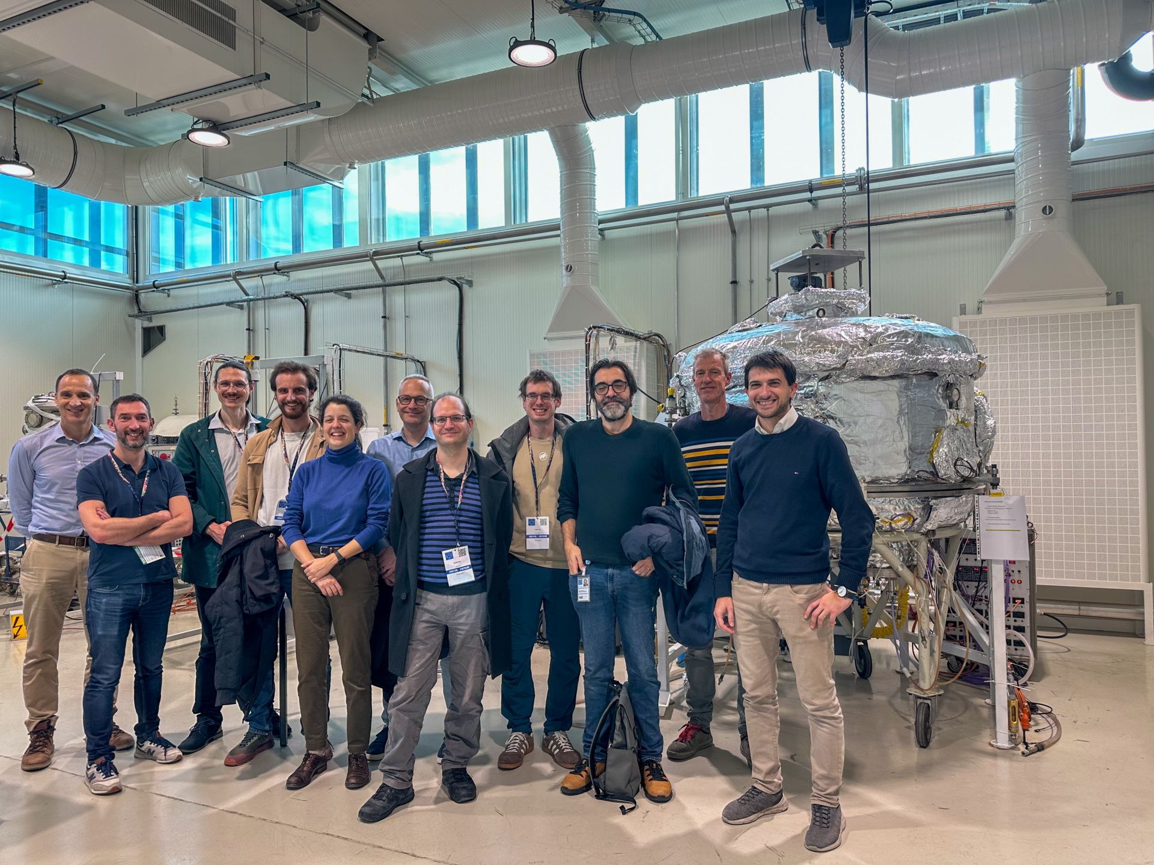

CERN’s vacuum expertise supporting companies developing quantum computers

Slide 5
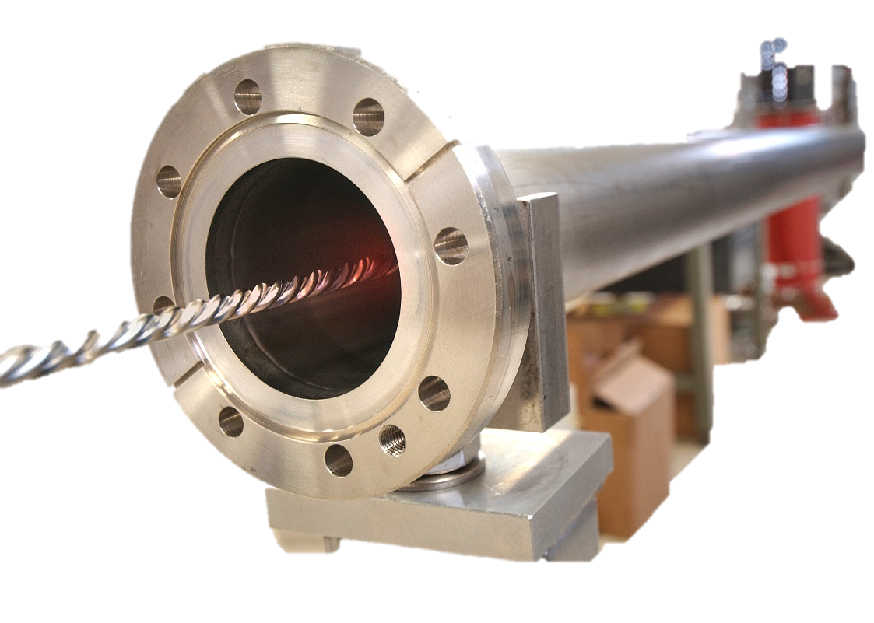
Vacuum
At CERN
With a total of 104 kilometres of piping under vacuum, the vacuum system of the LHC is among the largest in the world.
Three separate vacuum systems:
For insulating:
- the cryogenically cooled magnets
- the helium distribution line
- for the beam pipes
*In the beam pipes pressure is in the order of 10^(-10) to 10^(-11) mbar:
a vacuum almost as rarefied as that found on the surface of the Moon.
A vacuum as empty as interstellar space | CERN (home.cern)
https://home.cern/science/engineering/vacuum-empty-interstellar-space

Slide 6
Surface, Coatings and Chemistry section
TE (Technology) Department
~ 700 persons
VSC (Vacuum, Surfaces and Coatings) Group
~ 100 persons
SCC section
~ 40 persons
Plasma for acceleration
Surface Analysis / Modification
Chemical analysis
Surface Treatments (Wet)
Thin film Coatings
(PVD)

Slide 7
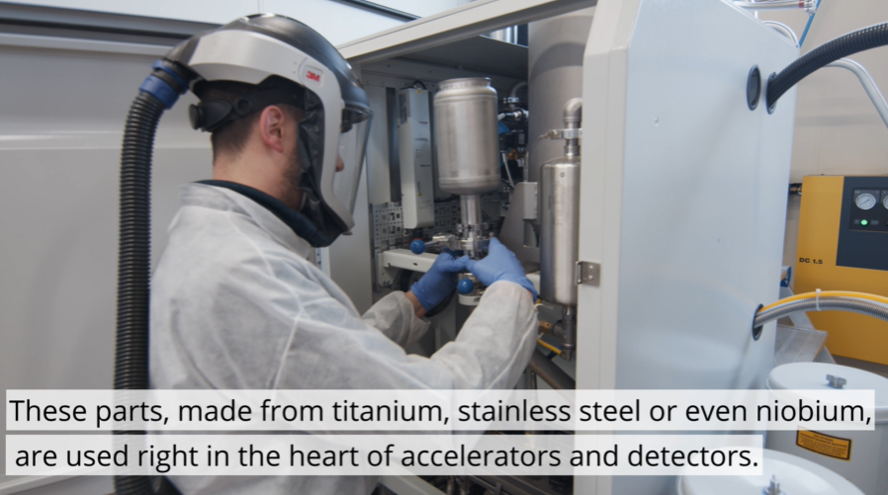
3D of Niobium
https://home.cern/news/news/engineering/additive-manufacturing-opens-new-prospects-cern

Slide 8
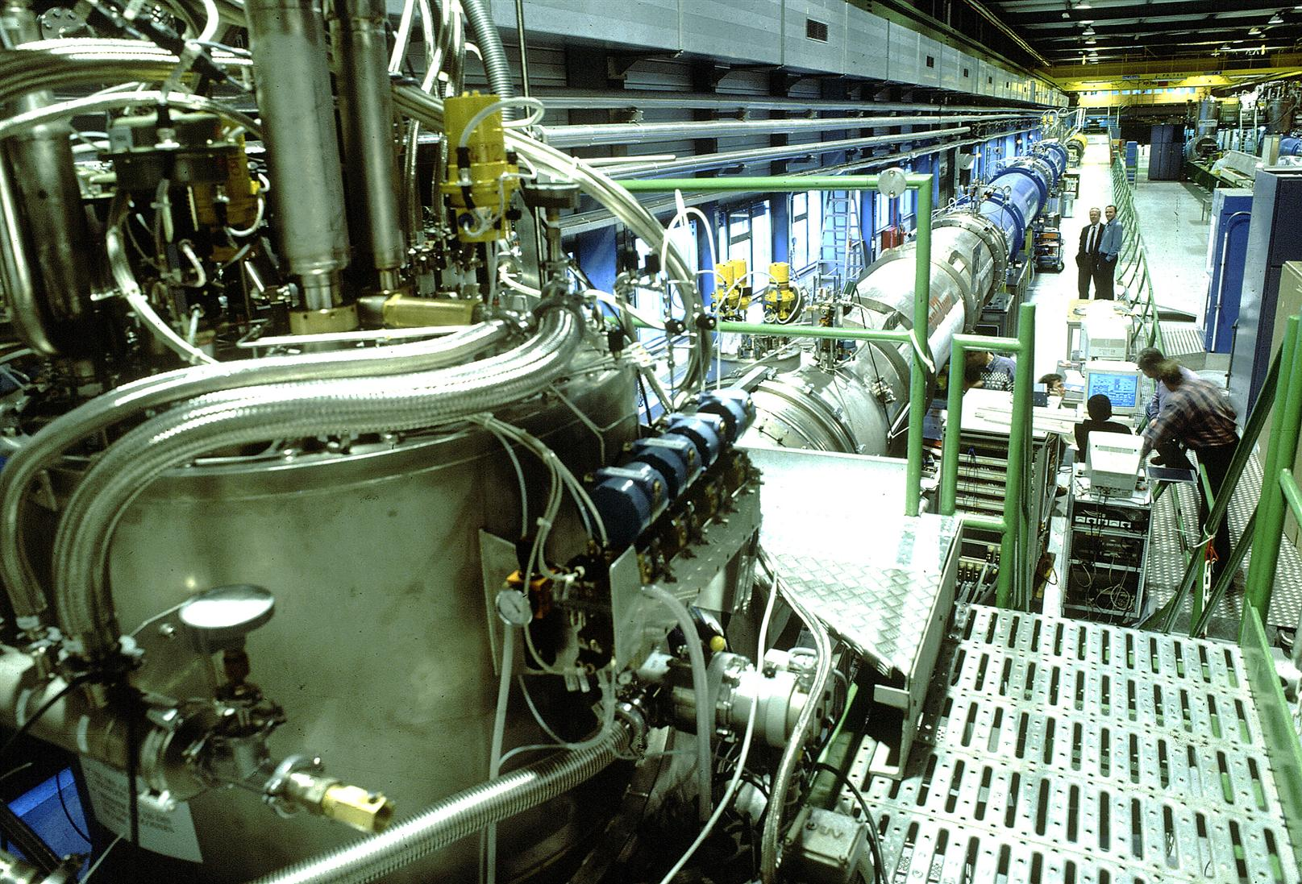
Cryogenics
At CERN
The Large Hadron Collider (LHC) is the largest cryogenic system in the world and one of the coldest places on Earth.
The LHC's main magnets operate at a temperature of 1.9 K, colder than the 2.7 K of outer space.
120 tonnes of helium to keep the magnets at 1.9 K.
https://cds.cern.ch/record/39306
Cryogenics: Low temperatures, high performance | CERN
https://home.web.cern.ch/science/engineering/cryogenics-low-temperatures-high-performance

Slide 9
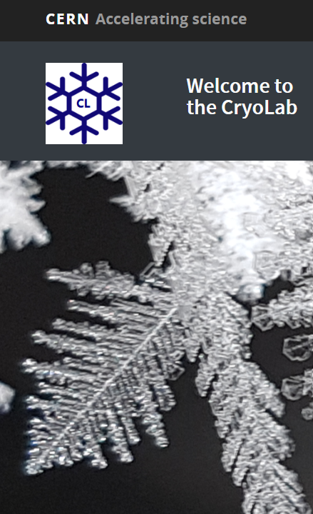
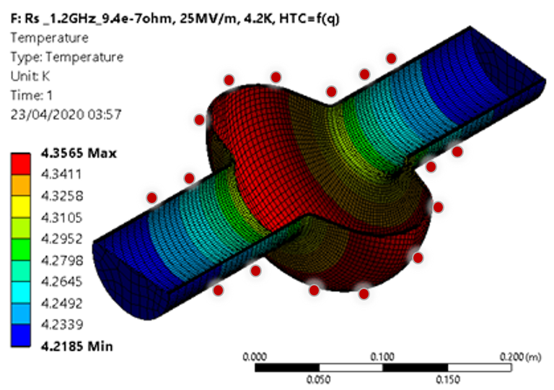





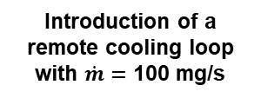
$p_{lp,out}=$ 1.3 bar
$p_{hp,in}=$ 3.7 bar
Cryocooler envelope
CFHEX 1
2-stage
GM
cryocooler
2-stage
GM
cryocooler
$≈$ 50 K
CFHEX 2
$≈$ 40 K
Introduction of a remote cooling loop with $\dot{m}=$ 100 mg/s
$≈$ 10 K
Remote envelope
8.8 K
0.4 W at 8.8 K at the 2nd stage
CFHEX 3
Boost: 0.4 W at 4.6 K at 0.7 m distance from the 2nd stage (demonstrated already) !
0.4 W @ 4.6 K
https://te-dep-crg-ci.web.cern.ch/

Slide 10
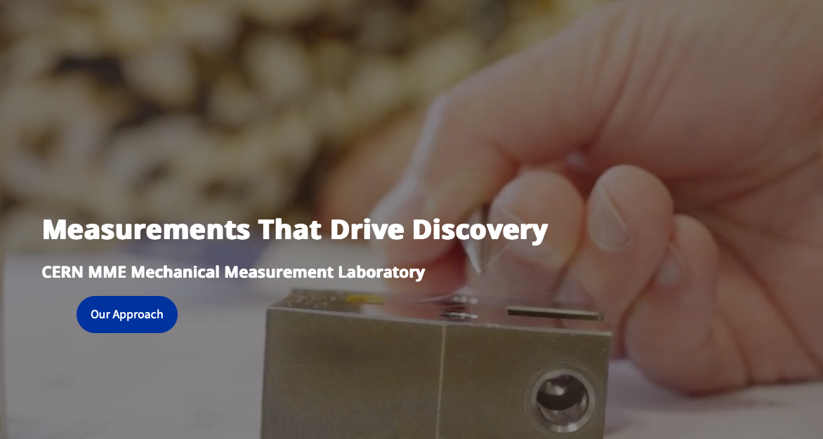
https://mechlab.web.cern.ch

Slide 11
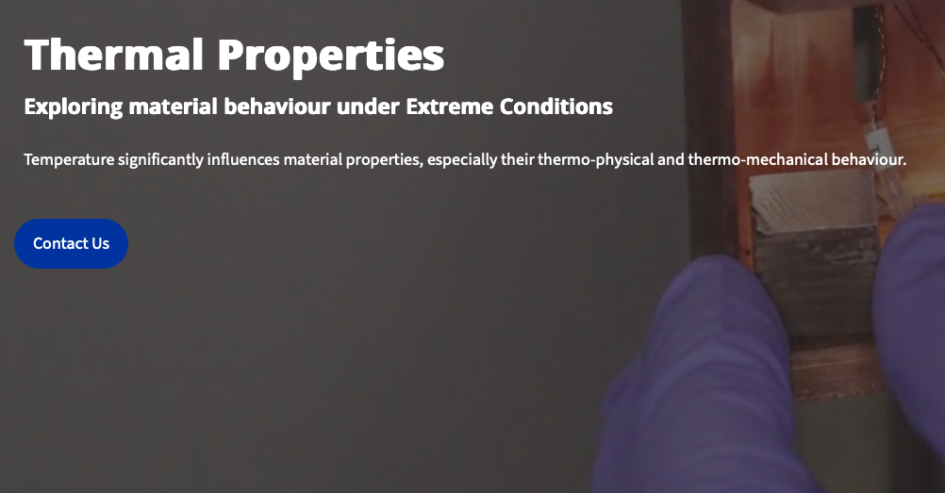
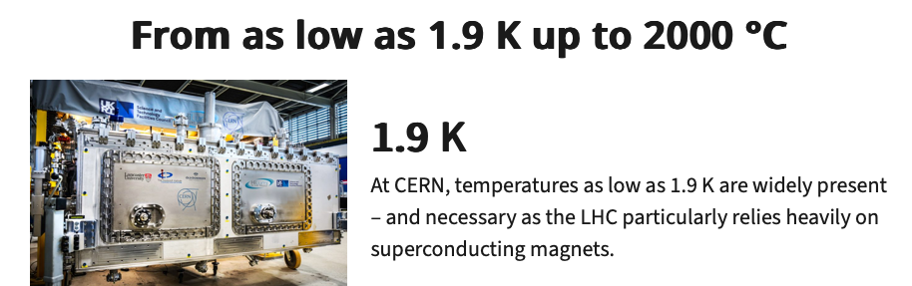
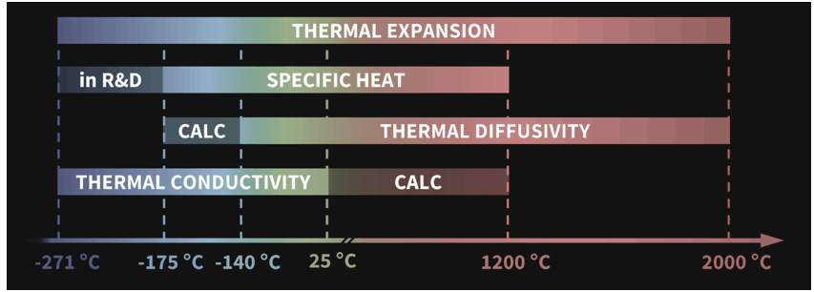

Slide 12
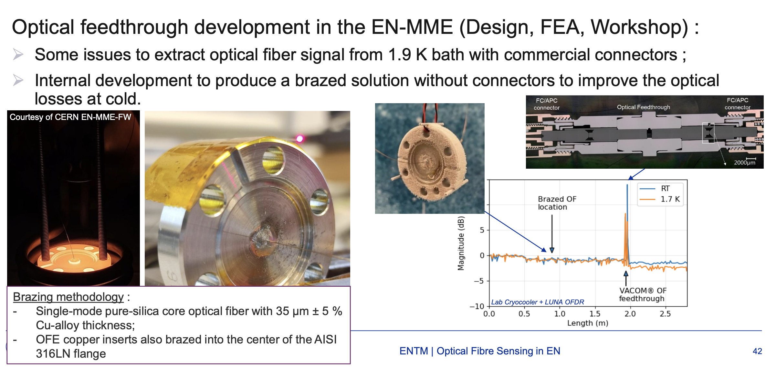
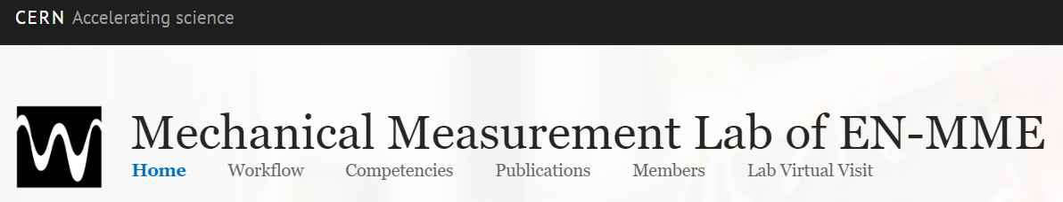
https://mechlab.web.cern.ch

Slide 13
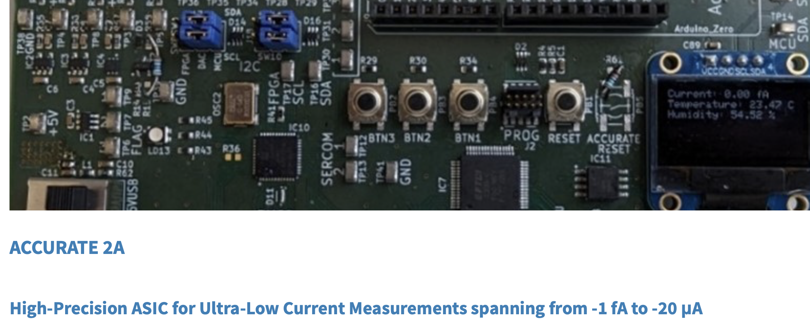
Complex radiation environment
Different chambers
Output current dynamic range
https://ventureconnect.cern/accurate-chip
> 9 decade
“An Accurate Ultra-low Current Measurement ASIC for Ionization Chamber Readout”
Kundumattathil Mohanan, Sarath (CERN)
https://cds.cern.ch/record/2809734?ln=es
Current resolution
Femtoampere
Complex input profile
Pulsed or slow changing
Design technology
Available, robust, reliable, cheap, feasible

