Slide 1

CERN VENTURE CONNECT
Deep Tech Startup Support Programme
Linn Kretzschmar
QuIC Business Community Summit

Slide 2


CERN Venture Connect
Supporting internal and external deep tech founders since 2023
At CERN
External startups
World-class talent in many technical fields with entrepreneurial ambitions.
Deeptech startups from CERN Member States seeking access to CERN technologies.
Limited entrepreneurial skills & access to network
Standard tech transfer model fails startup needs
2
Notes:
2,600+ staff and 12,000+ visiting scientists and engineers from over 110 nationalities, forming one of the world’s largest deep tech talent pools.
52% of CERN alumni transition into private sector roles—many in high-tech startups and R&D-intensive industries【source: CERN Annual Report 2023 & CERN Alumni Network

Slide 3
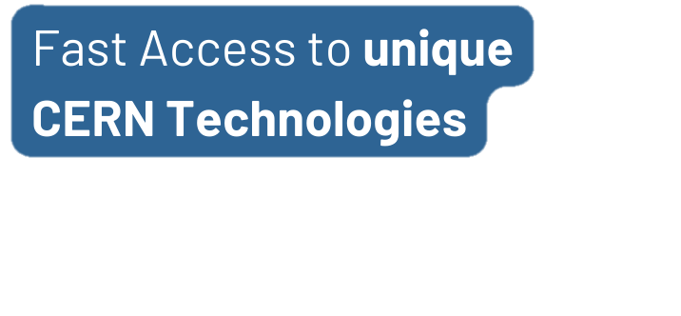
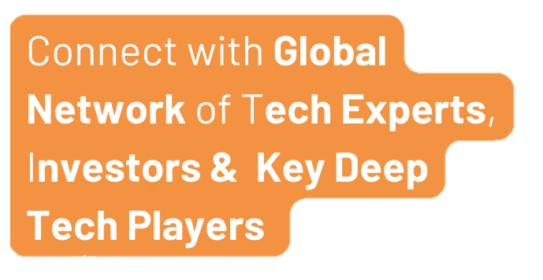

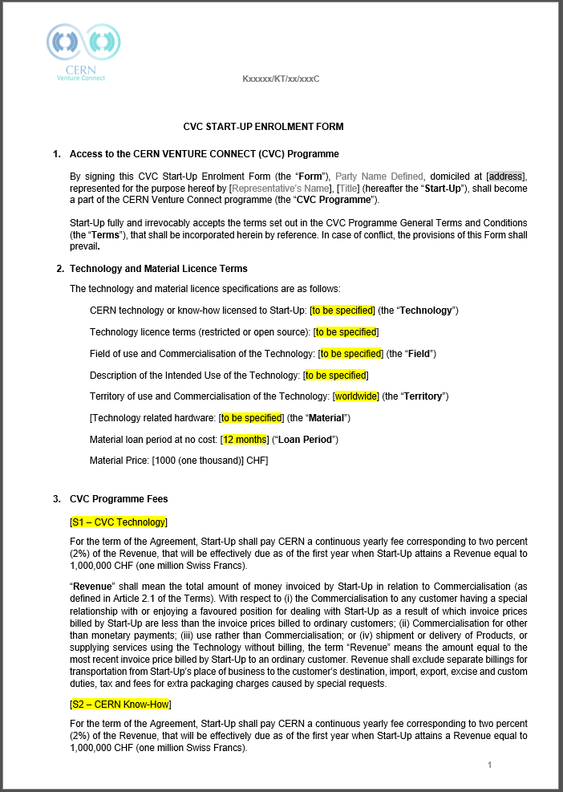
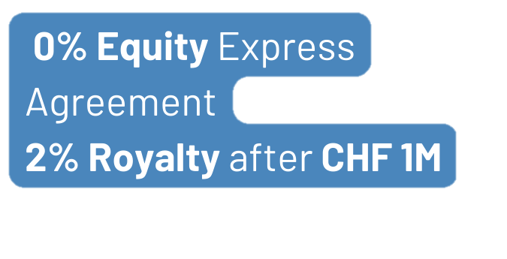
Foundations of the programme
Pillar 2
Network of established deep tech ecosystem players
Pillar 1
Preselected, high-TRL tech and expert support
Reduced in-house R&D through top-tier tech + support
Stronger product USP
International visibility
Direct access to deep tech ecosystem & expertise
QuIC Business Community Summit

Slide 4
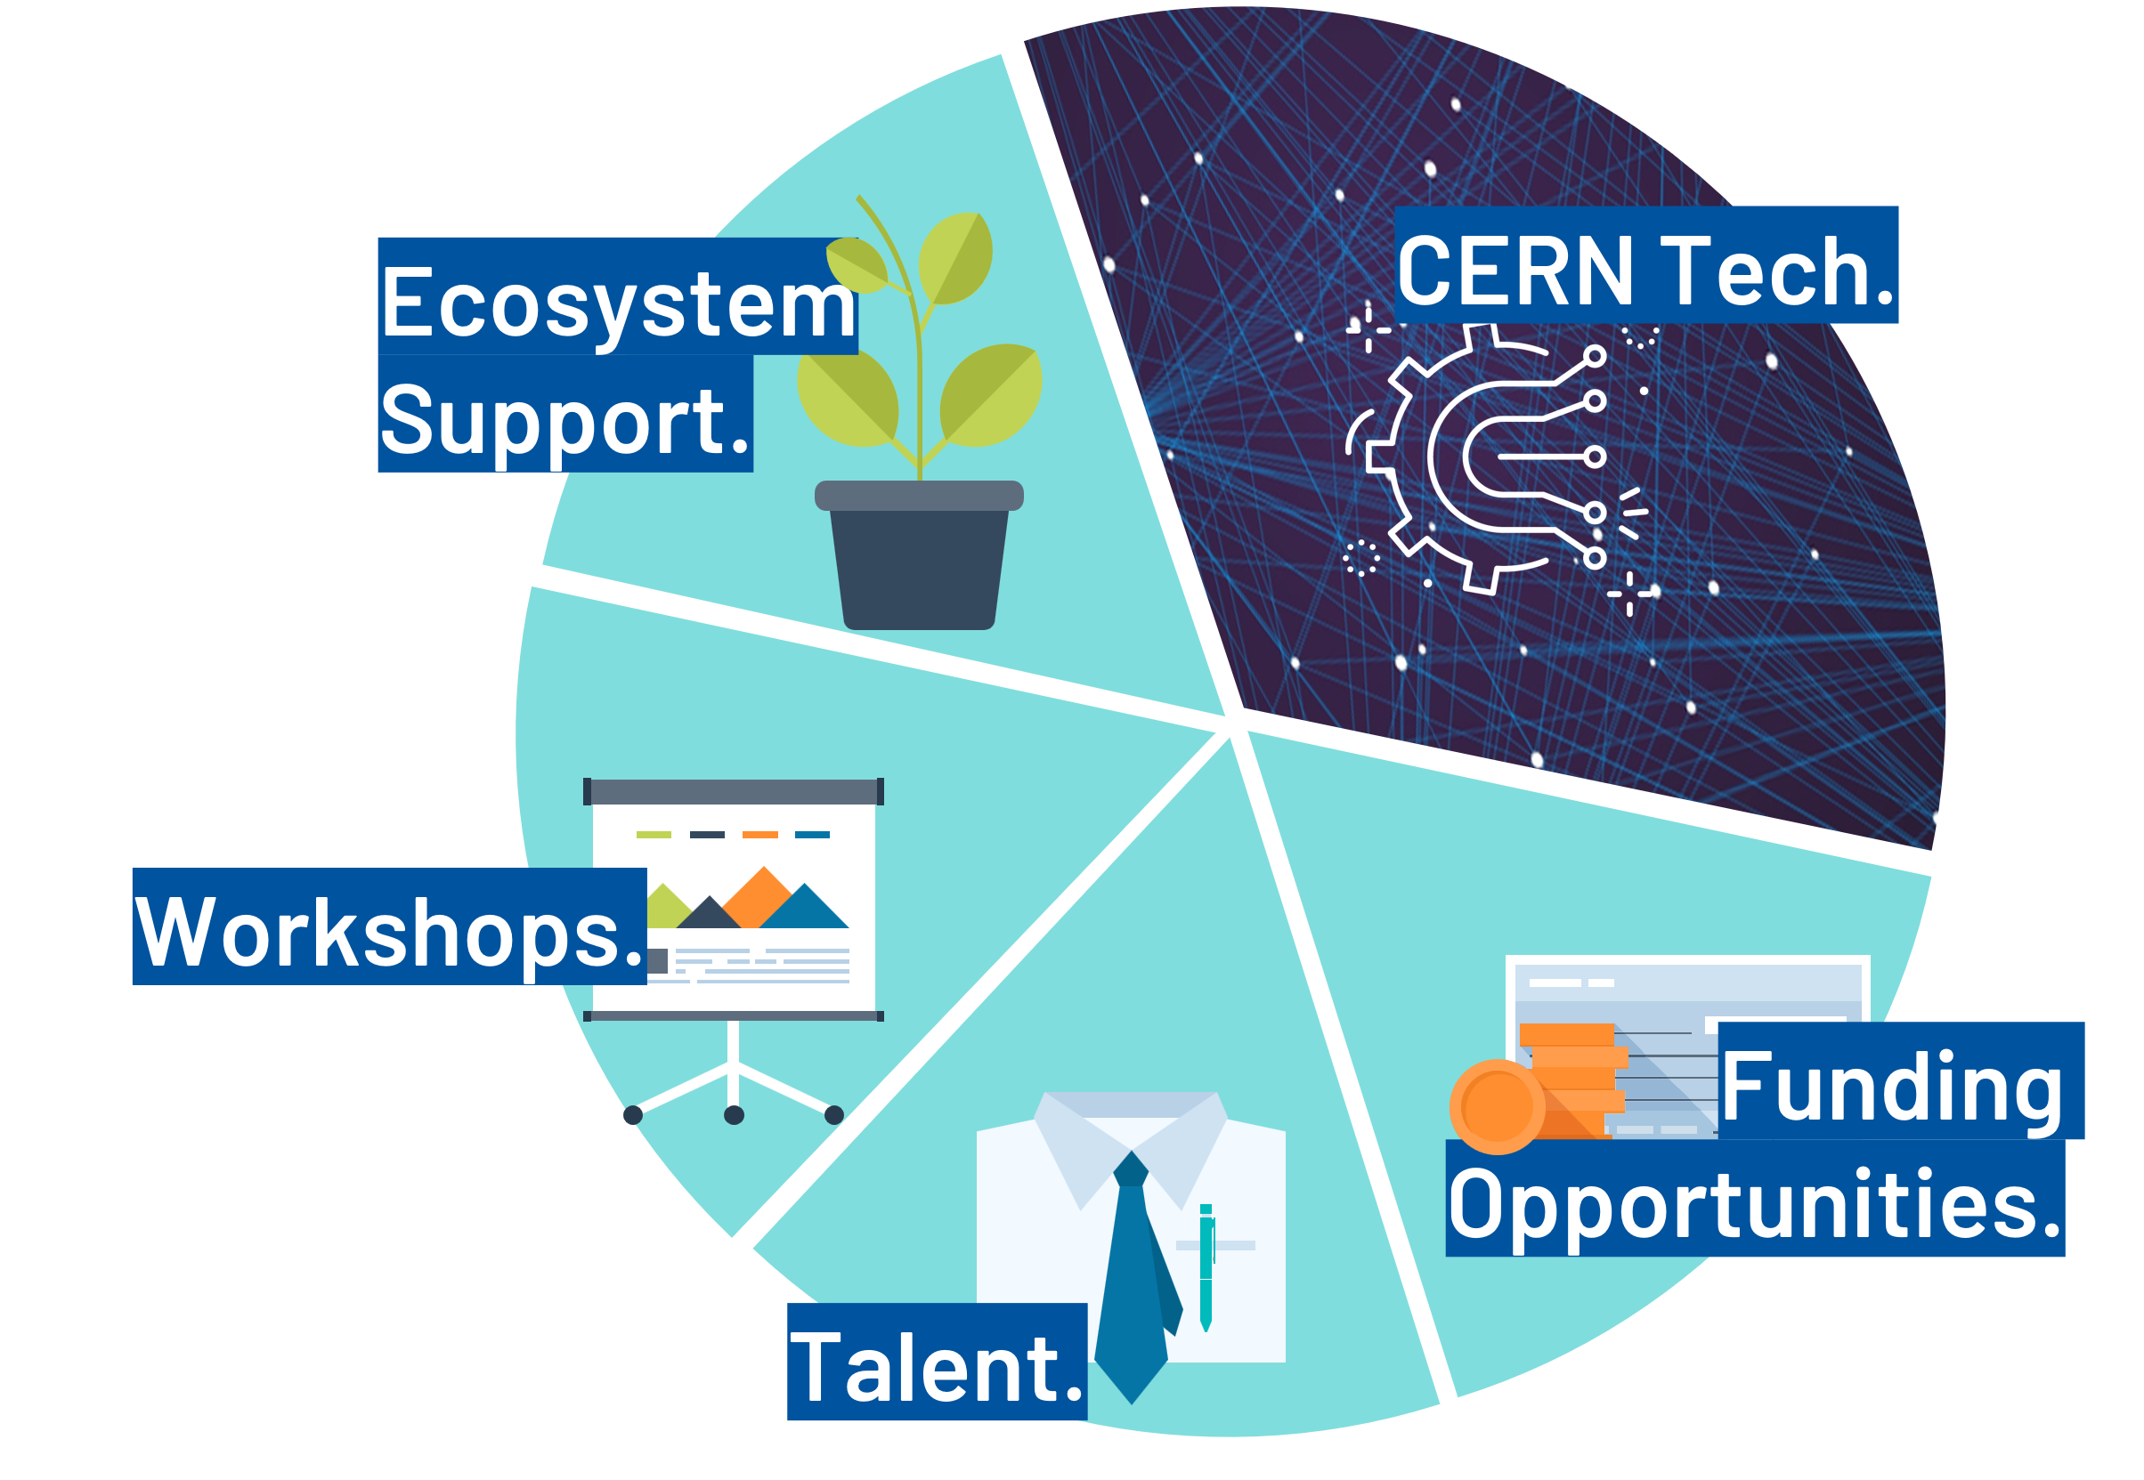
CVC Offering
Engage with our deep tech community & expand your professional network.
Receive a license for CERN’s cutting-edge tech & unlock expert support.
Participate in expert-led workshops tailored to enhance skills.
Connecting with the next investor among our network of 20+ deep tech VCs.
Leverage the CERN Alumni pool to recruit top-tier talent for the team.
QuIC Business Community Summit
Notes:
2,600+ staff and 12,000+ visiting scientists and engineers from over 110 nationalities, forming one of the world’s largest deep tech talent pools.
52% of CERN alumni transition into private sector roles—many in high-tech startups and R&D-intensive industries【source: CERN Annual Report 2023 & CERN Alumni Network

Slide 5


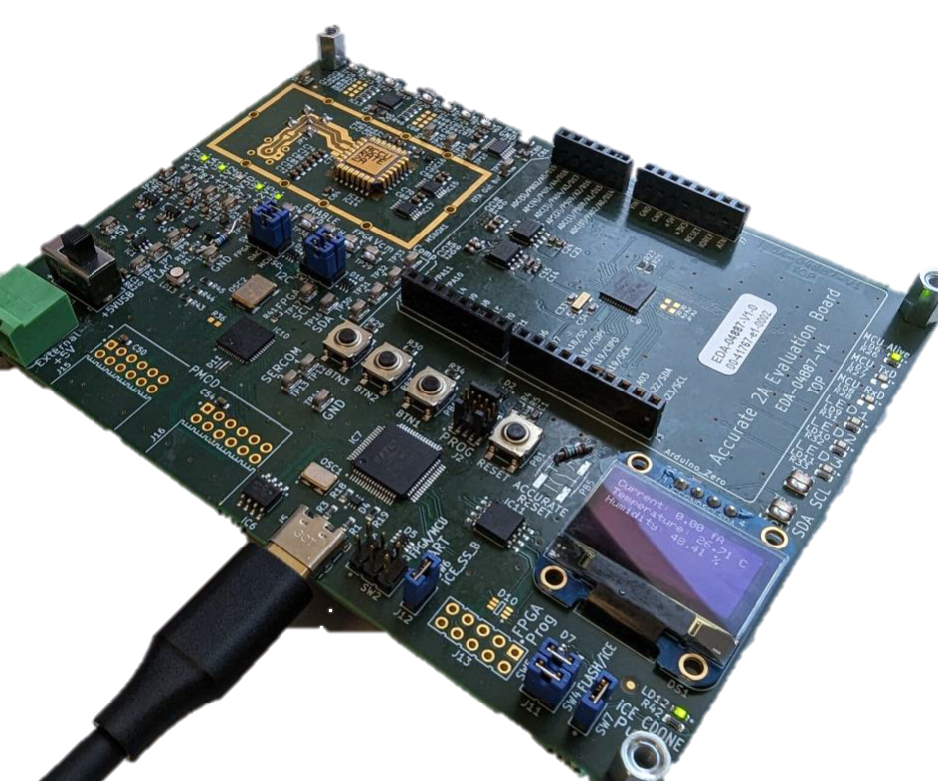



Technology Portfolio
Seven pioneering technologies ready to use
ACCURATE 2A
Structured Laser
Beam
Single Frequency
Laser
AstroMesh
High-Precision ASIC measuring current at femtoampere levels
Satellite mesh networking with radiation monitoring
Collimation system for focused laser beams
Ultra-narrow, multi-wavelength laser system
White Rabbit
Rucio
Ultralight Carbon
Coldplate
Tech
Prototypes
Sub-nano second time synchronization
Management of very large, distributed datasets
Lightweight thermal management
Readily available
for testing
QuIC Business Community Summit

Slide 6
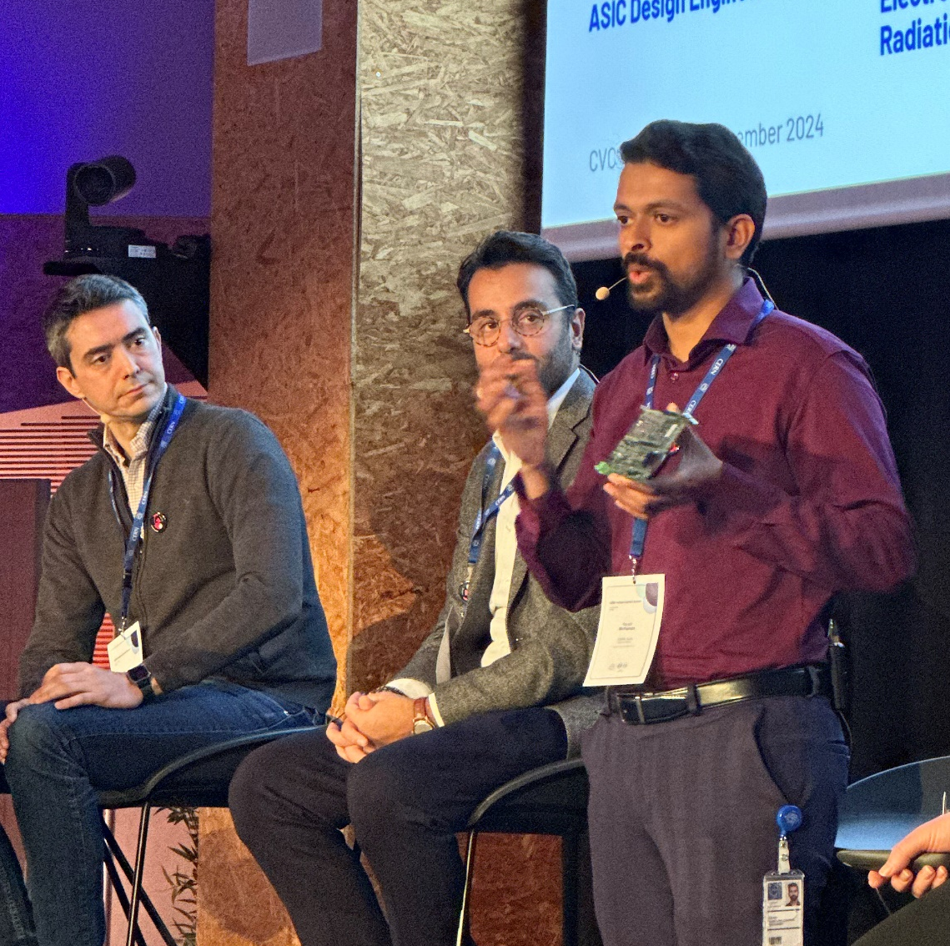
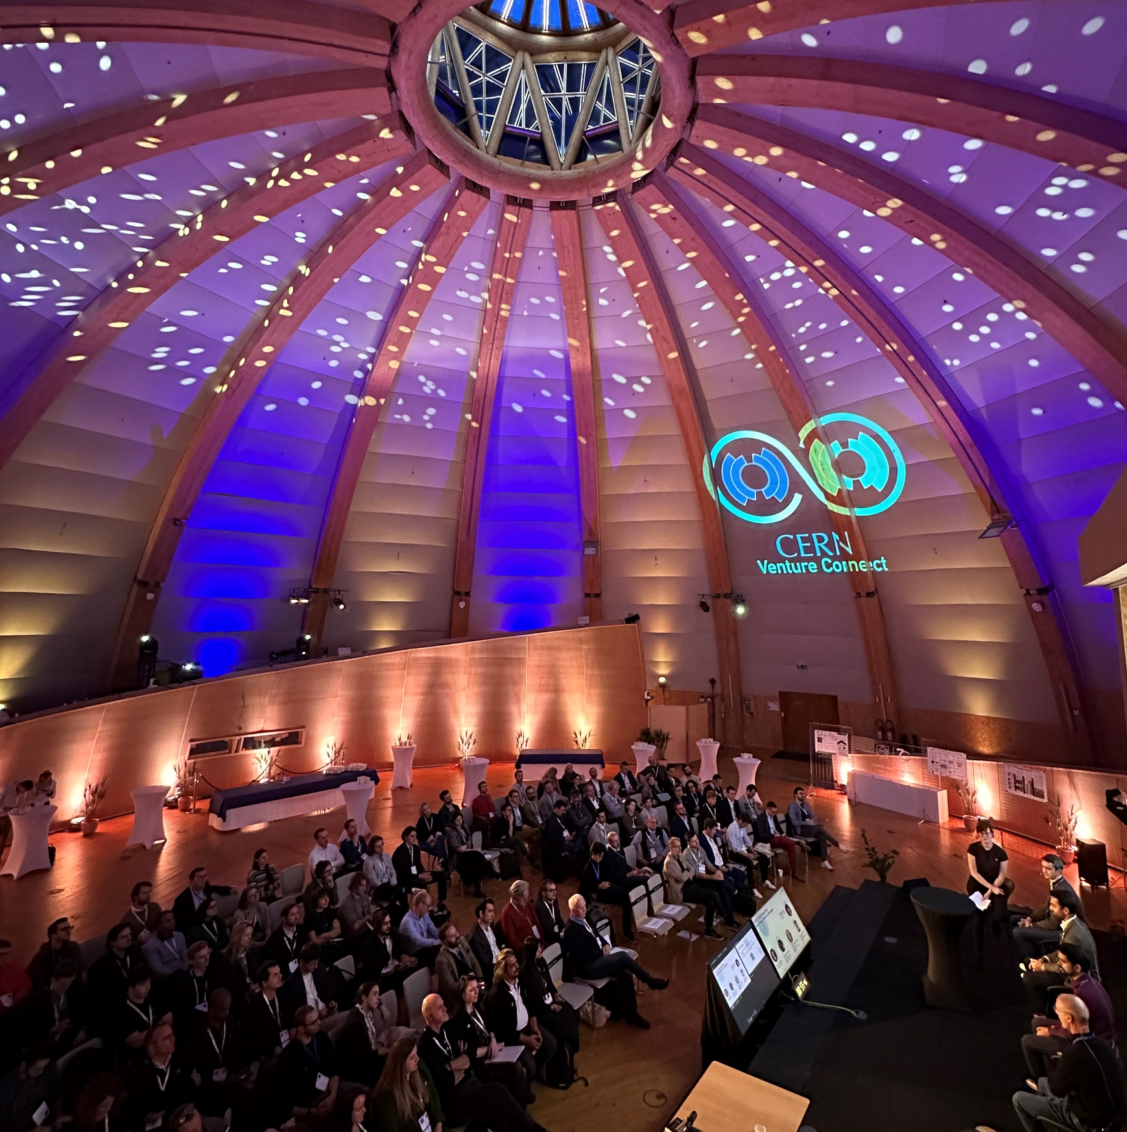
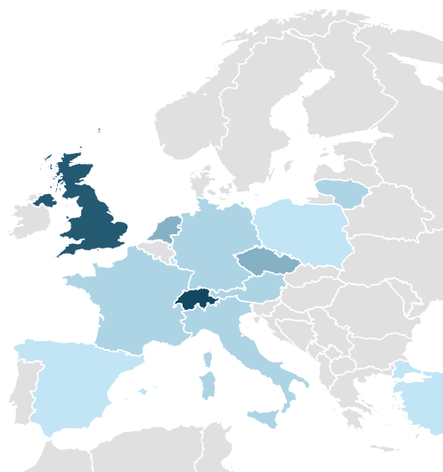
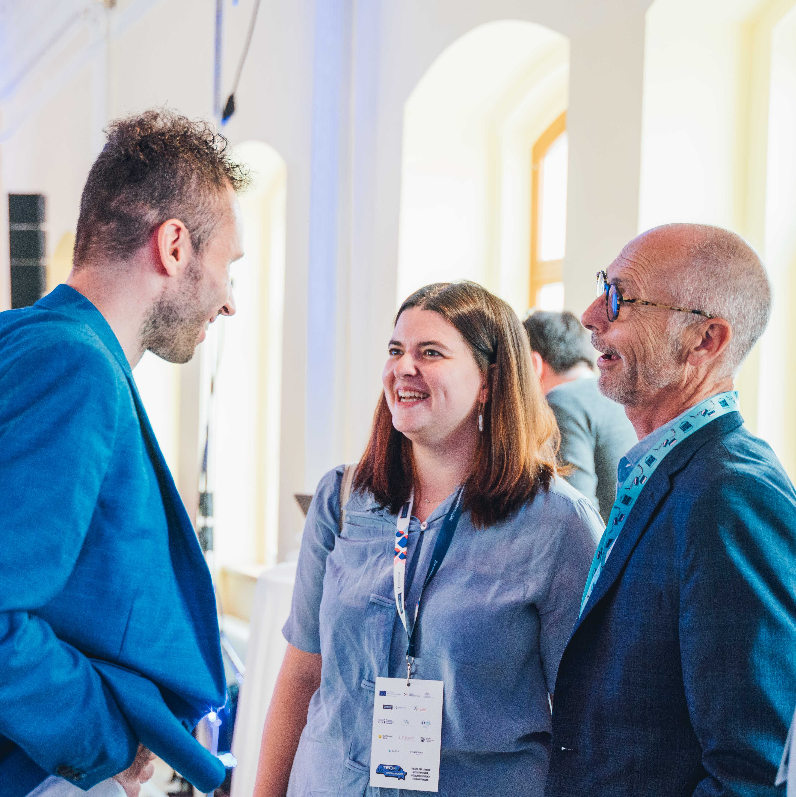





















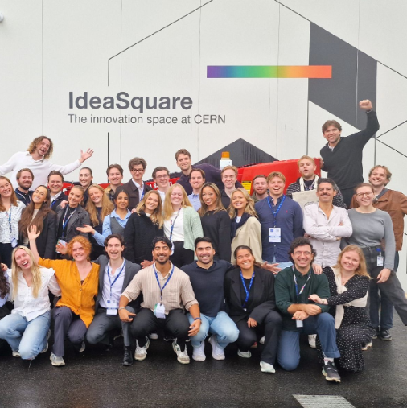



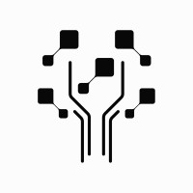















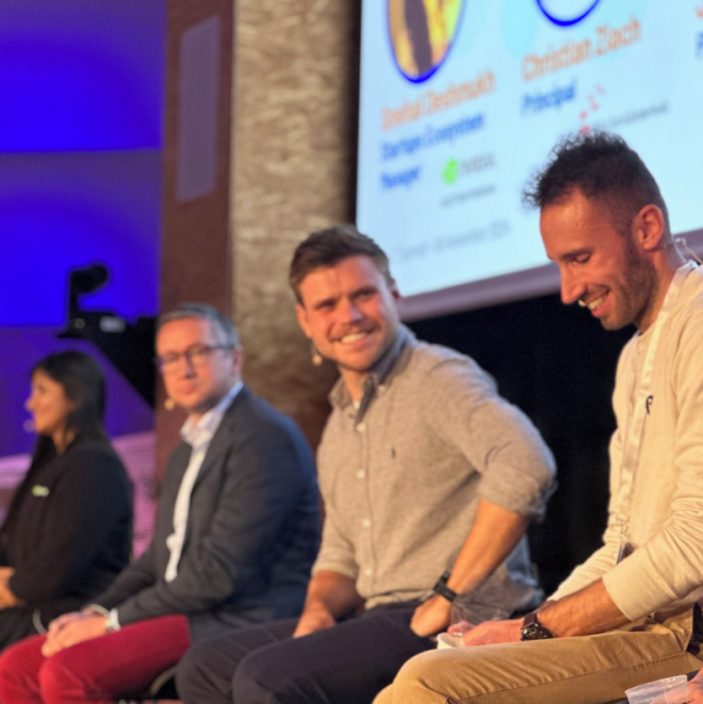














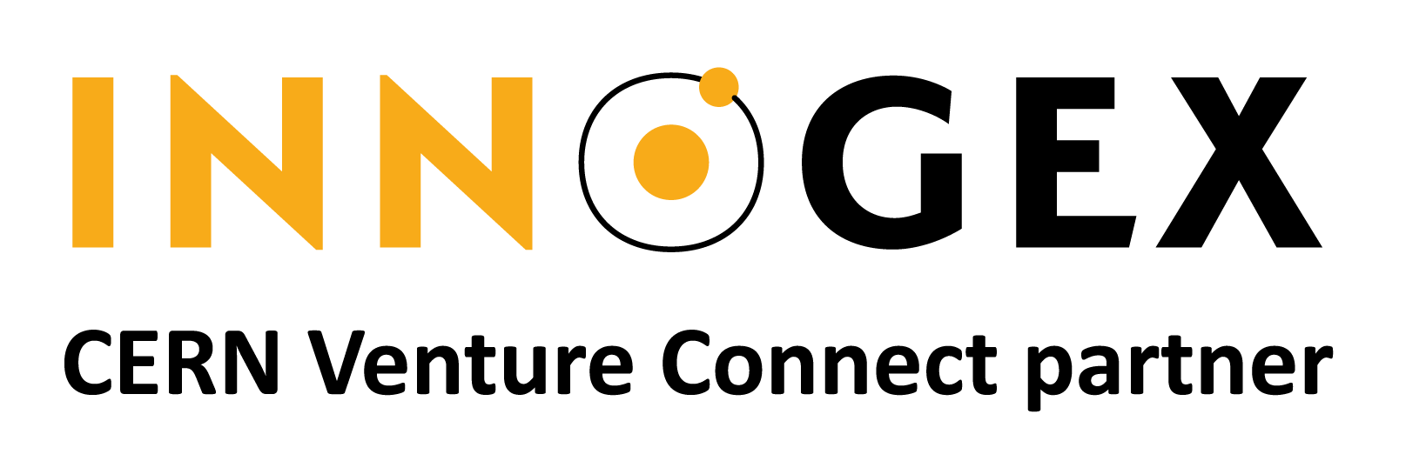



CVC Community.
Benefit from our regular networking events
Join us and connect with our 57 partners globally. Whether you look for funding, lab space, legal advice, your first customers or industry expertise, our network has got you covered.
Venture Capitalists & Funding
Support & Development
Hubs & Legal advice
6

Slide 7











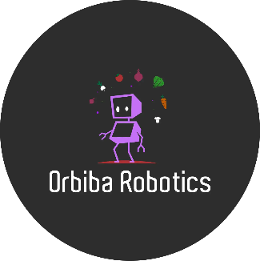



CVC Startups
CERN alumni
External
QuIC Business Community Summit
7

Slide 8
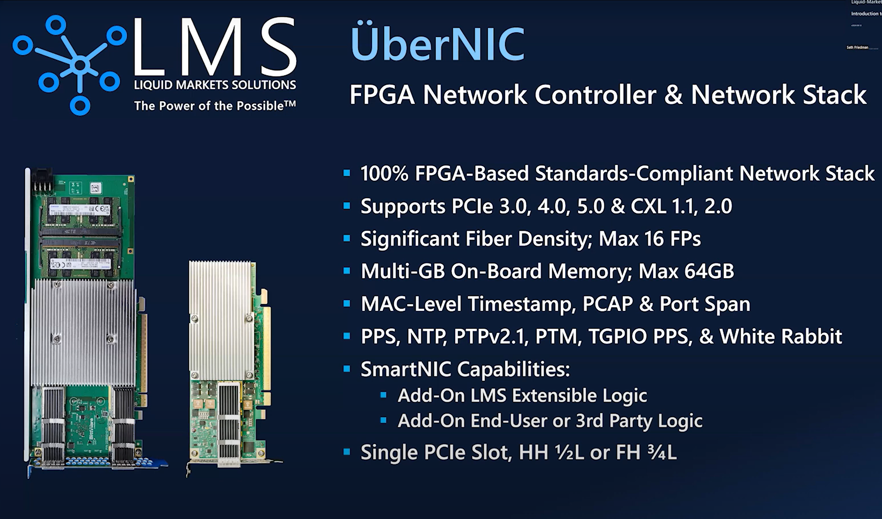

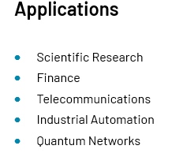
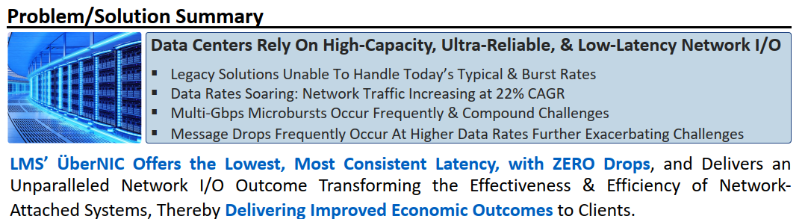

White Rabbit
Ultra-Precise Time Synchronization for Complex Systems
8

Slide 9

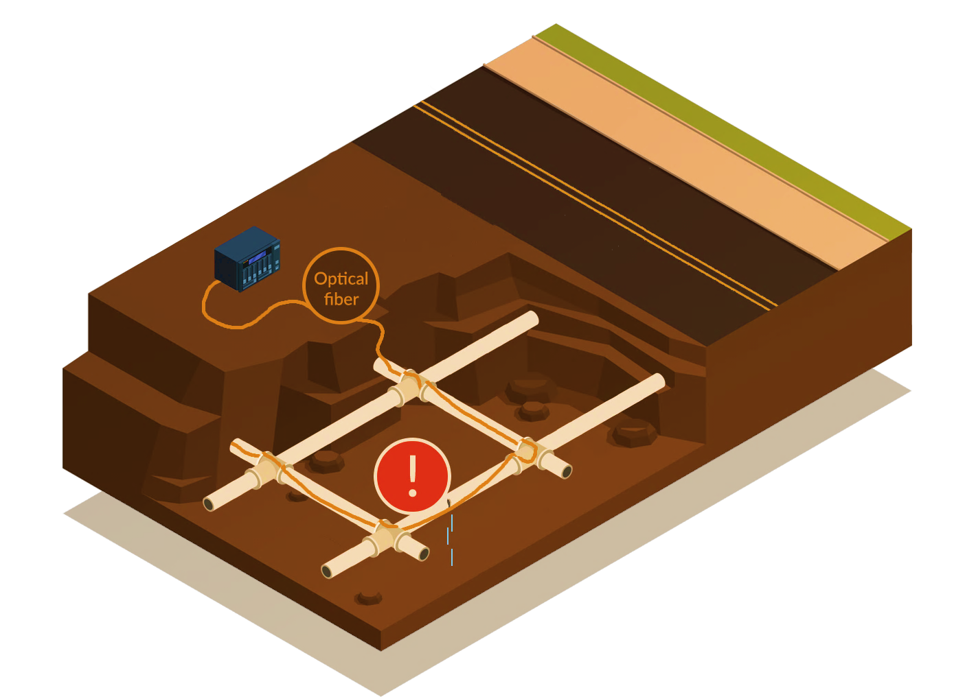
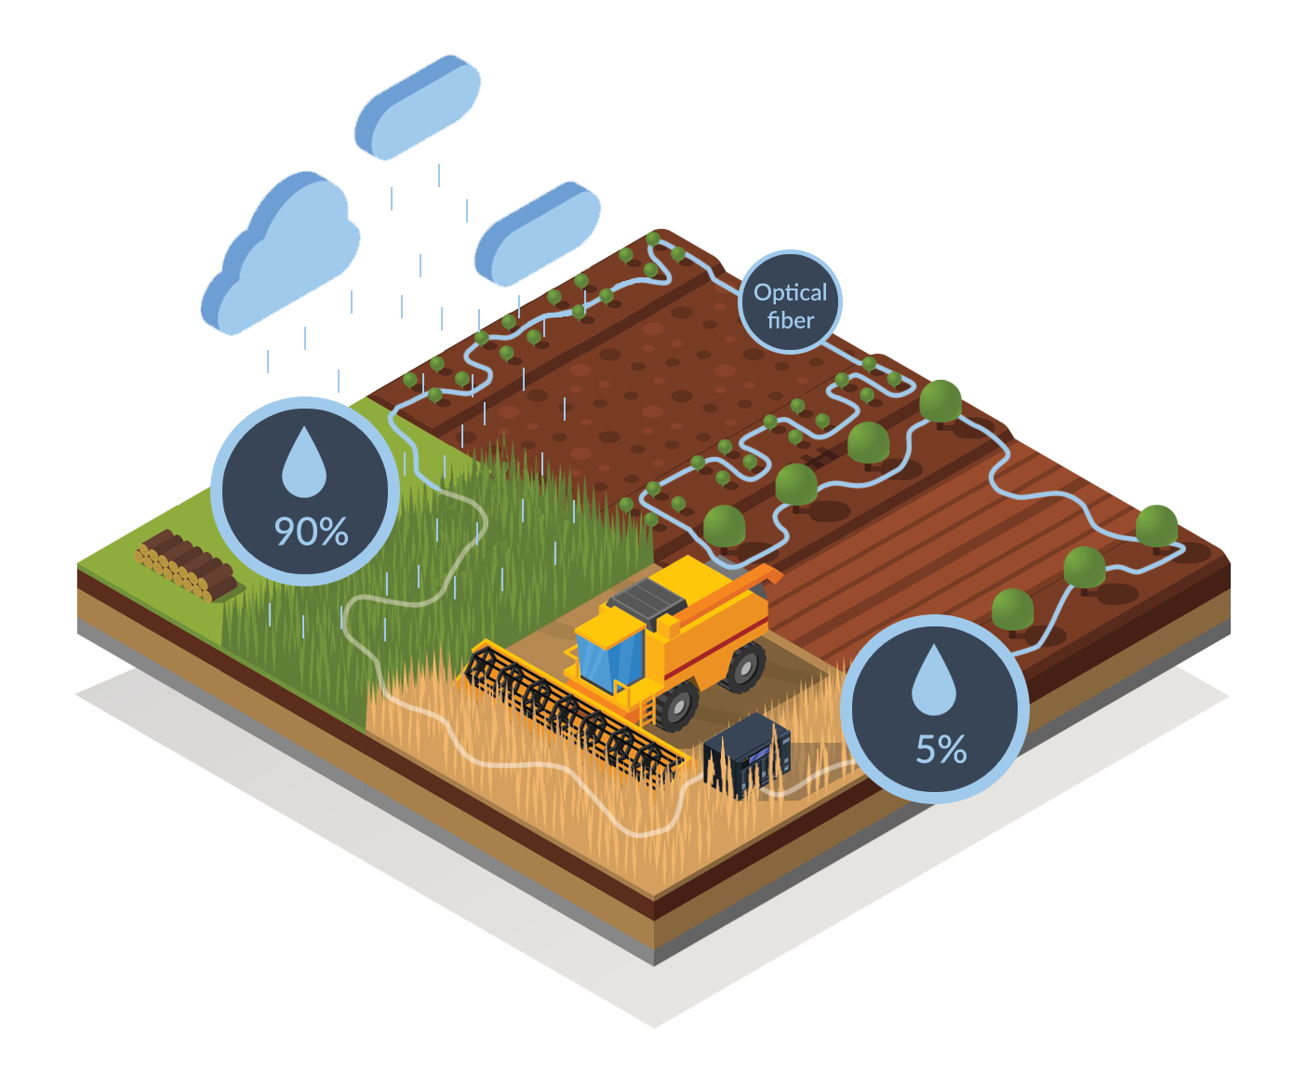
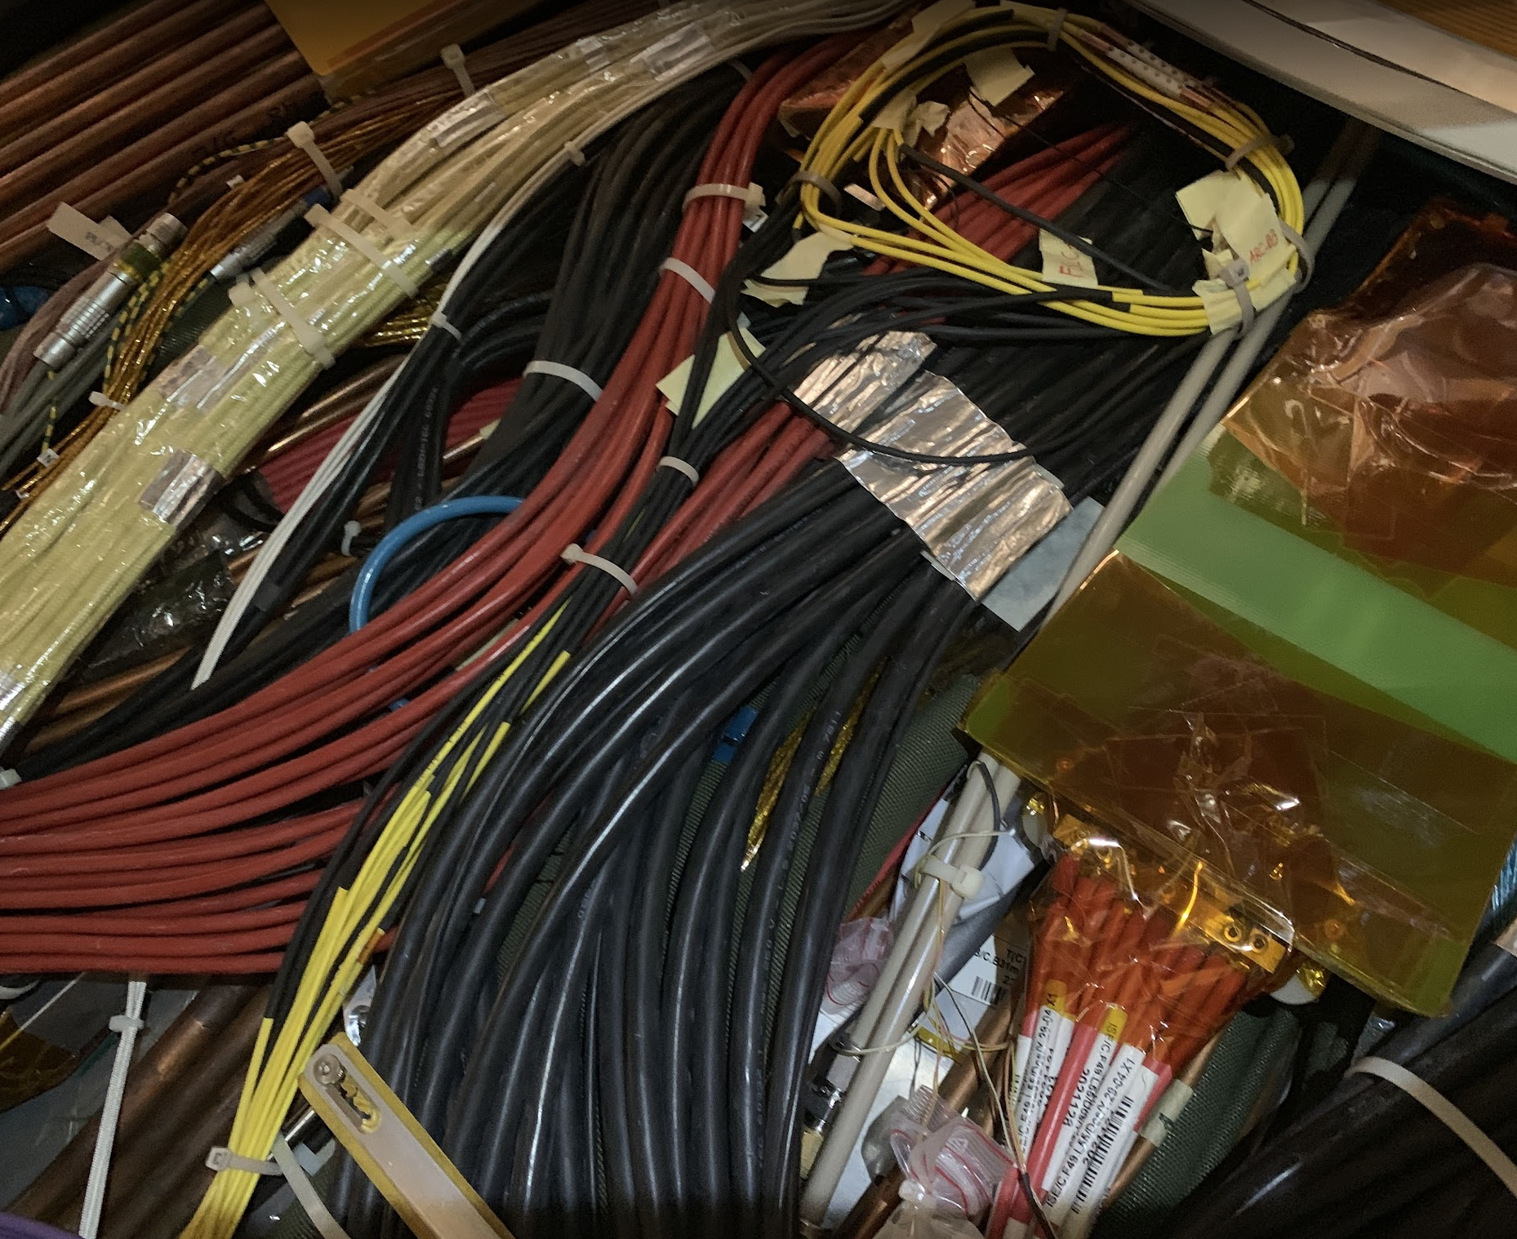
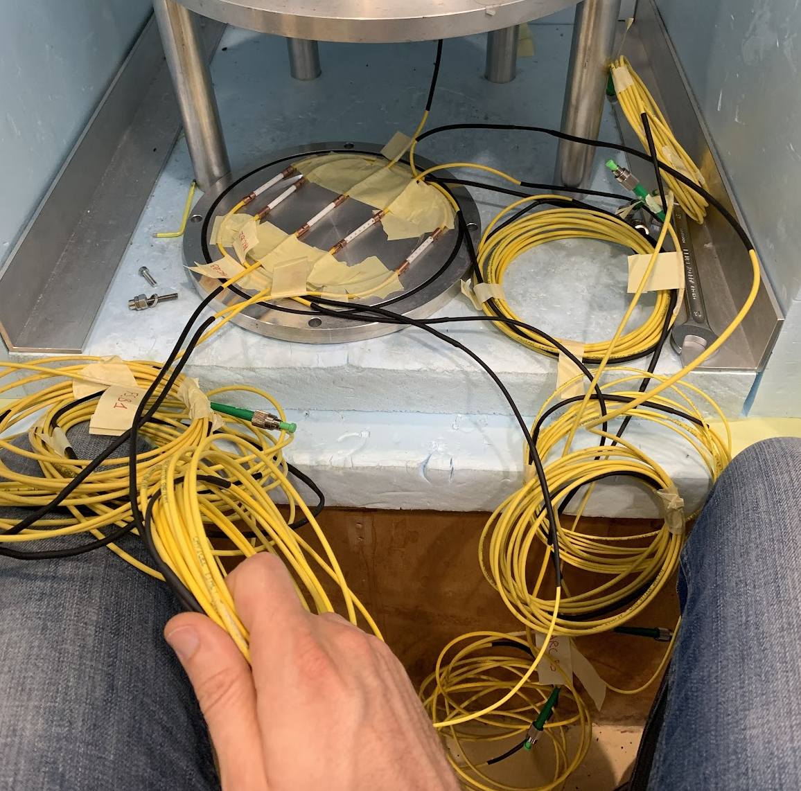
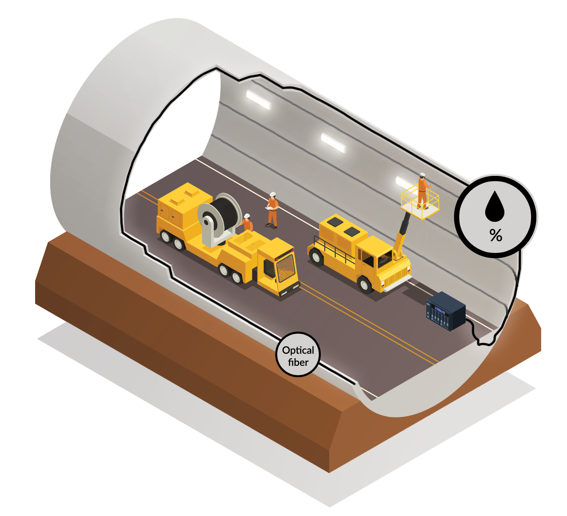
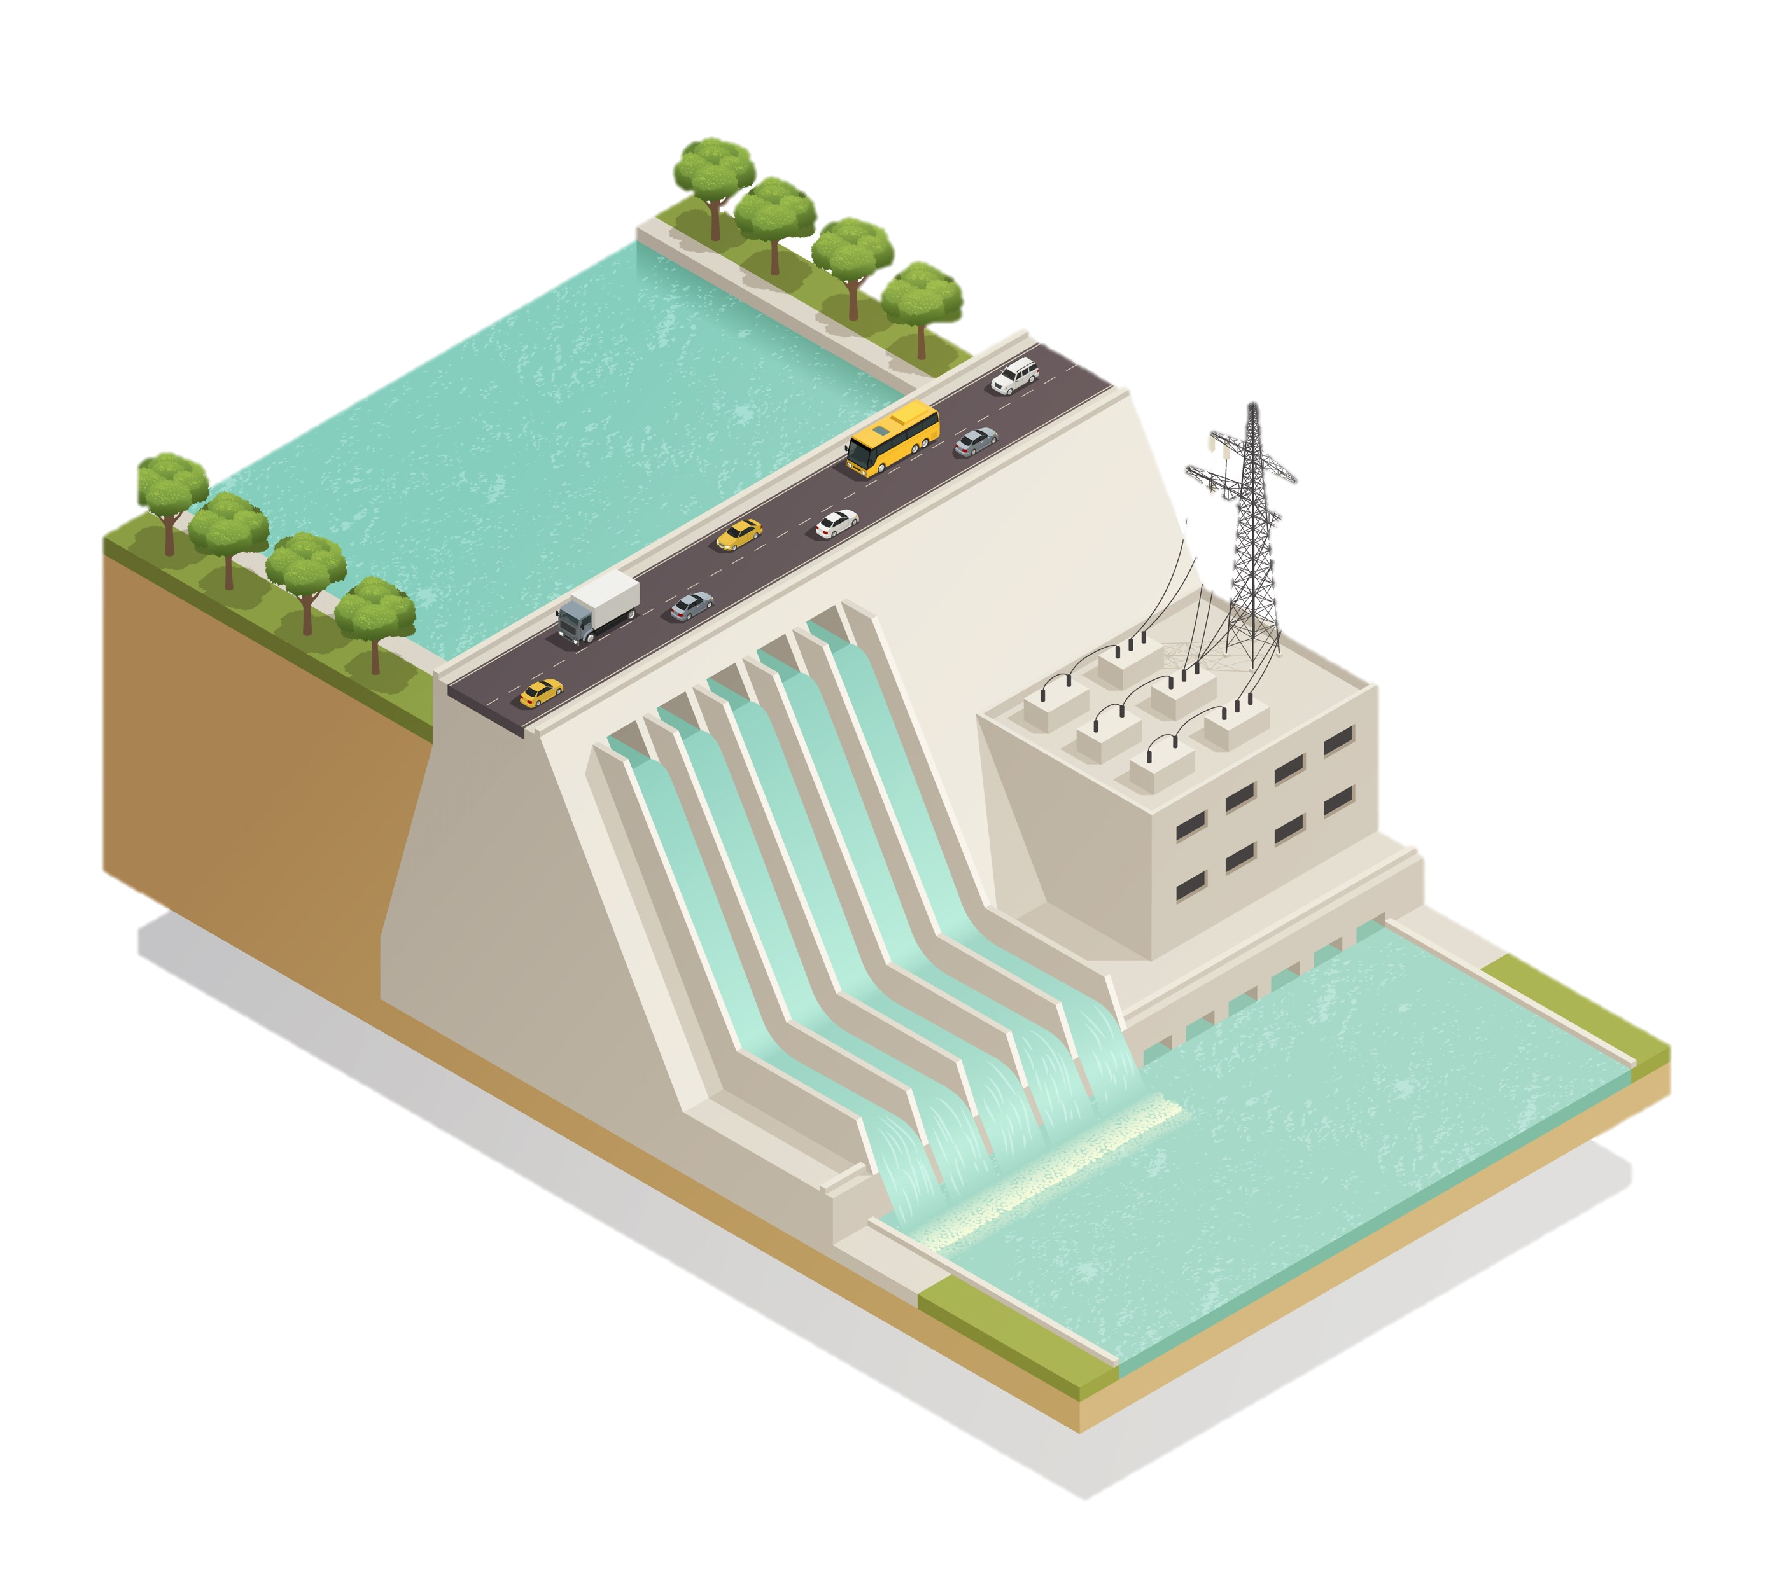
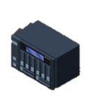
Fiber Optic Sensors for Temperature & Humidity
Water leaks
Real time Detection
Soil monitoring
Optimal Irrigation
Concrete curing
Water needs
Structural analysis
Radiation-hard, long-distance, ultra-high precision sensing
Infiltrations
Pictures courtesy of Fibersight
QuIC Business Community Summit

Slide 10
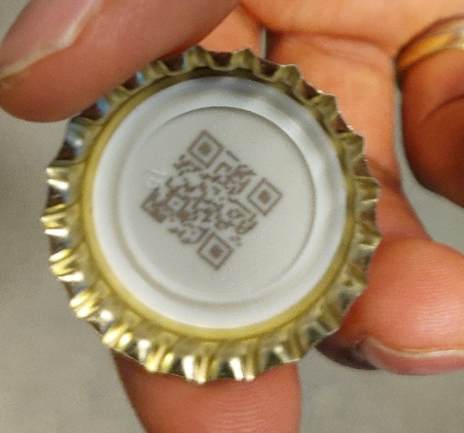
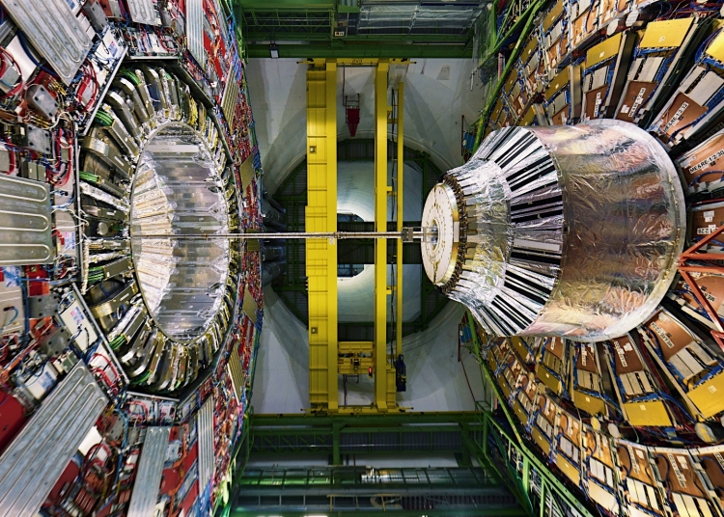
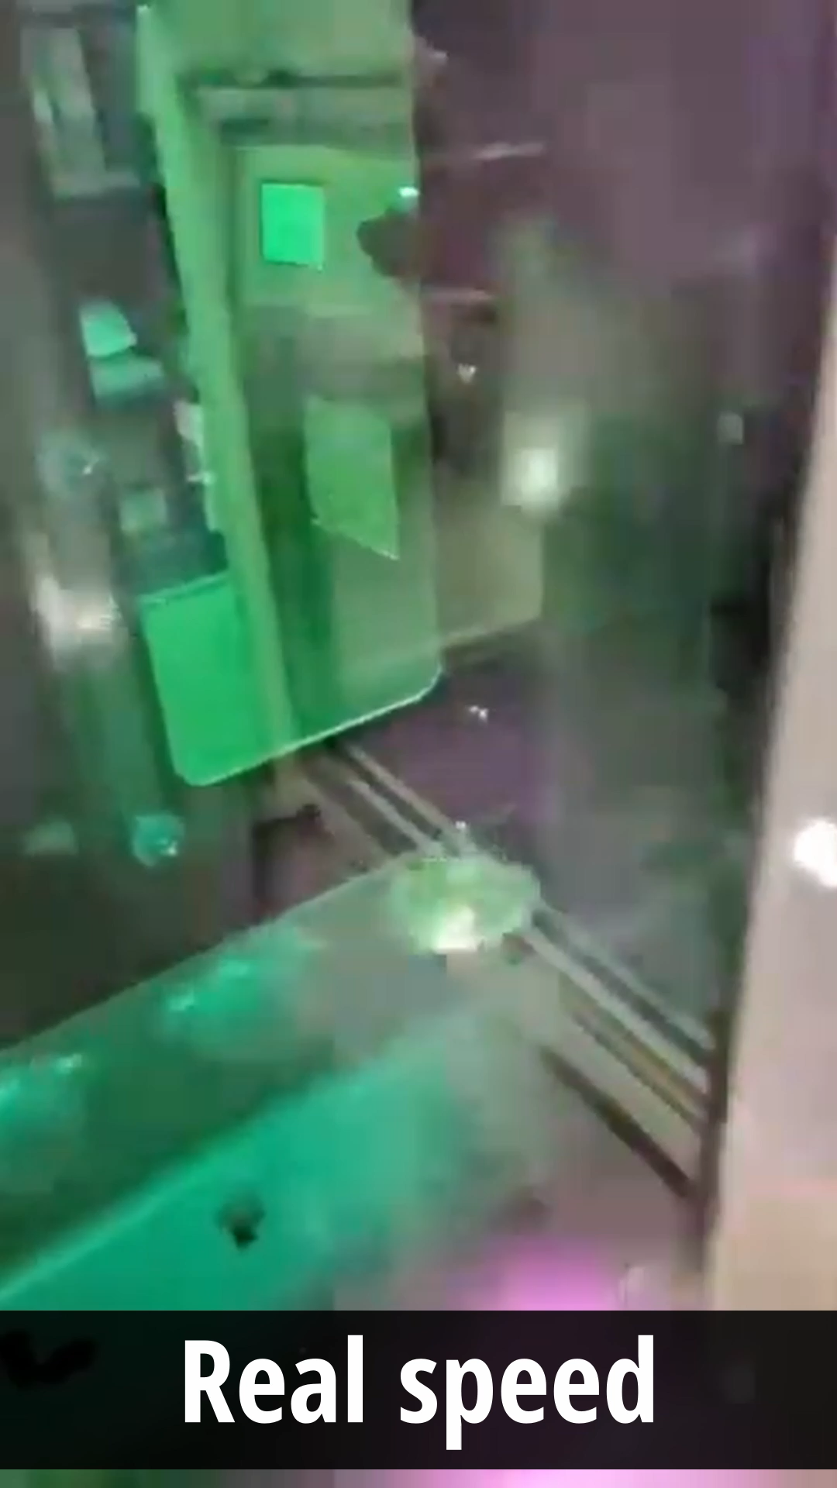
High-Speed Laser Marking of Consumer Goods
Alignment of heavy objects with 0.1 mm precision
Pictures courtesy of Inphocal
QuIC Business Community Summit

Slide 11

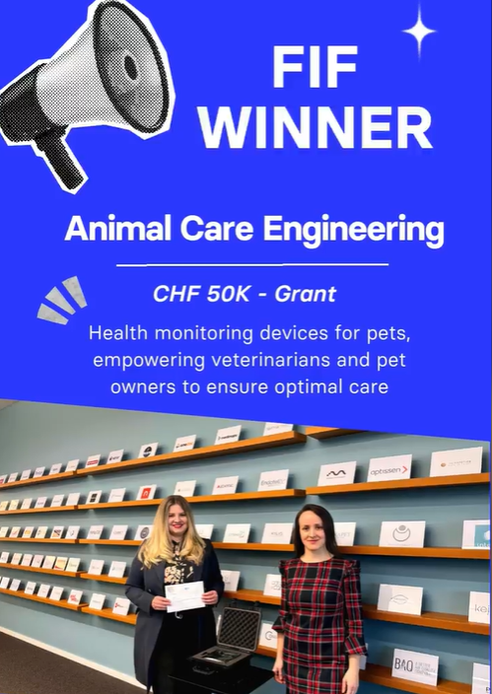
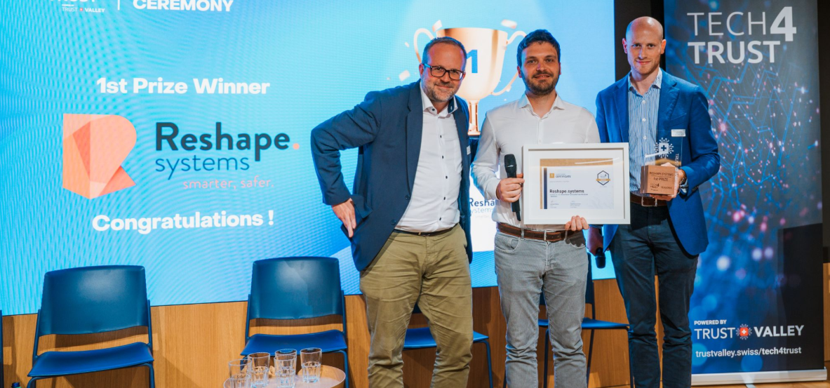









2025 Achievements
8 new startups from 7 countries
Achieved milestones
Patents filed & granted
First paying customers
Significant revenue growth
Launch of new product
New strategic partnership
+32% growth
(+15 Headcount*)
€5 Million
of funding accumulated*
* incl. 2 CERN Alumni
* incl. €1.6 M via CVC network
QuIC Business Community Summit
Notes:
2,600+ staff and 12,000+ visiting scientists and engineers from over 110 nationalities, forming one of the world’s largest deep tech talent pools.
52% of CERN alumni transition into private sector roles—many in high-tech startups and R&D-intensive industries【source: CERN Annual Report 2023 & CERN Alumni Network

Slide 12
Our Terms And Conditions.
No-fuss express agreement with founder-friendly terms
2%
PROGRAMME FEE p.a.
on revenue generated with CERN Tech applicable after exceeding CHF 1 million in annual sales.
Equity-free, non-exclusive worldwide license to commercialize the tech for 10 years
Exclusive access to technical support, resources, and activities to network and gain visibility
Official endorsement from CERN (use of CVC Logo)
Possibility for material transfer (where applicable)
QuIC Business Community Summit

Slide 13






How To Join
Straight-forward selection process
Apply via ventureconnect.cern
Introductory Meeting
CERN Technology Matching
CERN Tech
Expert Consultation
Feasibility Assessment with CVC Prototype
Contract Signing
Eligibility Criteria
Deep tech startups, scaleups or entrepreneurs that are
based in one of CERN’s member states or associated member states*
driven by a passionate team with an ambitious vision
CERN alumni or looking to leverage CERN technology to gain a competitive edge
operating in non-military and non-defense-related industries
No Deadlines
Applications considered
on a rolling basis
* List of CERN Member States
QuIC Business Community Summit

Slide 14
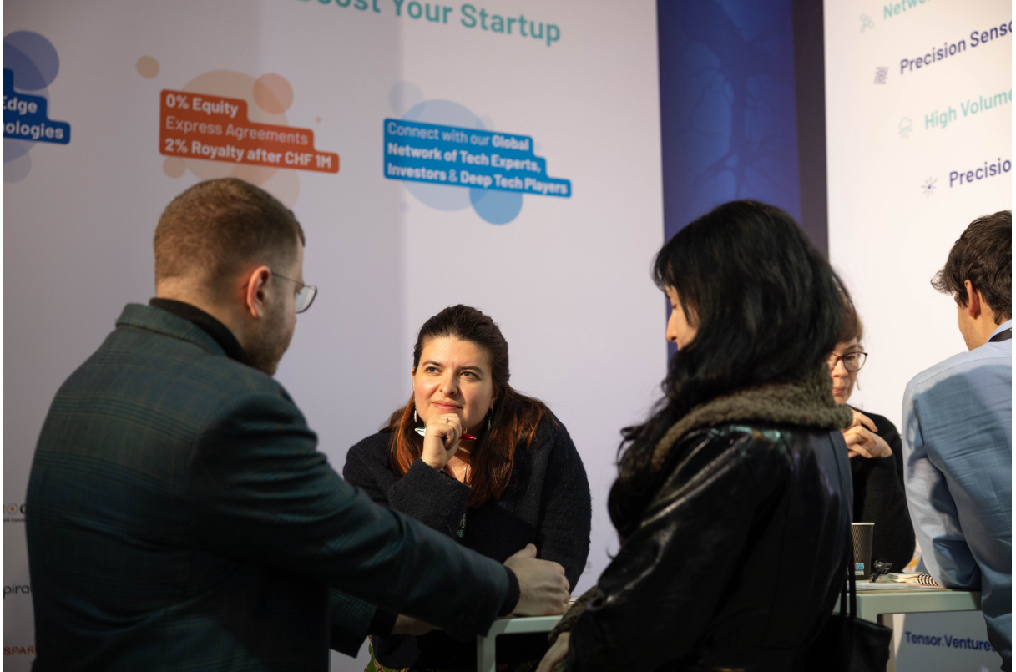
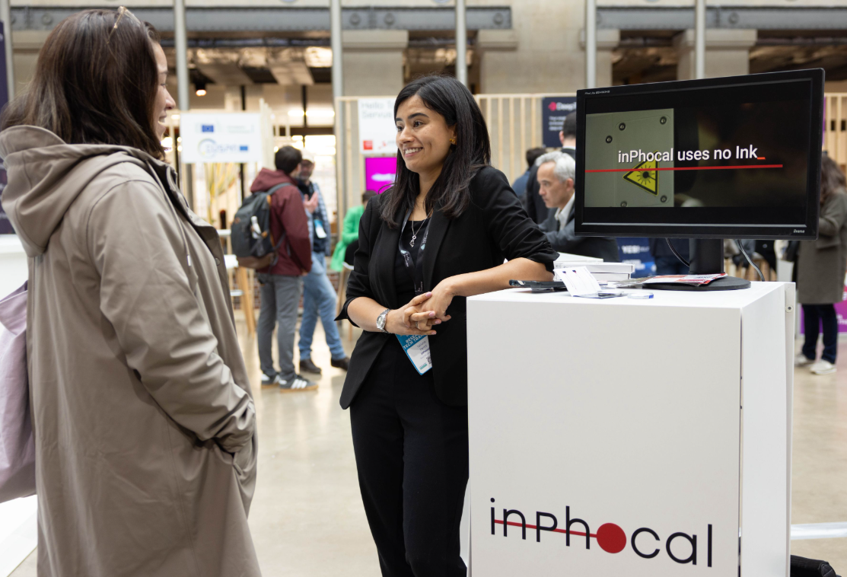
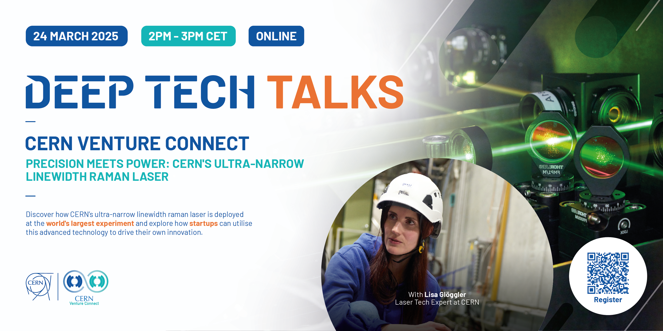
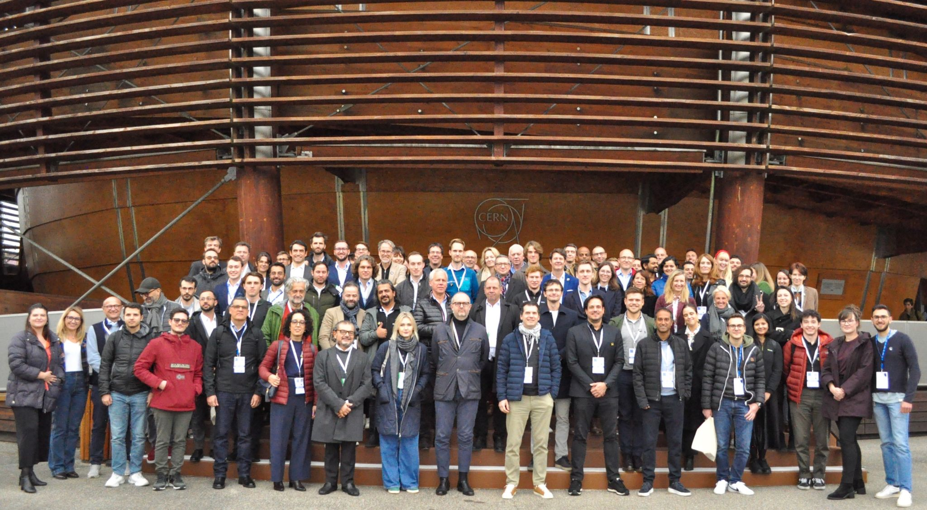
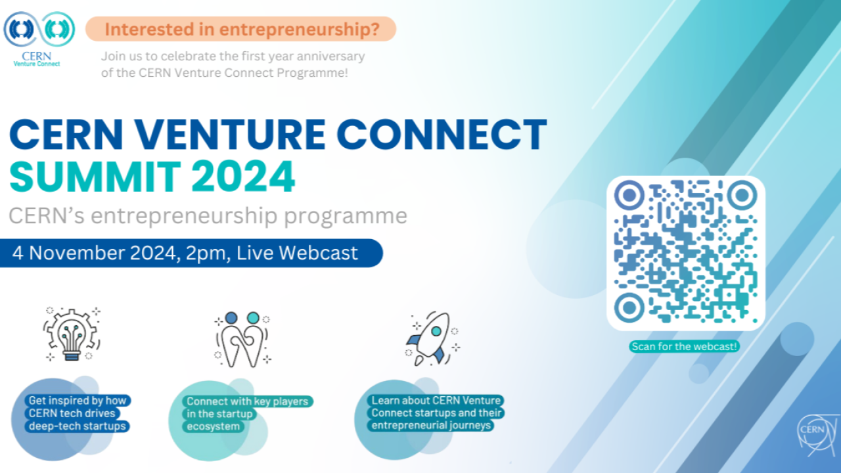
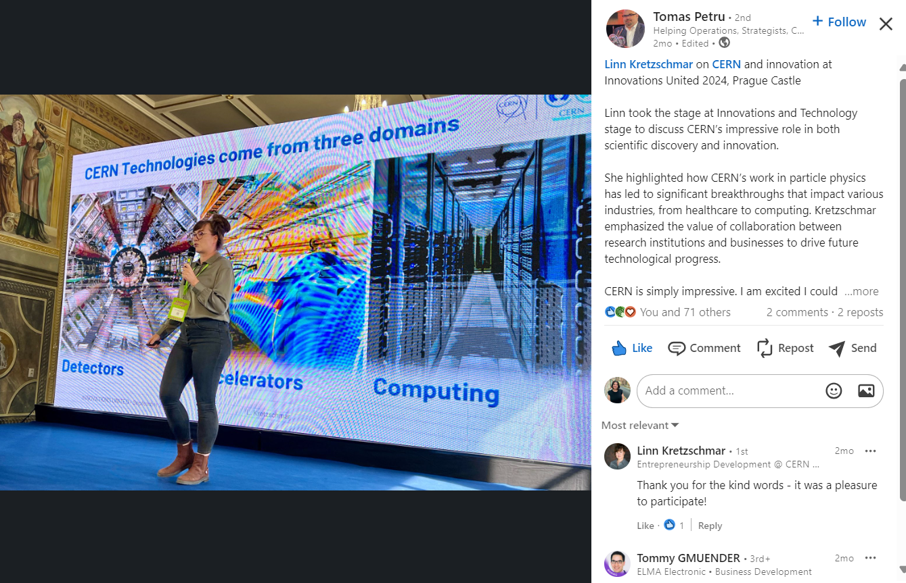
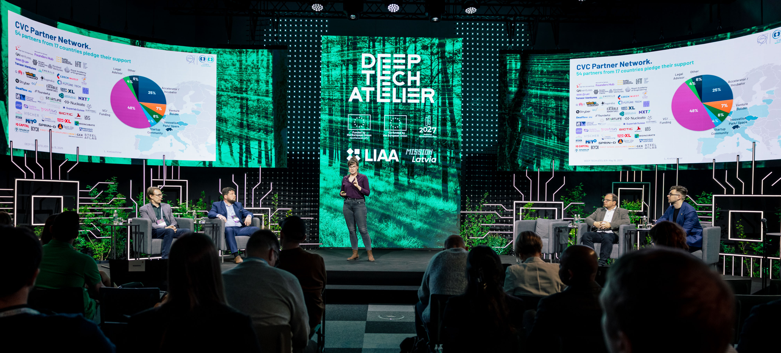
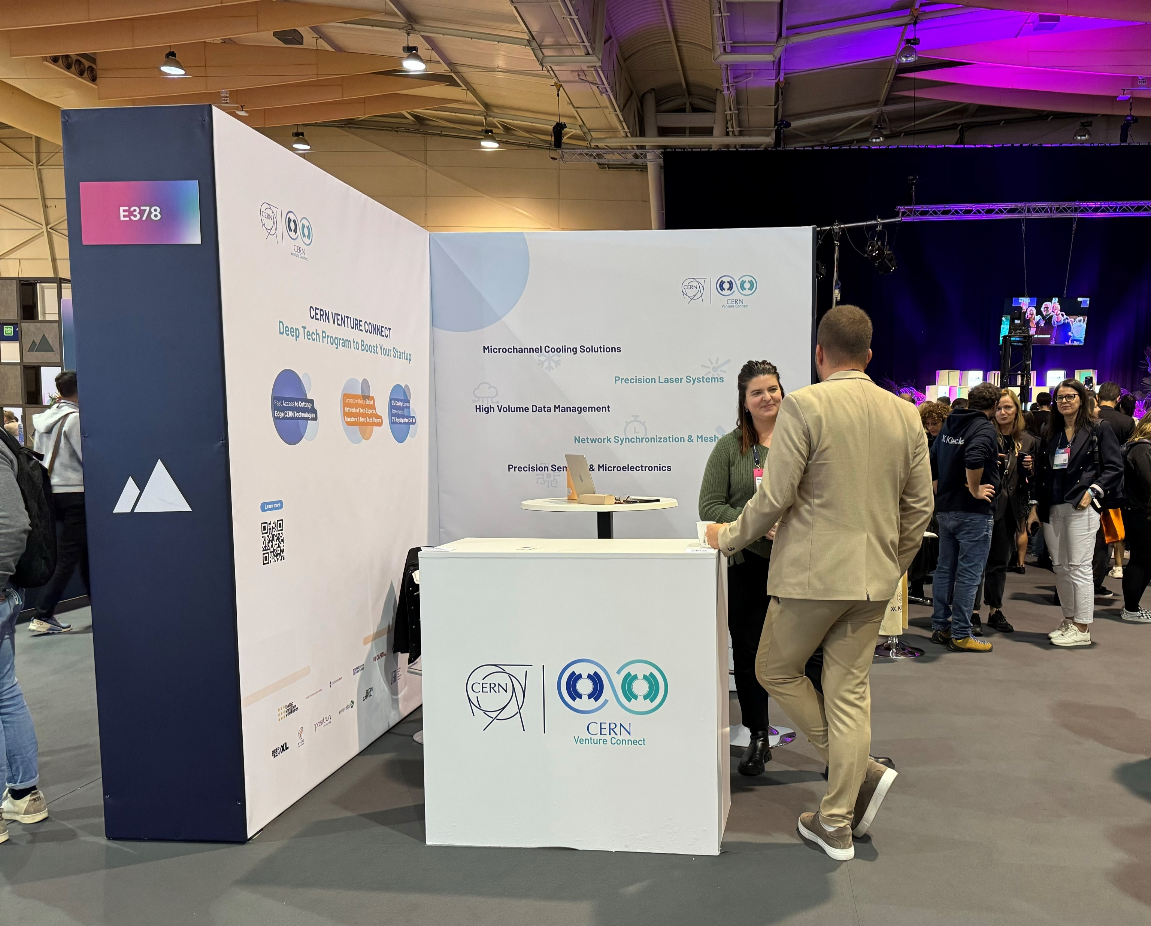
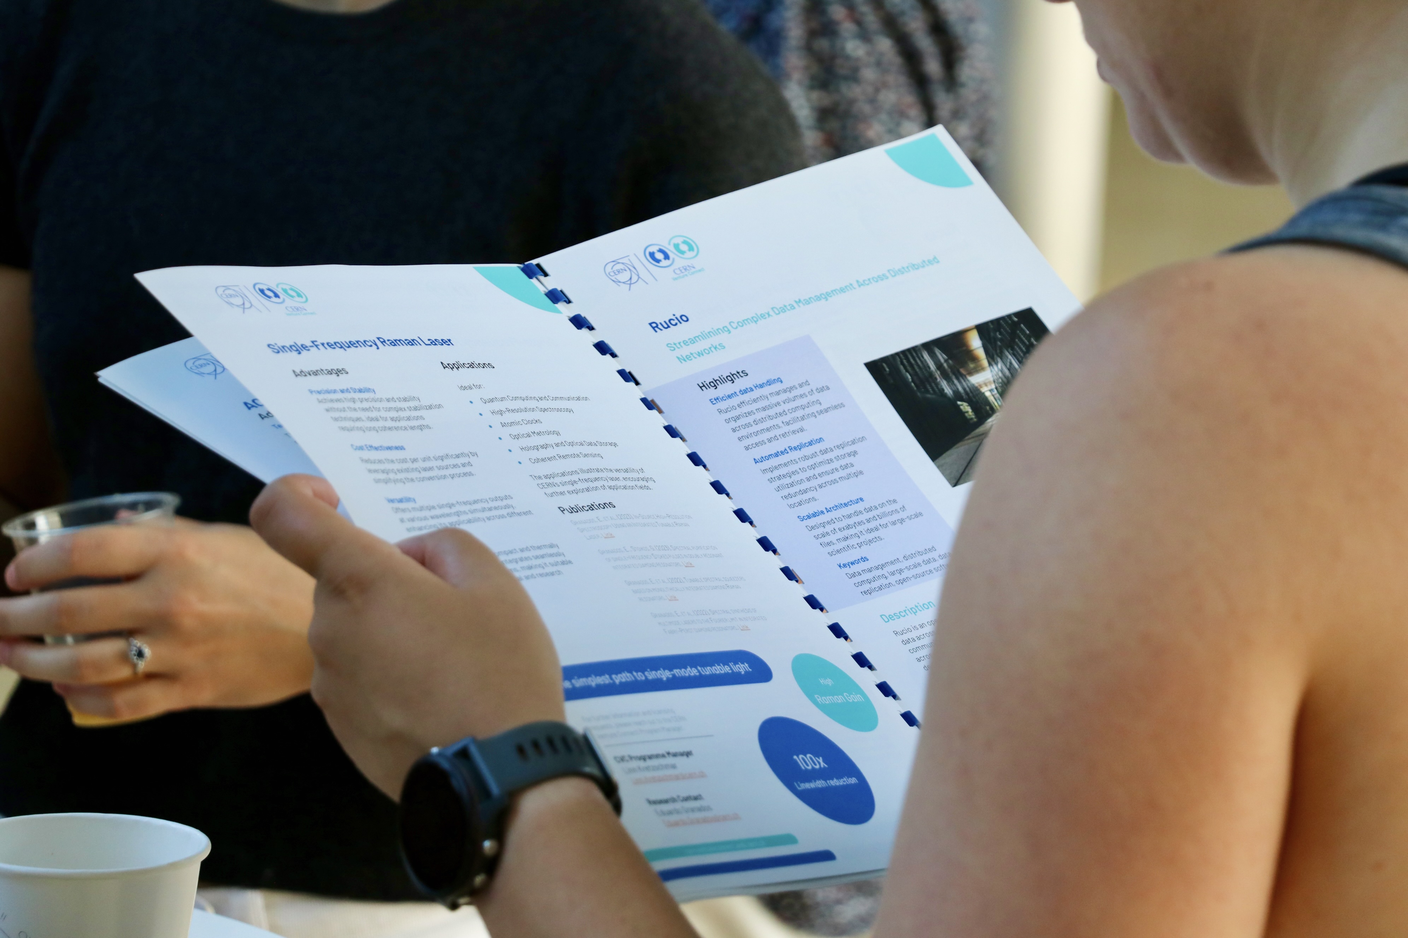
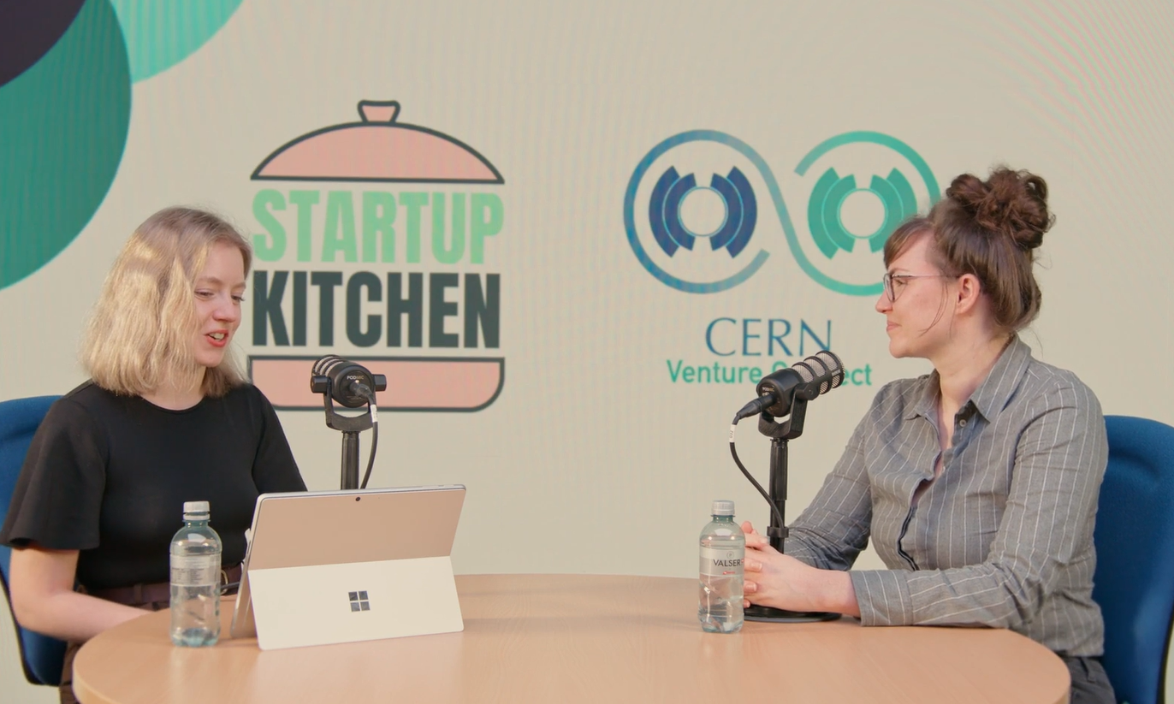
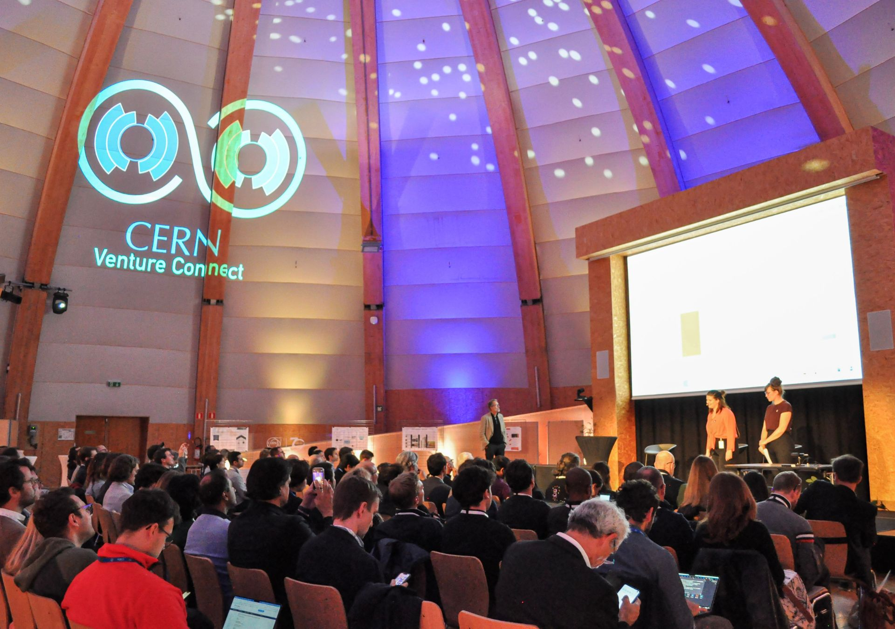
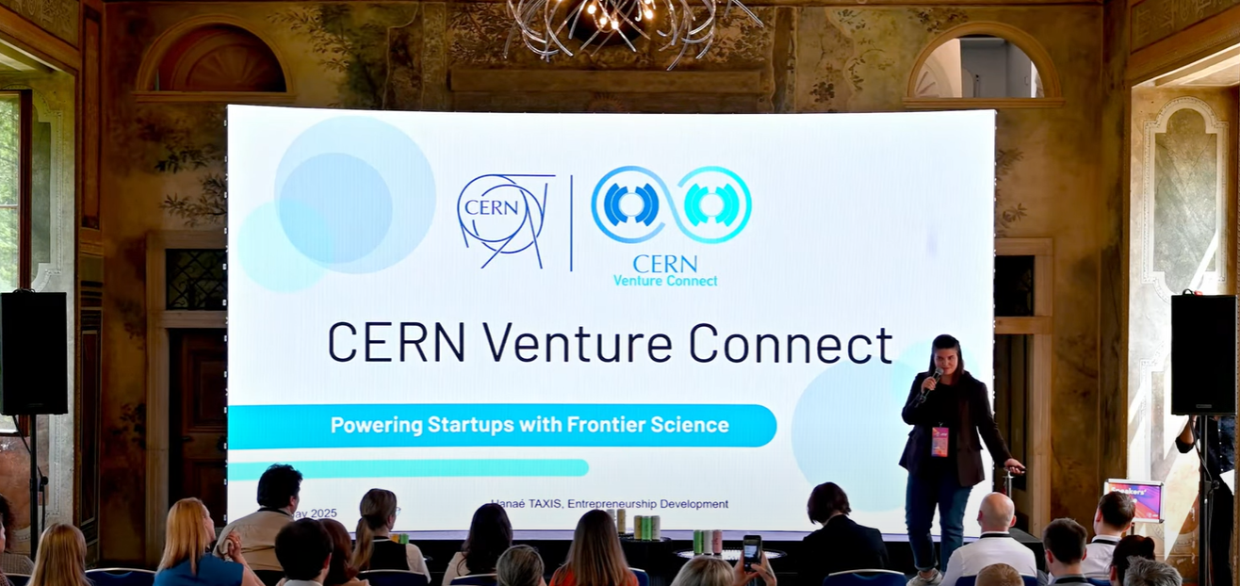
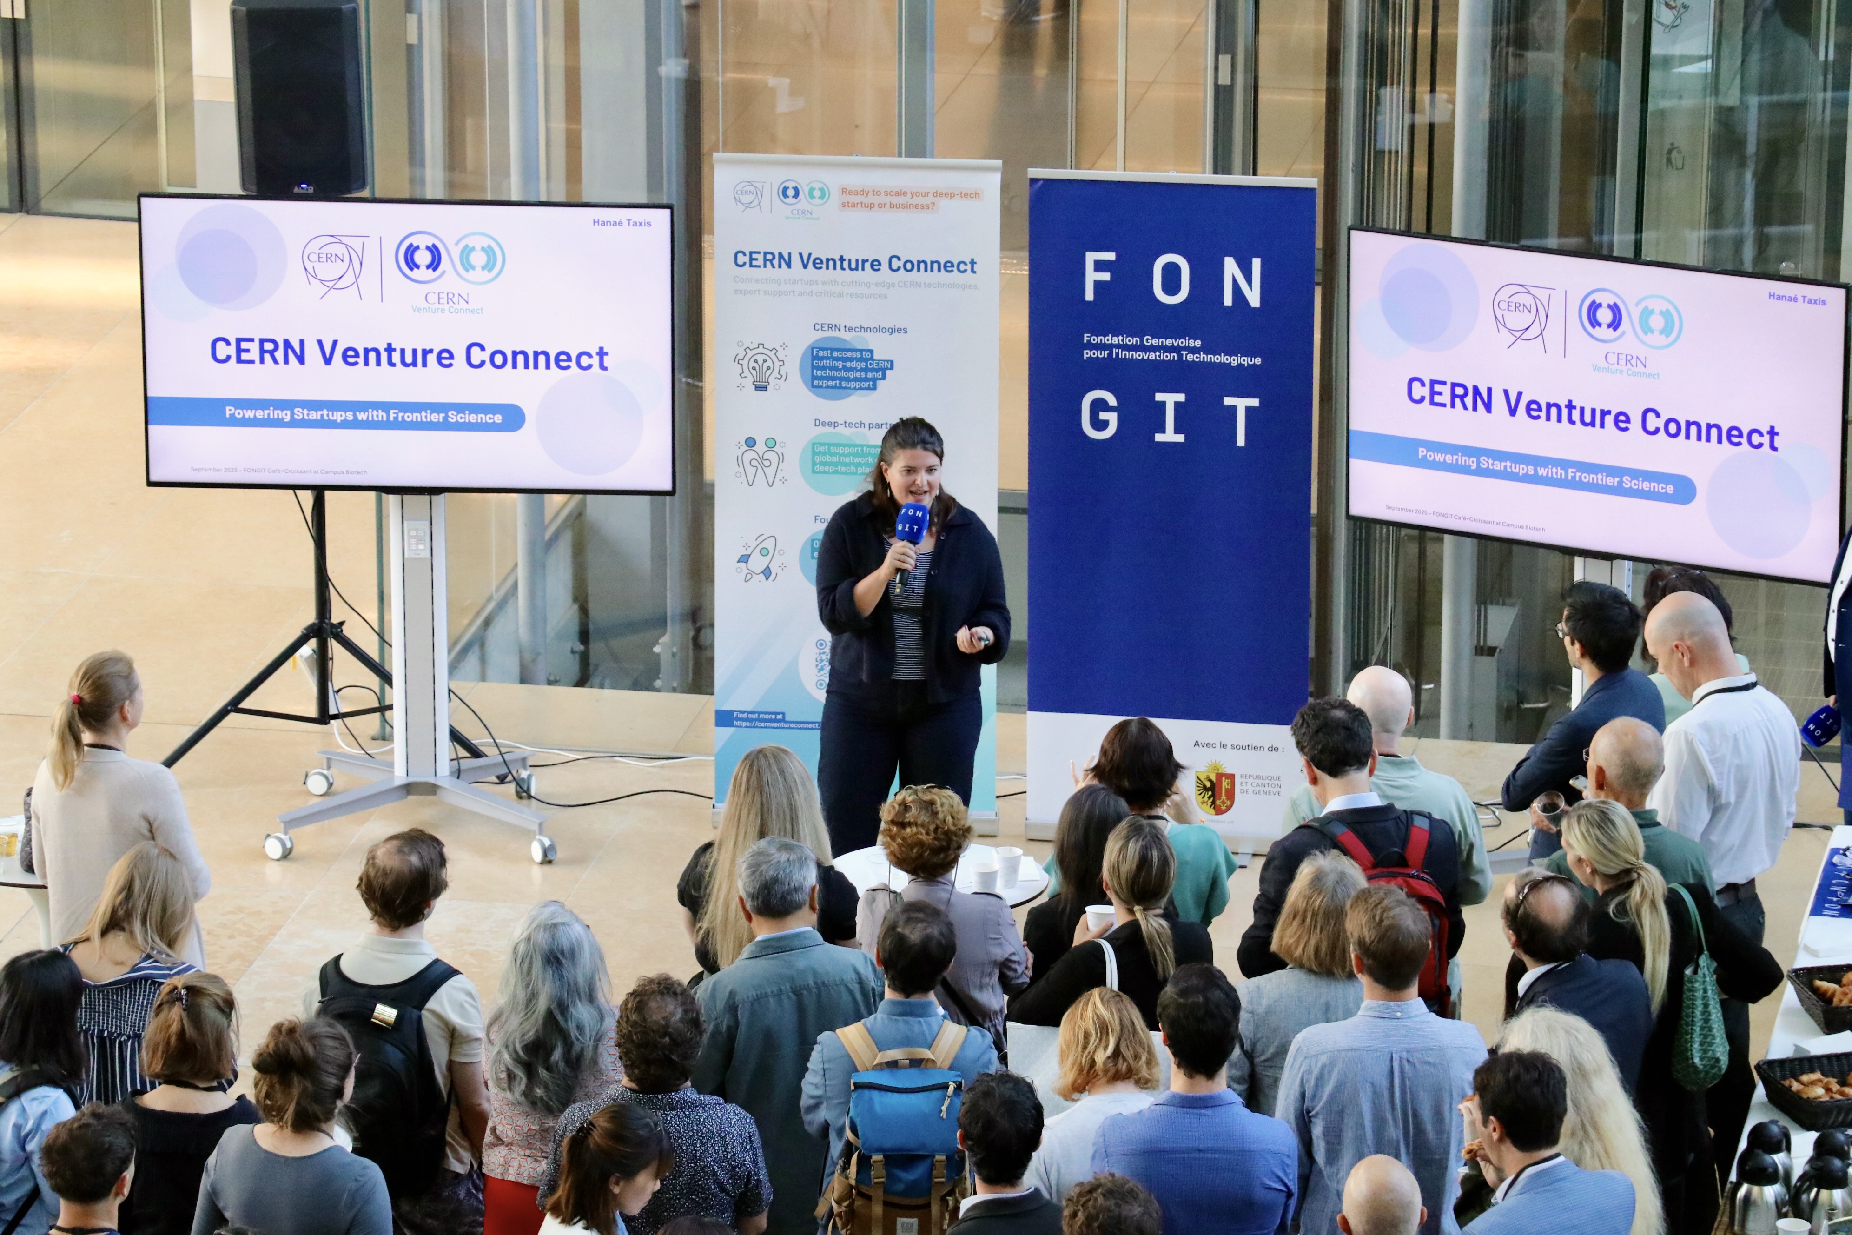
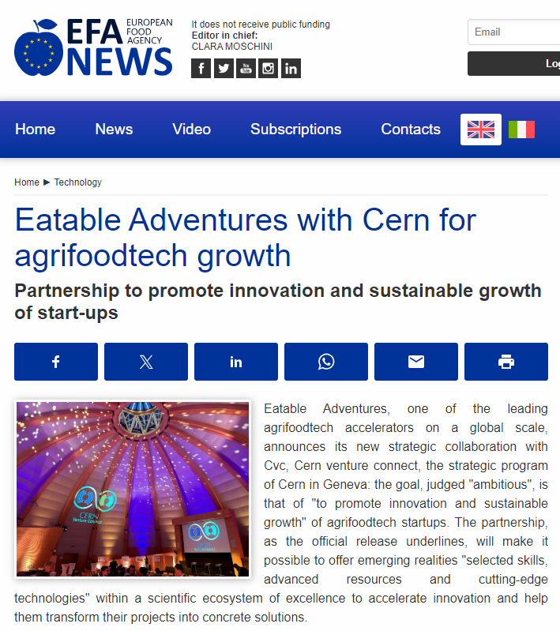
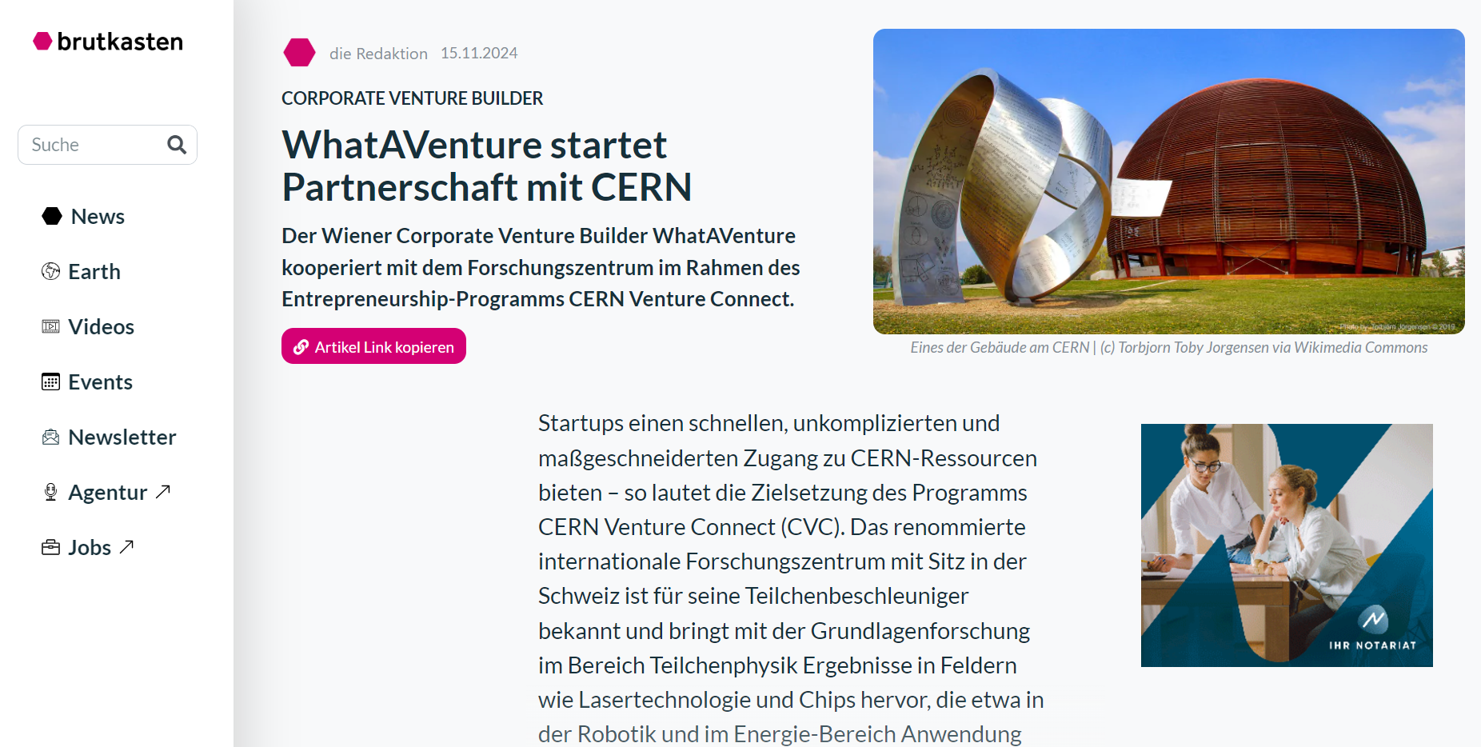
CVC Activities & Network Support

Slide 15
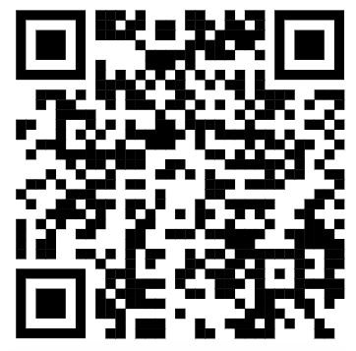
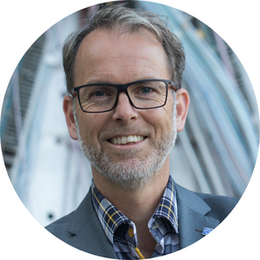
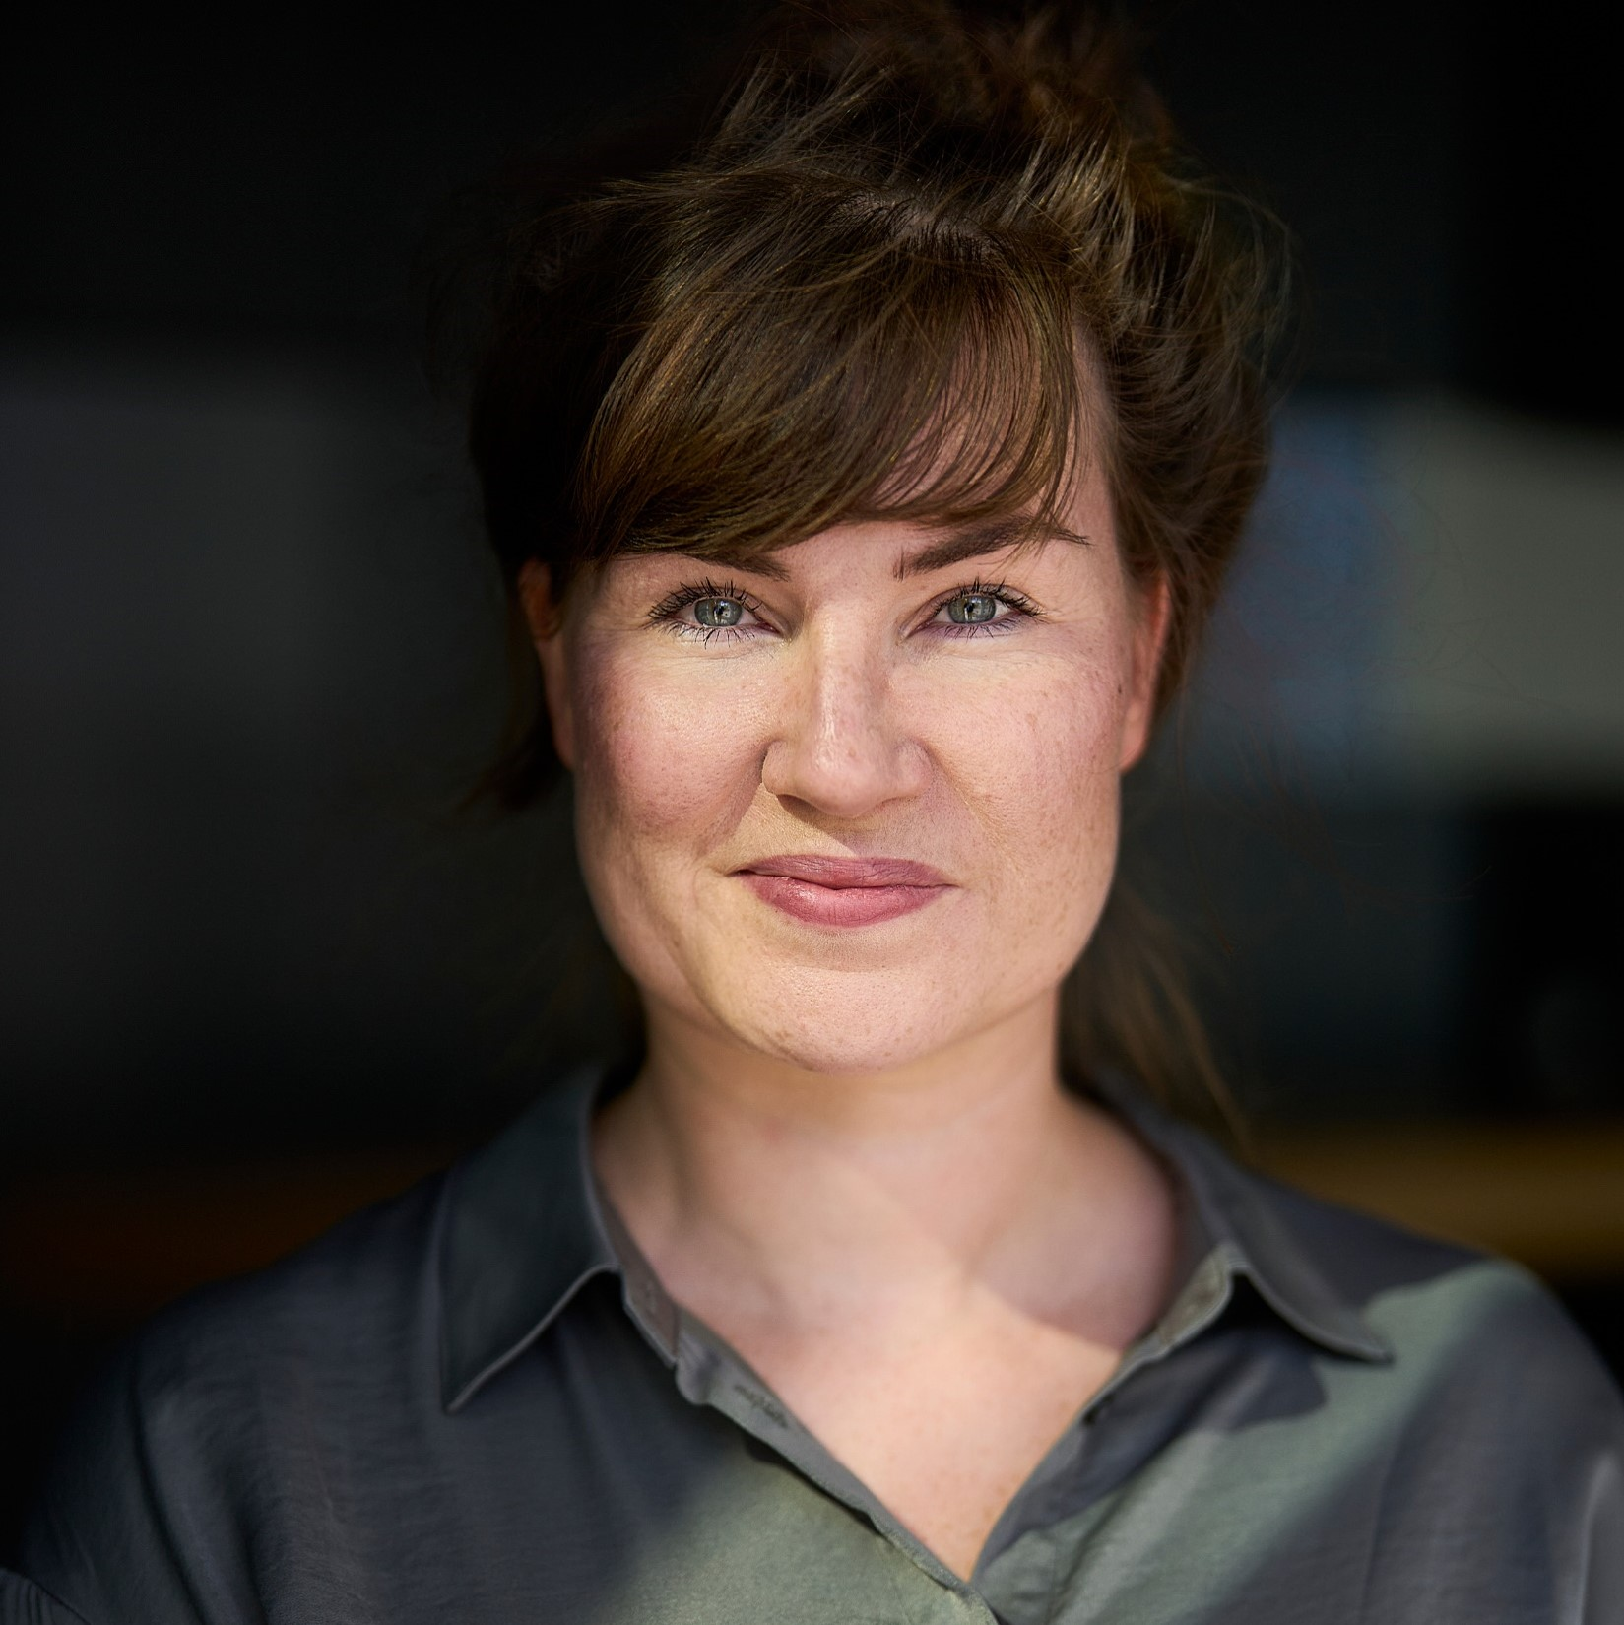

Thank you!
Han Dols
Linn Kretzschmar
Hanaé Taxis
Entrepreneurship & Innovation Networks Section Lead
CVC
Programme Lead
Communications & Partnerships
Linn.Kretzschmar@cern.ch
Hanae.Taxis@cern.ch
Han.Dols@cern.ch
Learn More
Meet the team
QuIC Business Community Summit

